Slide 1
So You’re Interested In Google Ads Management & SEO/AI Services….
GREAT!
Notes:
Add a Google Partner Badge

Slide 2


A Little About Our Company
Insert a brief overview on you and your contact information.
Insert a brief overview of what services you and your company provides.

Slide 3
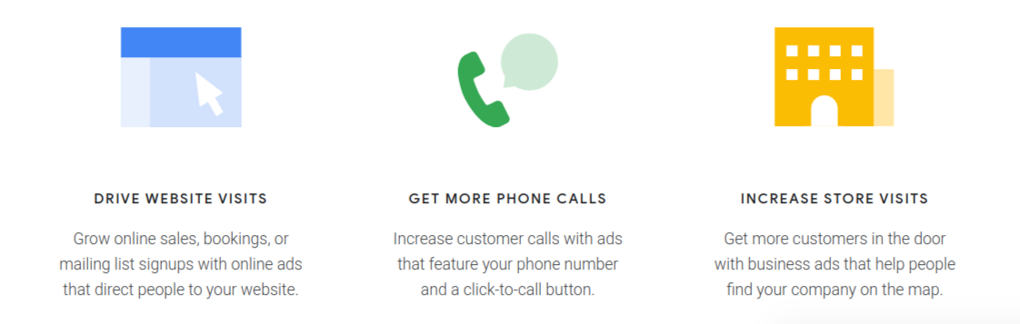
How Google Ads Can Help Your Business

Slide 4
Benefits Of Google Advertising
Google has 83-90% of the search engine market share in 2025. Google processes over 8.5 billion searches per day. Which means your clients potential customers are searching on Google.
Utilizing Google Ads or Search Engine Optimization means you can reach more potential customers to bring awareness to your business or in the moment they are searching for a business like yours.
One of the best benefits of using Google Ads versus most other forms of advertising is measurable results. You can see exactly how many potential customers see your ad and land on your site. Depending on your lead collection system, our team can set up your account to see how many purchases, phone calls, and form fills result from your Google spend.
One of the best benefits of investing in your SEO/AI is to position yourself an the expert relating to your service or products. We highly recommend combining an SEO/AI and Google Ads strategy to dominate page one of Google.

Slide 5
Benefits Of Google Ads
Advertising with Google can help you reach folks at both the awareness and interest levels of the marketing funnel, there’s even an option to target folks that fall out of the funnel.
Display & YouTube ads can target folks who match characteristics of your ideal customer so you can introduce yourself. These are best for branding.
Search & Shopping ads can target folks in the moment they are searching for your service or products. The are best for conversions.
Remarketing ads can target folks who visited your website but maybe didn’t convert, or to increase repeat business.
Performance Max ads can both target folks who are a good match to introduce your business too and when they are searching for your products.
Search Engine Optimization (SEO)/AI targets folks in the moment they are searching for your service or products and you don’t have to pay for clicks.

Slide 6
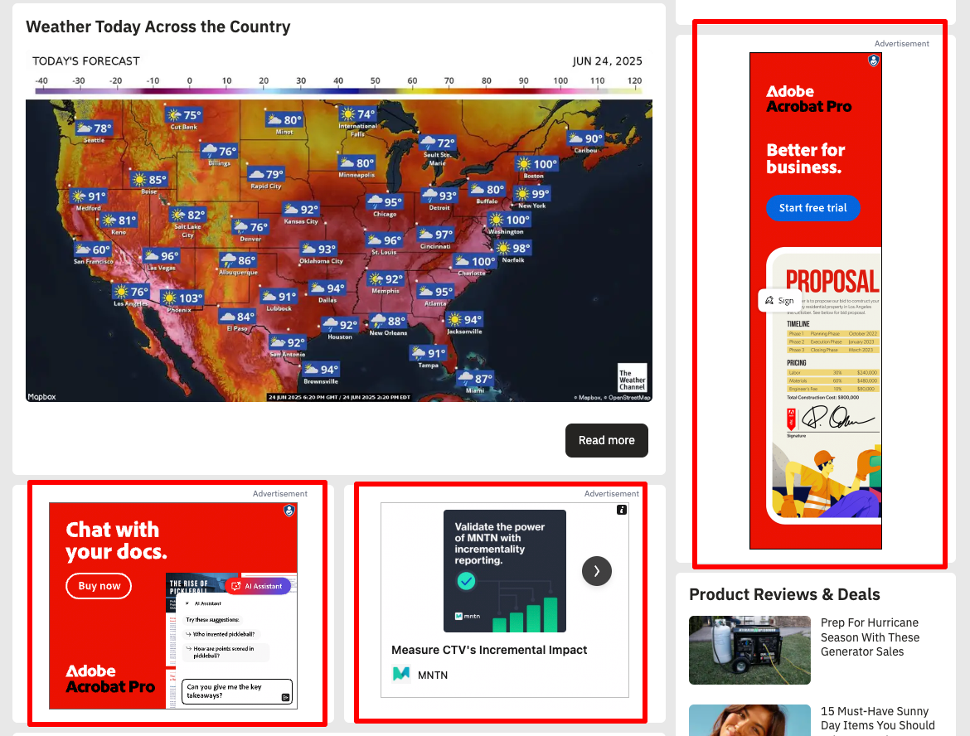
Display Ads (Awareness/Branding)
Google Display Ads are a very effective way to deliver a message to a very targeted audience. Display ads can not only be targeted geographically, they can also be targeted by:
The content of the web page the ad appears on.
The history of a person’s web browser.
Recent Google searches a person has made.
These ads are also pay-per-click, which means that it cost nothing for the ad to appear on another website. You only pay when someone clicks on the ad and sees your website. Display Ads typically get hundreds of impressions for each click, so they can help build brand awareness for your business while delivering quality traffic to your website.

Slide 7
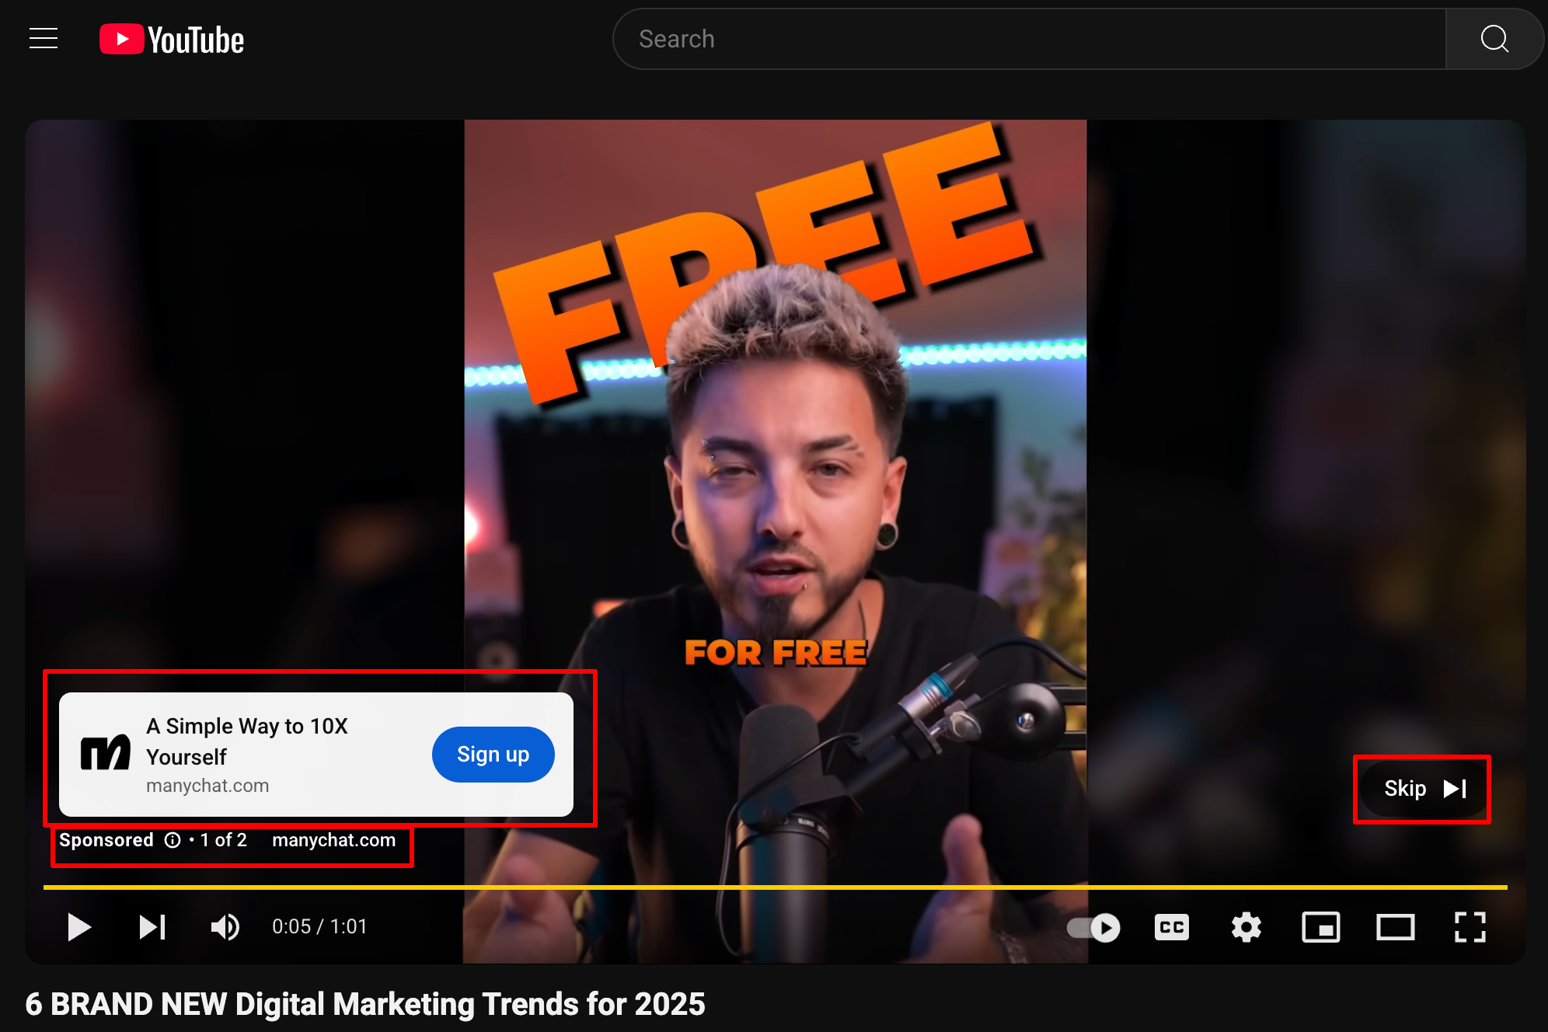
YouTube Video Ads (Awareness/Branding)
Yes, we can even run Video Ads on the YouTube network for your YouTube Videos. If you have a 30-second or longer video uploaded on YouTube, we can promote that video in a number of ways, and target the audience using several techniques including geo-targeting, remarketing and content targeting.
The ads work on a ‘pay-per-view’ basis. It cost nothing for someone to watch the first 29 seconds of your video. You only pay when someone watches 30 seconds or more of your commercial. (Yes, the video needs to be at least 30 seconds long).
You will need to already have a video produced and uploaded to your YouTube account.

Slide 8
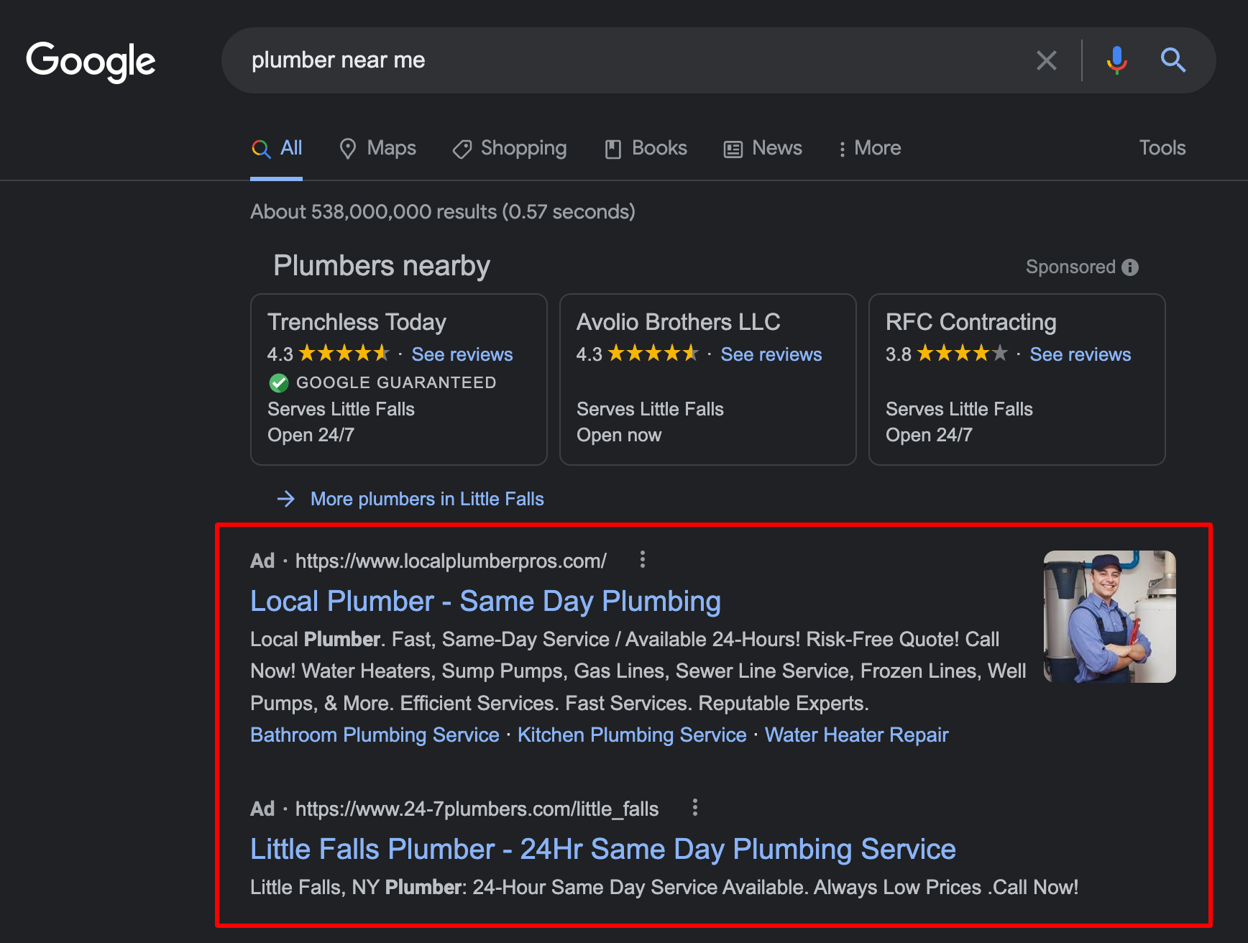
Search Ads (Interest/High Converting)
By targeting keyword phrases that indicate someone is in that moment searching for your product or service we can drive the most highly qualified, relevant visitor to the website possible. If your website does its job of converting visitors to actions, then this can be a very profitable way to feed your sales funnel!
These ads are best for driving traffic of folks in the market for your product or service. Search Ads usually have some of the highest conversion rates.

Slide 9
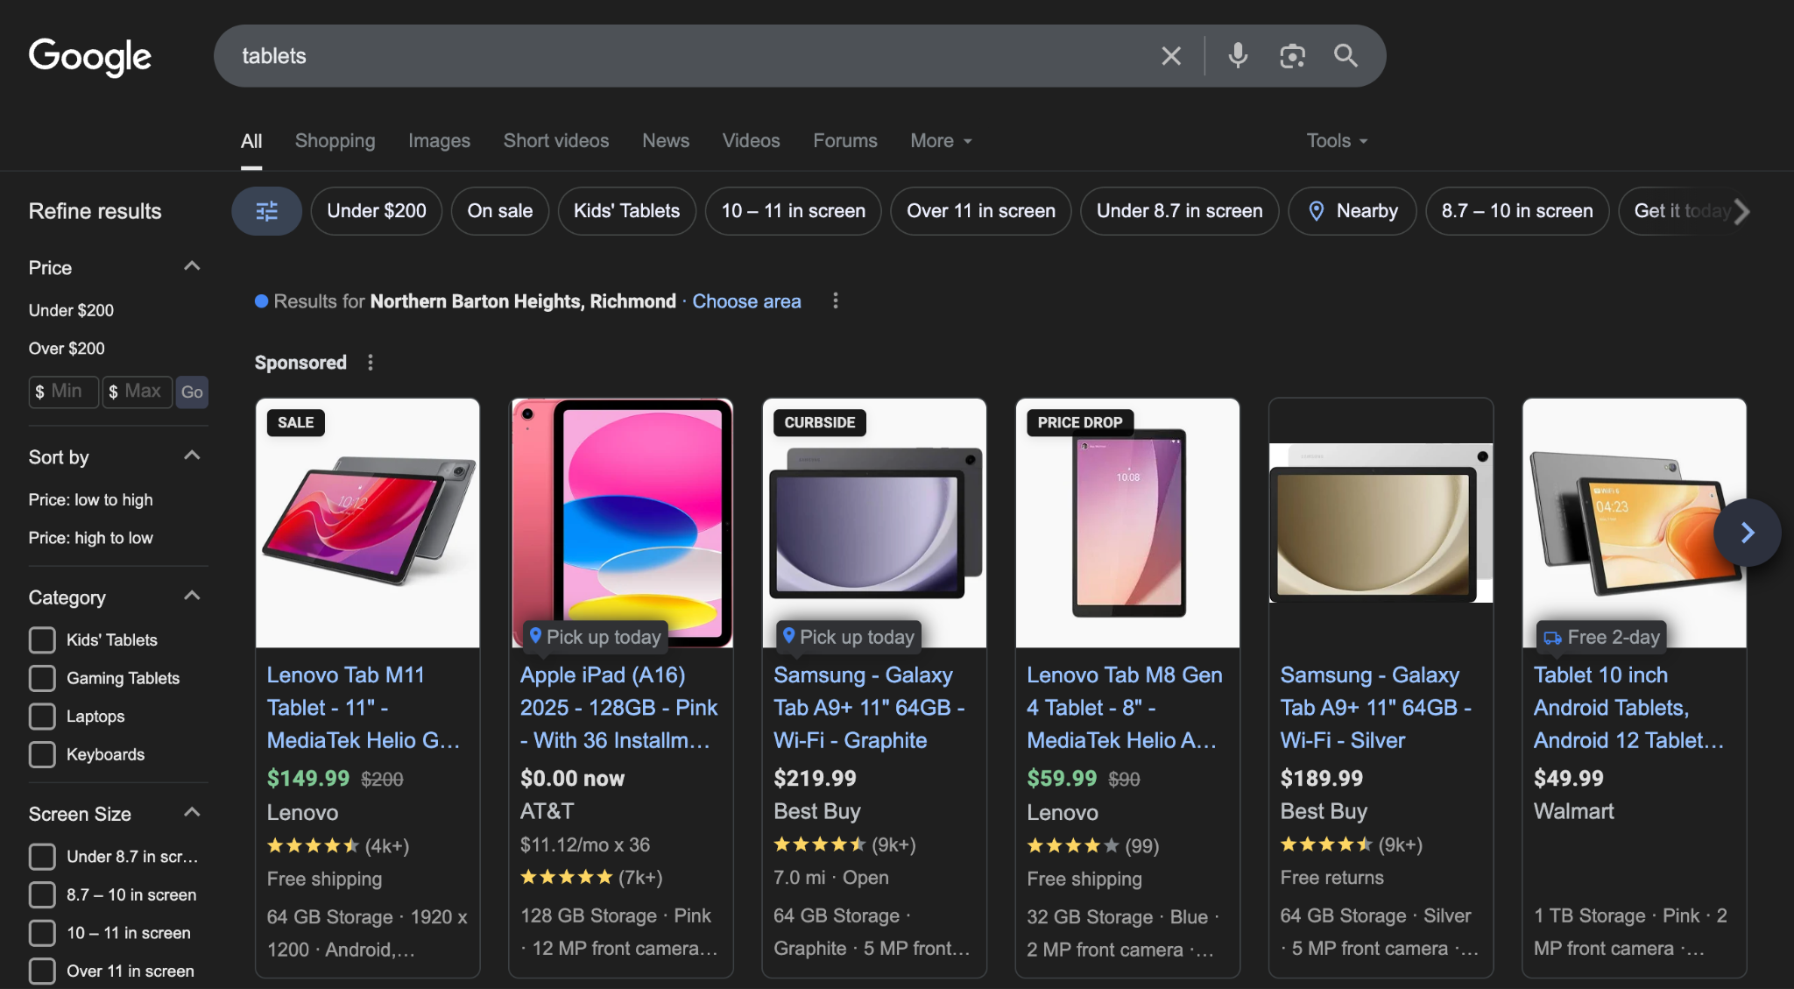
Google Shopping Ads
Google Shopping campaigns and ads are used to promote your online and local inventory, boost traffic to your website or local store, and find better-qualified leads. Just like other ad formats, your Shopping ads are charged using cost-per-click (CPC), you only pay when someone clicks on your ad.
Shopping Ads show users a photo of your product, a title, price, your store name, and more. By providing as much information as possible, it gives the searcher a strong sense of the product you are selling before they click the ad, which provides you with more qualified leads.
You will need to set up a Google Merchant Center account and upload it with your data feed from your ecommerce platform.
Notes:
*Remember that you will need to have a Google Merchant Center already uploaded with the data feed of their ecommerce platform.*

Slide 10
Google Performance Max (PMax) (Both!)
Get your products in front of hundreds of millions of potential customers from a single campaign.
YouTube - Over 40% of global shoppers say they have purchased products they discovered on YouTube. Reach shoppers, however they’re watching videos about products, whether it’s tagging along on shopping trips with influencers or searching for reviews.
Display - Start connecting with shoppers before they even search for what you offer - like when they’re reading their favorite blogs, using mobile devices and apps, or browsing millions of partnering websites, videos, and apps.
Search - People search for what they want. Performance Max campaigns will put your products in front of shoppers looking for what you sell on Google. The best part? You only pay when they click.
Discover - Surface your products in front of hundreds of millions of shoppers as they scroll through their favorite topics and stay connected to their interests—no search query needed.
GMail - More than a billion active users come to Gmail every month. Show your products to potential customers wherever they’re consuming content—including their inbox.
Maps - Be visible when customers are nearby and show interest for locations like yours while they're searching or browsing.
Google Business Profile - Promote products and special offers available in your store.
Notes:
*Remember that you will need to have a Google Merchant Center already uploaded with the data feed of their ecommerce platform.*

Slide 11
Remarketing Google Ads
Remarketing Ads (sometimes called ‘retargeting ads’) are a great way to get people to return to your website. By dropping a Remarketing Code on every page of your website, we can advertise your business to the people that have visited your website in the last 30, 60, 90… days.
Remarketing Ads are the same as Display Ads – except they only target people that have visited your website. They are very simple, very cost effective and best of all, they are extremely targeted. It’s an excellent way to get folks who have fallen out, back into the sales funnel. Try making an attractive offer and landing page to convince someone on the fence to take action.

Slide 12
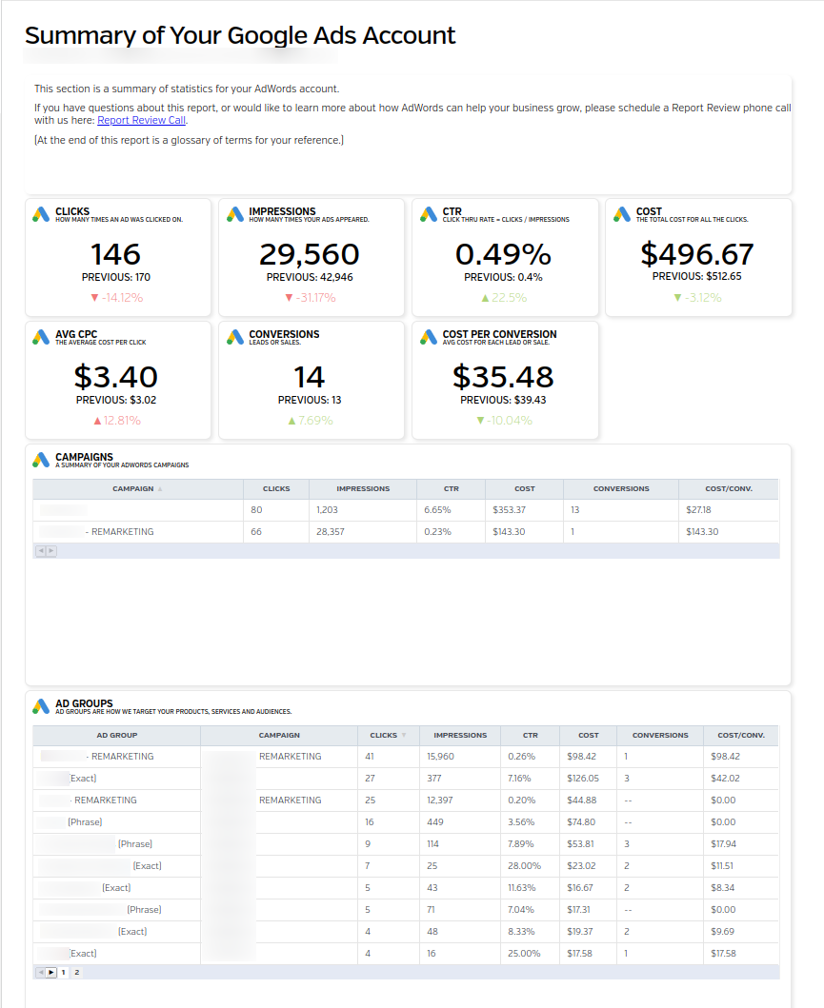
Our Google Ads Management Service
Step 1: When you sign-up for our Google Ads Management Service, we’ll need a few pieces of information:
Your Google Ads ID (if you have one)
The Click Budget – How much do you want to spend each month on clicks?
The Geography – Where do they want the ads to run?
  A Radius – ie. How many miles from your location? OR,
  A list of Zip codes. OR,
  A list of Cities or States.
The Products and Services to advertise – What do you want to advertise?
Step 2: We set-up your Google Ads campaign using your website and the sign-up information above. If possible, our team will setup your campaign to track phone calls, form-fills, and purchases that result from your Google Ads.
Step 3: Our team monitors and optimizes the campaign regularly. We will provide you with monthly reporting that makes reviewing your campaigns success easy.

Slide 13
Conversion Tracking Setup
For Maximum ROI it’s best your website/landing page has the following:
Consent Management Platform (CMP)
  You’ll want to pick something that is v2 Compliant and has an Advanced Consent Mode. (Unfortunately the “free” versions do not meet those requirements.)
First-Party Forms
  Third-Party forms have increased in popularity because they’re simple to install and integrate easily with backend CRM or marketing systems. These forms are embedded in your website and are not part of your website.
  When advertising consent is given on your website, that consent does not transfer to the Third-Party form or website, so the Data Chain will break - which means we cannot track your leads resulting from your Google Ads campaign.
Being able to track all of your conversions/leads is imperative for the following reasons:
Allow us to prove our success/track your ROI
In the future we can implement AI tactics to further your campaigns success and improve your results (Enhanced Conversion Tracking and Customer Match Lists)
Increases your leads

Slide 14
What You Can Expect From Us

Slide 15
How Do We Set Lead Goals?
Leads
A | Average Customer Value | $ | What’s your average sale OR customer value (whichever is higher)
B | Cost (Labor + Cost) | $ | How much does it cost you to provide product or service? (Cost of goods, labor, ect.)
A - B= C | Average Profit | $ | How much you make with each sale?
D | Close Rate | % | How many quality leads to get the sale?
C x D = E | Breakeven Cost Per Lead | < $ | Our Goal is get leads at less than this number
Notes:
Goal Setting Formula - leads

Slide 16
How Do We Set Ecommerce Goals?
Ecommerce
A | Average Order Sale | $ | What’s your average order?
B | Average Cost (Labor + Cost) | $ | How much does it cost you to provide product or service? (Cost of goods, labor, ect.)
A - B = C | Average Profit | $ | How much you make with each sale?
Ratio | Sales : Cost | X : 1 | X = A / B
Notes:
Goal Setting Formula - Ecommerce

Slide 17
Google Ads Management Pricing
EXPLAIN YOUR GOOGLE ADS PRICING HERE

Slide 18
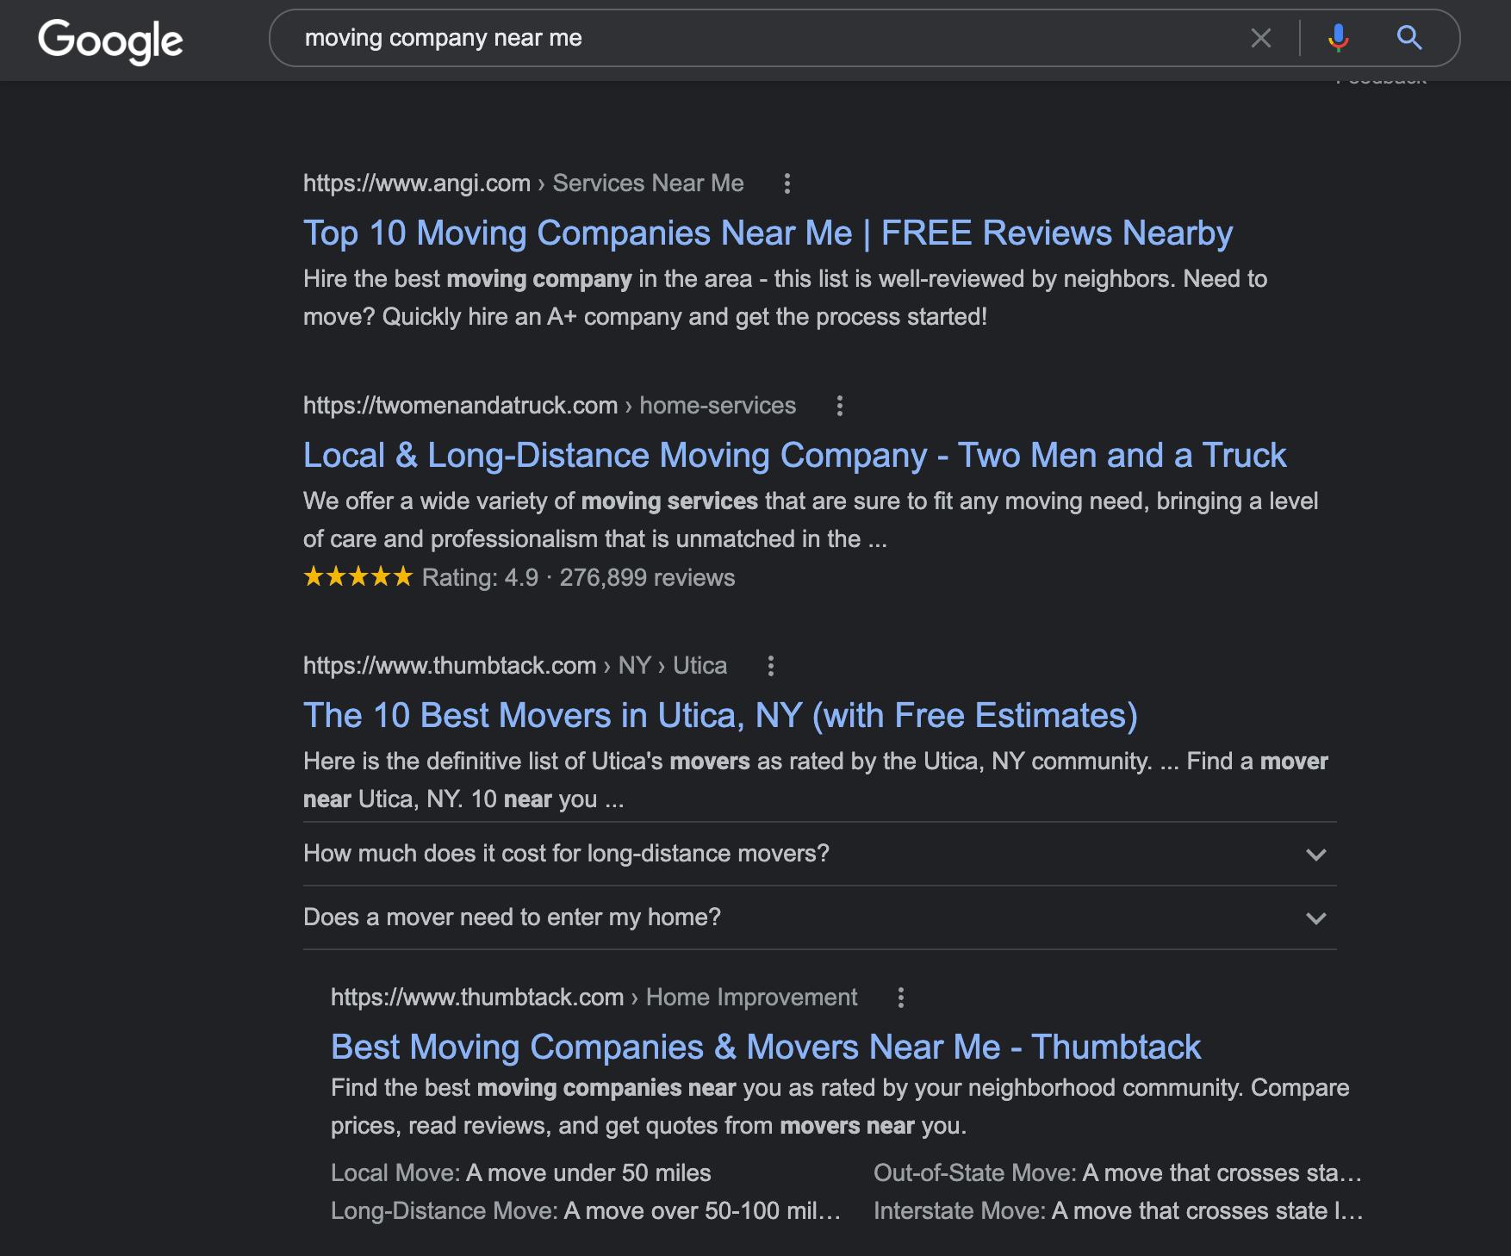
SEO/AI Services
We have three options for Search Engine Optimization Services (SEO).
Basic - Minimal focus on AI (GEO)
Enhanced - Medium focus on AI (GEO)
Premier - High focus on AI (GEO)
Local businesses face the added challenge of ranking well on Google Maps. Our Local Packages are designed to help your client get the most from their Google Business Profile.
Local Package 1
Local Package 2

Slide 19
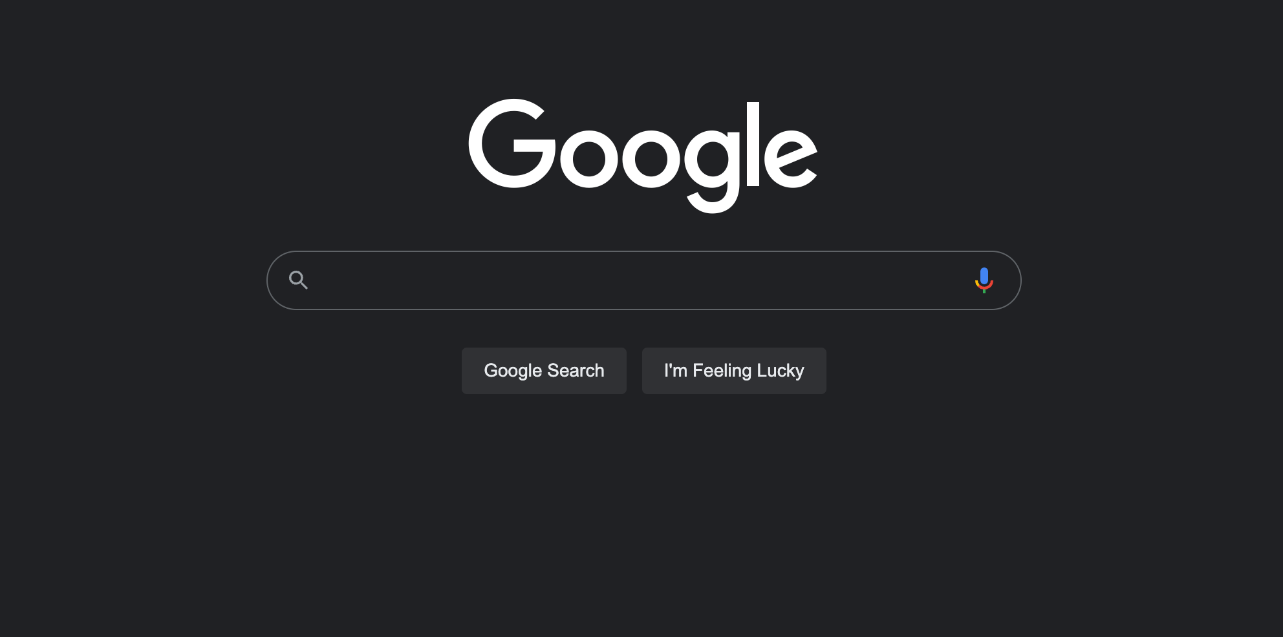
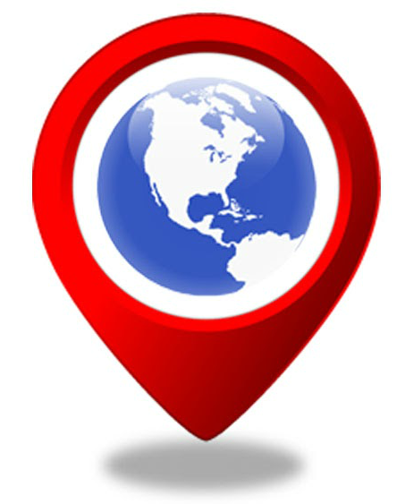
SEO/AI is Constantly Changing
We Work to Improve & Keep Your Rankings
Google makes over 400 changes to its SEO algorithms every year. It would be challenging and time-consuming for the average business owner to research and react to these changes. While the process below outlines the basic tasks we perform in each phase to improve your local organic rankings.
Remember that your package also includes our team adapting to Google's changing algorithms and doing additional work to your website each month.

Slide 20
SEO/AI Packages
 | Basic | Enhanced | Premium
Monthly Fee | $ | $ | $
AI (GEO) Focus | Minimal | Medium | High
Your Online Competition | Low/No >30 Competitors | Medium 20-100 Competitors | High 50+ Competitors
Your Business Size | Small Business $1M | Small Business $1-5M | Medium Business $2M+
Page Optimizations | Up to 15/Month | Up to 30/Month | Up to 50/Month
Quarterly Backlinks | 6 Low Domain Authority | 3 Medium, 18 Low Domain Authority | 3 High, 6 Medium, 18 Low Domain Authority
Content Writing | None | Quarterly | Monthly
Review Meetings | Quarterly | Quarterly | Monthly

Slide 21
Local Packages
Local Package 1 | Local Package 2
$ | $
Google Business Profile Optimizations | Google Business Profile Optimizations
Business Listing Citations - 3/Month | Business Listing Citations - 3/Month
Google Business Profile Protections (Helps Prevent Competitors from Making Changes) | Google Business Profile Protections (Helps Prevent Competitors from Making Changes)
 | One GBP Post Per Month
 | Up to 10 Positive Review Replies Per Month
If you have a physical storefront or local service business, we highly recommend you add on a Local Package.
The Local Packages are not stand alone services, you will need to choose an SEO/AI package from previous slide.

Slide 22
We Look Forward To Helping Grow Your Business!
We have a whole team here ready to get you data driven results. We look forward to serving you for years to come!
Notes:
Add social media links for them to follow us

