Slide 1
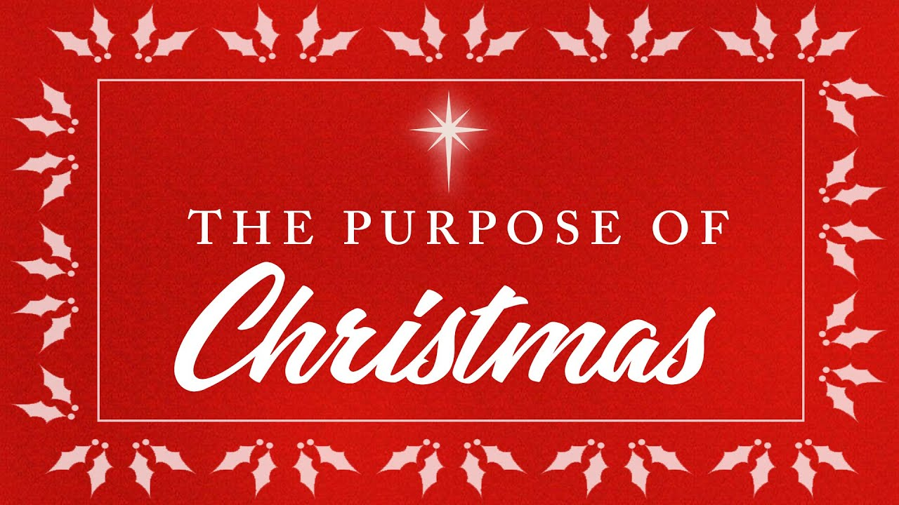
(1)

Slide 2
Why is Christmas such a big deal?
Christmas is emphasized for an entire month of December.
Christmas brings good news of great joy for all the people.
Good news: The baby in the manger was not simply any baby. He was Savior, Lord, and Christ
Great joy: The baby is promised Immanuel (God with us), the long awaited promised One.
For all people: Whether rich or poor, popular or outcast, people from all cultures can find hope in the Christmas message.
Christmas is the most expensive gift from God you will ever receive.
The story of Christmas

Slide 3
The purpose of Christmas (1)
God came to earth and He became a human so we will see what he’s really like.
There were shepherds living out in the fields nearby, keeping watch over their flocks at night. An angel of the Lord appeared to them, and the glory of the Lord shone around them, and they were terrified. But the angel said to them, “Do not be afraid. I bring you good news that will cause great joy for all the people. Today in the town of David a Savior has been born to you; he is the Messiah, the Lord. This will be a sign to you: You will find a baby wrapped in cloths and lying in a manger.” Suddenly a great company of the heavenly host appeared with the angel, praising God and saying, “Glory to God in the highest heaven, and on earth peace to those on whom his favor rests.” (Luke 2:8-14)

Slide 4
The purpose of Christmas (2)
God lived a sin-free life on earth, then paid for our sins so we would not have to.
The next day John saw Jesus coming toward him and said, “Look, the Lamb of God, who takes away the sin of the world! (John 1:29)
When he had received the drink, Jesus said, “It is finished.” With that, he bowed his head and gave up his spirit.(John 19:30)

Slide 5
The purpose of Christmas (3)
Jesus defeated death by raising himself back to life so we can live forever with him
The angel said to the women, “Do not be afraid, for I know that you are looking for Jesus, who was crucified. He is not here; he has risen, just as he said. Come and see the place where he lay. Then go quickly and tell his disciples: ‘He has risen from the dead and is going ahead of you into Galilee. There you will see him.’ Now I have told you.” (Matthew 28:5-7)
When suddenly two men dressed in white stood beside them. “Men of Galilee,” they said, “why do you stand here looking into the sky? This same Jesus, who has been taken from you into heaven, will come back in the same way you have seen him go into heaven.” (Acts 1:10-11)

Slide 6
The purpose of Christmas (4)
Good plan isn’t finished; Jesus will return to complete it and take us to heaven
“Look, he is coming with the clouds,” and “every eye will see him, even those who pierced him; and all peoples on earth will mourn because of him.” (Revelation 1:7)
Here I am! I stand at the door and knock. If anyone hears my voice and opens the door, I will come in and eat with that person, and they with me (Revelation 3:20)

Slide 7
Christmas is…
“I bring you good news that will cause great joy for all the people. Today in the town of David a Savior has been born to you; he is the Messiah, the Lord. This will be a sign to you: You will find a baby wrapped in cloths and lying in a manger” (Luke 2:10-12)

Slide 8
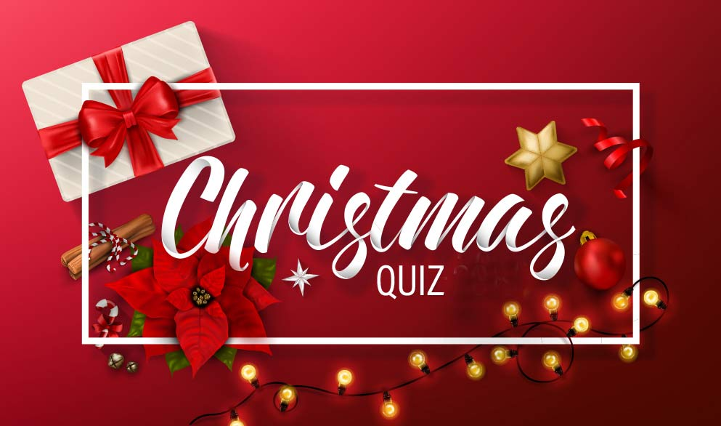

Slide 9

Quiz 1
What is the meaning the word ‘Immanuel’?
God saves us!
God with us!
God loves us!
God punishes us!

Slide 10
Quiz 2
Who all came to see baby Jesus?
Shepherds
King Herod
Wise men
Drummer boy

Slide 11
Quiz 3
When angels appeared to shepherds, announcing the birth of Jesus, what did they sing?
Do not be afraid, for you have found favor with God
Joy to the World that the Lord has come.
Get up! Take the child and his mother and escape to Egypt.
Glory to God in the highest heaven, and on earth peace to those on whom his favor rests!

Slide 12
Surprised; Bethlehem, Afraid, Bad, Good,
Best, Great, Some, Messiah, All, Jerusalem,
Fill the blank
Don’t be . I bring you news that will bring joy to people. The Savior, the , has been born today in , the city of David!

