Slide 1
2025/2026 Grant Application
Non-Profit Training and Q&A
November 13, 2025
♥ Women's Hearts Aligned For Impactful Giving ♥
Notes:
Leslie – introduce self

Slide 2
Impact100 MetroDetroit
We are an all-women, all-volunteer 501(c)3 nonprofit
Our Mission: To serve as catalysts for transformation in Metro Detroit by aligning women through collective giving to support local nonprofit organizations. Women’s Hearts Aligned!
Our Focus:
To award High-Impact grants for sustainable projects that focus the impact on our own community. We do that by funding local organizations doing amazing work in the tri-county area of Oakland, Macomb and Wayne Counties.
Our History:
  Founded in 2001 by Wendy Steele (activist, philanthropist, entrepreneur and author)
  Over 80 chapters in 4 countries have collectively granted $178M+
  Impact100 Metro Detroit chapter was founded in 2016
Our Impact: Since our inception, we have awarded $1.8M in grants
Notes:
Megan
**Pass to Leslie

Slide 3
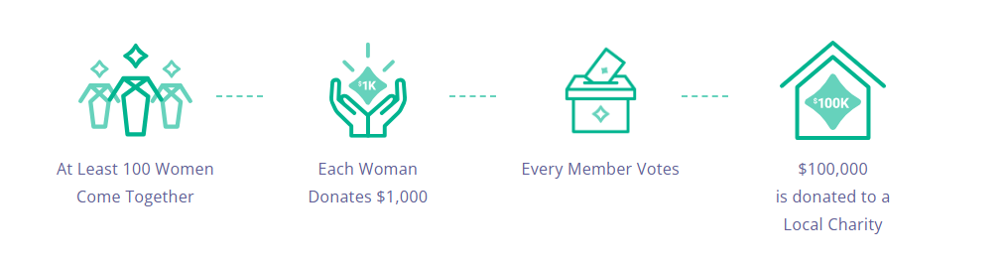
OUR MODEL
Designed to empower women to see themselves as philanthropists and overcome the barriers women have historically faced in this arena.
Notes:
Barb

Slide 4
OUR MODEL, cont.
For every 100 women members we have each year we award a $100,000 Grant.
Example: If we receive 260 members our money will be awarded as follows:
5 Finalists will present at the BIG GIVE dinner
The top 2 based upon member votes will each be awarded a $100,000 grant
The other 3 split the $60,000 equally – each will receive a $20,000 unrestricted grant
Remember ALL OF THE MONEY we receive each year is given away at the BIG GIVE
and we start all over from scratch in the following year.
Notes:
Barb

Slide 5





OUR FOCUS AREAS
Shine a spotlight on nonprofits making a difference in our community.
Arts & Culture
Family & Individual Support
Health & Wellness
Revitalization, Recreation & Environment
Education
Projects that foster greater exposure or participation in the arts and culture (including culinary arts) or use art as a medium for creative expression. ​
Projects that revitalize or create public spaces for the community, including community gardens and greenhouses, support environmental awareness, and/or promote a positive, sustainable relationship between people and their environment; or promote the welfare of animals in our communities.​
Projects that support the lives of individuals and families, focusing on housing, transportation, living wage, food insecurity, job skills training or other basic needs.
Projects that improve physical and/or mental skills, foster healthy living habits or life skills programs that promote independent living.​
Projects that expand or improve learning, primarily for children, focused on literacy, tutoring, mentoring, GED, or college prep.​

Slide 6

Eligibility
What makes your Organization Eligible?
Be classified as a “Public Charity” with tax-exempt status under Section 501(c)(3) of the Internal Revenue Code. Private foundations are not eligible.
Be located in the counties of Wayne, Oakland or Macomb.
Have at least three years (36 months) of financial statements (audited or reviewed preferred) (best understood as three Full consecutive IRS Form 990’s)
Not be a recipient of an Impact100 Metro Detroit project grant in the past three grant cycles

Slide 7
Eligibility
What Projects are Eligible for Funding?
Impact100 looks to fund initiatives that are both TRANSFORMATIONAL and SUSTAINABLE
To be considered your project must.....
Be a new program, the expansion of an existing program, or a new or expanded collaboration
Fit within one of the five focus areas
Serve residents of and expend funds primarily in the geographic areas of Wayne, Oakland and Macomb counties
Have a total project budget of at least $100,000. (We allow up to 15% of our Impact100MD project grant to be allocated to organization overhead expense for that project)
Expend the funds within 18 months of being awarded

Slide 8
Eligibility
Clarifying "Transformational"
Transformation Activity
Solves a Community Problem
Pursues change
Thinks Beyond Today
Drives Innovation
Grows the org to provide more
Operating Activity
Runs the business
Manages the Status Quo
Fills the Daily Need
Keeps the lights on
Notes:
Leslie

Slide 9
Funding Priorities:
Impact100 Metro Detroit will give preference to organizations that:
Have annual operating revenue of at least $300,000 and below $5,000,000
Are not affiliated with a larger national or regional parent organization
Have an innovative, long lasting impact opportunity
Have a DEI policy and a board/leadership team that reflects the population served
Impact100 Metro Detroit will give priority to the following project characteristics:
Target under-served populations that highlight unmet needs in the community
Have a clear sustainability plan on how outcomes will be delivered – even after the grant money has been spent.
Have a measurable high-impact on beneficiaries
Projects where we fund the majority of the whole project or a specific carve out of the project

Slide 10
Not Eligible:
Grants will not be provided for the following:
  Debt reduction, operating deficits, interim or bridge funding, or endowment funding
  Activities that are religious or political in nature
  Fund drives, annual appeals, fundraising events, or general capital campaigns
  Individuals or private foundations
  Projects that will only provide current services to current clients for another year

Slide 11
New for 2026:
  2026 Application Key Changes:
    Eligibility Section expanded – read and answer it thoroughly
    More sections for ease for reviewers and applicants
    Standardized Detailed Project Budget
    Greater emphasis placed on transformational project – current services to current clients are not the types of projects we fund – DREAM BIG!
    Discuss Sustainability and Project's Significant Impact
    How large of a project is it?

Slide 12
Financial Review Committee: What to Know
Within the grant application, Non-Profits are expected to provide the following items:
Past three years of 990s
Past externally reviewed CPA-prepared statements
Copy of their project budget
GRANT REVIEW SELECTS THE THREE SEMI-FINALISTS FROM EACH CATEGORY TO MOVE TO FINANCIAL REVIEW
The Financial Review Committee Chair(s) complete a preliminary review of all semi-finalists information to ensure all financial information is uploaded as expected. Immediate disqualifiers could include:
Insufficient financial detail, which would not allow for the Financial Review Committee to Complete a thorough and adequate review of financial stability.
Missing/inaccurate financial/budget information (i.e. missing 990s)
Abbreviated financial information is sent to all members of Financial Review Committee to complete independent financial review.
KEY FOCUS OF FINANCIAL REVIEW: FINANCIAL STABILITY OF THE ORGANIZATION AND ABILITY TO ADMINISTER AN IMPACT 100 GRANT IF AWARDED ONE.

Slide 13
Financial Review Committee: What is Important?
Review Financial Information – determine ongoing financial viability:
Total Revenue greater than $50,000
We look at key financial metrics such as composition of net assets, cash flow, and revenue /expense trends
Funding sources and concerns about future fundraising
General sense of financial controls and ability to use the money responsibly
Governance and proper non-financial controls
Review Budget and Project:
Reasonableness of overall budget
Contingency for cost overruns
Sustainability of project after the grant is used
SCORING: Financial Review will recommend a rating of:
Pass
Pass with reservations
Fail

Slide 14

On-line Application
Link to SlideRoom will be available on website and will come out in an email
Secure, streamlined tool for application submission and review
Application information saved as you enter; can choose to complete over time
No charge for submitting application
Grant Application Sections:
    Eligibility Information
    Background Organization Information
    Project Details
    Project Funding/Budget and Sustainability
    Financial Information
    Legal and Governance

Slide 15
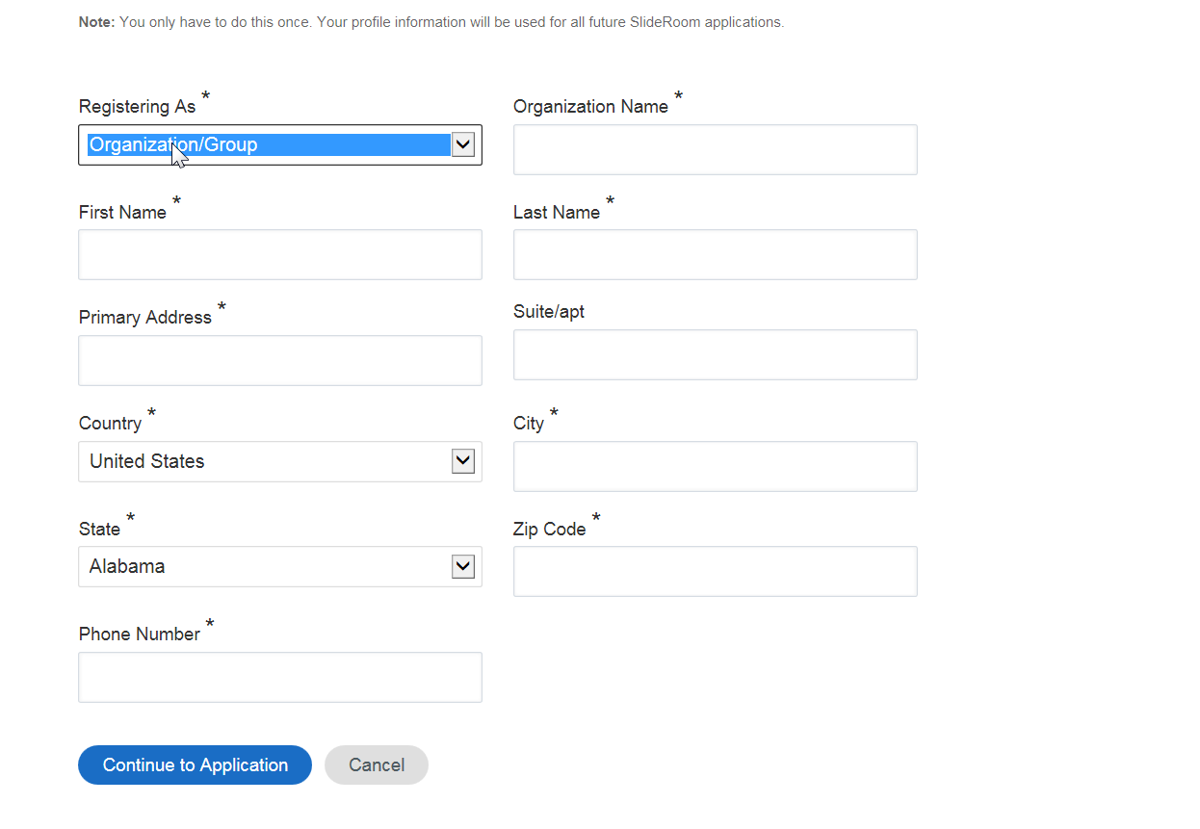
SlideRoom Features
If you have not used SlideRoom before, you will need to register before starting the application

Slide 16
2026 Grant Cycle: Key Dates
Event | Timeframe
Non-Profit Info Session | Nov 13, 2025
2026 Application Opens - email | Dec 1, 2025
2026 Application Closes - email | Jan 17, 2026
Eligibility Review – email y/n | Jan 18 – Jan 24
Grant Review | Jan 25 – Feb 20
Financial Review Period | Feb 21 – Mar 14
Semifinalists/Site Visits – email | Mar 23 – Apr 3
Finalists Notification - call | Mid April
Pitch Presentations | May 4 – May 8
Big Give Event | May 20, 2026

Slide 17
The benefits of applying even if you are not the $100,000 recipient:
Even if you don’t become a $100,000 grant awardee…
All Finalists and semifinalists will be posted in our newsletter and/or on our website.
They all get the opportunity to come to a professional PITCH training session to learn how to best position themselves in a pitch situation.
Just by saying you are a semifinalist can earn a lot of credibility in other processes.

Slide 18
The benefits of applying even if you are not the $100,000 recipient:
What’s in it for YOU no matter the outcome:
Going through our process really helps you become the kind of organization with the vision, planning, governance and financial understanding that is needed to win other grants.
EVERY application is read by typically 15 to 25 members.
Our grant volunteers are always looking to volunteer their time and talents and their other connections to help support the community.
In many examples in the past connections have provided or helped connect organizations to other funding sources to receive support.

Slide 19
FIRST THINGS FIRST – from past winners…….
Before beginning your application, think deeply and carefully about your project and ask yourself, and others, questions like:
What difference does our project make for individuals we serve and for the larger community?
What problem(s) does it solve?
Does it make individual’s lives better – how and why?
Does our project result in growth and capacity building?
What makes our project stand out among the crowd? What aspects of it make it unique?
If I could, would I give a $1,000 toward this project if it was someone else’s idea?

Slide 20
Some feedback from prior applicants:
Keep Applying!
If at first, you don't succeed, try, try again. Some of our grantees have applied more than once.
Don’t be intimidated by process!
It’s a thrill to make it to the Big Give and pitch your project to 100’s of women who really care and want to make a difference.

Slide 21
Top 10 Tips for Writing a Non-Profit Grant

Slide 22

Top 10 Tips for Writing a Nonprofit Grant Application
1. Understand the Funder’s Priorities
  Research the grant maker thoroughly.
  Align your mission and project goals with their funding interests, values, and past grantees.

Slide 23

Top 10 Tips for Writing a Nonprofit Grant Application
2. Follow the Guidelines Exactly
  Stick to the format, word limits, and required documents. Missing even one detail can disqualify your application. (ESPECIALLY SECTION ONE)
  Thoroughly read the requirements, submission process and application BEFORE you start writing

Slide 24
Top 10 Tips for Writing a Nonprofit Grant Application
3. Tell a Compelling Story
  Use storytelling to highlight the problem your nonprofit addresses, the people you serve, and the impact you aim to make. Remember you are trying to persuade people to want to help.
  Remember, for us it’s a group of women reading the grants – APPEAL to THEM
  The narrative should illustrate how the grant will fit with your mission.
  Tell what makes your program unique?
  Use the active, not passive voice.

Slide 25
Top 10 Tips for Writing a Nonprofit Grant Application
4. Clearly Define the Problem
  Present data and evidence to show the urgency and relevance of the issue.
  Make it clear why your project is needed now.
  Make it clear how the grant will assist in a meaningful way.
  Powerful statement of need and evidence of need. Have a good program and be able to prove it!

Slide 26

Top 10 Tips for Writing a Nonprofit Grant Application
5. Outline Specific, Measurable Goals
  Use SMART goals to show how you’ll track success:
    S pecific
    M easurable
    A chievable
    R elevant
    T ime-bound

Slide 27
Top 10 Tips for Writing a Nonprofit Grant Application
6. Demonstrate Capacity and Credibility
  Highlight your team’s qualifications, past successes, and partnerships.
  Show that you’re capable of delivering results.
  Convene a team –
    Leadership
    finance and accounting
    program mangers/subject matter experts

Slide 28

Top 10 Tips for Writing a Nonprofit Grant Application
7. Create a Realistic PROJECT Budget
  Ensure your budget aligns with your narrative. Include justifications for each expense and show how funds will be used efficiently.
  Get Estimates if it involves construction or capital purchases and include them
  Make sure it is clear what funding is secured and what is still needed
  Make sure it is clear what our funds will be used for

Slide 29

Top 10 Tips for Writing a Nonprofit Grant Application
8. Include Sustainability plans
  Explain how you’ll be able to continue to deliver outcomes -
  even after the grant money is all spent.

Slide 30
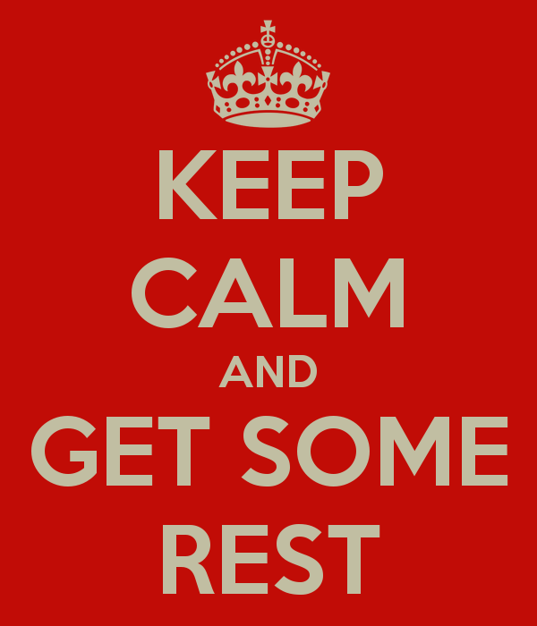
Top 10 Tips for Writing a Nonprofit Grant Application
9. Proofread and Edit Thoroughly - REREAD
  Typos and unclear writing can undermine your credibility.
  Create a WORD document and cut and paste into online forms.
  Have multiple people review the application before submission.
  Most importantly, read your proposal back to someone that is not acquainted with your organization to be sure that it is all easily understood.
  Allow enough time to let your proposal and your mind to rest for a day.

Slide 31

Top 10 Tips for Writing a Nonprofit Grant Application
10. START and Submit Early and Confirm Receipt
  It is a very thorough application!
  Don’t wait until the last minute. Submit ahead of the deadline and confirm that your application was received.
  Contact the program officer if you have questions

Slide 32
Any Questions?
Grants@Impact100MetroDetroit.org
Notes:
Barb

Slide 33
Thank
You
Notes:
Barb

