Slide 1
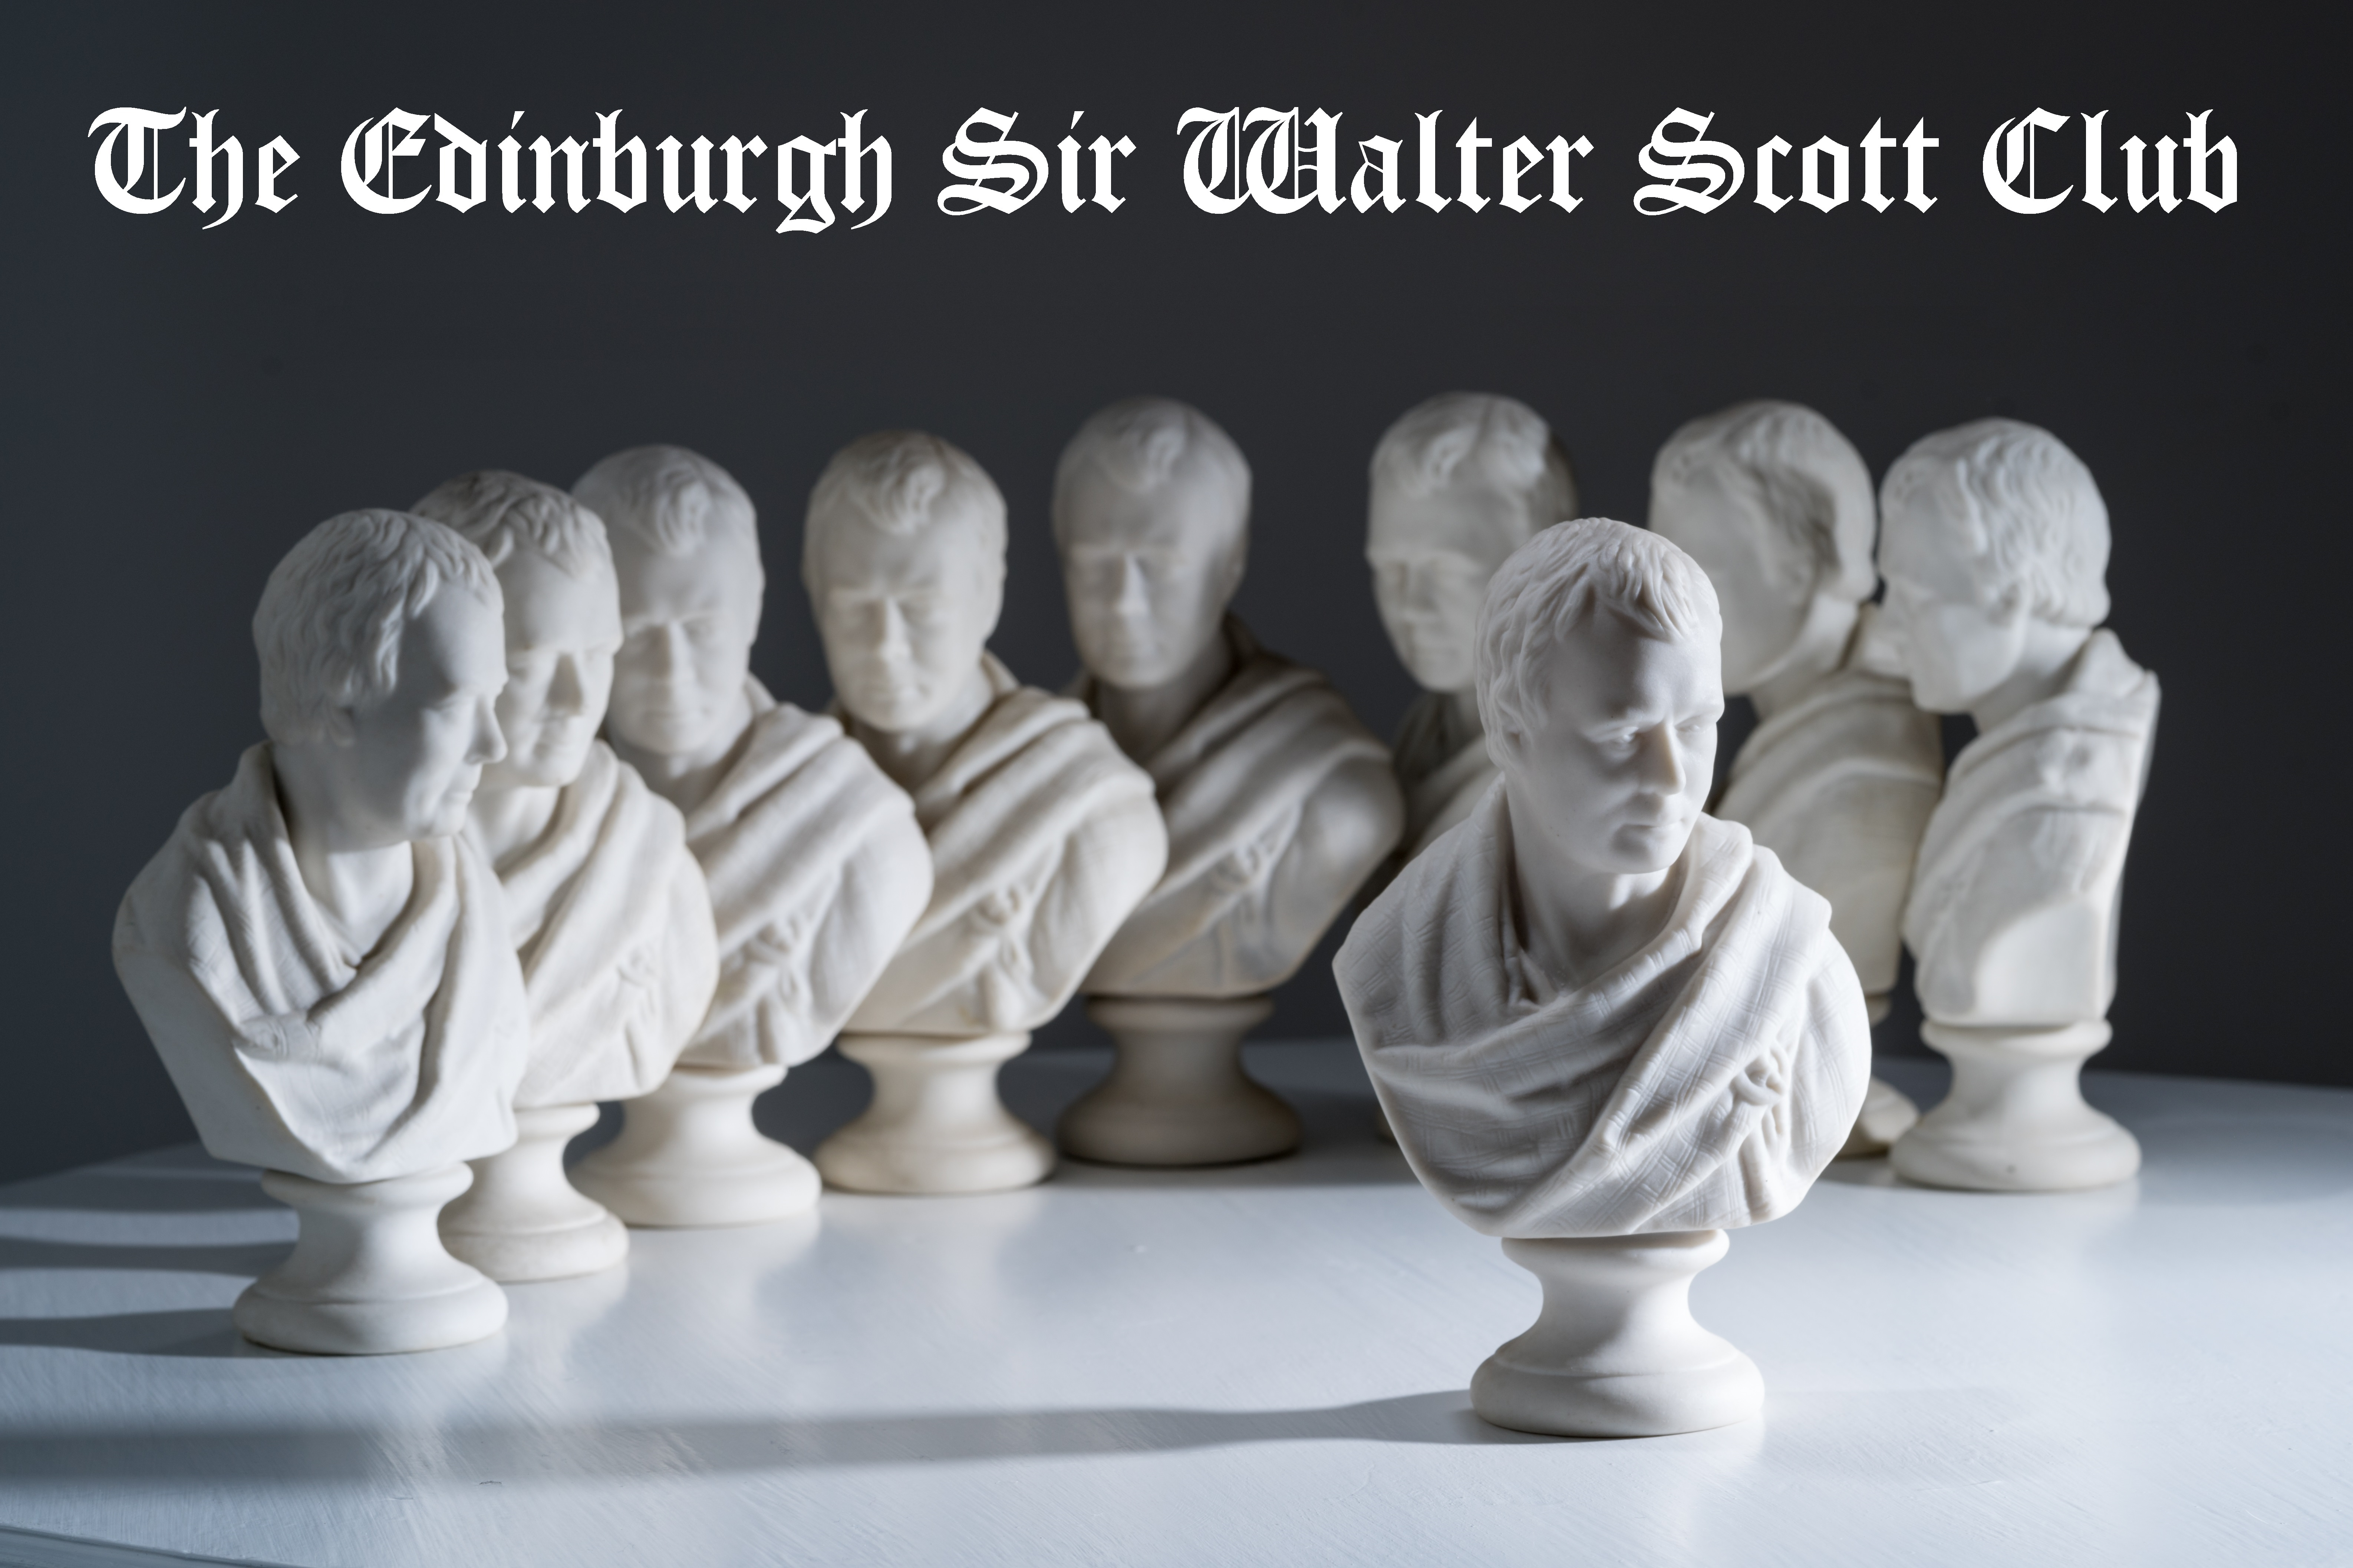
Scott and the Classics
Kristian Kerr / Edinburgh, November 2025

Slide 2
Scott and the Classics
Kristian Kerr / Edinburgh, November 2025

Slide 3
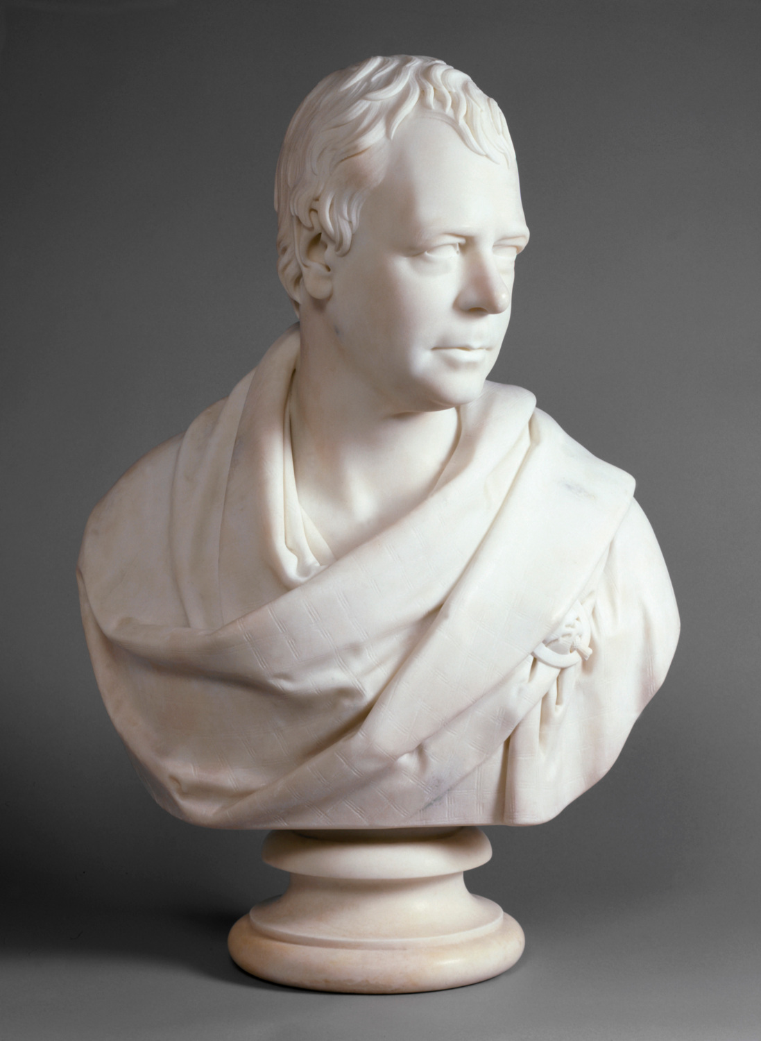
Sir Walter Scott, 1st Bt
by Sir Francis Leggatt Chantrey
1841, based on a work of 1820 30 3/4 in. x 20 1/2 in. (780 mm x 520 mm) overall NPG 993
© National Portrait Gallery, London

Slide 4
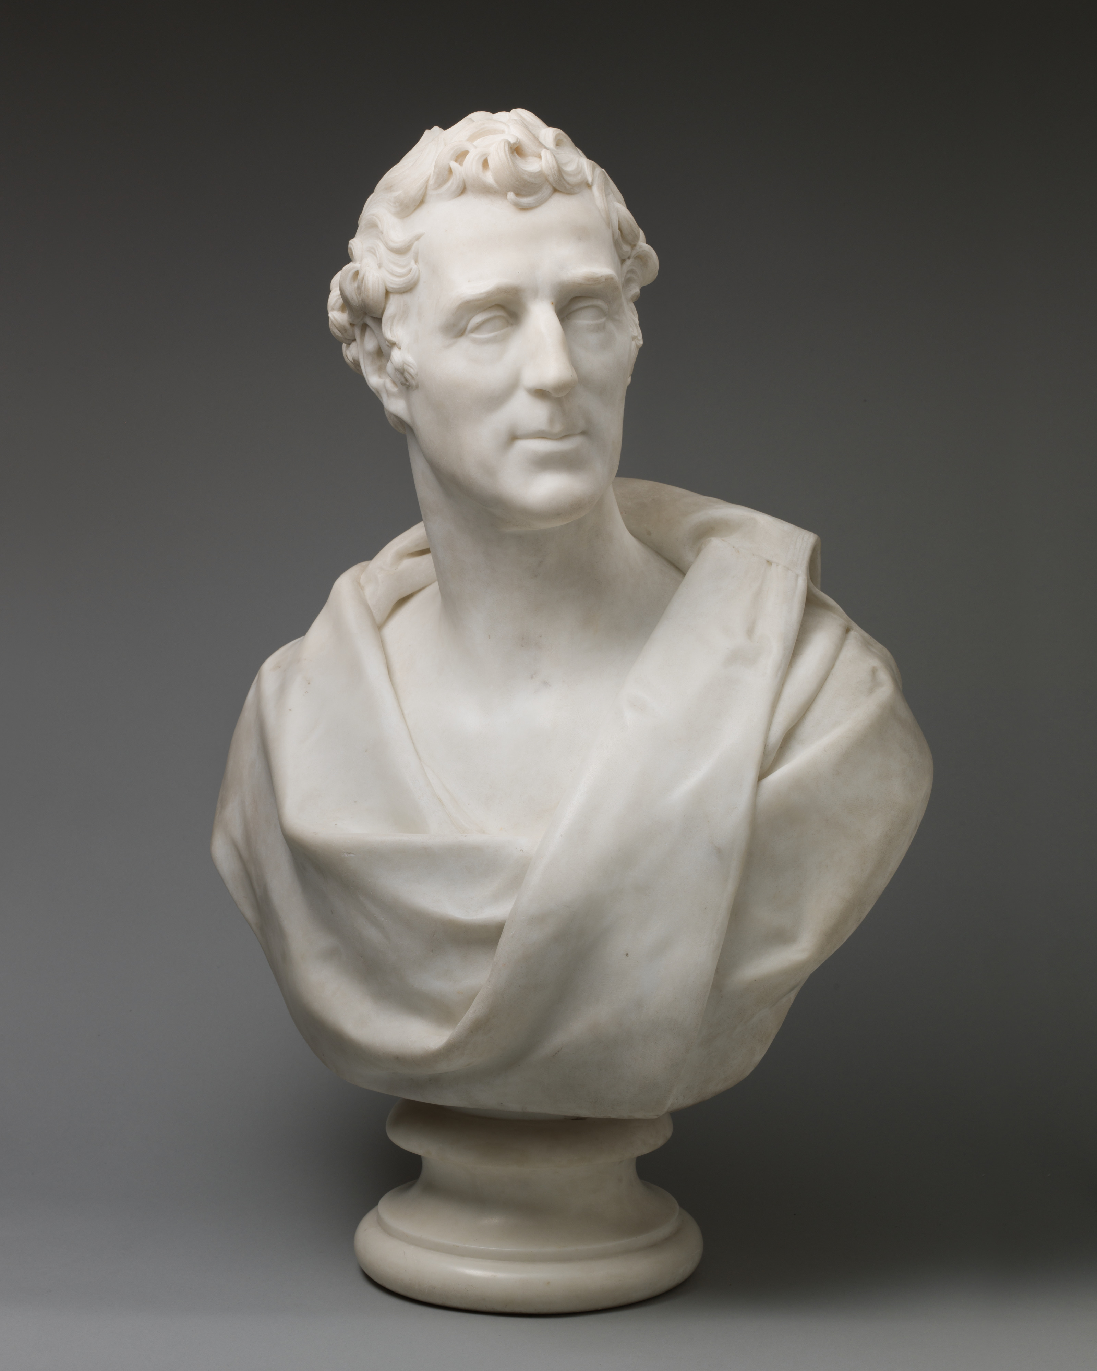
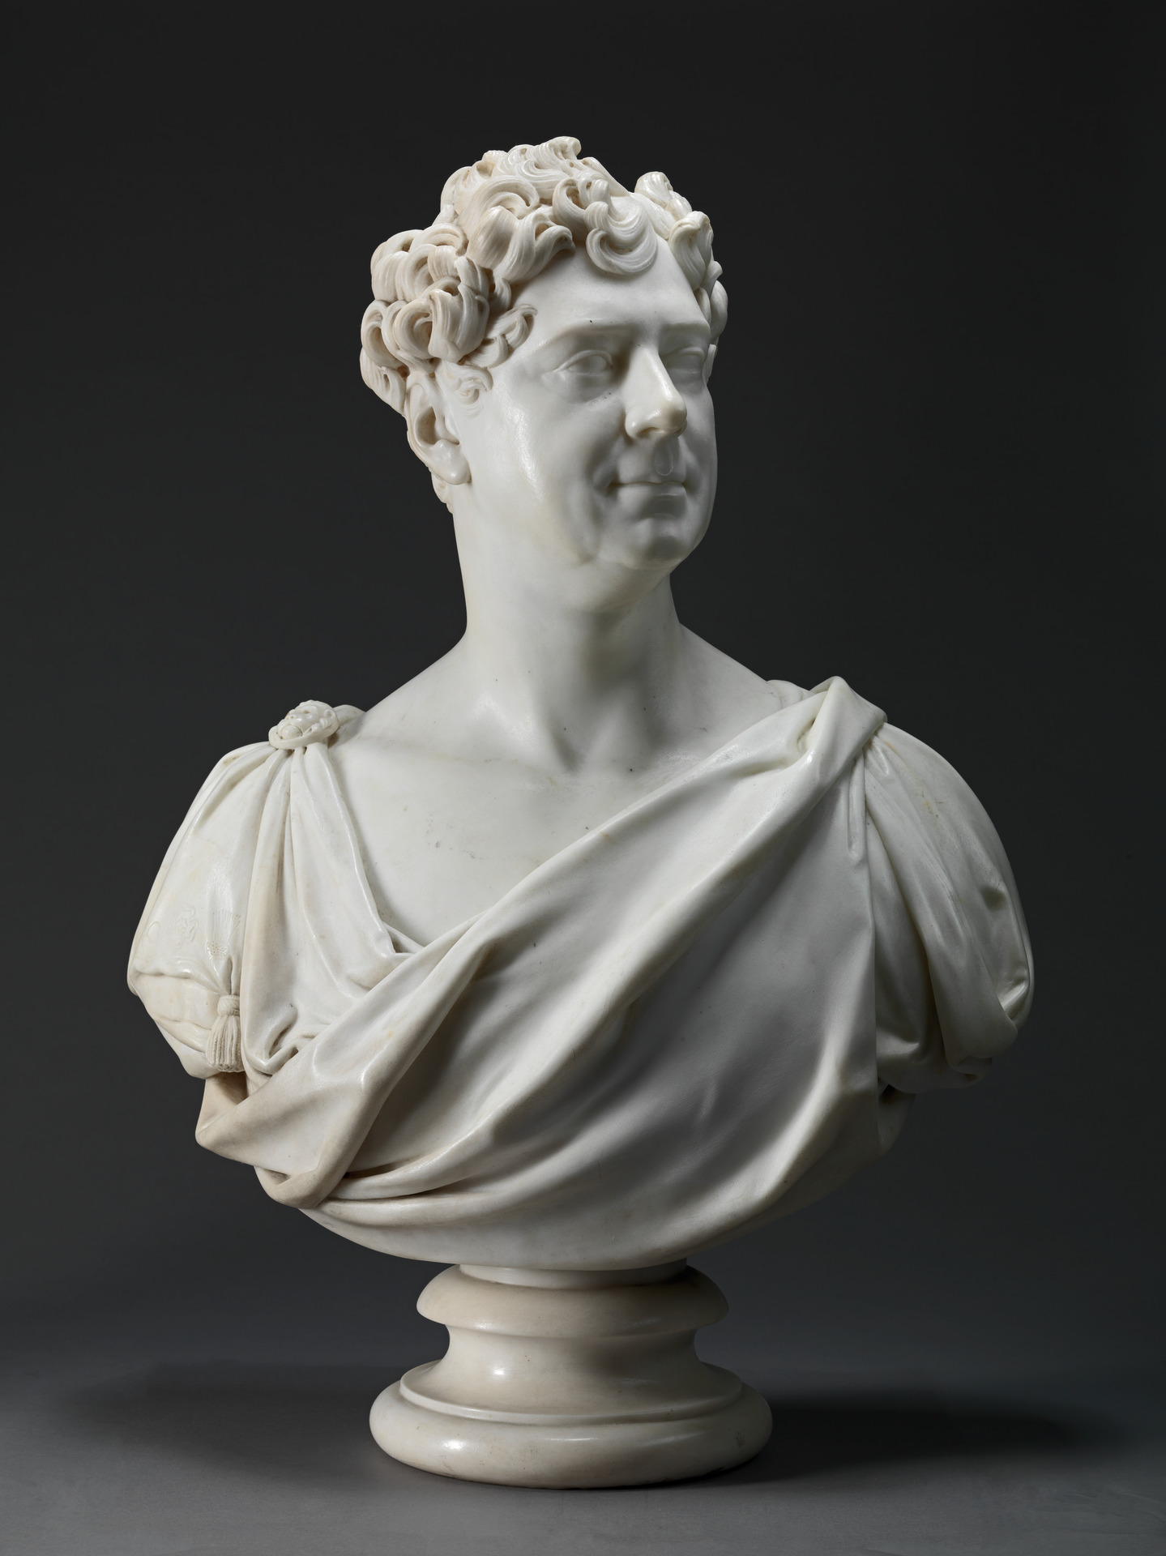
Left: Arthur Wellesley, 1st Duke of Wellington
Sir Francis Chantrey
1823
Metropolitan Museum of Art
1994.295a, b
Right:
George IV
Sir Francis Chantrey
1827
Yale Centre for British Art
B1977.14.37

Slide 5
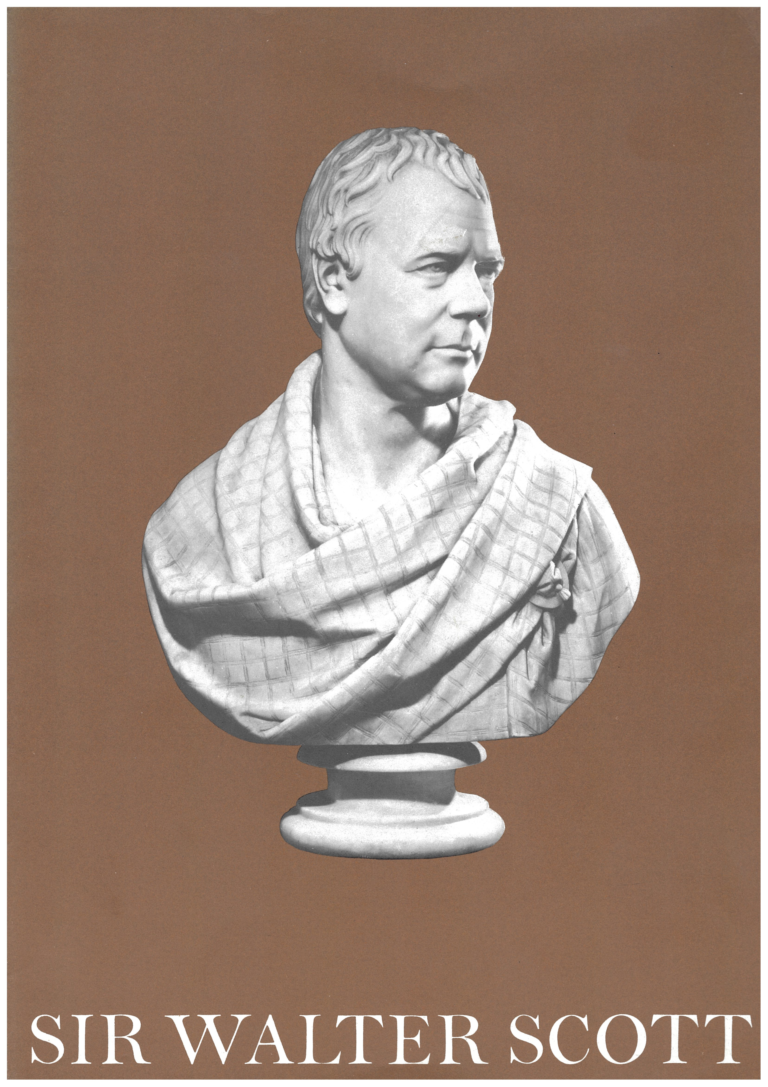
Sir Walter Scott 1771-1971
A Bicentenary Exhibition
Edinburgh
Organised by the Court of Session, the Faculty of Advocates and the National Library of Scotland
In the Parliament House, Edinburgh. 15th August - 11th September. 1971
Exhibition Catalogue (Edinburgh, 1971)

Slide 6
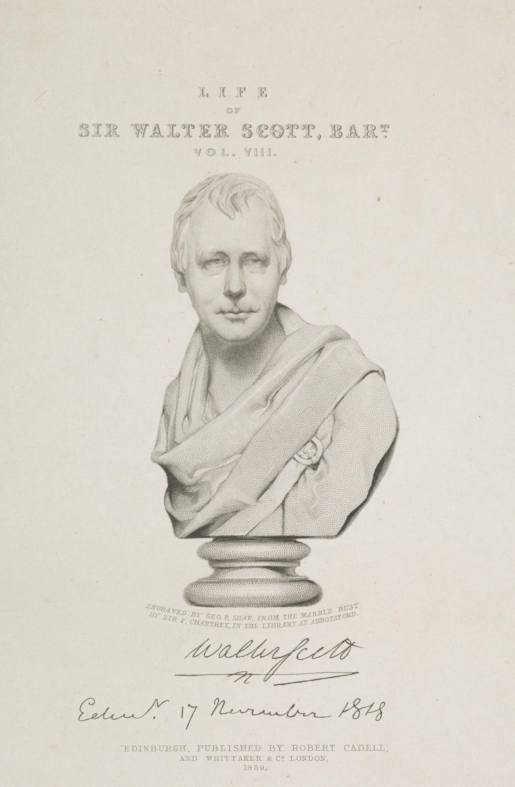
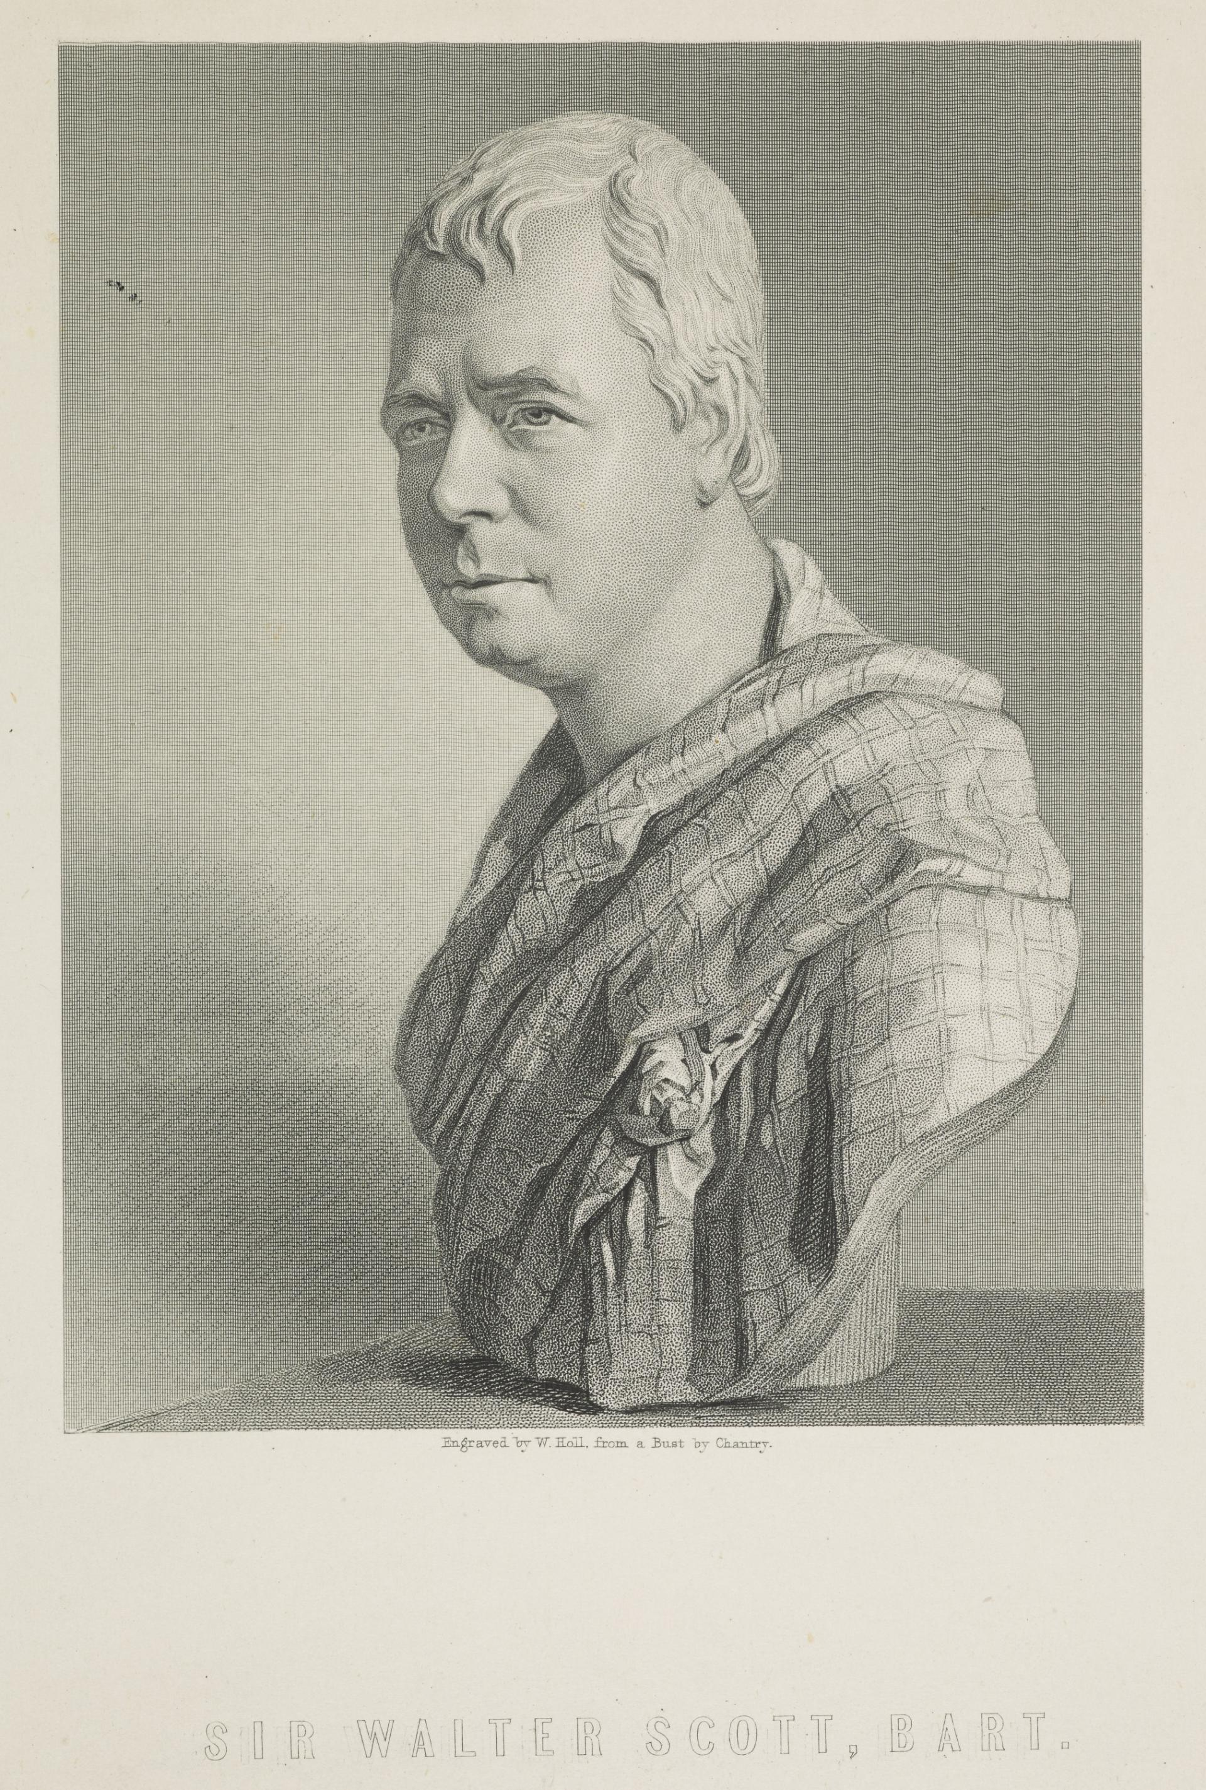
Left: George Baird Shaw, engraving for frontispiece of Lockhart’s Life of Sir Walter Scott, Bart. Vol VIII. (Edinburgh, 1839)
Right: William Holl, engraving first published in The Gallery of Portraits: With Memoirs (London: Charles Knight, 1833-37, Vol. VII), generally known as Knight's Gallery of Portraits.

Slide 7
My bookseller has tantalized me with the hopes of Appol[l]onius these two months and I have partly delayed writing on that account not that my verdict on Classical matters is worth six pence but because if the book had been written in Arabic and by so kind a friend I should have been anxious at least to say I had seen it. My education was of a very desultory nature not from want of the kindest paternal [care] but partly from bad health in early youth partly from the interruptions seclusions and indulgences I was too much permitted to study what I liked and and when I liked, which was very little and very seldom. To mend the matter I stuffed my brains with all such reading as was never read and in the department of my memory where should be a Roman Patera lo! there is a witches cauldron. I am more apt to pray to Thor or Woden than Jupiter think of the fairies oftener than the Dryads and of Bannockburn and Flodden more than Marathon and Pharsalia.
Letter to Rev. Mr. Berwick, Leixlip, 10th April 1810 (Grierson, II.322-3)
Notes:
Points here:
Seen this before – rejection of the classical but actually Scott is quite precise here
Composition is elevated, mock heroic
Book of Apollonius is new translation of Life of Apollonius of Tyana by Philostratus; C2 divine – ‘magician’ translated by ‘bouncing priest’

Slide 8
‘A perfect knowledge of the classical languages has been fixed upon and not without good reason as the mark of a well educated young man and though many people may have scrambled into distinction without it, it is always with the greatest difficulty just like climbing over a wall instead of giving your ticket at the door.’
Letter to son Charles (b.1805) at school, 1820 (VI. 293-4)
‘I am glad to find…you are reading Tacitus with some relish. His stile is rather quaint and enigmatical which makes it difficult to the student but then his pages are filled with such admirable apothegms and maxims of political wisdom as infer the deepest knowledge of human nature and it is particularly necessary that any one who may have views as a public speaker should be master of his works as there is neither ancient or modern who affords such a selection of admirable quotations.’
To the same, 1822 (VII.157-8)

Slide 9
‘I wish to express that we become tired of the task before we can comprehend the beauty; that we learn by rote before we can get by heart; that the freshness is worn away, and the future pleasure and advantage deadened and destroyed by the didactic anticipation, at an age when we can neither feel nor understand the power of compositions, which it requires an acquaintance with life, as well as Latin and Greek, to relish or to reason upon. For the same reason, we never can be aware of the fulness of some of the finest passages of Shakspeare (‘To be, or not to be,’ for instance), from the habit of having them hammered into us at eight years old, as an exercise not of mind but of memory; so that when we are old enough to enjoy them, the taste is gone, and the appetite palled. In some parts of the continent, young persons are taught from mere common authors, and do not read the best classics until their maturity.’
Byron / Hobhouse note to Childe Harold IV, 75 (1818)

Slide 10
‘The humorous and happy adaptation of legal terms shew no moderate acquaintance with the arcana of the law, and a perpetual allusion to the English and the Latin classics no common share of scholarship and taste.’
‘Waverley, supposed by W Scott’, British Critic 2 (1814), 209

Slide 11
‘those passions common to men in all stages of society, and which have alike agitated the human heart, whether it throbbed under the steel corslet of the fifteenth century, the boarded coat of the eighteenth, or the blue frock and white dimity waistcoat of the present day.
Upon these passions it is no doubt true that the state of manners and laws casts a necessary colouring; but the bearings, to use the language of heraldry, remain the same, though the tincture may be not only different, but opposed in strong contradistinction.
The wrath of our ancestors, for example was coloured gules; it broke forth in acts of open and sanguinary violence against the objects of its fury. Our malignant feelings, which must seek gratification through more indirect channels, and undermine the obstacles which they cannot openly bear down, may be rather said to be tinctured sable. But the deep-ruling impulse is the same in both cases. …
It is from the great book of Nature, the same through a thousand editions, whether of black letter or wire-wove and hot-pressed, that I have venturously essayed to read a chapter to the public.’
Lamont, ed. Waverley 1814 (Oxford, 1998, 5.
Notes:
Why does this link back to Scotland and the Classics?

Slide 12
‘those passions common to men in all stages of society, and which have alike agitated the human heart, whether it throbbed under the steel corslet of the fifteenth century, the boarded coat of the eighteenth, or the blue frock and white dimity waistcoat of the present day.
Upon these passions it is no doubt true that the state of manners and laws casts a necessary colouring; but the bearings, to use the language of heraldry, remain the same, though the tincture may be not only different, but opposed in strong contradistinction.
The wrath of our ancestors, for example was coloured gules; it broke forth in acts of open and sanguinary violence against the objects of its fury. Our malignant feelings, which must seek gratification through more indirect channels, and undermine the obstacles which they cannot openly bear down, may be rather said to be tinctured sable. But the deep-ruling impulse is the same in both cases. …
It is from the great book of Nature, the same through a thousand editions, whether of black letter or wire-wove and hot-pressed, that I have venturously essayed to read a chapter to the public.’
Lamont, ed. Waverley 1814 (Oxford, 1998, 5.
Notes:
Why does this link back to Scotland and the Classics?

Slide 13
‘those passions common to men in all stages of society, and which have alike agitated the human heart, whether it throbbed under the steel corslet of the fifteenth century, the boarded coat of the eighteenth, or the blue frock and white dimity waistcoat of the present day.
Upon these passions it is no doubt true that the state of manners and laws casts a necessary colouring; but the bearings, to use the language of heraldry, remain the same, though the tincture may be not only different, but opposed in strong contradistinction.
The wrath of our ancestors, for example was coloured gules; it broke forth in acts of open and sanguinary violence against the objects of its fury. Our malignant feelings, which must seek gratification through more indirect channels, and undermine the obstacles which they cannot openly bear down, may be rather said to be tinctured sable. But the deep-ruling impulse is the same in both cases. …
It is from the great book of Nature, the same through a thousand editions, whether of black letter or wire-wove and hot-pressed, that I have venturously essayed to read a chapter to the public.’
Lamont, ed. Waverley 1814 (Oxford, 1998, 5.
Notes:
Why does this link back to Scotland and the Classics?

Slide 14
LETTER I
DARSIE LATIMER TO ALAN FAIRFORD
Dumfries
Cur me exanimas querelis tuis? – In plain English, Why do you deafen me with your croaking? The disconsolate tone in which you bade me farewell at Noble-House, and mounted your miserable hack to return to your law drudgery, still sounds in my ears. It seemed to say, ‘Happy dog! you can ramble at pleasure over hill and dale, pursue every object of curiosity that presents itself, and relinquish the chase when it loses interest; while I, your senior and your better, must, in this brilliant season, return to my narrow chamber and my musty books.’
Such was the import of the reflections with which you saddened our parting bottle of claret, and thus I must needs interpret the terms of your melancholy adieu.
And why should this be so, Alan? Why the deuce should you not be sitting precisely opposite to me at this moment, in the same comfortable George Inn; thy heels on the fender, and thy juridical brow expanding its plications as a pun rose in your fancy? Above all, why, when I fill this very glass of wine, cannot I push the bottle to you, and say, ‘Fairford, you are chased!’ Why, I say, should not all this be, except because Alan Fairford has not the same true sense of friendship as Darsie Latimer, and will not regard our purses as common, as well as our sentiments?
Sutherland, ed. Redgauntlet. 1824 (Oxford, 1998), 13.

Slide 15
‘I afterwards found that his only pleasure in seeing new places arose from the poetical ideas they inspired as applicable to other scenes with which his mind was more familiar. … As an antiquary I felt that my citadel of Cumae with my Greek and Roman tombs had produced little ef[f]ect on the mind of the poet, and we therefore returned to Pozzuoli to an excellent dinner… ’
William Gell, Reminiscences of Sir Walter Scott’s Residence in Italy, 1832 (London, 1957), 22

Slide 16
Finis.

Slide 17
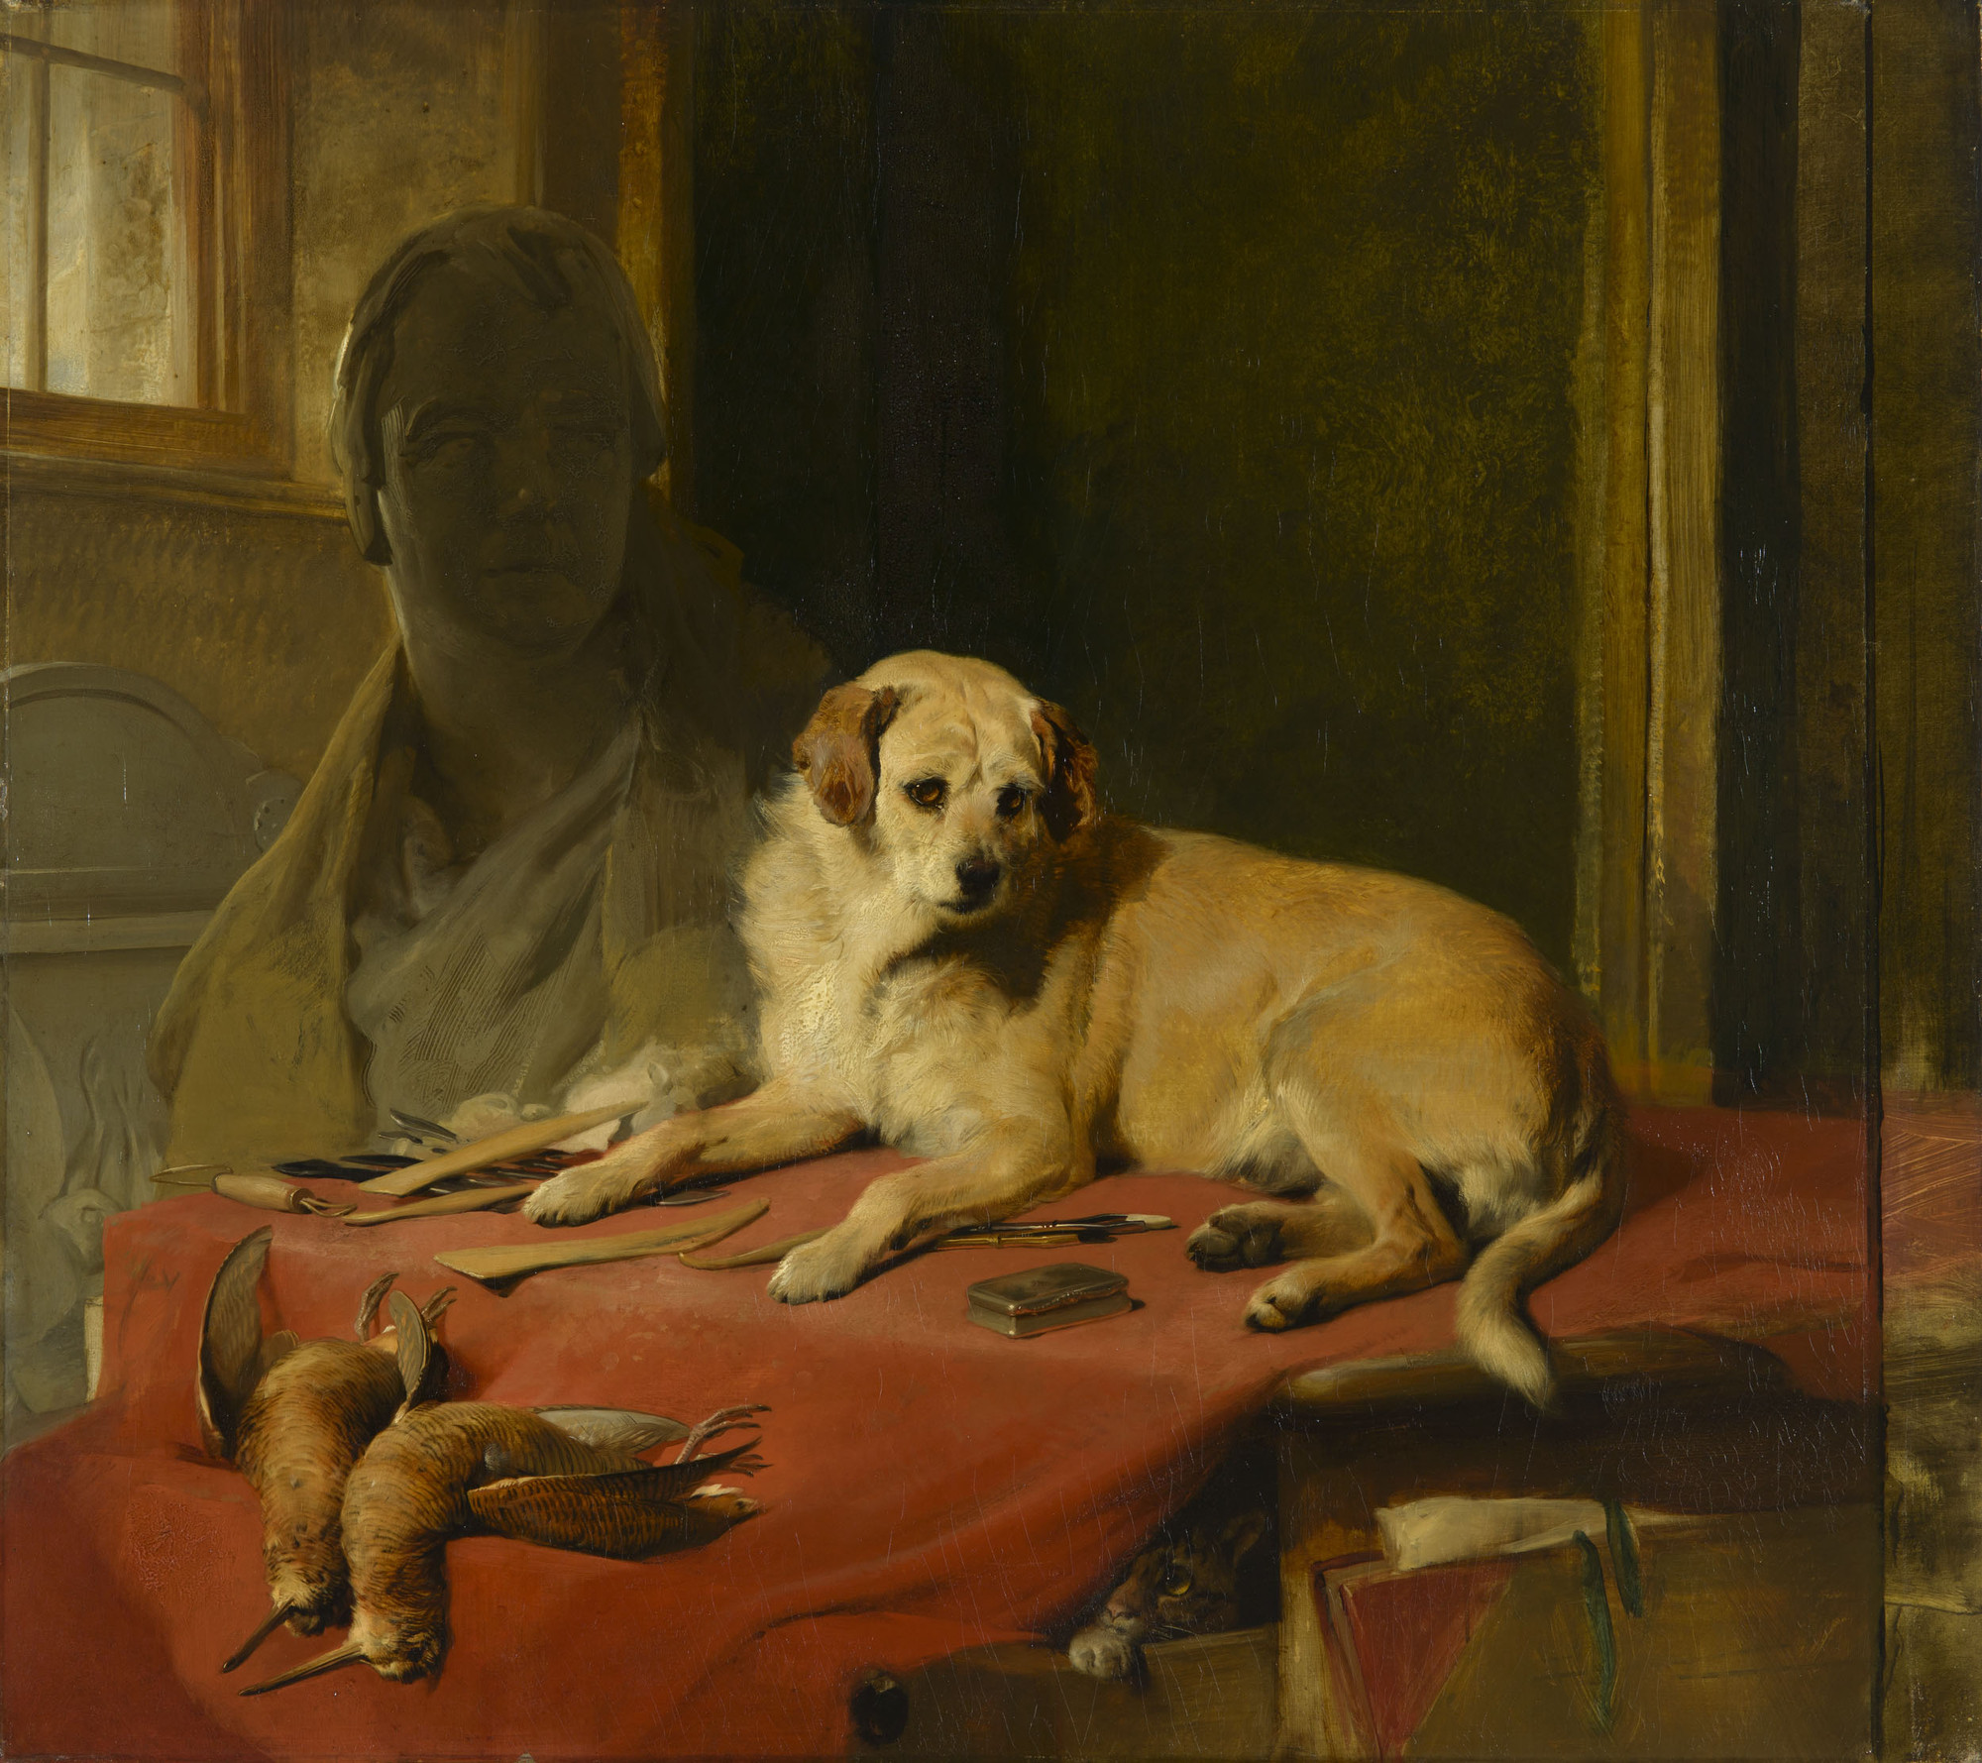
Sir Edwin Landseer
Pen, Brush and Chisel: The Studio of Sir Francis Chantrey
Also displayed as “‘Mustard’ the son of ‘Pepper’. Given by the late Sir Walter Scott to Sir Francis Chantrey, R.A.’
(1835, Royal Collection)

