Slide 1
‘out-of-the-way reading’ and ‘hoary-headed tradition’:
Walter Scott’s Supernatural Scholarship and Poetry
Dr Natalie Tal Harries
natalie.harries@abdn.ac.uk

Slide 2

‘I rejoice in the progress of your demoniacal collection; we will have a meeting one day upon the Border, and compile a system of Daemonology, with the choicest examples which out-of-the-way reading and hoary-headed tradition can supply.’ ~ Letters, II. 246 (1809)
‘My education was of a very desultory nature not from want of the kindest paternal [care] but partly from bad health in early youth partly from the interruptions seclusions and indulgences I was too much permitted to study what I liked and when I liked which was very little and very seldom. To mend the matter I stuffed my brains with all such reading as was never read and in the department of my memory where should be a Roman Patera lo! there is a witches cauldron. I am more apt to pray to Thor or Woden than Jupiter think of the fairies oftener than the Dryads and of Bannockburn and Flodden more than Marathon and Pharsalia.’ ~ Letters, II. 322 (1810)
‘the Witch corner’ in Walter Scott’s Library
Image courtesy of the Abbotsford Trust

Slide 3
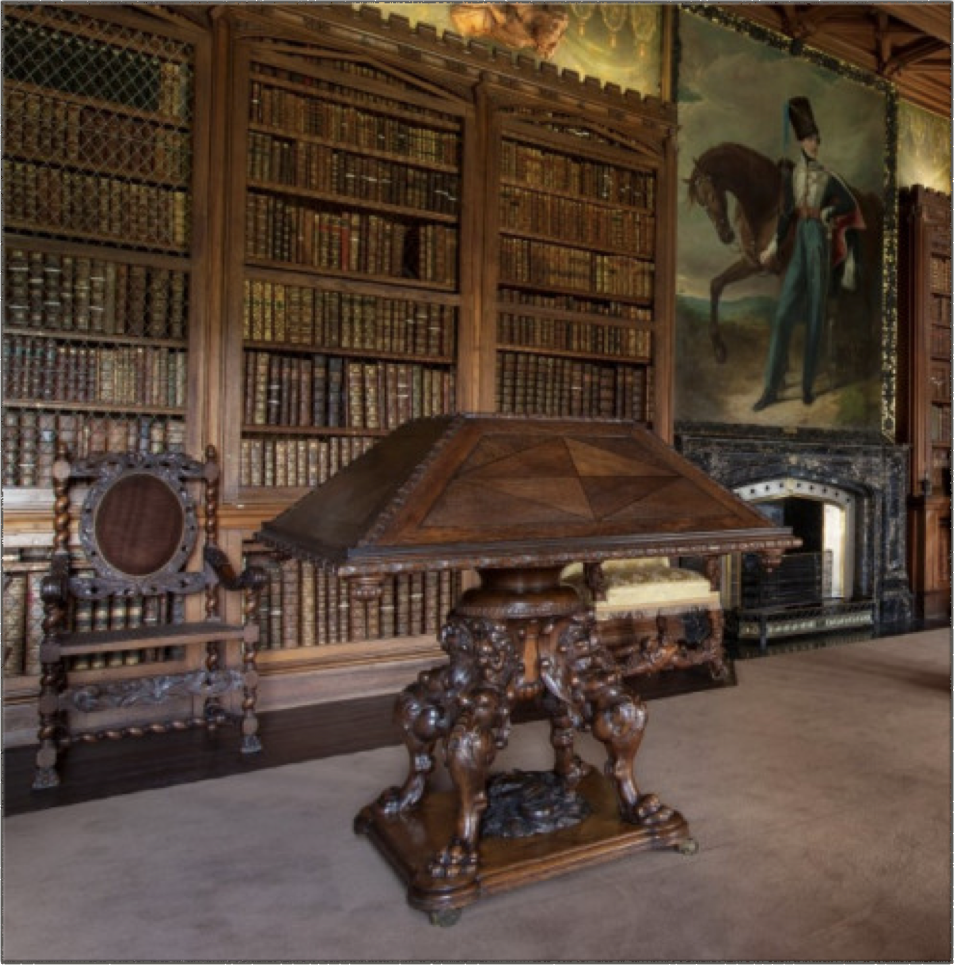
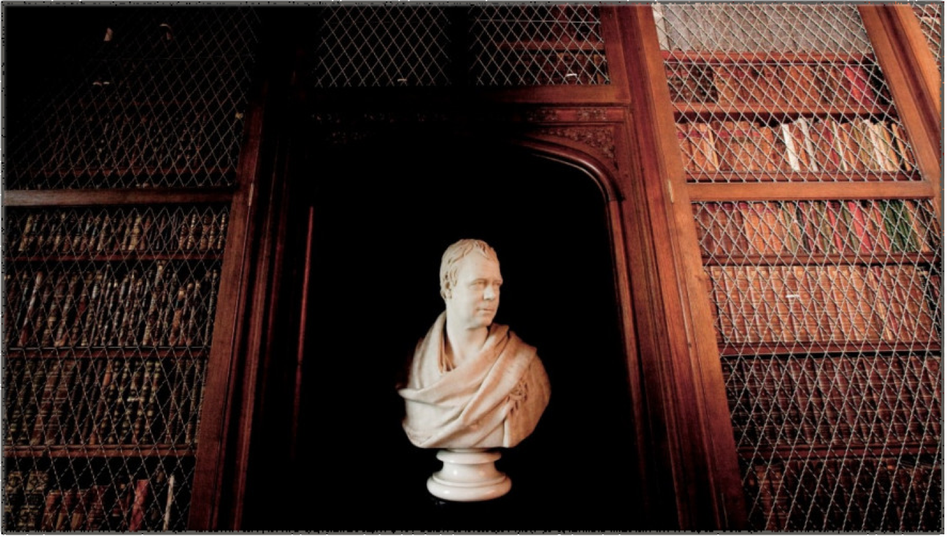
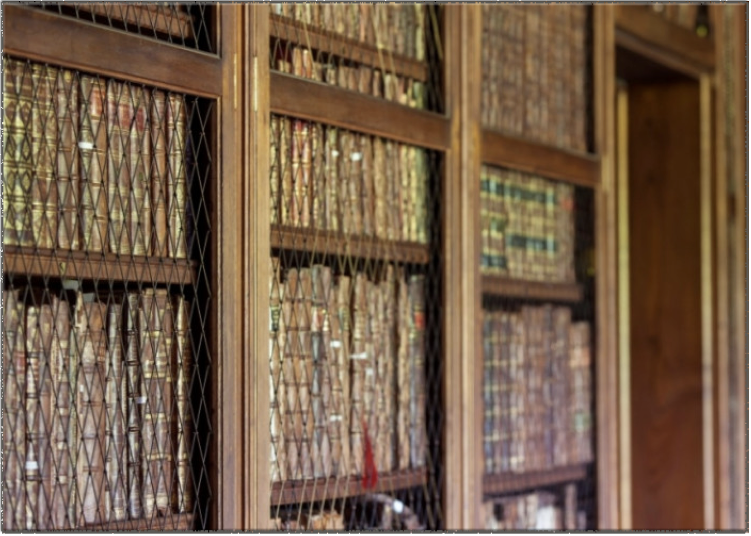
Walter Scott’s Library - Images courtesy of the Abbotsford Trust

Slide 4
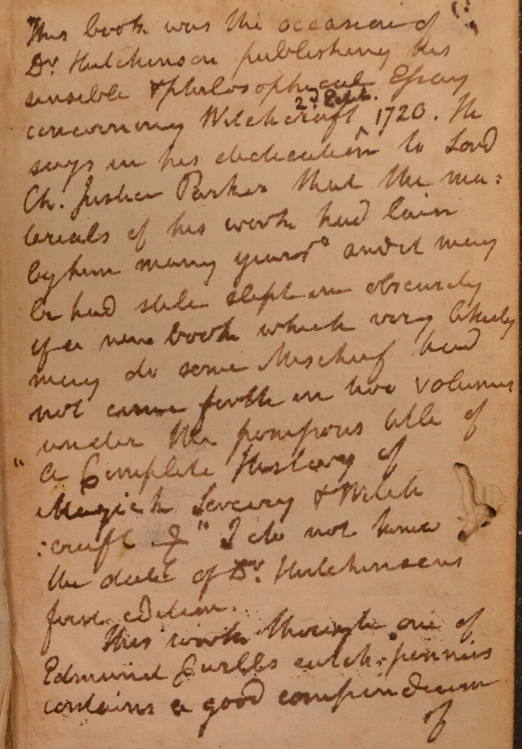
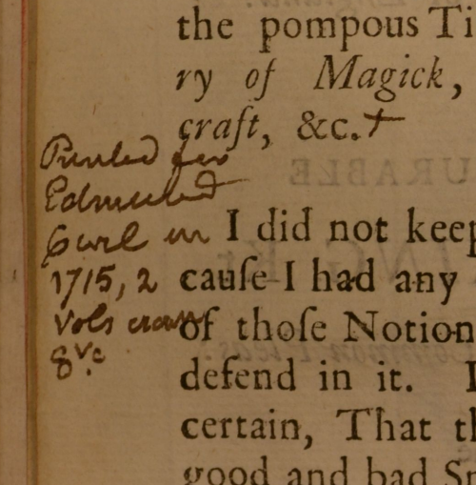
An Historical Essay Concerning Witchcraft
Dr Francis Hutchinson, 2nd ed. (1720)
A Compleat History of Magick, Sorcery, and Witchcraft
Richard Boulton (1715)
https://lib1.advocates.org.uk/Annotations/79091.pdf
https://lib1.advocates.org.uk/Annotations/78577.pdf

Slide 5
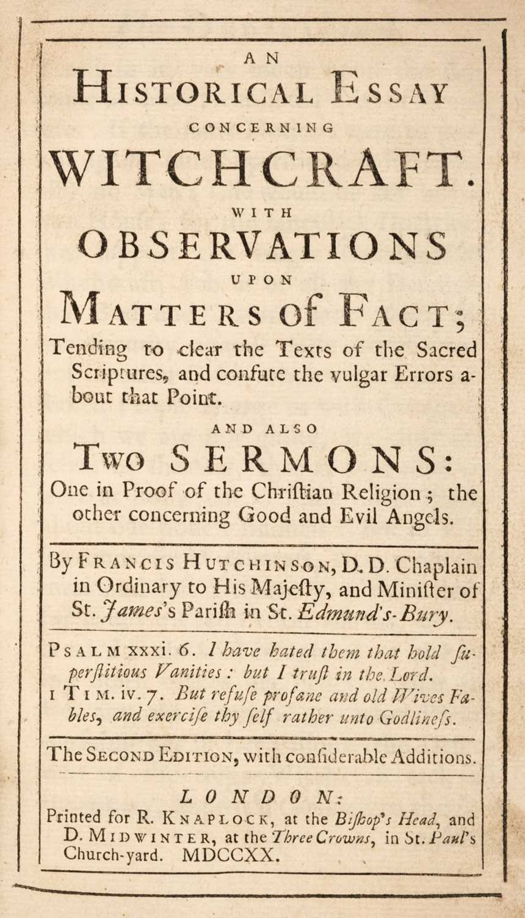
‘If the same Notions were to prevail again, (and Superstition is never far off) no Man’s Life would be safe in his own House; for the fantastick Doctrines that support the Vulgar Opinions of Witchcraft, rob us all of the Defences that God and Nature have plac’d for our Security against false Accusations. (…) The credulous Multitude will ever be ready to try their Tricks, and swim the old Women, and wonder at and magnify every unaccountable Symptom and odd Accident.’
(vi-viii)

Slide 6

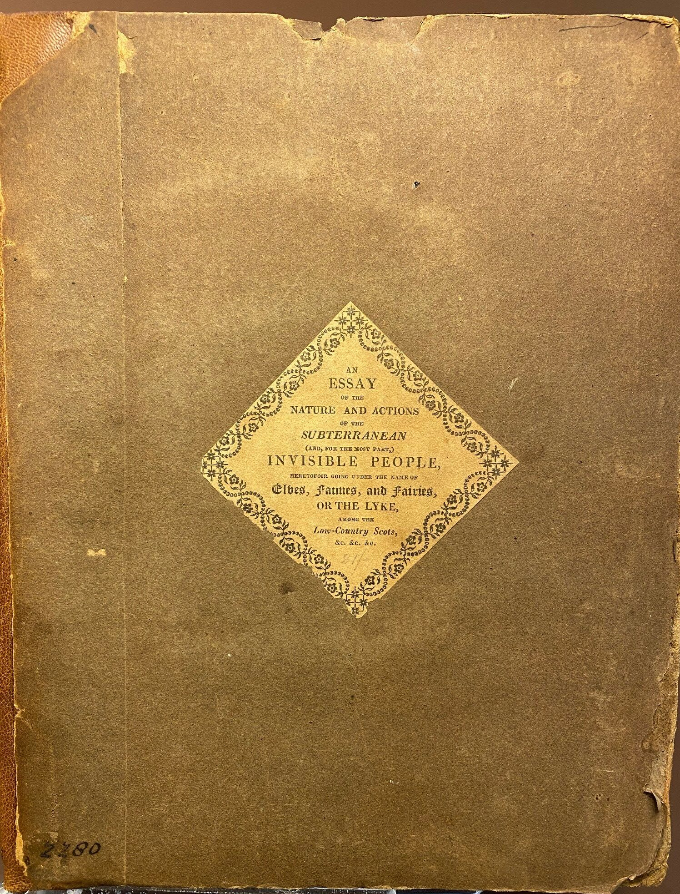


Slide 7
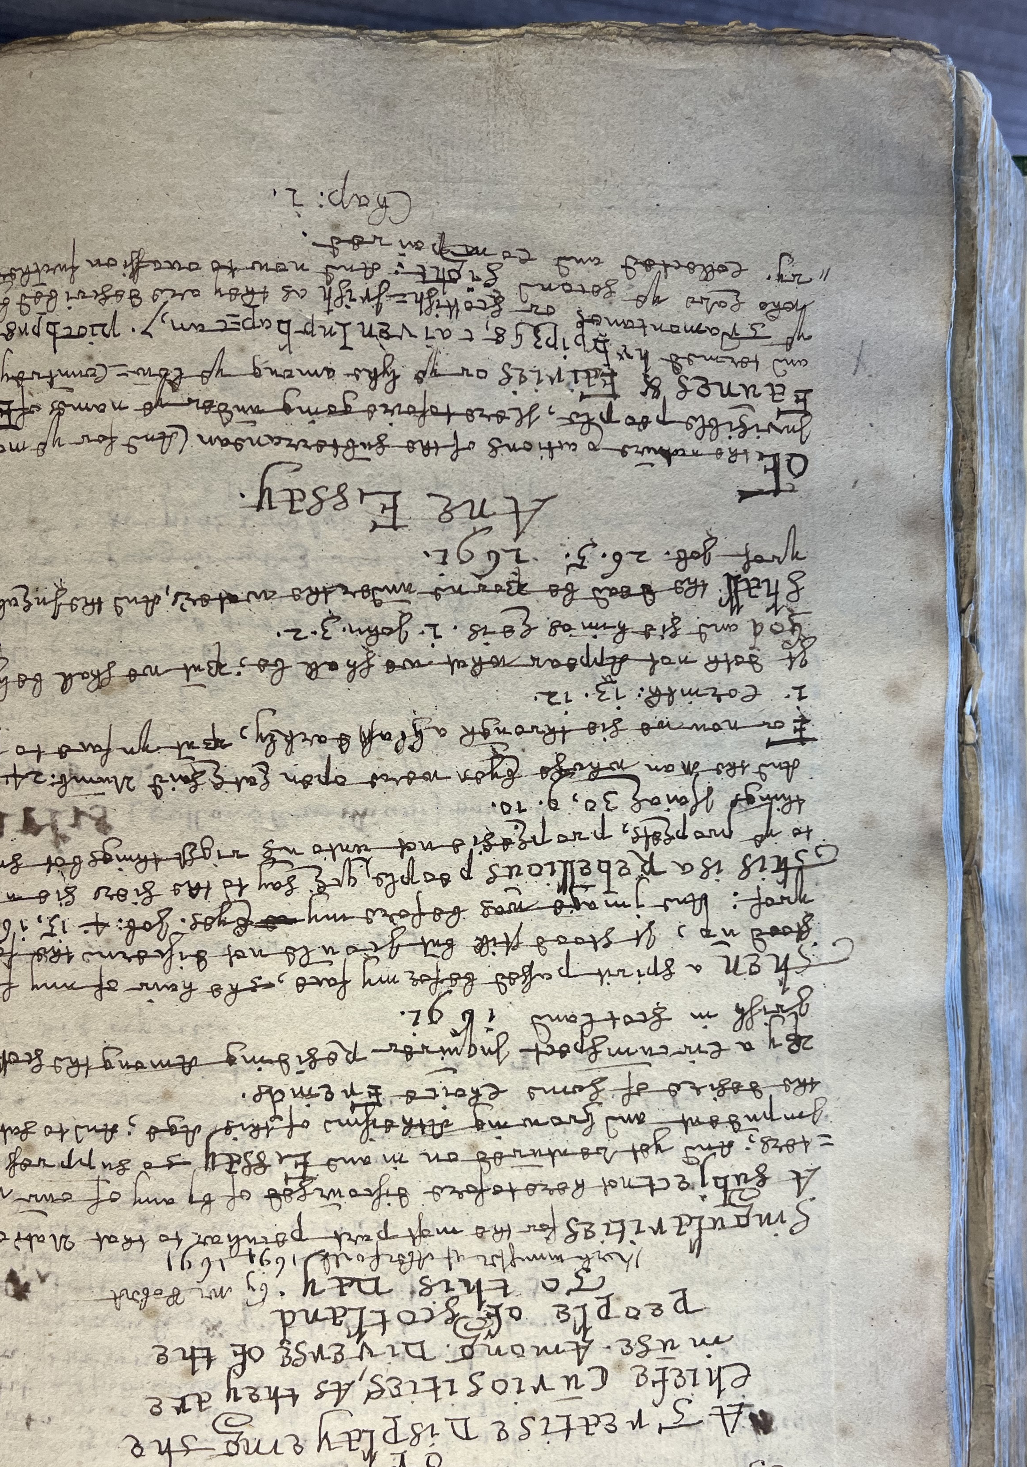
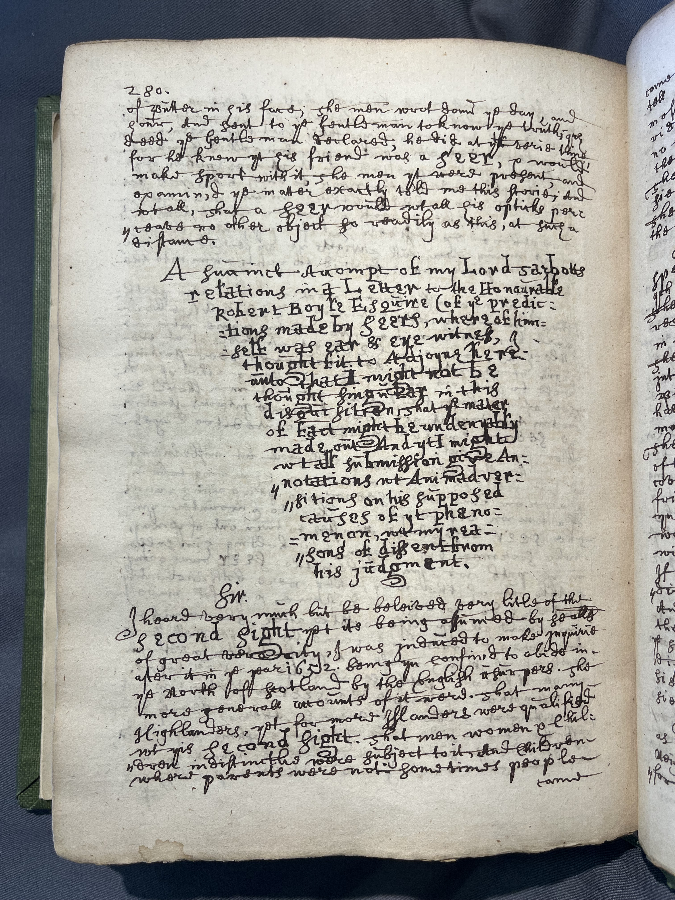
Adv. MS. 34.6.9

Slide 8


‘I hope to send you in a few weeks a very curious treatise on the second sight, published (not for sale) from a manuscript in 1691 which fell into my hands.’
~ Letter to Lady Macleod, 1815 (Letters, 4.38)
https://lib1.advocates.org.uk/Annotations/79008.pdf

Slide 9
‘It is clear that the function of Scott’s notes goes far beyond what we would normally recognise as the function of annotation. Such notes cannot simply be dismissed as an antiquarian or Enlightenment exercise in documentation, since what they document is no longer what is certain, verifiable and supported by witness, but a far more complex amalgamation of written authority, local folklore, literary heritage and what can only be described as parallel narrative. Rather than creating a taxonomy of knowledge, as the notes to Minstrelsy do, they bring many different forms of knowledge into play to create additional, or even alternative, forms of discourse to those offered by the text proper of the poem.’
~ Alison Lumsden, ‘Scott and the Art of Surplusage: Excess in the Narrative Poems’ in Caroline McCracken-Flesher and Matthew Wickman (eds), Walter Scott at 250 (Edinburgh, 2021), 116.

Slide 10
‘Ghosts like many other things have of late been put out of fashion by a promiscuous & ill-judged introduction of tales relating to them. I differ from many of my contemporary Ghost-raisers upon this subject. I think the Marvellous in poetry is ill-timed & disgusting when not managed with moderation & ingrafted upon some circumstance of popular tradition or belief which sometimes can give even to the improbable an air of something like probability.’ ~ Letter to Dr Currie, 1801 (Letters, I.121)
‘Yet this inclination to believe in the marvellous gradually becomes weaker. Men cannot but remark that (since the scriptural miracles have ceased,) the belief in prodigies and supernatural events has gradually declined in proportion to the advancement of human knowledge; and that since the age has become enlightened, the occurrence of tolerably well attested anecdotes of the supernatural character are so few, as to render it more probable than the witnesses have laboured under some strange and temporal delusion, rather than that the laws of nature have been altered or suspended. At this period of human knowledge, the marvellous is so much identified with the fabulous, as to be considered generally as belonging to the same class.’ ~ ‘On the Supernatural in Fictitious Composition’

Slide 11
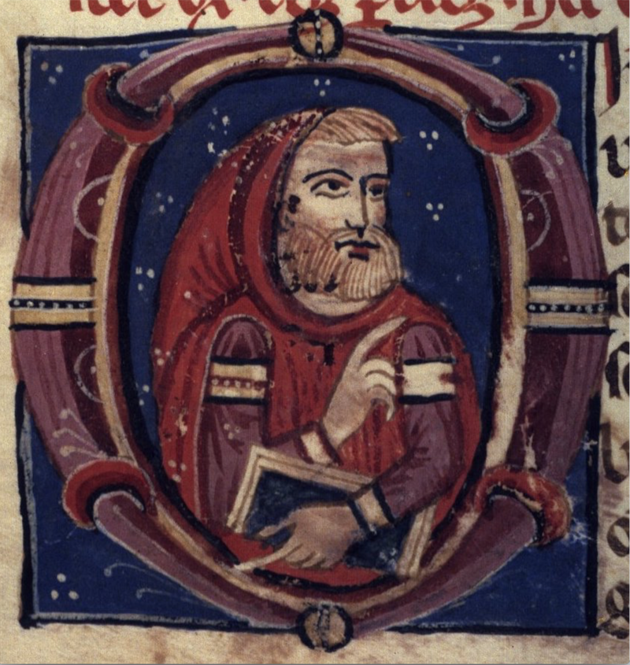
‘A personage, thus spoken of by biographers and historians, loses little of his mystical fame in vulgar tradition. Accordingly, the memory of Sir Michael Scott survives in many a legend; and in the south of Scotland, any work of great labour and antiquity, is ascribed, either to the agency of Auld Michael, of Sir William Wallace, or of the devil. Tradition varies concerning the place of his burial: some contend for Holme Coltrame, in Cumberland; others for Melrose Abbey. But all agree, that his books of magic were interred in his grave, or preserved in the convent where he died.’
~ The Lay of the Last Minstrel, Notes to Canto Second

Slide 12

This is a work concerning the fairy people, in whose existence Mr. Kirke appears to have been a devout believer. He describes them with the usual powers and qualities ascribed to such beings in Highland tradition.
But what is sufficiently singular, the Rev. Robert Kirke, author of the said treatise, is believed himself to have been taken away by the fairies, in revenge, perhaps, for having let in too much light upon the secrets of their commonwealth. We learn this catastrophe from the information of his successor, the late amiable and learned Dr. Patrick Grahame, also minister at Aberfoil, who, in his sketches of Perthshire, has not forgotten to touch upon the Dun Shie, or fairy mound, when he sunk down, in what seemed to mortals a fit, and was supposed to be dead. This, however, was not his real fate. ~ Note on ‘Fairy Superstition’ in Rob Roy

Slide 13
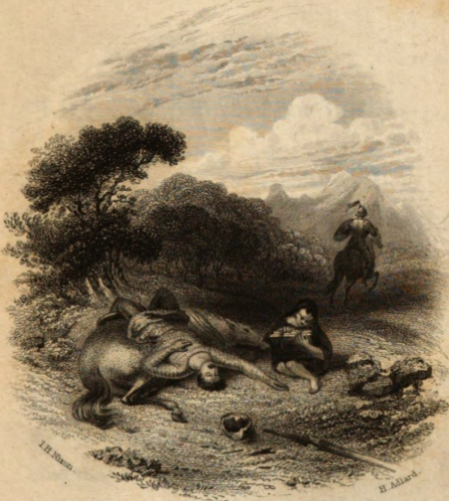
‘As much has been objected to Gilpin Horner on account of his being supposed rather a device of the author than a popular superstition, I can only say, that no legend which I have ever heard seemed to be more universally credited, and that many persons of very good rank and considerable information are well known to repose absolute faith in the tradition.’
~ The Lay of the Last Minstrel, 12th ed. (1811), Notes to Canto Second.

Slide 14

‘The desert gave him visions wild, | Such as might suit the spectre’s child (…) In adopting the legend concerning the birth of the Founder of the Church of Kilmallie, the author has endeavoured to trace the effects which such a belief was likely to produce, in a barbarous age, on the person to whom it related. It seems likely that he must have become a fanatic or an imposter, or that mixture of both, which forms a more frequent character than either of them (…) It was a natural attribute of such a character as the supposed hermit, that he should credit the numerous superstitions with which the minds of ordinary Highlanders are almost always embued.’
~ The Lady of the Lake, Notes to Canto Third

Slide 15
‘Other spirits of the desert, all frightful in shape, and malignant in disposition, are believed to frequent different mountains and glens of the Highlands, where any unusual appearance, produced by mist, or the strange lights that are sometimes thrown upon particular objects, never fails to present an apparition to the imagination of the solitary and melancholy mountaineer.’
~ The Lady of the Lake, Notes to Canto Third

Slide 16
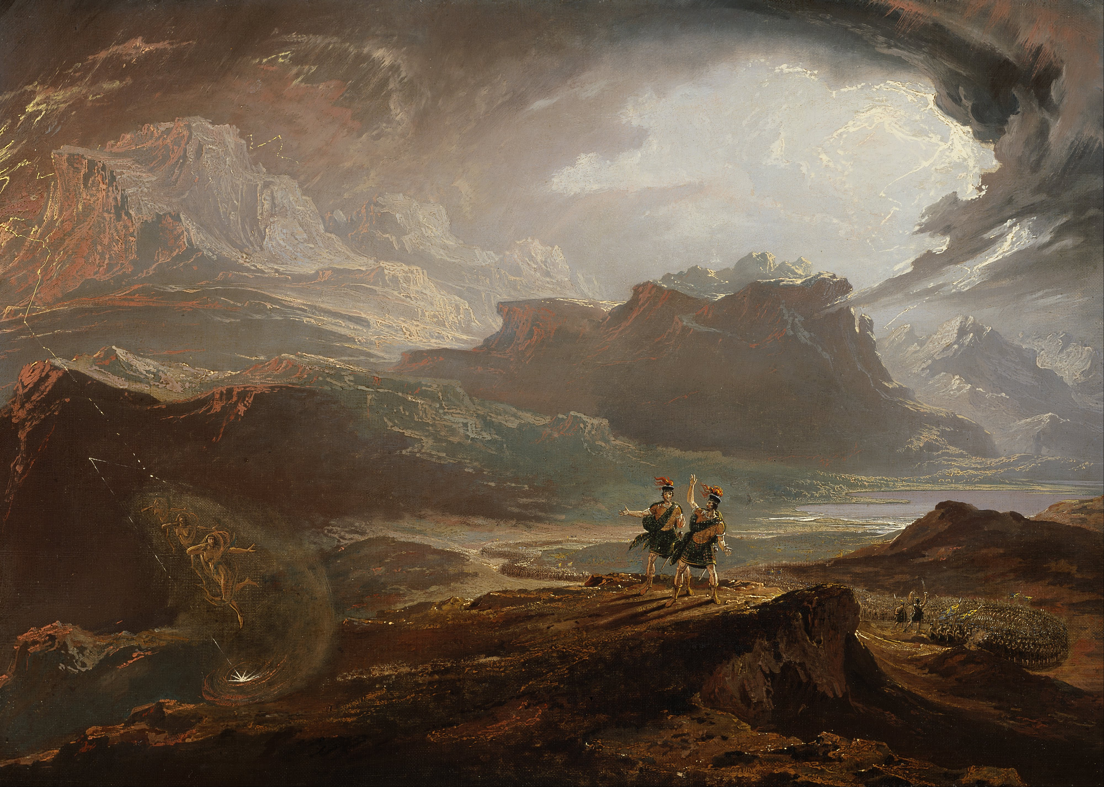
‘It is possible he [the author] may differ from modern critics, in supposing that the records of human superstition, if peculiar to, and characteristic of, the country in which the scene is laid, are a legitimate subject of poetry. He gives, however, a ready assent to the narrower proposition, which condemns all attempts of an irregular and disordered fancy to excite terror, by accumulating a train of fantastic and incoherent horrors, whether borrowed from all countries, and patched upon a narrative belonging to one which knew them not, or derived from the author’s own imagination.’
~ The Lady of the Lake, Notes to Canto Third
Artist: John Martin

Slide 17
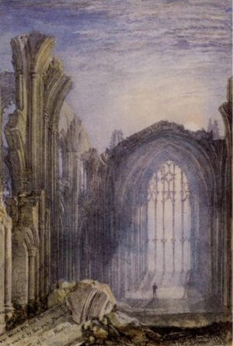
The moon on the east oriel shone,
Through slender shafts of shapely stone,
By foliaged tracery combined;
Though wouldst have thought some fairy’s hand
’Twixt poplars straight the osier wand,
In many a freakish knot, had twined;
Then framed a spell, when the work was done,
And changed the willow-wreaths to stone.
If thou would’st view fair Melrose aright,
Go visit it by the pale moon-light;
For the gay beams of lightsome day
Gild, but to flout, the ruins gray.
When the broken arches are black in night,
And each shafted oriel glimmers white;
When the cold light’s uncertain shower
Streams on the ruined central tower;
When buttress and buttress, alternately,
Seem framed of ebon and ivory;
When silver edges the imagery,
And the scrolls that teach thee to live and die;

Slide 18
‘The interest which it excites is indeed a powerful spring; but it is one which is peculiarly subject to be exhausted by coarse handling and repeated pressure. It is also of a character which it is extremely difficult to sustain, and of which a very small proportion may be said to be better than the whole. The marvellous, more than any other attribute of fictitious narrative, loses its effect by being brought much into view. The imagination of the reader is to be excited if possible, without being gratified.’
~ ‘On the Supernatural in Fictitious Composition’

Slide 19
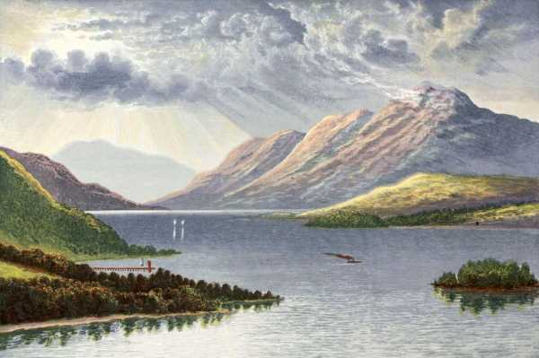
‘I have been spending some time on the banks of Lochlomond lately, where I have heard so many stories of raids, feuds, and creaghs, that they have almost unchained the devil of rhyme in my poor noddle.’ ~ Letters, 2.247
‘I have indeed begun to skirmish a little upon the frontiers of Perthshire and Lennox, into which I was led by the romantic scenery, the number of strange stories connected with it, and above all, by the inveterate [habit] of coupling the lines together by jingling rhymes, as I used to couple spaniels in sporting days.’ ~ Letters, 2.261
Loch Lomond – Thomas A. Croal

Slide 20
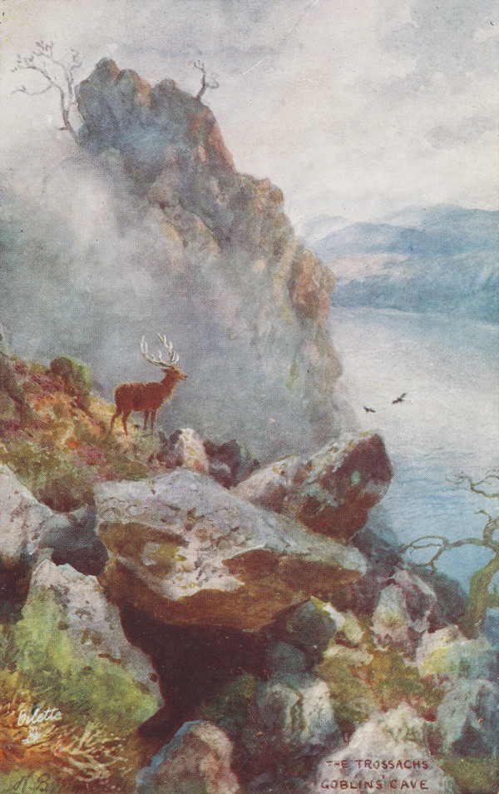
‘A dale in so wild a situation, and amid a people whose genius bordered on the romantic, did not remain without appropriate deities. The name literally implies the Corri, or Den, of the Wild or Shaggy Men. Perhaps this, as conjectured by Mr Alexander Campbell, may have originally only implied its being the haunt of a ferocious banditti. But tradition has ascribed to the Urisk, who gives name to the cavern, a figure between a goat and a man; in short, however much the classical reader may be startled, precisely that of a Grecian Satyr. The Urisk seems not to have inherited, with the form, the petulance of the sylvan deity of the classics: his occupations, on the contrary, resembled those of Milton’s lubbar fiend, or of the Scottish Brownie, though he differed from both in name and appearance.’
~ The Lady of the Lake, Notes to Canto Third
‘The Trossachs, Goblin Cave’ – Henry Bowser Wimbush
National Galleries of Scotland: Gift of Mrs. Riddell in memory of Peter Fletcher Riddell, 1985

Slide 21
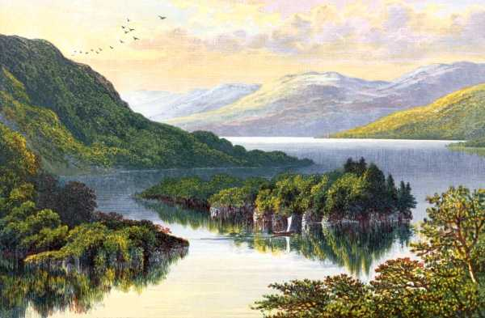
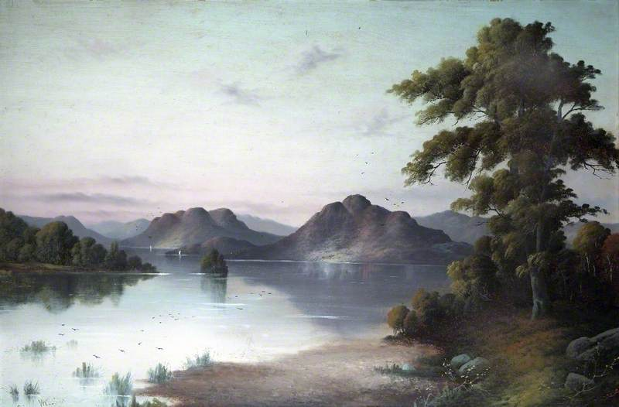
The shaggy mounds no longer stood,
Emerging from entangled wood,
But, wave-encircled, seemed to float,
Like castles girdled with its moat;
Yet broader floods extending still,
Divide them from their parent hill,
Till each, retiring, claims to be
An islet in an inland sea.
The broom’s tough roots his ladder made,
The hazel saplings lent their aid;
And thus an airy point he won,
Where, gleaming with the setting sun,
One burnish’d sheet of living gold,
Loch-Katrine low beneath him roll’d;
In all her length far winding lay,
With promontory, creek, and bay,
And islands that, empurpled bright,
Floated amid the livelier light;
And mountains, that like giants stand,
To sentinel enchanted land.
Loch Katrine – Cecil John Arnold Wallinger

Slide 22
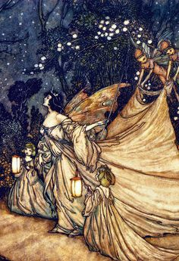
‘There remains yet another cause to be noticed, which seems to have induced a considerable alteration into the popular creed of England, respecting Fairies. Many poets of the sixteenth century, and, above all, our immortal Shakespeare, deserting the hackneyed fictions of Greece and Rome, sought for machinery in the superstitions of their native country. "The fays, which nightly dance upon the wold," were an interesting subject; and the creative imagination of the bard, improving upon the vulgar belief, assigned to them many of those fanciful attributes and occupations, which posterity have since associated with the name of Fairy. In such employments, as rearing the drooping flower, and arranging the disordered chamber, the Fairies of South Britain gradually lost the harsher character of the dwarfs, or elves. Their choral dances were enlivened by the introduction of the merry goblin Puck, for whose freakish pranks they exchanged their original mischievous propensities. The Fairies of Shakespeare, Drayton, and Mennis, therefore, at first exquisite fancy portraits, may be considered as having finally operated a change in the original which gave them birth.’ (Minstrelsy, II.)
Artist: Arthur Rackham

Slide 23
