Slide 1
“Scotch Novels”
Dr Gerard McKeever, University of Edinburgh

Slide 2
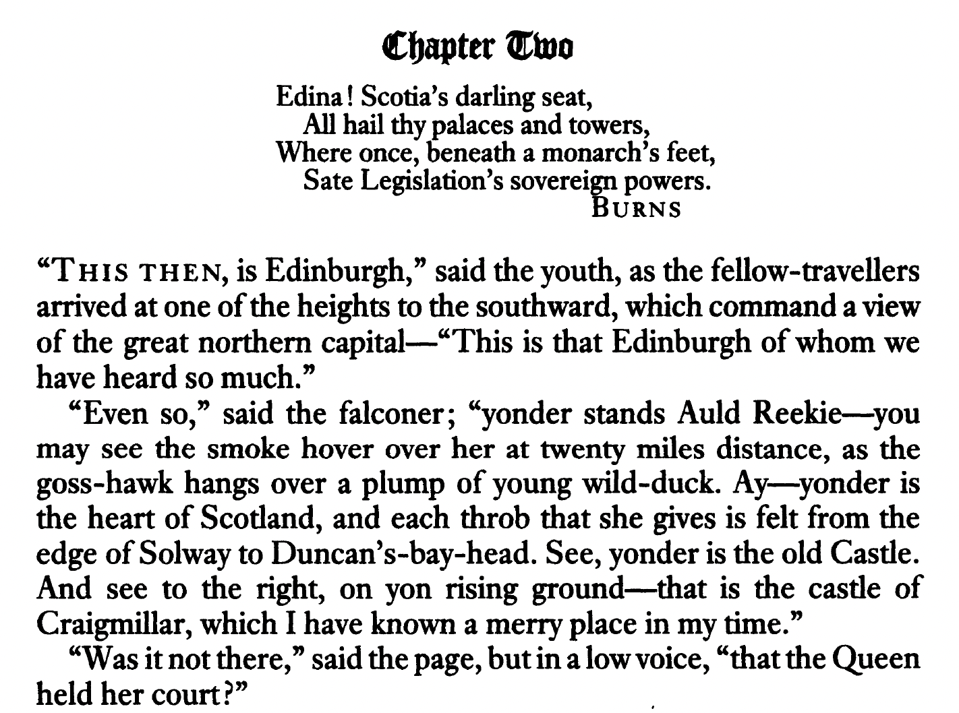

Slide 3
1. Waverley (1814) | 15. The Fortunes of Nigel (1822)
2. Guy Mannering (1815) | 16. Peveril of the Peak (1822/23)
3. The Antiquary (1816) | 17. Quentin Durward (1823)
4. The Black Dwarf (1816) | 18. St Ronan’s Well (1823/24)
5. The Tale of Old Mortality (1816) | 19. Redgauntlet (1824)
6. Rob Roy (1817/18) | 20. The Betrothed (1825)
7. The Heart of Mid-Lothian (1818) | 21. The Talisman (1825)
8. The Bride of Lammermoor (1819) | 22. Woodstock (1826)
9. A Legend of the Wars of Montrose (1819) | 23. Chronicles of the Canongate (1827)
10. Ivanhoe (1819/20) | 24. The Fair Maid of Perth (1828)
11. The Monastery (1820) | 25. Anne of Geierstein (1829)
12. The Abbot (1820) | 26. Count Robert of Paris (1831/32)
13. Kenilworth (1821) | 27. Castle Dangerous (1831/32)
14. The Pirate (1822)

Slide 4
1. Waverley (1814) | 15. The Fortunes of Nigel (1822)
2. Guy Mannering (1815) | 16. Peveril of the Peak (1822/23)
3. The Antiquary (1816) | 17. Quentin Durward (1823)
4. The Black Dwarf (1816) | 18. St Ronan’s Well (1823/24)
5. The Tale of Old Mortality (1816) | 19. Redgauntlet (1824)
6. Rob Roy (1817/18) | 20. The Betrothed (1825)
7. The Heart of Mid-Lothian (1818) | 21. The Talisman (1825)
8. The Bride of Lammermoor (1819) | 22. Woodstock (1826)
9. A Legend of the Wars of Montrose (1819) | 23. Chronicles of the Canongate (1827)
10. Ivanhoe (1819/20) | 24. The Fair Maid of Perth (1828)
11. The Monastery (1820) | 25. Anne of Geierstein (1829)
12. The Abbot (1820) | 26. Count Robert of Paris (1831/32)
13. Kenilworth (1821) | 27. Castle Dangerous (1831/32)
14. The Pirate (1822)

Slide 5
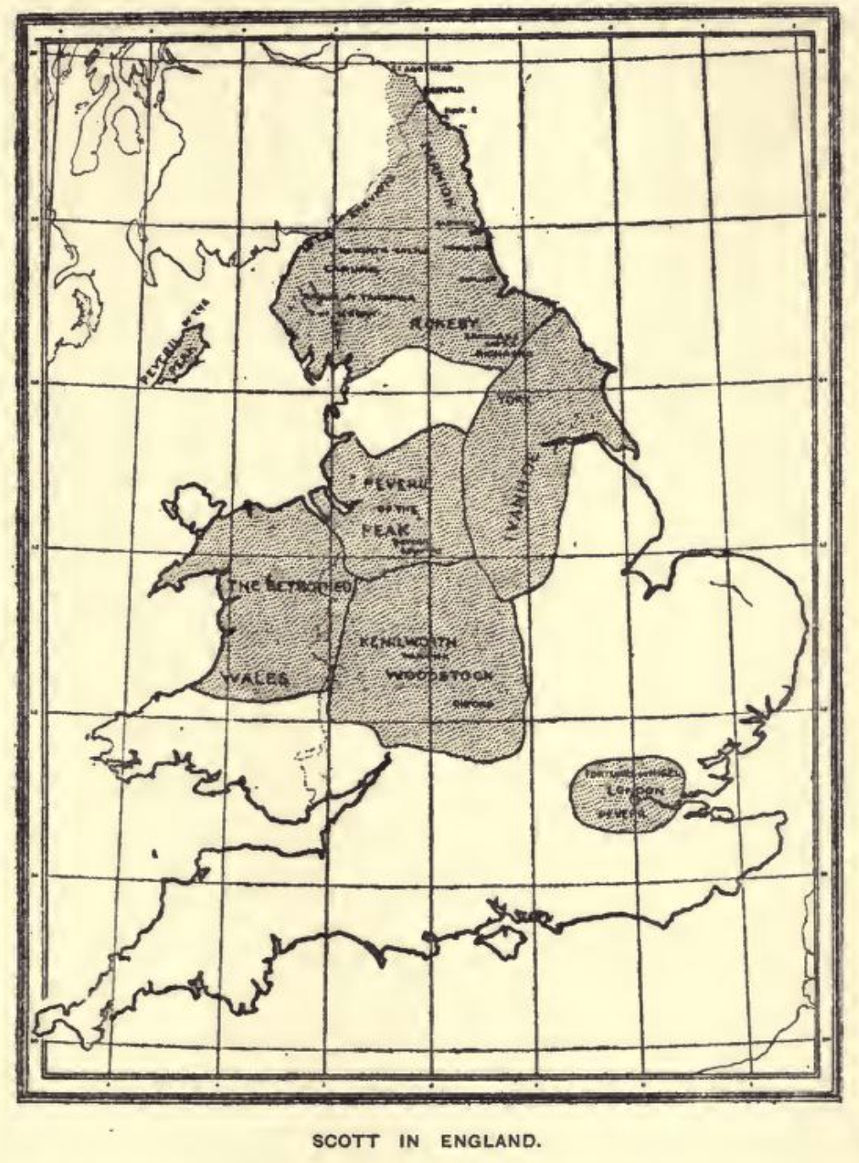
William Sharp, Literary Geography (Pall Mall, 1904)

Slide 6
1. Waverley (1814) | 15. The Fortunes of Nigel (1822)
2. Guy Mannering (1815) | 16. Peveril of the Peak (1822/23)
3. The Antiquary (1816) | 17. Quentin Durward (1823)
4. The Black Dwarf (1816) | 18. St Ronan’s Well (1823/24)
5. The Tale of Old Mortality (1816) | 19. Redgauntlet (1824)
6. Rob Roy (1817/18) | 20. The Betrothed (1825)
7. The Heart of Mid-Lothian (1818) | 21. The Talisman (1825)
8. The Bride of Lammermoor (1819) | 22. Woodstock (1826)
9. A Legend of the Wars of Montrose (1819) | 23. Chronicles of the Canongate (1827)
10. Ivanhoe (1819/20) | 24. The Fair Maid of Perth (1828)
11. The Monastery (1820) | 25. Anne of Geierstein (1829)
12. The Abbot (1820) | 26. Count Robert of Paris (1831/32)
13. Kenilworth (1821) | 27. Castle Dangerous (1831/32)
14. The Pirate (1822)

Slide 7
1. Waverley (1814) | 15. The Fortunes of Nigel (1822)
2. Guy Mannering (1815) | 16. Peveril of the Peak (1822/23)
3. The Antiquary (1816) | 17. Quentin Durward (1823)
4. The Black Dwarf (1816) | 18. St Ronan’s Well (1823/24)
5. The Tale of Old Mortality (1816) | 19. Redgauntlet (1824)
6. Rob Roy (1817/18) | 20. The Betrothed (1825)
7. The Heart of Mid-Lothian (1818) | 21. The Talisman (1825)
8. The Bride of Lammermoor (1819) | 22. Woodstock (1826)
9. A Legend of the Wars of Montrose (1819) | 23. Chronicles of the Canongate (1827)
10. Ivanhoe (1819/20) | 24. The Fair Maid of Perth (1828)
11. The Monastery (1820) | 25. Anne of Geierstein (1829)
12. The Abbot (1820) | 26. Count Robert of Paris (1831/32)
13. Kenilworth (1821) | 27. Castle Dangerous (1831/32)
14. The Pirate (1822)
?
?
?
?
?

Slide 8
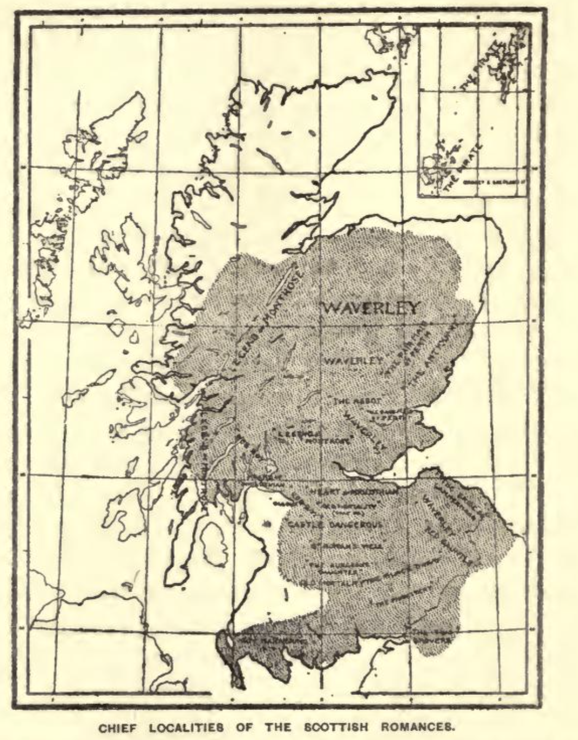
William Sharp, Literary Geography (Pall Mall, 1904)

Slide 9
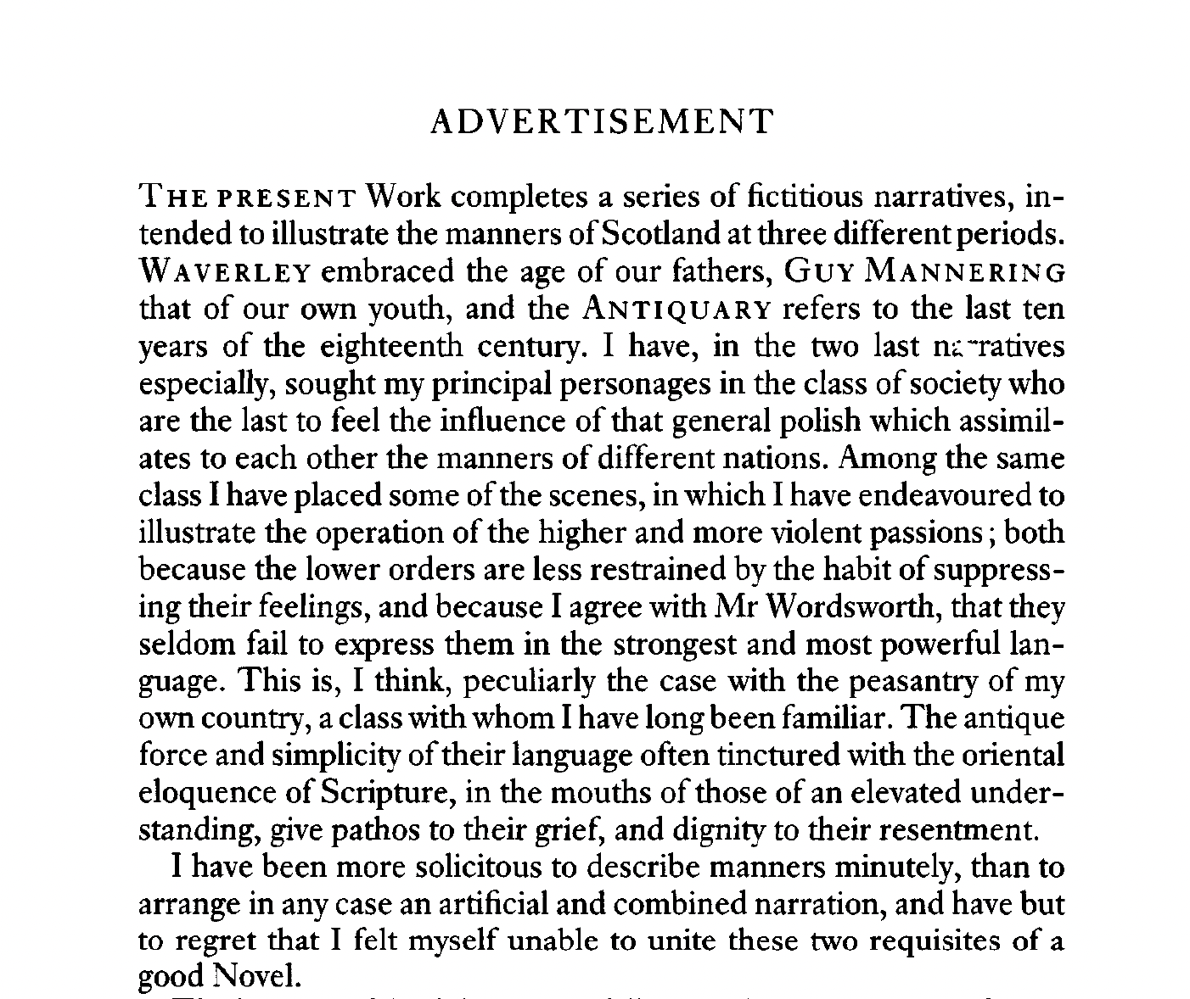

Slide 10
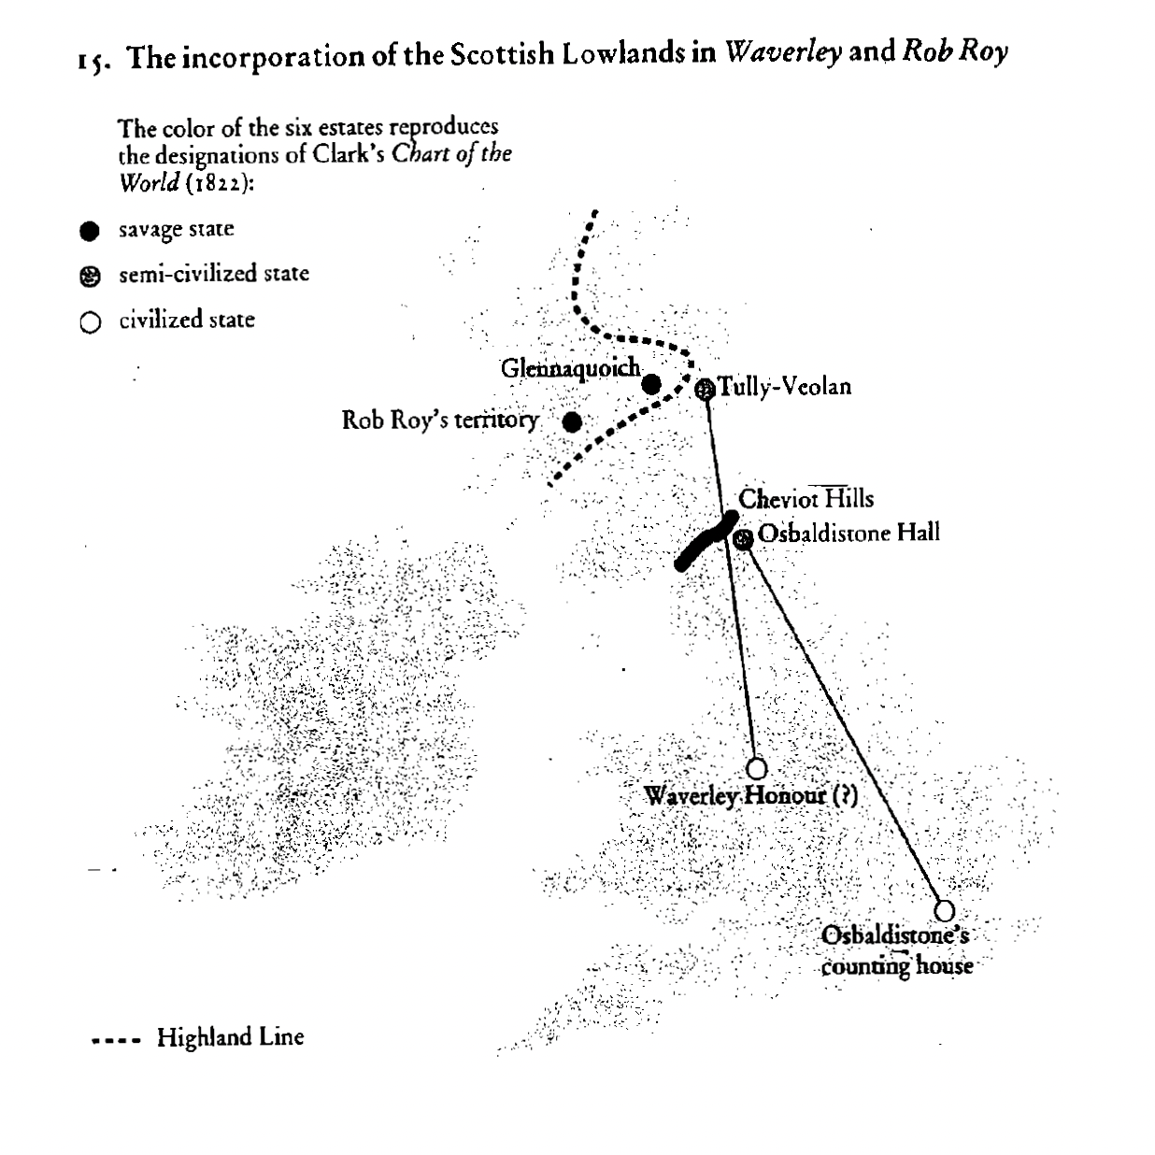
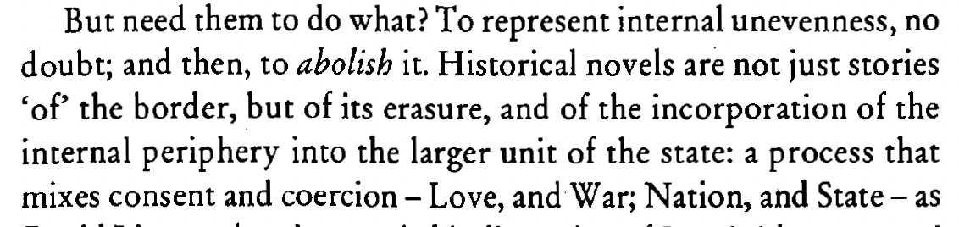
Franco Moretti, Atlas of the European Novel 1800–1900 (Verso, 1998), 40–41.

Slide 11
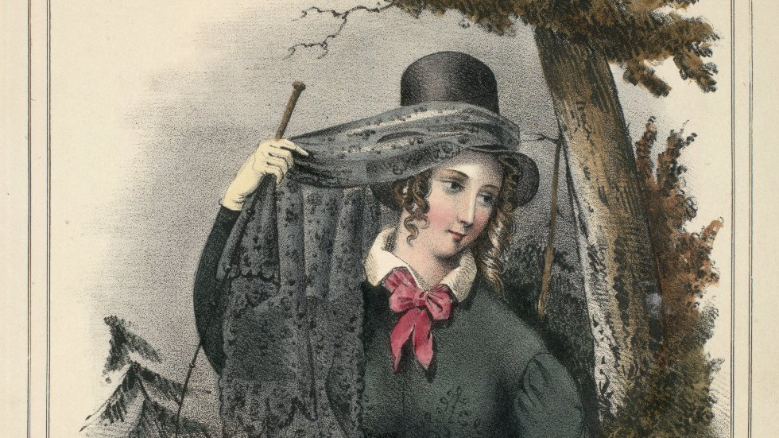
Clara Mowbray
St Ronan’s Well

Slide 12
‘The little watering-place has returned to its primitive obscurity; and lions and lionesses, with their several jackalls, blue surtouts, and bluer stockings, fiddlers and dancers, painters and amateurs, authors and critics, dispersed like pigeons by the demolition of a dove-cot, have sought other scenes of amusement and rehearsal, and have deserted Saint Ronan’s Well.’

