Slide 1


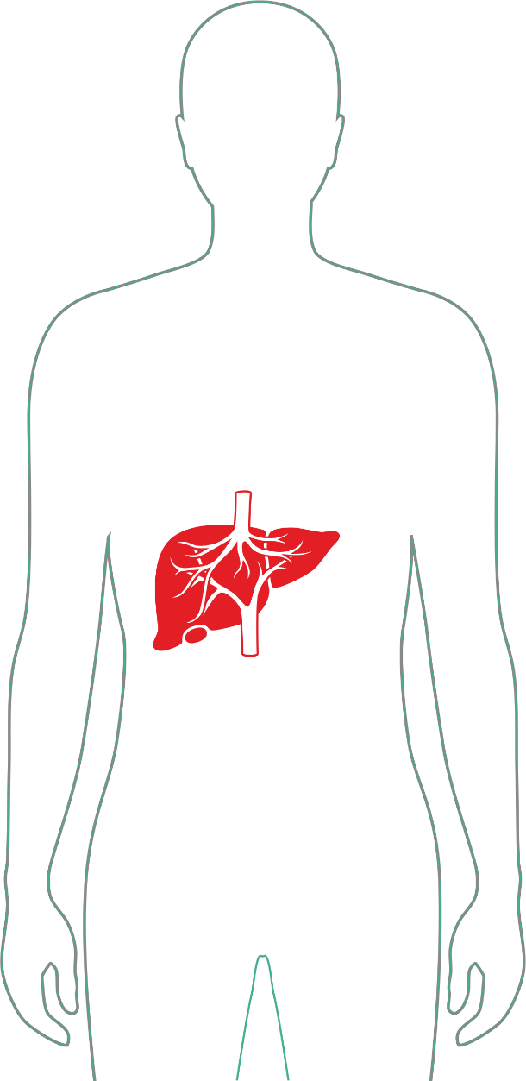

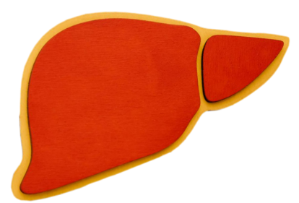
YOUR LIVER
WORKS 24×7
Did You Know?
But most people ignore it until it's too late. The organ doing the most for your body is often the one we think about the least - until a crisis forces us to pay attention.
WORLD LIVER DAY - 19 April

Slide 2

YOUR LIVER Your Body's Silent Hero
Quietly operating behind the scenes, your liver performs over 500 vital functions every single day - without a single complaint. It is one of the most hardworking organs in the human body, and yet it rarely gets the recognition it deserves.
WORLD LIVER DAY - 19 April

Slide 3
Detoxifies Your Body
Filters harmful toxins, drugs, and waste products from your bloodstream around the clock.
Stores Energy
Regulates blood sugar by storing and releasing glucose so your body always has fuel on demand.
WORLD LIVER DAY - 19 April

Slide 4
Aids Digestion
Produces bile to break down fats and absorb essential fat-soluble vitamins like A, D, E, and K.
Supports Immunity
Removes bacteria and pathogens from the blood, acting as a critical line of immune defense.
WORLD LIVER DAY - 19 April

Slide 5


The Hidden Danger
Liver disease often shows NO symptoms in its early stages - silently progressing until the damage is already severe.
WORLD LIVER DAY - 19 April

Slide 6
🚨
Fatty Liver Is Rising Rapidly
Non-alcoholic fatty liver disease (NAFLD) now affects roughly 1 in 4 adults globally - and most don't know they have it.
🍔
Linked to Everyday Habits
Poor diet, sedentary lifestyles, and alcohol consumption are the biggest drivers of preventable liver disease worldwide.
⏰
Often Detected Too Late
Because the liver has no pain receptors, serious conditions like cirrhosis or liver cancer are frequently discovered only in advanced stages.
WORLD LIVER DAY - 19 April

Slide 7
What Damages
Your Liver?
Liver disease rarely happens overnight. It builds slowly - driven by the choices we make daily. Understanding the root causes is the first step toward protecting this vital organ before it's too late.
WORLD LIVER DAY - 19 April

Slide 8



Unhealthy Diet
Processed, oily, and sugar-laden foods overwhelm the liver, leading to fat buildup and inflammation.
Alcohol Consumption
Excessive drinking is a leading cause of alcoholic liver disease, cirrhosis, and liver failure.
Obesity & Inactivity
Extra body fat, especially around the abdomen, dramatically increases the risk of fatty liver disease.
WORLD LIVER DAY - 19 April

Slide 9


Viral Infections
Hepatitis A, B, and C viruses directly attack liver cells and can cause chronic, life-threatening damage.
Self-Medication
Overuse of painkillers, supplements, and unregulated drugs can be toxic to the liver even in small doses.
WORLD LIVER DAY - 19 April

Slide 10
Don't Ignore These Signs
Your liver rarely shouts for help — it whispers. These warning signs are easy to dismiss as "just tired" or "just stressed." Don't. When the liver finally sends signals, it often means damage has already begun.
⚠️ Watch for These Symptoms
Persistent fatigue and weakness
Unexplained loss of appetite
Nausea or vomiting after meals
Yellowing of skin or eyes (jaundice)
Abdominal pain or swelling
Dark-colored urine
Pale or clay-colored stools
WORLD LIVER DAY - 19 April

Slide 11
Symptoms may appear very late in the disease process. By the time jaundice appears, liver function may already be significantly compromised.
Even if you feel "fine," if you have risk factors — including family history, obesity, or alcohol use — routine liver function tests are essential. Regular check-ups can catch damage before it becomes irreversible.
WORLD LIVER DAY - 19 April

Slide 12
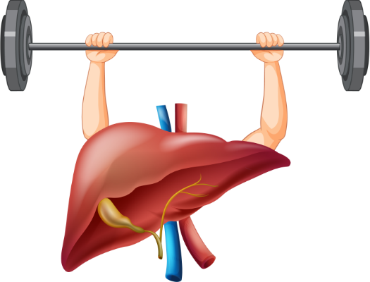
Solid Habits,
Strong Liver
Your liver doesn't ask for much. It just asks that you show up for it -every single day. Your daily choices decide your liver health. Small, consistent actions compound into a lifetime of protection.
🌿 Lifestyle Is Medicine
💧 Prevention Over Cure
🏃 Move. Eat. Protect.
WORLD LIVER DAY - 19 April

Slide 13
Build Solid Habits
Protecting your liver doesn't require radical changes — it requires consistent, conscious choices. These six habits form the foundation of a liver-healthy lifestyle that benefits your entire body.
WORLD LIVER DAY - 19 April

Slide 14
Eat Balanced, Nutritious Food
Prioritize whole grains, lean proteins, fruits, and vegetables. Reduce processed foods, excess sugar, and saturated fats that trigger liver inflammation.
Exercise Regularly
Even 30 minutes of moderate exercise five days a week reduces liver fat, improves insulin sensitivity, and supports healthy weight maintenance.
Maintain Healthy Weight
Even a 5–10% reduction in body weight can significantly reduce liver fat in people with NAFLD and reverse early-stage damage.
WORLD LIVER DAY - 19 April

Slide 15
Stay Hydrated
Drinking 6–8 glasses of water daily helps your liver flush toxins efficiently and supports healthy metabolic function.
Limit Alcohol
There is no completely "safe" level of alcohol for the liver. Limiting or eliminating alcohol is the single most impactful lifestyle choice for liver health.
Avoid Unnecessary Medications
Never self-medicate. Always consult a doctor before taking supplements or over-the-counter drugs — many are processed by the liver and can cause harm in excess.
WORLD LIVER DAY - 19 April

Slide 16


Foods Your
Liver Loves
You can literally eat your way to a healthier liver. These nutrient-dense superfoods have been shown to reduce inflammation, lower liver enzymes, and support the organ's natural detoxification processes.
WORLD LIVER DAY - 19 April

Slide 17
🥦
Green Vegetables
Broccoli, spinach, kale, and Brussels sprouts contain compounds that activate liver detox enzymes and reduce fat buildup.
🍎
Fresh Fruits
Berries, citrus fruits, and apples are rich in antioxidants and vitamin C, which protect liver cells from oxidative damage.
☕
Coffee (In Moderation)
Studies show 2–3 cups of coffee daily may lower the risk of liver cirrhosis and liver cancer — one of the most surprising findings in liver research.
WORLD LIVER DAY - 19 April

Slide 18
🫒
Healthy Fats
Olive oil and avocados provide anti-inflammatory monounsaturated fats that improve liver enzyme levels and reduce fat accumulation.
🥜
Nuts & Seeds
Walnuts, almonds, and flaxseeds are rich in omega-3 fatty acids and vitamin E, both of which reduce liver inflammation.
WORLD LIVER DAY - 19 April

Slide 19
Protect Your
Liver Today
Prevention is always more powerful - and less costly - than treatment. Most liver diseases are completely preventable with the right knowledge, habits, and timely medical care. Don't wait for symptoms. Act now.
WORLD LIVER DAY - 19 April

Slide 20
🩺
Regular Health Check-Ups
Liver function tests (LFTs) and ultrasounds can detect fatty liver, elevated enzymes, or early fibrosis long before symptoms appear. Annual screening is recommended for high-risk individuals.
🧼
Practice Safe Hygiene
Hepatitis A spreads through contaminated food and water. Washing hands thoroughly, safe food handling, and clean water are your first line of defense.
WORLD LIVER DAY - 19 April

Slide 21
💉
Get Vaccinated
Vaccines for Hepatitis A and Hepatitis B are safe, effective, and widely available. Hepatitis B vaccination is one of the most important steps you can take to prevent liver cancer.
🔬
Early Diagnosis Saves Lives
Fatty liver, when caught early, is completely reversible. Even Hepatitis B and C can be effectively managed with modern antivirals when diagnosed in time.
Early detection of liver disease can increase
survival rates dramatically. A simple blood
test could change — or save — your life.
WORLD LIVER DAY - 19 April

Slide 22


You don't feel
Liver Damage…
until it’s Serious.
The liver has no pain receptors. It cannot tell you when it's struggling. By the time you feel something is wrong, up to 70–80% of liver function may already be lost. This is not meant to frighten you — it's meant to wake you up.
Act early. Live better. Your liver is fighting for you right now. It's time to fight for it.
WORLD LIVER DAY - 19 April

Slide 23



How Liver
Disease
Progresses
Hepatitis
Cirrhosis
Fatty
Liver
Inflammation; treatable with medical
care
Irreversible, life‑threatening liver failure
Fibrosis
Reversible with lifestyle changes
Scarring; partially reversible
The good news: Stages 1 and 2 are almost always reversible with the right lifestyle changes and medical treatment. The earlier you act, the better your outcome. Waiting is never the safer option.
WORLD LIVER DAY - 19 April

Slide 24
Know the
Numbers
Liver disease is a global health crisis hiding in plain sight. These statistics reveal the staggering scale of the problem — and why World Liver Day awareness campaigns like this one matter so deeply.
WORLD LIVER DAY - 19 April

Slide 25
1B+ People Affected
More than 1 billion people worldwide are estimated to have some form of liver disease.
25% NAFLD Prevalence
1 in 4 adults globally has non-alcoholic fatty liver disease — the majority undiagnosed.
2M Annual Deaths
Approximately 2 million people die from liver disease and its complications every year globally.
80% Preventable Cases
An estimated 80% of liver disease cases are preventable through lifestyle modifications and vaccination.
WORLD LIVER DAY - 19 April

Slide 26
Take Charge of Your Liver Health
Knowledge is only the first step. The next step is action. If you have risk factors — or if you've been putting off that check-up — today is the day to change that. Your liver has been working for you without complaint. Now it's your turn.
WORLD LIVER DAY - 19 April

Slide 27

When to See a Doctor
You notice any symptoms listed earlier
You have a family history of liver disease
You drink alcohol regularly
You are overweight or have diabetes
You haven't had a check-up in over a year
What a Liver Health Check Includes
A comprehensive liver screening typically includes liver function tests (LFTs), a hepatitis panel, abdominal ultrasound, and metabolic blood work. It's painless, fast, and potentially life-saving.
Consult a doctor if you notice any symptoms or have known risk factors. Early detection is the most powerful tool in liver care.
WORLD LIVER DAY - 19 April

Slide 28
Your Action Plan Starts Now
Change doesn't have to be overwhelming. Start with one habit this week. Then another. Small steps, taken consistently, are the foundation of lasting liver health. Here is your practical road map to getting started today.
WORLD LIVER DAY - 19 April

Slide 29
Your Action Plan Starts Now
This Week
1
Cut one processed food from your diet and drink one extra glass of water per day. Schedule a liver function test if overdue.
2
This Month
Begin a 30-minute daily walk routine. Review your medications with a doctor. Check your Hepatitis B vaccination status.
This Year
3
Commit to annual liver screenings. Achieve or maintain a healthy weight. Build lasting habits around whole foods and consistent exercise.
4
For Life
Make liver health a family conversation. Share this awareness. Inspire those around you to treat their bodies — and their liver — with the respect it deserves.
WORLD LIVER DAY - 19 April

Slide 30
Advanced Liver Care You Can Trust
World-class specialists. Cutting-edge diagnostics. Compassionate, patient-first care - every step of the way.
WORLD LIVER DAY - 19 April

Slide 31

🏥
Advanced Liver Care
State-of-the-art diagnostic and treatment facilities for all stages of liver disease — from fatty liver to transplant evaluation.
👨‍⚕️
Expert Specialists
A multidisciplinary team of hepatologists, gastroenterologists, and liver surgeons with decades of combined experience.
Preventive Health
Comprehensive wellness screening programs designed to detect liver conditions early — before they become serious.
WORLD LIVER DAY - 19 April

Slide 32
Next Gen Medicare - Because Your Health Can't Wait.
This World Liver Day, make a promise to yourself. One check-up. One conversation. One step toward a longer, healthier life.
WORLD LIVER DAY - 19 April

Slide 33


