Slide 1
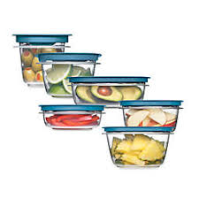
Storing Food Training
First Choice Support Services, Inc.
Mailing address: PO Box 2392, Salina, Ks 67402-2392
Office: 115 N 7th, Salina, Ks 67401
Phone: (785) 823-3555
Email: firstchoice@ruraltel.net
Website: www.firstchoicesupportservices.org

Slide 2
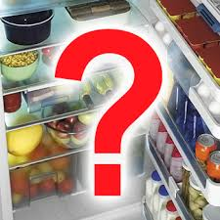
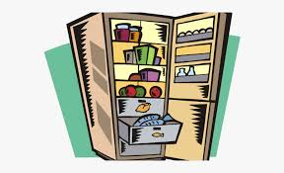
Objective:
Unsafe storage procedures and temperatures could lead to the growth of bacteria and food borne illness!
In this training you will learn:
The proper way to store food in dry storage, refrigerators, and the freezer.
How to properly freeze and thaw out foods.
Some tips to help when storing/organizing food.
**If you can, take notes!! There will be a test at the end.**

Slide 3
What are “perishable foods”?
Perishable Foods: These include raw fruits and vegetables, meat, dairy, and eggs. All cooked foods are considered perishable foods. To store these foods for any length of time, perishable foods need to be kept at refrigerator or freezer temperatures. If refrigerated, many perishable foods should be used within 7 days.

Slide 4
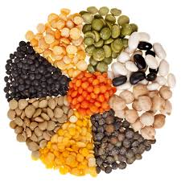
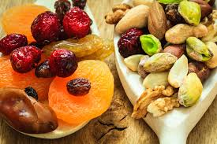
What are “semi-perishable foods”?
Semi-perishable Foods: These foods, depending on how they are stored and handled, can go bad quickly or they can have an extended shelf life. Flour, grain products, dried fruits, and dry mixes are considered semi-perishable. If properly stored and handled, semi-perishable foods may remain unspoiled for six months to a year. If frozen, some foods can last even longer.

Slide 5
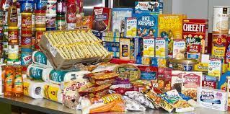
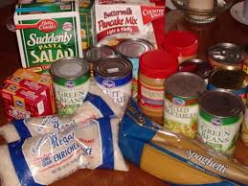
What are “non-perishable foods”?
Staple, or Non-perishable Foods: Dried beans, spices and canned goods are all non-perishable foods. They won’t spoil unless they’re handled improperly. However, even if they’re stored under ideal conditions, they can start to lose quality over long periods of time.

Slide 6
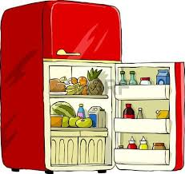
Refrigeration
The refrigerator must be at a temperature of 40 degrees F or colder.
Temperature of the refrigerator needs to be recorded every day.
Refrigerated foods should be the first foods stored when it is received.
Food needs to be stored at least 6 inches off the floor and away from walls.
Food needs to be stored in a way that allows air circulation.
Ready‐to‐eat or cooked foods should always be stored above raw foods and covered properly to prevent cross contamination.
All food that is not stored in its original packaging is covered and labeled with date
Proper food covering is a food‐grade lid, plastic wrap, or aluminum foil.

Slide 7
More tips for refrigerating foods
Make sure that the refrigerator is never overloaded! You are in danger of blocking the cooling unit that will chill your food. There is also a danger that the fridge door could not be properly shut, leaving you food that is not good to eat the next day! Air needs to be able to circulate around the food.
Open cans should never be stored in the refrigerator as this may result in chemical contamination. Store in a sealed container.
Stick to the "two-hour rule" for leaving items needing refrigeration out at room temperature.
Deep clean your fridge every 3-4 months!
Immediately clean up any spills or leaks.
Go through all the items in your fridge and toss out expired items weekly.

Slide 8
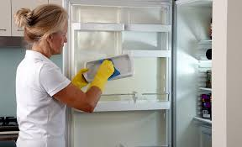
How to properly clean & sanitize your fridge:
1. Take all food items out of the fridge and place in a cooler.
2. Remove all removable parts, like drawers and shelfs, and wash them with lukewarm water and dishwashing soap (soaking them first will make it easier to clean). Also scrub the inside of the fridge.
**Remember washing cold glass with hot water can shatter the glass! Use lukewarm water!!**
3. To sanitize: Wipe all surfaces with sanitizing wipes.
4. Dry everything with a clean microfiber towel.
5. Make sure to throw away any expired food and wipe down any sticky, messy bottles or packages before putting it back in the fridge.
*Don’t forget to clean the outside of the fridge too!*

Slide 9
Why is it important to organize your fridge properly?
Organizing your fridge correctly is important because it ensures that your food remains safe to eat and it stops harmful bacteria from spreading on raw & ready-to-eat foods.
https://www.youtube.com/watch?v=w77Ghy945eE&t=287s
*Next 4 pages will tell you how to organize your fridge.*
Video by “Bright Side”

Slide 10
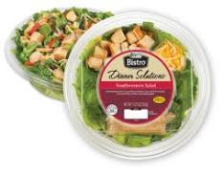
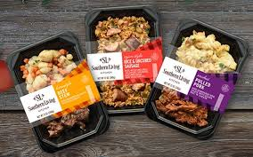
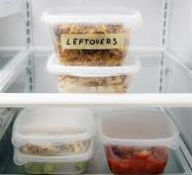
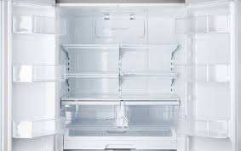
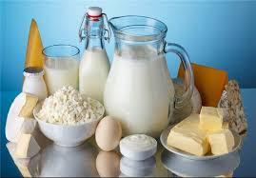
Top & Middle Shelfs
Ready-to-eat foods, such as dairy products, packaged foods, leftovers, cooked meats and prepared salads should be placed here. These should all be covered or kept in sealed containers to prevent contamination. Ready-to-eat foods are stored at the top of the fridge, away from raw foods so that harmful bacteria cannot transfer from the raw food to the cooked food.

Slide 11
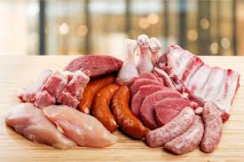
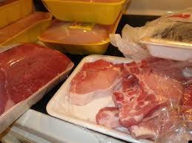
Bottom Shelf
Raw meat, poultry and fish in sealed containers should be placed here to stop them touching or dripping onto other foods. Raw meats should always be stored at the bottom of your fridge to prevent cross-contamination. Ensure that each item is wrapped or in a sealed container so that it doesn’t come into contact with other foods.

Slide 12
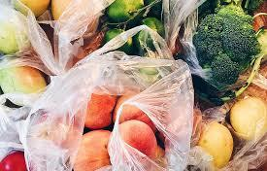
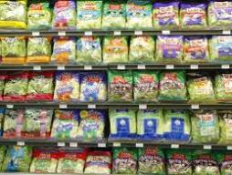
Salad Drawers (Crisper Drawers)
Fruit and vegetables that have been washed prior to storage should be placed here. Make sure that your fruit & vegetables are wrapped in paper or plastic with air holes to keep them protected from any contamination. For salads and herbs, try wrapping them in a damp paper towel before storing to prevent them from drying out and to keep them fresher for longer.

Slide 13
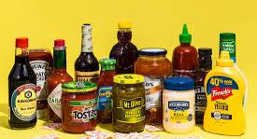
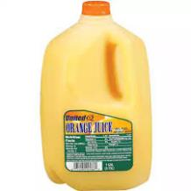
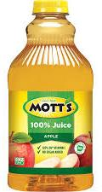
Refrigerator Doors
Put your least perishable items here, such as condiments, juices, bottled water. Never put dairy products or eggs in the doors! Although, in some refrigerators, there are placements for butter or cheeses, it is not good for them the be in the warmest part of the fridge. Since the doors are constantly opened, they are exposed to room temperature air.

Slide 14
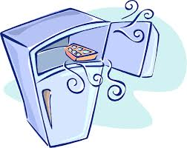
Freezer
The freezer must be at a temperature of 0 degrees F or colder.
Frozen foods should be the second products stored, behind refrigerated foods, when it is received.
Food products should be stored 6 inches above the floor and away from walls.
Foods need to be stored to allow air circulation. Remember to never place hot foods in the freezer to cool.
All food that is not stored in its original packaging is covered and labeled with the date.
Proper food covering is a food‐grade lid, plastic wrap, or aluminum foil.

Slide 15
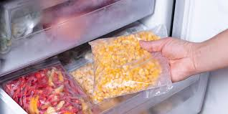
Tips for freezing foods
Always cool your food before freezing! Put the warm food into shallow and wide containers and put them in the fridge to properly cool before freezing.
Make sure your food is wrapped tightly to prevent freezer burn.
Freeze food in smaller, realistic portions.
Don’t forget to label when the food was made!!
Avoid refreezing thawed foods.
Use a vacuum sealer to eliminate all the air in the bags of food to prevent freezer burn.

Slide 16
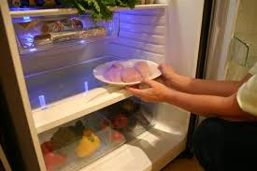
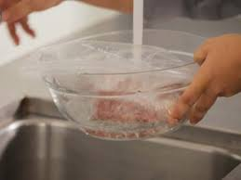
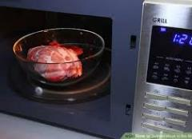
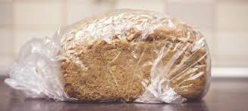
Ways to thaw frozen foods
Refrigerator thawing: Place frozen food in the fridge to safely thaw out. This is the best and easiest way to thaw foods, but it takes the longest amount of time!
Cold water: Place the sealed frozen food item in the sink, bowl or bucket of cold water. Change the water every 30 minutes until the food is defrosted.
Microwave thawing: Place the frozen food in a safe container and in the microwave and hit the defrost button. Check on it often! Plan to cook the food right after it is thawed when using this method! This is the fastest method of thawing.
Room temperature: This method is dangerous and not recommended for most foods! Breads, pastries and fruits may be thawed out at room temperature up to 4 hours! Do not use for meats, poultry, fish or vegetables.

Slide 17
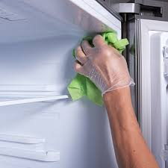
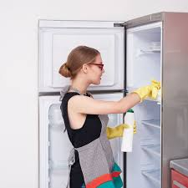
How to properly clean the freezer
1. Take out all the food and place in a cooler.
2. Remove any removable racks or shelfs and scrub with lukewarm water and dish soap.
3. Scrub the inside of the freezer with a damp soapy rag or sponge. Use a spray bottle full of vinegar and water for stubborn stains.
4. Dry the inside of the freezer and the removable parts. Place the removable parts back in.
5. Throw out any expired/old foods before placing everything back in!

Slide 18
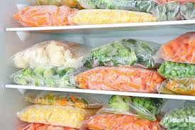
Freezing Vegetables
The recommended time for freezing vegetable is 8-12 months.
How to tell if a frozen vegetable has gone bad:
Excessive, caked-on ice crystals.
A loss of color in the vegetable
In a shriveled state.
Tips on freezing vegetables:
Consider puréeing high-water content vegetables (like tomatoes) before freezing, particularly if you intend to use them in that condition, like for sauce.

Slide 19
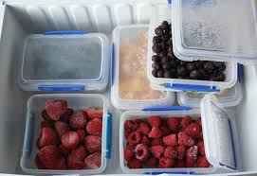
Freezing Fruits
The recommended time for freezing fruit is 8 months.
How to tell if a frozen fruit has gone bad:
Fruit that has a dull color or frosty look, with white-colored ice, is probably past its date and will taste bland.
Tips for freezing fruits:
Purée fruits (such as apples and strawberries) that you intend to use in jam, smoothies, and sauces. This saves space and can help it stay fresh for longer. For products such as strawberries that do not freeze well, it is especially beneficial.
If serving frozen fruits as fresh, serve them when they still have a small amount of ice remaining. This gives them a firmer texture.

Slide 20
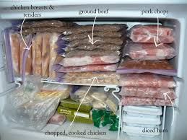
Freezing Cooked Meats
The recommended time for freezing cooked meat is 3-6 months.
How to tell if frozen meat has gone bad:
The meat is a gray color.
If it has an odor once thawed.
Tips on freezing cooked meats:
Trim off excess fat before freezing. Greater amounts of fat increase the risk of rancidity occurring during frozen storage (this doesn’t make it unsafe but makes it unappetizing to eat).
Always defrost meat slowly and safely, preferably for a few hours in the fridge. Make sure it’s in a suitable container and on the lowest shelf so it doesn’t drip onto other foods.
Do not cook meat directly from frozen. You must defrost it first.
Don’t put stuffing in meat or poultry before freezing. It can keep growing bacteria before it’s fully frozen.
Wrap the meat properly or keep it in sealed containers, otherwise it may get freezer-burn.

Slide 21
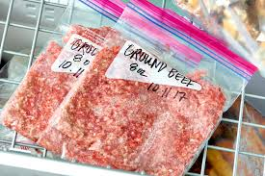
Freezing Minced Meats
The recommended time for freezing minced meat is 2-3 months.
How to tell if frozen minced meat has gone bad:
If all the meat has turned a grayish color.
If it has an odor once thawed.
Tips on freezing minced meat:
The best way to freeze it is flat, rather than rounded. This enables the mince to freeze and thaw evenly.
Be sure to cook it as soon as it defrosts.

Slide 22
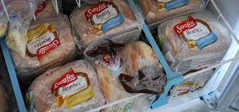
Freezing Breads
The recommended time to freeze breads is 3 months.
How to tell if your frozen bread has gone bad:
The bread has ice on the surfaces.
There is mold spots on the bread.
Tips for freezing breads:
Make sure you keep it in an air-tight, freezer-safe container or in its original packaging.
Bread fresh from an in-store bakery is often open or wrapped in paper or thin film that will prevent the bread from freezing well. Replace them with sealable freezer bags or plastic freezer wrap when freezing.
If freezing your own baked bread, be sure to let it cool before freezing to prevent sogginess or mold.
When defrosting bread, remove any ice within the pack, as this can thaw and cause the bread to become soggy in places

Slide 23
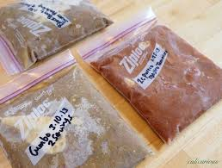
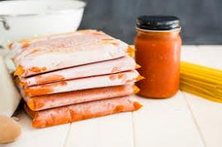
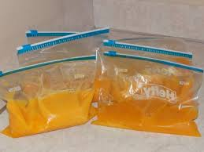
Other tips on freezing foods
Leftovers: They can last for up to 3 months in the freezer. Try to minimize overfilling plates, or serve from a central bowl, so that it’s easier to freeze leftovers from the pan. Make sure to put it in an air-tight container.
Raw eggs: Can be frozen for up to 12 months but must be removed from the shell and blended. If you want to freeze either the yolk or white separately, be sure to separate them, but be aware that the yolk may thicken.
Sauces: Freeze separately (from the pasta or rice) if possible. Sauces may thicken in the freezer. Therefore, you should add extra water after thawing.
Milk: Can sometimes curdle or separate when frozen, depending on its fat content. Semi or full skimmed milk is likely to freeze most successfully. Don’t worry if it separates; after thawing simply shake the bottle.

Slide 24
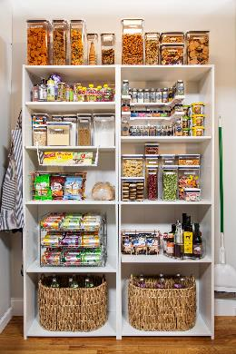
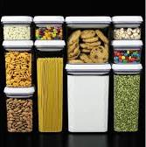
Dry Storage
In dry storage food must be stored 6 inches above the floor and away from the walls.
The temperature of the dry storage area must be between 50 degrees to 70 degrees and the humidity level between 60% and 70%.
All products must be stored in containers that cannot be damaged by pests or water.

Slide 25
Ideas for organizing your dry storage!
Here is some videos to give you some awesome ideas on how to organize your dry storage areas! They also name some products that will help keep it organized. Please watch both! It is very important to keep your dry storage/pantry's organized too!
https://www.youtube.com/watch?v=yJZ9loOuf1g&t=221s
Video by Brittany Vasseur

Slide 26
https://www.youtube.com/watch?v=Oijc5JuMJZc&t=3s
Video by “This Crazy Life”

Slide 27
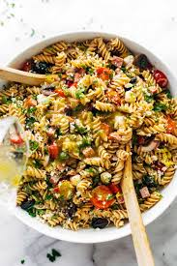
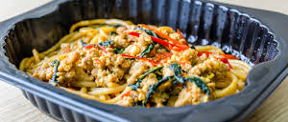
High risk foods
Food-poisoning bacteria can grow on certain types of food more easily than others. Be cautious when storing these foods!
Some examples of high-risk foods are:
Raw and cooked meat, including poultry and fish, foods containing them.
Dairy products
Eggs/egg products
Small goods, such as hams and salamis
Seafood
Cooked rice and pasta
Prepared salads like coleslaws, pasta salads and rice salads
Ready-to-eat foods, including sandwiches, rolls, and pizzas that contain any of the food above

Slide 28
Tips for grocery shopping
Select products labeled “keep refrigerated” only if they are stored in a refrigerated case and are cold to the touch. Frozen products should be solidly frozen. Packages of precooked foods should not be torn or damaged.
Shop for perishables last. Keep refrigerated and frozen items together so they will remain cold. Place perishables in the coolest part of your car during the trip home. If the time from store to home refrigerator is more than one hour, pack them in an insulated container with ice or an ice pack.
If you are running low on something write it down! Don’t wait until you run out.
Never grocery shop while you’re hungry or thirsty! When you are hungry/thirsty it causes you to buy more than what you need, resulting in food waste.
Choose loose fruit and vegetables over pre-packaged to better control the quantity you need and ensure fresher ingredients.
Avoid marketing gimmicks that encourage you to buy more than you need. If you get 10 items for $10 and only eat five before they spoil, that’s $5 wasted.

Slide 29
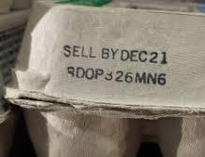
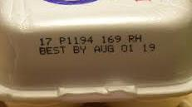
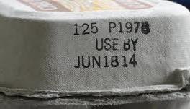
What the dates on food packages mean:
“Sell-By” tells the store how long to display the product for sale. Buy the product before the date expires.
“Best if Used By (or Before)” is recommended for best flavor or quality. It is not a purchase or safety date.
“Use-By” is the last date recommended for the use of the product while at its peak quality. This is not a safety date. Even if the date expires during home storage, a product should be safe and of good quality so long as it has been stored properly.

Slide 30
Please watch this educational video about food waste!
Video by “simpleshow foundation”

Slide 31
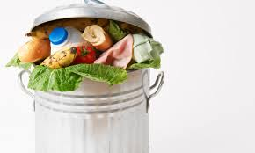
Food waste facts
Roughly 1.3 billion tons of food all around the world is wasted every year!
Approximately $1 trillion of food is lost or wasted every year.
8% of greenhouse gases heating the planet are caused by food waste.
If wasted food was a country, it would be the third largest producer of carbon dioxide in the world, after the United States and China.
Fruits and vegetables are the most common food waste items.
The food currently wasted in Europe could feed 200 million people.
About 94% of the food we throw away ends up in landfills or combustion facilities.

Slide 32
How to prevent food waste:
Create a more detailed shopping list by planning your meals in advance. This way you won’t overbuy produce.
Use smaller plates when eating or serving others can help you properly portion your food.
Don’t be afraid of an emptier fridge! When you can’t see the food you buy, you’re more likely to forget about it. Keeping your fridge and pantry cleaner and pared down can help you use all your ingredients.
Keep track of the food you’re throwing away the most to cut down on trends.
Eating your leftovers doesn’t mean eating the same thing over and over. Plan one night a week to repurpose your leftovers in a “use it up” meal.
Expiration dates are guidelines, not standard across the board. Trust your sense of smell, and your gut, before throwing items away.
Donate foods that you will not eat!

Slide 33
Remember!
Date products when they were made. Use Month/Year format for all shelf and frozen items. Use Month/Day format for perishable items like produce.
Throw out all foods past the expired date. If something is homemade keep it no longer than 7 days. (The recommended time to keep leftovers is about 4 days).
Keep labels on products, so the content of the product is known.
Rotate products! Use the oldest products first (first in, first out).
Store food at least 6 inches off the floor and away from walls.
Storage areas should be kept at the correct temperature, ventilated and clean. Areas should be cleaned on a regular basis.

Slide 34
Fun Facts!
In 1812, Brian Donkin tried canning food in tin cans instead of glass. Limited technology made the tin cans very expensive to make and the can opener hadn’t been invented yet—so tin cans didn’t really catch on until later.
Mason jars were later invented. These jars were capable of being heated to high temperatures without breaking.
Frozen foods hit the industrial market in the 1800’s.
Frozen foods can sometimes contain more nutrients than fresh produce.
November 15th is national “Clean Out Your Refrigerator Day”.
Over 8 million refrigerators are sold in the US each year.
Pennsylvania has a law that says that it is illegal to sleep outside on a refrigerator…

Slide 35
Quiz Time!
Please click the link below. It will take you to a “Google Form” https://forms.gle/ka8ASiHCf2m4CAR48
Take the quiz and hit submit. We will automatically get your scores so no need to send in your scores!
If you pass, we will create your certificate and enter in your hour for this training!

