Slide 1
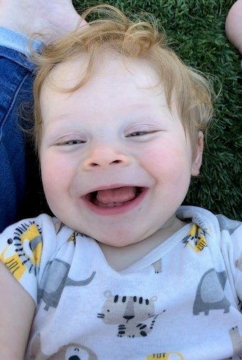
Delta Early Head Start
End of Year Outcomes Report
2024-2025
Delta Community Action
Head Start/Early Head Start Program
Lindsay, Oklahoma
Serving Garvin, McClain, and Stephens Counties

Slide 2
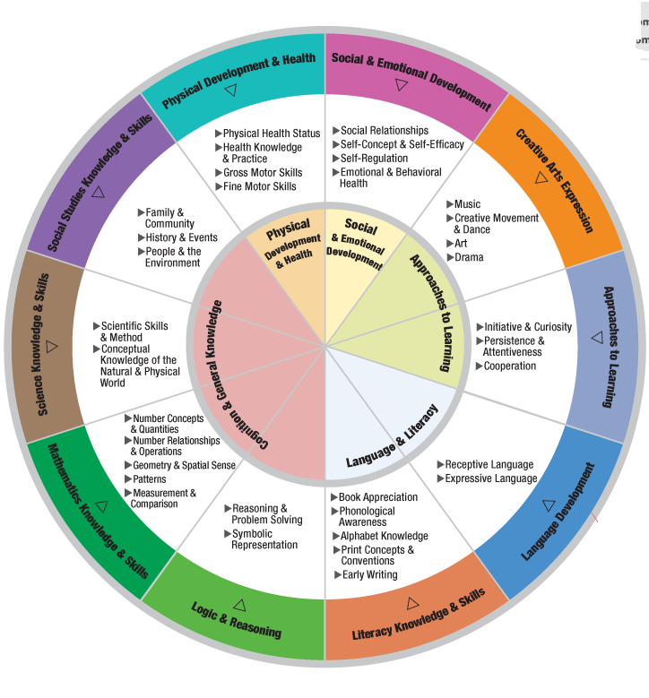
Educational Outcomes
The results outlined and discussed in this section addresses the Goals for Rapid Growth and Development, the Significance of learning within trusting relationships and the importance of continuity of care for Learning and Development in the 6 Domain Areas of Teaching Strategies GOLD Assessment. These Domains are at the center of the Head Start Early Learning Outcomes Framework- Birth to Five (HSELOF).

Slide 3
EHS Gender
Data Summary

Slide 4
Ethnicity Data Summary
EHS

Slide 5
EHS Race Data Summary

Slide 6
EHS Language Data Summary

Slide 7

Assessment Tool
  This assessment is completed by teachers on each individual student three times a year. It measures a child’s growth in each of the goals objectives for learning and their indicators. These objectives are aligned with the Head Start Early Learning Outcomes Framework. This also enables teachers to see student movement toward School Readiness goals within the Head Start Program, so teachers can individualize learning for each child.

Slide 8
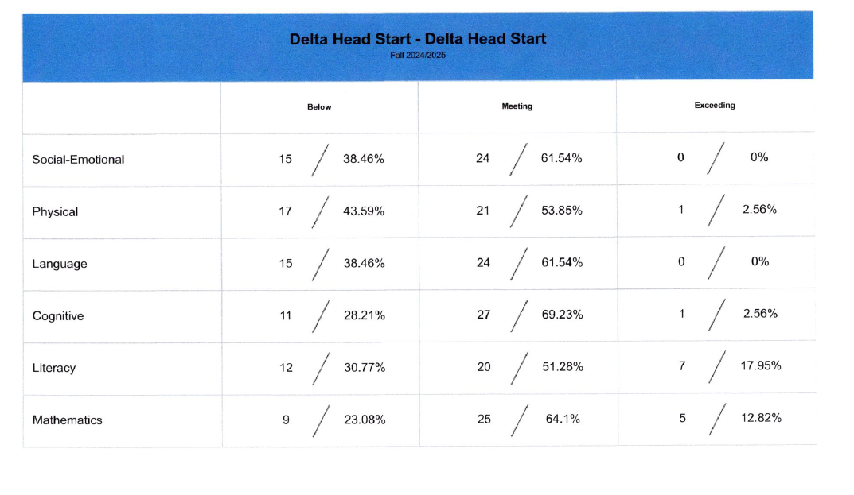

Slide 9
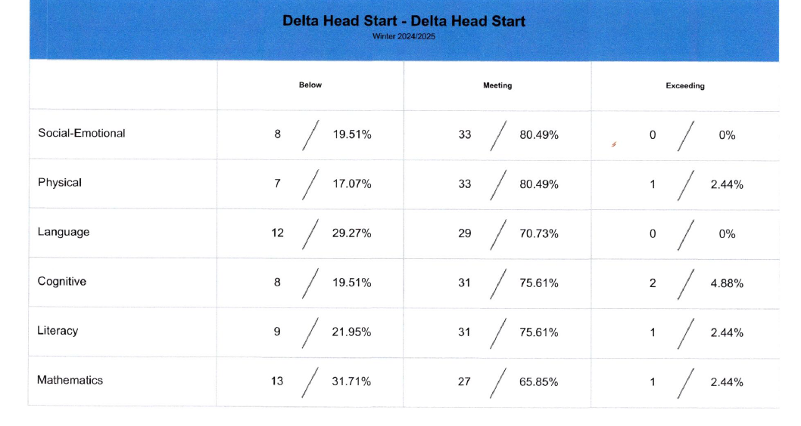

Slide 10
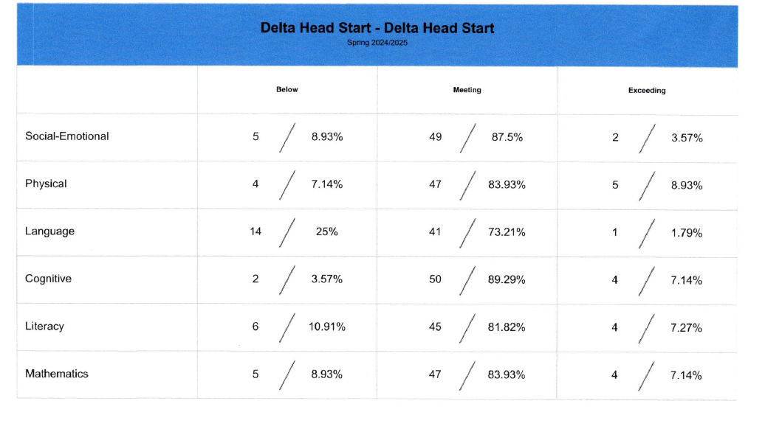

Slide 11
Summary Results
Domains | Fall | Winter | Spring | Growth
Social-Emotional | 72% | 69% | 91% | 19%
Physical | 67% | 78% | 93% | 26%
Language | 69% | 62% | 75% | 6%
Cognitive | 78% | 69% | 96% | 18%
Literacy | 81% | 76% | 89% | 8%
Mathematics | 69% | 67% | 72% | 22%

Slide 12
Summary of Information
This summary is a culmination of data based on the infant/toddlers who have attended our program from July 2024-June 2025. It is important to notate Early Head Start is a mixed age program and therefore students age into a different color bands throughout the year and are held to evolving expectations as the age into a different color band. For instance, on the fall assessment a student may have been 1 year old and scored at the high end of 1 year old objectives, however they turned 2 before winter assessment and are scoring low as a young 2 year old, as they are being held to higher expectations of the 2 year old color band they are currently developing, therefore a domain may show a temporary negative growth. Based on data, all domains had a positive growth, this year. Physical domain had a 26% growth, Social Emotional domain 19%, Language domain 6%, and Cognitive domain 18%, Literacy domain 8%, and Mathematics22%. This example is ongoing throughout our program year which accounts for smaller amounts of growth in certain domains. Additionally, 91% of students are meeting/exceeding in the Social E-Emotional domain, 93% in the Physical domain, 96% in the Cognitive domains, 89% in the Literacy domain, 72% in the Mathematics domain and 75% in the Language domain. As an agency, based on outcomes data we will increase supports in these domains to promote further growth in these areas. Assessment data supports program goals including those for school readiness for our infant/toddlers are being met by establishing nurturing relationships, providing safe and stimulating environments, and implementing strong curriculum fidelity in our EHS classrooms.

