Slide 1

St. Paul Catholic School
2025 Curriculum Night
At St. Paul Catholic School,
We strive for excellence in faith and academics.
Our mission is to be a loving and forgiving community that receives our Lord, Jesus Christ, and reflects His teachings.
God is our focus, Heaven our goal.

Slide 2

Oh good and gracious God,
We praise you and thank you for the gift of St. Paul Catholic School where the message of Jesus’ life, death, and resurrection is proclaimed. It is a sacred privilege to prepare each child to have a personal relationship to Jesus.
Listen to our prayers as we ask you, Lord, to increase our enrollment of students so they can benefit from a Catholic education, where Christ’s love abounds; and that our school grows in nurturing the sould and forms the minds of its students for generations to come.
We ask these blessings in the name of your Son, Jesus Christ. Amen.

Slide 3

<iframe width="560" height="315" src="https://www.youtube.com/embed/Z84zT31EP6c?si=2dTUYBCJ7KhNJHNV" title="YouTube video player" frameborder="0" allow="accelerometer; autoplay; clipboard-write; encrypted-media; gyroscope; picture-in-picture; web-share" allowfullscreen></iframe>

Slide 4


Important Information
Drop Off/Pick Up
FACTS for communication; Tuition; student progress; lunches; Resource documents
Absences/early pick up; Please call or email the office!
Kids Connection - RSVP in Notebook outside Kids Connection door
Refer to 411 sheet for information reminders
This Photo by Unknown Author is licensed under CC BY-NC

Slide 5
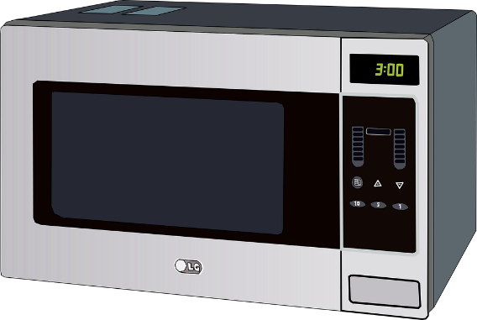
A Word About Lunch
Thank you to all who have volunteered to help with lunch!
Would like to have at least one more person on Mondays and one more person on Wednesdays.
Thursday lunch; asking families to consider sending a cold lunch or something in a thermos. 60 kids x 4 minutes = 240 minutes! 240 minutes divided by 3 microwaves = 80.
Even if half the kids bring something that needs microwaved would still need 40 minutes to heat everyone’s lunch. ☹ Lunch period is 25 minutes.
Thank you for considering this change on Thursdays!

Slide 6
Welcome New Staff Members!
Mrs. Mueller 1st Grade
Mrs. Nerbonne 3rd/4th Grade
Mrs. Lobb 5th/6th Grade
Mr. Doherty PE
Mrs. Snyder Art
Welcome All!

Slide 7

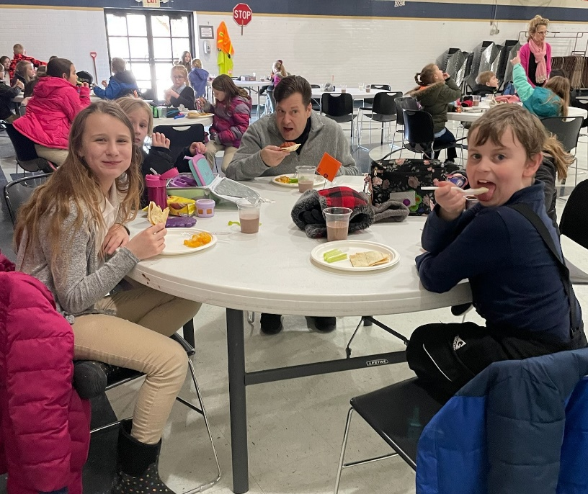
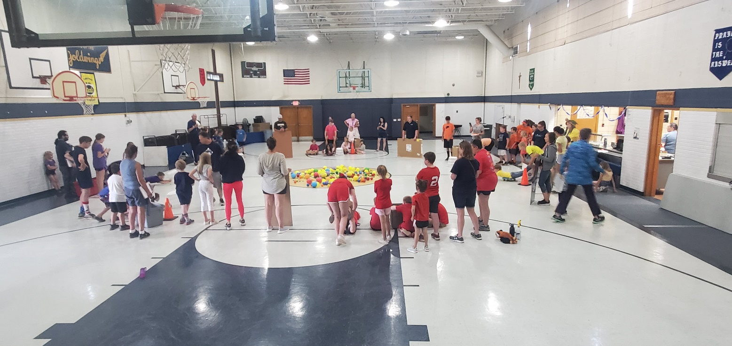
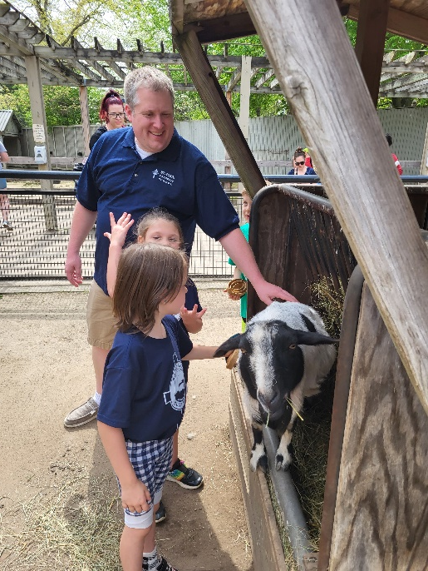
Lots of Ways to be Involved!!
Lunch help!
PTC
Auction
Field Trips!

Slide 8


Slide 9

Thank you for joining us!
Questions? Please feel free to reach out!

