Slide 1



Slide 2

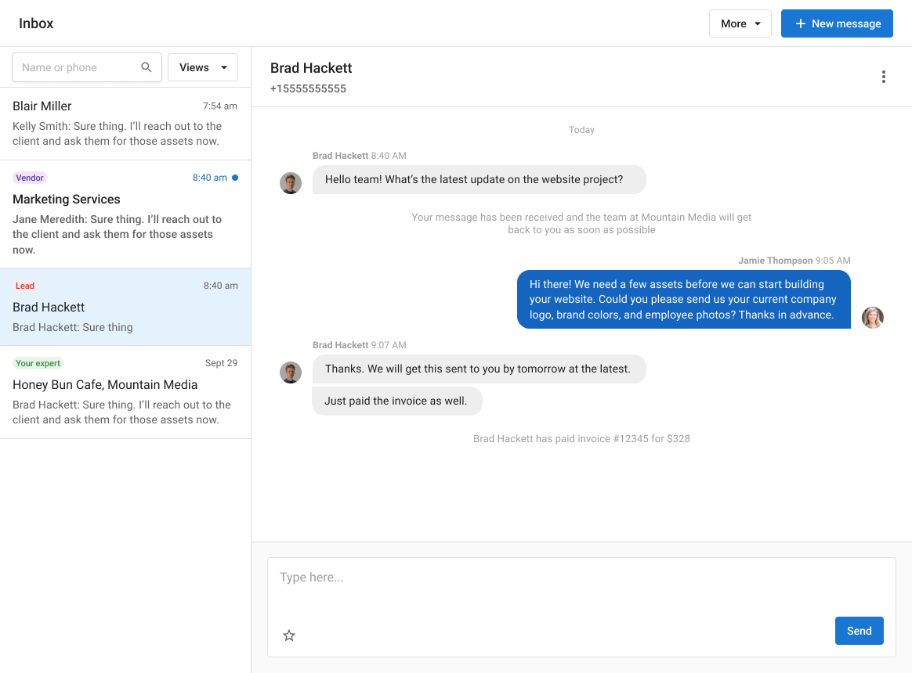


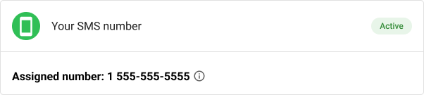

Slide 3
Small and medium-sized businesses are losing money from online communication
Notes:
We know that every day, small and medium-sized businesses are losing money from online communication.

Slide 4

68%
of consumers are more likely to buy from a business that offers convenient communications
Source: Forrester/Google, U.S., “What Businesses Need to Know About Communicating With Consumers,” Dec. 2020.
Notes:
Online communication is important because a large majority of customers want to buy from businesses that are easy to communicate with.
And for so many customers, the way they want to communicate with a business is changing.

Slide 5
How have customer contact methods evolved?
Used for the first time
Increased usage
Third-party messaging
4%
51%
Text
3%
40%
Chat on a business’s website
5%
38%
Social media
7%
36%
Chat on a business’s mobile site
5%
37%
Source: Forrester/Google, U.S., “What Businesses Need to Know About Communicating With Consumers,” Dec. 2020.
Notes:
Most customers have increased their usage of tools like third-party messaging, texting, or website chat to communicate with a business. Some have even used these tools for the first time! It’s almost mandatory for a business be available anywhere a customer might look online.

Slide 6






Most SMBs don’t have time for more communication channels.
Only 33%
of an SMB’s time is spent practicing their craft.
LSA Tech Adoption Index Survey (2017)
Notes:
However, most SMBs we talk to don’t have time to handle all of thesee communication channels. They have so many other things they need to do. They don’t have the time or people resources to fully invest in customer communication.
As a result, they lose out on customers and sales in a number of different ways that they might not even be aware of.

Slide 7
Small and medium-sized businesses need help with online communication
Notes:
To help them overcome this, small and medium-sized businesses need help with the communication problems they face everyday.

Slide 8


You need help capturing lead info when you are busy
Notes:
For example, let’s say you are a plumber busy working under the sink when a lead wants to request a quote. You can’t stop what you’re doing to answer the phone, but when the lead doesn’t get a response right away they’ll go find someone else who does respond right away.
You need to stay focused on the task at hand, but you might have lost out on a customer in the process!

Slide 9


You need help organizing and responding to messages
Notes:
…or imagine you are a flower-shop with multiple employees. A customer might order a bouquet of flowers with Employee 1 on Tuesday through webchat, and then on Thursday ask a question through Google Maps to Employee 2.
Employee 2 will have no idea who this customer is, what their order was, or what their co-worker talked with them about, and the customer is not going to be happy explaining everything again or waiting for the employee to find the right info… wherever the info might be!
The worst case scenario is an employee might completely miss a message from a customer because they aren’t checking in the right places until it’s too late!

Slide 10


You need help managing customer data and communication
Notes:
A local auto shop is another good example of how communication can cost you money. Let’s say you have your staff text using their personal smartphone to let customers know when their tires are finished being changed. Well, that staff member now has the customer’s data and communication on their personal phone, and that info can easily walk out the door if the staff member gets a job somewhere else.
Next time the customer texts to ask for a tune-up, they may end up at the competitor auto-shop down the street!

Slide 11

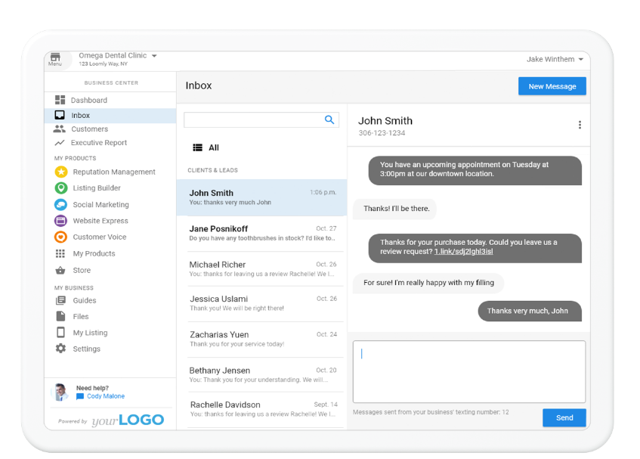
Let us help with an essential digital inbox
Notes:
We’ve built Inbox Pro to solve these problems and more as part of running your business every day.

Slide 12

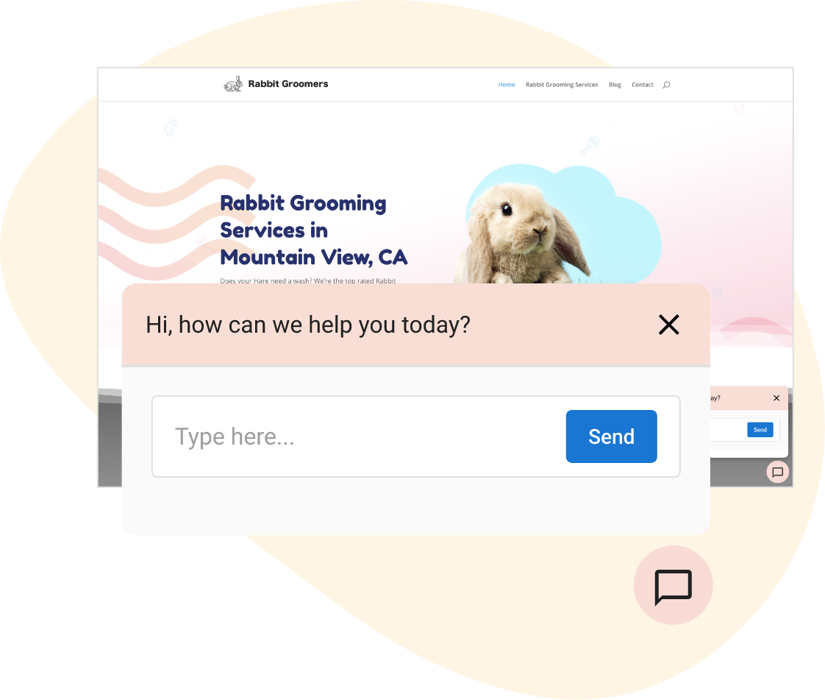
Capture More Leads with AI
AI-assisted web chat
Let AI automatically get contact details from website visitors
Answer basic questions automatically using business data
Add knowledge and instructions using a simple interface
Notes:
Inbox AI Pro lets you capture leads right from your website using an AI chat assistant. The AI has been carefully set-up to not only get a customer’s name and contact information, but to also answer basic questions.
This way, customers get the information they need without having to make a phone-call, and you get a qualified lead!

Slide 13

Share and Simplify Communications
Unified and shared inbox
Centralize messaging from SMS, Google Business Chat, and other channels
Own customer relationships as the business; not the staff
Collaborate on communication across the whole businesses team
Notes:
Inbox Pro also makes it easy for you to see and respond to all your customer communication in one place, whether customers are sending a message through SMS or from Google Maps!
You will never have to worry about missing a message because it came through a different app or because your customer was talking with a different staff member.

Slide 14


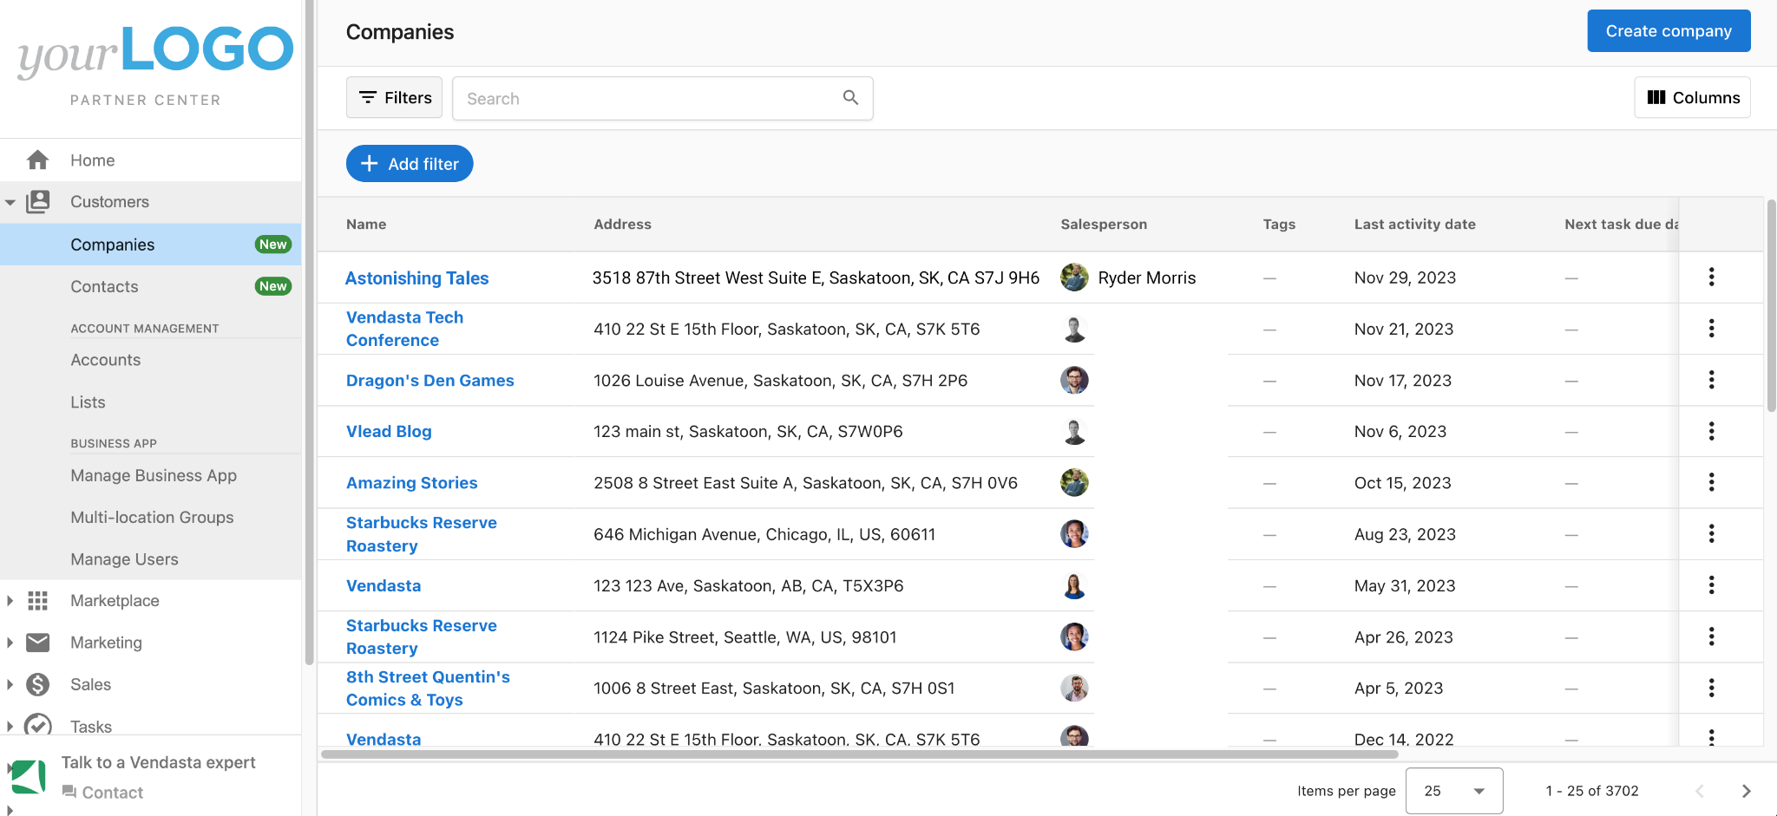
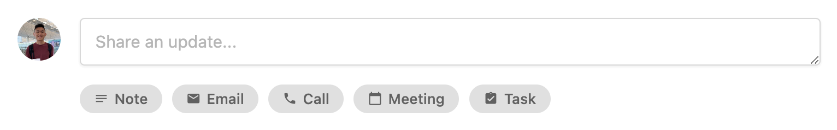
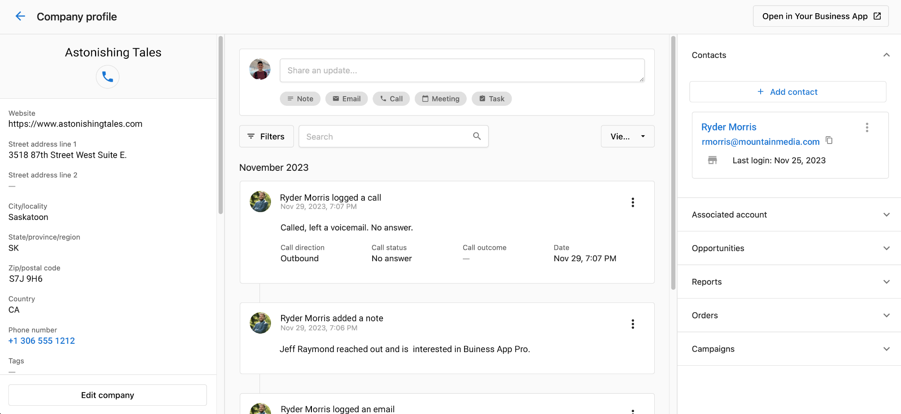
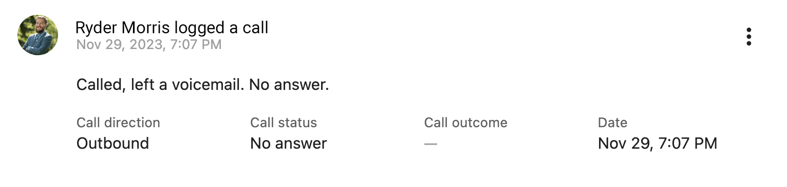
Put Customer Data to Use
Flexible and Simple Integrated CRM
Start detailed customer records with just an email or phone number
Segment customers with flexible filters and sorting
Automate admin tasks to ensure data integrity
Notes:
Finally, by using Inbox Pro you will have all of your customer data captured in one place. You don’t have to worry that customer data is living in your employees smartphone, and you can now use that customer data to provide an exceptional experience and even generate repeat business.

Slide 15
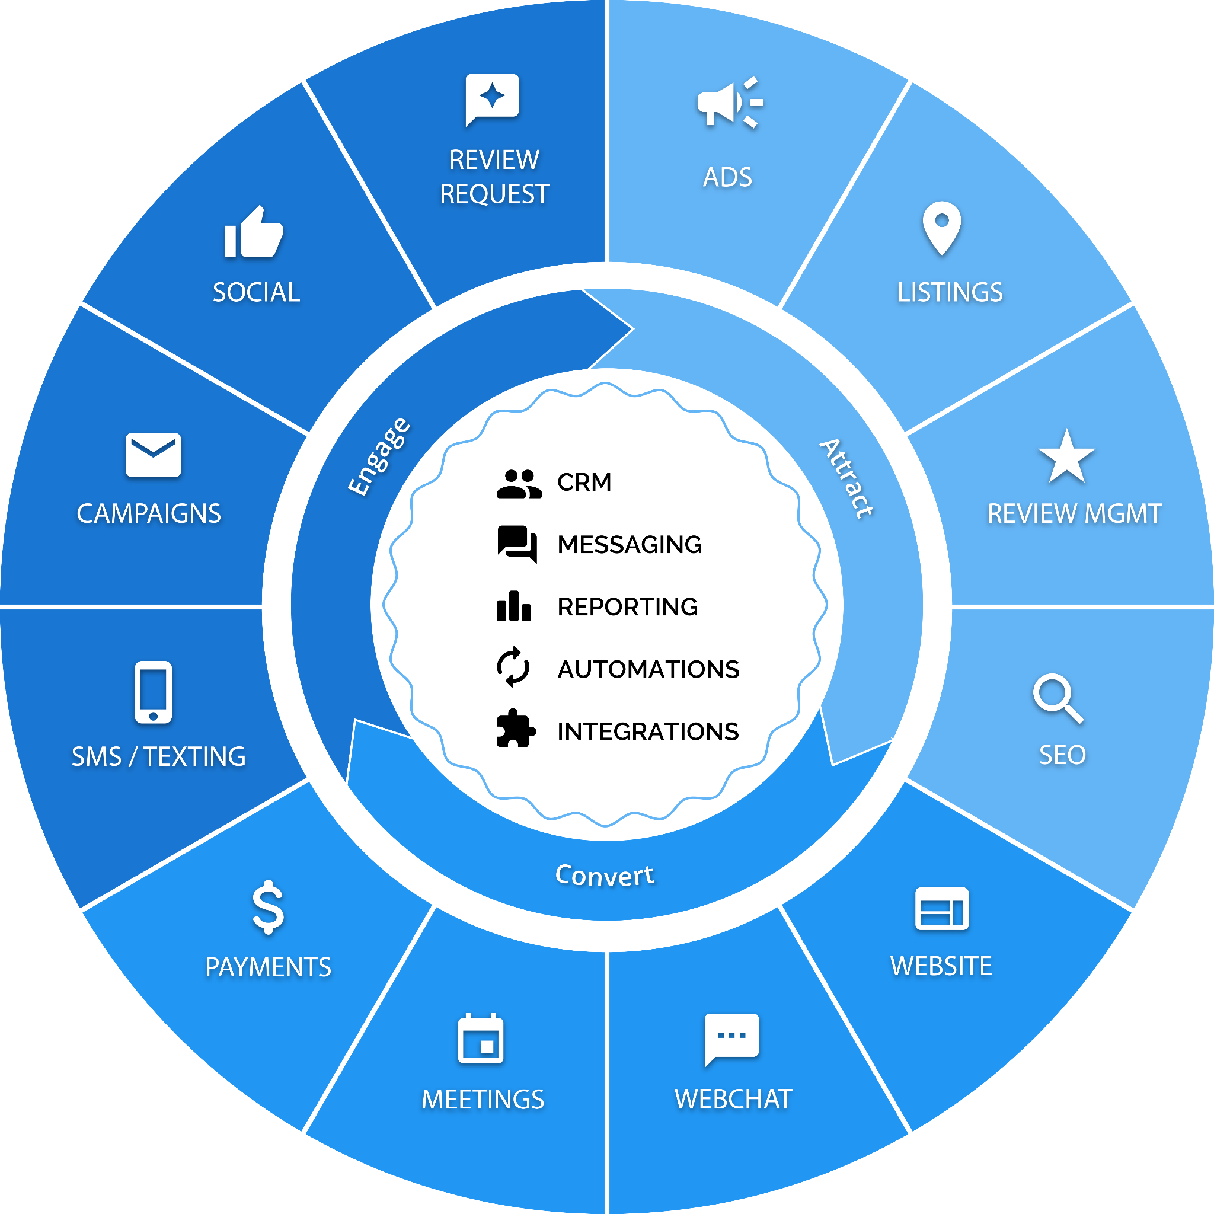
Notes:
Inbox AI Pro not only helps your clients convert leads engage customers – it provides the foundational elements of a customer experience platform. With the CRM and messaging capabilities, you are better positioned to win repeat from their customers and your business gets to be deeply integrated in their daily operations.

Slide 16
303.880.3920
Sonia@NsiteTechStudios.com

