Slide 1



“WHY DO I NEED A WEBSITE?”
5 reasons why having a website is a must

Slide 2

INTRODUCTION
In an era dominated by social media, you might wonder, "Do I need a website?" The response is a definitive yes, and let me explain the reasons.
Even back in 2019, approximately 70 to 80% of individuals were exploring online before deciding to make a purchase.
This indicates that small businesses without a website stand at risk of losing potential customers.
Moreover, with the subsequent shift towards a more digital-centric world, the importance of owning a website has only intensified.

Slide 3
REASONS YOU NEED A WEBSITE
PROFESSIONAL APPEAL
1
Boost Credibility and Trust
CUSTOMER GROWTH
2
Expand Reach, Enhance Conversions
EASY WEB CREATION
3
Affordable, User-Friendly Approach
CONTROL MASTERY
4
Own Your Online Presence
MARKETING HUB
5
Centralize Your Promotional Efforts

Slide 4

1
PROFESSIONAL APPEAL
Boost Credibility and Trust

Slide 5
SOLUTION
Unlike social media platforms where anyone can create accounts with minimal verification, a professional website is unique to you and your brand and harder to replicate.
Additionally, a professional website includes verifiable contact information, testimonials, and detailed information, which social media profiles might lack.
PROBLEM
Anyone can easily create a Facebook page or an Instagram account with fake data, your name, and the profiles may look identical to yours.
How can you prove your identity to your customers?

Slide 6
2
CUSTOMER GROWTH
Expand Reach, Enhance Conversions

Slide 7
PROBLEM
For businesses without a website, turning to social media seems like a viable method to increase reach.
However, this approach has limitations, as dependence on social media alone may not fully establish credibility or offer a comprehensive representation of your brand.
SOLUTION
Opting for a professional website sets your brand apart from the commonplace nature of social media platforms.
It provides a comprehensive platform to display verifiable contact information, testimonials, and detailed insights about your offerings, which goes beyond the scope of what social media profiles can typically convey.

Slide 8
3
EASY WEB CREATION
Affordable, User-Friendly Approach

Slide 9
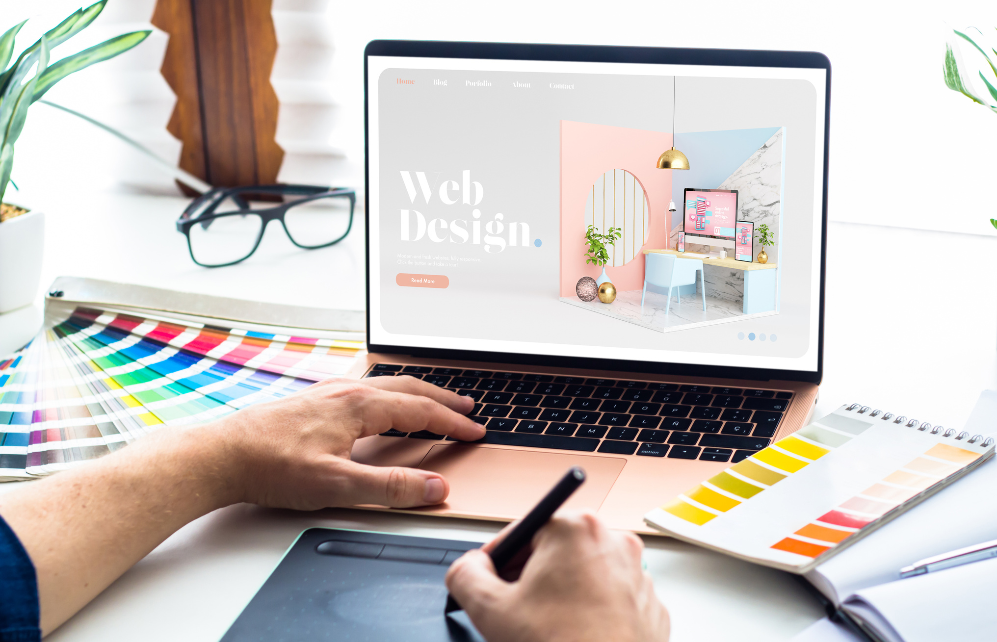
YOUR WEBSITE: EASIER AND MORE AFFORDABLE THAN EXPECTED
Creating a stunning website is more accessible than ever with our services.
You don't need technical skills or a team of professionals – we handle it all.
Our experts will design a professional, mobile-friendly website, and tailor it to your needs.
Plus, we offer personalized, AI-assisted website designs, ensuring a unique online presence for your brand.

Slide 10
4
CONTROL MASTERY
Own Your Online Presence

Slide 11

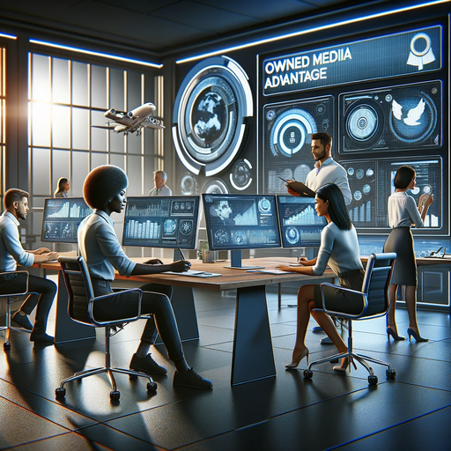
Full Control Over Your Image:
A website is a controlled environment where you decide what goes public.
Whether it's a stunning gallery, a detailed portfolio, or dynamic content changes, you have the liberty to redesign and update your site whenever you wish.
CONTROL MASTERY
Owned Media Advantage:
Your website is your owned media, free from the fluctuating rules of social platforms.
While social networks may come and go, your website remains a constant in your business, accessible to all internet users without the need for an account.

Slide 12
5
MARKETING HUB
Centralize Your Promotional Efforts

Slide 13

MARKETING HUB
A website often serves as the initial or final interaction point for potential customers, encompassing everything from first discovery to final purchase.
It's a pivotal destination, whether they're redirected from digital ads, social media, or even physical marketing like business cards.
It's where they sign up for emails, view pricing, or access special offers.
Central to all marketing efforts, a website unifies campaigns, making it a critical first step for any business's success.

Slide 14
THANK YOU
Have any question?
+123-456-7890
mail@mail.com
www.yoursite.com

