Slide 1

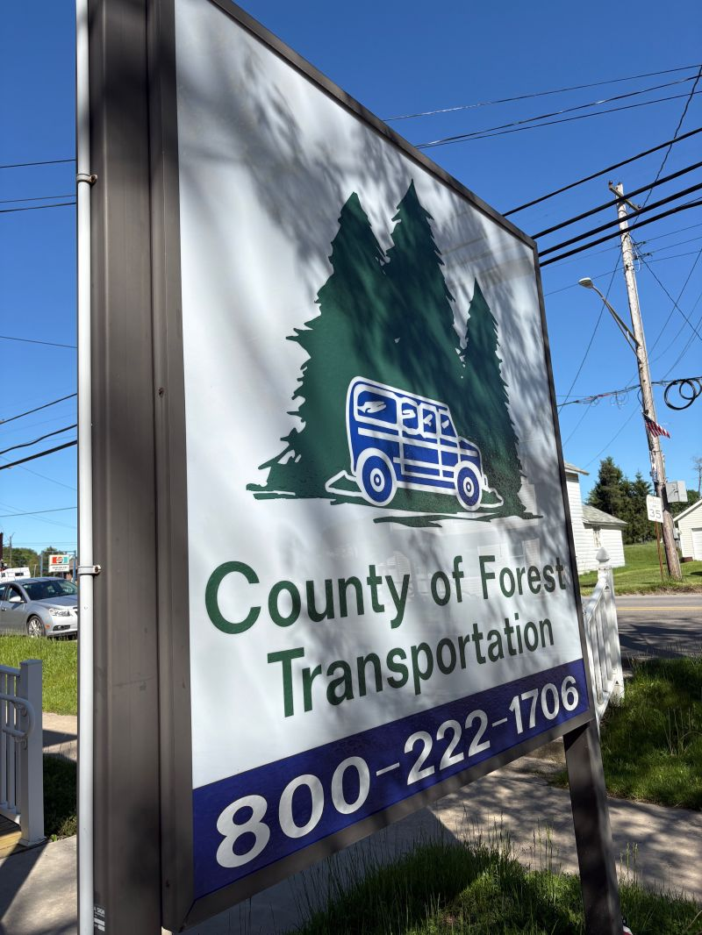
Medical Assistance
Transportation Program
Public Meeting | June 9, 2026
Operated by Forest County Transportation
Transitioning to CATA effective July 1, 2026

Slide 2
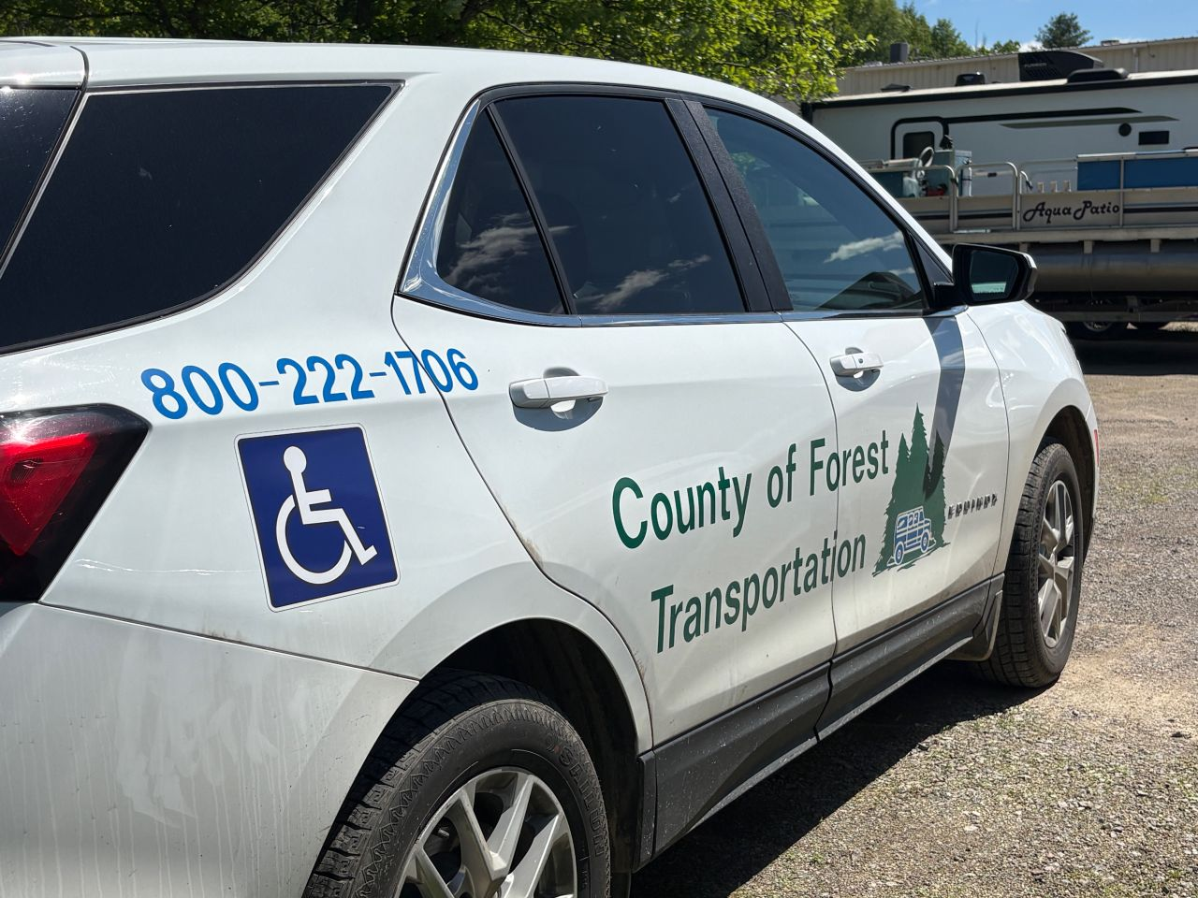
Welcome & Agenda
Today's Meeting
What is MATP and who can use it
What services are provided (rides, mileage reimbursement)
How to schedule a ride
Pickup, drop-off, and timing rules
Escort, urgent care, and pharmacy policies
Sanction and complaint processes
What changes with CATA on July 1, 2026
Contact information and questions

Slide 3
What is MATP?
Understanding your transportation benefit

Slide 4
What is MATP?
What It Is
What MATP Provides
MATP is a transportation service available to Medical Assistance consumers in Forest County.
Funded by the Pennsylvania Department of Human Services.
Currently operated by Forest County Transportation.
Transitioning to CATA effective July 1, 2026.
Transportation to medical appointments
Mileage reimbursement if you have a vehicle available
Trips to doctors, dentists, psychiatrists, drug & alcohol clinics, psych rehab, and any MA provider
Pharmacy trips for prescriptions
Hospital visits for tests
Medical equipment suppliers

Slide 5
What MATP Does NOT Cover
MATP cannot be used for:
Emergency ambulance transportation
  Call 911 for medical emergencies
Non-medical trips
  Such as grocery shopping, errands, or social activities
Services not covered by Medical Assistance
Stretcher transportation (we will refer you to your MCO or CAO)
A more extensive list of covered and non-covered services is available at the DHS MATP website here: MATP Covered and Non-Covered Services

Slide 6
Transportation Services
How we get you where you need to go

Slide 7
Transportation Services We Provide
Depending on your destination, needs, and cost, we provide:
Shared Van
Lift-Equipped Bus
Wheelchair Accessible Van
Standard transportation shared with other passengers going to similar destinations
Bus with accessibility lift for passengers who require it
Fully accessible vans for consumers using wheelchairs
We will always provide the least expensive, most appropriate option that meets your needs.

Slide 8
Mileage Reimbursement
When You May Qualify
How It Works
You have a car available, OR someone with a car can take you
Mileage reimbursement is the least costly option available
You notify the office at least 1 business day in advance
You complete and return the required trip forms
Reimbursed at the DHS-specified rate per mile
Actual parking and toll costs also reimbursed (receipts required)
All trip forms must have the medical provider's signature
Only one reimbursement per vehicle, even if multiple consumers travel together
Return forms to: FCT, 128 Cherry St, Marienville, PA 16239 OR CATA-FCT, 285 Elm St, Oil City, PA 16301
Due by the 5th of the month following the trip — late submissions will not be paid

Slide 9
How Far Can MATP Take You?
MATP serves any qualified MA-enrolled provider of your choice within Forest County — and beyond when necessary.
Out-of-County Travel
Transportation outside Forest County is provided when a needed service is not available locally OR when your doctor refers you out of county.
Counties We Serve:
Clarion, Jefferson, Venango, Clearfield, Allegheny, Warren, Erie, Butler, Mercer, Elk, Crawford, Armstrong, McKean, Beaver, Lawrence
Appointment Hours
Most counties: 5 AM – 5 PM
Allegheny, Erie & Butler: 9 AM – Noon only (longer travel times require this limit)
Exceptions may be granted if medically necessary and approved by Forest County Transportation.

Slide 10
Scheduling a Ride
What to know before you call

Slide 11
How to Schedule a Ride
2 days
5–30 days
Call Us First!
advance notice for regular appointments
(call before 2:00 PM)
advance notice for out-of-county / long-distance trips
As soon as you know you need a ride — the earlier the better
Information to Have Ready When You Call
1
Date & time of appointment — We need to know when and where you're going
4
Additional needs — Wheelchair, walker, cane, escort, accessible vehicle
2
Appointment location — Full address or facility name
5
Cancellations / changes — Call us immediately if your appointment changes
3
Estimated appointment length — If you know how long you'll be there

Slide 12
Pickup, Drop-Off & Timing Rules
30-Min Pickup Window
Day-Before Confirmation
Be ready 15 min BEFORE your scheduled pickup time. Drivers may arrive up to 15 min AFTER — pickups within this 30-minute window are considered on time.
For shared-ride trips, call the office the day before (call Friday for Monday trips) — you will receive your pickup time.
1-Hour Arrival Rule
Driver Wait Policy
We drop you off no more than 1 hour before your appointment and pick you up no later than 1 hour after it ends. For long-distance trips, this window may extend up to 2½ hours.
If a driver arrives early, they must wait until the scheduled time before leaving. Drivers are not required to wait for passengers who are not ready within the 30-minute window.

Slide 13
Special Transportation Policies
Pharmacy Trips
Methadone Treatment
Up to 2 pharmacies closest to your home, OR
Up to 2 pharmacies closest to your prescribing physician's office (when filling a prescription on the way home from that visit)
Transportation only to the closest in-network methadone program from your home
Exceptions may be granted for: medical emergency, physical health, safety issues, or availability of a closer clinic
Contact our office with any questions
Urgent Care Transportation
Urgent care = your provider says you must be seen that same day or within the next 24 hours
Call our office immediately to arrange transportation — we will verify urgency with your provider
After-hours urgent needs: leave a message with your name and phone number; someone will call you back
We will arrange a ride or provide mileage reimbursement forms

Slide 14
Escort Policy
An escort is someone who accompanies you as an aide — at no cost to you — when your circumstances require it.
You may bring an escort if:
Under 18
Cannot travel independently
Limited English proficiency
You can be escorted by a parent, relative, or guardian
You need assistance due to age, illness, physical or mental disability (physician verification required)
You may bring someone to interpret for you
Escorts include: parents, guardians, adult children of geriatric parents, or any individual who assumes responsibility.

Slide 15
Program Rules & Sanctions
No-shows, behavior, and complaints

Slide 16
No-Show Policy
A no-show is any scheduled trip that is not taken and not cancelled with sufficient notice.
You are a no-show if:
You (or someone on your behalf) do not call to cancel at least 2 hours before your scheduled pickup time
You are not present at the pickup location when the driver arrives
Consequences (2 no-shows within 90 days):
After 1st No-Show
After 2nd No-Show
You receive a verbal or written notice and a warning. You may be asked to call in the day before all scheduled trips to confirm.
You will receive a letter requiring you to call in the day before all trips for confirmation. Unconfirmed trips will be cancelled automatically with no call from us.

Slide 17
Inappropriate Behavior Policy
Behaviors That May Lead to Suspension
Consequences
Loud, boisterous, obscene, or offensive language
Disruptive behavior that jeopardizes vehicle safety
Being under the influence of alcohol or controlled substances
Violating moving-vehicle safety rules or leaving before the designated drop-off point
Threats or physical action toward passengers, drivers, or staff
Property damage or threat of damage to the vehicle or equipment
1st Offense: Written warning stating that service is in danger of being reduced or terminated
2nd Offense: Written Notice reducing or terminating your MATP service

Slide 18
Complaints & Appeals
Filing a Complaint
Written Notices & Appeals
A complaint can be any issue, dispute, or objection about our agency, coverage, operations, or policies.
Call our office to report it. We will:
Record your complaint
Investigate it
Respond to you within 5 business days
Call to explain the decision and send a written summary
DHS requires us to issue a Written Notice if we:
Deny your MATP request
Plan to reduce, change, suspend, or terminate your service
The Written Notice will include:
The reason for our action
When the action takes effect
Your right to appeal
To appeal: complete the designated section of the Written Notice and return it within the listed time limits.
Need help with an appeal?
Call us, visit PALawHELP.org, or call the PA Health Law Project at (800) 274-3258.

Slide 19
What Changes with CATA on July 1, 2026?
Short answer: Very little changes for you as a consumer.
✓ What Stays the Same
What Changes
Same drivers you know
Same vehicles
Same phone number
Same great service
Administrative operator transitions from Forest County Transportation to CATA
New mailing address for reimbursements: CATA-FCT, 285 Elm St, Oil City, PA 16301

Slide 20
How to Contact Us
Office Address
Phone Numbers
Office Hours
128 Cherry Street
Marienville, Pennsylvania 16239
(814) 927-8266
(800) 222-1706
Monday–Friday
7:30 AM – 4:00 PM
After Hours
Reimbursement Mail (after 7/1/26)
Need Help with an Appeal?
Leave a message — we will return your call the next business day
CATA-FCT
285 Elm Street
Oil City, PA 16301
PALawHELP.org
PA Health Law Project: (800) 274-3258

Slide 21
Thank You!
Questions are welcome.
Forest County Transportation
(814) 927-8266 | (800) 222-1706
128 Cherry Street, Marienville, PA 16239
Monday–Friday | 7:30 AM – 4:00 PM

