Slide 1
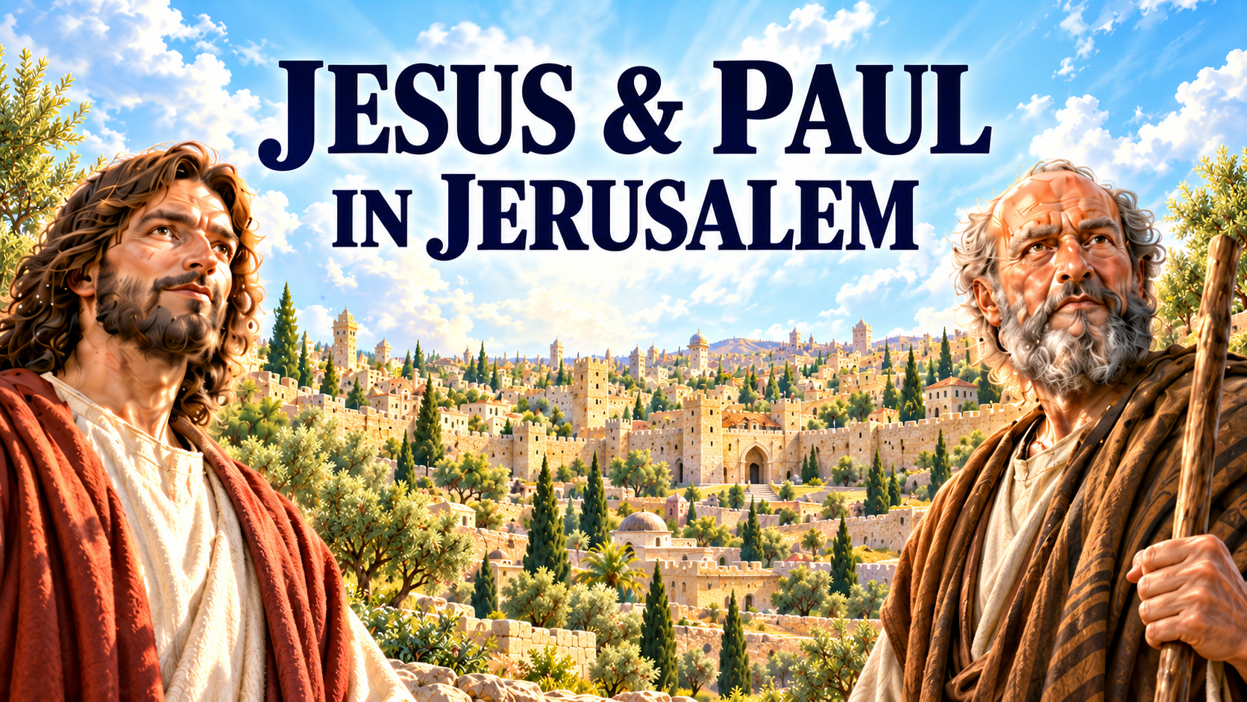

Slide 2


Slide 3
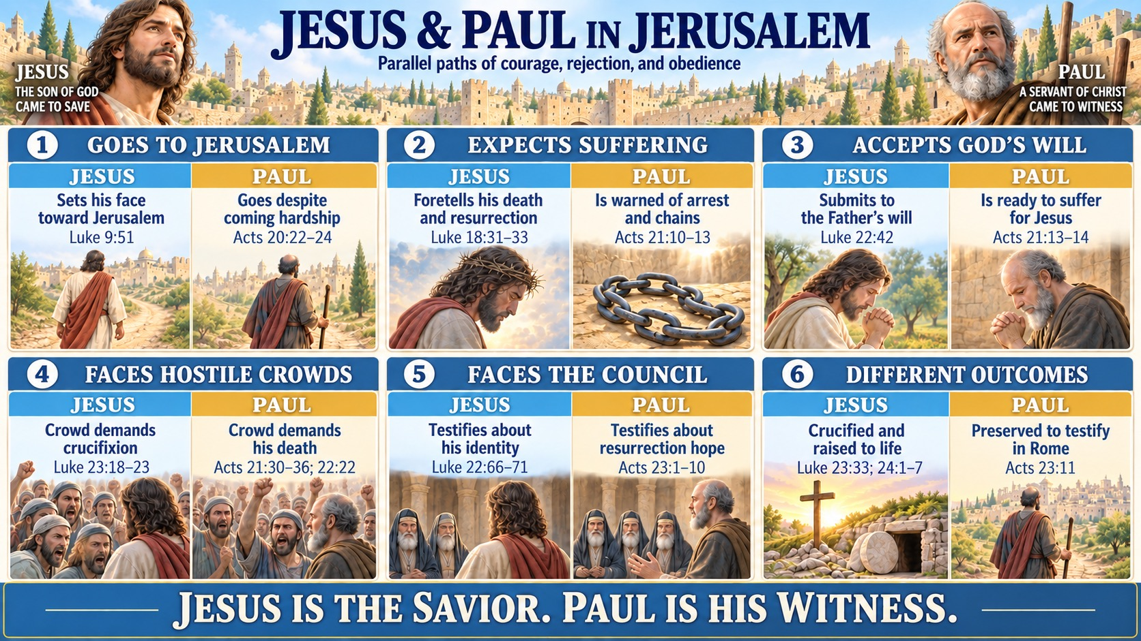

Slide 4
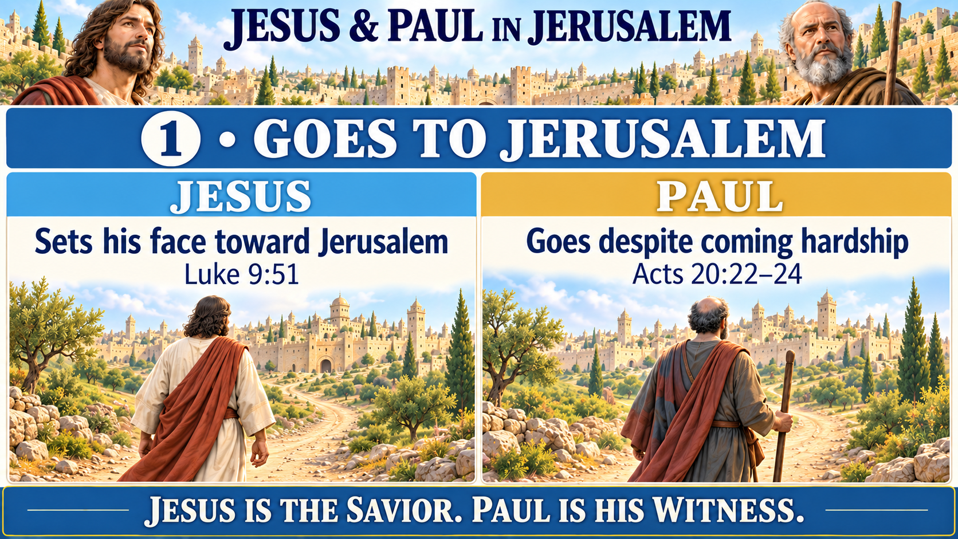

Slide 5
1 JESUS
1 PAUL
Luke 9:51
Acts 20:22–24
51 As the time approached for him to be taken up to heaven, Jesus resolutely set out for Jerusalem.
22 “And now, compelled by the Spirit, I am going to Jerusalem, not knowing what will happen to me there.
23 I only know that in every city the Holy Spirit warns me that prison and hardships are facing me.
24 However, I consider my life worth nothing to me; my only aim is to finish the race and complete the task the Lord Jesus has given me—the task of testifying to the good news of God’s grace.”
Notes:
NIV Scripture text supplied by the user.

Slide 6
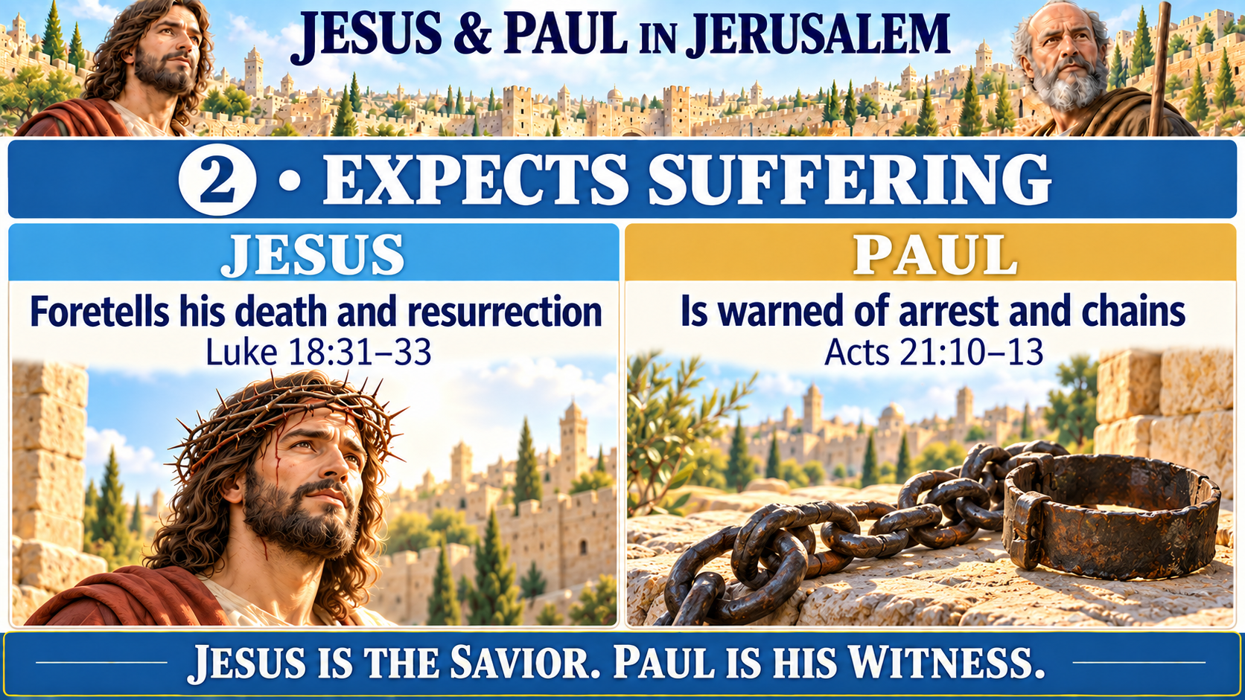

Slide 7
2 JESUS
2 PAUL
Luke 18:31–32
Acts 21:10–11
31 Jesus took the Twelve aside and told them, “We are going up to Jerusalem, and everything that is written by the prophets about the Son of Man will be fulfilled.
32 He will be delivered over to the Gentiles. They will mock him, insult him and spit on him;
10 After we had been there a number of days, a prophet named Agabus came down from Judea.
11 Coming over to us, he took Paul’s belt, tied his own hands and feet with it and said, “The Holy Spirit says, ‘In this way the Jewish leaders in Jerusalem will bind the owner of this belt and will hand him over to the Gentiles.’”
1/2
1/2
Notes:
NIV Scripture text supplied by the user.

Slide 8
2 JESUS
2 PAUL
Luke 18:33
Acts 21:12–13
33 they will flog him and kill him. On the third day he will rise again.”
12 When we heard this, we and the people there pleaded with Paul not to go up to Jerusalem.
13 Then Paul answered, “Why are you weeping and breaking my heart? I am ready not only to be bound, but also to die in Jerusalem for the name of the Lord Jesus.”
2/2
2/2
Notes:
NIV Scripture text supplied by the user.

Slide 9
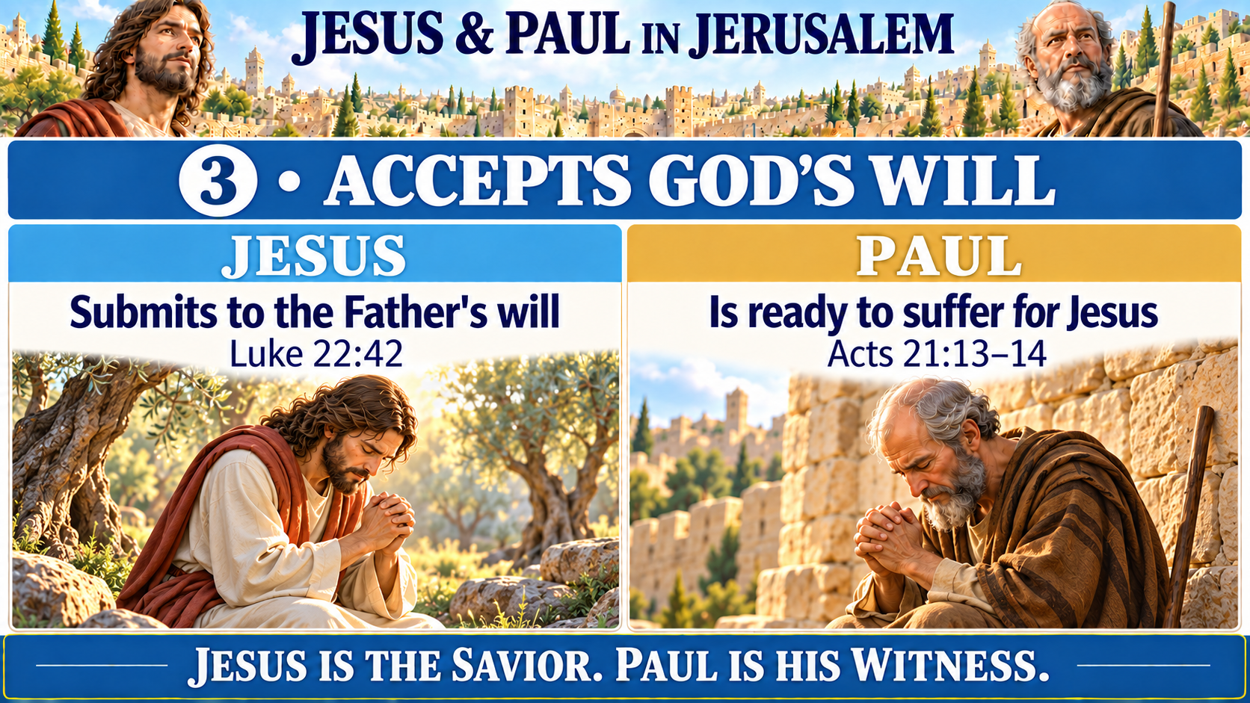

Slide 10
3 JESUS
3 PAUL
Luke 22:42
Acts 21:13–14
42 “Father, if you are willing, take this cup from me; yet not my will, but yours be done.”
13 Then Paul answered, “Why are you weeping and breaking my heart? I am ready not only to be bound, but also to die in Jerusalem for the name of the Lord Jesus.”
14 When he would not be dissuaded, we gave up and said, “The Lord’s will be done.”
Notes:
NIV Scripture text supplied by the user.

Slide 11
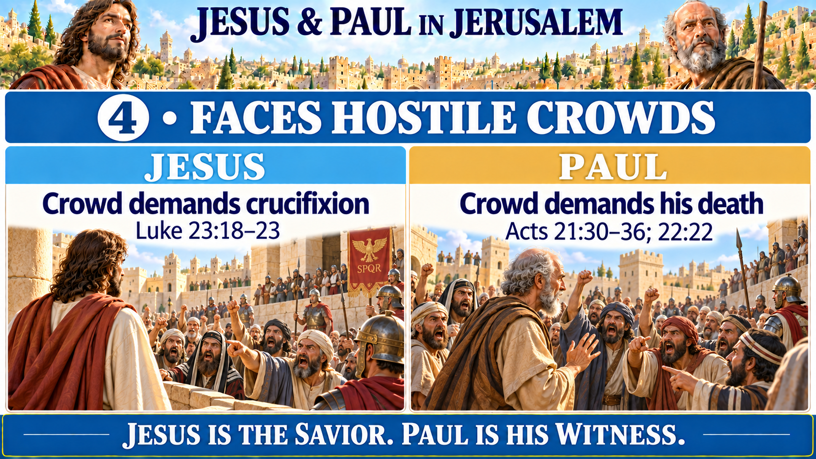

Slide 12
4 JESUS
4 PAUL
Luke 23:18–21
Acts 21:30–32
18 But the whole crowd shouted, “Away with this man! Release Barabbas to us!”
19 (Barabbas had been thrown into prison for an insurrection in the city, and for murder.)
20 Wanting to release Jesus, Pilate appealed to them again.
21 But they kept shouting, “Crucify him! Crucify him!”
30 The whole city was aroused, and the people came running from all directions. Seizing Paul, they dragged him from the temple, and immediately the gates were shut.
31 While they were trying to kill him, news reached the commander of the Roman troops that the whole city of Jerusalem was in an uproar.
32 He at once took some officers and soldiers and ran down to the crowd. When the rioters saw the commander and his soldiers, they stopped beating Paul.
1/3
1/3
Notes:
NIV Scripture text supplied by the user.

Slide 13
4 JESUS
4 PAUL
Luke 23:22–23
Acts 21:33–34
22 For the third time he spoke to them: “Why? What crime has this man committed? I have found in him no grounds for the death penalty. Therefore I will have him punished and then release him.”
23 But with loud shouts they insistently demanded that he be crucified, and their shouts prevailed.
33 The commander came up and arrested him and ordered him to be bound with two chains. Then he asked who he was and what he had done.
34 Some in the crowd shouted one thing and some another, and since the commander could not get at the truth because of the uproar, he ordered that Paul be taken into the barracks.
2/3
2/3
Notes:
NIV Scripture text supplied by the user.

Slide 14
4 JESUS
4 PAUL
Luke 23:22–23
Acts 21:35–36; 22:22
22 For the third time he spoke to them: “Why? What crime has this man committed? I have found in him no grounds for the death penalty. Therefore I will have him punished and then release him.”
23 But with loud shouts they insistently demanded that he be crucified, and their shouts prevailed.
35 When Paul reached the steps, the violence of the mob was so great he had to be carried by the soldiers.
36 The crowd that followed kept shouting, “Get rid of him!”
22 The crowd listened to Paul until he said this. Then they raised their voices and shouted, “Rid the earth of him! He’s not fit to live!”
3/3
3/3
Notes:
NIV Scripture text supplied by the user.

Slide 15
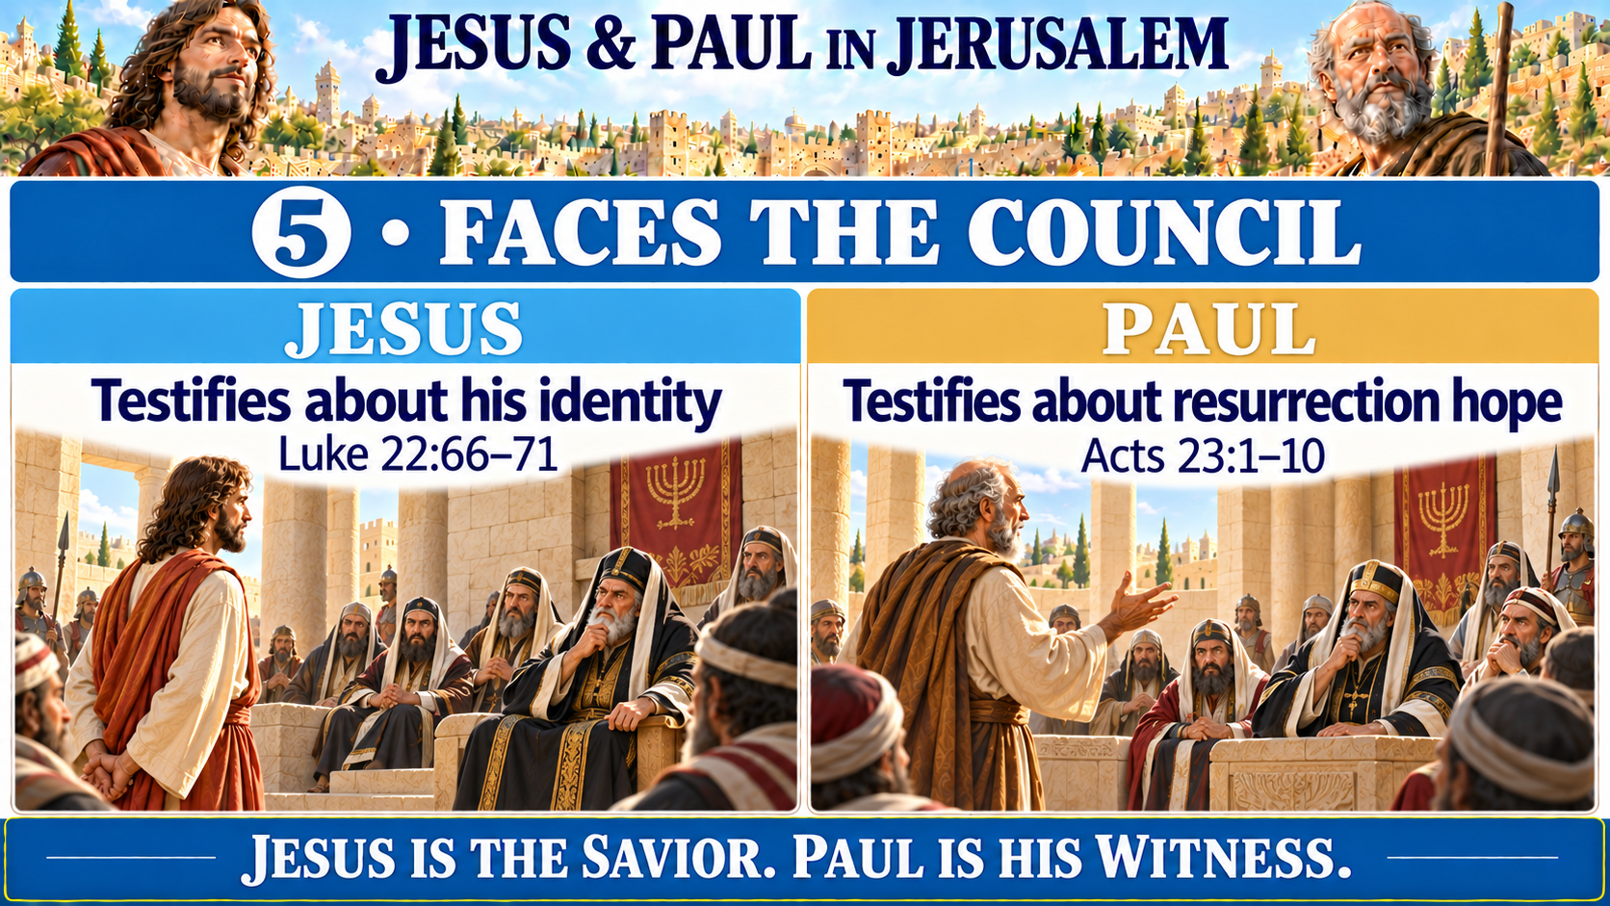

Slide 16
5 JESUS
5 PAUL
Luke 22:66–67
Acts 23:1–3
66 At daybreak the council of the elders of the people, both the chief priests and the teachers of the law, met together, and Jesus was led before them.
67 “If you are the Messiah,” they said, “tell us.”
Jesus answered, “If I tell you, you will not believe me,
1 Paul looked straight at the Sanhedrin and said, “My brothers, I have fulfilled my duty to God in all good conscience to this day.”
2 At this the high priest Ananias ordered those standing near Paul to strike him on the mouth.
3 Then Paul said to him, “God will strike you, you whitewashed wall! You sit there to judge me according to the law, yet you yourself violate the law by commanding that I be struck!”
1/4
1/4
Notes:
NIV Scripture text supplied by the user.

Slide 17
5 JESUS
5 PAUL
Luke 22:68–69
Acts 23:4–5
68 and if I asked you, you would not answer.
69 But from now on, the Son of Man will be seated at the right hand of the mighty God.”
4 Those who were standing near Paul said, “How dare you insult God’s high priest!”
5 Paul replied, “Brothers, I did not realize that he was the high priest; for it is written: ‘Do not speak evil about the ruler of your people.’”
2/4
2/4
Notes:
NIV Scripture text supplied by the user.

Slide 18
5 JESUS
5 PAUL
Luke 22:68–69
Acts 23:6–8
68 and if I asked you, you would not answer.
69 But from now on, the Son of Man will be seated at the right hand of the mighty God.”
6 Then Paul, knowing that some of them were Sadducees and the others Pharisees, called out in the Sanhedrin, “My brothers, I am a Pharisee, descended from Pharisees. I stand on trial because of the hope of the resurrection of the dead.”
7 When he said this, a dispute broke out between the Pharisees and the Sadducees, and the assembly was divided.
8 (The Sadducees say that there is no resurrection, and that there are neither angels nor spirits, but the Pharisees believe all these things.)
3/4
3/4
Notes:
NIV Scripture text supplied by the user.

Slide 19
5 JESUS
5 PAUL
Luke 22:70–71
Acts 23:9–10
70 They all asked, “Are you then the Son of God?”
He replied, “You say that I am.”
71 Then they said, “Why do we need any more testimony? We have heard it from his own lips.”
9 There was a great uproar, and some of the teachers of the law who were Pharisees stood up and argued vigorously. “We find nothing wrong with this man,” they said. “What if a spirit or an angel has spoken to him?”
10 The dispute became so violent that the commander was afraid Paul would be torn to pieces by them. He ordered the troops to go down and take him away from them by force and bring him into the barracks.
4/4
4/4
Notes:
NIV Scripture text supplied by the user.

Slide 20
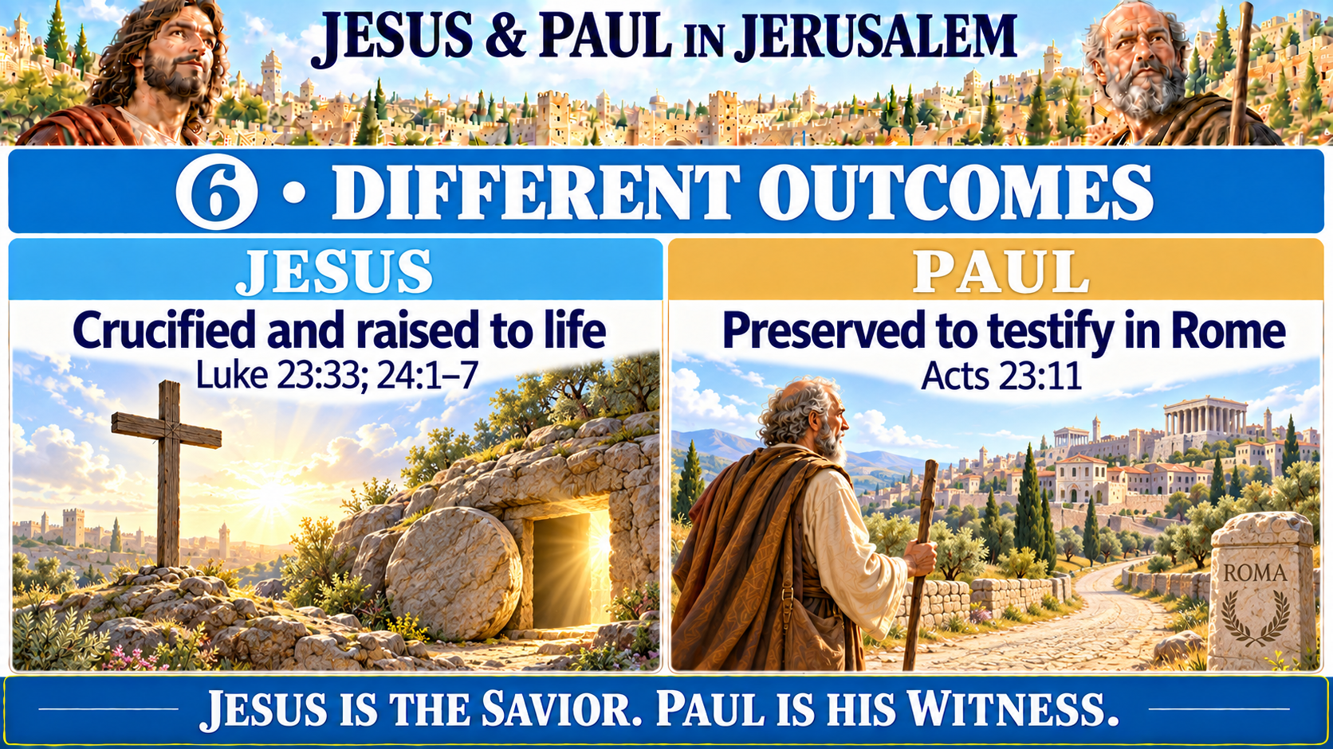

Slide 21
6 JESUS
6 PAUL
Luke 23:33; 24:1–3
Acts 23:11
33 When they came to the place called the Skull, they crucified him there, along with the criminals—one on his right, the other on his left.
1 On the first day of the week, very early in the morning, the women took the spices they had prepared and went to the tomb.
2 They found the stone rolled away from the tomb,
3 but when they entered, they did not find the body of the Lord Jesus.
11 The following night the Lord stood near Paul and said, “Take courage! As you have testified about me in Jerusalem, so you must also testify in Rome.”
1/2
1/2
Notes:
NIV Scripture text supplied by the user.

Slide 22
6 JESUS
6 PAUL
Luke 24:4–7
Acts 23:11
4 While they were wondering about this, suddenly two men in clothes that gleamed like lightning stood beside them.
5 In their fright the women bowed down with their faces to the ground, but the men said to them, “Why do you look for the living among the dead?
6 He is not here; he has risen! Remember how he told you, while he was still with you in Galilee:
7 ‘The Son of Man must be delivered over to the hands of sinners, be crucified and on the third day be raised again.’ ”
11 The following night the Lord stood near Paul and said, “Take courage! As you have testified about me in Jerusalem, so you must also testify in Rome.”
2/2
2/2
Notes:
NIV Scripture text supplied by the user.

Slide 24
