Slide 1
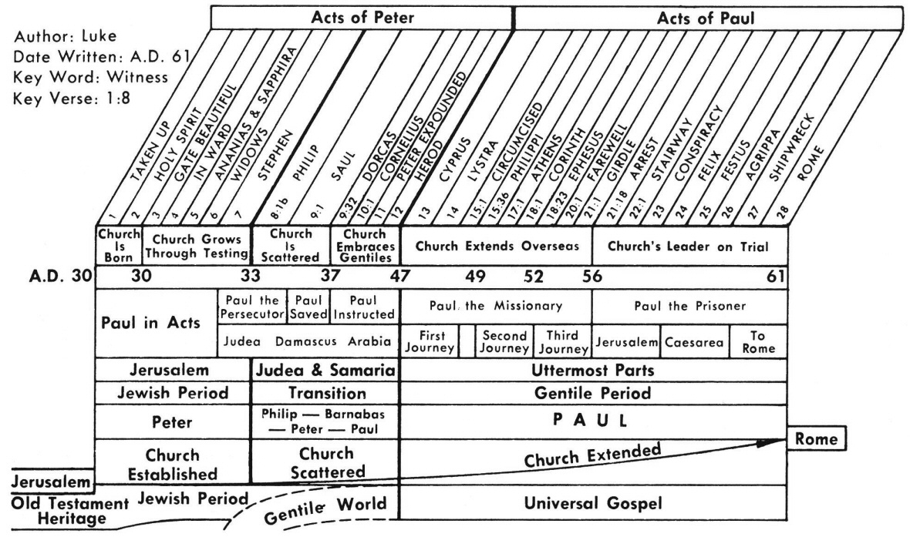

Slide 2
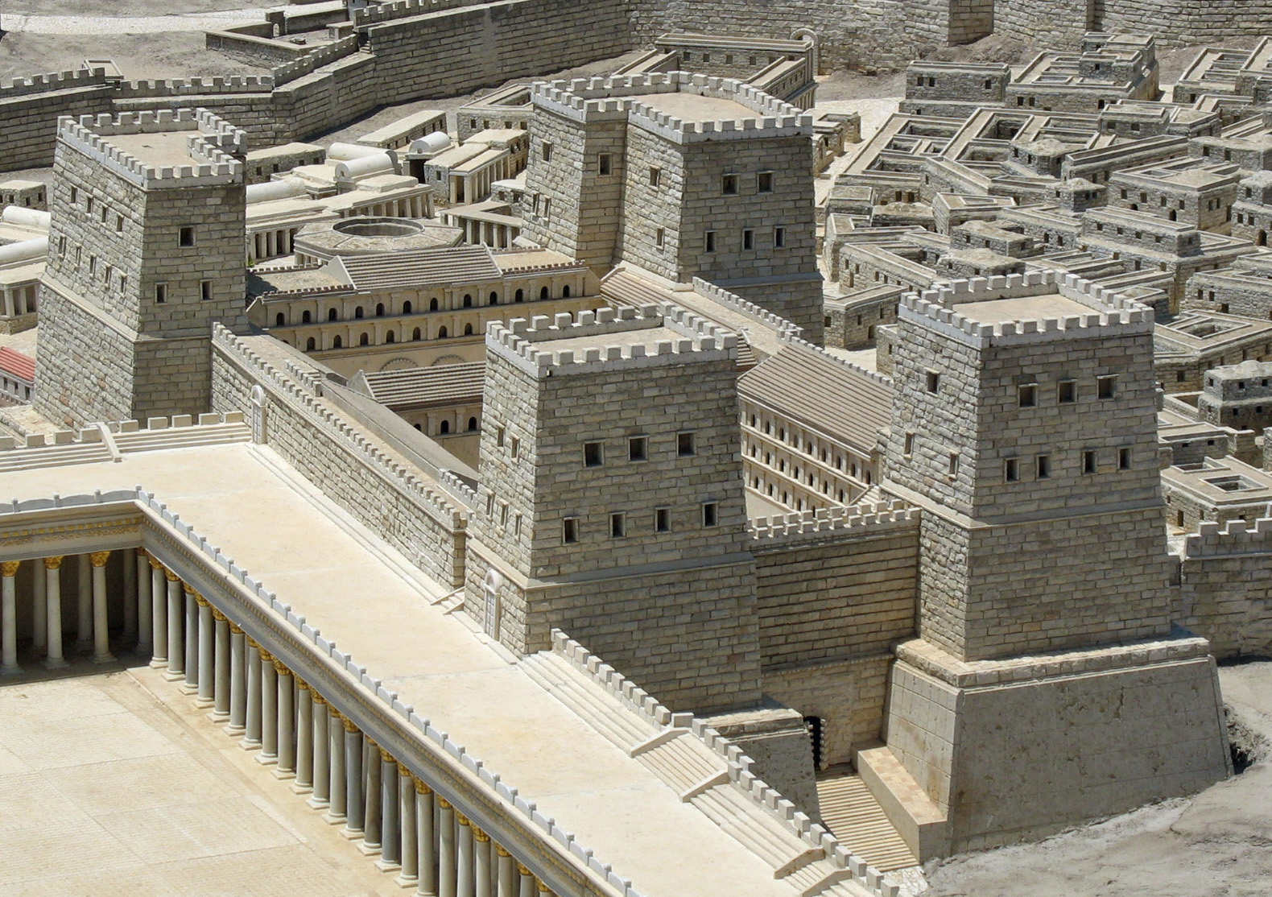
The Antonia Fortress was built by Herod the Great (r. 37–4 BC),
the client king of Judaea,
who named it after his then-patron,
the Roman politician and general Mark Antony.

Slide 3
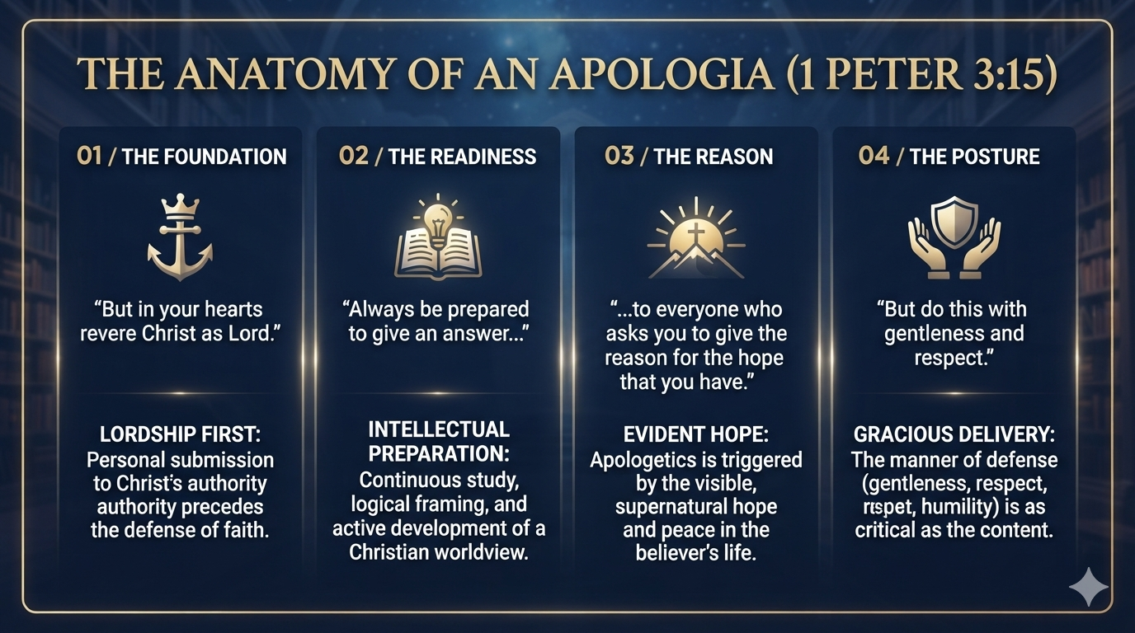

Slide 4
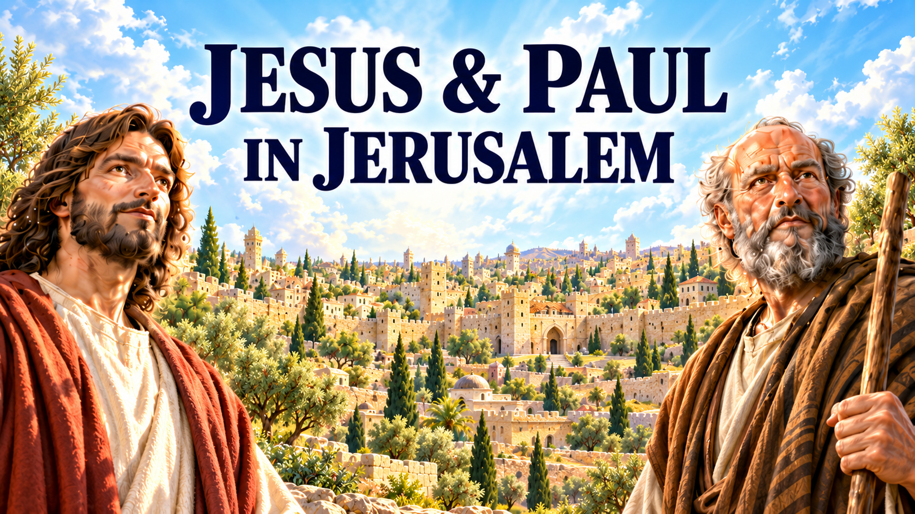
Notes:
Acts 22: Paul’s Testimony in Jerusalem. Analysis, outline, and discussion.

Slide 5
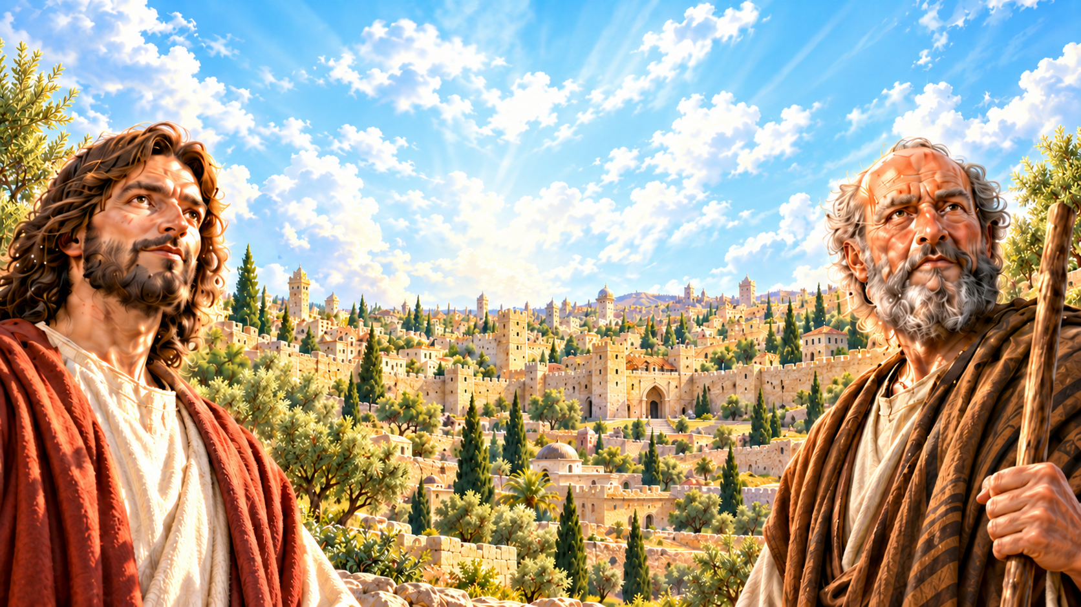
The main idea
Acts 22
Jesus transforms Paul from a persecutor of Christians into a witness sent to the Gentiles.
His audience listens until he mentions that mission.
Roman citizenship protects him from an unlawful flogging.
02
Notes:
Based on the Acts 22 analysis and outline supplied in this conversation. Scripture summaries are paraphrases. Acts 22

Slide 6
The chapter at a glance
Acts 22
Movement | Paul’s experience | Central lesson
Before Jesus vv. 1–5 | Zealous persecutor | Zeal needs truth
Encounter with Jesus vv. 6–11 | Confronted and humbled | Recognize and obey Jesus
Calling from Jesus vv. 12–16 | Restored and commissioned | Grace leads to witness
Sent by Jesus vv. 17–21 | Directed toward Gentiles | God’s mission crosses boundaries
Opposition and protection vv. 22–30 | Rejected but legally protected | Witness requires courage and wisdom
19
Notes:
Based on the Acts 22 analysis and outline supplied in this conversation. Scripture summaries are paraphrases. Acts 22

Slide 7
The setting in Jerusalem
Acts 21:27–40
A crowd attacks Paul at the temple.
Roman soldiers intervene.
Paul receives permission to address the people.
03
Notes:
Based on the Acts 22 analysis and outline supplied in this conversation. Scripture summaries are paraphrases. Acts 21:27–40

Slide 8
1. Paul connects with his audience
Acts 22:1–5
Paul respectfully addresses the crowd as brothers and fathers, speaking in their own language.
Born in Tarsus, he was educated in Jerusalem under Gamaliel in the ancestral law.
He was zealous for God and persecuted followers of “the Way,” arresting both men and women.
04
Notes:
Based on the Acts 22 analysis and outline supplied in this conversation. Scripture summaries are paraphrases. Acts 22:1–5

Slide 9
Common ground and religious zeal
Acts 22:1–5
Paul understands his listeners’ religious zeal because he once shared their opposition to Jesus’ followers. His testimony shows that his commitment to Jesus arose from a life-changing encounter.
TEACHING POINT
Sincerity and religious zeal do not guarantee that we understand God’s purposes correctly.
05
Notes:
Based on the Acts 22 analysis and outline supplied in this conversation. Scripture summaries are paraphrases. Acts 22:1–5

Slide 10
2. Jesus confronts Paul
Acts 22:6–11
Paul approaches Damascus to arrest believers. A brilliant light surrounds him.
Jesus identifies himself as the one Paul is persecuting.
Blinded by the encounter, Paul must be led into Damascus.
06
Notes:
Based on the Acts 22 analysis and outline supplied in this conversation. Scripture summaries are paraphrases. Acts 22:6–11

Slide 11
Paul’s turning point
Acts 22:8, 10
Who is speaking to him? (verse 8)
What should he do? (verse 10)
These questions mark a change in Paul’s understanding and direction.
07
Notes:
Based on the Acts 22 analysis and outline supplied in this conversation. Scripture summaries are paraphrases. Acts 22:8, 10

Slide 12
Authority gives way to dependence
Acts 22:6–11
The man traveling with authority to arrest others becomes dependent on others for guidance. Jesus reveals that persecuting his followers is an attack on Jesus himself.
TEACHING POINT
Following Jesus begins with recognizing who he is and submitting to his direction.
08
Notes:
Based on the Acts 22 analysis and outline supplied in this conversation. Scripture summaries are paraphrases. Acts 22:6–11

Slide 13
3. God restores and commissions Paul
Acts 22:12–16
Ananias comes to Paul. He observes the law and is respected by the local Jewish community.
Paul receives restored sight.
God calls him to know his will, see the Righteous One, Jesus, and hear his voice.
09
Notes:
Based on the Acts 22 analysis and outline supplied in this conversation. Scripture summaries are paraphrases. Acts 22:12–16

Slide 14
A commission and a response
Acts 22:14–16
Paul will tell others what he has seen and heard.
Ananias calls him to baptism and to call on Jesus’ name for cleansing from sin.
10
Notes:
Based on the Acts 22 analysis and outline supplied in this conversation. Scripture summaries are paraphrases. Acts 22:14–16

Slide 15
Grace brings a new responsibility
Acts 22:12–16
Paul describes his calling in language rooted in Israel’s faith: the God of their ancestors has acted through Jesus. Verse 16 closely connects baptism, cleansing, and calling on Jesus’ name as Paul responds to the gospel.
TEACHING POINT
God’s grace gives Paul both a new beginning and a new responsibility.
11
Notes:
Based on the Acts 22 analysis and outline supplied in this conversation. Scripture summaries are paraphrases. Acts 22:12–16

Slide 16
4. Jesus sends Paul to the Gentiles
Acts 22:17–21
Paul recounts a later experience while praying in the Jerusalem temple.
Jesus warns that the people will reject his testimony and tells him to leave.
Paul thinks his past persecution, including his approval of Stephen’s death, should make his transformation persuasive.
12
Notes:
Based on the Acts 22 analysis and outline supplied in this conversation. Scripture summaries are paraphrases. Acts 22:17–21

Slide 17
Jesus directs the mission
Acts 22:17–21
Jesus sends Paul far away to the Gentiles. Paul’s mission comes from Jesus’ authority. The temple setting challenges the accusation that Paul simply despises Jewish worship. Paul expects his history to convince people, but Jesus knows the response he will face.
TEACHING POINT
God’s assignment may differ from where we expect to be most effective.
13
Notes:
Based on the Acts 22 analysis and outline supplied in this conversation. Scripture summaries are paraphrases. Acts 22:17–21

Slide 18
5. The crowd rejects Paul’s message
Acts 22:22–23
The crowd listens until Paul mentions being sent to the Gentiles.
Then the people demand his death.
14
Notes:
Based on the Acts 22 analysis and outline supplied in this conversation. Scripture summaries are paraphrases. Acts 22:22–23

Slide 19
The challenge of prejudice
Acts 22:22–23; Acts 21:28–29
The Gentile mission triggers this crowd’s anger. The preceding accusations concerning the law and temple help explain the hostility surrounding Paul’s ministry. This reaction should not be treated as the attitude of every Jewish person.
TEACHING POINT
We must examine whether our prejudices cause us to resist the people God intends to reach.
15
Notes:
Based on the Acts 22 analysis and outline supplied in this conversation. Scripture summaries are paraphrases. Acts 22:22–23; Acts 21:28–29

Slide 20
6. Paul appeals to his citizenship
Acts 22:24–29
The Roman commander orders Paul to be interrogated by flogging.
Paul asks whether it is lawful to flog an uncondemned Roman citizen.
The soldiers withdraw. The commander becomes afraid after learning Paul’s citizenship.
16
Notes:
Based on the Acts 22 analysis and outline supplied in this conversation. Scripture summaries are paraphrases. Acts 22:24–29

Slide 21
Faithfulness and lawful protection
Acts 22:24–29
Paul uses an available legal protection. His willingness to suffer for Jesus does not require him to accept every preventable injustice.
TEACHING POINT
Faithfulness can include speaking up and using lawful protections.
17
Notes:
Based on the Acts 22 analysis and outline supplied in this conversation. Scripture summaries are paraphrases. Acts 22:24–29

Slide 22
7. Paul appears before the council
Acts 22:30
The commander arranges a hearing before the chief priests and the Jewish council to discover the actual charge against Paul.
TEACHING POINT
The chapter ends without a verdict and prepares for Paul’s defense in Acts 23.
18
Notes:
Based on the Acts 22 analysis and outline supplied in this conversation. Scripture summaries are paraphrases. Acts 22:30

Slide 23
Discussion: Paul’s testimony
Questions 1–2
1. How does Paul show respect toward people who oppose him?
2. What changes in Paul’s understanding of God and himself?
20
Notes:
Based on the Acts 22 analysis and outline supplied in this conversation. Scripture summaries are paraphrases. Questions 1–2

Slide 24
Discussion: Opposition and response
Questions 3–4
3. Why does the mention of the Gentiles provoke such a strong reaction?
4. What can Paul’s use of citizenship teach us about responding to injustice?
21
Notes:
Based on the Acts 22 analysis and outline supplied in this conversation. Scripture summaries are paraphrases. Questions 3–4

Slide 25
Discussion: Your story
Question 5
5. How would you explain your own story?
Before Christ / Encountering Christ / Following Christ
22
Notes:
Based on the Acts 22 analysis and outline supplied in this conversation. Scripture summaries are paraphrases. Question 5

