Slide 1


A Retirement Plan that Works for You
Kristina Fox
TCDRS Employer Services
Version Date: June,

Slide 2






394,000
more than
members and retirees
890
employers
8.0%
30-year return
$51B
in assets
90%
funded
As of Dec. 31, 2024

Slide 3
Set Up for Success
Created in 1967 by the Texas Legislature
Receive no funding from the State of Texas
Operating costs average 0.17% of assets
Managed independently by a nine-member board of trustees

Slide 4


Unique Features That Make TCDRS
Financially Strong
Responsible Plan Funding
Flexibility & Local Control
Savings-Based Benefits

Slide 5

How the Plan Works

Slide 6
Our Plan Design
 | Defined Benefit Plans Traditional Pension Plans |  | TCDRS |  | Defined Contribution Plans 401(k)
 | Benefit based on employee final salary |  | Benefit based on employee account balance and employer matching |  | Benefit based on employee savings and employer matching, if provided
 | Monthly benefit lasts a lifetime |  | Monthly benefit lasts a lifetime |  | Benefit may not last a lifetime
 | Employer assumes investment risk |  | Investment risk is shared |  | Employee assumes investment risk
More Employer Risk
Shared Risk
More Employee Risk

Slide 7



A Benefit for Your Employees
Employee savings earn 7% compound interest
Lifetime benefit at retirement that includes employer matching
Account options
when employees leave

Slide 8

Compound Interest Pays Off
$120,000
Cumulative Interest
$100,000
$56,990
Cumulative Employee Deposits
$80,000
$60,000
$29,301
$40,000
$48,474
$13,131
$34,461
$20,000
$22,893
$807
$4,545
$13,395
$0
$5,774
Year 5 Year 10 Year 15 Year 20 Year 25
Example only – Projected amounts based on employee deposit of $1,000 in year 1 and annual salary increases using the TCDRS graded valuation salary scale.

Slide 9
Employee Participation
All permanent employees must be enrolled in TCDRS
Only temporary employees may be excluded
Good idea to review enrollment periodically
No probationary periods for participation

Slide 10

How Employees Earn Service Time
Employees earn one month of service time for each month they make a deposit
Service time counts toward eligibility for
  Vesting
  Retirement benefits

Slide 11



Other Ways to Earn Service Time
=
Proportionate Retirement Program
City of Austin Employees’ Retirement System (COAERS) Employees Retirement System of Texas (ERS)
Judicial Retirement System of Texas (JRS) Teacher Retirement System of Texas (TRS) Texas Municipal Retirement System (TMRS)
Military or USERRA
Multiple TCDRS Accounts

Slide 12

Portability for Employees
Option 1: Keep money with TCDRS
Account continues to earn 7% compound interest
Lifetime monthly benefit with employer matching (when vested and eligible to retire)
Option 2: Rollover
Forfeit a lifetime monthly benefit and lose employer matching
Avoid paying tax penalties
Option 3: Withdraw
Forfeit a lifetime monthly benefit and lose employer matching

Slide 13

Your Plan Options: Finding the Right Fit

Slide 14
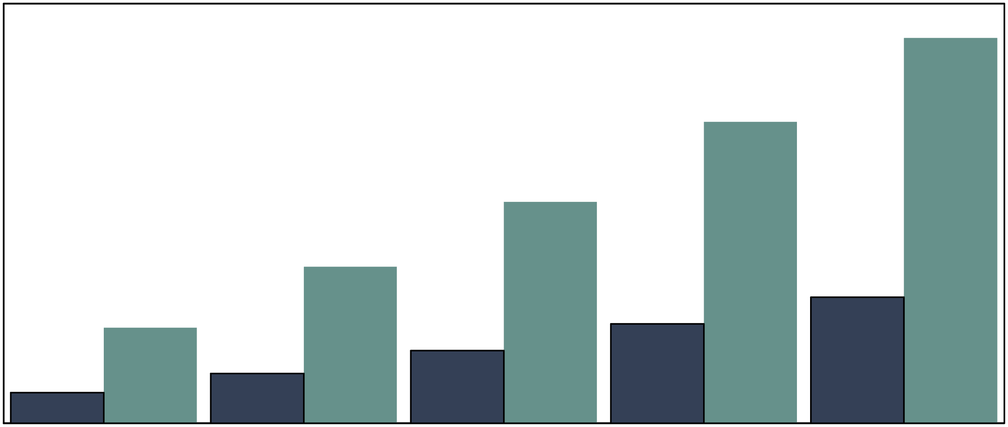
How Much Will TCDRS Benefits Provide?
4% Employee Deposit 100% Employer Match
7% Employee Deposit 250% Employer Match
100 %
Final Salary
Estimated TCDRS
replacement ratios
101%
80 %
60 %
79%
40 %
58%
41%
20 %
33%
25%
26%
8%
Hired at 55
Retired at 65
13%
19%
0 %
Hired at 50
Retired at 65
Hired at 45
Retired at 65
Hired at 40
Retired at 65
Hired at 35
Retired at 65
Notes:
The replacement ratio is the estimated monthly benefit compared to the final monthly salary earned before retirement.
Assumptions: The estimated percentages shown above are based on a new hire who will work for you until retirement. Plan provisions will remain in effect through the employee’s retirement. Current laws governing TCDRS will continue as they are. Graded salary scales give bigger raises early in careers, with smaller raises later in careers. Based on Single Life benefit.

Slide 15
Basic Plan Options [Non-SocSec]
Employee deposit rate: 5%, 6% or 7%
Employer matching: $1.10 per dollar to $2.50 per dollar*
Retirement eligibility
  At age 60 with 5, 8 or 10 years of service (vesting)
  Rule of 75 or Rule of 80 (must be vested)
  20 or 30 years of service at any age
*To meet IRS Safe Harbor rule, employer who elects a 5% employee deposit rate must have a minimum employer match of $1.90; 6% employee deposit rate must have a minimum employer match of $1.45; 7% employee deposit rate must have a minimum employer match of $1.10

Slide 16
Additional Plan Options
Monetary Prior Service
Group Term Life
Partial Lump-Sum Payment at Retirement

Slide 17

Funding Your Plan

Slide 18


74¢
Investment Earnings
15¢
Employer Contributions
Investment Income Funds Benefits
11¢
Employee Deposits
Estimated

Slide 19
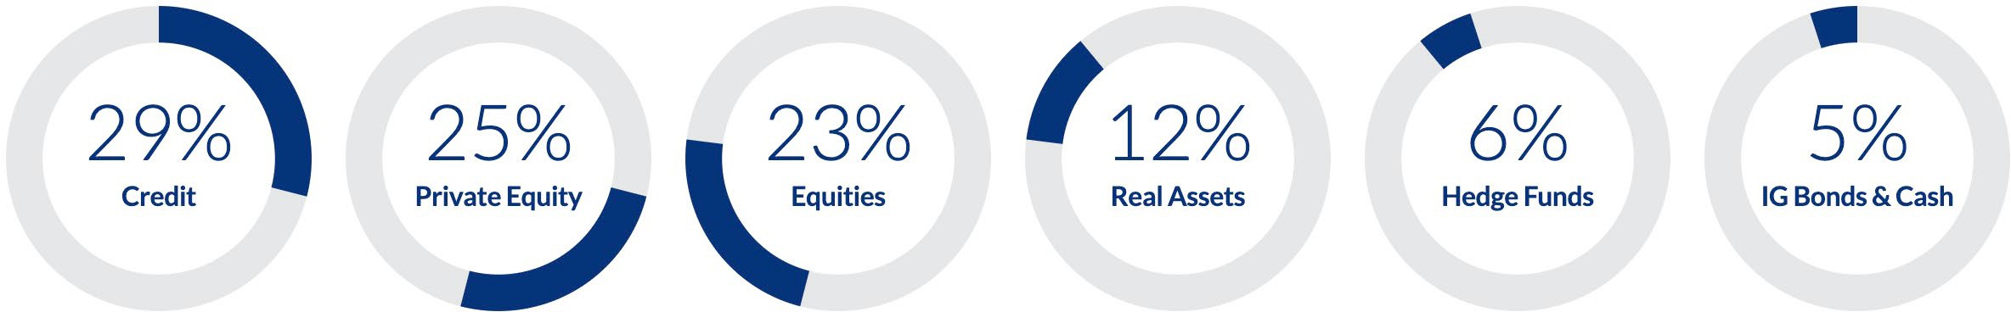
Diversified Portfolio Reduces Risk
Target Asset Allocation
As of March 2025

Slide 20
Investment Returns
(Net of All Fees)
As of Dec. 31, 2024
Annualized Returns | 5 Year | 10 Year | 20 Year | 30 Year
Total Fund | 9.2% | 8.1% | 7.2% | 8.0%
Benchmark | 7.8% | 7.0% | 6.3% | 7.0%

Slide 21




















Investment Returns 2005–2024
(Net of All Fees)
Expected Risk & Return
28.0%
26.5%
23.0%
22.0%
18.0%
16.6%
16.4%
14.7%
13.0%
13.9%
12.6%
12.6%
11.1%
10.3%
8.0%
10.5%
7.2%
7.9%
6.8%
7.5%
3.0%
-2.0%
-1.2%
-0.7%
-1.9%
-7.0%
-5.8%
-12.0%
-17.0%
-22.0%
-27.0%
-32.0%
-29.0%
As of Dec. 31, 2024

Slide 22
Employer Contributions
Independent actuaries perform an annual valuation on your retirement plan
Determines your required employer contribution rate and measures your funded status
Your rate can change each year based on changes in your workforce and investment earnings

Slide 23
Controlling Plan Costs
Contribute at a higher elected rate or make an additional contribution
Allows you to prefund benefit increases
Provides a cushion against possible future negative plan experience, such as investment losses
Adjust your benefits

Slide 24

We Are Here for You

Slide 25




Committed to Service
Member Services
Employer Services Resources:
Website
Educational videos
Free webinars and training
Annual Conference

Slide 26
Take the next step, join TCDRS!
Eligible to Participate
Workforce Analysis
Benefit and Cost Review Decision to Join
Select plan and sign plan/participation agreements
Begin participation 1st of any month
First payment due by 15th of following month

Slide 27
TCDRS Plan Administration
For initial plan setup you will be responsible for:
− Adding employer contacts
− Enrolling employees
− Terminating employees
− Submitting payroll
− You are responsible for working with your payroll provider/bookkeeper/accountant/auditor to make sure your payroll system is set up properly for TCDRS employee deductions
− TCDRS provides basic guidance
− Encouraging employees to register for their TCDRS online account
TCDRS will provide you with step-by-step training to help you administer your TCDRS retirement plan

Slide 28


ANY
Q U E STI O N S?

