Slide 1

Grant Applicant’s
Workshop
January 8th, 2026

Slide 2
Monies Available to Grant in 2026
$112,000 Total
3 Impact Grants- $10,000 each
3 Acorn Grants- $10,000 each
2 Inspiration Grants- $26,000 each

Slide 3
Inspiration Grant
Inspiration Grants do not have a specific focus, inspiring nonprofits to identify and address our community’s most pressing needs.
No Inspiration Grant will be awarded for more than 50% of $52,000 = $26,000
A minimum of 2 grants will be awarded in this category.
Notes:
May apply two times, two years in a row or skip a year and apply again?

Slide 4
Impact and Acorn Grants
6 total- $10,000 each
Acorn Grant- Open to new community organizations and programs who have never been FUNDED by WFED. If you have a fiscal agency sponsoring you and they have received funding from the WFED you can not apply for an Acorn grant. 3 grants available.
Impact Grant- Formerly Community Benefit and Human Services categories, will be awarded to nonprofit organizations offering direct impacts on the western slope of El Dorado County. This includes but is not limited to human services, such as those pertaining to mental or physical health, education, youth development, or services to children, families or seniors, arts, community beautification, animal welfare, or community development. 3 grants available.
Notes:
COVID grants do not count

Slide 5
Can an organization apply for more than one grant type?
No, an organization must choose to apply for an Inspiration, Acorn or Impact Grant.
Each organization must make a determination which category to apply for.
Notes:
Plan to apply for a grant that fits your project and that fits within the scope of the budget outlined. Ie- 8,000 or less apply for an Impact or Acorn

Slide 6
Who is eligible to apply?
Any nonprofit, or sponsoring agency, serving the residents and communities on the Western Slope of El Dorado County.
Notes:
Non profits may partner but the program must take place on the Western Slope of EDC.

Slide 7
Nonprofit organizations are welcome to apply for grants so long as:
The non-profit is in good standing with the IRS, SOS, and DOJ (AG)
1) IRS database shows IRS filings for the past year(s).
2) CA Secretary of State website will show “active and up-to-date” when in compliance.
3) CA Department of Justice website to verify registration is current.

Slide 8
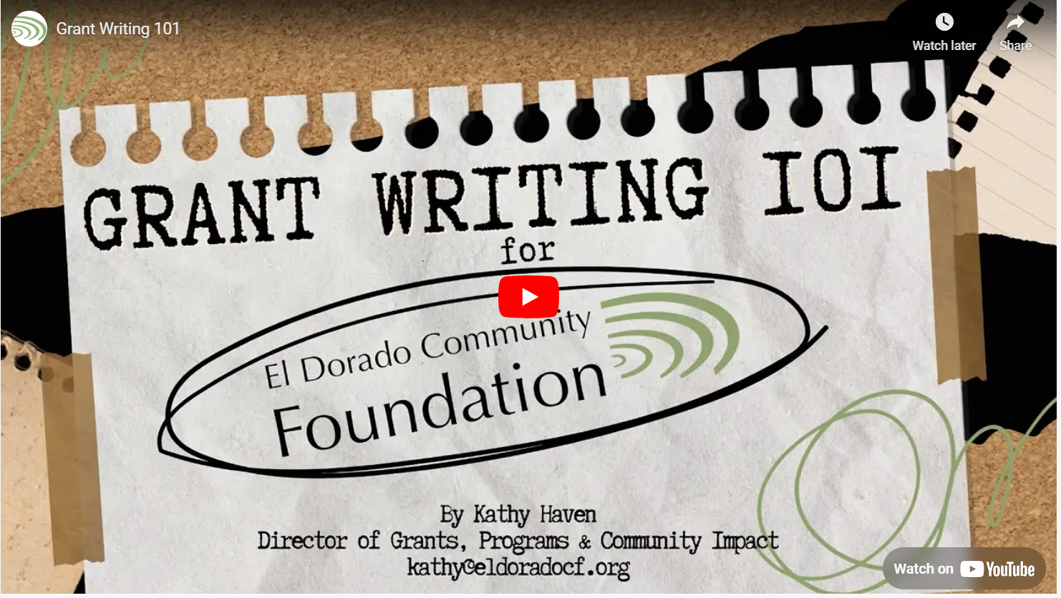
Be Sure to look at this Grant Writing 101 video on YouTube created by the El Dorado Community Foundation. It will provide you with a lot of valuable information.

Slide 9

The *RFP Process
*Request for Proposal

Slide 10
RFPs released January 5th, 2026.
Notification emailed to nonprofits on the Western Slope of EDC by Women’s Fund El Dorado
Grant Applicant’s Workshop is held.
  Application is reviewed and nonprofits are able to ask questions and review process.
Notes:
Be sure to update us with new email addresses so we get the RFPs to you in a timely manner. We get a lot of mailer daemons!

Slide 11
APPLICATIONS ARE DUE!!!
All grant applications are due to the Women’s Fund El Dorado no later than 11:59 p.m. on January 29, 2026 via the online system. Paper applications are not accepted
Late applications will not be accepted.
Applications may not be accessed after the deadline.
All fiscal sponsorship letters & nonprofit verification documentation are due on this date or the application will not be accepted.

Slide 12
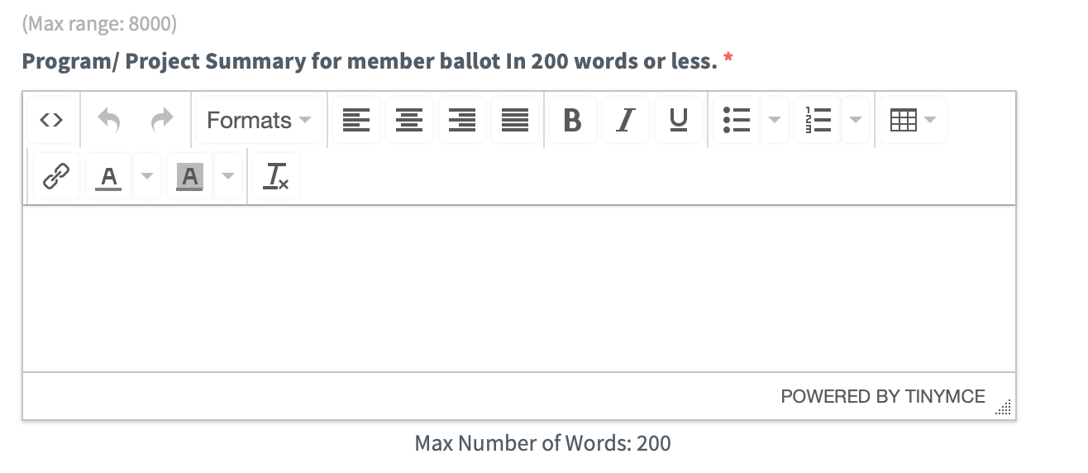
Tips and FAQs
The Program/Project Summary and Title is all the members will see to inform their vote.
  Inspiration Grants: 300 words
  Impact/ Acorn Grants: 300 words
Notes:
Editing and spelling can’t be looked at too much. Only the grant’s committee sees the entire ballot. Be specific and informative in this section. Read and reread for all of your pertinent information to be seen.

Slide 13
Budget Information
Upload your organizational budget
Can be in Excel or PDF format
Add the dollar amounts in red, in a separate column to show where WFED funding would be used
Budget narrative question should include the detailed explanations of how the costs and expenses of your project were formulated.
Notes:
Emogene

Slide 14
A one year “sit out” period applies for any nonprofit that has been funded two years in a row.
When writing your application, try to be as specific as possible, don’t assume the readers “know what you mean.”
Share experiences that illustrate your ability to be successful in your project. Use your own history and data as much as possible.
Be specific in your outcomes and goals, even if the questions seem repetitive.
If your application is chosen, you need to make sure to contact WFED if anything changes during the course of the grant.
Notes:
EX: If there is another pandemic? A funding loss from another source? Do you have plans for sustainability?

Slide 15
Write your proposal to best describe your project, not what you think the members want to hear.
If your application is chosen, you need to make sure to contact WFED if anything changes during the course of the grant.
Allow yourself time to have your application read by other people and yourself!
Don’t rush it and use spell check.
Notes:
This is just a reinforcement page of things already mentioned. They are important points

Slide 16
THE READING BEGINS !!
Grants Committee members receive the online applications February 5, 2026.
Proposals are carefully read and scored individually by the Grants Committee.
A rubric, or scoring guide based on a point system, is used to score each proposal.
Grants Committee meets March 9, 2026 to compile scores and set the ballot. Nonprofits are notified the week of March 13th if they were chosen for the ballot.
Notes:
When you hover over the question blanks, more in depth questions appear that we use to score each section. This includes a point value for each question.

Slide 17
Ballot Showcase: April 2nd, 2026.
  ALL finalists will have the opportunity to share their project with members.
  Have other people able to speak to the members about the project. Think about involving some of the people you serve to speak to members.
  Visual aids are helpful.
  Event format will be determined closer to the date and finalists will be given more details.
Inspiration Grants: A max of 5 will be moved forward to attend the showcase and the members will vote for 2.
Acorn and Impact Grants: 6 from each category will be moved forward to attend the showcase and members will vote for 3 in each category.
Notes:
Probably virtual event. Pre-taped for later viewing - information will be shared upon grant acceptance.

Slide 18
Voting Begins!
Ballots are sent to our members via email, immediately following the Ballot Showcase.
Member voting closes at midnight on April 17th, 2026

Slide 19
BALLOT RESULTS
Reviewed by the WFED Cabinet.
Reviewed by the El Dorado Community Foundation Board.
Grant Recipients will be notified via email the week of April 23, 2026.

Slide 20
Let’s Celebrate!
Grants Gala: May 14, 2026
Notes:
If your nonprofit is chosen for a grant award, an invitation will be extended for you to attend our Grants Gala and receive your award.

Slide 21
What’s Next?
Steps for after the
Grants are awarded.

Slide 22
Receiving Funds
All grant recipients will receive funds and sign agreements at the Funding Meeting.
Meeting will be scheduled May 29, 2026.
Site Visit Committee then takes over as the grant’s liaison.

Slide 23
Reporting Requirements
All grant recipients will submit interim and final grant reports that include a budget.
Site Visit Committee will be responsible for all follow up activities from funding forward.
Notes:
Emogene

Slide 24
Site Visit Committee
In the summer, the Site Visit Committee will contact the past year’s Inspiration, Acorn and Impact Grant recipients.
Each grant recipient will have one main point of contact on the Site Visit Committee. This will be the first person to contact regarding any questions or issues which arise, and who will arrange for a site visit based on the project timeline.
Reviews the progress made towards goals and outcomes as defined in the nonprofit’s award proposal
Experiences firsthand the programs or projects in action
Notes:
Emogene

Slide 25
For any questions please contact us at:
grants@womensfundeldorado.org

Slide 26
The Women’s Fund El Dorado harnesses the power of collective giving to support community philanthropy. By pooling our funds, we enhance the quality of life on the western slope of El Dorado County and cultivate future philanthropists.
So…

Slide 27
Join us!
All nonprofit members are invited to join WFED and help make a difference in our county
(yes, you can vote for yourself)
Head to:
womensfundeldorado.org/joinus
to sign up
Thank you for attending

