Slide 1
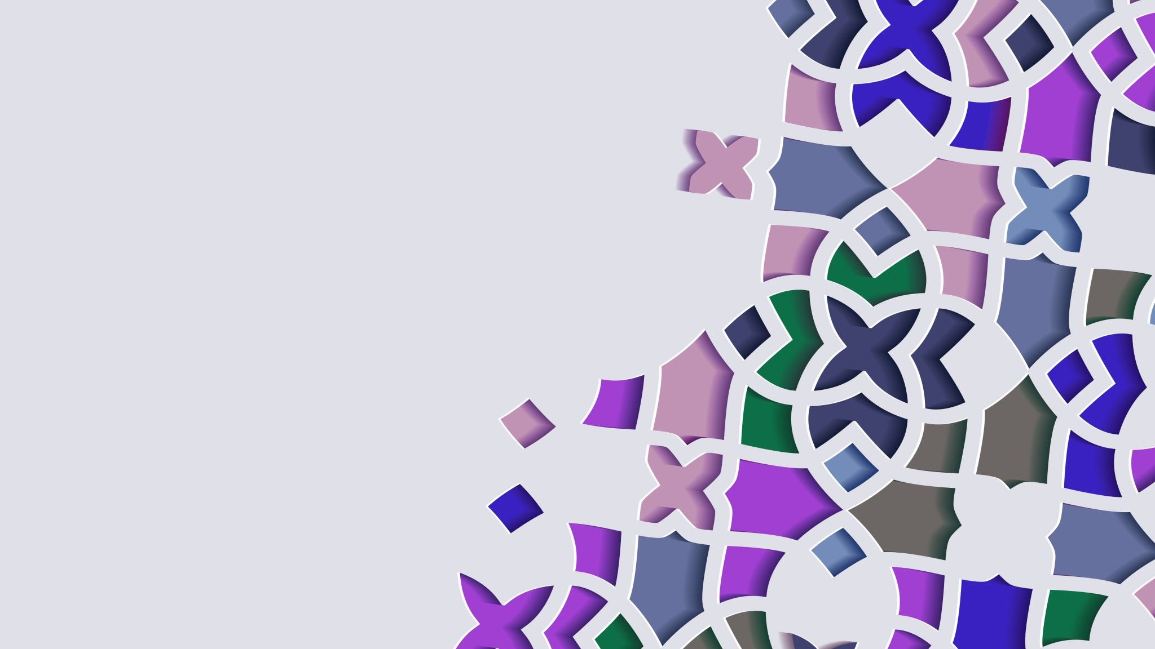
Helping Students Access Lesson Plans

Slide 2
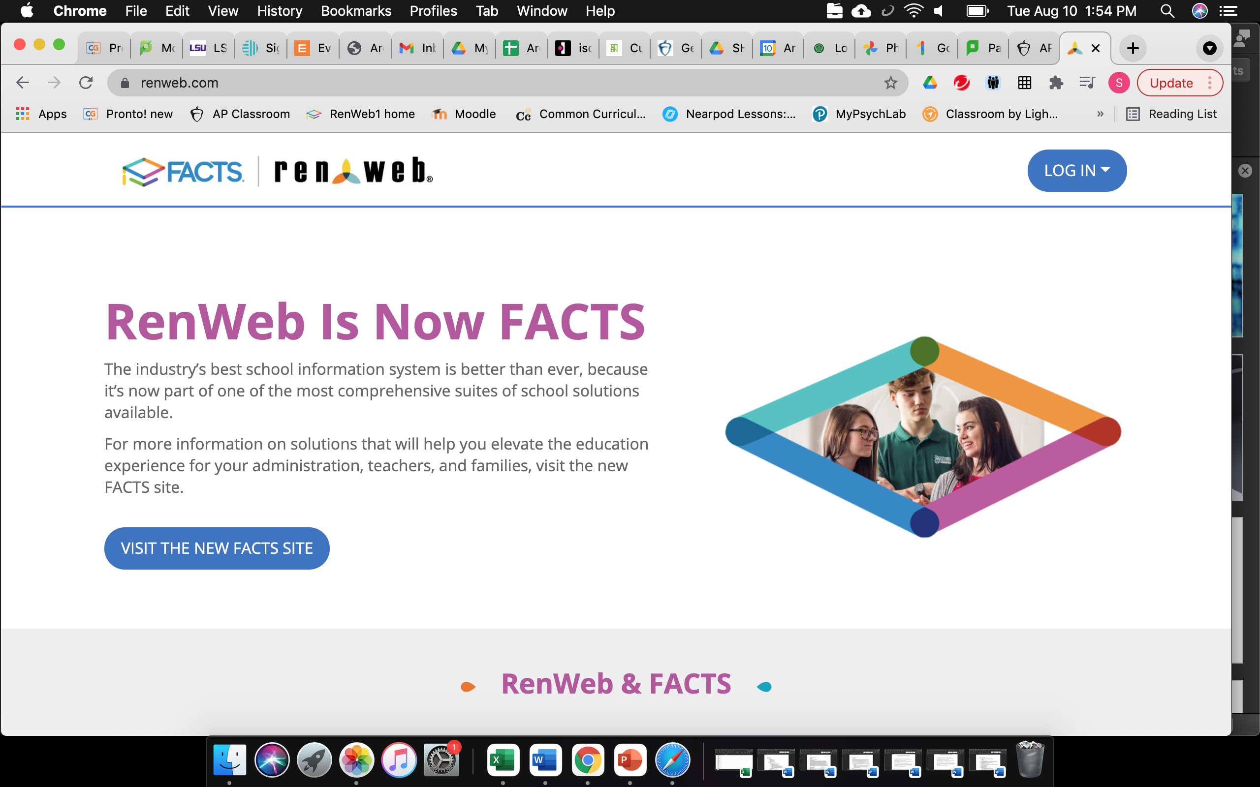
Enter RenWeb like normal

Slide 3
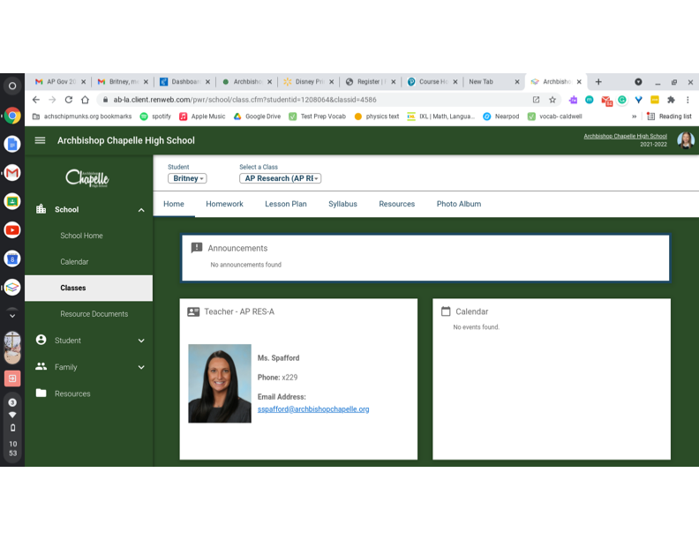
Select specific class

Slide 4
Click on Resources

Slide 5
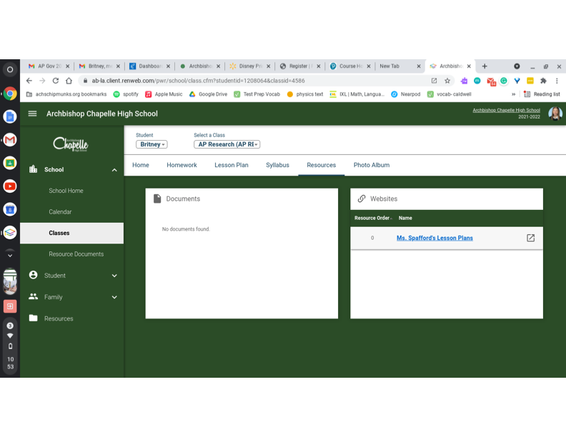
Click on Lesson Plans

Slide 6
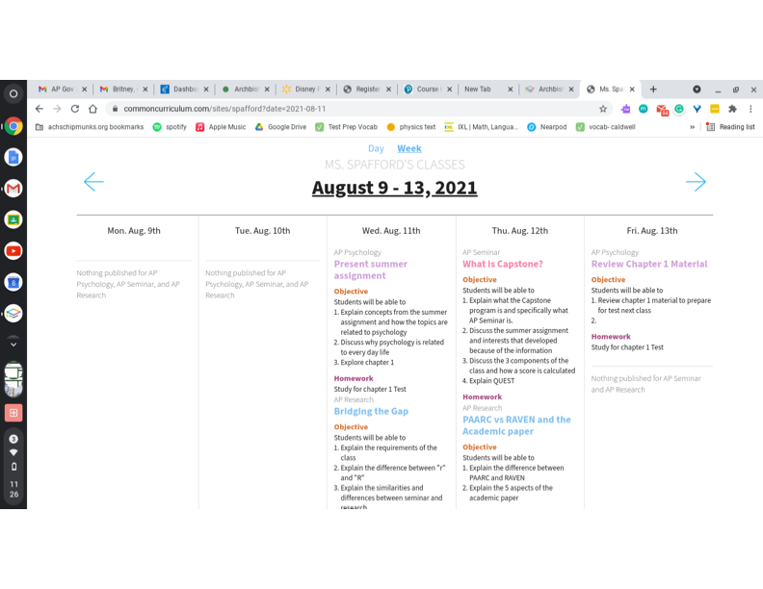
Student View of Lesson Plans

