Slide 1

Accessing Lesson Plans

Slide 2
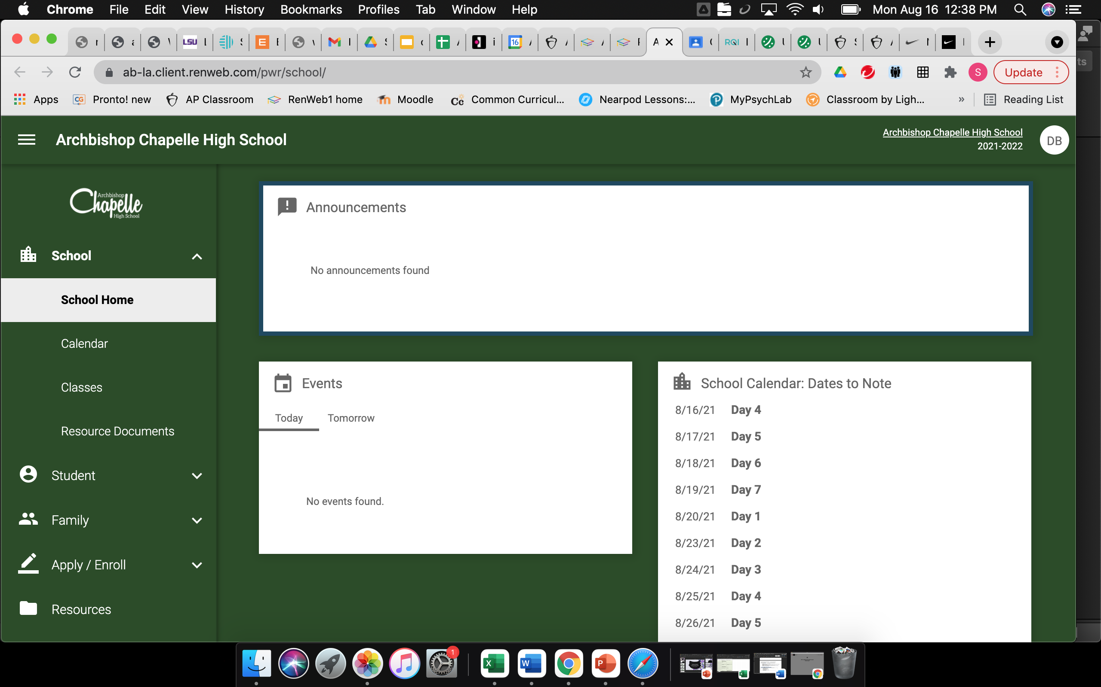
Go to Parents Web

Slide 3
Click on Classes

Slide 4
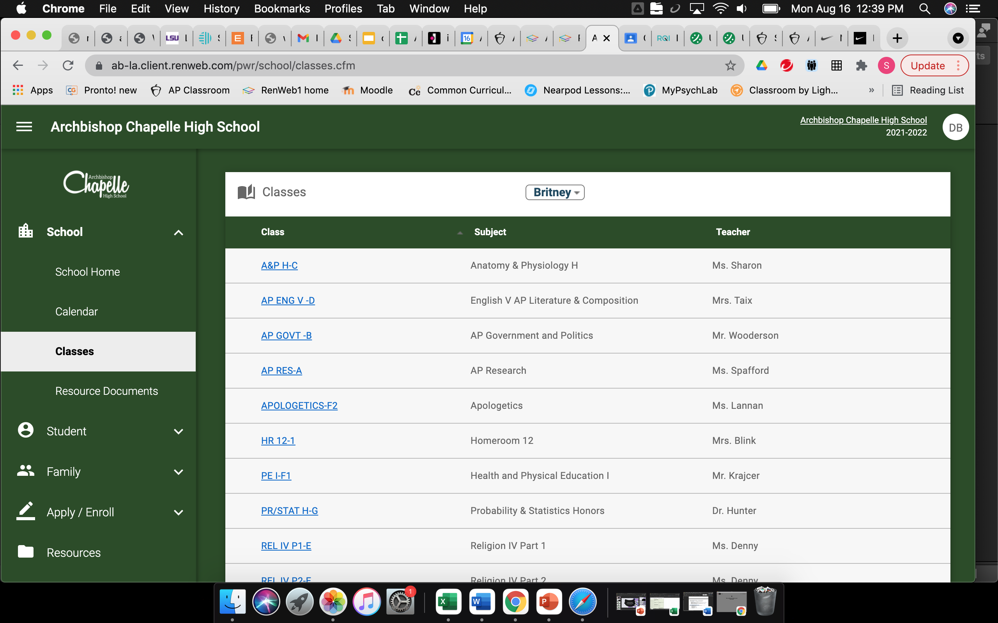
Click on Specific Class

Slide 5
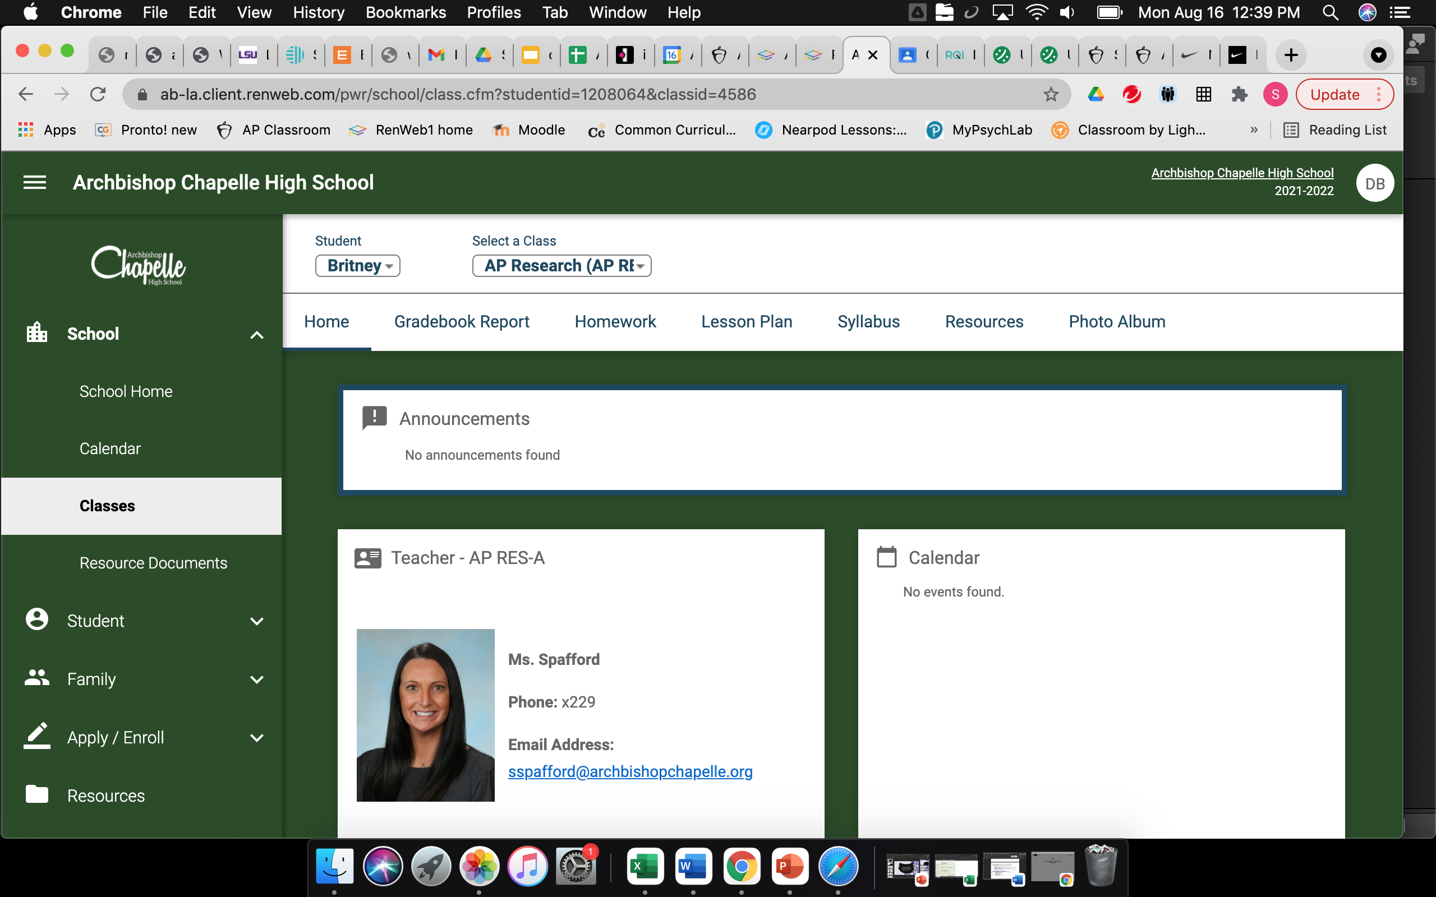
Click on Resources

Slide 6
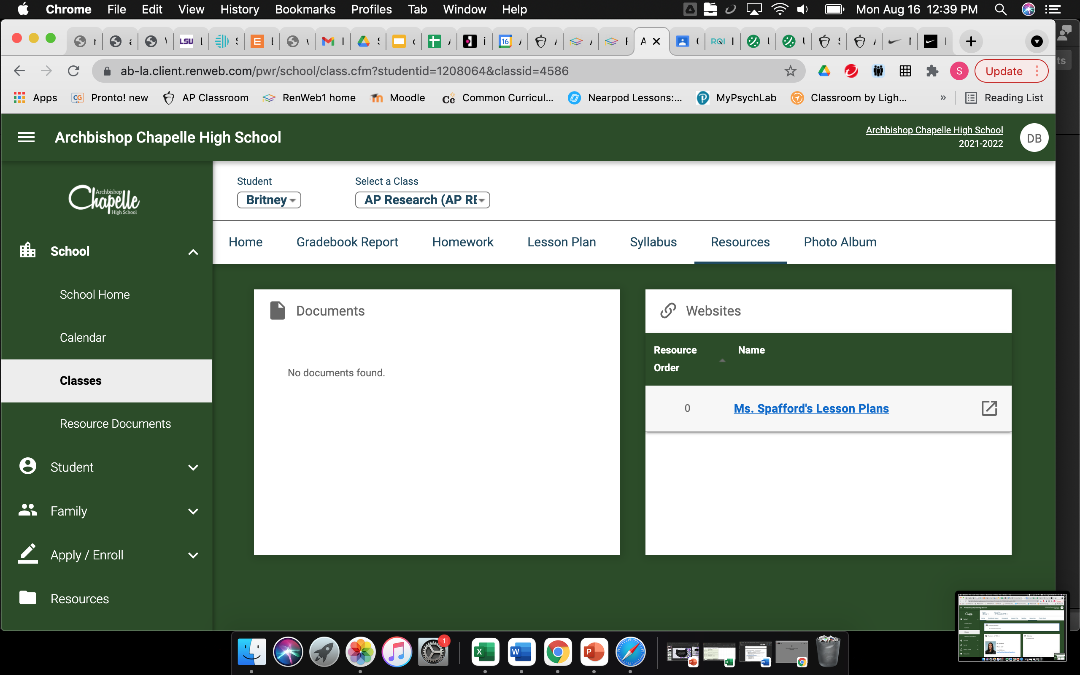
Click on Lesson Plans

Slide 7
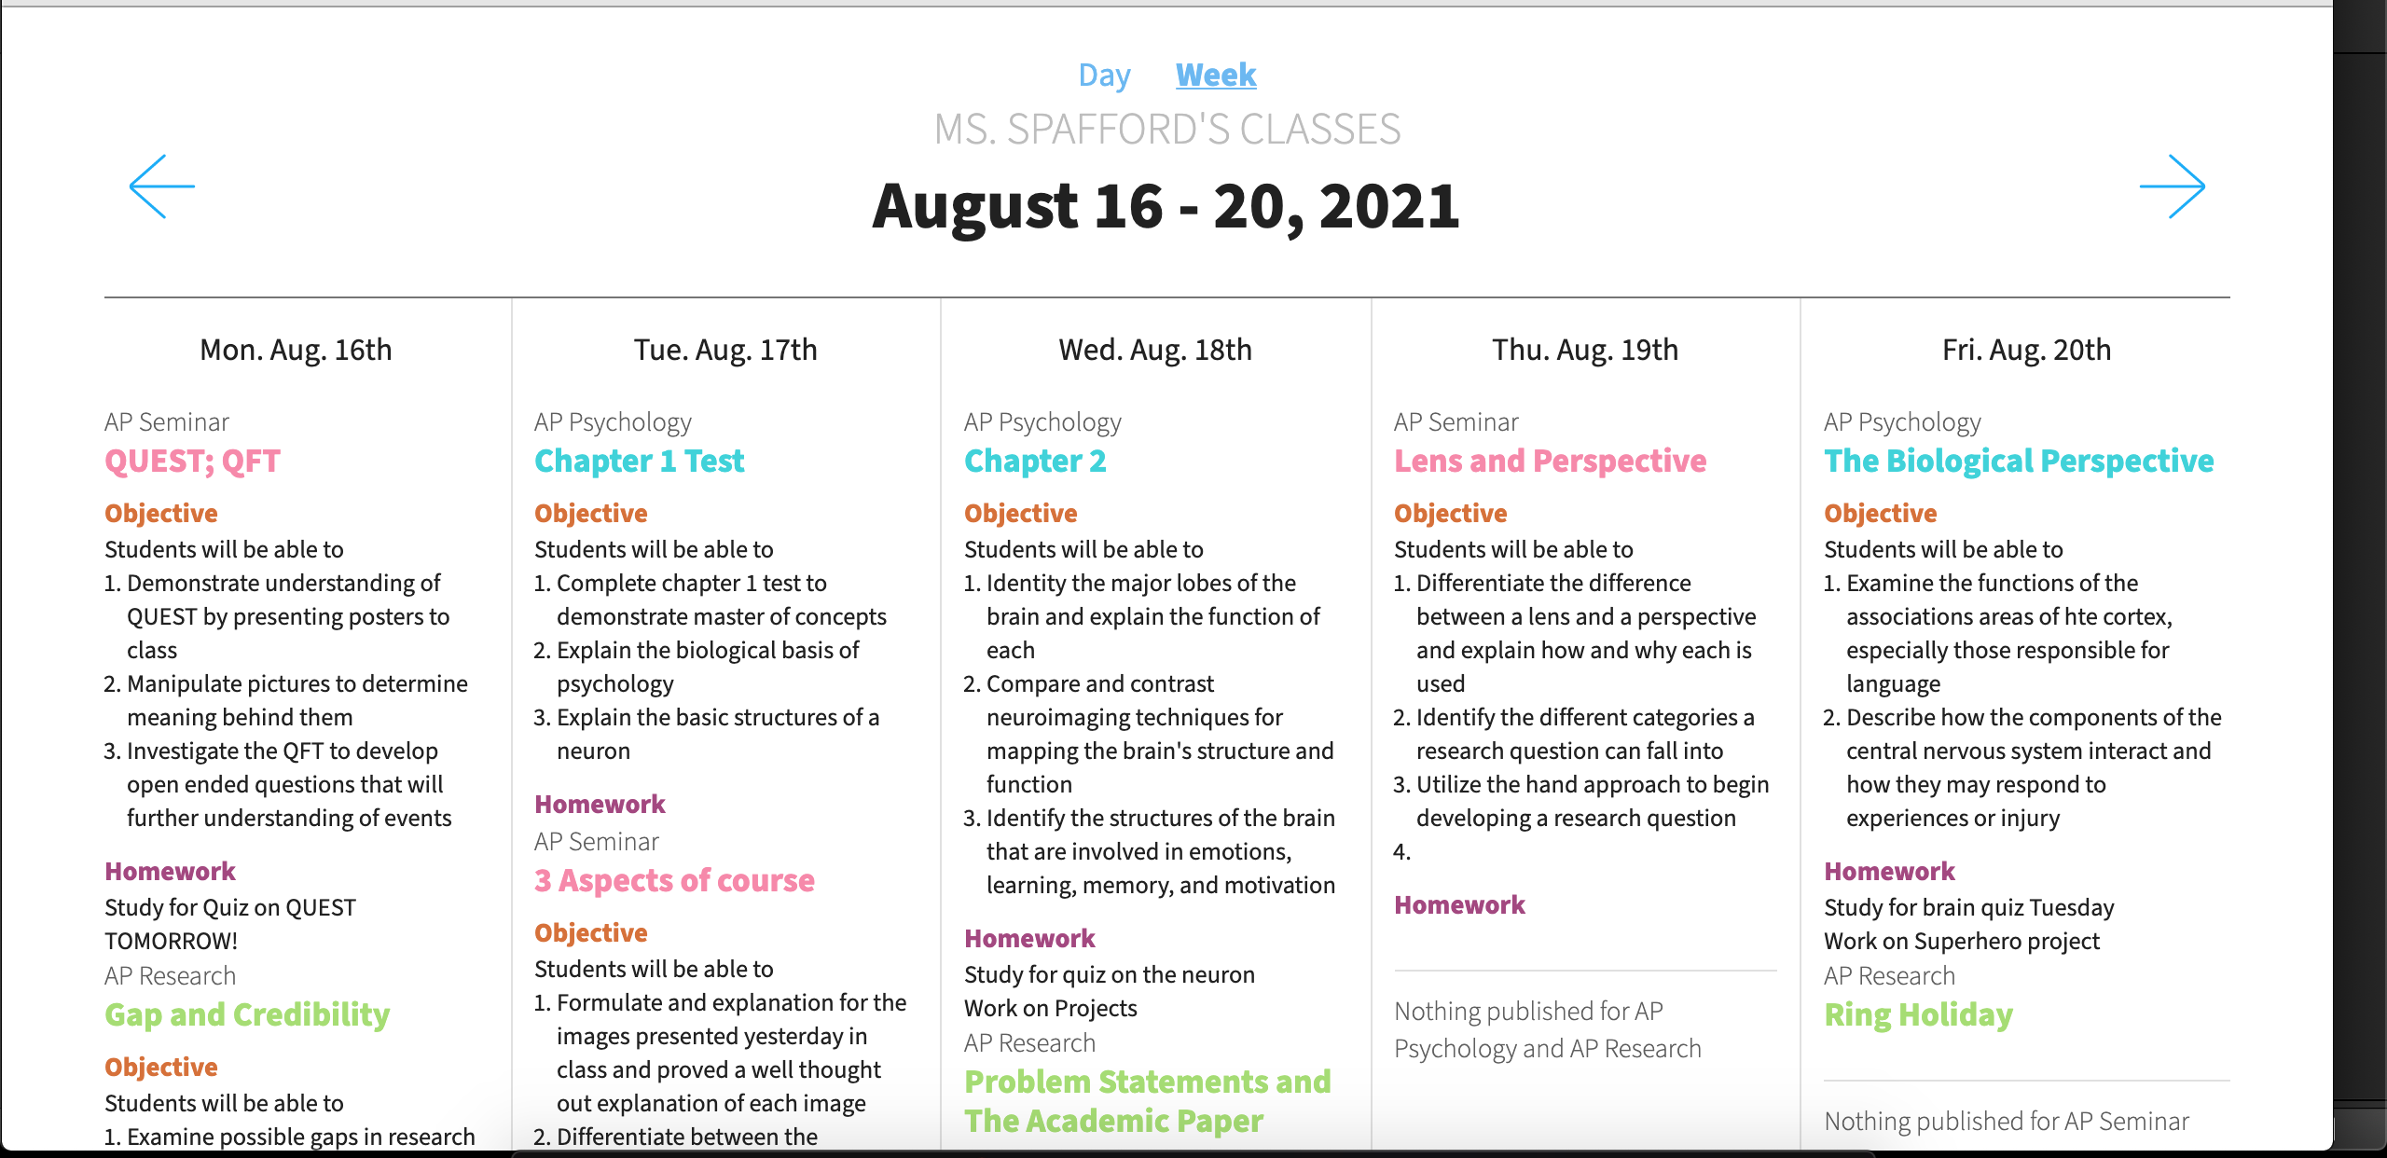
Lesson Plan View

