Slide 1






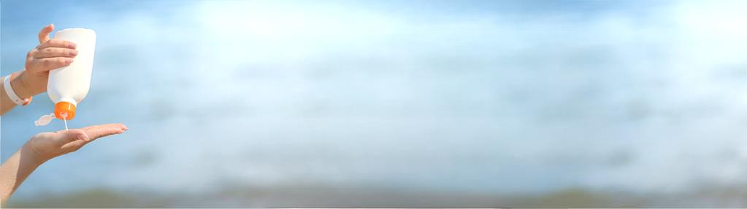
The Sun Bus
Skin Savvy Monthly
August 2025
Edition Sponsored By
Your monthly guide to sun safety, expert skin health insights, and the latest updates from The Sun Bus's community outreach initiatives.
Occupations at High Risk for UV Skin Damage
By Bianca Patel, MS3
Outdoor occupations: agriculture, construction, maritime industries^{1,2}
Military Personnel^{1,2}
Postal Workers²
Knowing your risk is important in taking the proper precautions for UV protection. If you or a loved one has a high-risk occupation, prioritize sun protection and consult a dermatologist for regular skin checks.
SPF: The Super Power Formula for Kids!
By Keana Khodadad, Predoctoral Research Fellow
Did you know that sunburns during childhood significantly increase the risk of skin cancer later in life?³ Kids should apply SPF 30+ sunscreen, wear a hat and sunglasses, and seek shade to protect their skin during outdoor play so the fun never ends.³ Sun-safe kids are happy kids, all summer long!
Has Your Sunscreen Gone Bad? Four Signs to Watch
By Lola Oladinni, MS4
1. It’s past the expiration date. Sunscreen degrades and loses potency over time.⁴
2. The texture has changed. Separation or clumping = time to toss.⁵
3. It smells off. A sour or rancid odor means it’s unstable.⁵
4. It’s been stored in heat. Storage in hot, humid places reduces SPF effectiveness.⁵
Abbreviations: MS= Medical Student, UV= Ultraviolet, SPF= Sun Protective Factor
References: 1. Occupational Exposures and Skin Cancer: A Brief Report. Skin Res Technol, 2024. 2. Solar ultraviolet radiation exposure in workers with outdoor occupations: a systematic review and call to action. Int J Dermatol. 2024. 3. Skin Pearls For Kids: Evaluation of a Youth Skin Health Education Program. 4. U.S. Food and Drug Administration. Sunscreen: How to help protect your skin from the sun, 2025. 5. American Academy of Dermatology Association. Sunscreen FAQs, 2025.
Editor: Aliya Rogers, MD | Graphics: Aaron Szymonik, MS1 | Director: Darren Lynn, MD | www.thesunbus.org
Pg 1

Slide 2
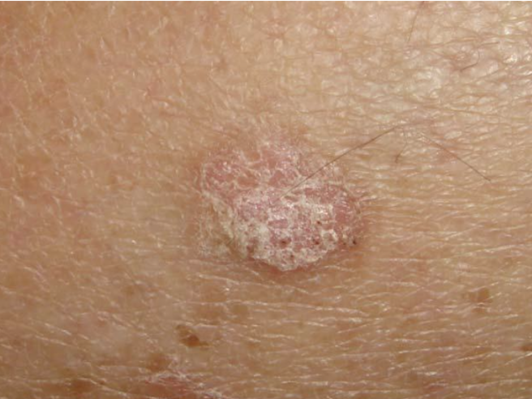
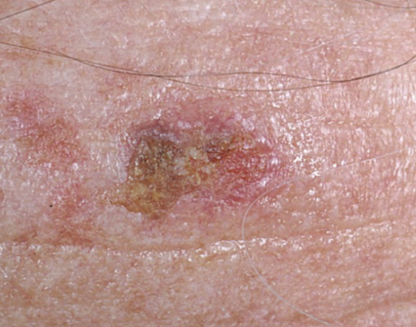
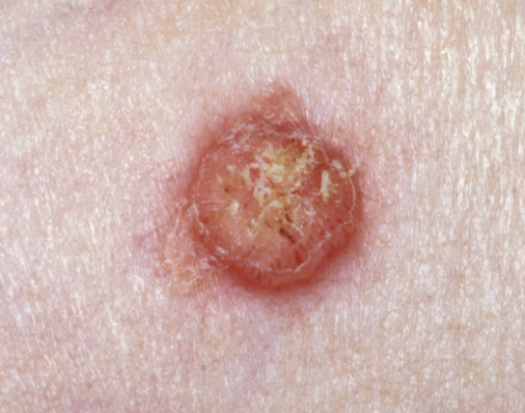

Actinic Keratosis: A Precancerous Lesion
Benazir Merchant, MS2
Actinic keratoses are precancerous skin lesions that typically appear as rough, dry, scaly patches or bumps in sun-exposed areas of the body.⁶
They are caused by prolonged sun exposure and are more common with age or a history of skin cancer. ⁶
Without treatment, they may progress to a type of skin cancer called squamous cell carcinoma.⁶
Source: The Skin Doctor
What You Need to Know About Squamous Cell Carcinoma
By Kiley Hassevoort, MS3
Squamous cell carcinoma (SCC), the second most common skin cancer, often affects fair-skinned individuals with sun or tanning bed exposure.^{7.8}
Source: VisualDx
It can look like a red, scaly patch or bump, sore, wart-like growth, or horn, and can be tender.⁸
​
SCC is commonly found on sun-exposed areas like the face, hands, or lips.​
Source: VisualDx
Stay One Step Ahead: Your Skin Self-Check Survival Guide
By Jonique Depina, OMS3
Use a full-length mirror to check the front, back, and sides of your body for any unusual spots including the head, neck, torso, arms, and legs.⁹
Don’t forget to check nails, spaces between toes, palms, and soles of feet.⁹
Use a handheld mirror or a partner to check hard-to-see areas like the scalp, back of the neck, back, and buttocks.⁹
Repeat monthly and track any changes!⁹
Abbreviations: MS= Medical Student, OMS= Osteopathic medical student, SCC= Squamous Cell Carcinoma
References. 6. Reinehr CPH, Bakos RM. Actinic keratoses: review of clinical, dermoscopic, and therapeutic aspects. An Bras Dermatol. 2019. 7. Linares MA, Zakaria A, Nizran P. Skin Cancer. Prim Care. 2015. 8.. Skin cancer types: Squamous cell carcinoma overview. 2023. 9. “Find skin cancer: How to perform a skin self-exam”. American Academy of Dermatology. 2023.
Editor: Aliya Rogers, MD
Graphics: Edwine Coulanges, MS4
Director: Darren Lynn, MD
www.thesunbus.org
Pg 2

