Slide 1
SUPPORTING OUR 4TH CENTURY
A Foundation for our Future Together
Celebrating 300 Years (1726-2026) | Envisioning the Next 100

Slide 2

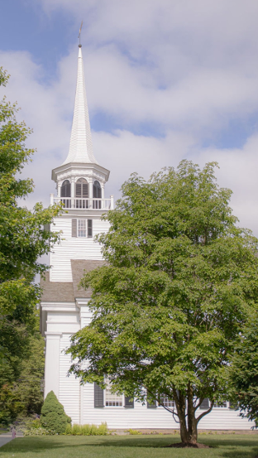
Our History
The sanctuary was built in 1790. The 3rd Century Fund was generously established by our congregation in 1990 to care for our building. We stand on their shoulders – and now take our turn in passing on the legacy for the next generation.
In the congregation’s fourth century, we honor those who came before and those who will come after.
300 Years of Faith
100 Years Ahead

Slide 3
Our Vision
What do you want our church to look like for your children, grandchildren, and our community?
We envision a place that meets not only the physical demands of family and community, but most importantly their spiritual needs — even if they don't realize it yet.
300 Years of Faith
100 Years Ahead

Slide 4
Mission: The 4th Century Fund
2 Corinthians 5:20
We are ambassadors for Christ, since God is making his appeal through us, implore you on behalf of Christ, be reconciled to God.
This is not to fund operations and short-term fixes.
It’s to accomplish WCC’s mission!
WCC’s mission is to help people find a community of
safety, peace and spiritual worship!
300 Years of Faith
100 Years Ahead

Slide 5

What will help our Mission
There are at least three critical needs for us to be successful with our mission
1
2
3
Long-term capital improvements
Space enhancements
Community
Outreach and
Engagement
Enhanced spaces for worship, celebrations, education, youth and community gathering
Intentionally funding our effort to grow our community through outreach, programming, and new member engagement
Setting us for long-term maintenance
300 Years of Faith
100 Years Ahead

Slide 6

Space Enhancement Priorities
Assessment Team: Pam Brown, Angela Lowy, Jerry Sprole, Carol Boehly, Giff Broderick, Fred Kaoud
Colonial Room & Library
Need larger space with better lighting and furniture
Combine rooms into versatile multi-use space
Provide calm, conducive setting for weddings, funerals and family gatherings
Create flexible space for various community uses
Youth
Transform unused choir room into a dedicated space for our future members
Other Needs:
Enhance meeting rooms with modern sound and IT systems
Reconfigure basement for efficient space utilization
Refresh flooring and furniture in offices

Slide 7
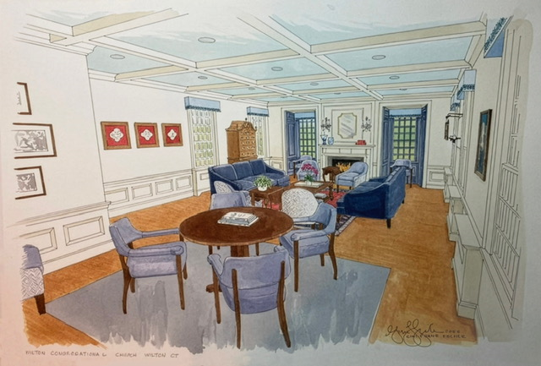

Space Enhancements
Assessment Team: Pam Brown, Angela Lowy, Jerry Sprole, Carol Boehly, Giff Broderick, Fred Kaoud

Slide 8
Community Outreach and Engagement
Key reasons
Key Goals
Focus on attracting and engaging people seeking worship community
Develop and coordinate community events
Create compelling social media presence
Support clergy and youth programming
Current staff at capacity with existing responsibilities
Opportunity to engage community in meaningful worship, education and programming
Growing need for social media presence and digital outreach
Strategy
Initial funding for 3-4 years to establish position while building sustainable membership base. Ultimate goal: position will self fund out of operating budget.

Slide 9
Financial Need for our 4th Century
TOTAL CAMPAIGN GOAL: $1Million

Slide 10
Shaping Our Future
Fulfilling our Mission
This investment is about more than buildings and staff.
It's about creating a spiritual home for generations to come.
Together, we can ensure Wilton Congregational Church continues to be a beacon of faith, community, and hope for the
next 100 years.
Thank you for your prayerful consideration

