Slide 1
A PROPOSAL TO THE VILLAGE OF SUGAR GROVE
Sugar Grove Self-Storage
A Modern, Needed, and Community-Friendly Use for a Long-Vacant Site
Presented by PMC Investment Partners

Slide 2
OVERVIEW
Why This Project, Why This Site
01
A Real Market Need
Sugar Grove is under-supplied for self-storage relative to a balanced market.
02
A Benefit to the Village
$80K–$90K in annual property tax revenue funding local schools — with zero new students.
03
Productive Use of Vacant Land
A site that has sat empty for years and is poorly suited for modern retail.
04
A Modern, Attractive Facility
Today's self-storage is secure, well-landscaped, and fits seamlessly.
PMC Investment Partners | Sugar Grove Self-Storage
2

Slide 3
THE NEED
Sugar Grove Has a Storage Shortage
Supply Ratio: Oswego vs. a Balanced Market
THE GAP
Self-storage square feet per capita
80,000+
SSUGAR GROVE TODAY
2.53 sf
square feet
BALANCED MARKET
8.0 sf
of self-storage shortage in the trade area, based on supply ratio analysis.
WHO NEEDS IT
Senior housing residents
New households as the city grows
Small businesses
PMC Investment Partners | Sugar Grove Self-Storage
3

Slide 4
VILLAGE BENEFIT
"Free Money" for Local Schools
$80,000 – $90,000
estimated annual property tax revenue
01
02
03
Funds Local Schools
Zero New Students
A Stronger Village
The vast majority of property tax revenue from this site flows directly to the school district.
Unlike housing or mixed-use, a storage facility generates no additional enrollment burden — pure upside for per-pupil funding.
Better-funded schools attract higher-income families, raising home values and the overall vitality of Sugar Grove.
PMC Investment Partners | Sugar Grove Self-Storage
4

Slide 5
THE SITE
A Productive Use for Long-Vacant Land
Why It Hasn't Worked for Retail
THE REALITY OF THIS PARCEL
Years
Set Back from the Corridor
The parcel lacks the direct visibility and frontage that modern retailers require.
of sitting vacant
Better Retail Sites Exist
Despite sitting along an established commercial corridor, this parcel has not attracted a viable retail or commercial user.
Sugar Grove offers far more attractive, prominent locations that retailers consistently choose first.
A Changed Retail Climate
Today's retail market is contracting in physical footprint — secondary sites like this are no longer competitive.
PMC Investment Partners | Sugar Grove Self-Storage
5

Slide 6
THE FACILITY
This Isn't Your Father's Self-Storage
PMC's facility will be designed as a quality commercial neighbor — not the dated, rusting metal sheds of decades past.
Modern Architecture
Professional Landscaping
Contemporary materials and design that reads as quality commercial
Buffered, planted edges and well-maintained grounds that enhance the surrounding corridor.
Secure & Well-Lit
A Quiet Neighbor
Perimeter fencing, controlled access, full lighting, and surveillance — a safer site than a vacant lot by every measure.
Minimal traffic, no noise, no late-night activity, no signage clutter. Among the lowest-impact commercial uses available.
PMC Investment Partners | Sugar Grove Self-Storage
6

Slide 7
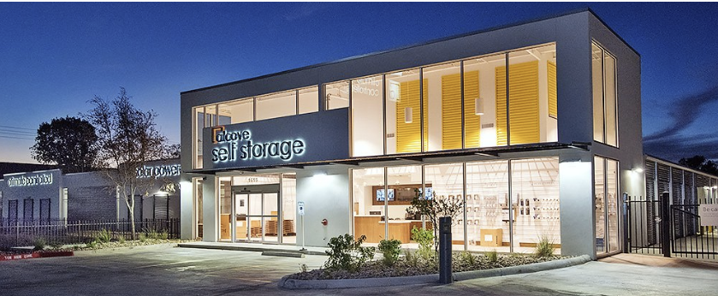
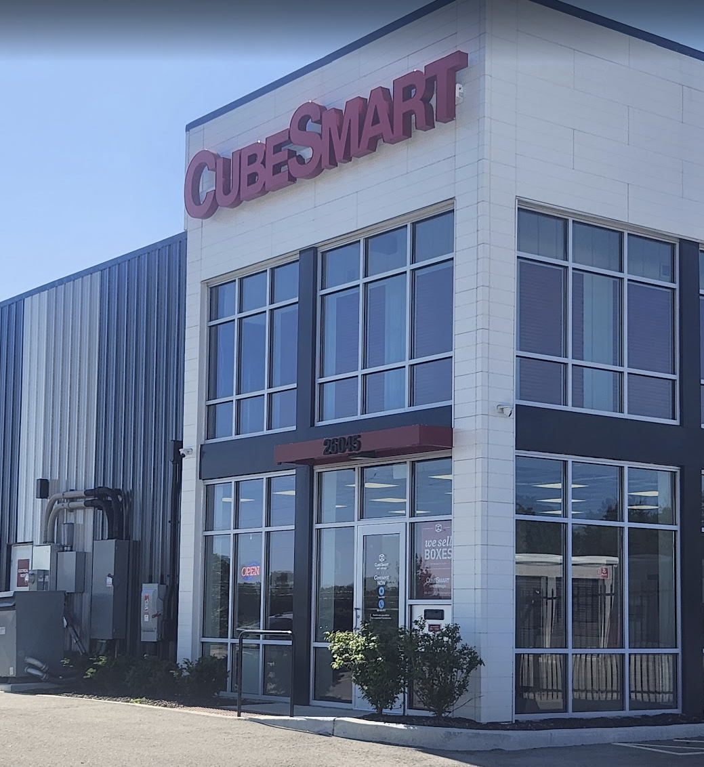
THE FACILITY
This Isn't Your Father's Self-Storage
PMC Investment Partners | Sugar Grove Self-Storage
6

Slide 8
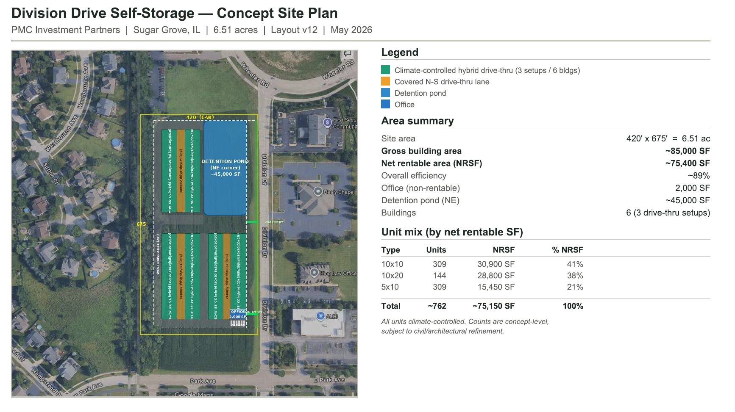
THE FACILITY
PMC Investment Partners | Sugar Grove Self-Storage
6

Slide 9
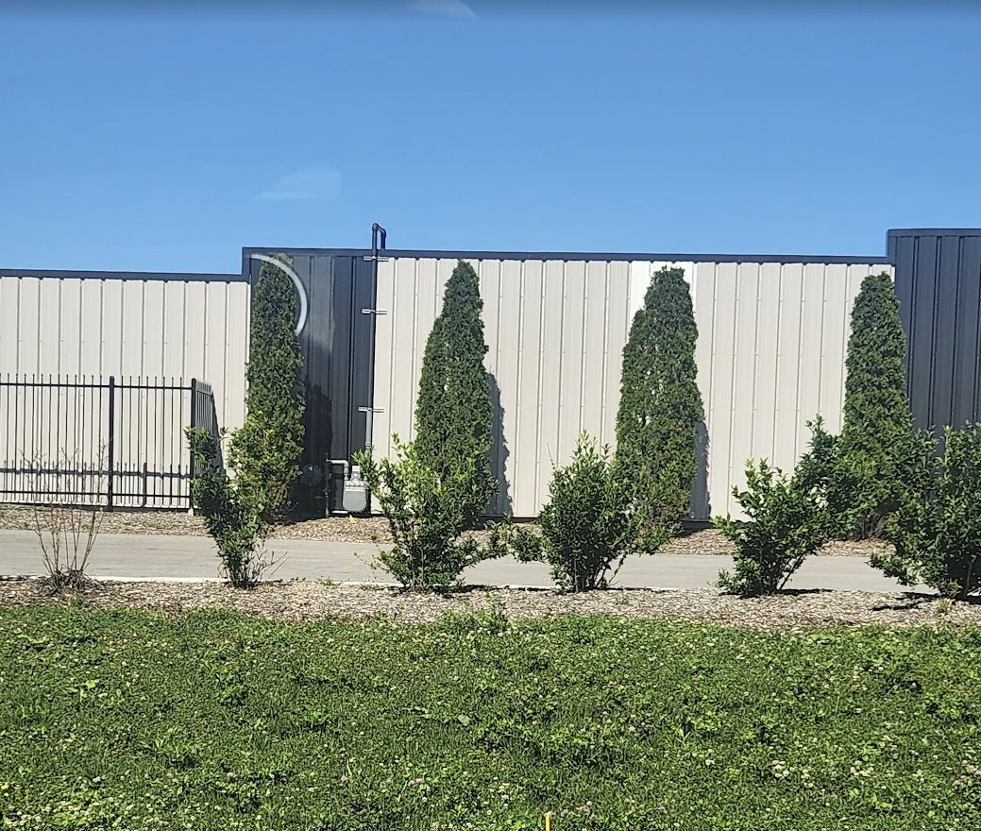
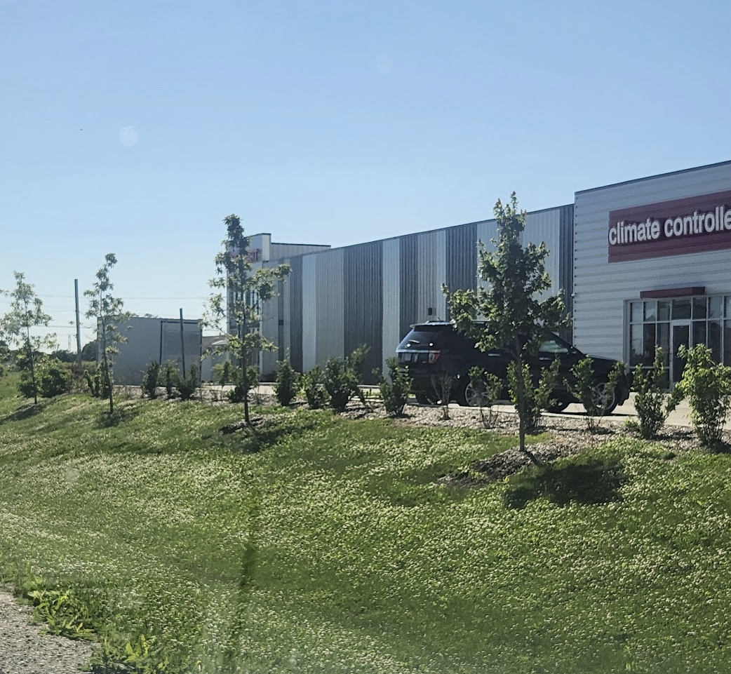
THE FACILITY
PMC Investment Partners | Sugar Grove Self-Storage
6

Slide 10
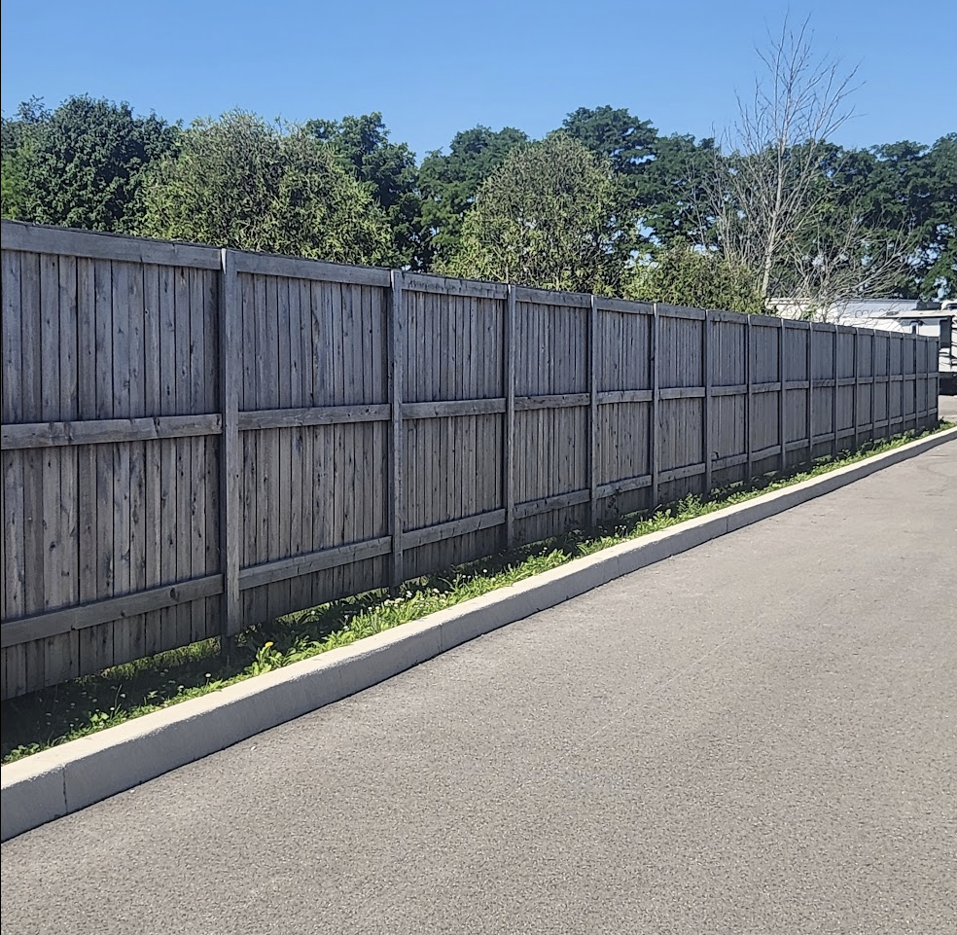
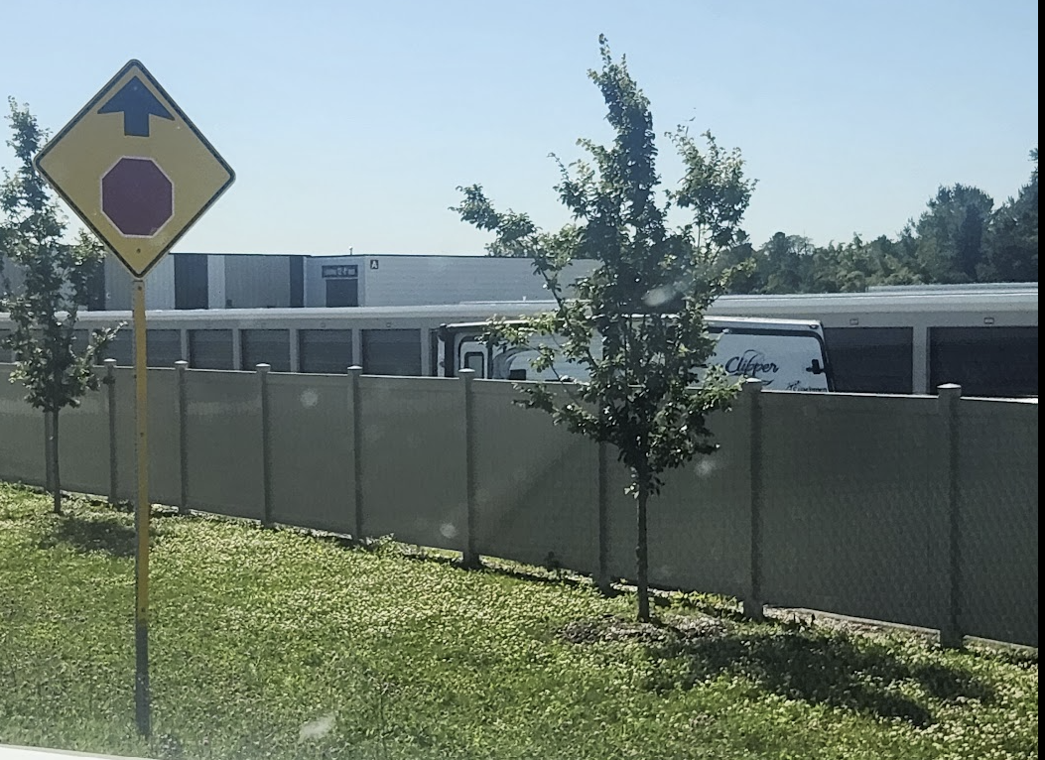
THE FACILITY
PMC Investment Partners | Sugar Grove Self-Storage
6

Slide 11
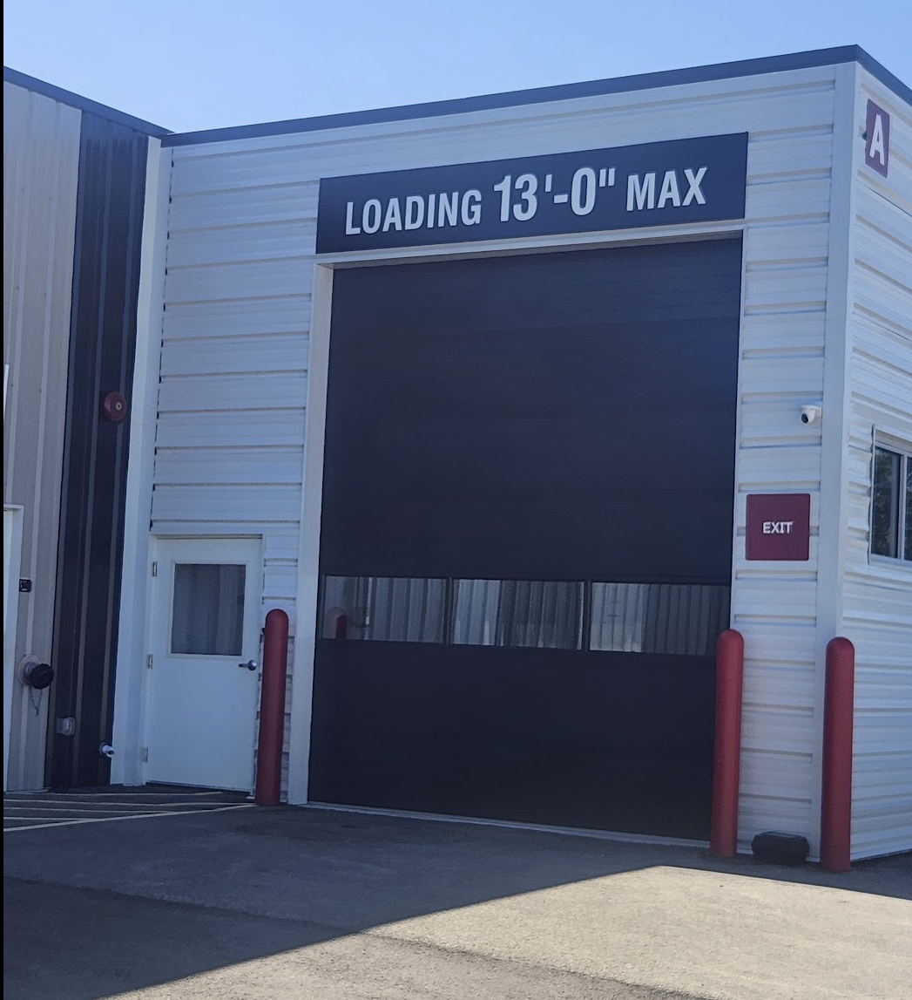
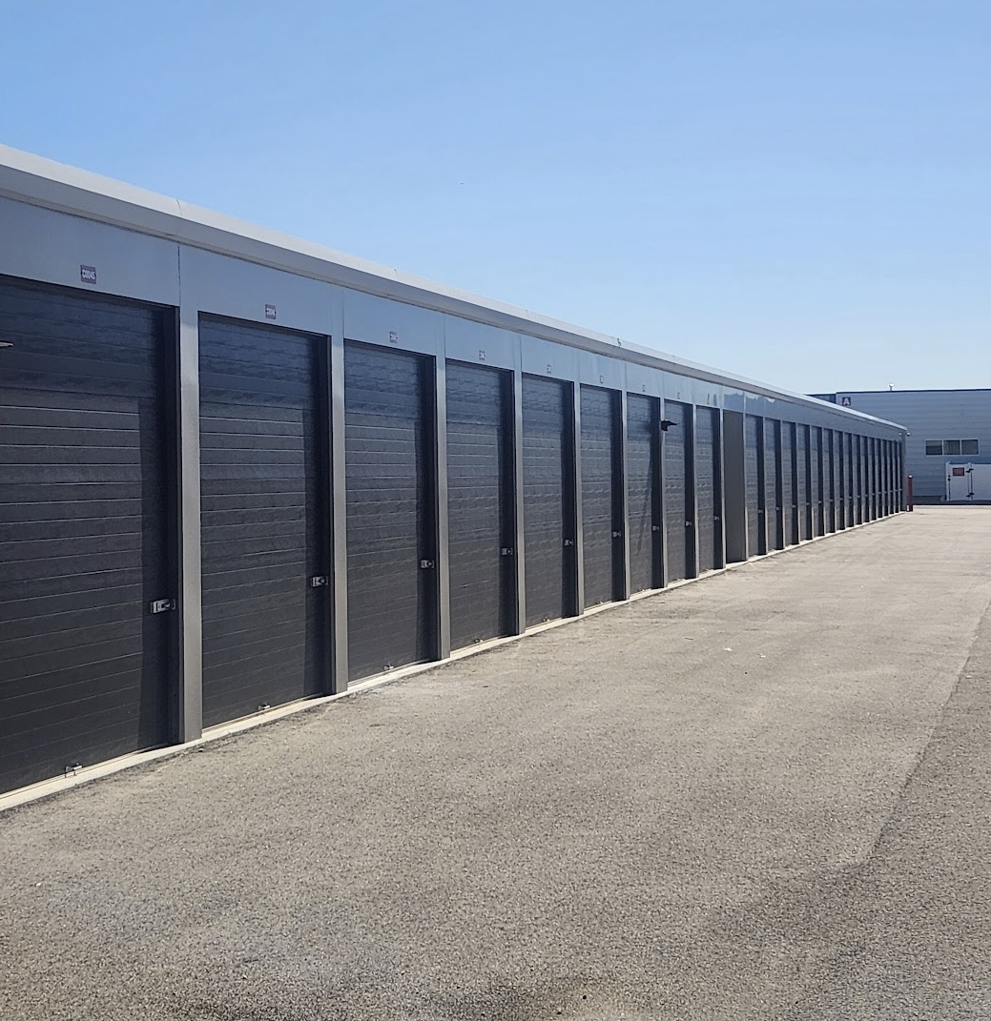
THE FACILITY
PMC Investment Partners | Sugar Grove Self-Storage
6

Slide 12
THE BOTTOM LINE
A Win for Sugar Grove.
A Real Need Met
Closing an 80,000+ sf storage gap for residents who genuinely need it.
Recurring School Funding
$80K–$90K per year in property taxes — with zero new students.
A Vacant Parcel Activated
Putting idle land to productive, tax-generating use.
A Quality Commercial Neighbor
Modern, secure, landscaped — built to enhance the corridor, not detract from it.
Thank you. PMC Investment Partners welcomes the Village's questions and feedback.

