Slide 1

Board Of Directors
Meeting: 2026 Q2

Slide 2

Call to Order
Financial Overview
2026 Financial Summary YTD
2026 Business Strategy
Adjourn
What’s Next for the Foundation?
Cash Calendars
YTD, Expense, Projected
Board Engagement
Expand Fundraising – Gaming Commission
Partnerships
Golf Tournament
Welcome
Lisa Ward, Director of Business Relationships
Joe Sinecola, Treasurer
This Photo by Unknown Author is licensed under CC BY-SA

Slide 3

2026 Financial Overview
YTD

Slide 4
YTD Financials' as of November 5, 2025 (Including Q4 Projections)
Executive Summary
  Current YTD Income:
    Total Income: $131,529.98
    Other Income (Donations): $9,288.52
  Gross Income: $140,818.50
  Projected Q4 Income:
    Cash Calendars: $12,000
    Cooperstown: $3,000
  Projected Year-End Total Income: $155,818.50
Key Observations
  Overall YTD Performance: Donations kept net income positive despite operating deficit.
  Expense Drivers: Tuition Assistance and Event Expenditures account for 93% of spending.
  Cash Position: Healthy at $26,804, but margins remain tight.
  Trend: Expenses slightly outpace core income; reliance on donations and Q4 fundraising is critical.
  Projection Impact: Expected Q4 income significantly improves outlook, raising projected net income to over $20K.

Slide 5
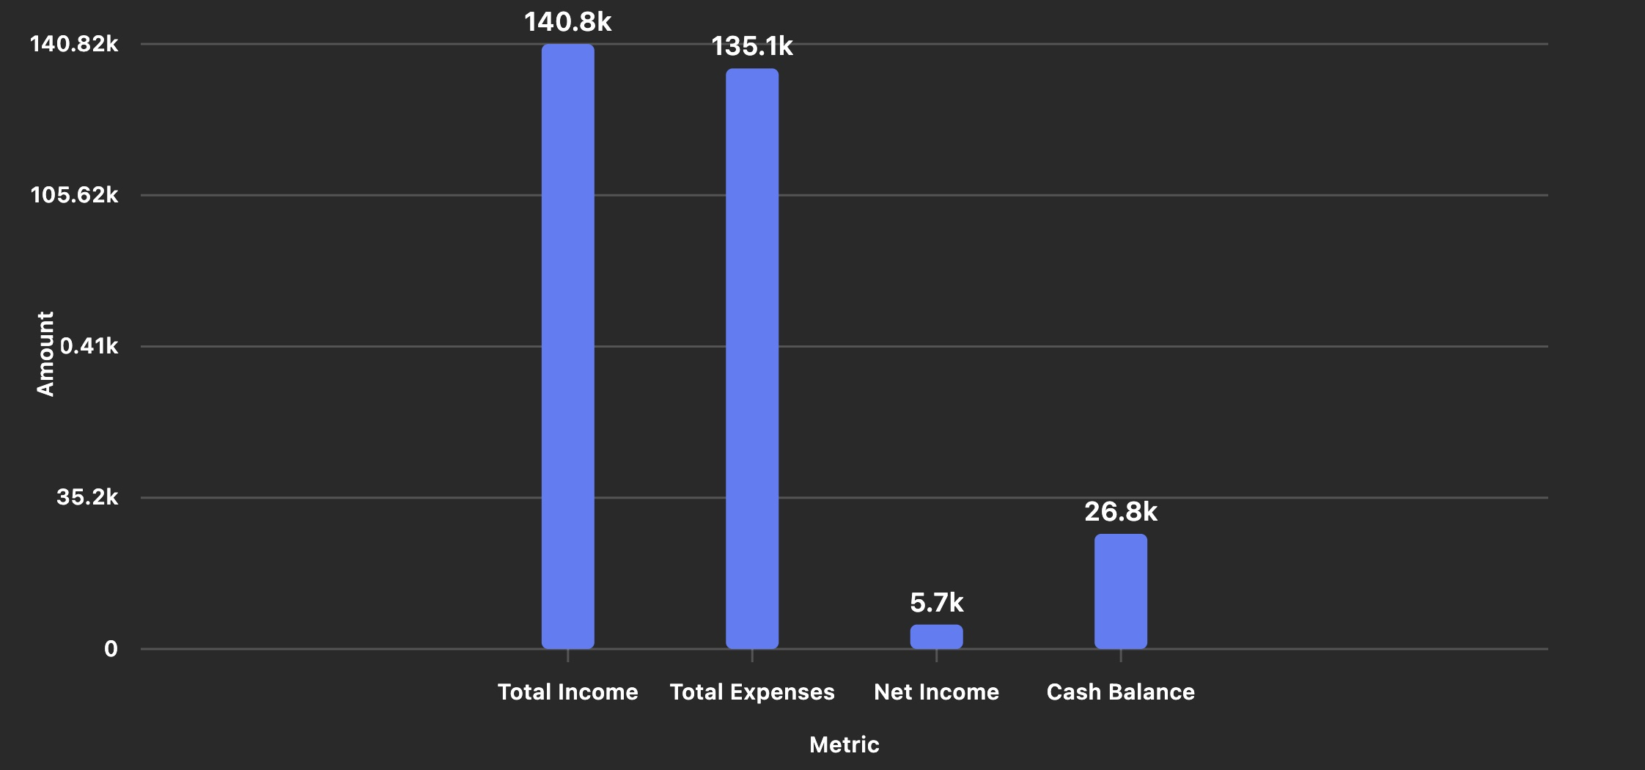
2025
YTD Financial Summary

Slide 6

2025
YTD Expense Breakdown

Slide 7
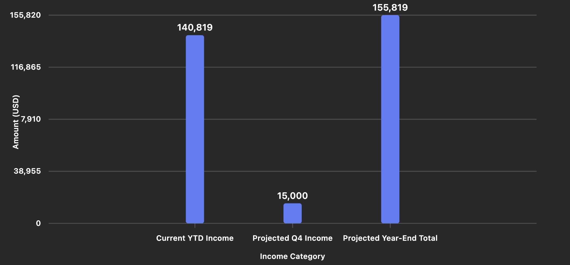
2025
Q4 Projected Income

Slide 8
2025-2026 Business Strategy

Slide 9
2025-2026 Business Strategy
Board Engagement & Expansion
Leverage current and incoming board members’ professional networks to build strategic partnerships and expand the Foundation’s reach.
  Candidate: Chris Ryan
  Interviewing Maine Candidates
Expand Fundraising Programs
  Launch recurring donor campaigns (monthly giving programs).
  Introduce corporate sponsorship packages for events and programs.
Grants & Partnerships
  Apply for sports development and youth education grants.
  Partner with local businesses for co-branded initiatives.
3 Fundraising Events
Execute one major fundraising event per quarter with a revenue target of $15,000 per event.
  Comedy Night, April 10, 2026
  Golf Tournament, October 9, 2026
  Gala, 2027

Slide 10
What’s Next?

Slide 11
Next Up For The Foundation
Cash Calendars Sales
  Goal to Raise: $12,000
Board of Directors
  Interviewing for 2/3 open positions
    Treasurer
    Sponsorship
    Program Coordinator
Scholarship Applications Open
  Activate Selection Committee
  Scholarship Give Goal: $18,000-$25,000
Scholarship Night, April 10, 2025
  Goal to Raise: $20,000
  Attendance Goal: 200

Slide 12
Thank you!
Next Meeting Date: 2026
Time: TBD
Agenda: TBD
Location: Microsoft Teams

