Slide 1


DFOA Six-Man Mechanics
9/2/2026

Slide 2
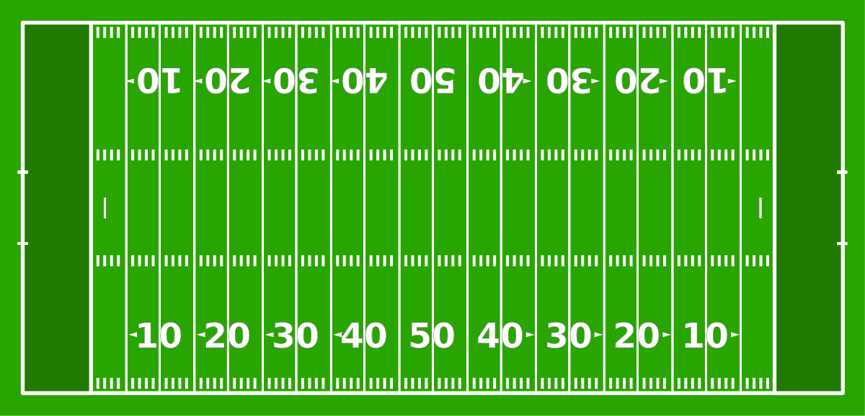


Coin Toss
Visitor
H
R
S
Scoreboard
L
F
U
Home

Slide 3
Coin Toss
Visitor
H
S
R
U
L
F
Scoreboard
Home

Slide 4

Free Kick
Visitor
H
S
R
U
L
F
Home

Slide 5
Short Free Kick
Visitor
H
S
R
U
L
F
Home

Slide 6
Scrimmage Play
Visitor
H
S
U
R
L
F
Home

Slide 7
Field Goals & Trys
Visitor
H
S
U
F
R
L
Home

Slide 8

Measurements
Visitor
H
S
F
U
L
R
Home

Slide 9
Goal Line
Visitor
H
S
U
R
F
L
Home

Slide 10
Punt
Visitor
H
S
U
R
L
F
Home

