Slide 1


DFOA Seven-Man Mechanics
11/12/2024

Slide 2
Pre-Game Responsibilities
Officials should be on the field no less than 45 minutes before the scheduled kick-off time to perform the following duties:
  Referee and Umpire
    Meet the head coach of each team.
    Inspect the entire field, including the goal post padding and proper pylon/yard-line marker placement.
    Address any hazardous condition that needs to be corrected prior to the game (notify DIAA game manager).
  Line Judge/Field Judge/Side Judge
    Make sure the ball crews knows/understands how footballs will be rotated in.
  Head Linesman
    Inspect line to game equipment.
  All Officials
    Check players for proper equipment.
    Check the field.
    Monitor team activities – teams must be on their side of the 40 yard-line – no players in between the 40 yard-lines, except for 1 kicker and 1 coach.
DO NOT STAND ON THE FIELD IN A GROUP AND CONDUCT A CASUAL CONVERSATION!

Slide 3
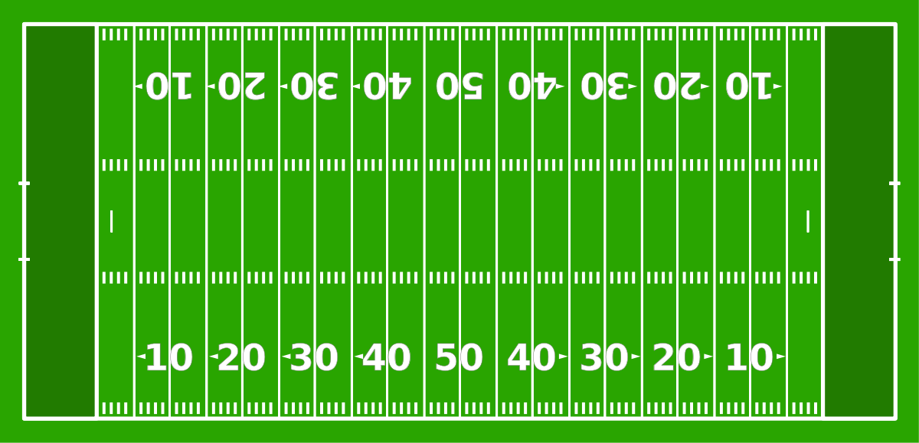

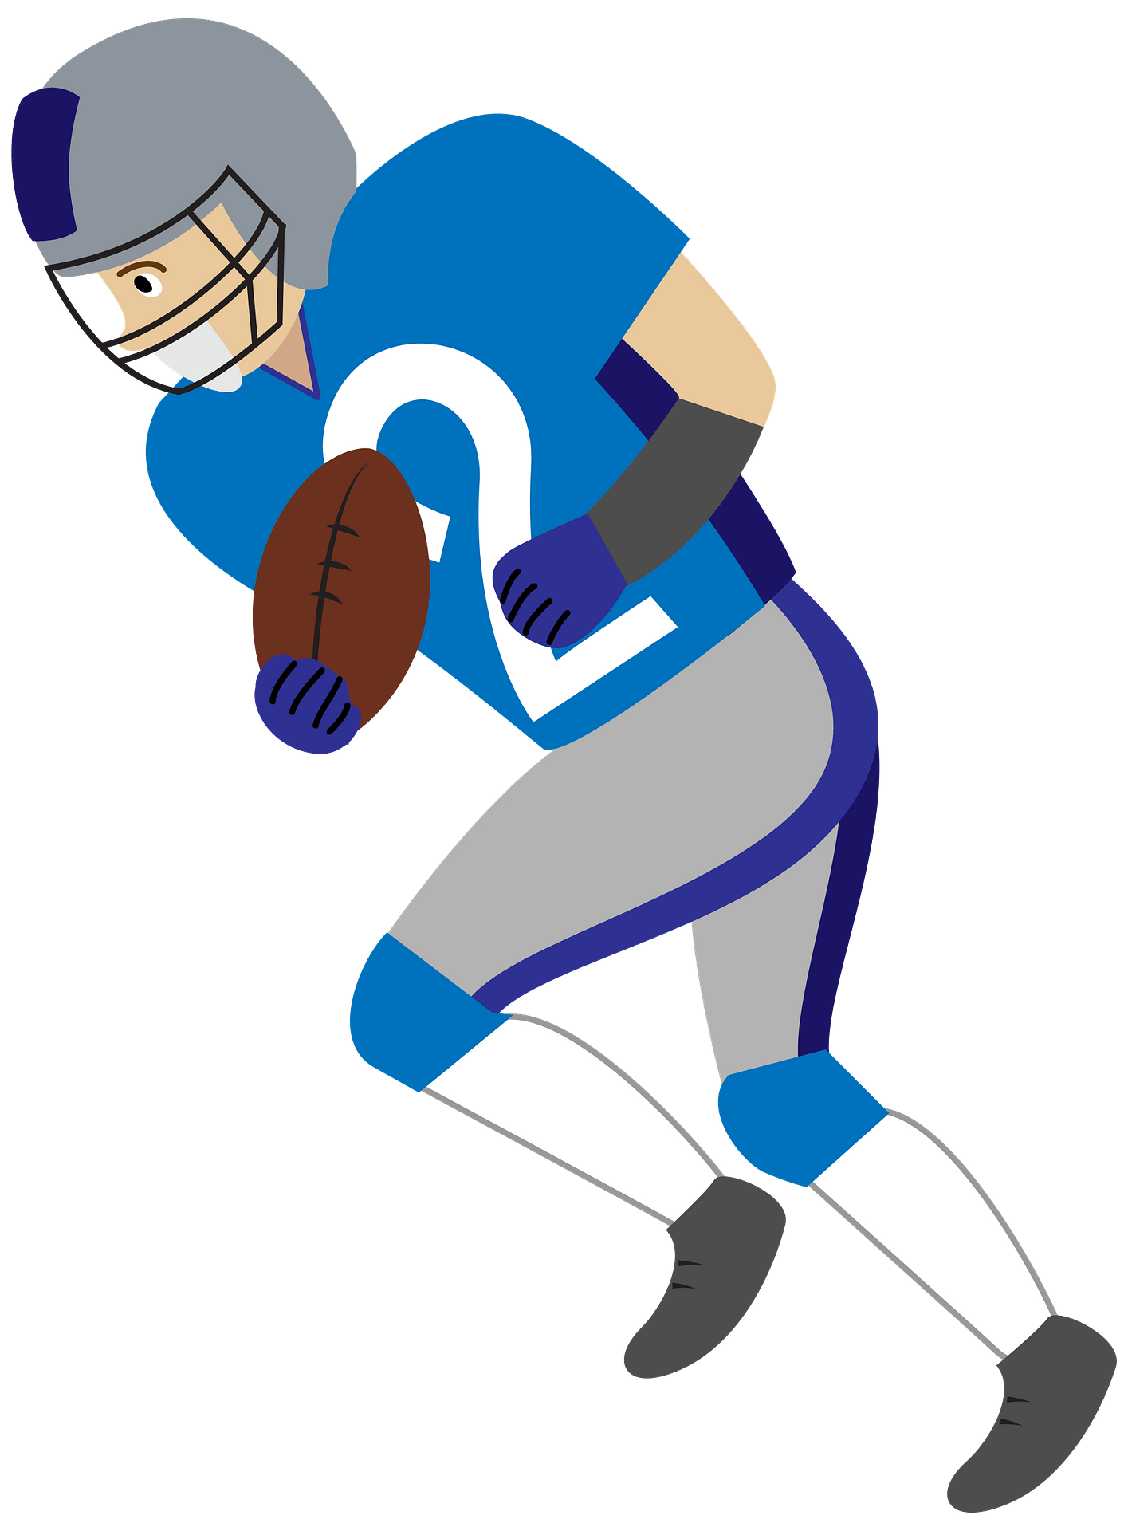
Coin Toss
Visitor
H
R
B
S
L
F
U
Home

Slide 4
Coin Toss
Visitor
H
B
S
R
U
F
L
Scoreboard
Home

Slide 5
Coin Toss
R and U position at center of field.
FJ and SJ escort captains in and stop at the hash mark.
L, LJ, and BJ remain on the sideline and monitor team bench areas.
  Do not allow teams to enter the field during the coin toss.
  Position with the team if they are not on their sideline during the coin toss.

Slide 6

Free Kick
Visitor
H
S
R
B
U
L
F
Home

Slide 7
Free Kick
Visitor
H
S
B
R
U
L
F
Home

Slide 8
Short Free Kick
Visitor
H
S
B
R
U
L
F
Home

Slide 9
Scrimmage Play
Visitor
H
S
U
B
R
L
F
Home

Slide 10
Field Goals & Trys
Visitor
H
S
B
F
U
R
L
Home

Slide 11

Measurements
Visitor
H
S
B
L
U
F
R
Home

Slide 12
Goal Line
Visitor
S
H
U
B
R
L
F
Home

Slide 13
Punt
Visitor
H
S
U
B
R
L
F
Home

Slide 14
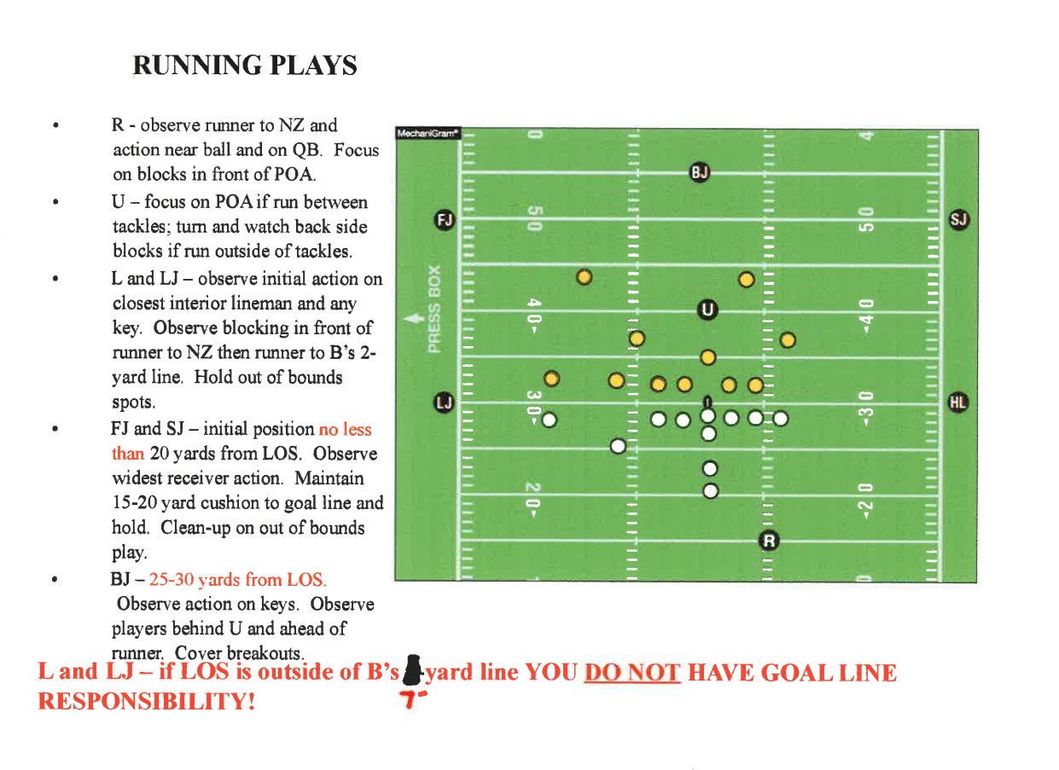

Slide 15
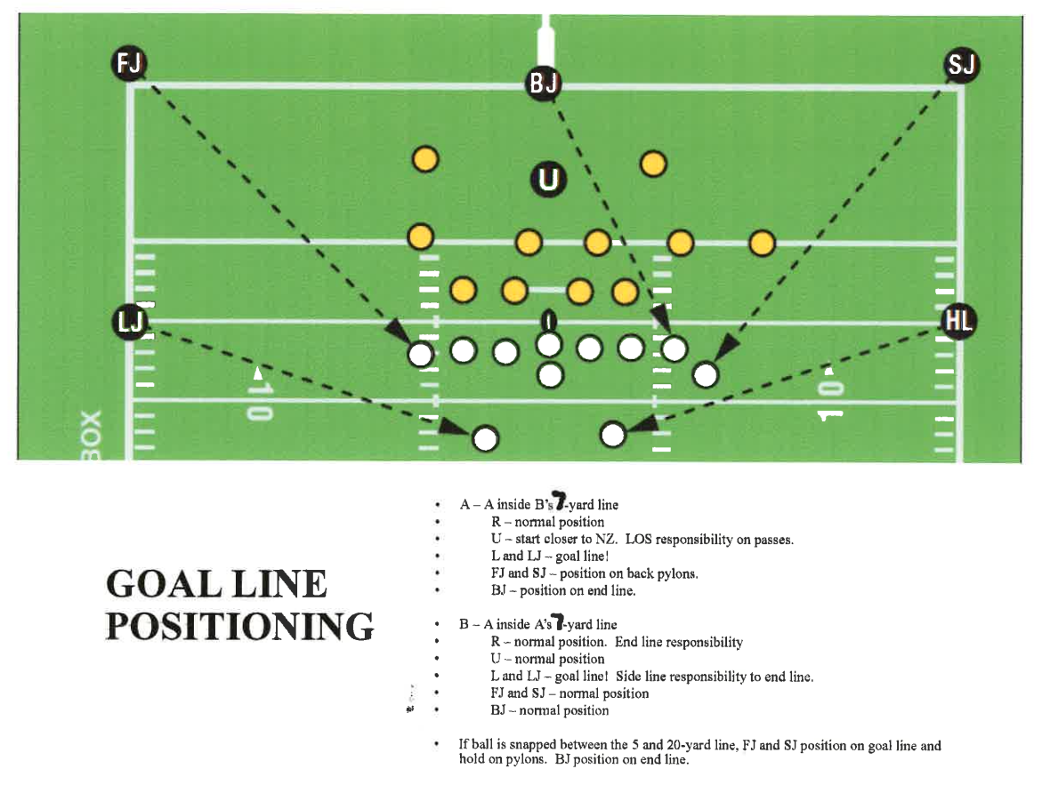

Slide 16
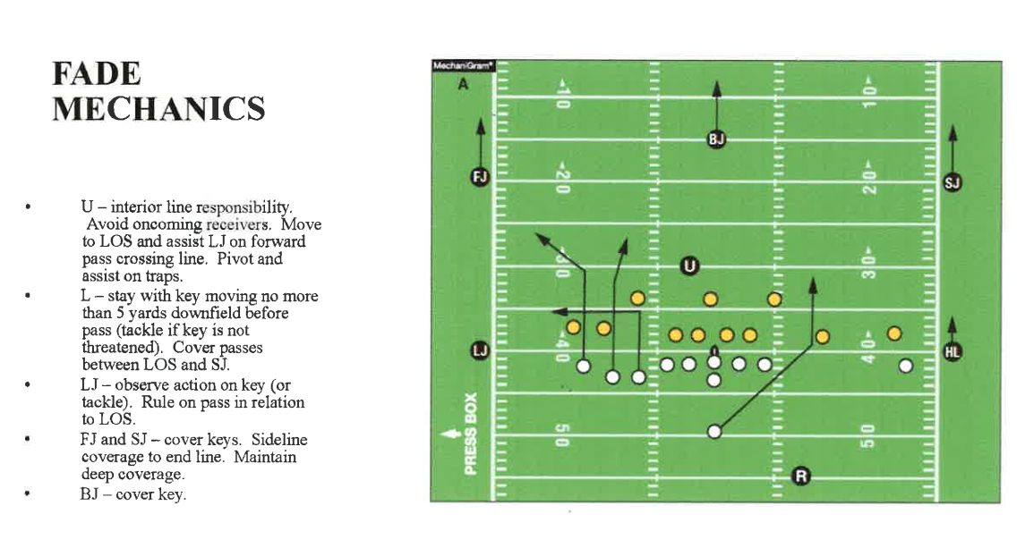

Slide 17
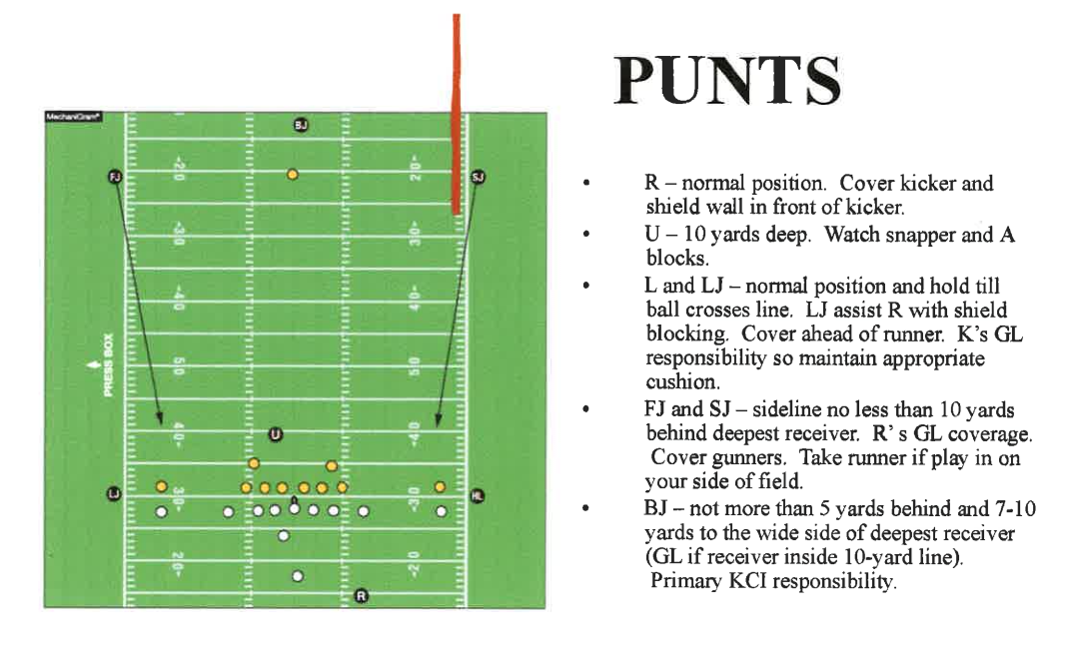

Slide 18
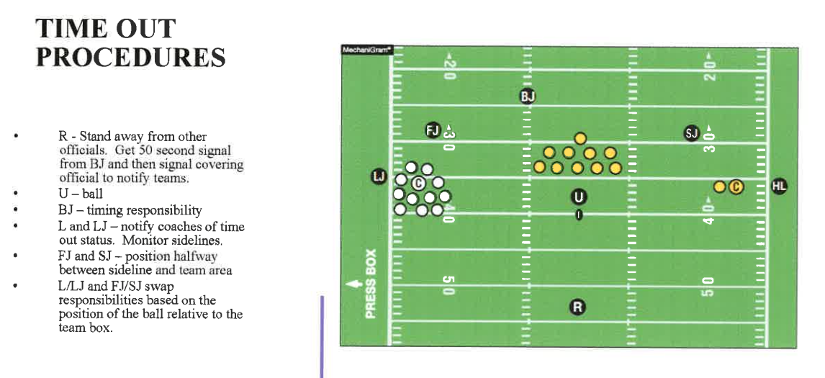

Slide 19
