Slide 1


DFOA Five-Man Mechanics
9/2/2026

Slide 2
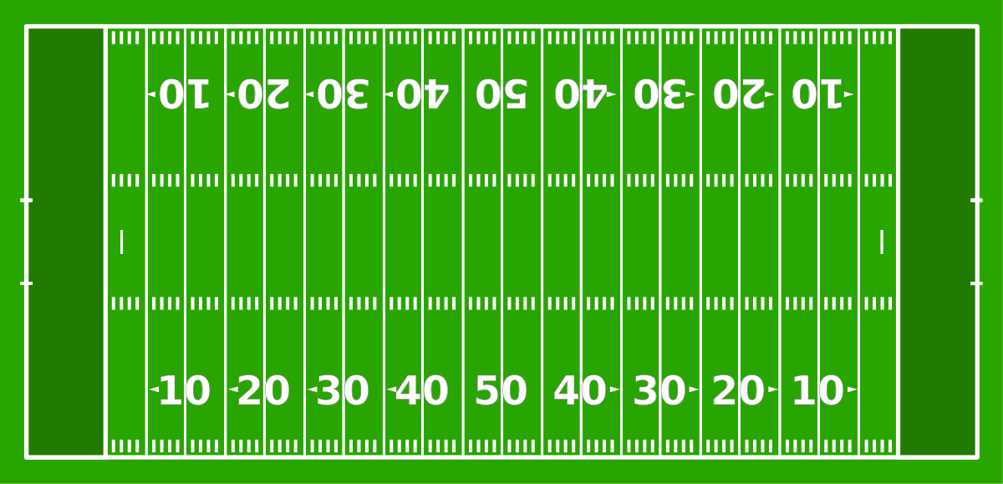


Coin Toss
Visitor
H
B
R
Scoreboard
L
U
Home

Slide 3
Coin Toss
Visitor
H
B
R
U
L
Scoreboard
Home

Slide 4

Free Kick
Visitor
H
B
R
U
L
Home

Slide 5
Short Free Kick
Visitor
H
B
R
U
L
Home

Slide 6
Scrimmage Play
Visitor
H
U
B
R
L
Home

Slide 7
Field Goals & Trys
Visitor
H
B
R
U
L
Home

Slide 8

Measurements
Visitor
H
B
R
L
U
Home

Slide 9
Goal Line
Visitor
H
B
U
R
L
Home

Slide 10
Punt
Visitor
H
B
U
R
L
Home

