Slide 1
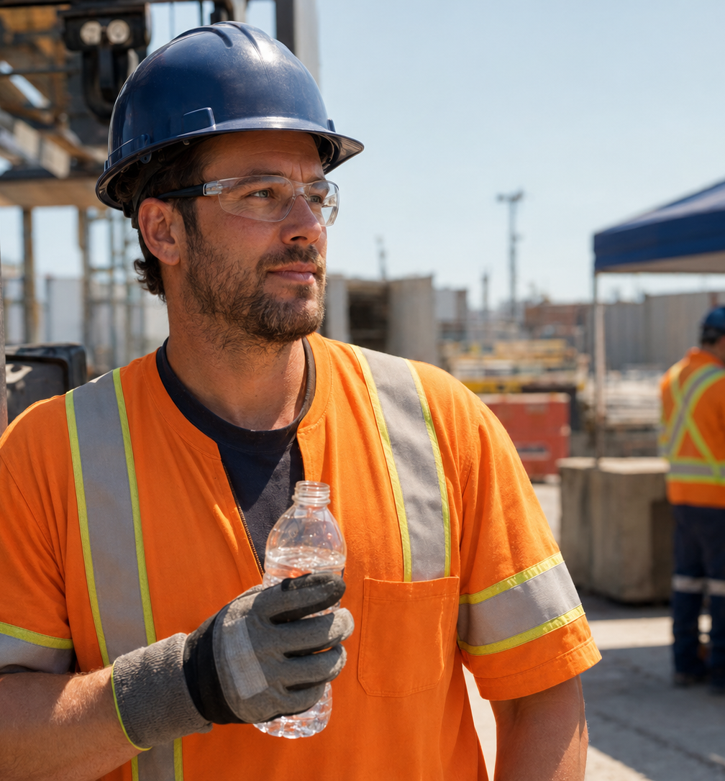
STALWART SAFETY • RESOURCE CENTRE
PPE and
Heat Stress
How to maintain protection in hot working conditions
Protection and heat controls must work together.
Hot-weather workplace safety guide

Slide 2
THE CORE CHALLENGE
Heat does not cancel the hazards that require PPE
A safe plan manages thermal strain and task hazards at the same time.
HEAT
+
PPE
+
TASK
ONE SYSTEM
Heat load
Task hazards
Temperature, humidity and radiant heat
Cuts, burns, impact and contamination
Physical effort and time exposed
Traffic, mobile equipment and visibility
Manage both—never one at the expense of the other.
Guidance basis: CCOHS — Heat Stress and Working in Hot Environments
02

Slide 3
WHY PPE CHANGES HEAT EXPOSURE
PPE can slow the body's main cooling pathways
The body releases heat and evaporates sweat; heavy, layered or impermeable PPE can interfere with both.
PPE may…
Heat burden rises with…
BODY
HEAT
Trap warmth
Weight • layers • coverage
Breathability • task demand • environment
Limit airflow
Slow evaporation
Planning implication
Account for the added burden when setting work-rest schedules, monitoring conditions and training workers.
Source: ccohs.ca/oshanswers/phys_agents/heat/heat_control.html
03

Slide 4
SELECTION LOGIC
Start with the hazard assessment—not comfort alone
Choose required protection first, then reduce unnecessary heat burden through product and job design.
1
Identify
2
Specify
Map the task, environment and immediate hazards.
Define required protection, coverage and standards.
3
Select
4
Control
Compare compliant options for weight, fit and breathability.
Adjust exposure time, ventilation, recovery and scheduling.
The safest choice meets the hazard requirement within a complete heat-control plan.
General information only; follow applicable requirements and manufacturer instructions.
04

Slide 5
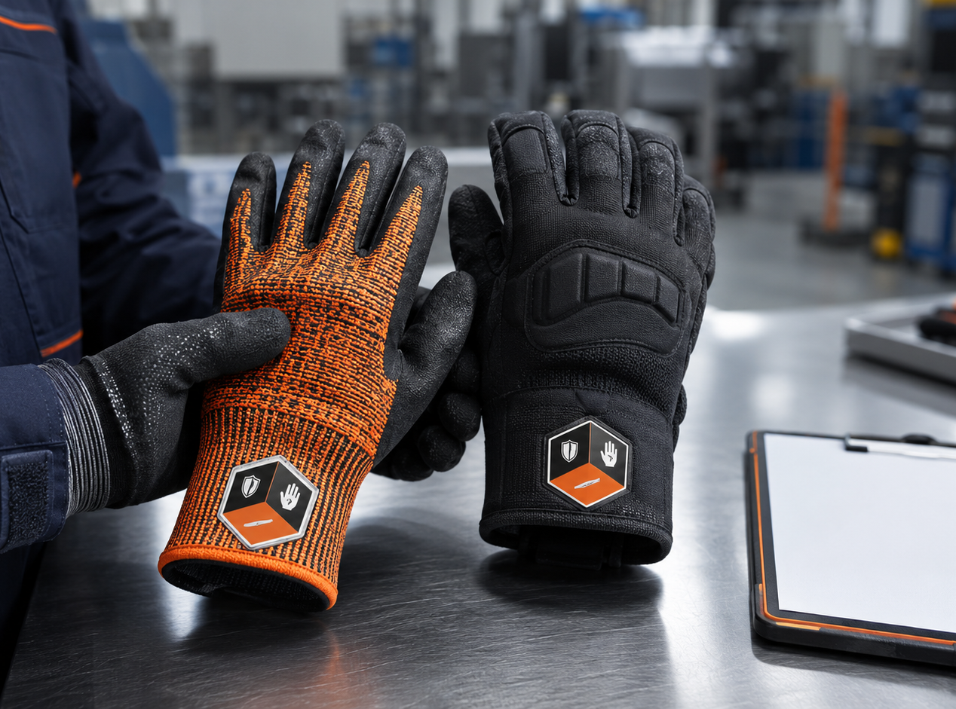
HAND PROTECTION
Hot-weather gloves must still match the hand hazard
Sweat can change fit, grip and comfort—but it does not remove the need for verified protection.
Required cut, abrasion, puncture, impact or thermal resistance
Grip performance in wet or sweaty conditions
Fit and dexterity after extended wear
Liner, coating, cuff style and area of coverage
Change-out and inspection practices during the shift
Important distinction
“Hot weather” does not mean “rated for contact heat.”
Selection must reflect the heat type, temperature, contact duration and task.
05

Slide 6
HIGH-VISIBILITY APPAREL
Visibility cannot be traded for comfort
Workers near traffic, vehicles or mobile equipment must remain visible when temperatures rise.
KEEP THE REQUIRED PERFORMANCE CLASS
01
Select for the season
02
Wear it as designed
Consider fit and layering without reducing required coverage.
Keep the garment fastened, visible and free from unapproved alterations.
03
Inspect condition
04
Protect the signal
Replace dirty, faded, damaged or heavily worn garments as required.
Rolling, covering or altering apparel can reduce its effectiveness.
Verify the class and edition required by the workplace and jurisdiction.
06

Slide 7
BEYOND PRODUCT SELECTION
PPE is only one layer of heat-stress prevention
Reduce exposure through the whole work system; do not rely on PPE selection alone.
01
Engineering controls
Improve ventilation or air movement and shield workers from radiant heat.
02
Work design
Schedule strenuous tasks in cooler periods, rotate work and set appropriate recovery time.
03
Recovery resources
Provide cool water and shaded or air-conditioned recovery areas.
04
People systems
Use acclimatization, buddy checks, training, monitoring and emergency planning.
PPE supports the plan—it does not replace the plan.
Source: CCOHS — Control Measures for Working in Hot Environments
07

Slide 8
WORKER RESPONSE
Recognize warning signs before the situation escalates
Encourage immediate reporting and make emergency actions clear before hot work begins.
REPORT IMMEDIATELY
EMERGENCY
Early warning signs
Possible heat stroke
Headache or dizziness
Confusion, collapse, loss of consciousness or other severe symptoms require prompt emergency assistance.
Nausea or muscle cramps
Unusual fatigue or weakness
Symptoms that worsen or do not resolve
Heat stroke is a medical emergency.
Follow the workplace emergency plan and seek medical help when required.
08

Slide 9
PRACTICAL APPLICATION
Turn the guidance into a workplace review
Evaluate required PPE during representative work—not only in a catalogue or meeting room.
1
Map
List PPE, task demands and environmental conditions.
2
Observe
Watch how fit, grip, visibility and comfort change over time.
3
Listen
Ask workers where heat burden or usability creates problems.
4
Adjust
Improve scheduling, recovery, ventilation and change-out plans.
5
Review
Inspect outcomes and repeat as conditions or tasks change.
Review again when the task, equipment, PPE, weather or workforce changes.
Worker feedback supports—rather than replaces—formal hazard assessment.
09

Slide 10
STALWART SAFETY • RESOURCE CENTRE
Build protection
around the real work
A stronger conversation starts with:
The task being performed
The hazards present
Bring Stalwart Safety your task, hazards, conditions and performance requirements.
The working conditions
Required ratings and coverage
Explore industrial work gloves and
high-visibility safety products
Fit, grip and dexterity needs
Contact Stalwart Safety.
stalwartsafety.com/shop
This guide provides general information and does not replace a formal workplace hazard assessment, applicable legislation, employer procedures or manufacturer instructions.
10

