Slide 1

STALWART SAFETY • RESOURCE CENTRE
Contaminated PPE
Can Carry Hazards Home
Cleaning, storage and disposal practices that help contain exposure
Protection is not complete until the contamination is controlled.
PPE lifecycle and take-home exposure guide
Notes:
Open by explaining that PPE can become a secondary source of exposure after the task ends.
Use this deck as a practical conversation guide; product-specific and contaminant-specific procedures still govern.
[Sources]
- Project-generated Stalwart blog thumbnail, August 2026
- https://www.ccohs.ca/oshanswers/prevention/ppe/personal-protective-equipment-contamination-and-decontamination.html
[/Sources]

Slide 2
THE CORE CHALLENGE
The hazard may remain after the work is finished
Once exposed, PPE can become part of the pathway that carries contamination beyond the task.
HAZARD
+
PPE
=
EXPOSURE PATHWAY
What may remain
Where it may travel
Dust, soot, oils and chemical residue
Skin, clothing, lockers and clean work areas
Biological material or process contamination
Vehicles, household laundry and home surfaces
Treat contamination control as part of the PPE lifecycle—not an afterthought.
Guidance basis: CCOHS PPE contamination and decontamination
02
Notes:
The protection decision does not end when the glove or garment is removed.
Ask the audience where exposed PPE goes immediately after the task; that answer often reveals the uncontrolled pathway.
[Sources]
- https://www.ccohs.ca/oshanswers/prevention/ppe/personal-protective-equipment-contamination-and-decontamination.html
- https://www.cdc.gov/niosh/reproductive-health/about/take-home.html
[/Sources]

Slide 3
HOW CONTAMINATION HAPPENS
PPE can spread hazards even when the residue is hard to see
Exposure may occur during use, removal, handling, transportation, cleaning or storage.
01
Direct contact
02
Removal and handling
A glove, garment or boot contacts a hazardous substance.
Contaminants transfer to hands, clothing or nearby surfaces.
03
Cross-contamination
04
Cleaning exposure
Used PPE enters clean zones, vehicles, offices or storage.
The person cleaning PPE encounters residue, splash, dust or vapour.
Appearance is not proof of safety
Some contaminants can remain invisible, transfer during contact or continue to release vapours through off-gassing.
Source: CCOHS — Personal Protective Equipment: Contamination and Decontamination
03
Notes:
Emphasize that visible dirt is only one signal; the contaminant and exposure history matter more than appearance.
Cleaning personnel may need their own controls and PPE because decontamination can create a new exposure task.
[Sources]
- https://www.ccohs.ca/oshanswers/prevention/ppe/personal-protective-equipment-contamination-and-decontamination.html
[/Sources]

Slide 4
TAKE-HOME EXPOSURE
Stop the take-home exposure pathway
Containment at the workplace breaks the chain before vehicles, laundry and family spaces become involved.
1
2
3
4
WORK AREA
VEHICLE
LAUNDRY
HOME
Hazard contacts PPE
Residue reaches seats or controls
Contaminants spread during handling
Family surfaces and people are exposed
Best control point
Keep contaminated PPE contained, managed and decontaminated before it leaves the workplace.
Take-home exposure can affect workers, family members and pets.
04
Notes:
Walk left to right and ask which stage the current workplace procedure is designed to stop.
The preferred control is prevention: keep hazardous residue from entering personal vehicles or homes.
[Sources]
- https://www.cdc.gov/niosh/reproductive-health/about/take-home.html
- https://www.ccohs.ca/oshanswers/prevention/ppe/personal-protective-equipment-contamination-and-decontamination.html
[/Sources]

Slide 5
CLEANING DECISIONS
Home laundering is not a universal decontamination method
The wrong process may spread contamination or damage the protective equipment.
Before cleaning, confirm
A poor cleaning choice can
The substance and exposure involved
Move residue into water, air or nearby surfaces
PPE material and construction
Expose the person doing the cleaning
Manufacturer care and decontamination instructions
Degrade coatings, fibres, seams or reflectivity
Whether specialist facilities or services are required
Create contaminated wastewater, filters or waste
If safe and effective cleaning cannot be confirmed, do not improvise a laundering method.
Certain hazards may require professional decontamination or disposal.
05
Notes:
Avoid offering a single washing formula; the correct method depends on the contaminant, PPE and manufacturer instructions.
Lead, asbestos and other hazardous materials may require specialist services and controls.
[Sources]
- https://www.ccohs.ca/oshanswers/prevention/ppe/personal-protective-equipment-contamination-and-decontamination.html
[/Sources]

Slide 6
WORKPLACE PROCESS
Use six steps to control contaminated PPE
Document who handles used PPE, where it goes and how the return-to-service decision is made.
01
Identify
02
Remove safely
Confirm the contaminant, task and exposure history.
Prevent transfer to skin, clothing and nearby surfaces.
03
Separate zones
04
Contain transport
Keep dirty handling and clean storage physically distinct.
Bag, seal and label equipment when the procedure requires it.
05
Protect the cleaner
06
Inspect and decide
Control splash, dust, vapour and contact during decontamination.
Return only clean, undamaged and serviceable PPE.
The procedure should be trainable, repeatable and specific to the hazard.
Support the process with training, records and clear responsibilities.
06
Notes:
Use the six steps as an audit: if one stage has no owner, location or decision rule, the process is incomplete.
Cleaning is only one stage; removal, zoning, transport and inspection are equally important.
[Sources]
- https://www.ccohs.ca/oshanswers/prevention/ppe/personal-protective-equipment-contamination-and-decontamination.html
[/Sources]

Slide 7
CONTAINMENT BY DESIGN
Separate dirty and clean zones by design
A simple physical flow helps people place used PPE correctly without relying on memory.
DIRTY ZONE
CONTROL
CLEAN ZONE
Controlled removal
Decontaminate, inspect and document the decision.
Verified clean PPE
Closed containers
Protected storage
Authorized handling
Ready for issue
Keep used equipment out of personal vehicles, lunchrooms, offices and clean storage.
Containment and separation reduce cross-contamination.
07
Notes:
The layout can be physical or procedural, but workers must know exactly where used PPE goes.
Closed containment and restricted handling can stop residue from moving into common spaces.
[Sources]
- https://www.ccohs.ca/oshanswers/prevention/ppe/personal-protective-equipment-contamination-and-decontamination.html
[/Sources]

Slide 8
RETURN-TO-SERVICE DECISION
Cleaning is not complete until the PPE passes inspection
A clean-looking item may still be unsuitable if its fit, material or protective performance is compromised.
After decontamination
CLEAN, UNDAMAGED
AND SERVICEABLE?
NO
YES
Remove from service. Follow the approved replacement and disposal procedure.
Return to protected storage and record the inspection.
When safe reuse cannot be confirmed, replacement is the safer decision.
Check manufacturer criteria, service life, fit and material condition.
08
Notes:
Inspection should cover contamination, damage, deterioration, fit and the manufacturer's service-life criteria.
Examples of removal signs include tears, cracking, thinning, stiffness, damaged seams or retained hazardous material.
[Sources]
- https://www.ccohs.ca/oshanswers/prevention/ppe/personal-protective-equipment-contamination-and-decontamination.html
[/Sources]

Slide 9
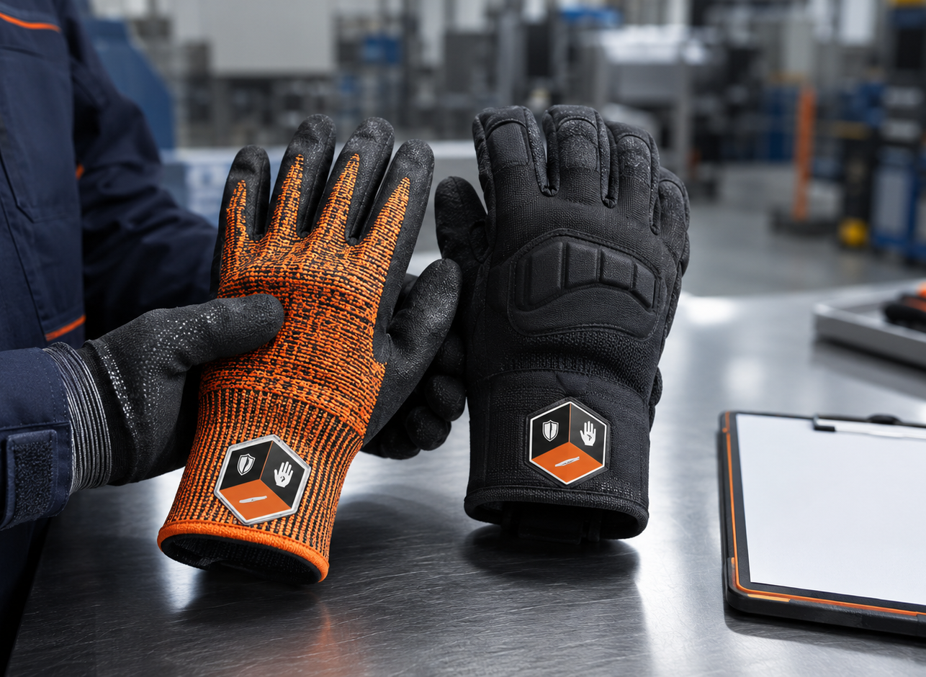
SELECTION AND LIFECYCLE
Choose PPE with maintenance and disposal in mind
The best-value product must protect the task and remain manageable through its intended service life.
Match the glove or garment to the actual hazard
Confirm whether the product is disposable or reusable
Review approved cleaning and decontamination methods
Plan inspection, storage, change-out and replacement
Consider contamination control in total product cost
Better purchasing question
Can this PPE be managed safely from first use to final disposal?
Selection should account for protection, fit, care and expected exposure.
09
Notes:
Move the conversation beyond unit price to the full lifecycle: use, cleaning, storage, replacement and disposal.
Stalwart can support hazard-based glove selection; the employer retains responsibility for the workplace program.
[Sources]
- https://www.stalwartsafety.com/how-to-choose-the-right-work-gloves-for-every-workplace-hazard
- https://www.stalwartsafety.com/shop
- https://www.ccohs.ca/oshanswers/prevention/ppe/personal-protective-equipment-contamination-and-decontamination.html
[/Sources]

Slide 10
STALWART SAFETY • RESOURCE CENTRE
Build contamination control
into every PPE decision
Start the conversation with:
The contaminant and exposure route
The PPE material and intended use
Bring Stalwart Safety the task, hazards, exposure conditions and performance requirements.
Required ratings, fit and coverage
Cleaning and reuse expectations
Explore industrial work gloves and
workplace PPE solutions
Storage, inspection and disposal plans
Contact Stalwart Safety.
stalwartsafety.com/shop
This guide provides general information and does not replace a formal hazard assessment, applicable legislation, employer procedures, safety data sheets or manufacturer instructions.
10
Notes:
Close by inviting the audience to bring a real task and hazard profile to Stalwart for a more useful product conversation.
Reinforce that selection guidance supports—but does not replace—the employer's exposure-control and PPE program.
[Sources]
- https://www.stalwartsafety.com/shop
- https://www.stalwartsafety.com/how-to-choose-the-right-work-gloves-for-every-workplace-hazard
- https://www.ccohs.ca/oshanswers/prevention/ppe/personal-protective-equipment-contamination-and-decontamination.html
[/Sources]

