Slide 1
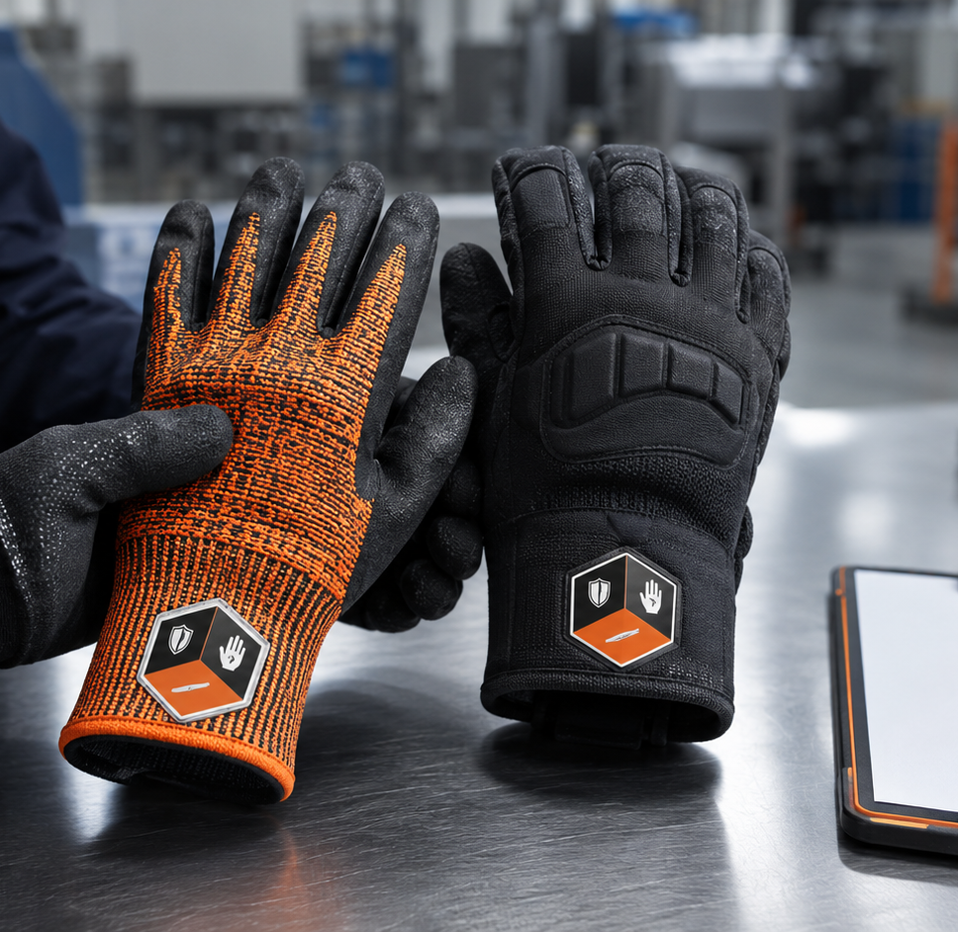
STALWART SAFETY • RESOURCE CENTRE
ANSI/ISEA
105-2024
Explained
A practical guide to the new safety glove performance label
Hand and arm protection classification

Slide 2
WHY THE UPDATE MATTERS
Similar gloves can perform very differently
Clearer markings help buyers compare tested protection without decoding a different label system for every manufacturer.
The selection challenge
A4
Different symbols and layouts can slow product comparison.
Cut, abrasion and puncture performance are separate properties.
The right glove still depends on the actual task and workplace hazards.
A cut rating answers one question—not every question about protection.
The update improves clarity—not automatic product selection.
Source: International Safety Equipment Association, ANSI/ISEA 105-2024 announcement
02

Slide 3
THE FOUNDATION
The standard classifies performance—it does not choose the glove
ANSI/ISEA 105 gives manufacturers and users a common language for tested hand and arm protection.
It can classify properties such as:
105
What it does not do
Cut, abrasion and puncture resistance
Heat, flame and cold performance
Chemical permeation and degradation
Protection for both hands and arms
It does not replace a workplace hazard assessment or guarantee that the highest rating is the best choice for every task.
North American voluntary consensus standard
Used to communicate how gloves and sleeves perform under controlled testing.
Source: ANSI overview of ANSI/ISEA 105-2024 Hand and Arm Protection Classification
03

Slide 4
THE 2024 EDITION
The major change is how ratings are shown
The established mechanical rating scales remain; the new marking makes them more consistent and recognizable.
01
02
03
One pentagon
Broader scope
Clearer conformity
Cut, abrasion and puncture ratings now share one standardized visual location.
The title and scope more clearly encompass protective sleeves and arm protection.
The edition adds clearer language around demonstrating conformity to claimed classifications.
The purpose: faster recognition, more consistent comparison and clearer communication.
Source: International Safety Equipment Association; ANSI/ISEA 105-2024 summary
04

Slide 5
READING THE MARKING
Three positions communicate three mechanical ratings
Each value belongs to a specific performance property. Do not treat the three numbers as interchangeable.
CUT RESISTANCE
Top position • A1 through A9
A1–A9
X = not tested or not applicable; it is not a zero rating.
ABRASION RESISTANCE
0–6
0–5
Left position • Levels 0 through 6
PUNCTURE RESISTANCE
Right position • Levels 0 through 5
Source: ANSI/ISEA 105-2024 marking positions; ISEA and ANSI summaries
05

Slide 6
INTERPRETING THE SCALES
A higher number means greater tested resistance—not universal superiority
Protection should be matched to the hazard while balancing fit, dexterity, grip, coverage and task demands.
CUT
ABRASION
PUNCTURE
A1–A9
0–6
0–5
Reflects the cutting force resisted during standardized testing.
Reflects resistance to repeated surface wear and material breakdown.
Reflects penetration resistance using a standard probe—not a hypodermic needle.
Needlestick resistance is a separate property. Standard puncture performance should never be assumed to cover needle hazards.
Source: ANSI overview of ANSI/ISEA 105-2024 classifications
06

Slide 7
BEYOND THE PENTAGON
The label improves comparison, but the task still decides the glove
Mechanical ratings are only part of a complete selection process.
Also consider:
1
Dry, wet or oily grip conditions
Impact and metacarpal hazards
Heat, cold and flame exposure
Fit, comfort and dexterity
Coating, liner and cuff design
Chemical compatibility and duration
standardized label
A useful comparison tool—not the whole hazard assessment.
PPE supports—not replaces—engineering and administrative controls.
Reference: Canadian Centre for Occupational Health and Safety, glove selection and PPE program guidance
07

Slide 8
EXISTING INVENTORY
Older markings are not automatic failures
Products tested or labelled under earlier editions may remain in circulation while organizations transition to the updated format.
≠
Verify before selection
01
Confirm which edition of the standard was used.
02
Review the manufacturer’s current technical data.
No new pentagon does not automatically mean no protection.
03
Match documented ratings to the workplace requirement.
04
Ask the supplier when markings or test data are unclear.
If documentation is uncertain, pause and confirm.
Source: ISEA guidance on the ANSI/ISEA 105-2024 label transition
08

Slide 9
PUTTING THE STANDARD TO WORK
Start with the hazard—not the number
Use the updated marking to compare eligible products after the workplace requirements are understood.
1
2
3
4
5
ASSESS
SPECIFY
COMPARE
EVALUATE
CONFIRM
Identify the task and credible hazards.
Set the protection levels actually required.
Read the cut, abrasion and puncture positions.
Check fit, grip, dexterity and environment.
Review documentation or ask a specialist.
Need help matching protection to the task?
stalwartsafety.com • 844-945-5050
Explore Stalwart Safety’s industrial glove and sleeve catalogue or contact our team for product-selection guidance.
STALWART SAFETY • RESOURCE CENTRE
09

