Slide 1




South Dallas County FCA
SALT Training

Slide 2

My Father is glorified by this: that you produce much fruit and prove to be my disciples.
JOHN 15:8
Notes:
4

Slide 3
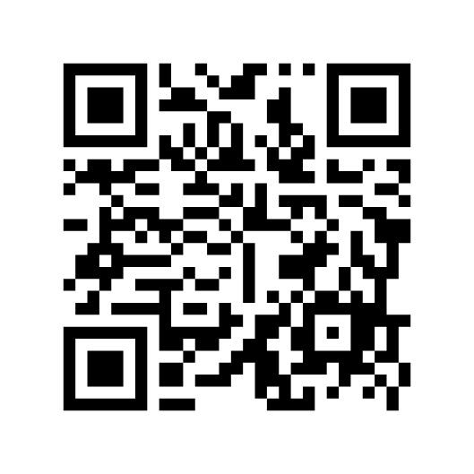

Student- Athlete Leader Information

Slide 4
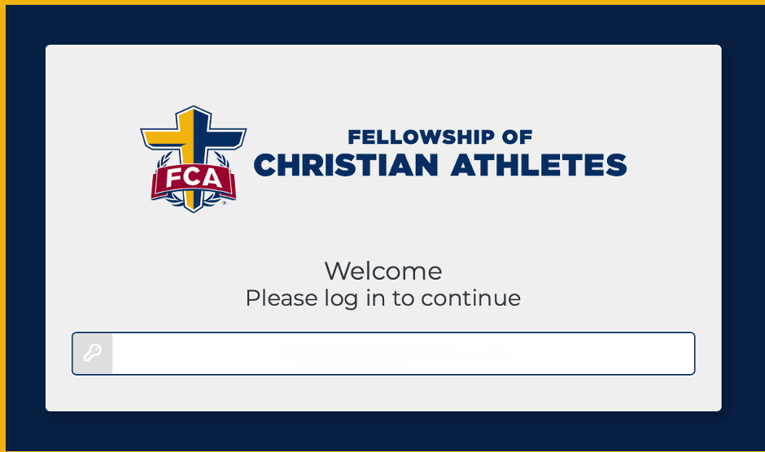
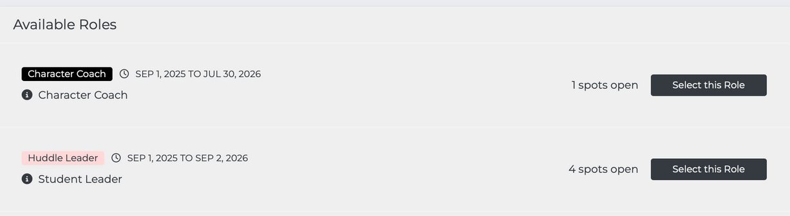

Create VIP account
•Check email for link
•Apply for your Student Leader Role
•Create account
•Parent consent
•Personal info
•References with emails
•Community Christian Statement
•Spiritual Profile
•Waivers

Slide 5

Upcoming Events​
  April 11 - Girls Basketball Camp
  April 25- Girls Basketball Camp
  July 10-12 - Coaches Time Out
  October 2026 Fields of Faith
  November 7 - FCA South Dallas County Golf Classic
Notes:
6

Slide 6

What is FCA?
Vision:
To see the world transformed by Jesus Christ through the influence of coaches and athletes.

Slide 7
What is FCA?
Mission:
To lead every coach and athlete into a growing relationship with Jesus Christ and His church.

Slide 8
What is FCA?
Values:
Integrity | Serving | Teamwork | Excellence​

Slide 9


Strategy
DISCIPLE:
Someone who is in a growing relationship with Jesus Christ and His church.
Notes:
9

Slide 10

Notes:
12

Slide 11
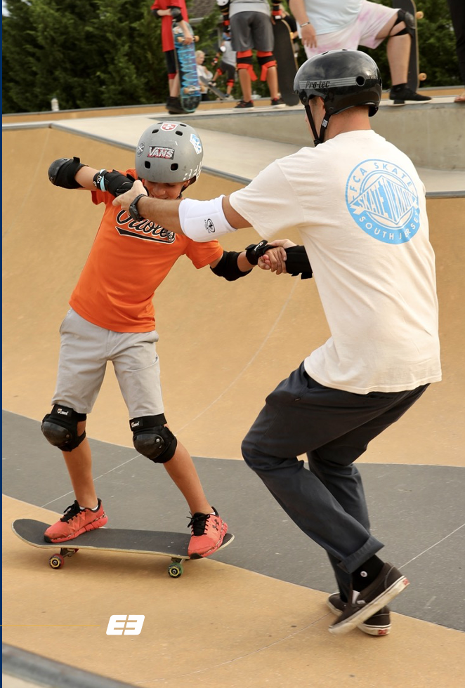
ENGAGE
1.Engage God First
2.Engage the Heart
3.Engage with the Gospel
4.Engage to Multiply

Slide 12

Engage with the Gospel
To help you engage others with the Gospel, FCA created a tool called THE FOUR
It’s a simple repeatable way to clearly communicate the Gospel using scripture and visual icons
TOOLS
The FOUR pg. 29 E3 PLAYBOOK

Slide 13
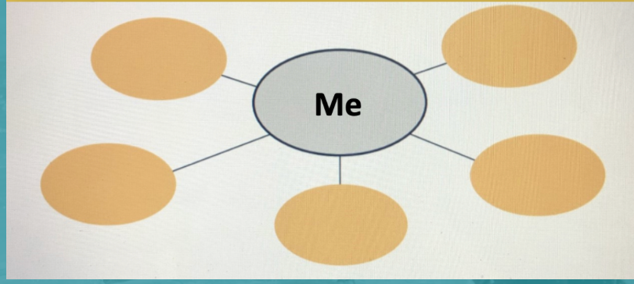
ENGAGE TO MULTIPLY
E3 MAP – page 30 ​E3 Playbook
In the diagram, write your name in the middle circle. In the outer circles, write the names of five people who are close to you relationally but far from God. Then, begin to pray for these people regularly and find ways to Engage them with the Gospel.
Notes:
15

Slide 14

Notes:
13

Slide 15

Equip
1.Equip with Prayer
2.Equip with Scripture
3.Equip with Community
4.Equip with a Clear Plan

Slide 16


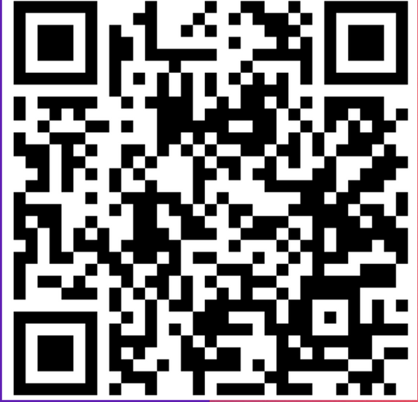
DAILY IMPACT​

Slide 17
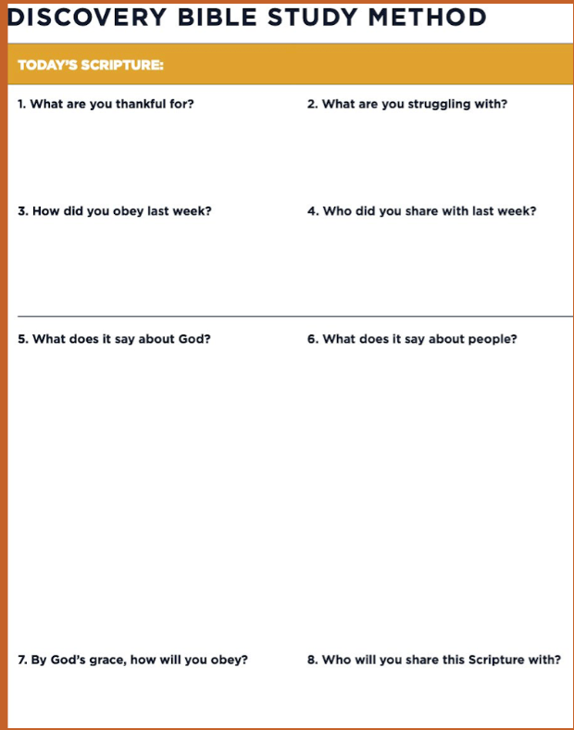


My Father is glorified by this: that you produce much fruit and prove to be my disciples.
JOHN 15:8

Slide 18


Slide 19
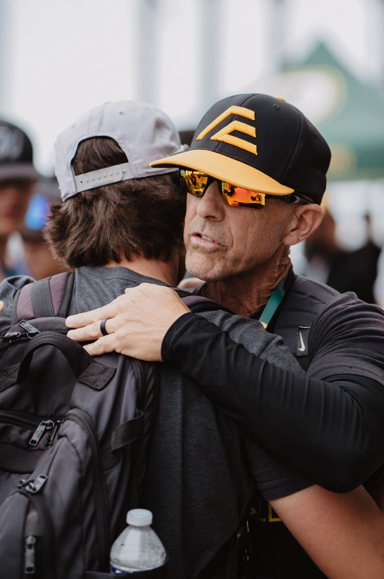
Empower
1.Empower by Modeling
2.Empower by Assisting
3.Empower by Watching
4.Empower by Launching

Slide 20

Guidelines to your Meetings​​

Slide 21




Which one represents your meetings?​

Slide 22



Remember The 4 Ws​
resources.fca.org
  Welcome​
  Warmup​
  Workout​
  Wrap-up​

Slide 23
WELCOME
Before
  Set the Tone
  Snacks
  Music Playing
  Connection
During
  Welcome
  Greeting
  Prayer

Slide 24


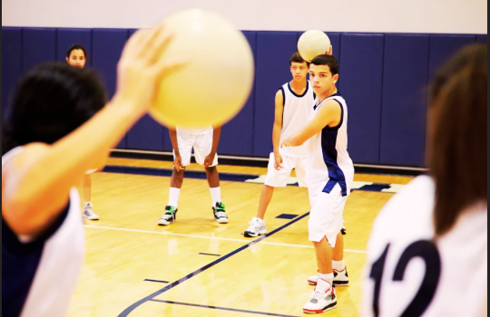
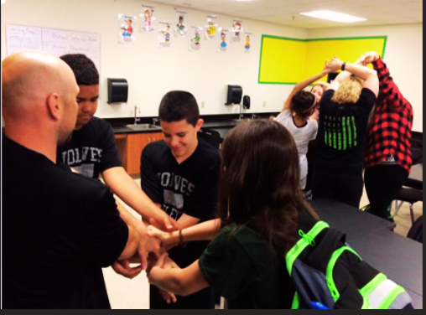
WARM
UP
  Game​
  Skit​
  Video

Slide 25


WORK
OUT
  The Four​
  The Core​
  Bible Study in Small Groups​ “DBS”
  Student Speaks​
  Student Testimony​
  Coach Speaks​
  Guest Speaker (1x-2x monthly)​
  Rap ​
  Drama​
  Worship​

Slide 26


WRAP
UP
  Recap​
  Challenge (DBS)​
  Upcoming Events​
  Close in Prayer

Slide 27



Don’t Forget!
RESOURCES
E3 Playbook – Discovery Bible Study Training / Method / Studies​
resources.fca.org​
fcaproven.org
fca.org/resources​
fca.org/virtual​
The Four​
The Core​
pursuegod.org​
greaterfriscofca.org
PROMOTE MEETINGS
  Posters
  Social Media
  Announcements

Slide 28


Contact Us
Danny Noah
dnoah@fca.org​
Website:​
southdallascountyfca.org

