Slide 1


Humanistic Human Error Management
Notes:
We all know when we’re having a good or a bad day, but how do we know? Are we paying attention to our conscious thoughts or how we feel, internally, emotionally?
What do we say when people ask us how we are on a good day and bad day?
What’s the difference in how we contribute at work on good and bad days?
We’re going to unpack that a little and talk about some things we can do to help ourselves and each other. After all the 2 most fundamental drivers for all human behaviour are survival and reproduction. We’re only going to talk about one of those today ☺

Slide 2

Why things go wrong
The mindset to manage it

Slide 3
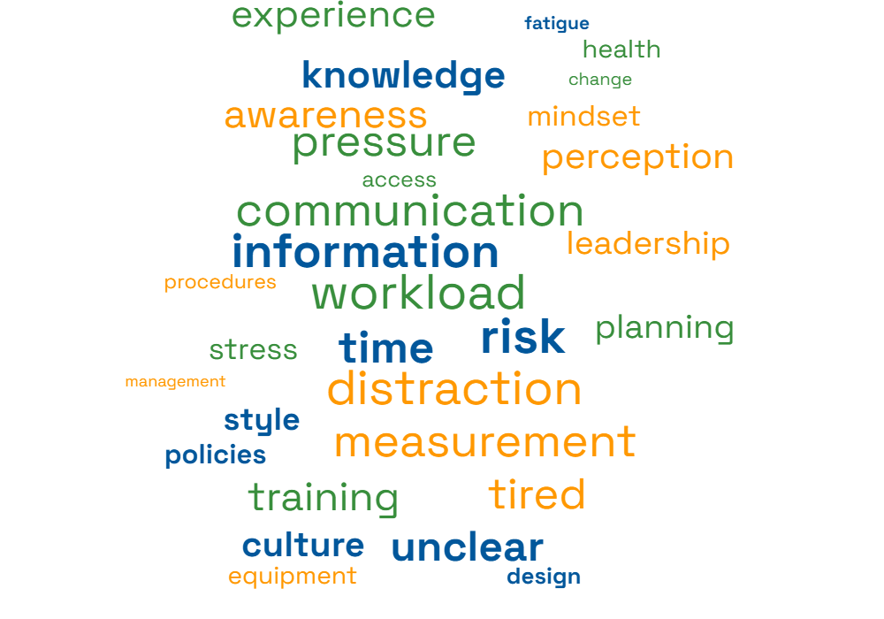
Understanding why things go wrong

Slide 4
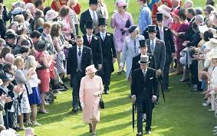
Culture is
King!
Notes:
Norms – compliance – strip clubs – garden party – nobody wants to be the black sheep

Slide 5

Design
Notes:
1. Rods and cones ability to detect colour becomes depleted without blinking (the refresher), so they begin to see no colour = pink dots disappear
2. One pink dot is removed at any given moment in a clockwise direction; your brain fills in the gap by producing an after image, which is usually the opposite colour in the spectrum. There is no green dot.
Ladbroke Grove:
Winters morning with low sun
Worst SPAD (8 recently recorded)
Waiting for a long time on red

Slide 6
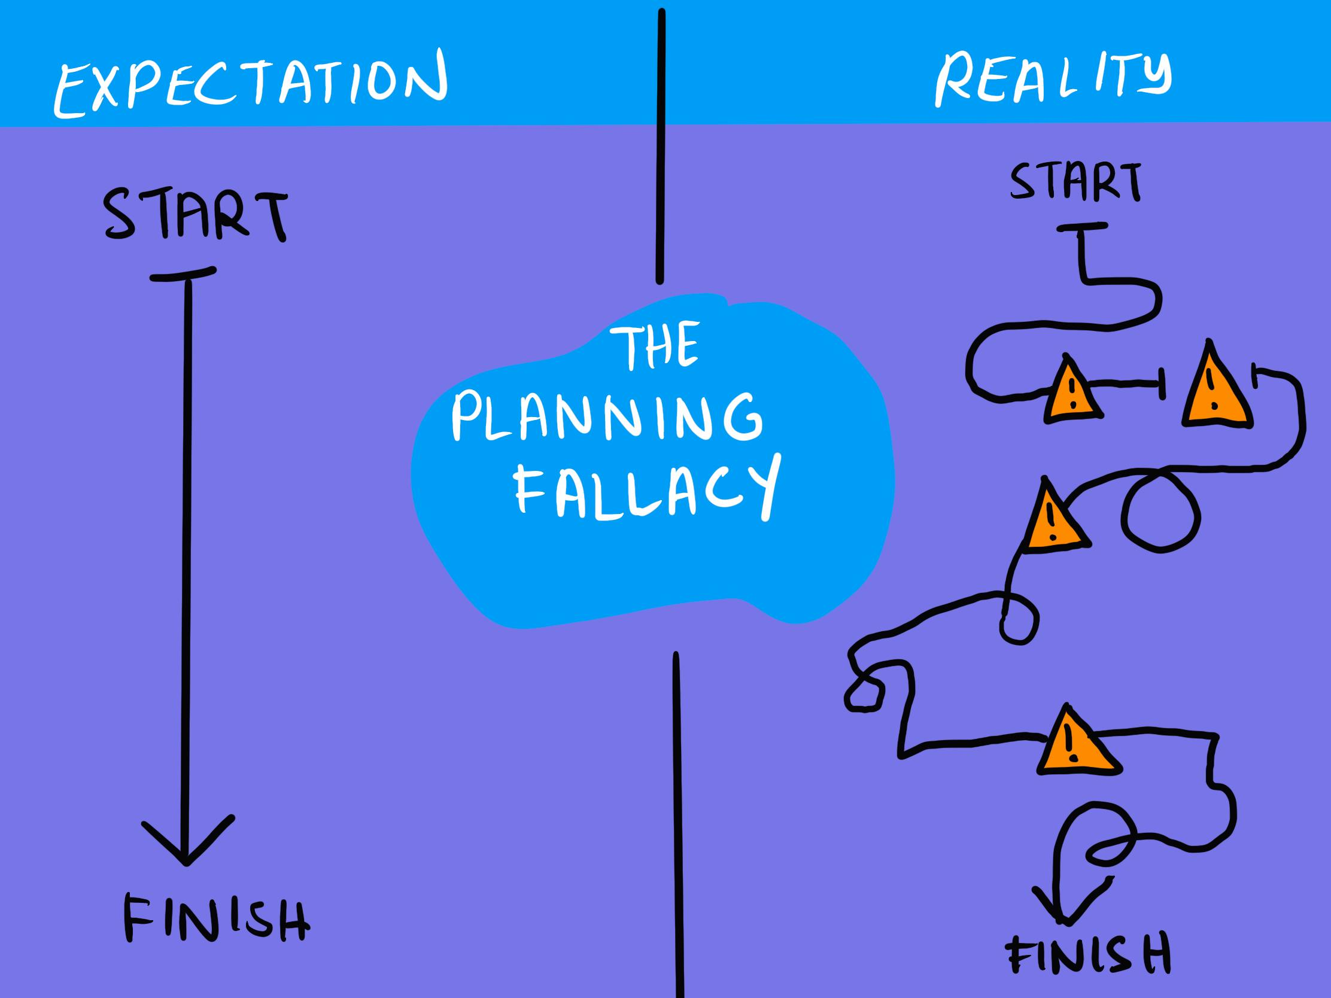
The Optimism Bias
Notes:
DOING 56 ON AN OPEN ROAD (55 LIMIT)
RED FERRARI – CUTTING PEOPLE UP BEHIND YOU, THEN YOU
GUY ON PHONE.
AT LAMPOST – ARE YOU GONNA BE ALL A – A? OR P – C – HE DESERVED THAT!
WHAT IF YOU KNEW SOMETHING DIFFERENT????
DOCTOR RESPONDING TO AN emergency
On the phone doing triage
Borrowed FIL car
Still an idiot???
When we’re involved, we understand the cisrumstances. When others, we judge first (system 1); maybe we analyse after (system 2)
Finger pointing makes us feel good.
A cognitive bias
People assume or emphasise blame on a person
And take no account of the environment / Human Factors

Slide 7

Prickly
Forgetful
Knackered
Compulsive
Over thinking
Brain fog
Notes:
Sleep
Home life
Like job?
Finances
Health
Mental health is not something that other people have.
We all have mental health; it’s really just physical health.
Emotions = a dashboard of feedback that tells us how we’re doing
Most of us, from time to time, have something significant going on.; how that’s regarded depends on where and when you were born.
It’s not cut and dry.
It’s about when it becomes a problem – i.e. it’s getting in the way of our ability to function effectively in our everyday life - & what do we do about it?
“Someone here today will be fully diagnosed with something, but taking their medication, looking after themselves with sleep, exercise and good diet etc … and having a better day than someone who is diagnosed with anything and so is not managing things very well …..
Sometimes that’s me and sometimes that’s you …..

Slide 8
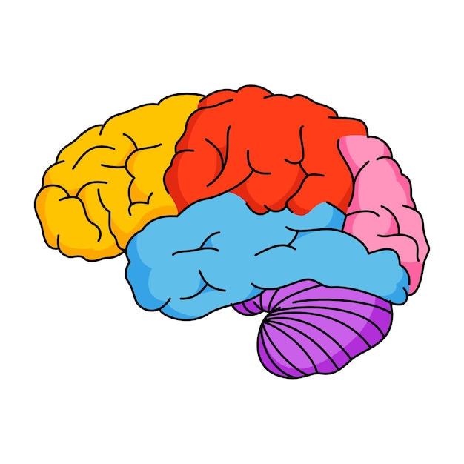
Front Brain
well rested
mono-tasking
new / interesting tasks
manageable workload
manageable time pressure
feeling organised
the right amount of challenge
feeling calm & engaged
Back Brain
tired or fatigued
multi-tasking
experienced / familiar tasks
workload – too high or low
time pressure
feeling unorganized
too much challenge (stress)
feeling strong emotions
Notes:
8
NOTES:
________________________________________________________________________________________________________________________________________________________________________________________________________________________________________________________________________________________________________________________________________________________________________________________________________________________________________________________________________________________________________________________________________________________________________________________________________________________________________________________________________________________________________________________________________
So when we do tasks that are familiar or boring we use this part of our brain as it uses a lot less energy
Mammalian Brain / Limbic system
Filters information from around us
Checks information against past experience
Makes fast assumptions – ok or not ok?
Always thinks it’s right
But as Lewis Hamilton kindly shows us here, this can lead to problems …..

Slide 9
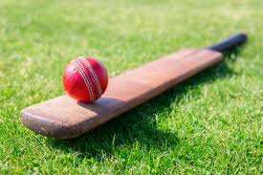
If a Bat + Ball = £1.10 and
The bat costs £1 more than
the ball,
how much does the ball cost?

Slide 10
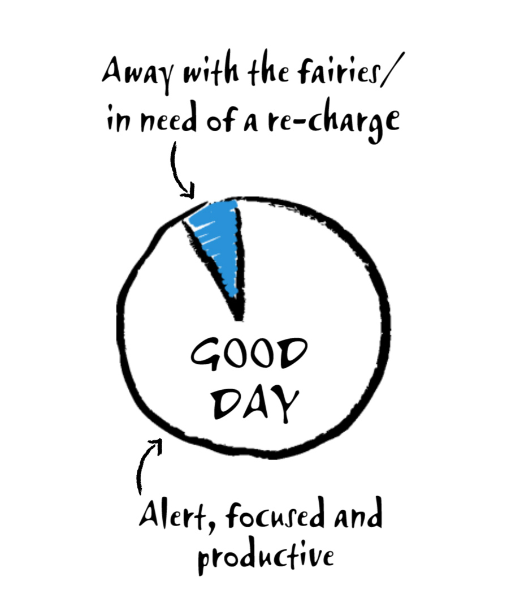
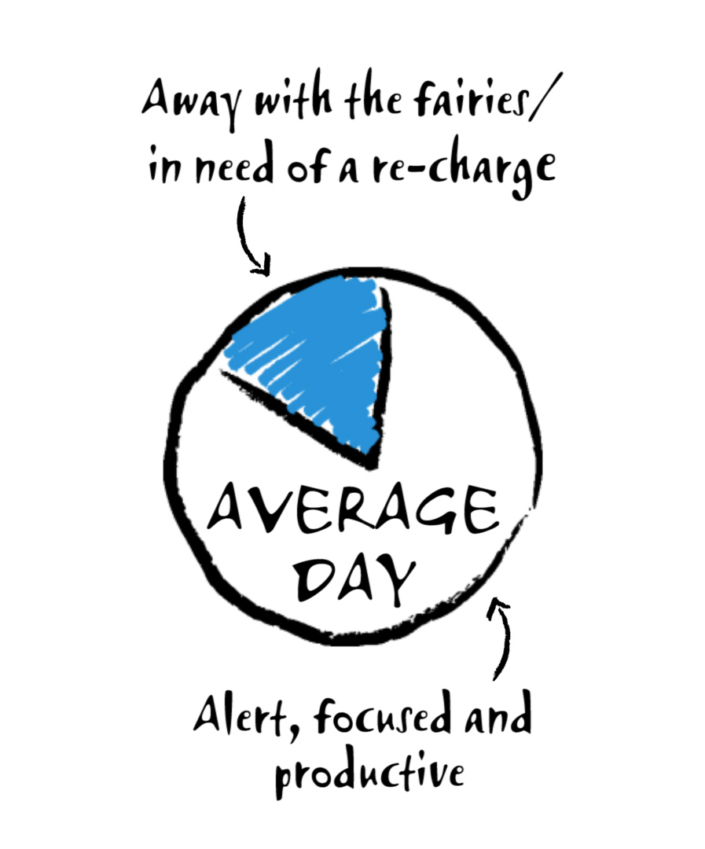
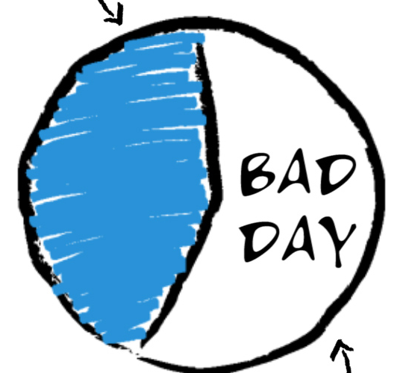
Blue Pie
Days
Notes:
10% - this is as good as it gets
20% - this is a more typical day
40% - but many people look like this

Slide 11
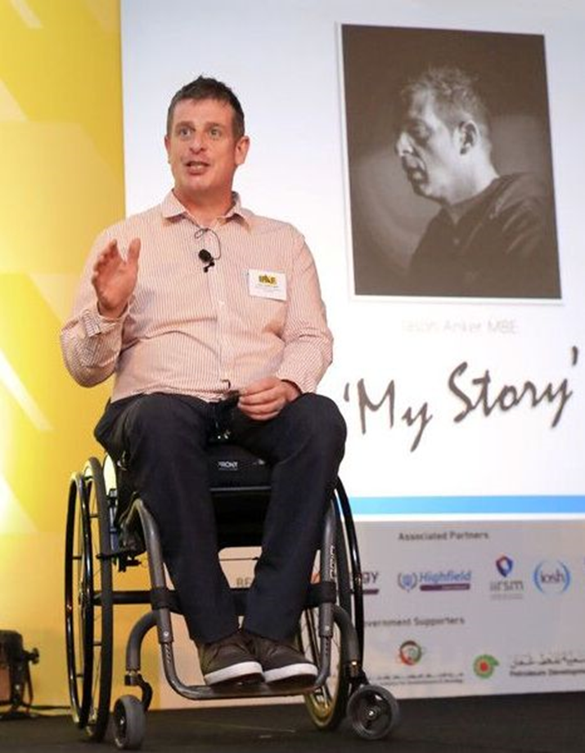
The Fatalism and Intolerance of Organisational, Interpersonal and Societal Factors Scale
AKA
The F. I. Score
Notes:
The Fatalism and Intolerance of Organisational, Interpersonal and Societal Factors Scale … or
Jason had:
tired,
been out drinking,
Unplanned
A favout
Not wanting to say no to client
End of shift
2 hr into 1

Slide 12
The mindset required to manage it
ERRORS
Unintentional
HUMAN
FAILURE
VIOLATIONS
Conscious choice

Slide 13
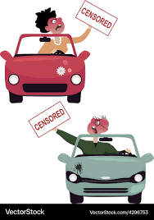
Fundamental Attribution Error
Notes:
DOING 56 ON AN OPEN ROAD (55 LIMIT)
RED FERRARI – CUTTING PEOPLE UP BEHIND YOU, THEN YOU
GUY ON PHONE.
AT LAMPOST – ARE YOU GONNA BE ALL A – A? OR P – C – HE DESERVED THAT!
WHAT IF YOU KNEW SOMETHING DIFFERENT????
DOCTOR RESPONDING TO AN emergency
On the phone doing triage
Borrowed FIL car
Still an idiot???
When we’re involved, we understand the cisrumstances. When others, we judge first (system 1); maybe we analyse after (system 2)
Finger pointing makes us feel good.
A cognitive bias
People assume or emphasise blame on a person
And take no account of the environment / Human Factors

Slide 14

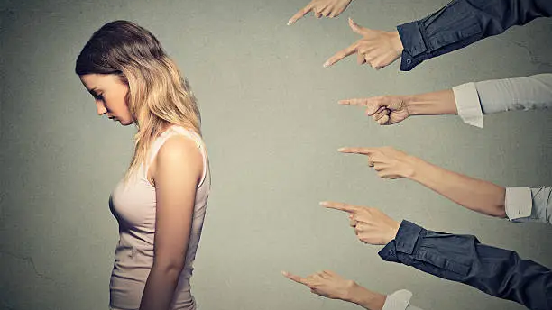

Slide 15
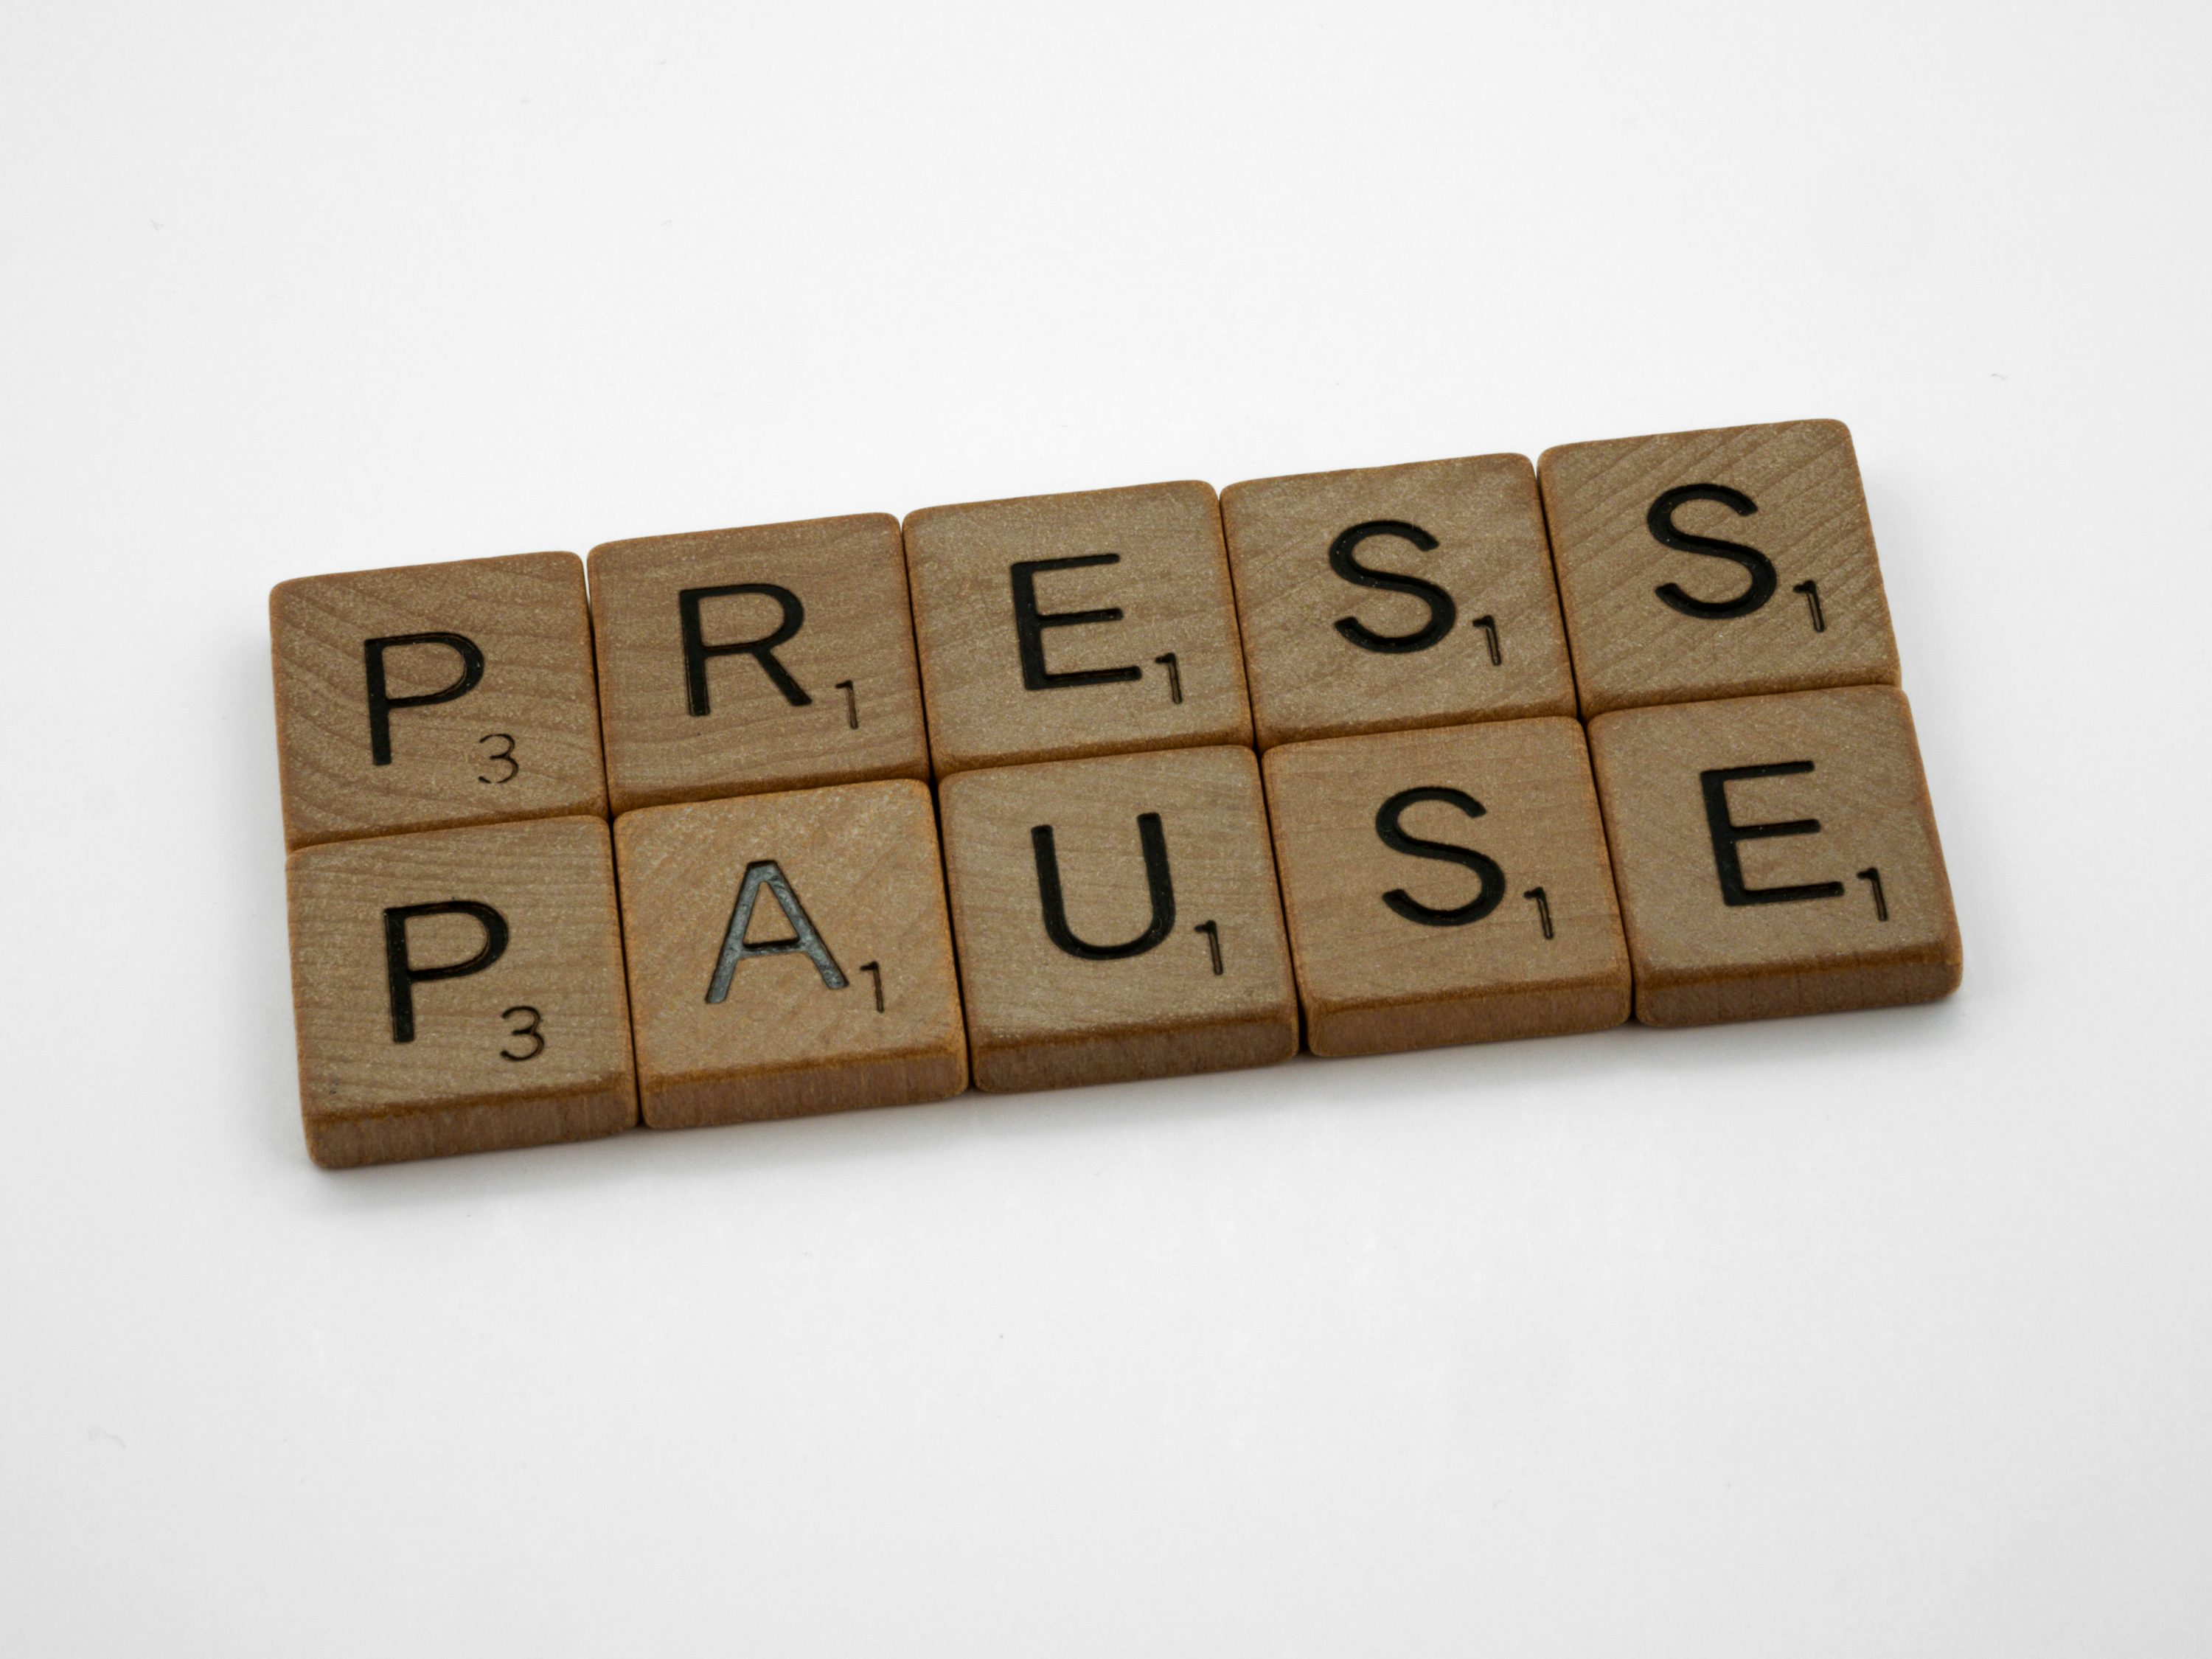
Notes:
Regularly through the day
Just before a safety significant task
Bring the logical brain back online:
Questions: “Do I really know or do I just think I know?”
Use your breath
Change your state
Count to 10!
asking a question is one of the best ways to re-engage the front brain (link to Transactional analysis getting into adult) and often the more ridiculous and less relevant the question, the more attention-getting it ill be. Ask yourself if you really know. Aks others something totally ridiculous.
Pause (like counting to 10 when you’re angry - i.e. giving your brain the space to react emotionally and then respond calmly) and breathe to help you become present and mindful in the room again (when we’re in back brain we’re not in the room anymore).
change your state by doing something different - have a break - leave the room and come back in - stand up - sit down - do a dance!
Picture Ref:
https://bsj.berkeley.edu/increasing-the-human-brain-memory-capacity-drugs-that-enhance-norepinephrine-and-dopamine-functionality-in-the-prefrontal-cortex/

Slide 16







Notes:
Access to Info for route planning:
Planning: assess the risks and ensure that routes are planned in advance, so far as is reasonably practicable. How do they know which risks are applicable?
Training: ensure that drivers, transport managers and planners are properly trained to enable them to assess the risks
height conversion charts
height measurement gauges
each vehicle and trailer in the fleet has an established running height on its technical record
running heights are available to anyone planning a route including drivers who encounter unexpected or unmapped obstructions, such as temporary works
ensuring that drivers do not use their own sat navs
3 months employment
relied upon vehicle height information supplied and did not independently verify the travelling height prior to departure;
No bridge-cleared or prescribed route was issued for the journey from Duxford to Scunthorpe so he utilised Google Maps for navigation;
He was aware that the height was close to the restriction but proceeded beneath the structure;
Multiple warning signs were passed prior to impact;
Communication: ensure that drivers are be provided with adequate information including about the vehicles which they are driving – when & how?

Slide 17

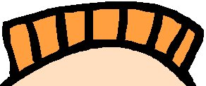
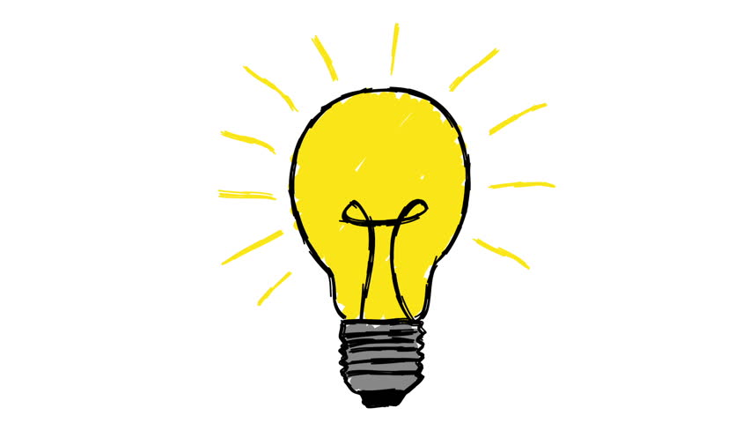




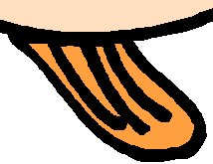

Slide 18
Eliminate
(remove the hazard completely)
Substitute
(alternative job/machine)
Isolate
(separate people & hazard)
Engineer Controls
(physical guards)
Admin
PPE
Notes:
What is easiest to do?
Reliability – balance
Do things go wrong at the top? More or less than at the bottom?
Humans
Detection of nuance
Perceiving a wide variety of stimuli
Pattern perception
Cars that can park themselves, brake automatically, and even self-change lanes
automatic emergency braking to lane-keeping assistance
adaptive cruise control and lane-keeping assistance. The former smartly controls the vehicle’s speed to keep a safe distance from other cars, whereas the latter helps drivers stay in their lanes.
Relevant recall of information
Creativity
Reaction to low probability events
Flexible problem solving
Utilising experience in the present
Performing even when overloaded
Inductive reasoning (hypothesising)
false sense of security, causing distraction, and reducing situational awareness.
Machines
Operating in environments that are hostile
Repetitive, precise operations
Fast response to signals
Fast information processing
Perform with high accuracy
Can detect stimuli beyond human capability (e.g. infrared)
Multi-tasking
Exerting large amounts of force smoothly
Insensitive to extraneous factors (e.g. mood)
Deductive reasoning (logic)
THE LAW OF UNINTENDED CONSEQUENCES
According to Forbes, these technologies reduce certain types of accidents, particularly those caused by driver inattention or fatigue. Data shows that vehicles equipped with blind-spot monitoring have 14% lower crash rates than those who don’t have any. It also suggests that if every automobile sold since 2015 had blind-spot monitoring, it would’ve prevented 50,000 accidents and over 15,000 accident injuries.
Furthermore, another study states that combining vehicle crash-preventative systems can reduce accident frequency by over 3.2%. Similarly, navigation apps like Google’s Waze now warn drivers of roads prone to accidents, aiming to improve overall road safety. By providing historical crash data about accident-prone areas, these apps empower drivers to make more informed decisions and potentially avoid hazardous situations.
CNBC News states that artificial intelligence analyzes the data, including road characteristics, everyday traffic volume, elevation, and road type, before creating a report. However, it’s important to consider whether drivers might become too reliant on these technologies. Could overconfidence in these systems lead to new risks on the road?
While technology promises to enhance safety, there’s a growing concern that drivers may rely too heavily on it. When drivers assume technology will handle everything, they may become less attentive. This over-reliance can lead to dangerous situations, especially if the technology fails.
The Verge reports that truck drivers who use automated driving technology have slower reaction times. Another report says that automation is making commercial pilots less skilled. There have been cases where Tesla’s self-driving technology, intended to prevent accidents, has contributed to them.
For instance, Craig Doty II revealed that his Tesla’s Full-Self Driving mode failed to detect a moving train, resulting in a tragic accident. Video evidence further revealed that the car didn’t slow down, forcing Doty to stop the car manually. Another incident occurred in November 2022 when a Tesla in Full Self-Driving mode erratically stalled on a busy highway.
Yahoo notes that this accident resulted in an eight-car pileup. Such incidents trigger questions about over-reliance on technology and the need for human supervision. If current technology can’t detect a large, high-risk object (a moving train), you can’t expect it to identify small, fast-moving entities like debris.
For instance, just last year, a 21-year-old woman in St. Louis County was killed after flying debris from another crash pierced her windshield. In such cases, even the most advanced systems might fail as they can’t account for sudden, unpredictable events. When such accidents occur, TorHoerman Law suggests having the necessary legal support.
In our case, a car accident lawyer in St. Louis would be familiar with the unique challenges of local roads and highways. This includes accident-prone areas. They can help victims or their families with the legalities when technology fails to prevent such unforeseen incidents. Moreover, they also fight for fair compensation and hold the responsible parties accountable.
Balancing the Risks and Benefits of Technology in Accident Prevention
Technology can only do so much to prevent accidents—human behavior remains a critical factor. Even with the best safety features, accidents can still occur if the drivers are distracted, impaired, or not 100% engaged. Technology is meant to complement, not replace, the driver.
But, when drivers overly depend on these systems, the risk of accidents may increase. Moreover, current ADAS technologies have limitations. They perform impressively in standard driving conditions but can struggle in complex situations, such as heavy traffic or adverse weather. For example, while adaptive cruise control works effectively on highways, it may not react quickly enough in sudden stop-and-go traffic, leading to rear-end collisions.
Proper training, education, and a clear understanding of the limitations of these features are crucial to maximizing their safety benefits. While these advancements are promising, they remind us that technology isn’t foolproof.
While technology can augment safety, it should not replace human judgment and responsibility. The future of accident prevention lies in combining advanced technology with responsible human oversight. The Verge emphasizes that drivers must remain vigilant and engaged, even with advanced safety features. An overreliance on technology can lead to complacency and a false sense of security, potentially undermining the safety benefits it aims to provide.

Slide 19
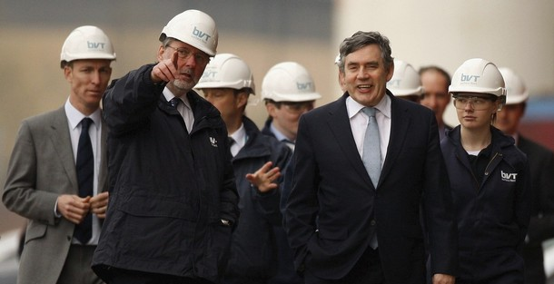
Notes:
Actions matching words
Do as I as and As I do
Walk the walk
Integrity

Slide 20


Get it done safely, but get it done by Friday
Get it done by Friday, but get it done safely
Get it done by Friday AND get it done safely ….. and if that difficult let’s talk
Notes:
Get it done safely, but get it done by Friday
Get it done by Friday, but get it done safely
Get it done by Friday AND get it done safely ….. and if that difficult let’s talk

Slide 21

Thank You
joyce@ankerandmarsh.com

Slide 22
SPARE SLIDES

Slide 23
The Phenomenal Power of the Mind
I cdnuolt blveiee taht I cluod aulaclty uesdnatnrd waht I was rdanieg.The phaonmneal pweor of the hmuan mnid! Aoccdrnig to a rseecherar at Cmabrigde Uinervtisy, it deosn't mttaer inwaht oredr the ltteers in a wrod are, the olny iprmoatnt tihng is taht the frist and lsat ltteer be in the rghit pclae. The rset can be a taotl mses and you can sitll raed it wouthit a porbelm. Tihs is bcuseae the huamn mnid deos not raed ervey lteter by istlef, but the wrod as a wlohe. Amzanig huh? And you awlyas thought slpeling was ipmorantt?!
Notes:
Seeing what we expect to see

