Slide 1


Safety Beyond Compliance
Reflection Session
Key points :
A good safety culture is paramount
Remember the human factor
Make sure your drivers know what to do and do what they know
Incident Investigation drives improvement
The power of procurement – Your suppliers need to manage their road risk well
Document what you – evidence of consistent good practice
Compliance is the starting point – safety beyond compliance is the goal
The challenge:
What will you do to improve safety for driving for work in your workplace

Slide 2
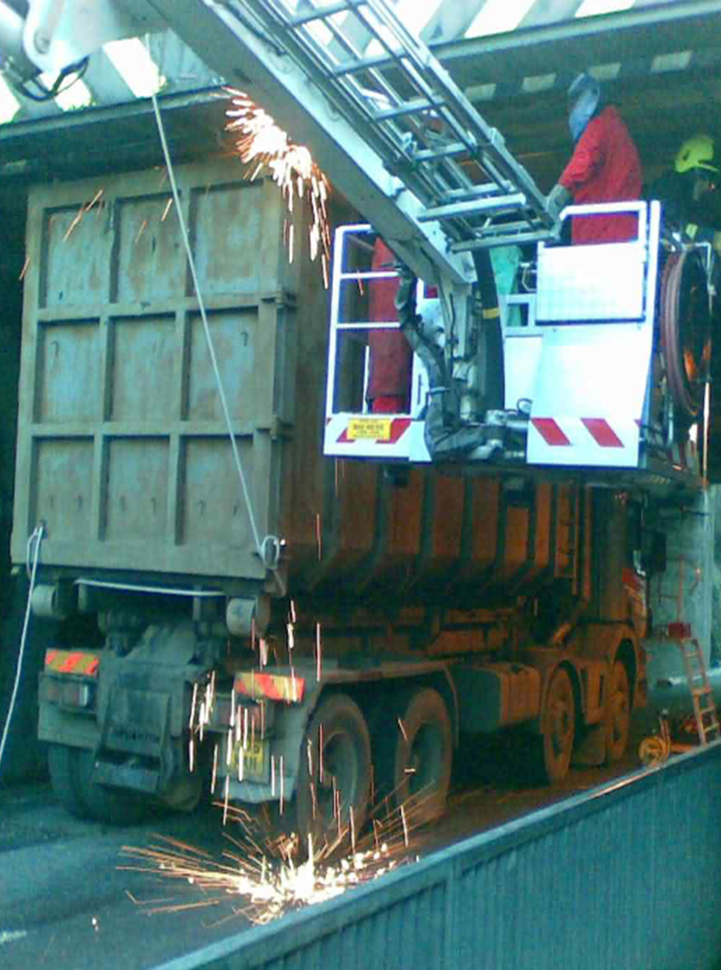
Safety Beyond Compliance
Useful resources:
Department for Transport – good practice guides:
www.gov.uk/government/publications/prevention-of-bridge-strikes-good-practice-guide
Network Rail - protocols and preventing bridge strikes:
www.networkrail.co.uk/our-work/looking-after-the-railway/bridges-tunnels-and-viaducts/the-risk-of-bridge-strikes/prevention-of-bridge-strikes/
www.networkrail.co.uk/our-work/looking-after-the-railway/bridges-tunnels-and-viaducts/the-risk-of-bridge-strikes/responding-to-bridge-strikes/
Wise up, Size up:
www.networkrail.co.uk/who-we-are/safety-in-the-community/railway-safety-campaigns/wise-up-size-up/

Slide 3
Safety Beyond Compliance
Useful resources:
Training & awareness
Logistics UK: https://training.logistics.org.uk/training-courses/managing-transport-operations/prevention-of-bridge-strikes-cpd/
Road Haulage Association: www.rha.uk.net/Training/Training-Details/Id/8584
Craig Baker Driver Training: www.cbakerdt.co.uk/blog-post/drivertraining/bridge-strike-prevention-training.html
Lloyd Morgan Group: www.lloydmorgangroup.co.uk/training/driver-training/understanding-preventing-bridge-strikes/
Management of driving for work: www.drivingforbetterbusiness.com

