Slide 1

Phil Breen Driver & Vehicle Standards Agency (DVSA)
Earned Recognition National Account Manager

Slide 2
The DVSA promise & strategy from the Department

Slide 3



Enable
Prevent
Respond
Use intelligence and evidence to take strong action for law breakers
Clear, easy to follow help and advice to customers
Monitor customers to make sure they maintain standards
Notes:
We aim to make every journey safer, greener and cleaner and put the customer at the heart of what we do. But our plan is also designed to achieve positive value for businesses.
We aim to:
enable customers with clear, accessible advice
prevent non-compliance with help to avoid repeated prohibitions
respond strongly, based on ever improving intelligence and evidence
This will reduce the burden enforcement places on us and on industry. Then we can concentrate our resources in the right place and at the right time to remove the serious and serial offenders from the market. Here is a summary of the priorities we are already working on.

Slide 4

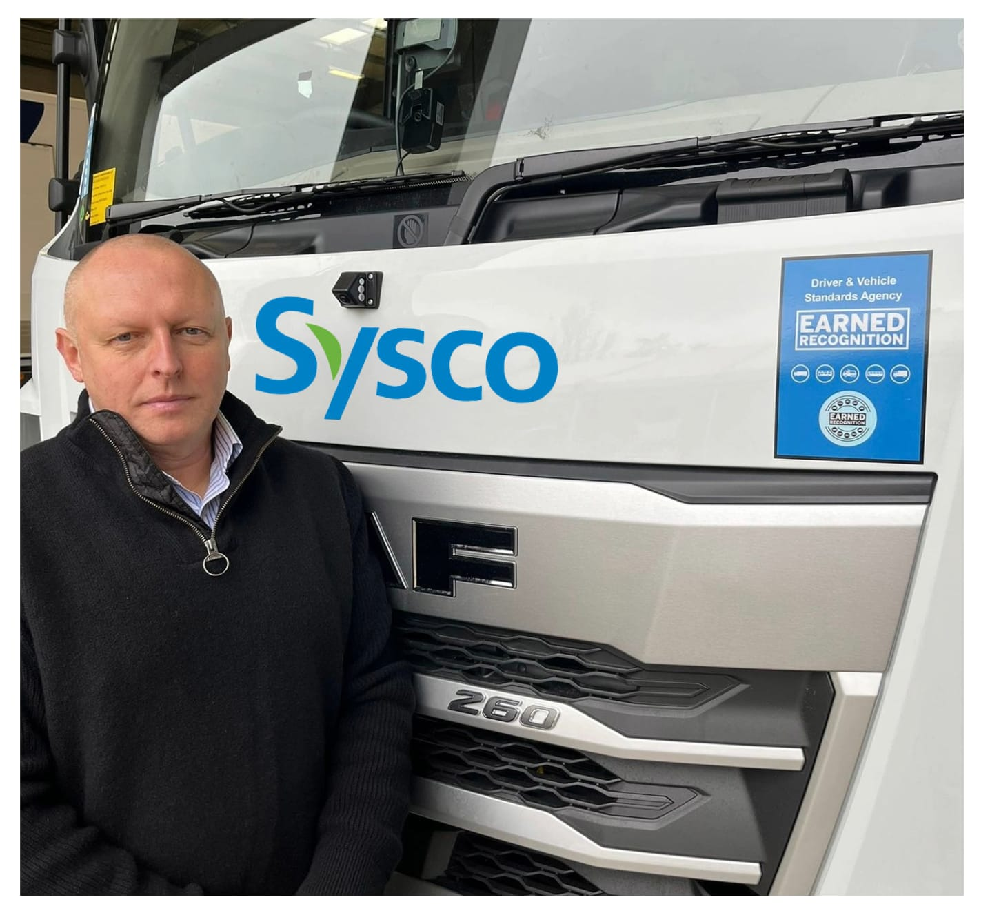
Lee Bedingfield, Head of Fleet Compliance at Sysco
“Joining the DVSA Earned Recognition scheme has sharpened our team’s commitment to driver and fleet compliance.
By working within the ER audit‑criteria framework, our transport managers now have clearer oversight and stronger tools to ensure we remain fully compliant across every part of our transport operations.”
Notes:
I am starting with a quote from Lesley at Freightlink, I cant say it any better than that. These ‘cowboys’ are playing fast and loose with road safety and potentially in some areas of industry are the same operators who may be winning contracts.
We need to make sure that the cost of none compliance is more expensive than being a compliant operator

Slide 5
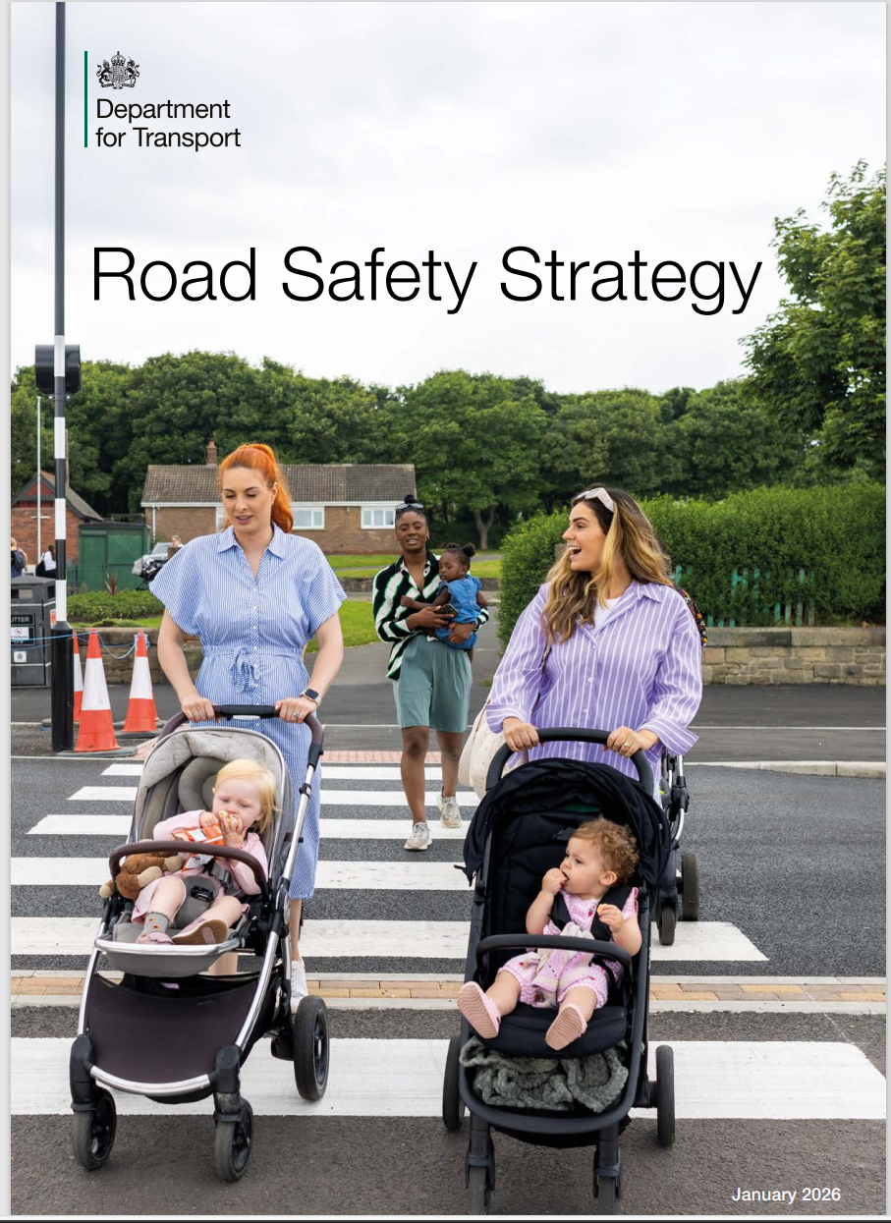

Road Safety Strategy
Notes:
Have you seen the DfT RSS, first in over a decade and it gives a clear view on the departments aim in the coming years. ER is mentioned several times. Wortha read

Slide 6
Understand the help that is given

Slide 7
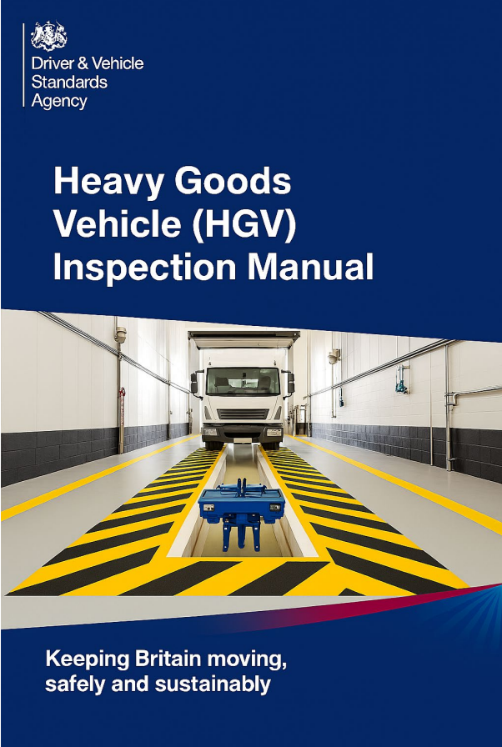
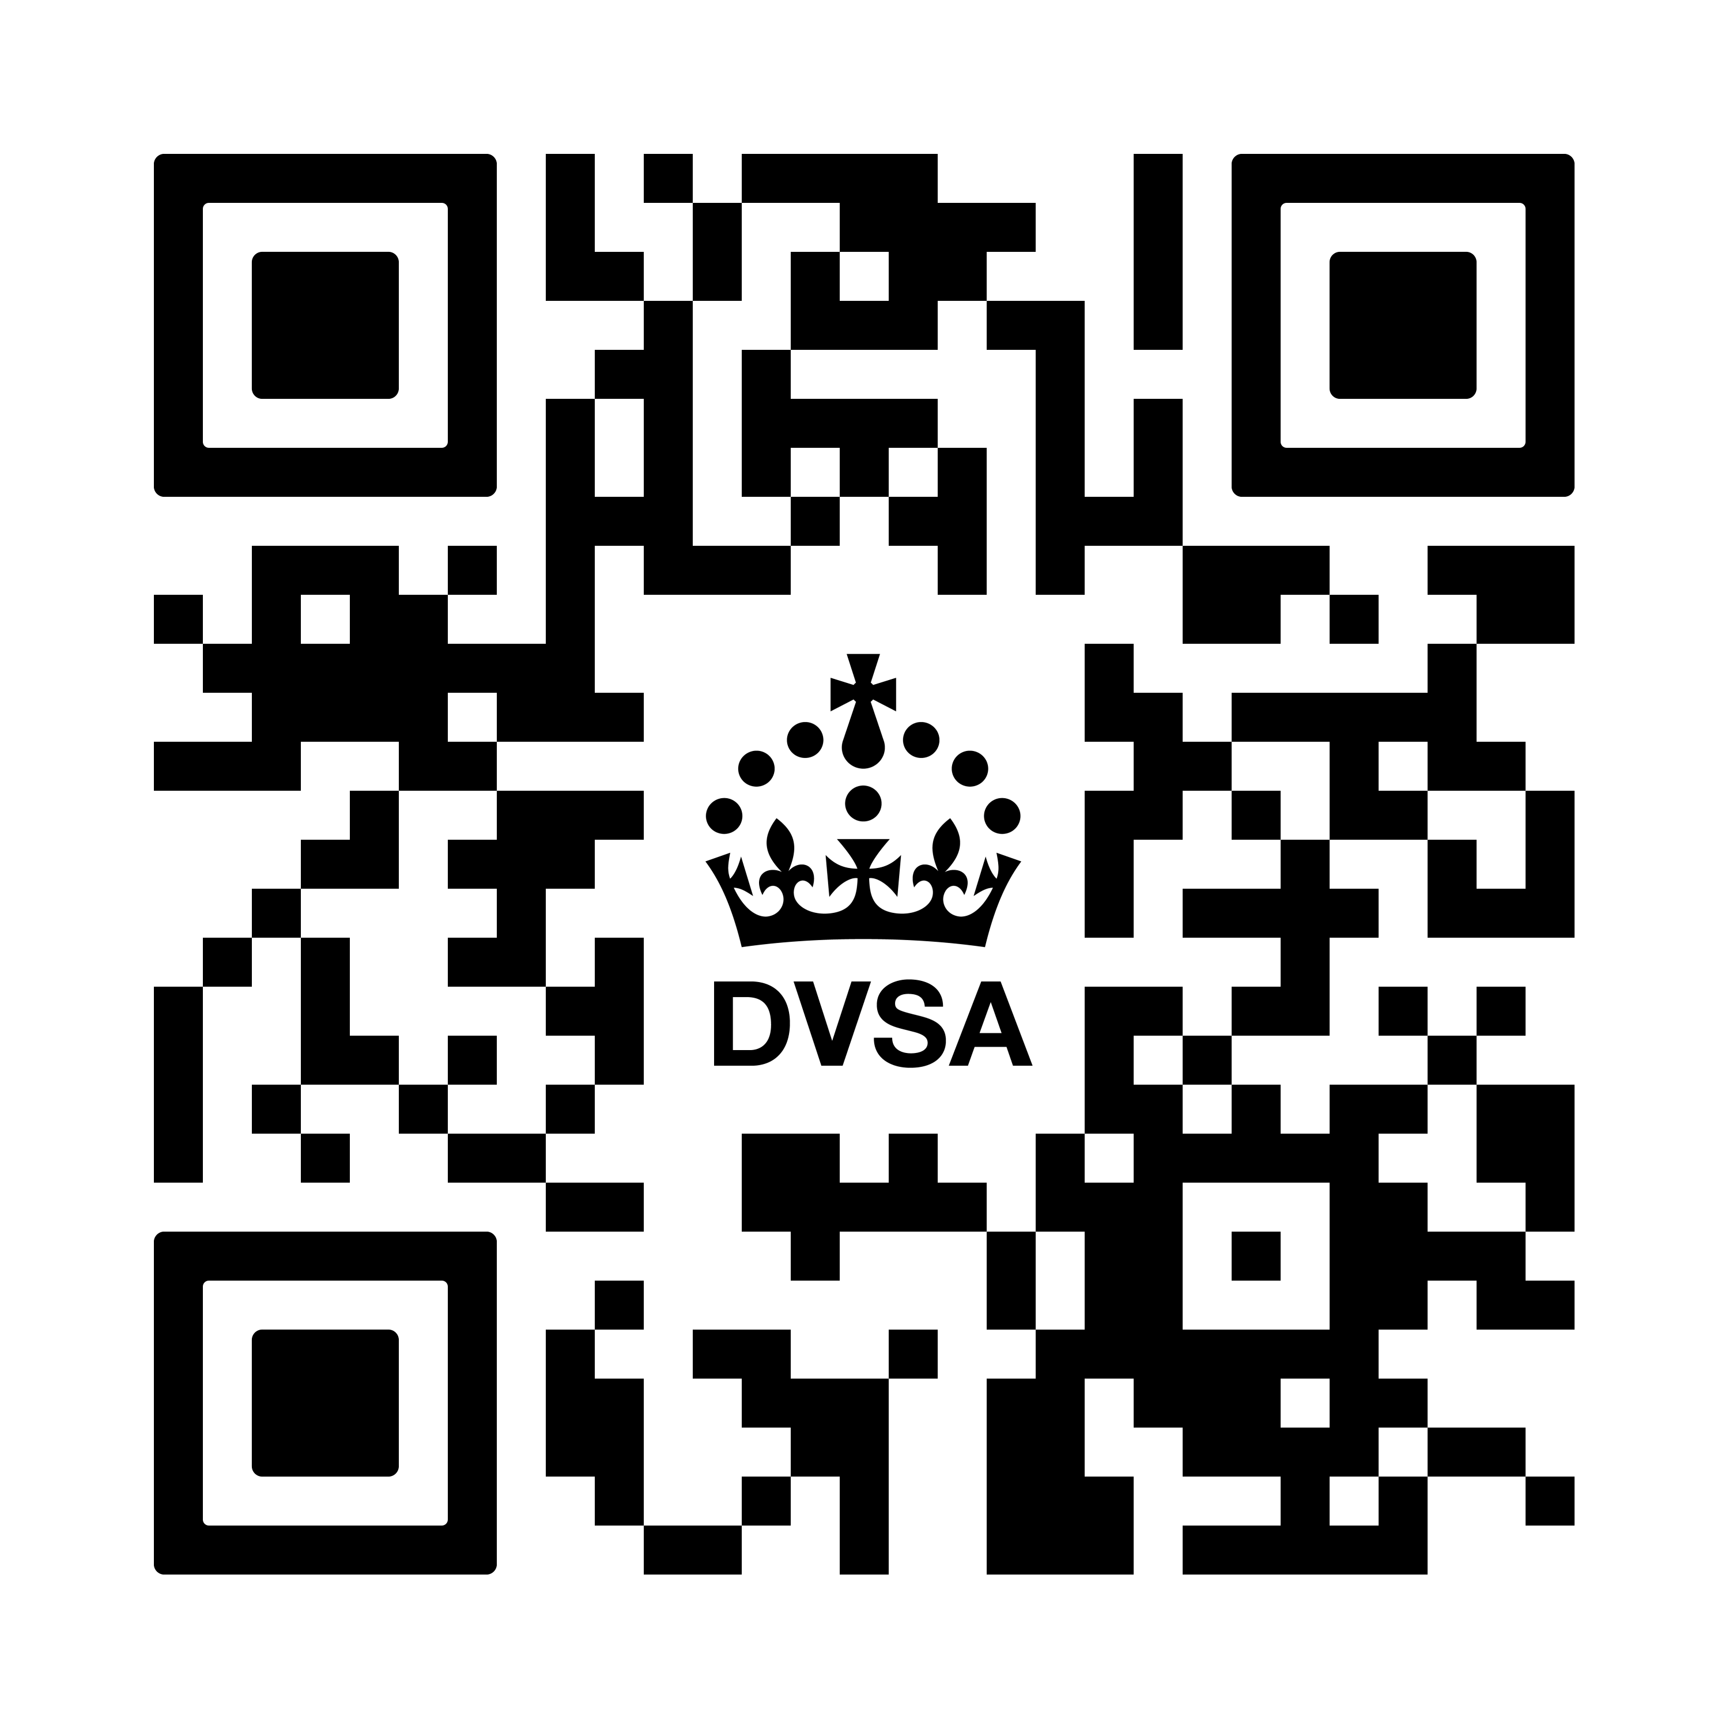
Update to the HGV Inspection Manual
New inspection manual comes into use from the 1 April 2026
15 Updates in the manual
The revision record and table show what has been updated in the manual and where each update appears
You can view, download and pint it from GOV.UK

Slide 8
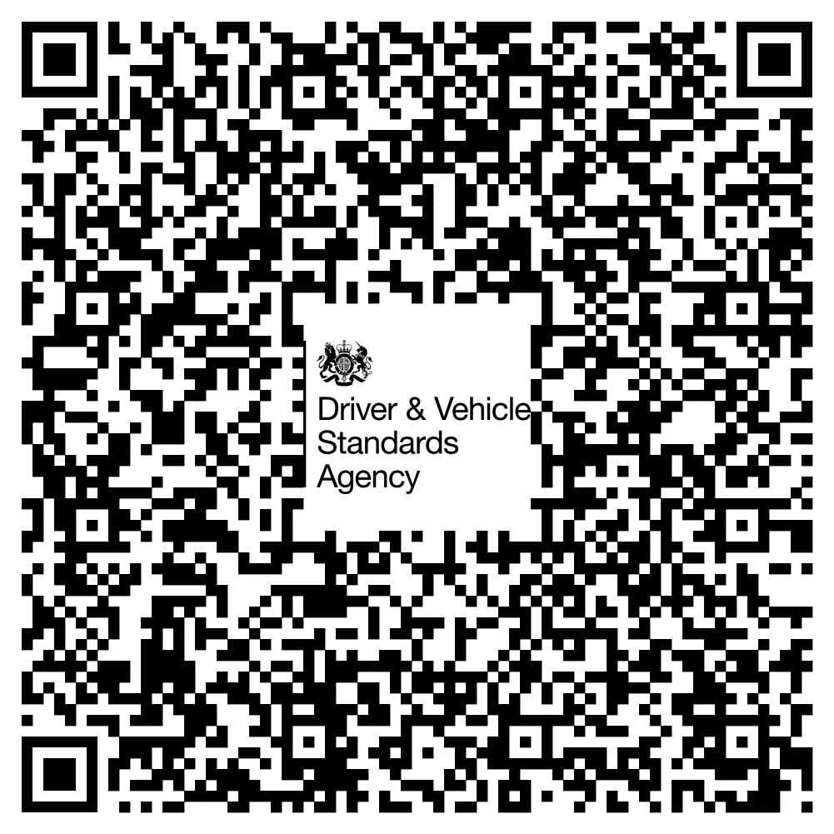
How to contact the DVSA Enforcement policy team…
Enforcementpolicy@dvsa.gov.uk
Notes:
Internal QR code only

Slide 9
Tackling non-complaince on all our roads and communities

Slide 10
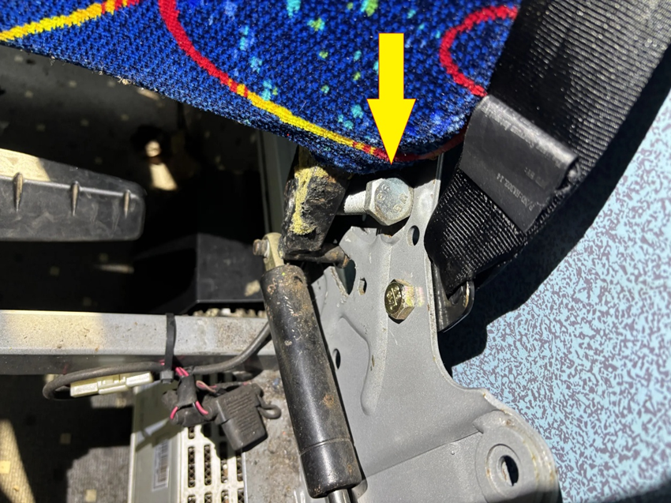
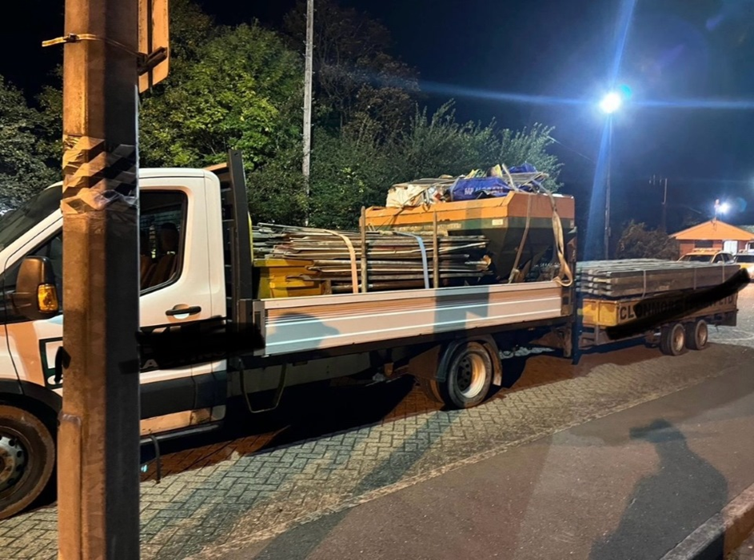
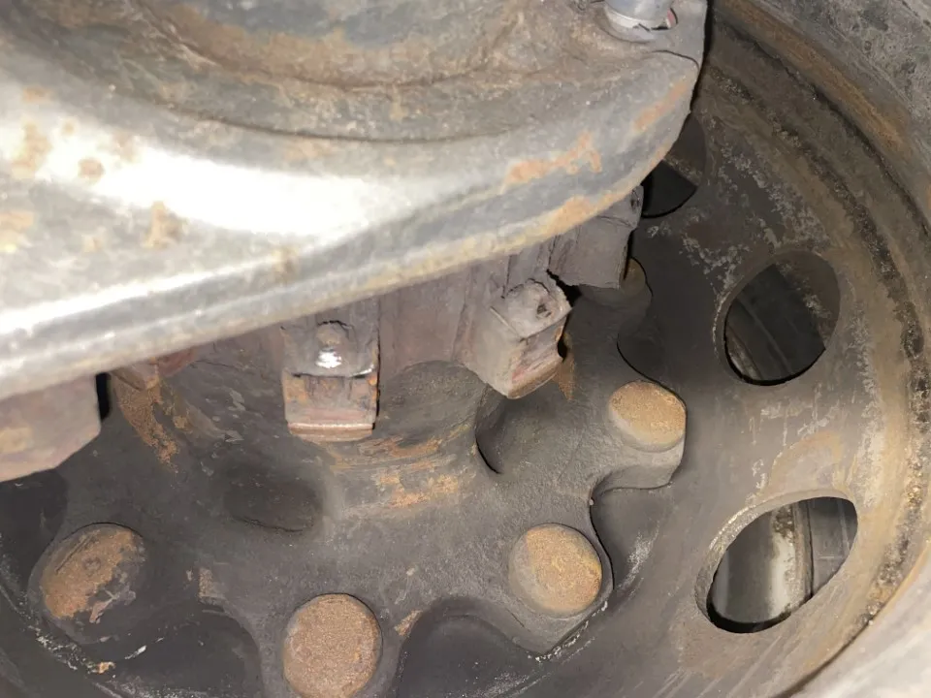
Notes:
It soon became clear that along with no tachograph fitted, no records and no operator licence, the occupants had no hope of leaving until the 98.2% overload on the second axle of the vehicle, 92.5% overload on the gross weight and the 88.3% overload on the train weight was removed, along with an appropriate towing vehicle for the trailer with drivers hours recording equipment was found with a new driver, along with a new tyre to replace the rear offside tyre of the vehicle with a depth measurement of 1.02mm.
A tall order during the day, but as it was almost midnight, the driver and the director (who happened to be in the passenger seat) decided to sit tight til day break.
With interviews suspended for the gentlemen to gain legal advice, drivers hours, overweight and roadworthiness prohibitions issued, a court deposit paid due to the drivers Non UK status, an immobilisation actioned and a promise from us that DVSA “will be in touch to arrange interviews for the intended prosecution “, we called it a night.
THIS is why we do what we do.
This combination was travelling from London to Ireland via Liverpool. So much could have gone wrong, lives potentially saved.
Things are difficult and uncertain at times with unrest and changes in the agency.
But this is the reason I come to work, along with the fantastic team I am lucky enough to work alongside.
(Feel free to zoom in to the incredulous look on my face that was captured just as I had calculated the weight percentages)😳
Pic 2: Whilst this was ongoing, I was interviewing the director and Transport Manager, and ensuring no alterations were made to any maintenance records, including VOR records, and these were removed from their possession for analysis.
The results of the fleet check were 6 of 8 inspected PSV's prohibited from use immediately. A total of 6 immediate prohibitions were issued for brake related defects, such as failed hydraulic brake pipes, contaminated brake discs with brake performance affected, and brake components defective affecting brake performance. There were also many driver reportable defects that had not been reported on the day, such as damage, warning lamps, insecure lamps, and a significant fuel leak. Many other defects were identified in safety critical areas including steering, suspension, and tyres.
Having had previous Operator licences revoked under this company director, it is not their first rodeo, but having been to a Public Inquiry this time in 2024 for this O licence, it could be their last.
Each of the 6 PSV's removed from the road network on the day had been carrying school children in the morning. Thankfully, with DVSA's intervention, that wasn't repeated in the afternoon. Although there would no doubt have been some disruption for the children who were not collected from school, the potential outcome had they been does not bear thinking about.
Picture 3: Anyone spot what’s missing? Brake disc✖️Parking brake inefficient
✖️Service brake not operating
✖️Brake disc missing
✖️Insufficient daily rest
✖️Exceed 4.5 hours drive
🚨Driving vehicle whilst disqualified
✅Driver remanded in custody
✅Vehicle seized by police

Slide 11
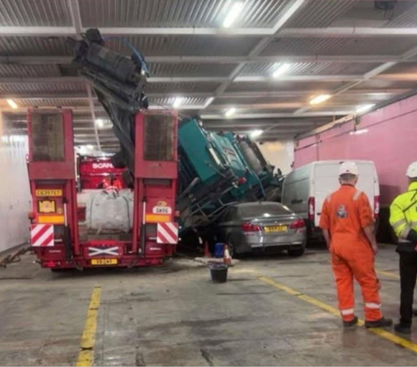
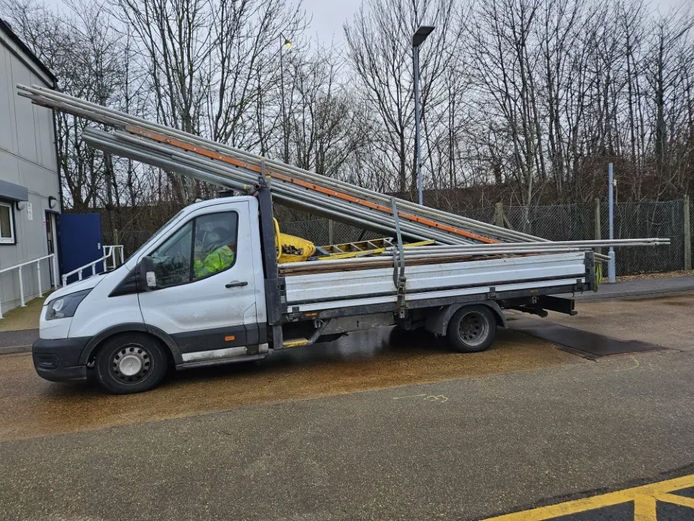
Know your limits and know your load
Notes:
Pic 1- Insecure load on a Highland ferry saw a shift in load.
Pic 2- Doesn’t look great from the side does it, looks worse in this video

Slide 12
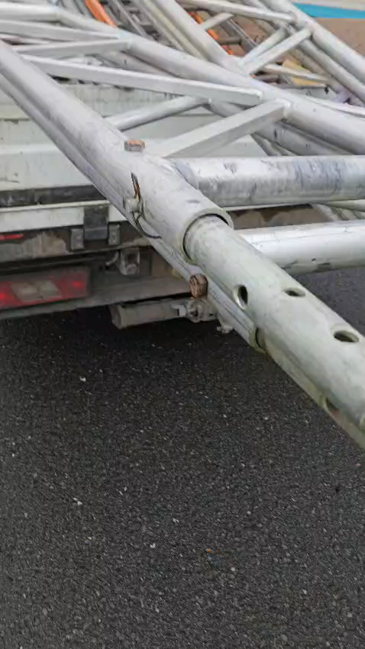
Video
Notes:
Insecure load, under inflated tyre, no insurance, no driving licence, 115% overload and then the driver was arrested for being in the UK illegally.

Slide 13
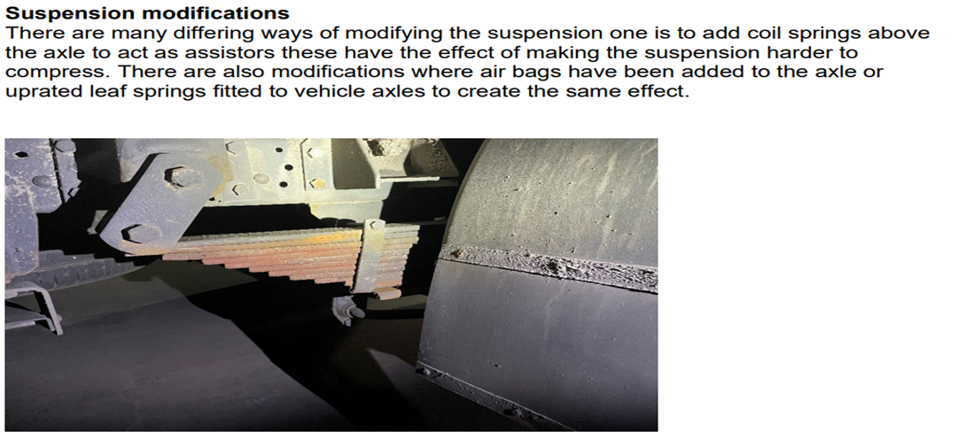
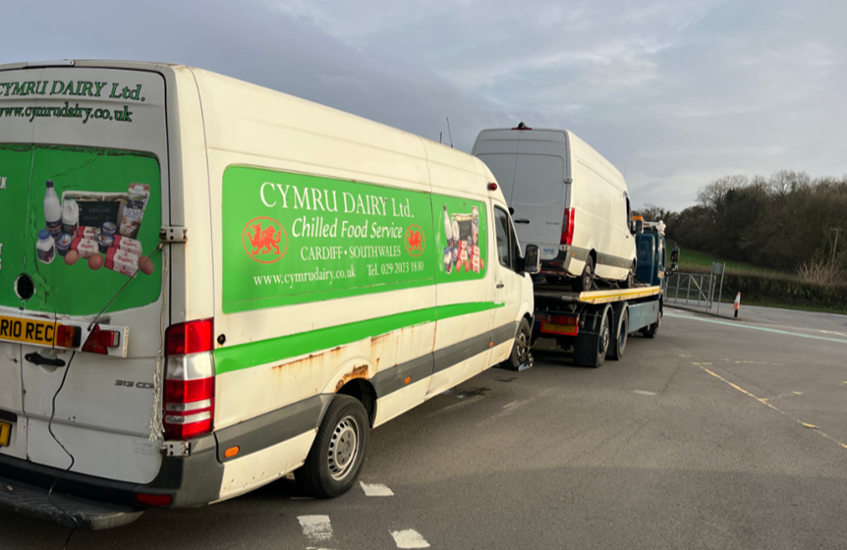
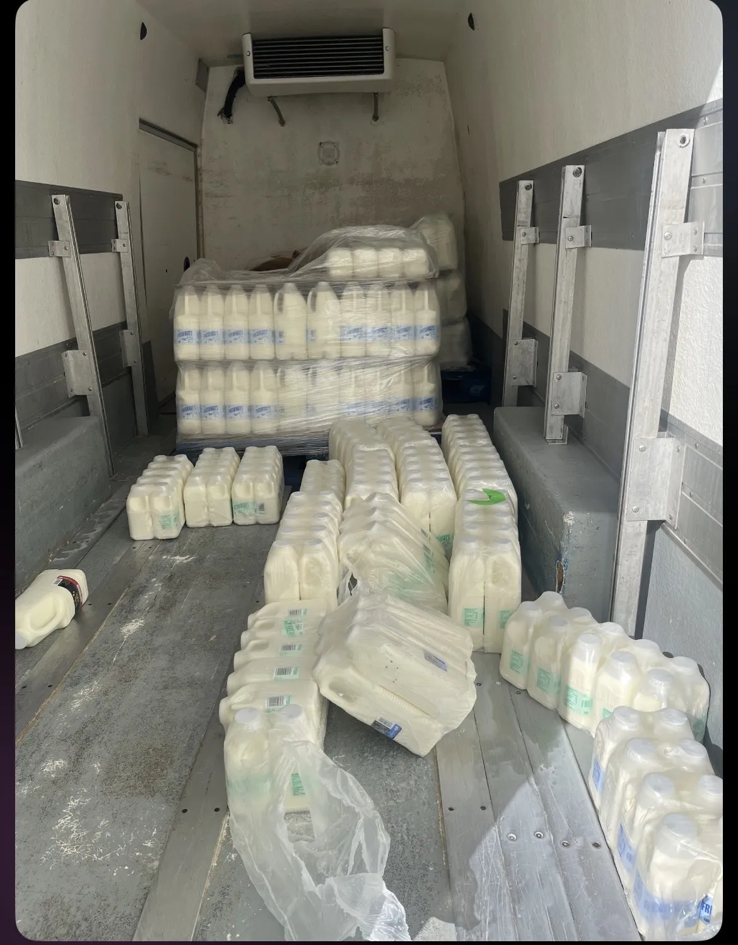
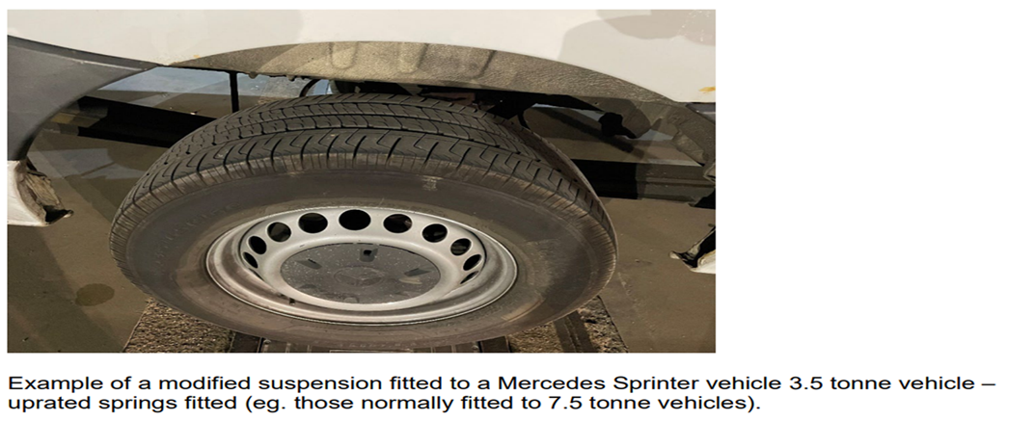
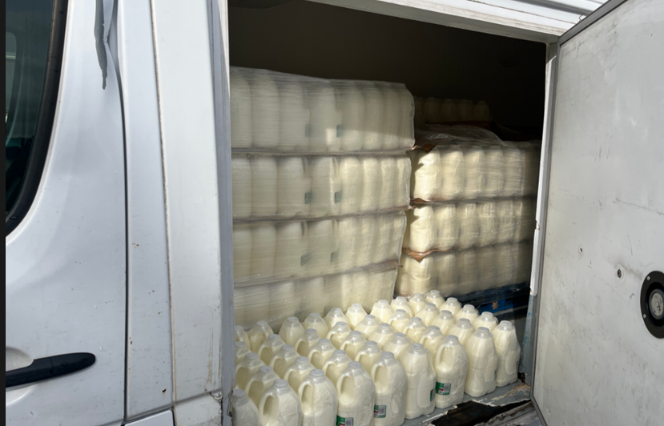
When is an LGV not an LGV?

Slide 14
Total Court fines now stand at:
£1,495,531
Keeping Britain moving, safely and sustainably

Slide 15
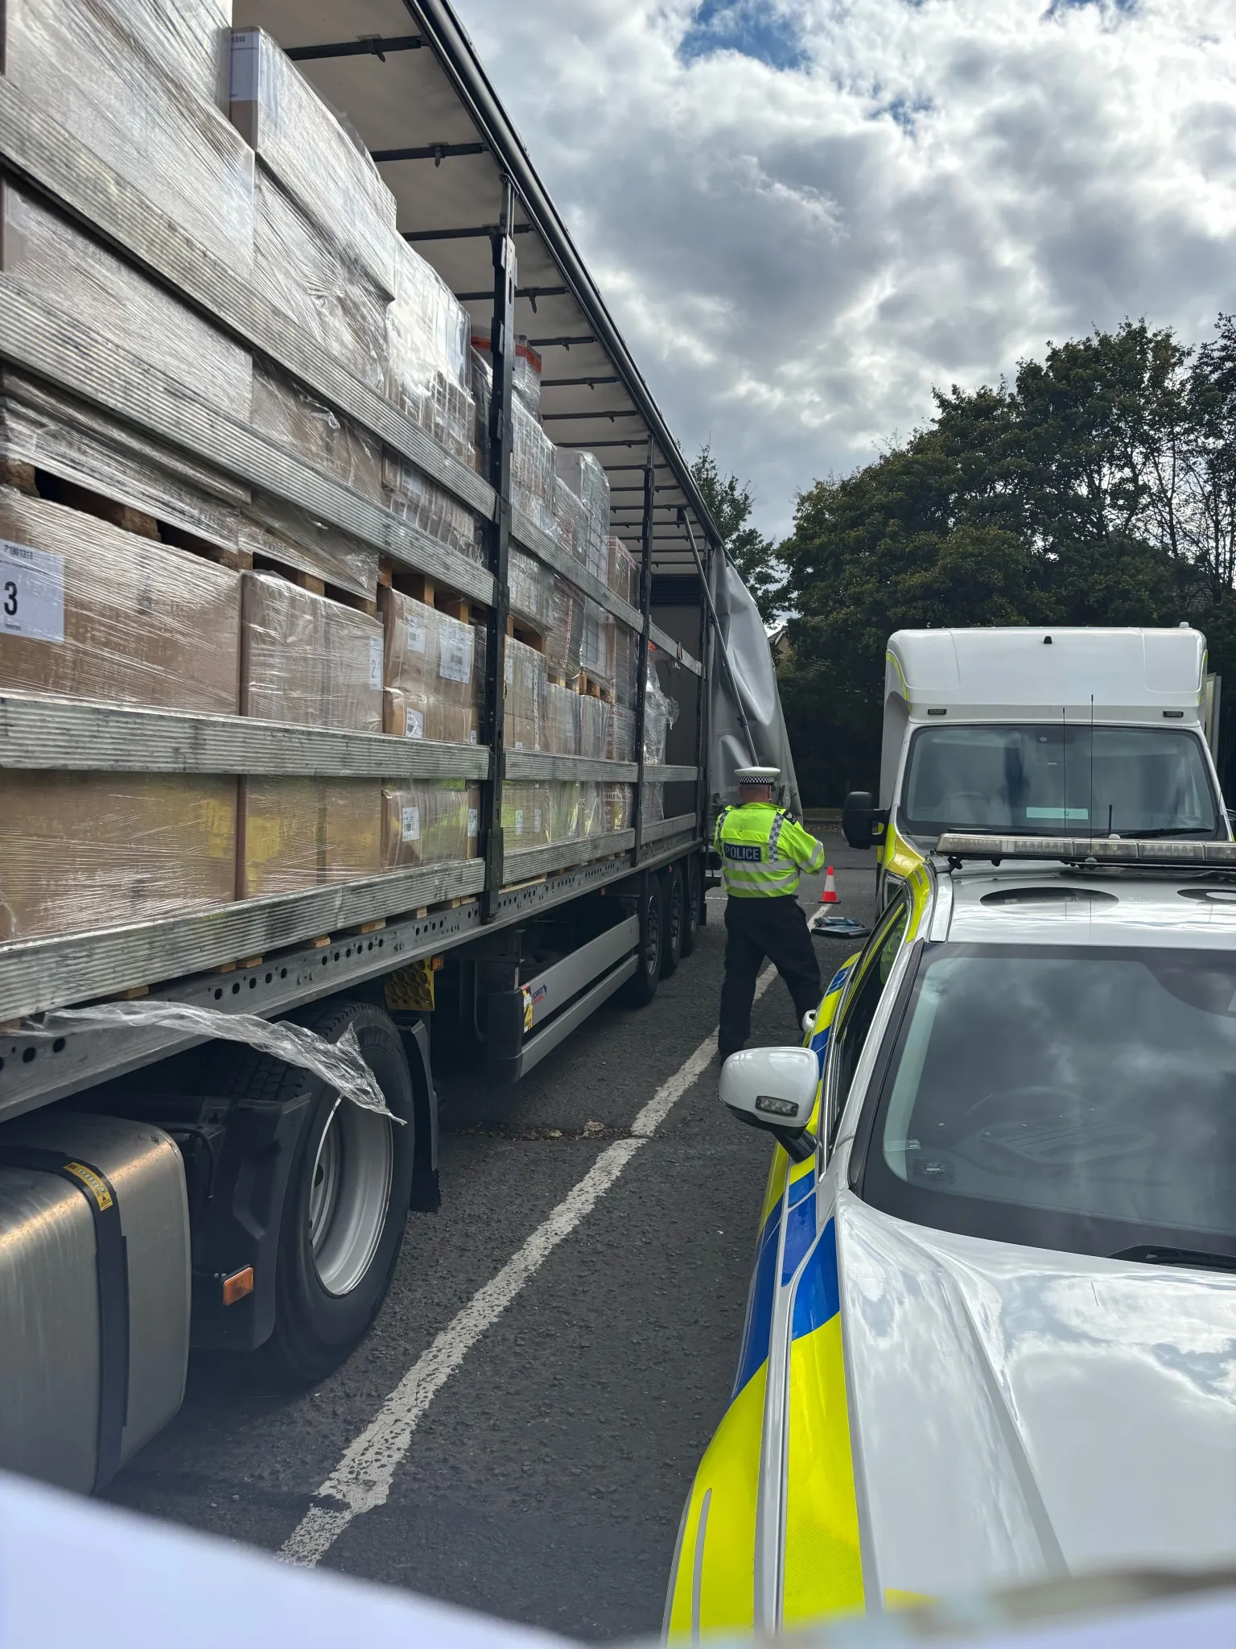
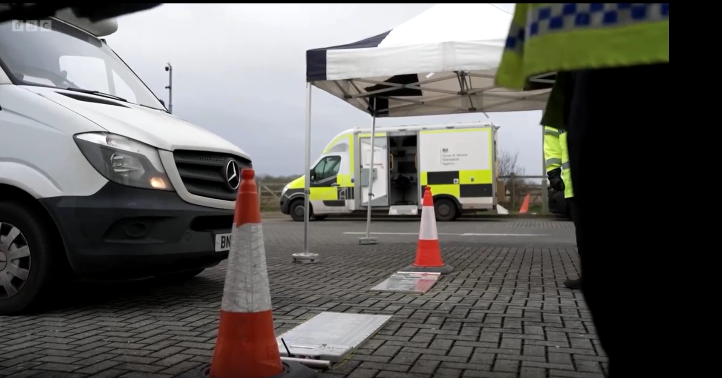
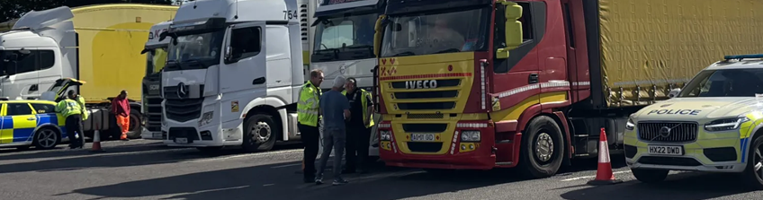
Operation Tiberius
Notes:
DVSA ,were involved in setting up Operation Tiberius, which ran in Bicester from Monday 16 - Tuesday 17 February 2026. This was a multi-organisation operation, including DVSA, TVP, DVLA, Oxfordshire Fire and Rescue, the Motor Insurance Bureau and officers from HM Border Force (among others).
the operation found:
12 arrests for immigration offences
4 people arrested for drug driving
82 vehicles prohibited
15 vehicles were seized for having no license
88 untaxed vehicles dealt with by the DVLA
34 overweight vehicles
18 people with no seatbelt
22 tyre defects
8 people for mobile phone offences
18 registration plate offences
18 window tint offences
14 vehicles in a dangerous condition
15 lighting offences
2 vehicles with no MOT
2 with no operator licences.

Slide 16
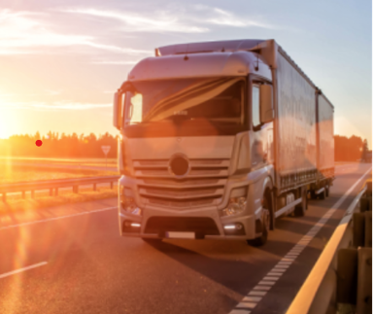
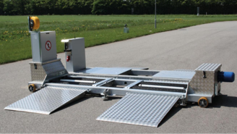
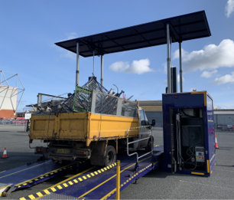
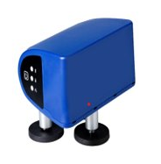
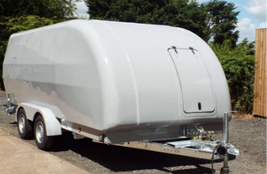
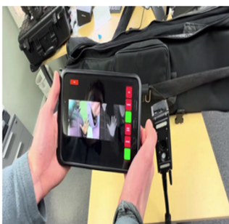

Remote and new
enforcement
approaches

Slide 17
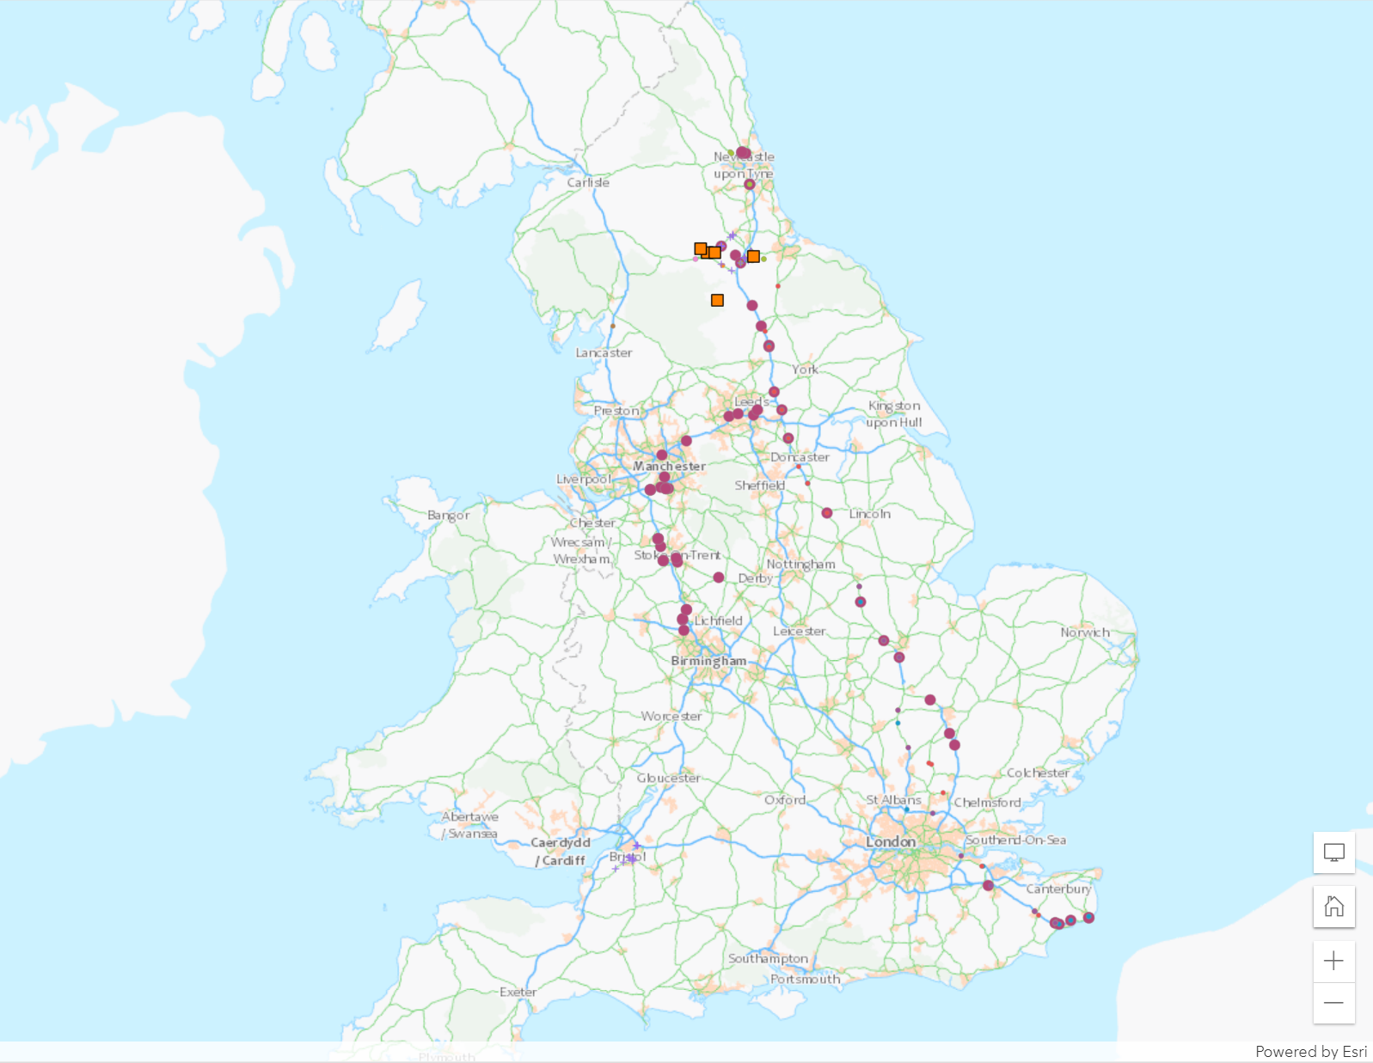
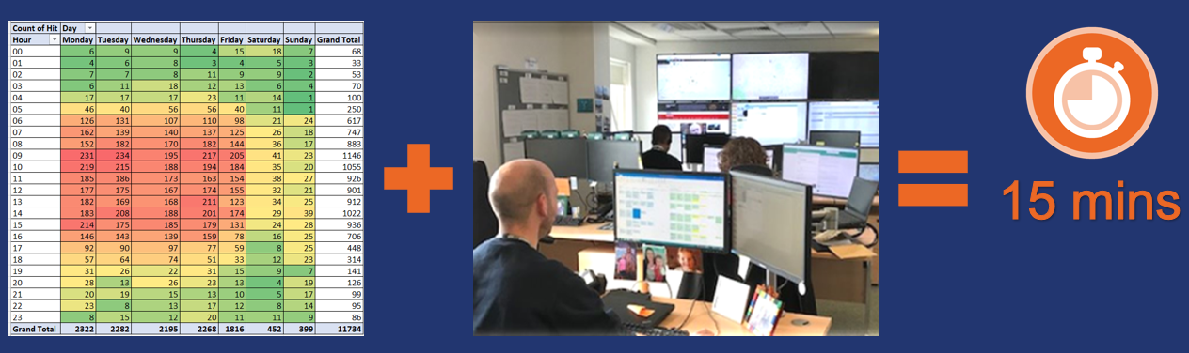
Remote targeted enforcement
recent pilot work identifying vehicles with no MOT remotely and taking action from the record proved remote interventions can improve road safety in an efficient way
using ANPR to remotely identify:
speed limiter interruption and fraud cases
offences in driving time
offences leading to civil penalties
26,213 ANPR searches completed during 2024/25

Slide 18
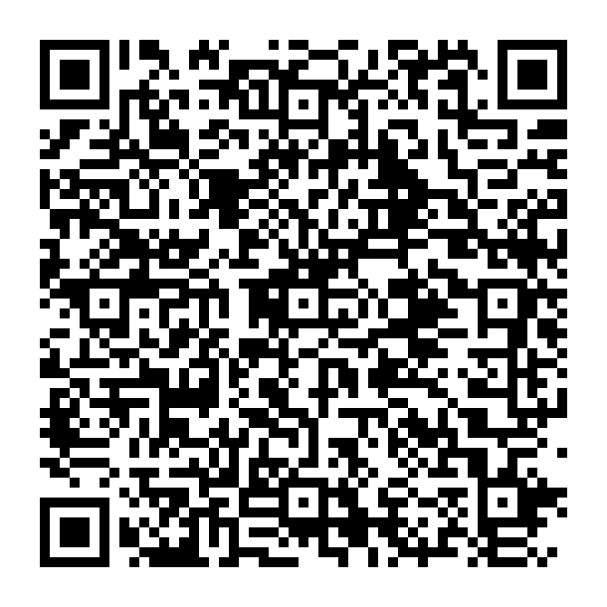
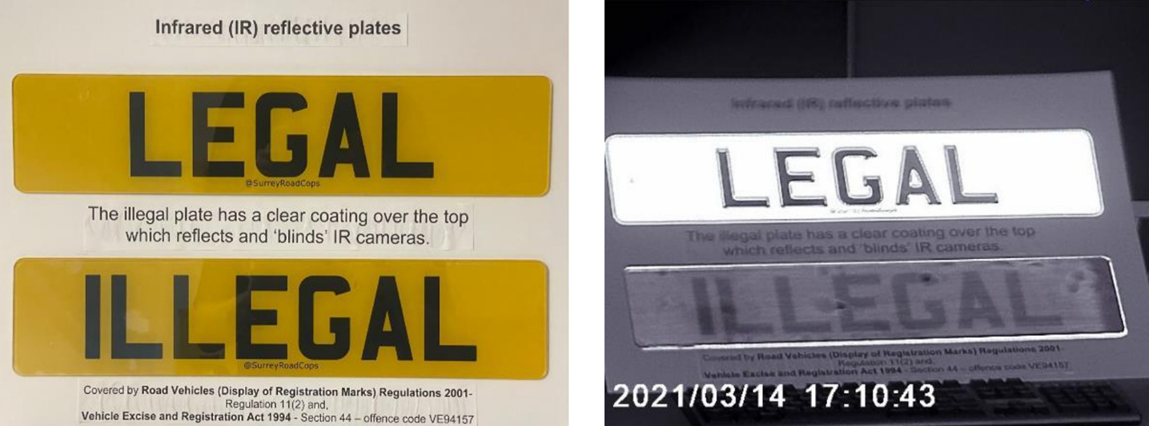
Ghost plates
Identified 250 plates in last 7 days
Algorithm on ANPR!
Consultation- Changes to motoring offences
Notes:
Consultation closes 1 min to midnight on the 11 May 2026

Slide 19
Setting exemplar standards for safety and compliance

Slide 20
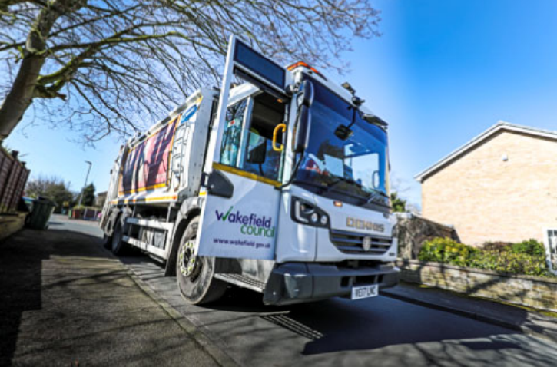
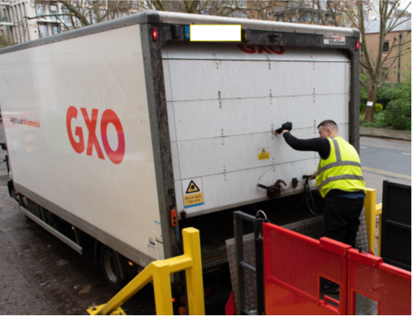
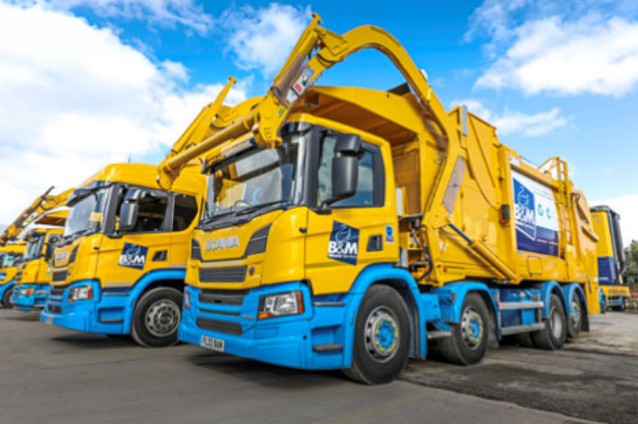
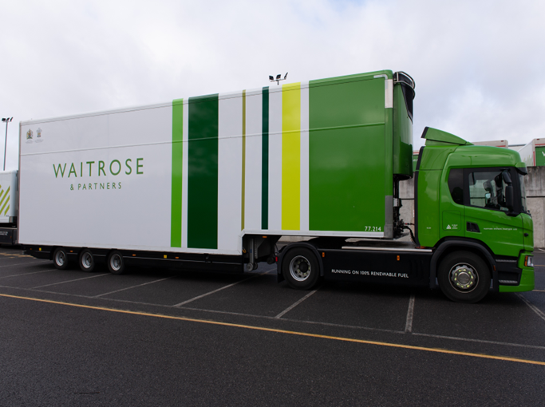
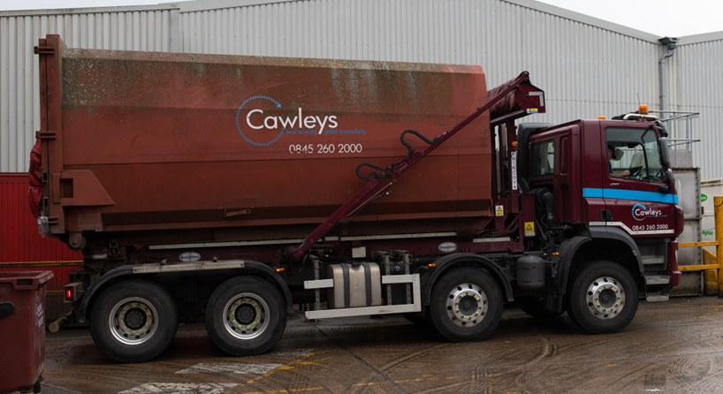
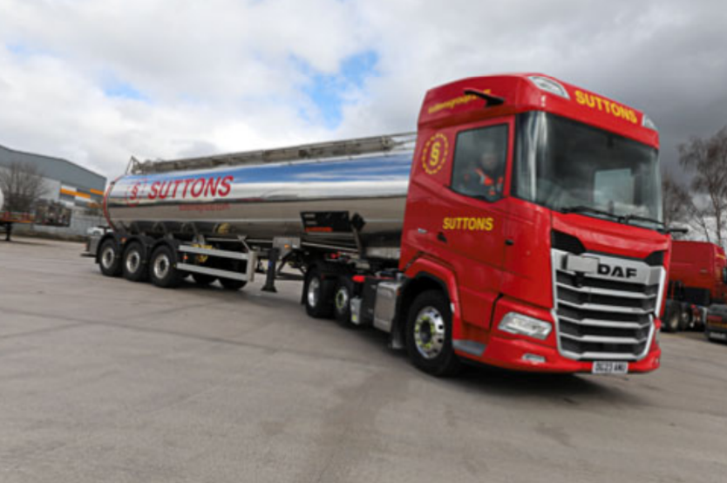
Earned Recognition: Recognising compliance & road safety
Notes:
The safest and most compliant within our industry. This was confirmed by the Traffic Commissioner on a recent DVSA ER summit event and the recent call to evidence around heavy goods testing options for ER operators by the ministry further strengthens the view that ER is the way forward for any complaint operator within GB.

Slide 21
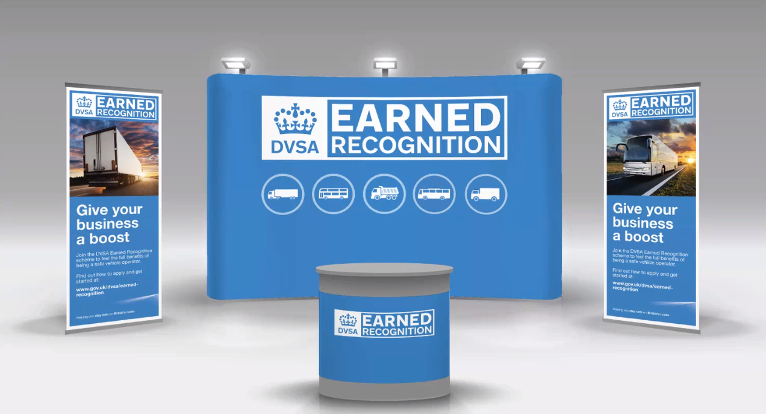
Notes:
The DVSA Earned Recognition.
The easiest way to stay in a compliant space is by becoming an Earned Recognition member. The scheme enables the exemplar in our industry demonstrate they take road safety and compliance seriously. With Audit standards covering everything from driver well-being, training and counter-terrorism it goes beyond just ensuring you are up to date with your driver’s hours and test status. The cost of non-compliance is huge to the UK, ER gives you a real opportunity to take compliance seriously and to help DVSA in keeping Britain's roads safe.
It’s more recognisable and a softer approachable that reflects the trusted relationship between the operators and the ER team. The blueprint of what a company should look like is ER in my opinion and we are pushing that question forward to contract holders and local authorities. I believe school children should be able to board a safe bus and I believe a refuse vehicle collecting your rubbish should be safe. These vehicles serve your community, but are they always the most compliant? The scheme means that DVSA can deal with the burden of compliance, ensuring the safest and most compliant are in the scheme. This means local authorities and contract holders who use ER operators can allow DVSA to focus on these topics and rest assured they are using the exemplar within our industry. Developing benefits Key Benefits of DVSA Earned Recognition
🚀 Commercial & Competitive Advantages
• Government recognition as an Exemplary Operator, giving you a stronger position when bidding for contracts.
• Permission to use the Earned Recognition marque on premises, websites, headed paper, and now on vehicles.
• Operator details published on GOV.UK, enhancing credibility and visibility.
🛣 Operational Benefits
• Reduced likelihood of being stopped at the roadside, desk-based assessments and DVSA site visits thanks to proven compliance.
• Efficiency gains through the use of digital monitoring systems.
• Access to dedicated DVSA Earned Recognition contacts for faster support.
🎓 Training, Support & Community
• Exclusive ER‑member workshops & summits including best‑practice sessions and open Q&A forums.
• Access to additional commercial and sector‑specific modules (HS2, LPT2, TfL, PSV Private Hire, Concrete sector, etc.).
• Opportunities involving DVSA apprentices.
💷 Financial & Practical Incentives
• 50% discount on M6 Toll crossings.
• 12‑month MOT exemptions for vehicles and trailers during COVID‑19 (historical benefit)

Slide 22
Earned Recognition Audit
An ER audit must be carried out by a DVSA authorised audit provider, there are numerous to choose from, listed on gov.uk
There are two sets of audit standards, one for HGV operators and one for PSV operators each with 10 sections
Operator Licence
Transport Manager or Responsible Person
Vehicle Standards
Driver Standards
Operational Management
Security Requirements
Driver Management
Training
Additional Policies
Section 10
Dangerous Goods (HGV Operators)
Service Work (PSV Operators)
Operators will not be audited
on Section 10 if they do not do these activities
Notes:
Once the application criteria has been met we then direct the operator to have an audit conducted
Two types of audits initial audits are carried out on the operator when they apply to become a scheme member and an interim or periodic audit conducted every 2 years to ensure the highest of standards are being adhered to
A further verification audit may be requested at any point if we feel there has been any slippage or change in structure
This could result in the ER team putting together an action plan for any elements not being met.

Slide 23
KPIs
Driver KPIs
Overall Infringement rate
Four Fixed Penalty Bands (current legislation)
Working Time Directive
PSV Domestic Drivers Hours KPIs are measured using Driver Allocation Systems (DAS)
Monitoring daily and fortnightly rest
MSI’s
Vehicle KPIs
Safety Records
Safety Inspection records completed correctly & signed off
Safety inspections completed within the stated frequency
Driver defect reports where road safety related items have been reported are appropriately actioned
Vehicle & trailer initial MOT pass rate
Notes:
What are the KPI’s DVSA look at
Operators will be measured against Key Performance Indicators,
Measured using the ISO calendar Rolling periods
4 weekly reporting period
4 weeks in arrears to allow analysis
13 reporting periods per year
MOT initial pass rate for ER 95% higher then National standard of 85%
The KPIs are all built around what your TMs, maintain providers, planners and drivers should be doing everyday.

Slide 24
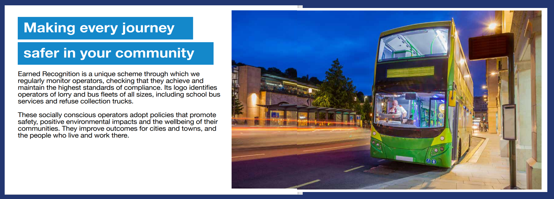
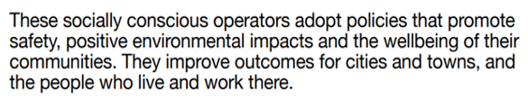
Road Safety Matters
Notes:
Road safety matters to us, it should matter to everyone involved in road transport.
(Take lead from what is on the slide) It is unique, we monitor operators because you share your information with us
You will already adopt the policies and processes that help your business thrive and keep your people safe – You will not be expecting your people to break the law to deliver your business
This is a key aim for the ER scheme, to work with local authorities and councils so we all play our part in road safety. Ensuring everyone understands that unsafe vehicles do not just appear on our roads, someone has ordered goods from these unsafe operators, booked their services or awarded them a contract. We aim to ensure that safety is at the top of any contract requirement.
Every vehicle DVSA stops on our roads is not there by chance. Someone hired that company to supply a service a deliver goods. Whether that be directly or through sub-contractor. We all have a duty to understand which vehicles are being used within our supply chain, the vehicles that operator within our community. I don’t think it is too much to ensure a school child gets on to a school and know that bus is safe. I don’t think it is too much for a driver to get into a cab and know they are in a better position to arrive home safe at the end of their shift. I don’t think it is too much to ask that the refuse vehicles collection the rubbish from outside my house has brakes that work. These things are not a given though, compliance is not a given. Is it timed that changed?
With industry leading audit standards covering everything from counter- terrorism, vehicles not being used as weapons, load security and emission outputs. The audit offers a clear blue-print of road safety & compliance looks like. All while being overseen by the regular of transport. This will help you to meet the Welsh Government net zero plans as laid out in your net zero strategic plan published in September 2022.

Slide 25
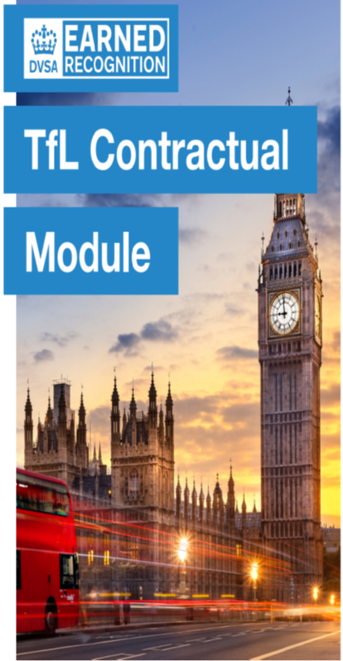

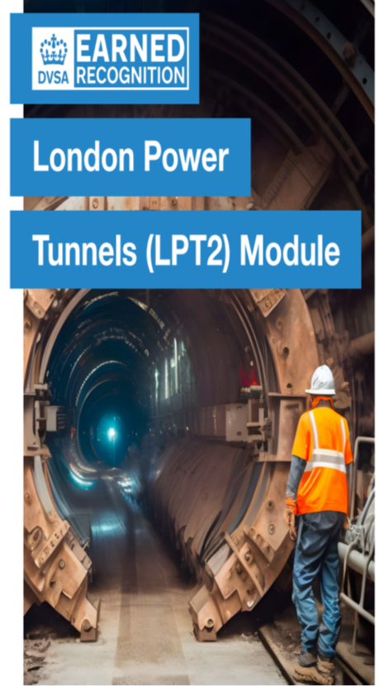
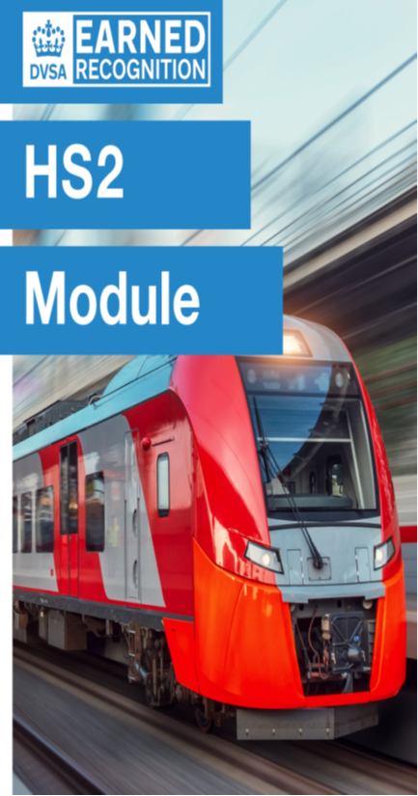
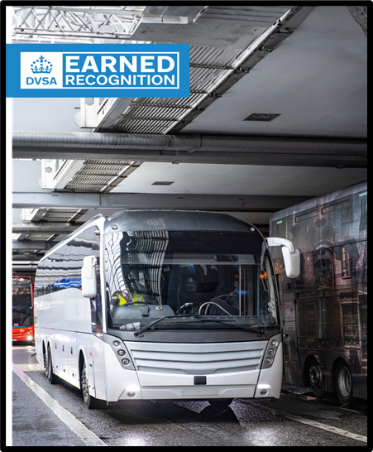

Earned Recognition: modules
Notes:
Additional commercial modules means that the safest operators can bid for contracts, or be part of organisation setting standards. Why would you not want the safest and most complaint operating in your towns & cities, carrying out your contracts? Within 6 years, the DVSA Earned Recognition scheme has launched five modules- which give commercially viable options for the scheme’s members. As well as improving standards for the related project or organisation.
The Concrete operational module, in partnership with the British Aggregates Association. The British Aggregates Association is the established voice of the UK’s independent SME (small or medium enterprise) quarry operators. The association provides essential support and advice in all health and safety, planning, transport, environmental, technical, and regulatory issues. Through the DVSA Earned Recognition scheme, operators can demonstrate they meet the highest levels of compliance and road safety standards. If you pass this module, it will help you bid for this type of contract.
The PSV Private Hire Module: This module offers operators the opportunity to apply to become members of the Guild of British Coach Operators. The Guild of British Coach Operators is an association of top-quality coach companies dedicated to providing their customers with a first-class service. The member companies provide luxury coaches for charter throughout Britain and Europe and offer comprehensive travel management services. Through the DVSA Earned Recognition scheme, Operators can demonstrate they meet the highest levels of compliance and road safety. It also allows for membership to the Scholl Travel Forum (STF), which means additional forms, applications etc do not need to be completed. But those that hold the module can access contracts for various school transport opportunities.
The HS2 Module: High Speed 2 (HS2) is Britain’s new high speed rail line being built from London to the North-West, with HS2 trains linking the biggest cities in Scotland with Manchester, Birmingham, and London. It is the largest infrastructure project in Europe and the most important economic and social regeneration project in decades. Through the DVSA Earned Recognition scheme, operators can demonstrate they meet the highest levels of compliance and road safety standards. If you pass this module, it will help when you bid for this type of contract.
The LPT2 module: The London Power Tunnels Phase 2 (LPT2) project works involve building the tunnels and shafts for the second phase of National Grid’s scheme to rewire the capital and replace existing electricity cables that are coming to the end of their life. � 20 miles of tunnel over 3 sections � 7 deep shafts (approximately 30m) � 11km EHV cable � Substation modification � Utilities diversions Through the DVSA Earned Recognition scheme Operators can demonstrate they meet the highest levels of compliance and road safety standards.
The TfL Contractual requirements module: Through the DVSA Earned Recognition scheme, operators can demonstrate they meet the highest levels of compliance and road safety standards. By passing this additional DVSA module, you’ll meet the contract requirements set by: � TfL � FORS Silver � Construction Logistics and Community Safety (CLOCS) � Work Related Road Risk (WRRR) � Direct Vision Standard (DVS) And you’ll be able to bid for nationwide contracts that require these standards.

Slide 26
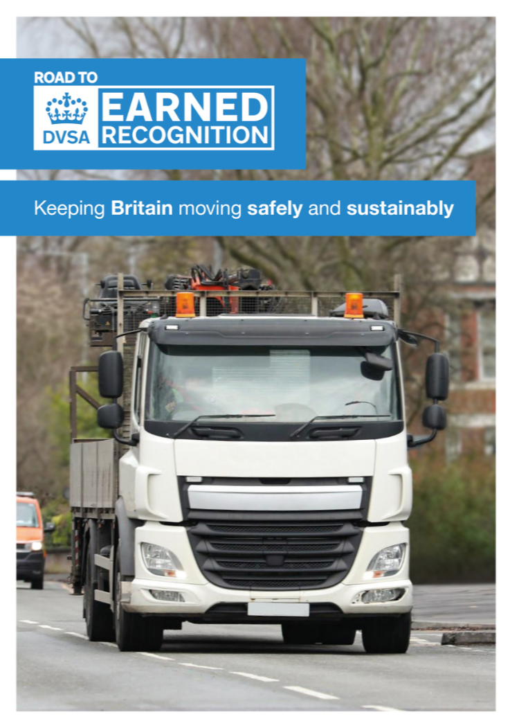
Journey with us on the Road to Earned Recognition (R2ER)
A new initiative to help new businesses develop and maintain high driver and vehicle standards
Promote effective transport management
Improve standards - Improve road safety – Improve employee wellbeing
Reduce the risk of non-compliance and potential regulatory action from the Traffic Commissioners.
Work with DVSA to improve road safety across Britain’s roads and improve the outcomes for cities and towns
Journey with us on the Road to Earned Recognition
(R2ER)​
Notes:
A new programme is launched on the 14th June 2023, aimed at operators who have held an operator licence for 6 months or less. The idea is to help new operators to get it right from the start of their transport journey and to help businesses establish a culture of safety & compliance, rather than un-learn bad behaviours.

Slide 27
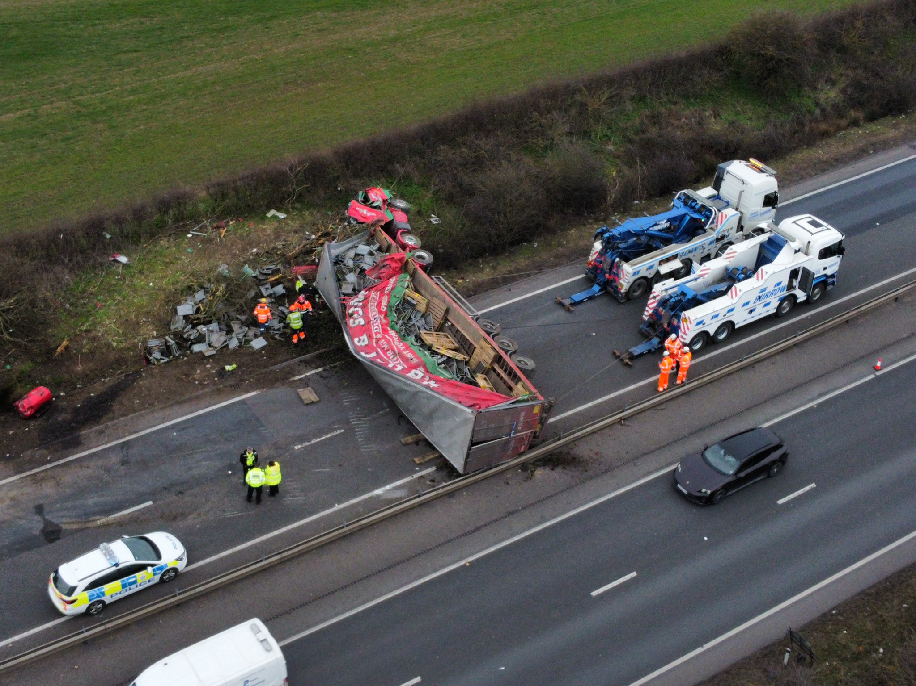
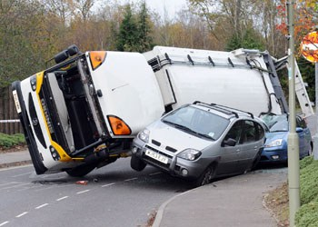
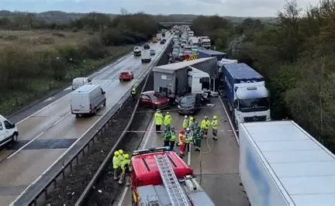
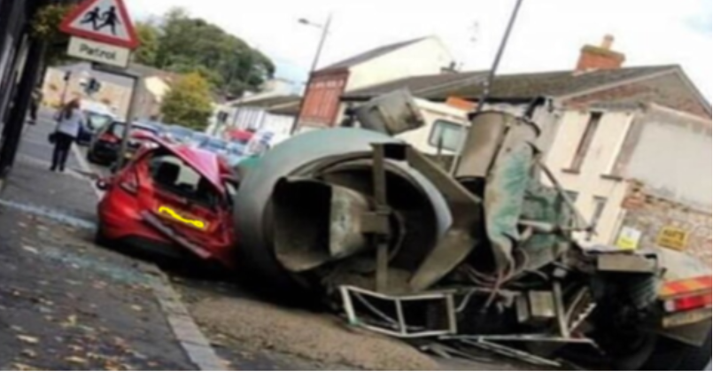
The consequences of non-compliance
Notes:
Many of these images are taken from incidents involving vehicles on local government or council contracts.
Last year there were a high number of incidents on contracts where drivers had not been training in manoeuvring refuse vehicles, coach trips operating with drivers, who did not hold driving licence, home to school transport being operated by vehicles out of MOT or without effective brakes. This is part of the reason why we wrote to all councils in GB, why we think it is important standards are raised in council fleets, but also in those you contract with our tender services to. I believe that any vehicles being operated on our roads should be safe, compliant and represent a manual risk to members of the public.

Slide 28
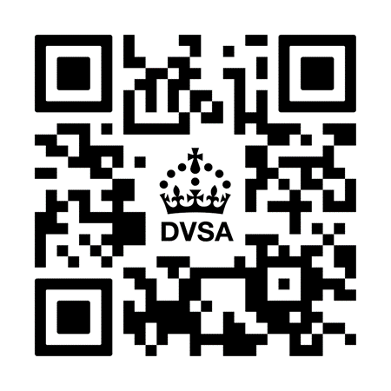
Find out more via Gov.uk or via the mailboxes
www.gov.uk/dvsa DVSAER@DVSA.gov.uk
R2ER@DVSA.gov.uk

