Slide 1
Investigating
Internal Incidents
Laura Thomas
Notes:
Add the name of the presenter and the date in the text box below the description above

Slide 2

What we will cover…
What do we investigate.
Why do we investigate.
Who should investigate.
How should we investigate.

Slide 3

What’s an incident?
It could be…
Near miss
Accident
RTA
Significant drivers’ hours breach
Ill (mental) health

Slide 4
Why do we
investigate?

Slide 5
What’s the purpose of an investigation?
Learn
Stop it happening again
Understand our business
Identify what works
Protect the company
Improve how we operate
Comply with legal and regulatory requirements
Ensure we have a skilled workforce
Commercial security

Slide 6
The benefits of a great investigation
An educational activity
Promotes understanding
Resource effective
Raises standards
Provides evidence to support change
Valuable source of information

Slide 7
Characteristics of an investigator
Trained
Objective
Inquiring
Interested
Flexible
Patient
Able to communicate
Judicious
Perceptive
Analytical
Mature
Open minded
Understanding
Integrity
Knowledgeable

Slide 8

Are you the right investigator?
Notes:
So with that in mind what are the benefits of Training

Slide 9
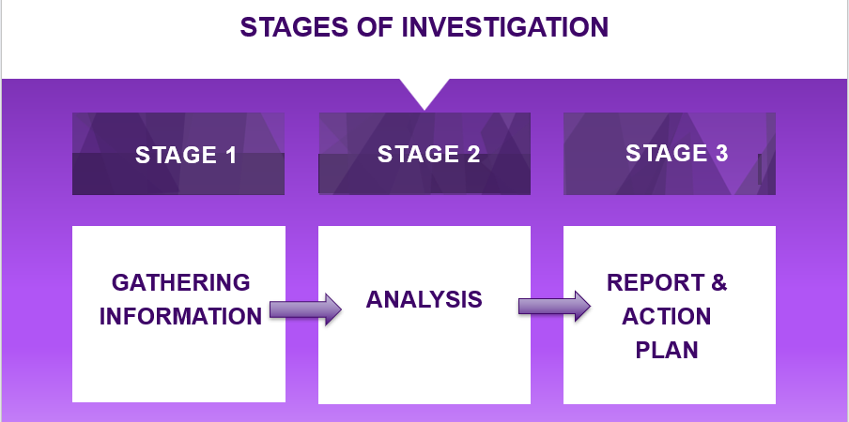

Slide 10
1. Gathering Information
Physical
Witness
Expert

Slide 11
It’s all about people…
Witness

Slide 12
Probe
Closed
Check
Evidence for your investigation

Slide 13

Open Questions: 5WH method
Who
What
Why
Where
When
How
Describe/Show me/Tell me
Notes:
'What?' often asks for noun responses, seeking things that are or will be.
‘Why' seeks cause-and-effect.
'When' seeks location in time.
‘How' seeks verbs of process.
‘Where' seeks to locate an action or event.
The question 'Who' brings people into the frame, connecting them with actions and things.

Slide 14

LISTEN…
Notes:
In summary:
FORS is free to join
Provides operational confidence
Provides a distinction against other operators
Improves efficiency
Provides access to advice and guidance
Provides a procurement advantage.

Slide 15
2. Analysis
It’s not you, it’s me…

Slide 16
Analysis techniques.
It’s not fact, it’s evidence.
Don’t substitute your opinion.
Balance any competing evidence.
Remain impartial.

Slide 17
3. Report Writing
Less is more!

Slide 18
Top tips…..
If it looks good, you’re halfway there!
Clear sections with headings.
Appendices.
Chronology.
Use phrases like…
  “The evidence points to…”
  “I was told by…that…”
  “The photographs taken by me indicate…”
Always have an action plan with sign offs.

Slide 19
Any Questions?

Slide 20
Notes:
Add the name of the presenter and the date in the text box below the description above

