Slide 1
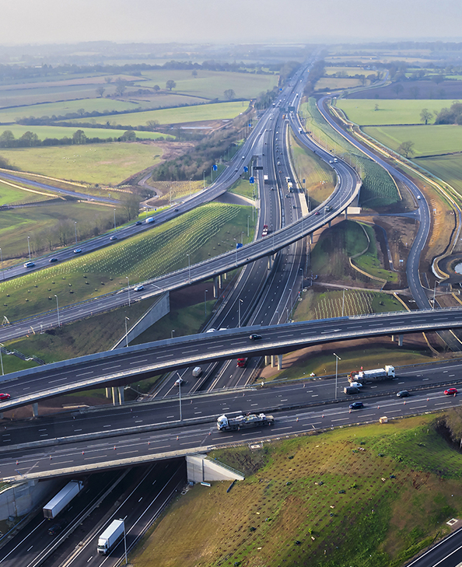

Fleet Vision International Roundtable
Safety Beyond Compliance
Bridge Strikes: The Impact
Anne-Marie Penny
Senior Road Safety Policy Adviser
National Highways
from

Slide 2


By kind permission of Network Rail

Slide 3
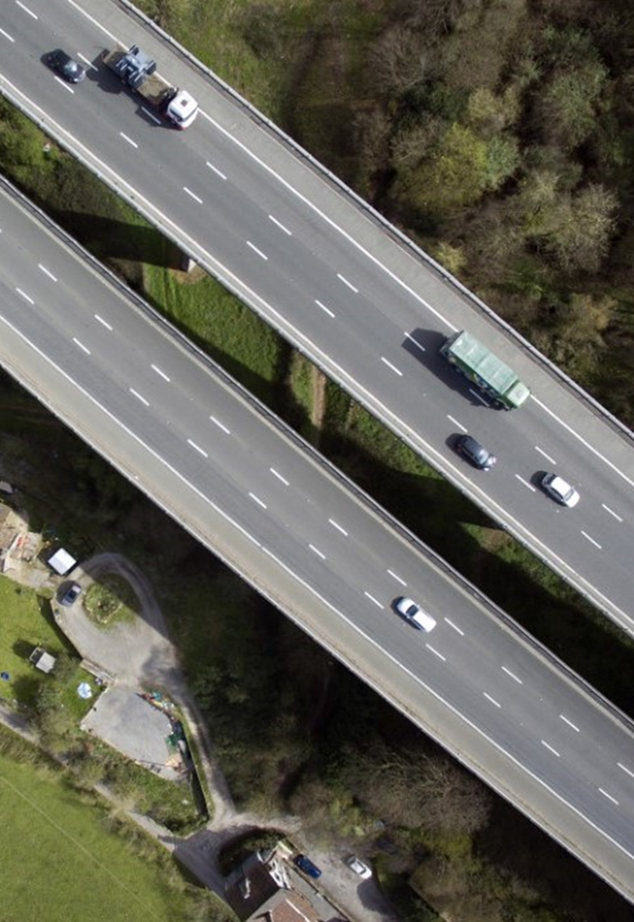

Safety Beyond Compliance
The Impact of Bridge Strikes
A bridge strike is defined as an incident in which a vehicle, its load, or equipment collides with a bridge
1 April 2024 to 31 March 2025 - 1,666 reported bridge strikes*
    Roughly 5 a day, or 1 every 5 hours
Mainly HGVs and buses
c£13,000 per strike but can be significantly more
Cost to the taxpayer - c£23m per year
*Network Rail provides the only validated data for bridge strikes in the UK. Other non rail bridge strikes occur but are not represented in these figures

Slide 4
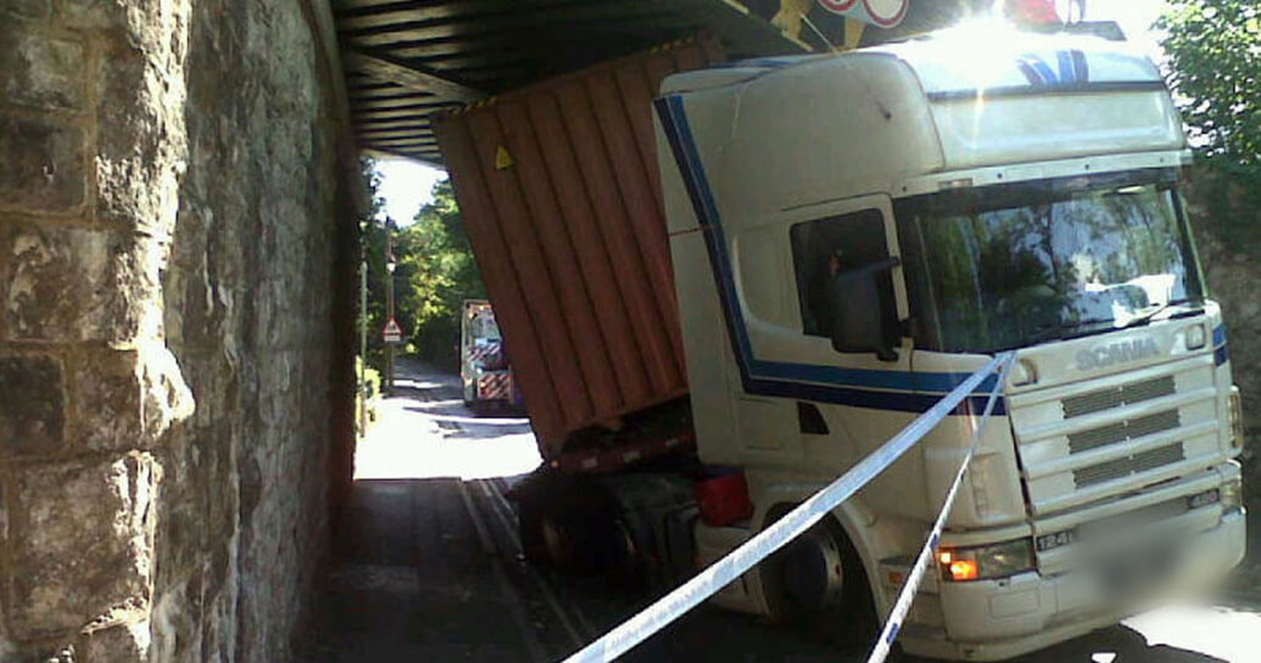
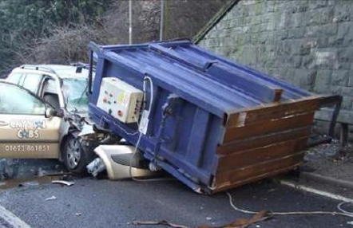
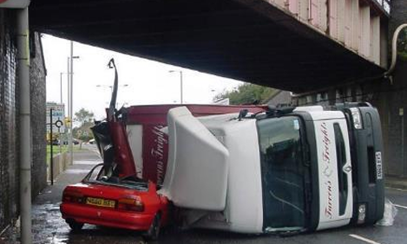
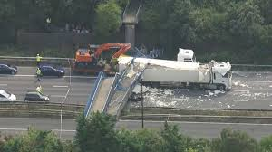
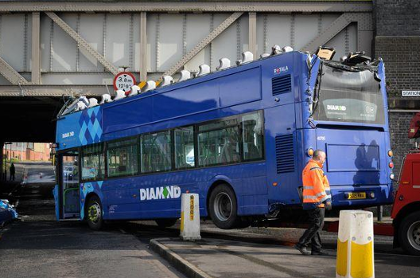
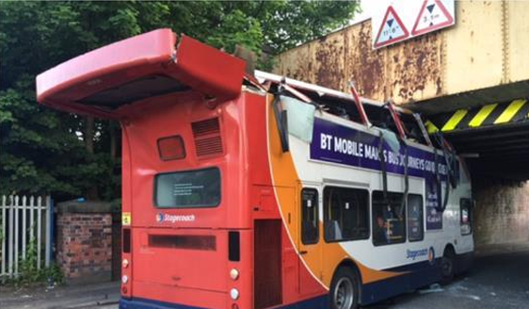
Safety Beyond Compliance
The Impact of Bridge Strikes

Slide 5
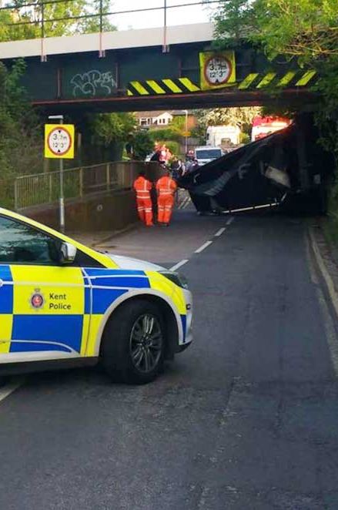
Safety Beyond Compliance
10 most hit bridges
Watling Street A5, Hinckley
Harlaxton Road, Grantham
Stuntney Road, Ely
Stonea Road, Cambs
Lower Downs Road, Wimbledon
Station Road, Berkswell
Ickleton Road, Great Chesterford
Barrowby Road, Grantham
Abbey Farm, Thetford
Coddenham Road, Needham Market

Slide 6
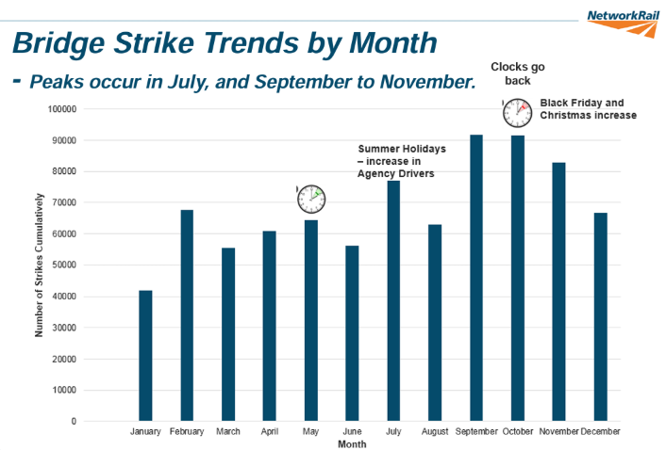


Safety Beyond Compliance
Clocks go forward

Slide 7
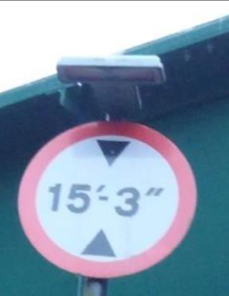
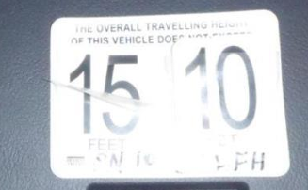
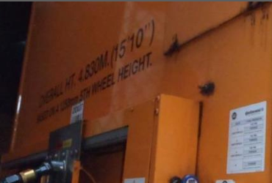
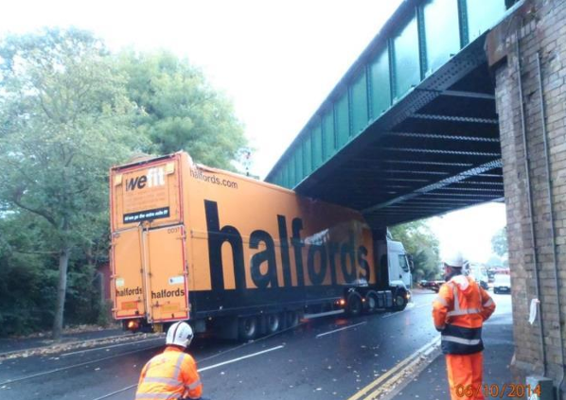

At what point does it go wrong?
Safety Beyond Compliance
Bridge 15’ 3”
Height on Trailer Headboard 15’ 10”
Height displayed in cab 15’ 10”
Poor route planning?
Driver in an unfamiliar cab?
Driver on an unfamiliar route?
Driver distracted impaired?
Other external factors?

Slide 8
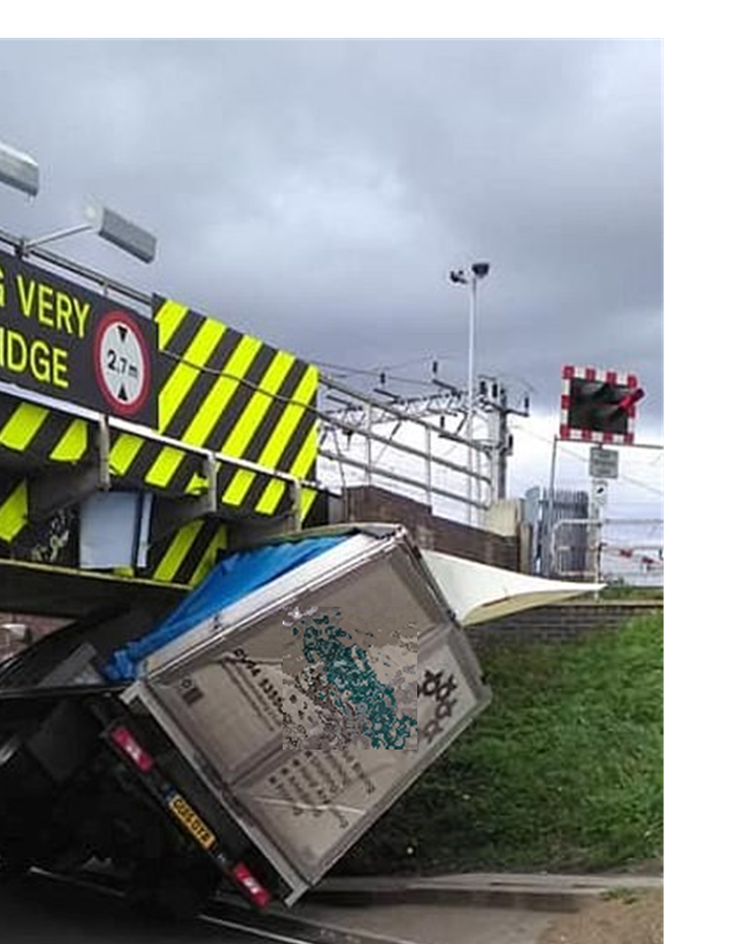
Safety Beyond Compliance
Causes of bridge strikes
Key Findings from Recent Surveys (2024-2025):
Primary Causes: 59% of respondents focused on driver error, while 14% highlighted inaccurate signage or infrastructure issues.
Lack of Vehicle Knowledge: 43% of lorry drivers admit to not measuring their vehicles before starting their journey.
Route Planning Failures: 52% of drivers admit to not taking low bridges into account when planning routes.
Pressure & Training: Drivers have reported that tight schedules and lack of proper training contribute to near misses, with some reporting that companies do not allow sufficient time for route planning
https://www.fleetnews.co.uk/news/bridge-strikes-costing-23m-per-year-caused-by-driver-error#:~:text=More%20than%20half%20of%20truck,into%20account%20when%20route%20planning.

Slide 9
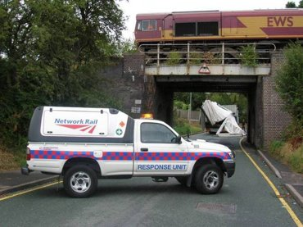
Safety Beyond Compliance
Causes of bridge strikes
    Research into the issue by SNAP:
    Driver Comments:
    "If all truck drivers did their job properly, checked the trailer height, adjusted their in-cab height marker, and checked the route they are taking, then this sort of thing would not happen."
    “They (the company) expect you to drive these trucks like small vans. Show me how to plan a route when companies allow no time for it. Then show me how to adapt when the route you planned is closed while you’re driving.”
    14% identified infrastructure inaccuracies:
    “A few years ago, resurfacing raised the road by a few inches under a bridge, but the sign still showed the old height.”

Slide 10
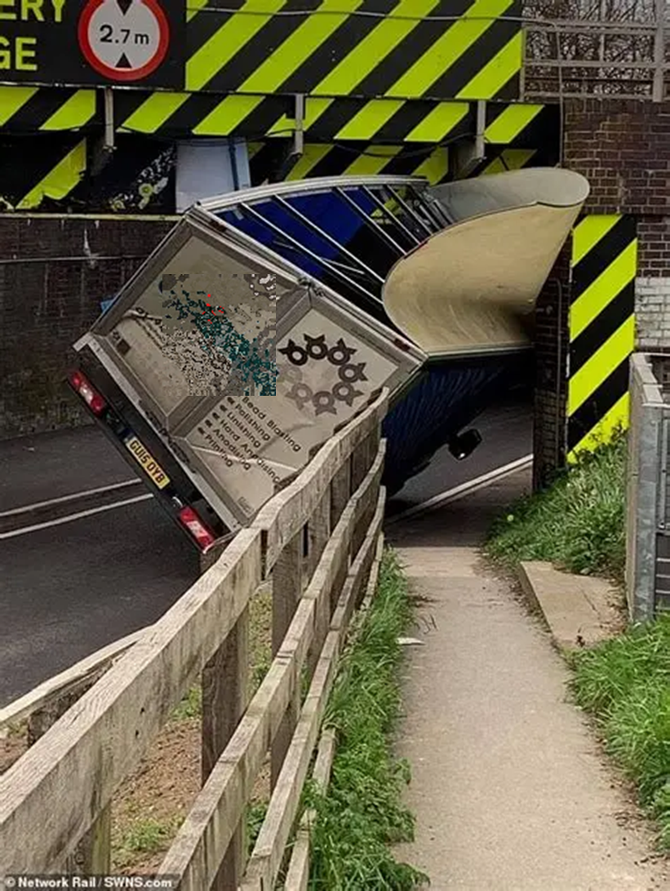
Safety Beyond Compliance
Consequences
  Safety Risk
    Vehicle drivers
    Members of the public
    Trains and passengers
    Incident response teams
  Personal
    Penalty points
    Fine
    Loss of job
    Imprisonment
  Cost
    Repairs to vehicles, bridges
    To the businesses
      Loss of O’ licence
      Insurance premiums
      Damaged loads
      Reputation
    Knock on effects to the community
      Road and rail delays
    To UK PLC

Slide 11
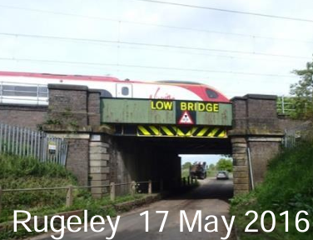
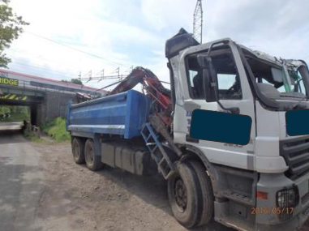
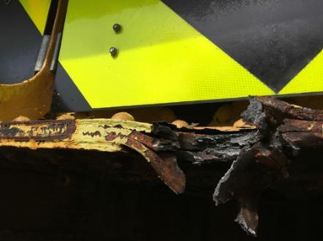
Safety Beyond Compliance
Cost of bridge strikes: Company
Dependent on:
  Location
  Extent of damage
Example: Rugeley May 2016 (Network Rail)
  Schedule 8 compensation £690,599
  Repairs £13,440
  Bridge examiner £193
  Total recovered by NR £704,232

Slide 12
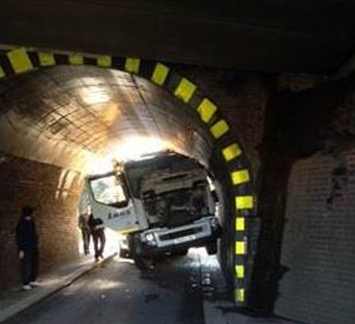
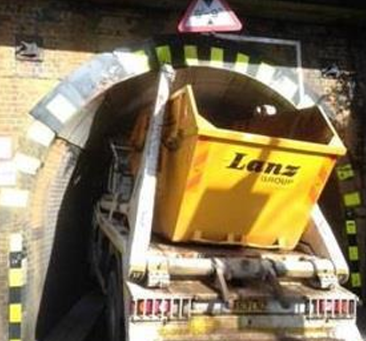
Safety Beyond Compliance
Cost of bridge strikes: Driver
Example: Bridge 2/79 Byfleet, Surrey
  Conviction Careless driving
  Points on licence 5
  Fine £454
  Enforcement legislation available: Failure to comply with road traffic sign and careless driving – section 3 RTA1988. Maximum fine £2,500, 3-9 penalty points

Slide 13
Hand over to Richard Turfitt/Laura Thomas for Driver conduct hearing
This slide can be removed

Slide 14
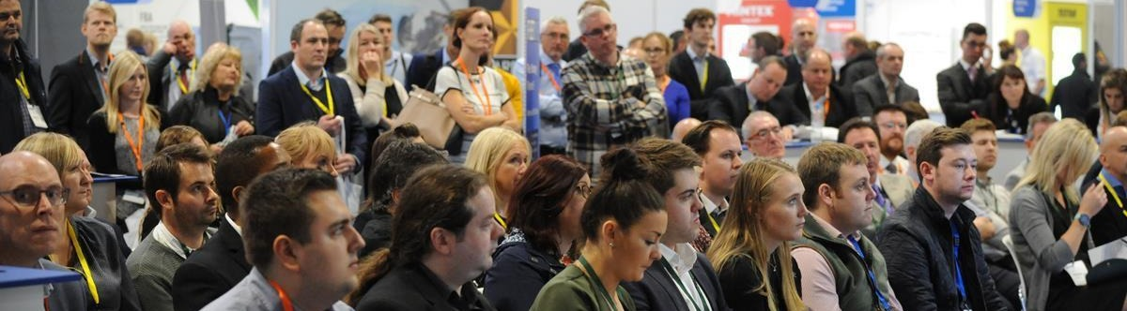
Safety Beyond Compliance
Panel Discussion

Slide 15
Into lunch
This slide can be removed

Slide 16
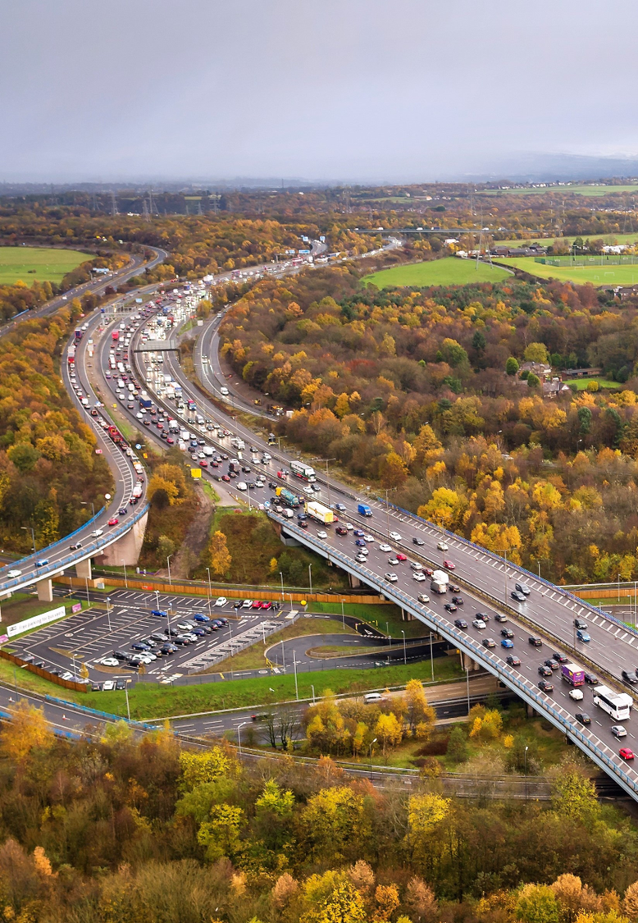
Safety Beyond Compliance
Reflection Session
What have we learned today:
To fill in during last break from discussions -

Slide 17
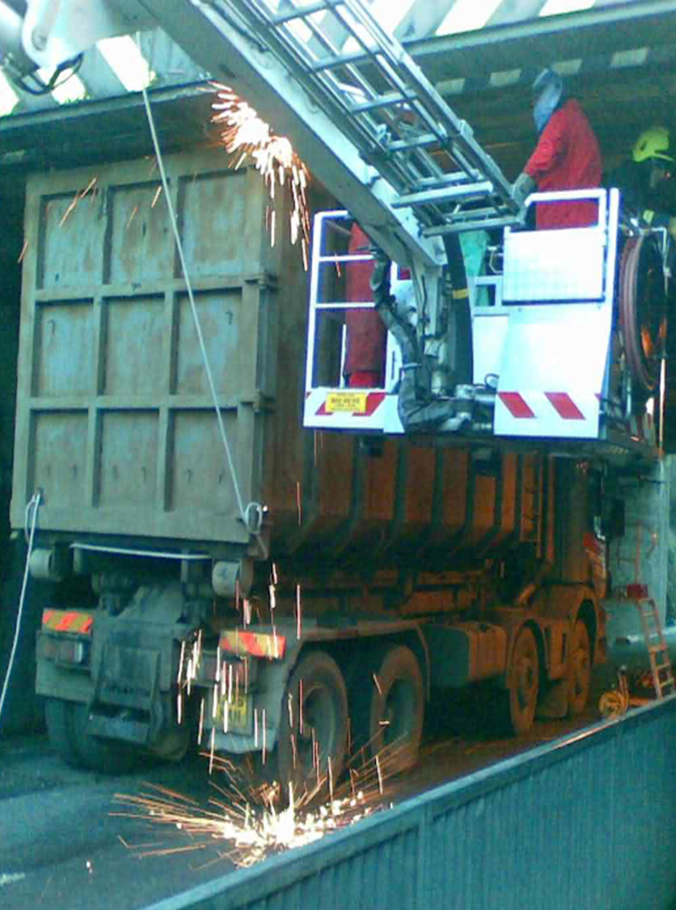
Safety Beyond Compliance
Useful resources:
Department for Transport – good practice guides:
  www.gov.uk/government/publications/prevention-of-bridge-strikes-good-practice-guide
Network Rail - protocols and preventing bridge strikes:
  www.networkrail.co.uk/our-work/looking-after-the-railway/bridges-tunnels-and-viaducts/the-risk-of-bridge-strikes/prevention-of-bridge-strikes/
  www.networkrail.co.uk/our-work/looking-after-the-railway/bridges-tunnels-and-viaducts/the-risk-of-bridge-strikes/responding-to-bridge-strikes/
Wise up, Size up:
  www.networkrail.co.uk/who-we-are/safety-in-the-community/railway-safety-campaigns/wise-up-size-up/

Slide 18
Safety Beyond Compliance
Useful resources:
Training & awareness
Logistics UK: https://training.logistics.org.uk/training-courses/managing-transport-operations/prevention-of-bridge-strikes-cpd/
Road Haulage Association: www.rha.uk.net/Training/Training-Details/Id/8584
Craig Baker Driver Training: www.cbakerdt.co.uk/blog-post/drivertraining/bridge-strike-prevention-training.html
Lloyd Morgan Group: www.lloydmorgangroup.co.uk/training/driver-training/understanding-preventing-bridge-strikes/

Slide 19
End of conference slide
This slide can be removed

