Slide 1
Drug Discovery and Development Course
Translation from preclinical to clinical and building an integrated product development plan
Cristina Donini, PharmD, PhD
Medicines for Malaria Venture

Slide 2

Terms of Use – CC BY 4.0 License
These materials are shared to support teaching, research, and presentation activities across the GC ADDA community. All content is provided under the Creative Commons Attribution 4.0 (CC BY 4.0) license, which allows you to use, share, adapt, and build upon the material freely, including for commercial purposes. Please ensure that any use includes proper attribution to the original creators, indicates any modifications you make, and maintains the same open license. No additional restrictions may be applied.
Credit the author(s) as follows:
CC BY 4.0 [author, institution]

Slide 3
Learning objectives
Understand what translational science is and its importance in drug development
Understand the key steps in translating preclinical research to clinical trials
Understand the challenges
Gain a broad understanding of what is required for drug development

Slide 4
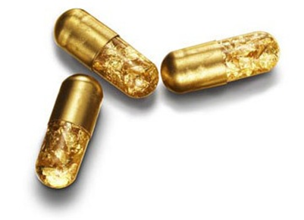
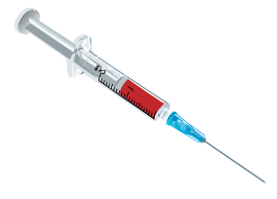
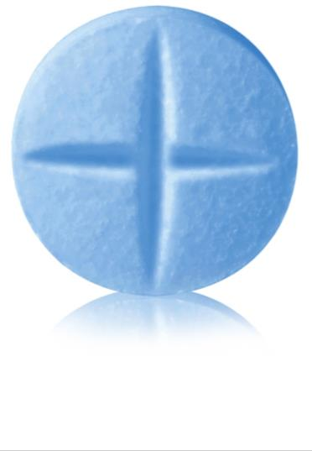

Start with the end in mind
TPP, Target Product Profile
A strategic document used in drug development to outline the desired attributes of a pharmaceutical product
IPDP, Integrated Product Development Plan
The roadmap that aligns stakeholders, including research, preclinical, clinical development, regulatory, and marketing teams, on the plan to market

Slide 5
What a TPP can look like
Parameters | Minimum essential (for first registration) | Ideal case (potentially life-cycle management)
Indication for use | Prevention against P. falciparum malaria | Prevention against malaria caused by any Plasmodium species or mixed infection
Target population | ≥5 years | ≥3 months All populations at risk Pregnant women in all trimesters and breastfeeding women Non-immune individuals
Dosing regimen | Once every 3 months (based on preclinical simulations) | Once every 6 months
Formulation | Intramuscular injection; volume injected and needle size in line with current standard for vaccines; partner drugs can be injected separately | Liquid pre-filled injection device for intramuscular or subcutaneous injection; fixed dose combination of the drugs (based on latest CMC data)
Antimalarial effects | Two blood schizonticide drugs | Same as minimum essential + at least one drug with causal prophylactic, gametocytocidal or sporontocidal activities
Efficacy | Preventive Efficacy against malaria infections of ≥80% over 3 months (based on preclinical PK) Clearance of asymptomatic infections (based on preclinical) | Same as minimum essential Non-immune (and pediatric): preventive efficacy against symptomatic malaria infections ≥80% over 3 months Pregnancy: preventive efficacy against malaria infections in the mother of ≥75% over 6 months and ideally, adverse pregnancy outcomes comparable to standard-of-care
Drug resistance | Partner drugs with different mechanism of resistance Active against known drug-resistant clinical isolates | Partner drugs with similar pharmacological duration of efficacy
Safety and Tolerability | Favorable risk–benefit profile, with safety and tolerability comparable to WHO recommended preventive treatment or standard-of-care (if any) | Improved safety and tolerability versus WHO recommended preventive treatment or standard-of-care (if any)
Drug–drug Interactions | Minimal interactions manageable with dose adjustments | No clinically significant interactions (based on SimCyp)
Cost of treatment course | Equivalent or lower than malaria vaccine | $1 for infants, $2 for children, $4 for adults
Stability | ≥2 years at ICH zone IVa/IVb conditions | ≥3 years at ICH zone IVa/IVb conditions

Slide 6
Why is TPP important?
Guides Development Decisions: Helps teams prioritize research activities based on the product’s ultimate goals.
Risk Mitigation: Helps identify potential gaps or challenges early in the development process.
Cross-Functional Alignment: Ensures consistency across research, development, and marketing strategies.
Regulatory Alignment: Provides a structured framework for discussions with regulatory agencies, such as the FDA or EMA.

Slide 7
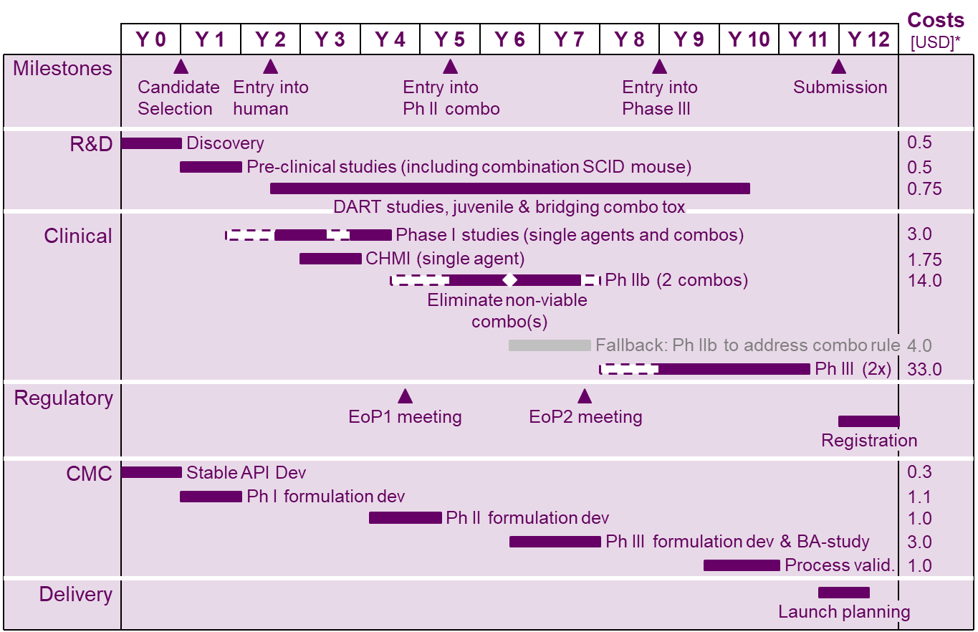
What an IPDP can look like

Slide 8
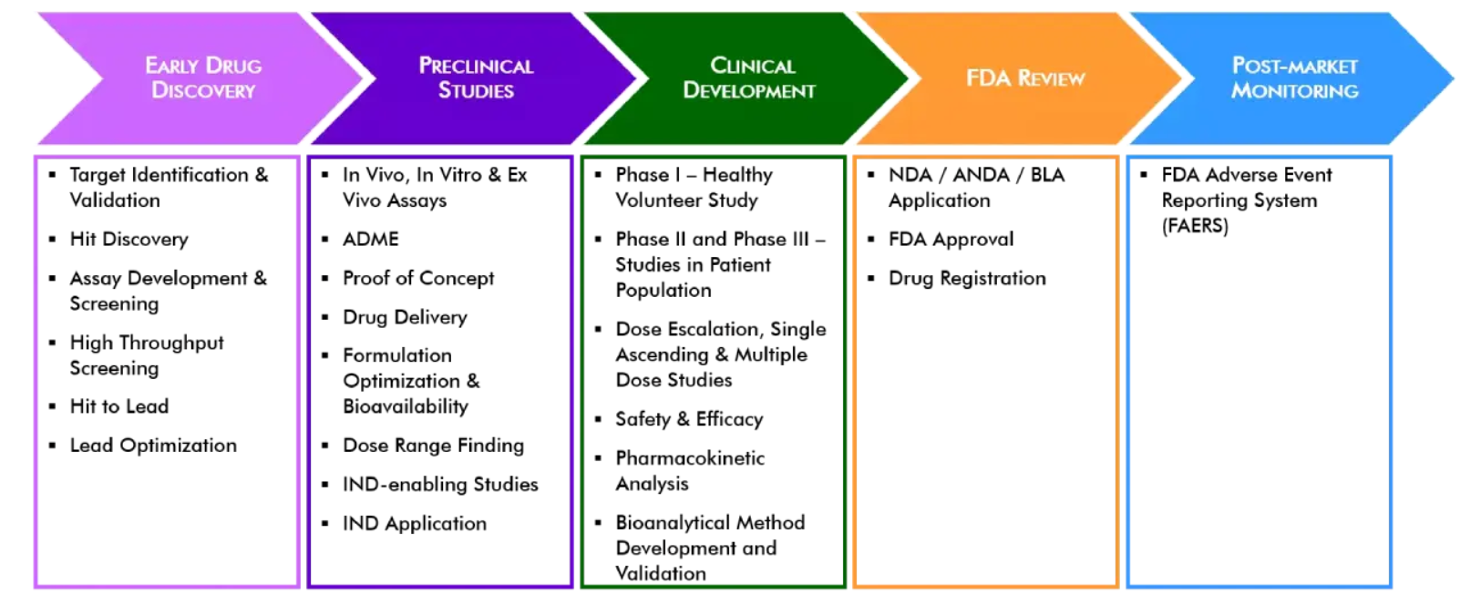
What does it take to get to a product?
Notes:
Combinations required
Get the right dose of both compounds
Large monotherapy study in clinically infected patients are not advisable
MIC studies are necessary but very difficult to implement in the field
How to utilise the challenge studies data
Extrapolate to doses in patients with higher baseline parasitemia

Slide 9
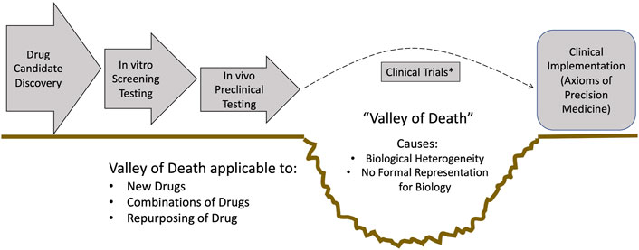
Translational gap: the “valley of death”
NDA
Front. Syst. Biol., 28 April 2022
Sec. Translational Systems Biology and In Silico Trials
Volume 2 - 2022 | https://doi.org/10.3389/fsysb.2022.901159
Notes:
Combinations required
Get the right dose of both compounds
Large monotherapy study in clinically infected patients are not advisable
MIC studies are necessary but very difficult to implement in the field
How to utilise the challenge studies data
Extrapolate to doses in patients with higher baseline parasitemia

Slide 10
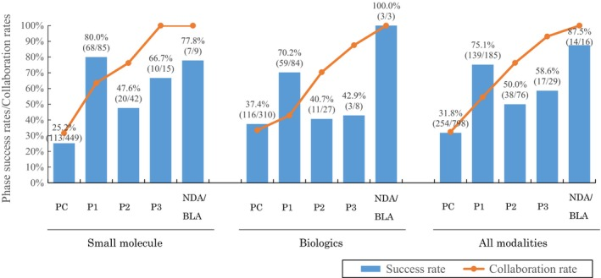
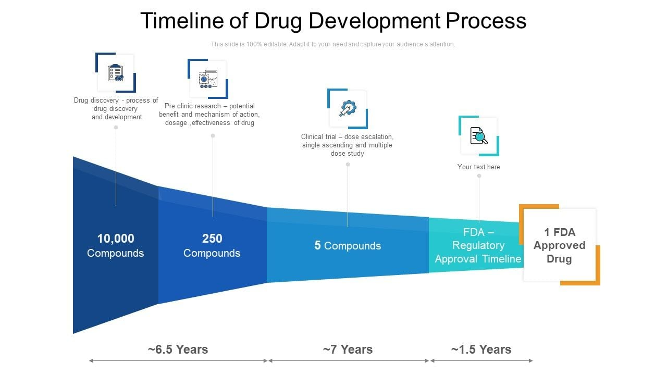
Translational gap: the “valley of death”
Notes:
Combinations required
Get the right dose of both compounds
Large monotherapy study in clinically infected patients are not advisable
MIC studies are necessary but very difficult to implement in the field
How to utilise the challenge studies data
Extrapolate to doses in patients with higher baseline parasitemia

Slide 11
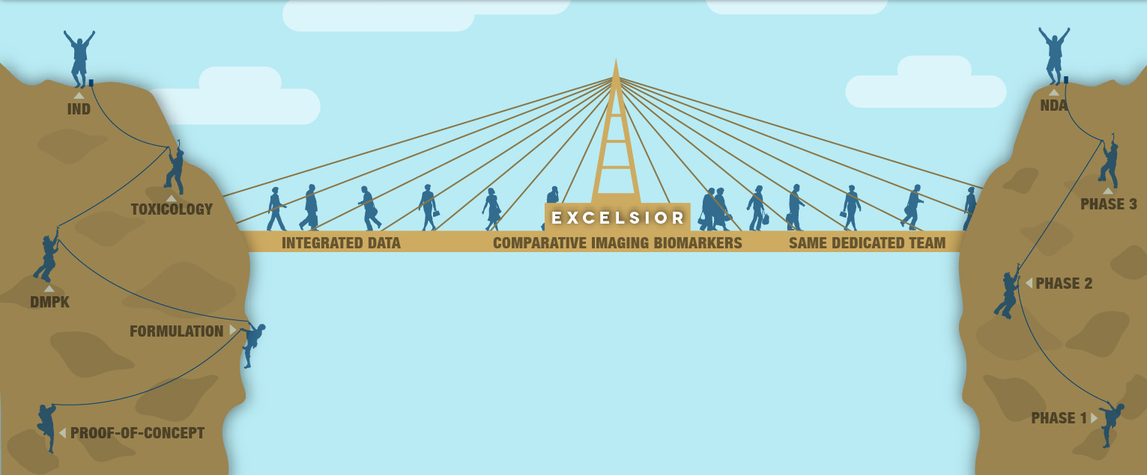
Bridging the gap between preclinical and clinical
Entry into human
Preclinical development:
Demonstrate proof of concept and ensure safety before human trials.
Clinical development:
Assess safety, tolerability, PK, and later efficacy in Ph2 and Ph3

Slide 12
Preclinical development
Goal: gather data that supports the safety and potential effectiveness of the drug before testing it in humans.
Key Studies:
Pharmacokinetics (PK) and pharmacodynamics (PD)
Toxicology studies (acute, sub-chronic, chronic)
In vitro and in vivo models
Go/No-Go Decision Criteria: therapeutic window, toxicity thresholds, meet TPP

Slide 13
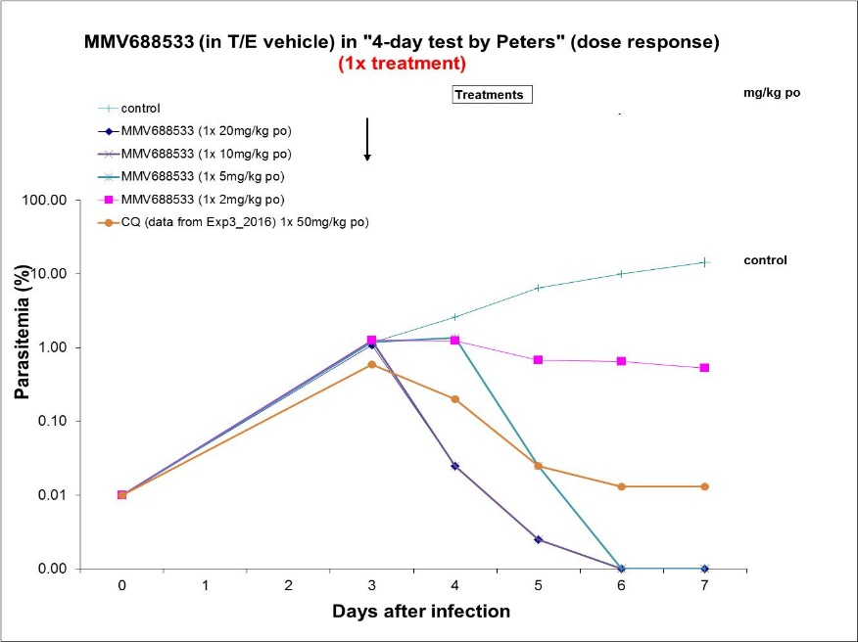
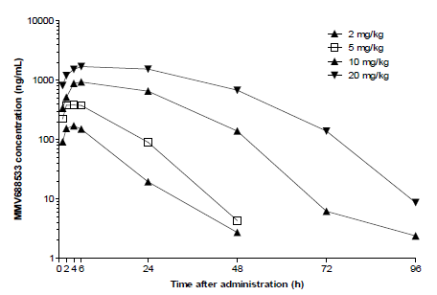
Building the bridge
Animal model to assess the pharmacodynamics (PD)
Dose response in animal to assess pharmacokinetics (PK)
Notes:
Key messages:
Two key criteria that determine the acceptability of a candidate or not are whether it has acceptable safety and whether the estimated dose in humans (which is very approximate) is in the right range
The estimated dose for blood stage comes from using a model in which the mouse is injected with human blood and P.falciparum, followed by drug a different doses. We then measure concentration over time (PK) and parasitemia over time (PD) in the mouse which Nathalie’s team use, in conjunction with a human PK prediction to predict a single human dose
Once ESAC and MMV have approved a candidate then the project moves from a Discovery to a Translational project director

Slide 14
Building the bridge
GLP toxicity studies to assess the safety profile of the molecule
Studies in rodents and non rodents
Regulatory guidelines to be followed (ICH M3 (R2), FDA/EMA)
Important considerations when designing a GLP tox package before FIH:
What is your intended indication? Disease? Treatment? Prevention?
What is the intended clinical duration? Acute (single dose), sub.chronic, chronic
What is the route of Administration( Match the intended clinical administration route oral, IV, im, sc, etc.)
Safety Endpoints
Toxicokinetics: Assess systemic exposure and bioavailability.
Clinical Observations: Behavioral changes (CNS), body weight, and clinical signs.
Hematology and Clinical Chemistry: Assess organ functions.
Histopathology: Evaluate tissue changes post-mortem.
Safety Pharmacology: Address cardiovascular, respiratory, and CNS risks if not covered in tox studies.
Developmental toxicity: assess potential use in pregnancy
Carcinogenicity studies for chronic indications

Slide 15
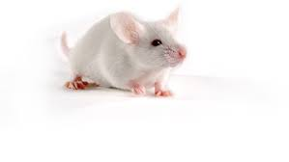

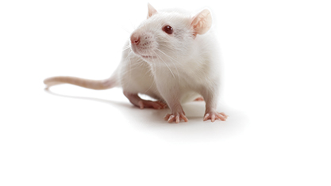
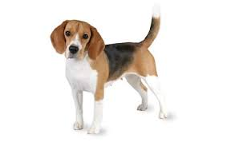
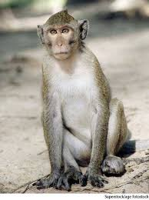
Translation: predicting the human
Predicted Human efficacious dose
Modelling & simulation
Innovative quantitative tools and modelling methods to inform dosing, combo choice, etc. (e.g., advanced PK/PD models)
Human PK parameters
Human safety margins

Slide 16
Safety margins calculation
NOAEL most sensitive species
(xx µg.h/ml)
Starting dose
(5 mg = 1.6 µg.h/ml)
NOAEL most sensitive species
(xxxx µg.h/ml)
Predicted human efficacious dose
(80 mg = 25.6 µg.h/ml)
xx fold OK
1
10
100
1000
10000
Cumulative AUC µg.h/ml MMV390048
16

Slide 17
Go/No go criteria to entry into humans
Translational
Screening
Preclinical Development
FIH
Candidate selection
THINK ABOUT YOUR TPP
Notes:
Key messages:
Two key criteria that determine the acceptability of a candidate or not are whether it has acceptable safety and whether the estimated dose in humans (which is very approximate) is in the right range
The estimated dose for blood stage comes from using a model in which the mouse is injected with human blood and P.falciparum, followed by drug a different doses. We then measure concentration over time (PK) and parasitemia over time (PD) in the mouse which Nathalie’s team use, in conjunction with a human PK prediction to predict a single human dose
Once ESAC and MMV have approved a candidate then the project moves from a Discovery to a Translational project director

Slide 18
Go/No go criteria to entry into humans
Translational
Screening
Preclinical Development
FIH
Candidate selection
Is the predicted human efficacious dose in line with TPP?
Are the safety margins acceptable?
What is the tox profile? Target organs, monitorable, reversible
Other considerations which won’t affect entry into human but should be assess :
Drug sustance (ease of production, cost of goods, stability, etc..)
Drug product (powder in bottle, tablet, child friendly formulation, stability, cost of goods, etc…)
FiH: First in Human
Notes:
Key messages:
Two key criteria that determine the acceptability of a candidate or not are whether it has acceptable safety and whether the estimated dose in humans (which is very approximate) is in the right range
The estimated dose for blood stage comes from using a model in which the mouse is injected with human blood and P.falciparum, followed by drug a different doses. We then measure concentration over time (PK) and parasitemia over time (PD) in the mouse which Nathalie’s team use, in conjunction with a human PK prediction to predict a single human dose
Once ESAC and MMV have approved a candidate then the project moves from a Discovery to a Translational project director

Slide 19
IPDP update

Slide 20
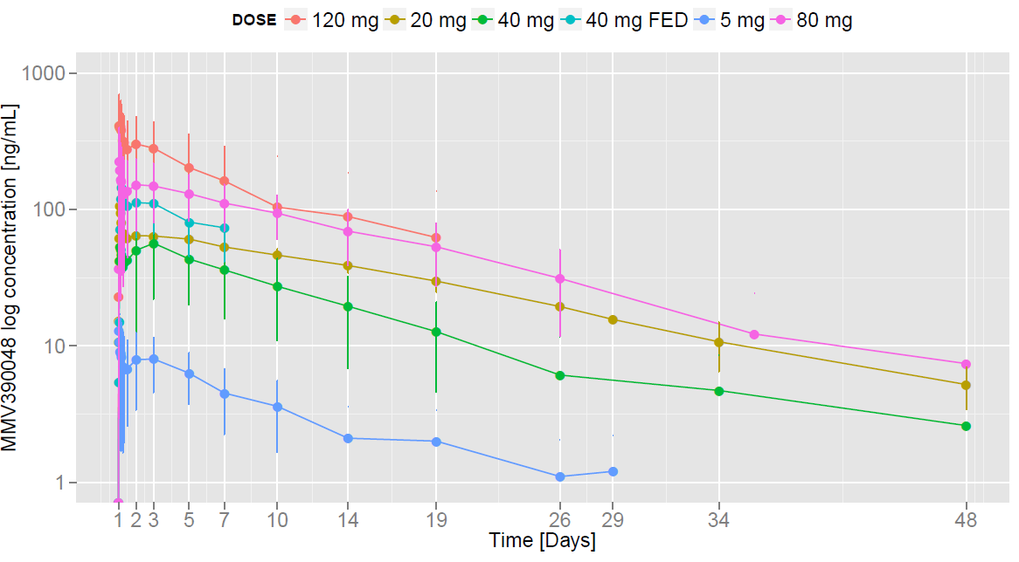
What does a PK curve in human look like?
Minimum pharmacologically active concentration

Slide 21
First stress test on translation is First in Human Trial (FiH)
Safety in human is the primary objective (was preclinical toxicity predictive of human safety?
Pharmacokinetic needs to be confirmed
Cohort | Dose (mg) | Predicted Cmax | C_{max} (μg/ml) | Predicted AUC | AUC_{0-inf} (μg.h/ml) | C_{max} Margin | AUC_{0-inf} Margin
A1 (fasted) | 5 |  | 0.021 |  | 1.60 | 345 | 94.9
A2 (fasted) | 20 |  | 0.085 |  | 6.41 | 86.2 | 23.7
A3 (fasted) | 60 |  | 0.254 |  | 19.22 | 28.7 | 7.91
A4 (fasted) | 120 |  | 0.508 |  | 38.44 | 14.4 | 3.95
A5 (fasted) | 220 |  | 0.932 |  | 70.46 | 7.83 | 2.16
A6 (fasted) | 340 |  | 1.440 |  | 108.9 | 5.07 | 1.40
A7 (fasted) | 500 |  | 2.118 |  | 159.8 | 3.45 | 0.95
A8 (fed) | TBD |  | - |  | - | - | -

Slide 22
Go/No go criteria to next clinical phase
Is the PK in line with predicted PK? Think if you need to change formulation, and go back to your TPP?
Is safety and tolerability acceptable? Think about your indication, go back to your TPP
POC: Proof of Concept (either challenge model or patient exploratory)
Notes:
Key messages:
Two key criteria that determine the acceptability of a candidate or not are whether it has acceptable safety and whether the estimated dose in humans (which is very approximate) is in the right range
The estimated dose for blood stage comes from using a model in which the mouse is injected with human blood and P.falciparum, followed by drug a different doses. We then measure concentration over time (PK) and parasitemia over time (PD) in the mouse which Nathalie’s team use, in conjunction with a human PK prediction to predict a single human dose
Once ESAC and MMV have approved a candidate then the project moves from a Discovery to a Translational project director

Slide 23
Human Proof of Concept (PoC)
Refers to an early-stage clinical study designed to determine whether a drug or therapeutic intervention demonstrates initial evidence of biological activity and clinical efficacy in humans. The goal is to confirm that the drug has the potential to achieve its intended effect in the target patient population or healthy volunteers.
Key Objectives:
Efficacy: Evaluate whether the drug shows meaningful biological or therapeutic activity.
Safety: Assess the drug's safety and tolerability in a limited population.
Pharmacokinetics (PK) and Pharmacodynamics (PD): Understand how the drug behaves in the body and its mechanism of action.
Dose Optimization: Identify dose ranges for further clinical development.
Notes:
Key messages:
Two key criteria that determine the acceptability of a candidate or not are whether it has acceptable safety and whether the estimated dose in humans (which is very approximate) is in the right range
The estimated dose for blood stage comes from using a model in which the mouse is injected with human blood and P.falciparum, followed by drug a different doses. We then measure concentration over time (PK) and parasitemia over time (PD) in the mouse which Nathalie’s team use, in conjunction with a human PK prediction to predict a single human dose
Once ESAC and MMV have approved a candidate then the project moves from a Discovery to a Translational project director

Slide 24
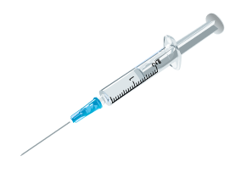
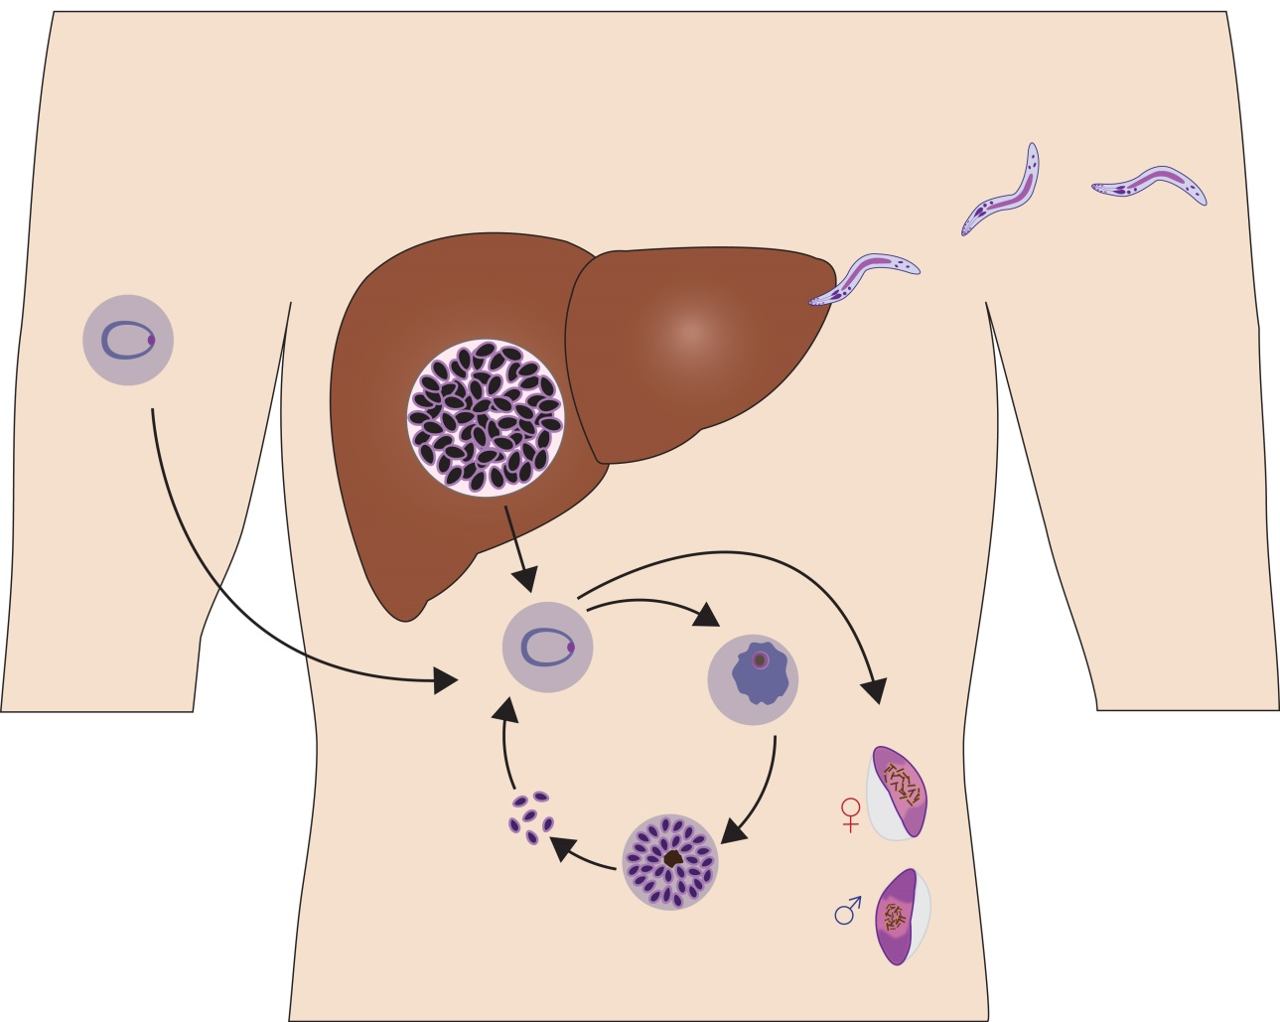
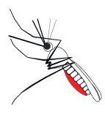
Volunteer Infection Studies (VIS)
Efficacy is the primary objective
And safety
IBSM
2800 Pf infected hRBC
SPZ-VIS
Cryopreserved
SPZ (3200) from Sanaria
SPZ-VIS
Mosquito-bite
(~100 SPZ)
Notes:
Blood-stage CHMI was originally developed in Australia at the Queensland Institute of Medical Research, using cryopreserved stocks of erythrocytes from two parasitemic donors who were deliberately infected with P. falciparum 3D7 via mosquito bite (65). This material has now been administered intravenously to 300 volunteers in numerous studies with diverse endpoints.

Slide 25
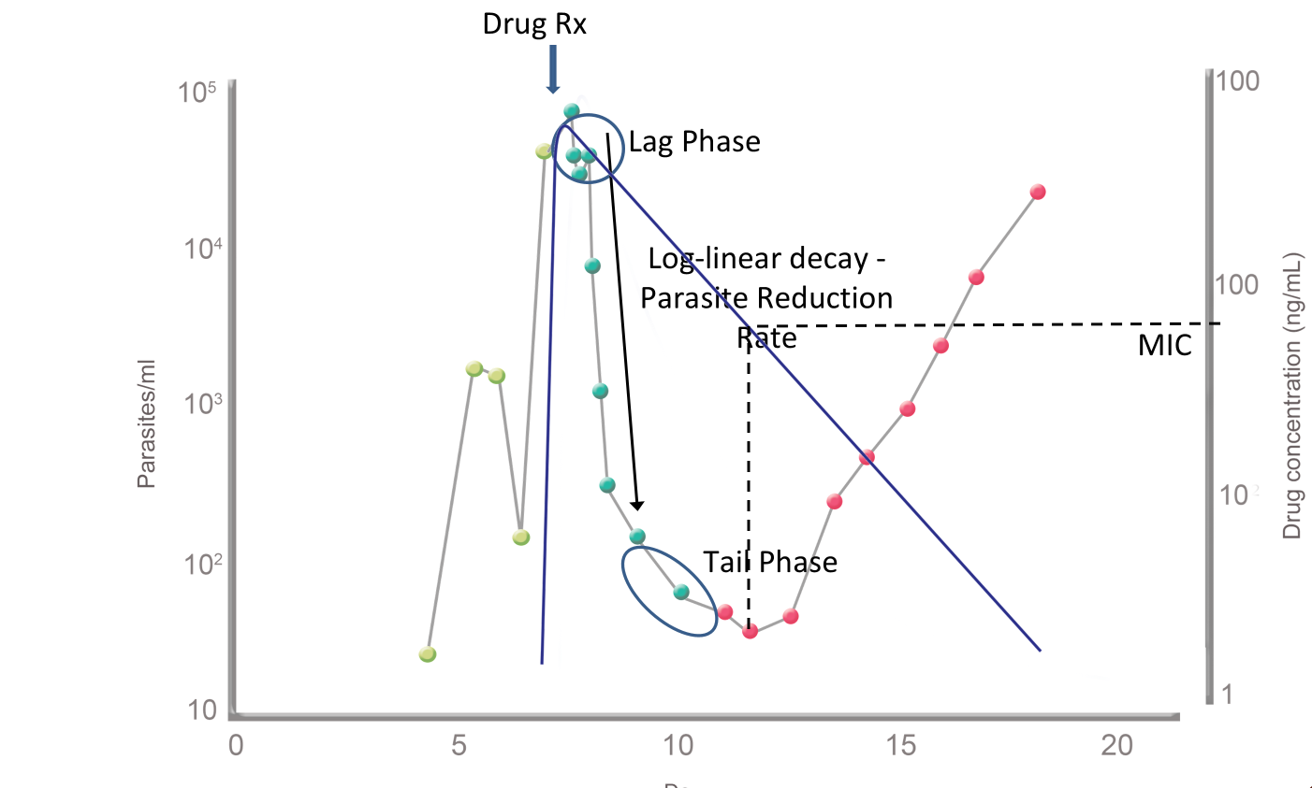
Using pharmacometric modelling: Combining PK and PD
Parasite number
Drug Concentration
s
Time
Combining PK and PD from human studies recalculate human efficacious dose to meet TPP

Slide 26
Go/No go criteria to next clinical phase
Is the efficacy in line with the one expected from preclinical data? Do you meet the TPP criteria?
What is the Probability of Success (PoS) of reach your efficacy goal in the next clinical phase? (PKPD modeling)
Is safety and tolerability acceptable in your patient population? Think about your indication, go back to your TPP
Patient confirmatory study (Ph2b/Ph3 – bigger sample size)
Notes:
Key messages:
Two key criteria that determine the acceptability of a candidate or not are whether it has acceptable safety and whether the estimated dose in humans (which is very approximate) is in the right range
The estimated dose for blood stage comes from using a model in which the mouse is injected with human blood and P.falciparum, followed by drug a different doses. We then measure concentration over time (PK) and parasitemia over time (PD) in the mouse which Nathalie’s team use, in conjunction with a human PK prediction to predict a single human dose
Once ESAC and MMV have approved a candidate then the project moves from a Discovery to a Translational project director

Slide 27
Efficacious Dose
Collect data (drug concentration, efficacy data) following compound administration
Healthy human volunteers
PoS in different target population
Patients data
Take decisions, design next experiment or clinical trial
Build/re-evaluate a mathematical model of PK/PD
In vitro assays
Make predictions for scenarios where we have no data
Pre-clinical species
Predicted human dose
27

Slide 28
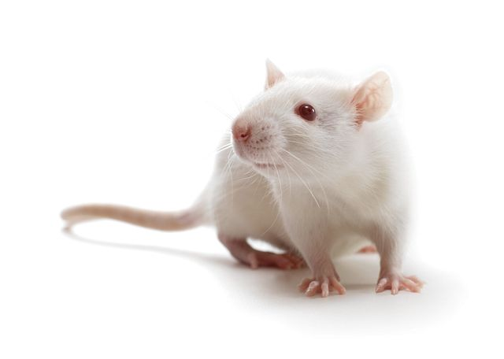



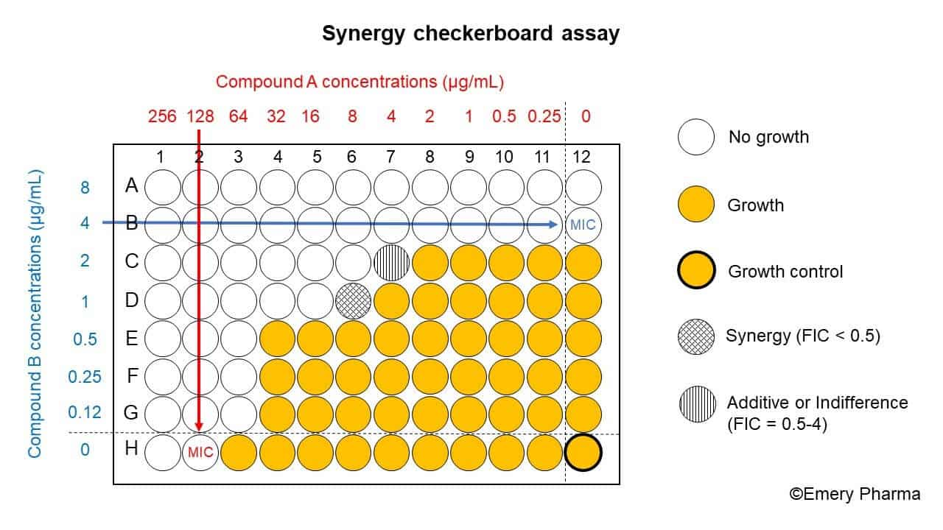
Early Development
Product development
Preclinical
Human volunteers
Development of
combinations
Patient exploratory
Patient confirmatory
First in Human (PK)
In vitro combination checkerboard
Phase 2 trials +
Interaction studies
Phase 3 non-inferiority trial against standard of care
Data
Animal experiments
In vitro assays
Volunteer infection (PK + PD)
Many assumptions
Fewer assumptions
First parameterization of combination
Some IIV explained by covariates
Model
Monotherapy PK+PD
In silico combination
In vivo combination PK+PD
Parameters better defined.
Initial estimate of IIV.
Sensitivity analysis of drug-drug interaction
Better estimation of drug-drug interactions
IIV and RSE reduce
E.g. Uncomplicated Malaria Treatment:
predict the probability of success once on the market (probability to reach the WHO target of 95% ACPR28* in African children)
* Adequate Clinical and Parasitological Response on Day 28
Decision
Decide dose ratio and doses to be tested in patients
Adjust doses in special population if needed (eg children)
Probability of success in phase 3 trial
Decide doses to be tested in First in Human and Volunteer Infection Studies
Next step
Notes:
New data (real or fake/in silico…eg MMVFree) triggers the modelling work:
when few data, need to make assumptions

Slide 29
Key take-aways
Translational science is key in drug development
Guides the selection of drug candidates with a higher probability of clinical success.
Uses predictive models to screen compounds for safety, efficacy, and pharmacokinetics.
Enables early decision-making on dose selection and trial design.
Helps in identifying early signals of efficacy or toxicity to guide adaptive clinical trials.
Reduces late-stage attrition by identifying potential safety or efficacy concerns before Phase 3 trials.
Informs go/no-go decisions early in the development process.

Slide 30
THANK YOU

