Slide 1
Drug Discovery and Development Course
Principles of Compound Optimization
Greg Basarab

Slide 2

Terms of Use – CC BY 4.0 License
These materials are shared to support teaching, research, and presentation activities across the GC ADDA community. All content is provided under the Creative Commons Attribution 4.0 (CC BY 4.0) license, which allows you to use, share, adapt, and build upon the material freely, including for commercial purposes. Please ensure that any use includes proper attribution to the original creators, indicates any modifications you make, and maintains the same open license. No additional restrictions may be applied.
Credit the author(s) as follows:
CC BY 4.0 [author, institution]

Slide 3
Learning Objectives
Make a molecule great
Consider key parameters associated with drug-likeness
Employ computational tools to assess compound parameters
Measure key compound parameters
Validate compound parameters relative to project goals

Slide 4
Druglikeness
Similar compound properties to existing drugs
or…
Think inside the box

Slide 5
Compound biological attributes
Cellular permea-bility
Com-pound distribu-tion
Target Potency
Drug Candidate
Bioavailability
Hepatic, renal, intestinal clear-ance
Meta-bolic/
plasma stability
Pharmaco-
dynamics
Toxicology

Slide 6
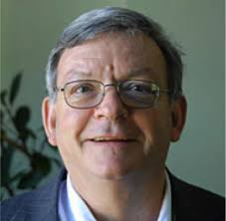
Lipinski ‘rule of five’
Oral drugs do not violate more than one of the following parameters:
≤ 5 H-bond donors
≤ 10 H-bond acceptors
MW ≤ 500 Da
LogP ≤ 5
Med Chemist @ Pfizer for 34 years
Best used in early hit identification stage to insure a viable scaffold is pursued
Lipinski, C. Drug Disc. Today, Tech. 1(4), 2004, 337.

Slide 7
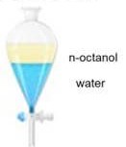
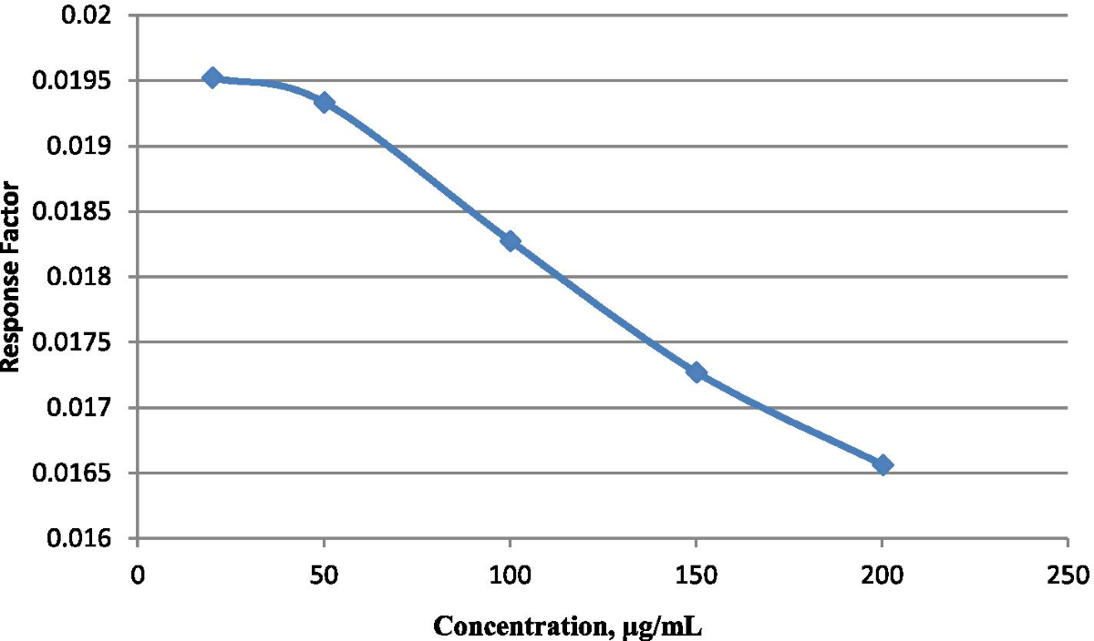
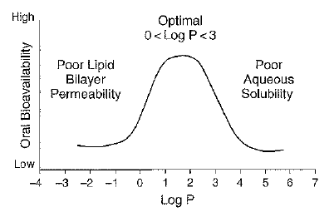
(c)LogD and (c)LogP
R-H + H₂O
R-H
R⁻ + H₃O⁺
buffer
1-octanol
D (Distribution
Coefficient) =
[drug]_{octanol}
[drug]_{buffer (7.4 usually)}
P (Partition
Coefficient) =
[drug]_{octanol}
Neutral species optimally permeate cellular lipid bilayers (passive diffusion)
- Expression of activity against intracellular targets
- Intestinal drug absorption
- CNS penetration
[unionized drug]_{buffer (7.4?)}
Notes:
How do we measure logP?
Algorithms exist to calculate both logP and logD.

Slide 8
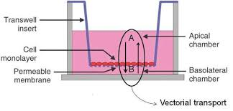
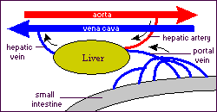
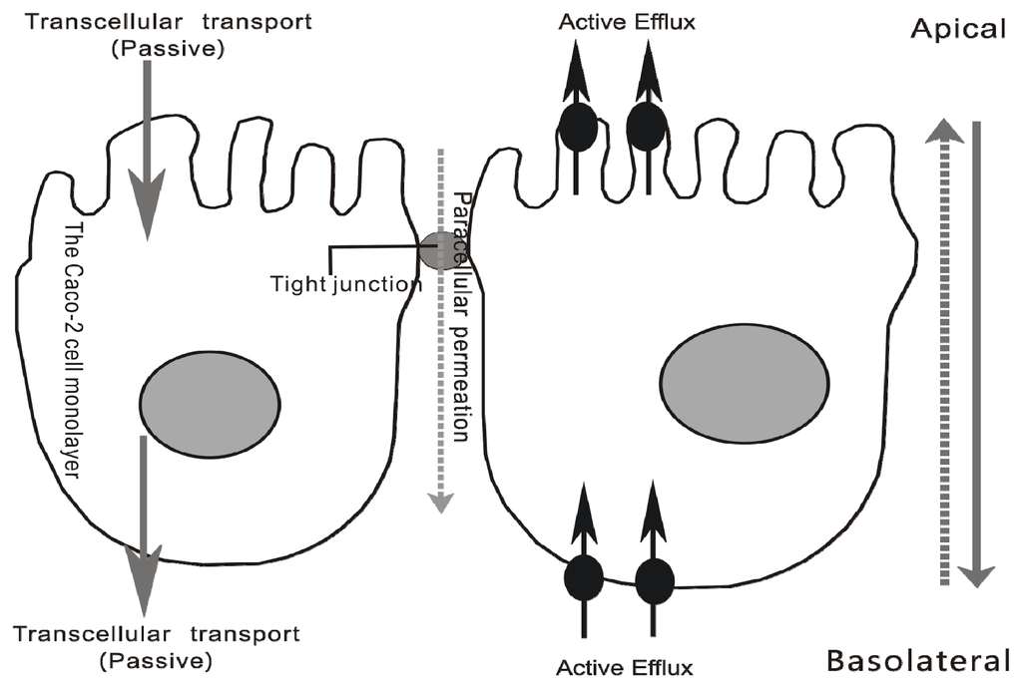
Transcellular permeability
Oral drugs transit small intestine epithelium to bloodstream & portal vein
Cancer coli (Caco-2) cells: human epithelial colorectal adenocarcinoma cells that aggregate directionally on filter surfaces
Madin-Darby canine kidney (MDCK) cells: derived from canine kidney tissue

Slide 9
Solubility
Solubility is perhaps the most important ADME property
Valid in vitro data relies on compound being soluble under the conditions
Poorly soluble compounds are difficult to formulate
Assessments of PK, PD, toxicology become problematic
High solubility is a must for IV administration
Thermodynamic solubility should be measured in:
pH 7.4 buffer (IV), 6.5 and/or 7.4 (PO)
Biorelevant media: FaSSIF – Fasted State Simulated Intestinal Fluid
(PO cmpds) FeSSIF – Fed State Simulated Intestinal Fluid
FaSSGF – Fasted State Simulated Gastric Fluid
Comment on the data for this compound
Solubility | < 1 μM
IC₅₀ (HepG2 cells) | > 200 μM
Notes:
Solubility is in the eye of the pharmacodynamic need.

Slide 10
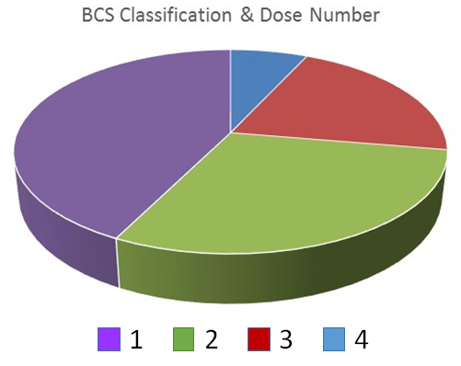
Solubility and Permeability Together (PO drugs)
BDDCS = Biopharmaceutics Drug Disposition Classification System
BDDCS Classification & Dose Number
Max. dose
Dose Number =
250*clogP*Sol
BDDCS 1 – high solubility & high permeability
Ave. Max. Dose = 113 mg
BDDCS 2 – low solubility & high permeability
Ave. Max. Dose = 204 mg
BDDCS 3 – high solubility & low permeability
Ave. Max. Dose = 276 mg
BDDCS 4 – low solubility & low permeability
Ave. Max Dose = 392 mg
BSC Classification – solubility 250 mg & permeability (≥90% absorption drug + metabolites)
Max Absorbable Dose =
Sol X K_{a} X SI_{WV} X SI_{TT}
Notes:
Meropenem dose for Adult Meningitis: 2 g IV every 8 hours, 7 – 21 days.

Slide 11
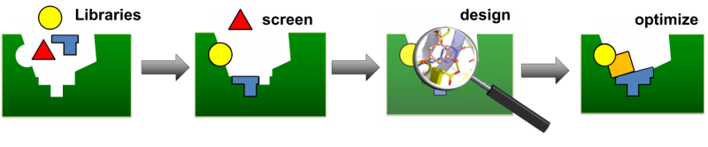
Fragment based lead discovery
Rule of three: begin small because growth is (seemingly) inevitable
≤ 3 H-bond donors
≤ 3 H-bond acceptors
MW ≤ 300 Da
LogP ≤ 3
# rot bonds ≤ 3
PSA ≤ 60 Å²
Congreve, M et al. H. Drug Disc. Today, 8(19), 2003, 876; Jhoti et al. Nat. Rev. Drug Disc. 12(8), 2013, 644; Mortenson et al. J. Med. Chem.62(8) , 3857, 2019.

Slide 12
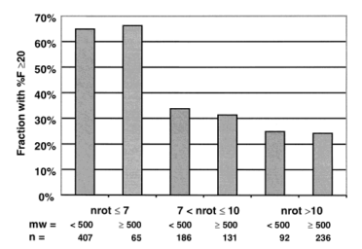
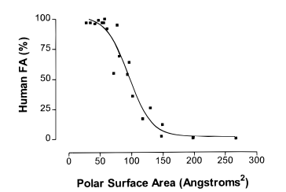
Other correlated parameters
≤ 10 rotatable bonds
Topological polar surface area
TPSA ≤ 140 Å²
Veber, D.F. et al J. Med Chem. 45(12), 2002, 2615; Clark, D. et al J. Pharm. Sci. 45(12), 2002, 2615.

Slide 13
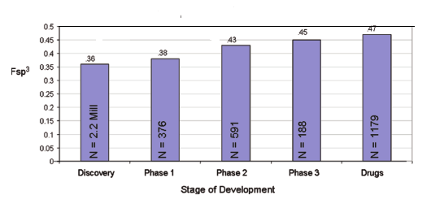
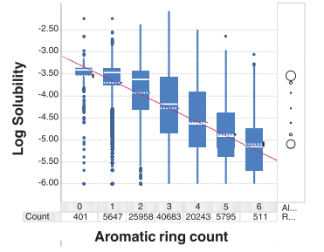
sp³ versus sp² (globular versus flat)
Number or aromatic rings - sp³ count - Aromatic vs heavy atoms - Aromatic Proportion
Increased # aromatic (flat) rings ⇒ decreases solubility ⇒ associated w/ promiscuity: inc. ppb, cyp inhibition, hERG inhibition, et al.
Heteroaromatics better than carboaromatics
Increasing # of stereocenters ⇒ associated with positive clinical outcomes
See 3D-Fragment Consortium (http://www.3dfrag.org/)
Lovering, F. et al J. Med. Chem., 52(21), 2009, 6752; Ritchie, T. M. et al Drug Disc. Today, 16(3/4), 2011, 164; Maccari, L. et al J. Med. Chem., 51(10), 2008, 2891.

Slide 14
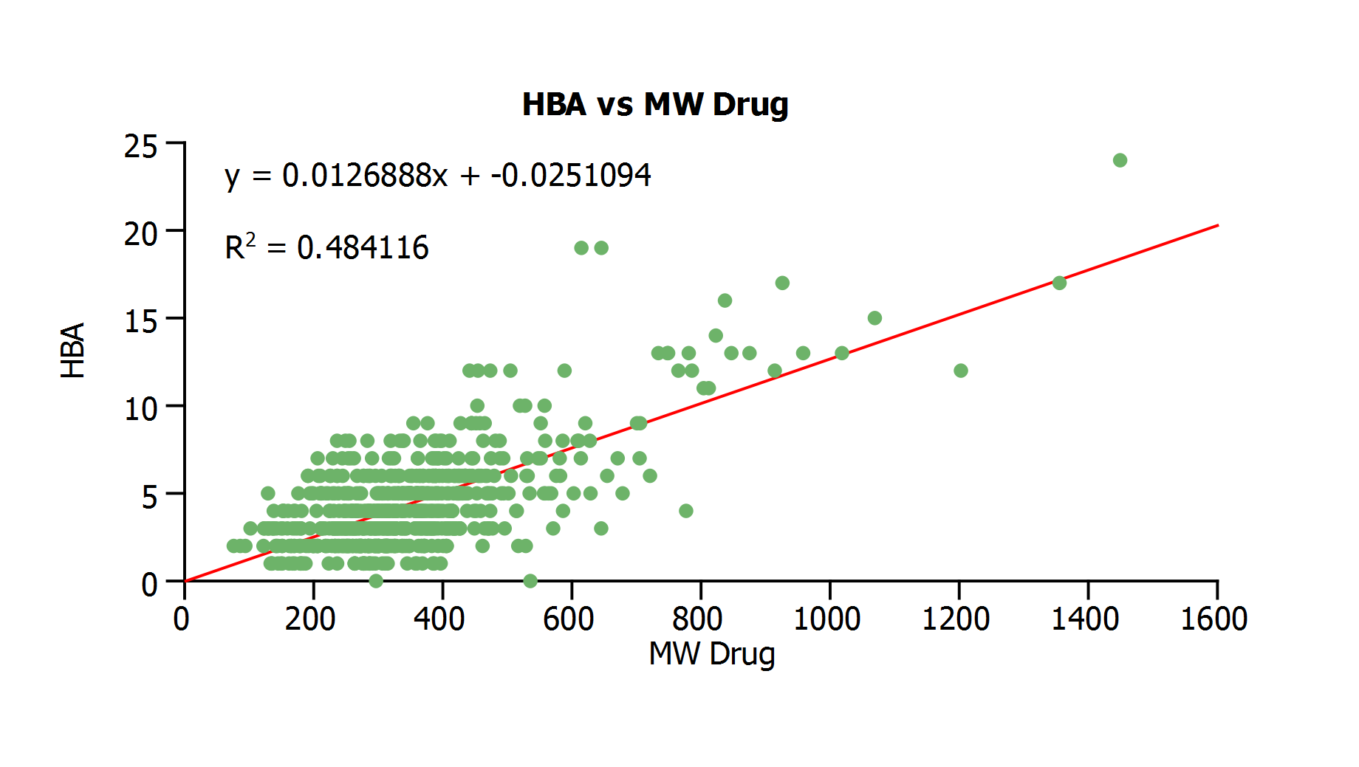
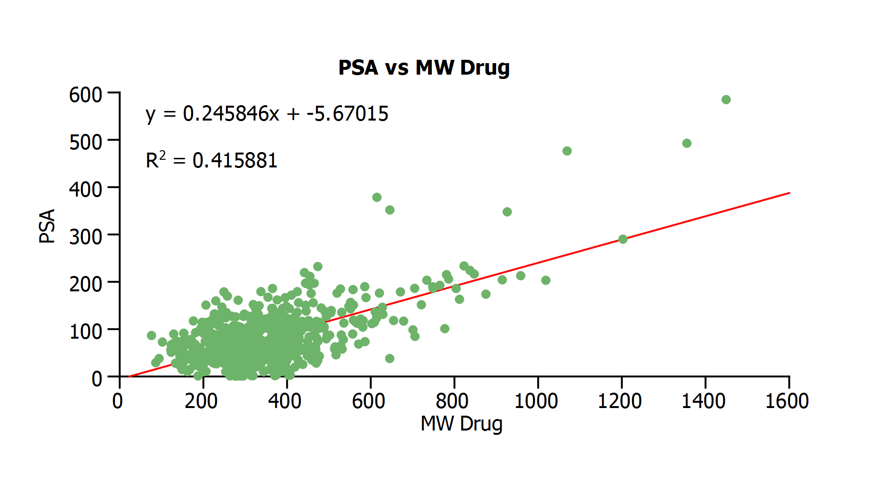
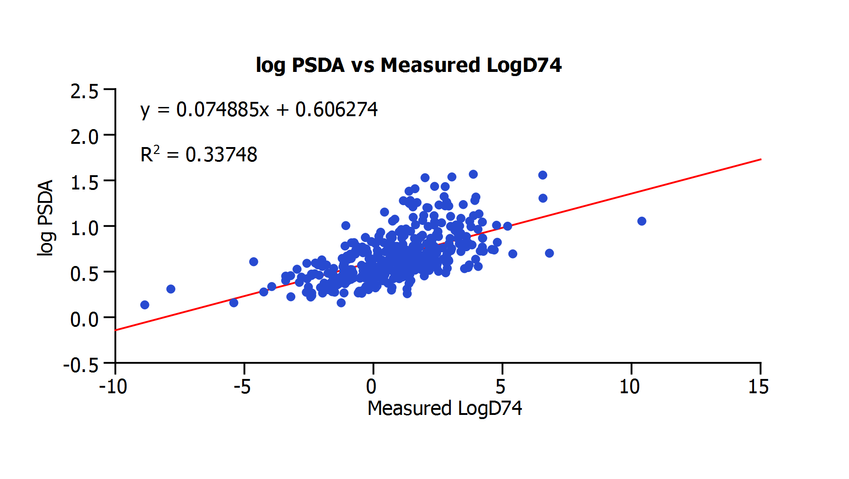
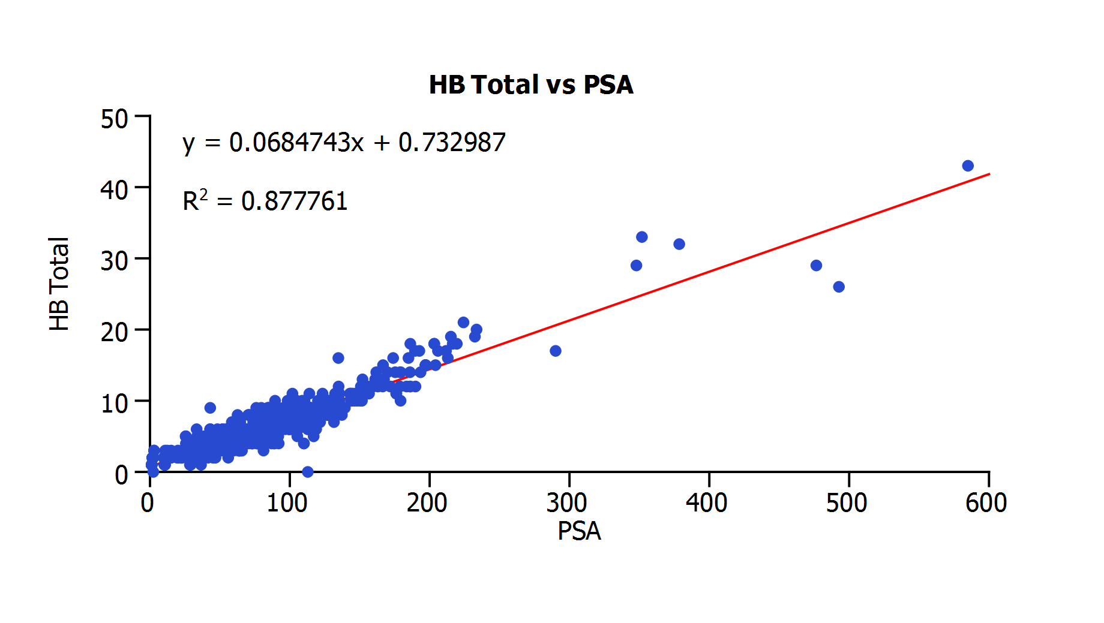
Cross-correlations – 700 oral drugs
PSAD
Data from Benet et al. AAPS J. 13(4), 519, 2011.
Notes:
Polar Surface Area Density (MW/PSA) – measure of polarity per compound size

Slide 15
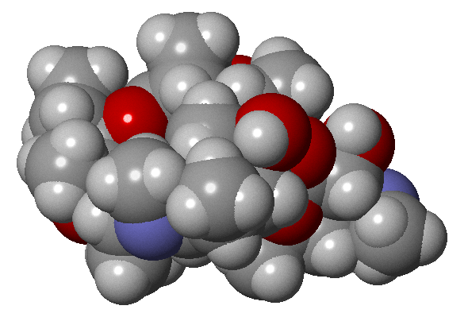
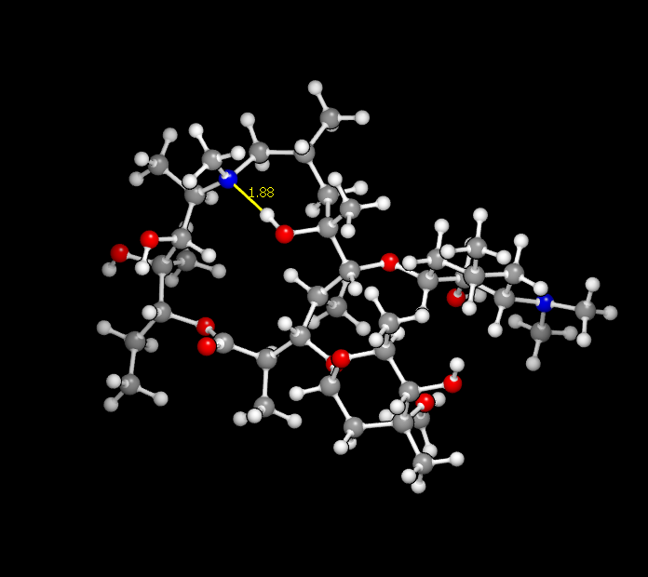
Anti-Lipinski
Azithromycin
F = 38%; 250 mg
MW = 749
PSA = 180 Å²
cLogP = 2.9
cLogD = 0.47
pK_{a} = 8.74; 9.45
H-acceptors = 14
H-donors = 5-7
Rot. Bonds = 7
Exposed PSA = 131 Å²
Solvent accessible H-bond acceptors = 8
Solvent accessible H-bond donors = 4
logP = 4.1
logD = 0.61
McFarland et al J. Med. Chem. 40(9),1997, 1340.

Slide 16
Anti-Lipinski

Slide 17
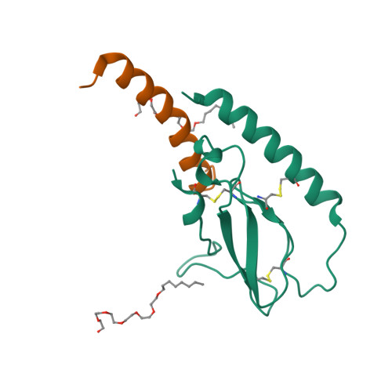
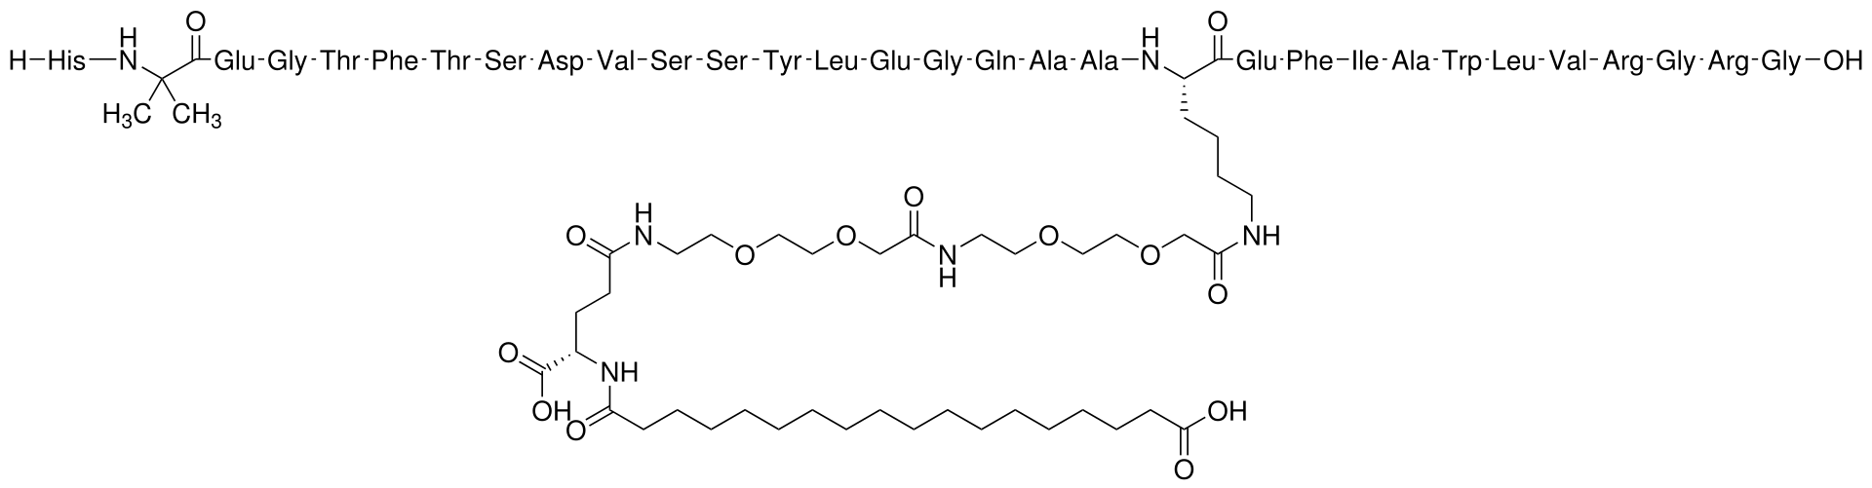
Semaglutide (Ozempic®)
Anti-diabetic (type2)/Anti-obesity medication
Dose: 0.25 mg once a week (first 4 weeks) – IM
3.0 mg daily for 30 days (PO)
T_{1/2} = 7 days
F = 0.8 – 1.4%
MW = 4114

Slide 18
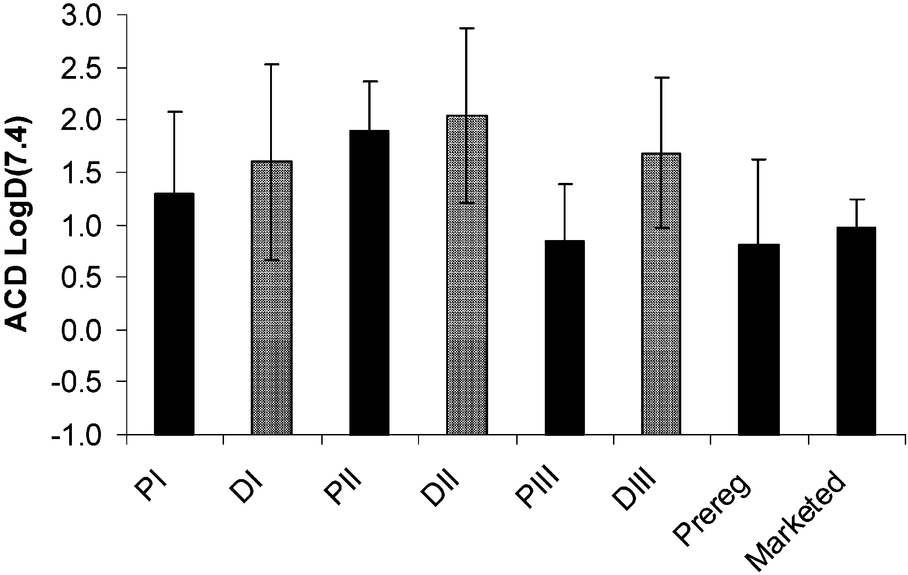
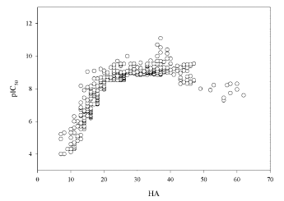
Composite parameter – ligand efficiency
Ligand efficiency (LE):
pIC₅₀ ÷ HAC (heavy atom count)
Others:
group efficiency (GE): Δ pIC₅₀ ÷ ΔHAC
size independent ligand efficiency (SILE): pIC₅₀ ÷ HAC^{0.3}
Target potency increases with increasing size
Tends to select for more lipophilic compound
Larger LE ⇒ better the hit or lead matter
Wentlock et al J. Med. Chem. 46(7)6, 1250, 2003; Reynolds et al J. Med. Chem. 51(8), 2432, 2008.

Slide 19
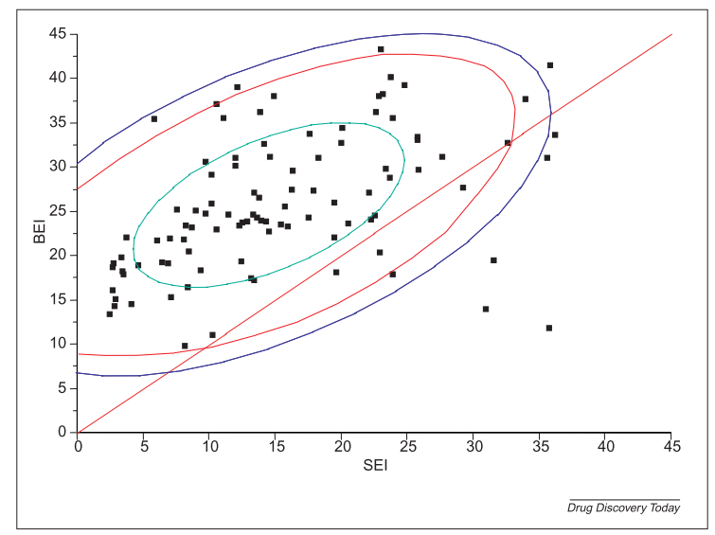
De-convolute hits from a screening library
percentage efficiency index (PEI): [Cmpd@50% inh] ÷ MW
- alternative to LE (better accounting for atomic weight)
binding efficiency index (BEI): pIC₅₀ ÷ MW
- similar to PEI w/ IC₅₀ data
surface binding efficiency index (SEI): pIC₅₀ ÷ TPSA
- normalize for polar atoms
122 marketed drugs
Drugs dominated by non-polar atoms (MW ➢ PSA)
Abad-Zacatero, C. et al Drug Disc. Today, 10(7), 2005, 467.

Slide 20
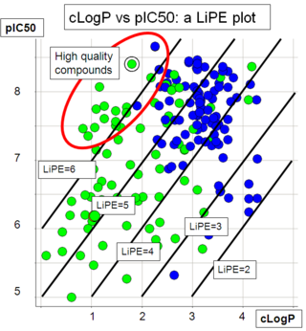

Lipophilicity Efficiency
Lipophilicity Efficiency (LiPE)
or Ligand Lipophilicity Efficiency (LLE)
(LiPE): pIC₅₀– cLogP
Battle the proclivity to increase target potency by increasing lipophilicity
Useful for lead optimization
Leeson et al Nature Rev. 2007, 6(11), 881-90; Abad-Zapatero Drug Disc. Today 2010, 15, 804-11

Slide 21
Enthalpy versus Entropy
H-bond interactions, electrostatic interactions, van der Waals interactions, etc.
Measurable via Isothermal Titration Calorimetry (ITC)
ΔG˚ = ΔH˚-TΔS˚
Primarily hydrophobic interactions – due to desolvation

Slide 22
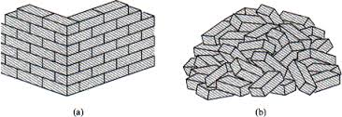
Entropy
Tied-ups, tied-backs, tie-dyed, cyclized, constrained,
Which took more energy to create???
Conformationally locked
farnesyltransferase inhibitors
Both ligands and targets sites become more ordered on association (binding) – costs associated
Pre-organization into binding conformations can greatly improve potency – money in the bank

Slide 23
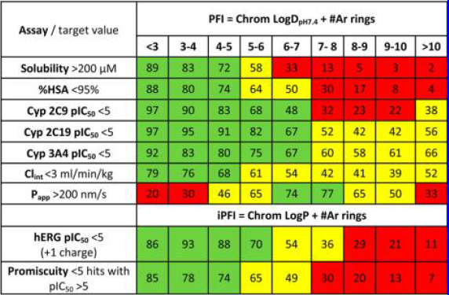
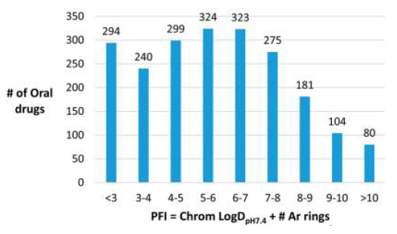
Propert Forecast Index (PFI)
PFI = logD + #Aromatics
Young, R. J. Nat. Rev. Drug Disc. 16(17-18), 822, 2011
Optimal for permeability ⇒ intermediate value
Optimal for potency ⇒ intermediate value
Optimal for all else ⇒ go small and go polar
Leeson, P.; Young, R. J. ACS Med. Chem. Lett. 6, 722, 2015

Slide 24
Other composite parameters
ligand efficiency dependent lipophilicity (LELP): clogP ÷ LE
- accounts for price of LE paid in clogP
polar surface area density (PSAD): MW ÷ PSA
- normalize for PSA going up as molecule size increases
dose number (Do): Max. Dose ÷ (250 x cLogP x Solubility)
- Lower solubility can follow low dose drug
ligand efficiency scale (LE_Scale): 0.072+7.5/(HA)+25.7/(HA²)-361.5/ (HA³)
- normalize for small molecules versus larger molecules
ligand lipophilicity index (LLE_{AT}):
LLE_{AT} = 0.11 – ln(10)·RT(log P - pIC₅₀) ÷ HAC
- subtract out lipophilicity component for ΔG of binding

Slide 25
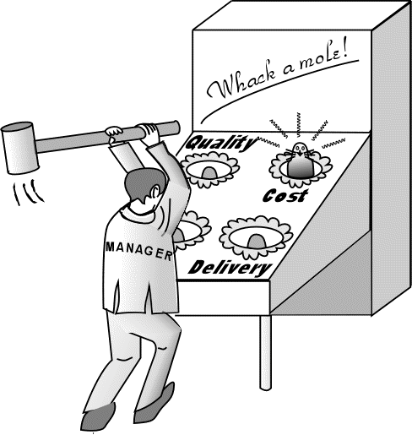
Too many (often conflicting) optimizations
Simultaneous optimization (or mitigation):
Target activity
Cell Permeability
Solubility
Clearance (biliary, metabolic, renal, etc.)
Reactive metabolites
Distribution
Plasma protein binding
Plasma stability
Absorption/bioavailability (oral)
Off-target activity
Ion channel binding
Genotoxicity
Hepatotoxicity
Mitochondrial toxicity
Drug-drug interaction (Cyp inhibition, transporter inhibition)
Cost-of-goods/synthetic feasibility
etc.
Solubility
DMPK
Hapless
Drug
Hunter
Activity
All drugs must make some compromises

Slide 26
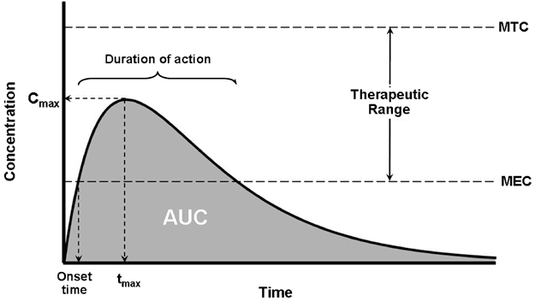
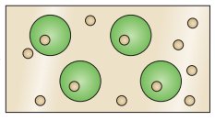
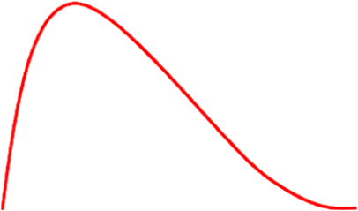
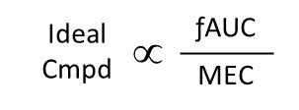
Multi-Parameter Optimization (MPO)
AUC = | Dose*F
 | Cl
Cl = | 0.693*V_{d}
 | t_{1/2}
MEC

Slide 27
MPO
 | Target pot. (IC₅₀) | PfNF54 IC₅₀ | PfK1 IC₅₀ | Solu-bility | µ-some Cl_{int} (Mo) | µ-some Cl_{int} (Hu) | hERG | HepG2 | Caco-2 (A⇒B) | Caco-2 (efflux) | TPSA | LogD
Hi-Low | Low | Low | Low | High | Low | Low | High | High | High | Low | Low | ~2
Weight | 2 | 10 | 8 | 10 | 7 | 4 | 3 | 6 | 5 | 5 | 3 | 3
A
B
C
D
E
F
G
H
I
J

Slide 28
MPO
 | Target pot. (IC₅₀) | PfNF54 IC₅₀ | PfK1 IC₅₀ | Solu-bility | µ-some Cl_{int} (Mo) | µ-some Cl_{int} (Hu) | hERG | HepG2 | Caco-2 (A⇒B) | Caco-2 (efflux) | TPSA | LogD
Hi-Low | Low | Low | Low | High | Low | Low | High | High | High | Low | Low | ~2
Weight | 2 | 10 | 8 | 10 | 7 | 4 | 3 | 6 | 5 | 5 | 3 | 3
L
W
M
Y
A
B
F
X
N
D

Slide 29
MPO Excercise
Rank order these 4 compounds from best to worse. The aim is to put into an in vivo mouse efficacy model towards selecting a development candidate
 | Target (IC₅₀, nM) | PfNF54 (IC₅₀, nM) | FaSSIF Solu-bility (μM) | Plasma Cl_{int} (Mo, ml/min/kg) | Bioavailability (Mo, %) | Plasma Protein Binding (Mo, %) | hERG (IC₅₀, μM) | HepG2 (IC₅₀, nM)
Hi-Low | Low | Low | High | Low | High | Low | High | High
Weight | ??? | ??? | ??? | ??? | ??? | ??? | ??? | ???
A | 24 | 32 | 36 | 2.6 | 76 | 93 | 100 | 270
B | 8 | 25 | 36 | 3.2 | 62 | 86 | 10 | 120
C | 23 | 5 | 3750 | 13 | 66 | 90 | 10 | 13
D | 1 | 5 | 255 | 19 | 66 | 82 | 30 | 100

Slide 30
Parting thought: Rules only make sense if they are broken. Breaking the rule is one way of observing it. Sir Thomas More English lawyer, judge, social philosopher, author, statesman, amateur theologian, and noted Renaissance humanist

