Slide 1
Drug Discovery and Development Course
Pharmacokinetic-pharmacodynamic (PK-PD) modelling
Mwila Mulubwa

Slide 2

Terms of Use – CC BY 4.0 License
These materials are shared to support teaching, research, and presentation activities across the GC ADDA community. All content is provided under the Creative Commons Attribution 4.0 (CC BY 4.0) license, which allows you to use, share, adapt, and build upon the material freely, including for commercial purposes. Please ensure that any use includes proper attribution to the original creators, indicates any modifications you make, and maintains the same open license. No additional restrictions may be applied.
Credit the author(s) as follows:
CC BY 4.0 [Mwila Mulubwa, H3D University of Cape Town, South Africa]

Slide 3
Learning objectives
Define PK–PD modelling and explain its importance in drug development and clinical pharmacology.
Distinguish between pharmacokinetics (PK) and pharmacodynamics (PD) and describe their integration.
Describe common PK–PD model structures (direct and indirect models).
Interpret key PK–PD parameters (EC50, Emax, ke0).
Explain time delays in drug response (hysteresis).
Apply compartmental PK models in PK–PD analysis.
Understand population PK–PD modelling and variability.
Recognize applications of PK–PD modelling in dose optimization.

Slide 4
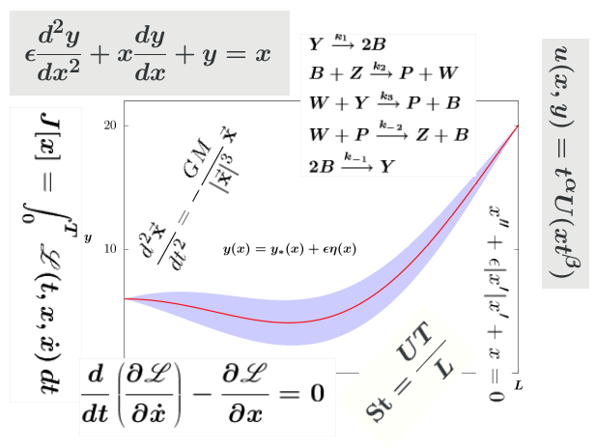
Introduction to PK–PD modelling
PK–PD modelling quantitatively links:
Pharmacokinetics (PK): what the body does to the drug (absorption, distribution, metabolism, excretion)
Pharmacodynamics (PD): what the drug does to the body (effect)
The goal is to establish a mathematical relationship between drug exposure and response.

Slide 5
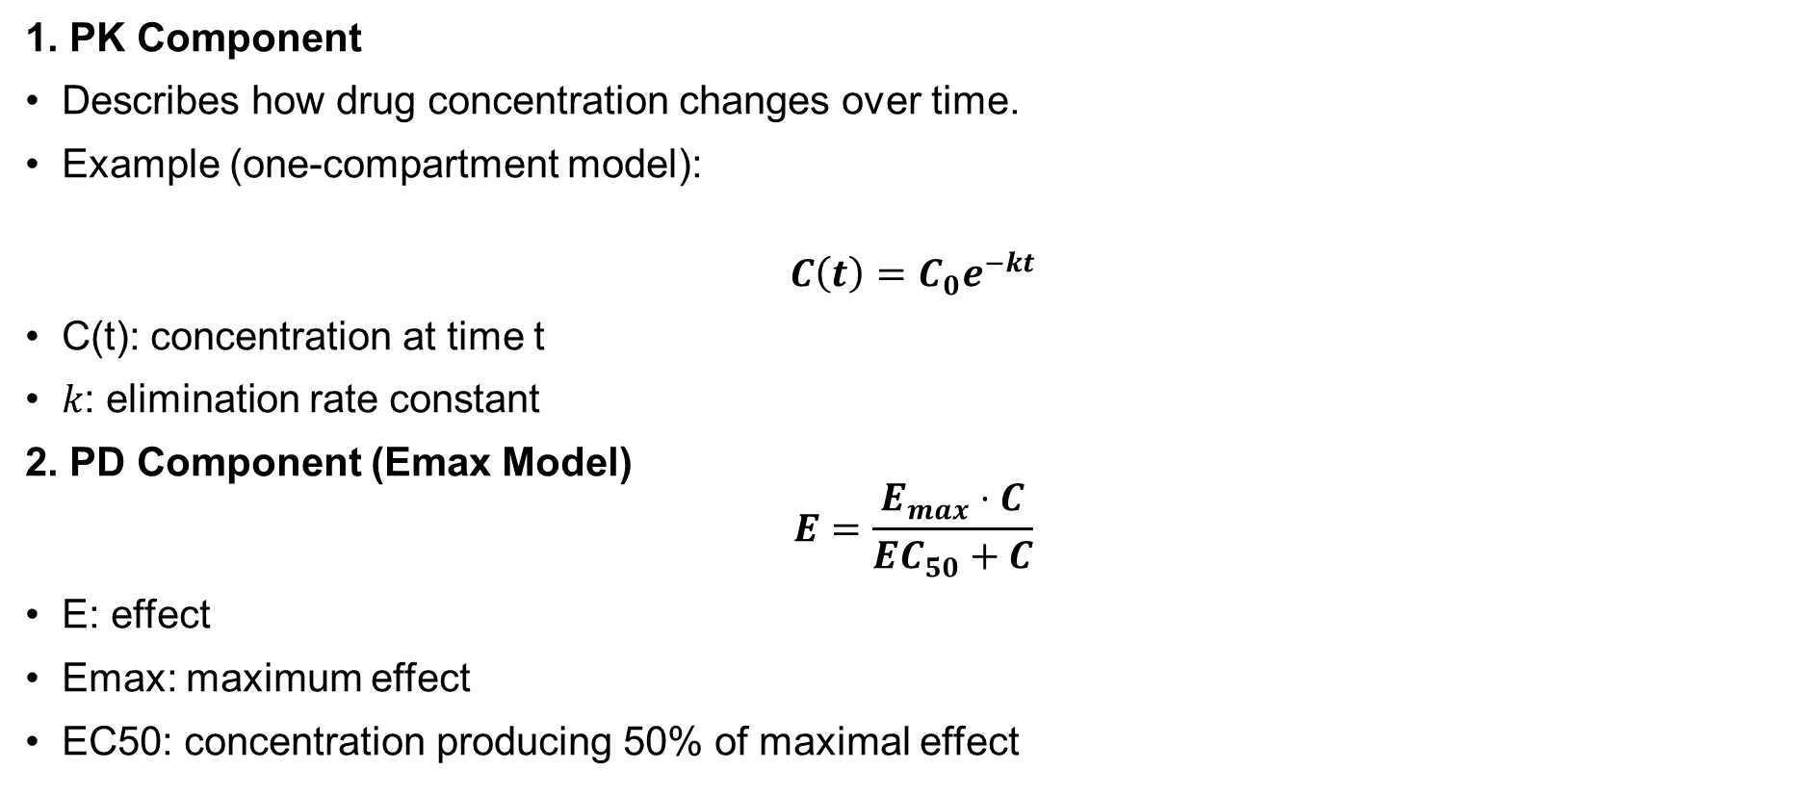
Basic PK–PD framework
1. PK Component
Describes how drug concentration changes over time.
Example (one-compartment model):
$$C\left(t\right)=C_{0}e^{−kt}$$
C(t): concentration at time t
𝑘: elimination rate constant
2. PD Component (Emax Model)
$$E=\frac{E_{max}⋅C}{EC_{50}+C}$$
E: effect
Emax: maximum effect
EC50: concentration producing 50% of maximal effect

Slide 6
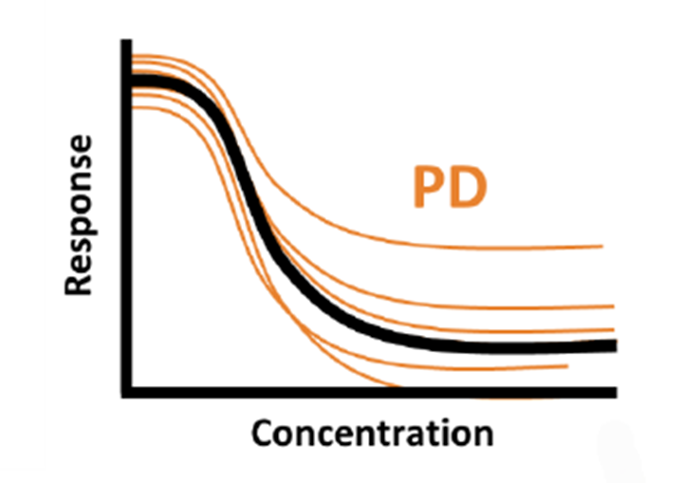

Basic PK–PD framework
3. Linking PK to PD
PK provides concentration–time profile
PD translates concentration into effect
Direct Link Models
Assume instantaneous relationship between concentration and effect.
Linear Model
$$E=S⋅C$$
Simple but rarely sufficient
Sigmoid Emax (Hill Model)
$$E=Emax∗\frac{C^{H}}{EC50^{H}+C^{H}}$$
H: Hill coefficient. It describes the steepness of the curve

Slide 7
Time delay in drug response
Often, effect does not immediately follow concentration.
Hysteresis Loops
Plot: effect vs concentration
Types:
Counterclockwise → delay in effect
Clockwise → tolerance or feedback
Ki, S. (2020). A semi-compartmental model describing the pharmacokinetic-pharmacodynamic relationship. Anesthesia & Pain Medicine, 15(1), 1-7.

Slide 8

Effect compartment model
Peripheral compartment
$$\frac{dC_{e}}{dt}=k_{e0}\left(C−C_{e}\right)$$
Ce: Effect-site concentration
Ke0: rate constant governing delay
C : concentration in the central compartment
k12
k21
Absorption compartment
ka
Central compartment
k10
ke0
Dose
Effect compartment
ke0

Slide 9
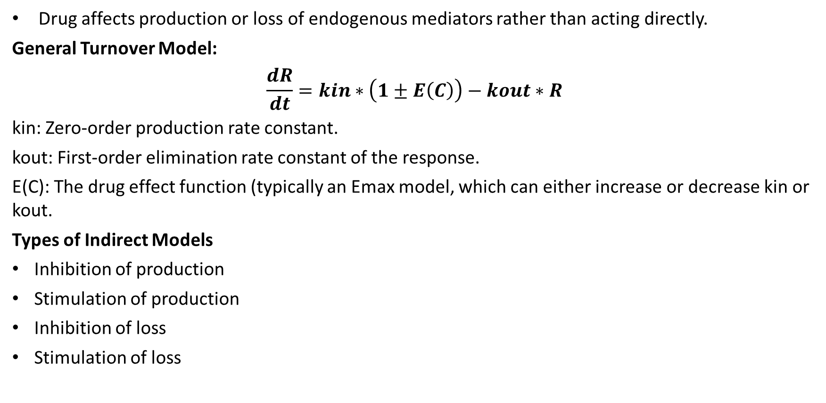
Indirect response models
Drug affects production or loss of endogenous mediators rather than acting directly.
General Turnover Model:
$$\frac{dR}{dt}=kin∗\left(1±E\left(C\right)\right)−kout∗R$$
kin: Zero-order production rate constant.
kout: First-order elimination rate constant of the response.
E(C): The drug effect function (typically an Emax model, which can either increase or decrease kin or kout.
Types of Indirect Models
Inhibition of production
Stimulation of production
Inhibition of loss
Stimulation of loss
9

Slide 10
Mechanism-based PK–PD models
Incorporate biological pathways
Include receptor binding, signal transduction, feedback loops
Applications:
Oncology
Infectious diseases
Immunology

Slide 11
Population PK–PD modelling
Modelling Approaches
Nonlinear mixed-effects modelling (NONMEM, Monolix, Pumas, Phoenix WiNonlin)
Variability Types
Inter-individual variability (IIV)
Intra-individual variability
Residual unexplained variability
Covariate Effects
Age, weight, genetics, disease state
Example:
CYP polymorphisms affecting response to Efavirenz

Slide 12
PK–PD indices in antimicrobial therapy
Important for optimizing antibiotic dosing:
Cmax/MIC → concentration-dependent killing
AUC/MIC → overall exposure
T>MIC → time-dependent killing
Example drugs:
Gentamicin (Cmax/MIC)
Penicillin (T>MIC)

Slide 13
Model evaluation and validation
Diagnostic Tools
Goodness-of-fit plots (observed Vs IPRED and PPRED)
Line of unit
Residual analysis (residuals Vs predicted marker and time)
Trend analysis
Predictive Checks
Visual predictive checks (VPC)
simulations
External validation

Slide 14
Applications of PK–PD modelling
Drug Development
First-in-human dose selection
Dose-ranging studies
Go/no-go decisions
Clinical Practice
Individualized dosing
Therapeutic drug monitoring
Special populations (pediatrics, renal impairment)
Precision Medicine
Integration with genomics
AI-driven PK–PD modelling (emerging field)

Slide 15
Summary
PK–PD modelling quantitatively links drug exposure to effect.
Models range from simple direct models to complex mechanistic systems.
Understanding delays, variability, and biological systems is essential.
PK–PD modelling is central to modern drug development and precision dosing.

Slide 16
Thanks!

Slide 17
Your key idea / concept / question

