Slide 1
Drug Discovery and Development Course
Patent Strategy, when to protect your innovation?
Jeremy Burrows

Slide 2

Terms of Use – CC BY 4.0 License
These materials are shared to support teaching, research, and presentation activities across the GC ADDA community. All content is provided under the Creative Commons Attribution 4.0 (CC BY 4.0) license, which allows you to use, share, adapt, and build upon the material freely, including for commercial purposes. Please ensure that any use includes proper attribution to the original creators, indicates any modifications you make, and maintains the same open license. No additional restrictions may be applied.
Credit the author(s) as follows:
CC BY 4.0 [author, institution]

Slide 3

Learning objectives
Understand what a patent application is and why it is important
Understand what can be patented and why
Understand enough, as drug discovery scientists, the important legal features of a patent application
Be aware of the difference between inventorship and authorship, and the risks of early compound structure disclosure

Slide 4
Patenting – things to think about
Who can help?
What is a patent?
Why and where do you file a patent?
What can I file?
When to file?
What is the process of getting a patent?
How to assign inventorship?
What is the scope and how to select examples?
Can additional examples be added?
What are the claims?
What can be published and when?
What about additional fillings?

Slide 5
Who can help?
Patent attorneys take responsibility for drafting and filing patent applications
Scientific legal discipline requiring incredible attention to detail, organisation and punctuality
Your institution will have assigned patent attorneys who can advise on when and how to patent, and then support you with the draft and filing
Your legal or tech transfer team likely to be the conduit
Collaboration with the project team – principally medicinal chemistry
If you file a patent do it well!

Slide 6
What is a patent?
A legal right granted to inventors for their invention
Inventors may own or assign their ownership to an employer
The right to prevent others from making, using, selling their invention
A patent does not give you a right to sell your invention, rather the right to prevent others from selling it
For a limited period of time (usually 20 years from the filing date)
In particular countries (geographical scope)

Slide 7
Why and where to file a patent?
If working on commercial diseases then patenting is driven more by exclusivity
Establishes a monopoly that prevents other companies selling your drug
Enables costs of R&D to be recouped and deliver a profit
Gives you freedom to operate – no-one can prevent you acting
Even if working on a neglected tropical disease it is a valuable asset to attract Pharma partners and reinforce quality
A patent needs to be filed and approved in every country in which the right might be exercised (e.g. manufacturing or sales)
Generally, the MMV default list is USA, China, Japan, Brazil, India, South Africa and EU (Germany, France, Spain, Netherlands, Italy, Turkey, Switzerland and UK)
Choice made by the filing institution

Slide 8
What can you file?
Adequately
Described
Inventive
Novel
Useful
Must be Useful, Novel and adequately described
Use = treat or prevent a disease (i.e. not inhibit a target)
Novel = either an undisclosed compound that is not obvious, or an undisclosed use of a compound – reduced to practise
A compound without biological activity or a virtual compound would not be patentable
Enabled so that someone “skilled in the art” can reproduce invention
All terms e.g. “alkyl”, “aryl”, “optionally substituted with X” must be defined
Medicinal chemistry
Chemical compounds, chemical intermediates, isomers, salts, new physical forms (crystal forms, polymorphs, solvates, hydrates), chemical processes
Other: Biotechnology e.g. DNA, RNA, proteins; formulations, combinations

Slide 9
Types of filing
Composition of matter
“Compound per se” means that novel chemistry is claimed
“Use” means that a use for the chemistry is claimed and justified
This type of patent is the strongest – novel chemistry and use
Use patent
Even if chemistry is published, a new “use” can be discovered
Such known chemistry can then be patented for the new “use”
Weaker type of filing – as no protection on the compounds per se
May even require a license from a third party
Others

Slide 10
When to file a patent?
x
x
x
x
x
x
x
x
First to file gets the patent (US slightly different and can go back to the date of the invention)
Timing depends on circumstances
Urgent competitive areas tend to file earlier
Non urgent/ first in class tend to be later
MMV strategy is to file late, around candidate selection and file narrow
Does have advantages in you can better define the scope
Less filings potentially needed
What constitutes ‘narrow’?
Two examples: one 15 compounds and one ~250 compounds
250 examples too many? expensive and unnecessary
15 too narrow? possibly ok if you are confident your Candidate Drug is covered, and you will not work outside that scope
x
x
x
x
x
x
x
x
x
x
x
x
x
x
x
x
x
x
Good
x
x
x
x
x
x
x
x
x
Avoid
x
x
x
x
x
x
x
Avoid
x
x
x
x
x
x
x
x
Avoid

Slide 11
Filing procedures
PCT (WIPO)
Patent Cooperation Treaty (PCT) - applicant files 1 patent application and potentially accesses 150 countries
Harmonisation saves a huge amount of time and money
National phase
30 months post filing
Translations and filings in each individual country
Patent costs high – but are 3 years post filing at which point the importance of the filing and likelihood of granting may be clear
Patent prosecution in each country

Slide 12
Filing procedures - Africa
South Africa
Strong IP infrastructure
Signatory to PCT
Africa harmonisation
ARIPO (African Regional Intellectual Property Organization) – 22 countries
OAPI (Organisation Africaine de la Propriété Intellectuelle) – 17 countries

Slide 13
What is the process of getting a patent?
A lengthy process
Up to 4-6 years
Maintaining a patent portfolio is expensive but can be valuable
Cost increases
Approx USD
6-10k
13-18k
36-42k 60-100k

Slide 14
Inventorship
Patent inventorship is a legal determination of who contributed to the claimed invention
Only individuals who made a contribution to the idea embodied by the claimed invention are inventors
This means individuals who have put in a lot of effort on a project, e.g. making examples or testing cpds, will not necessarily be an inventor
Being named as an inventor on a patent is not the same as being named as an author of a scientific paper
Naming the wrong inventors may have adverse legal consequences
Inventorship is always decided by a Patent Attorney
One option to keep a record of suggested ideas as you go along
Can use standard templates

Slide 15
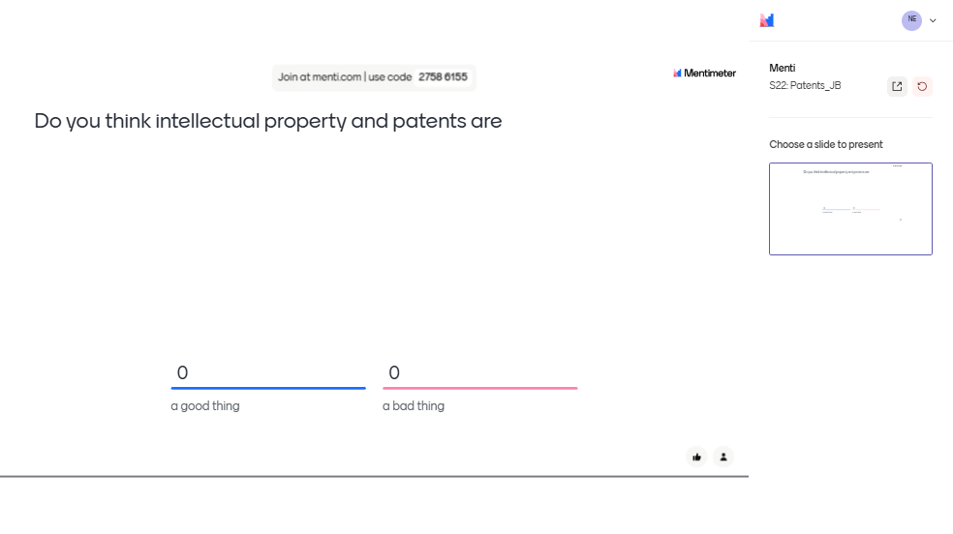
Mentimeter

Slide 16
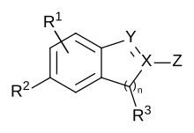
Structure of a patent
Title and background of the invention – setting the context
Summary of the invention – e.g. chemical series treating malaria
Detailed description of the invention
Define the scope of the patent application
Markush structures with definitions
Experimental
Synthesis of every example and biological data
Claims
Legal heart of the filing
These will be reviewed by a patent examiner and potentially contested
If a claim is rejected at prosecution, then that IP cover is lost

Slide 17
Scope and Examples
Prior art means – any information that is published or disclosed that could affect the “novelty” claim of your patent application
Be aware of the prior art
Get advice from a patent attorney as to what is novel
Scope is the chemical breadth claimed by the patent application
It is justified on the basis of synthesised and tested chemical examples
Do not try to cover too much – focus on your most interesting compounds
It is worth covering enough that it does not allow others to easily bypass or bust your patent
Include the assays used and the activity of the molecules
Do not hide anything

Slide 18
Adding Examples
You can add examples or modify the scope up until the priority application
Make sure you allow time to incorporate
Realistically you have 10-11 month after the original filling
Changes to scope will have that new priority date
New filings can be made up to publication without your patent counting as prior art
Make
additions
New
filing

Slide 19
Claims
These are actually the most important part as they define what will be granted
Do not be surprised if these change during prosecution – they usually do
Remember a patent application or published patent is not a granted patent
This is where you might have used “preferably” and “more preferably” to help define the dependant claims
So, if you lose claim 1 you still keep the most important ‘compounds’

Slide 20
Publications
MMV has a strong drive to publish as do you and many of your collaborators
However, a publication might invalidate your claim(s)
Remember a publication can be anything prior to the patent filing date
Written (paper, internet article or abstract), oral (lecture, chat room, conversation), prior use
If you make changes to the patent during the 12 months after the initial filing, your changes get that new date
Make sure you do not “prior art” yourself with your own publication!

Slide 21
Additional filings
These can be made up until your patent publishes without your patent counting as prior art
In terms of cost this is best avoided, and the file late approach reduces the need for this
Process chemistry or formulations (discussed 18/3/24)
Generally, not worth the expense for MMV
Could publish and remove novelty
Obviously, there could be exceptions eg if its your formulation that’s the project

Slide 22
Summary
Make sure your project has given thought to a patent strategy
Make sure you align any publications with your patent strategy
Keep a note of who has contributed to the invention and use an inventorship form
Remember an inventor is not the same as an author on a paper
When sharing information with the patent attorney:
Provide data table
Structure, IUPAC name, project number, potency
Be careful what you write
“We haven’t made an invention yet”, “It was obvious to .......”,“It was a mere replacement of X for Y” – disastrous statements!
Many inventions may appear obvious with hindsight, but were anything but that beforehand
Seek advice when needed

Slide 23
References
https://www.youtube.com/watch?v=6ZNC5jA3VSw
https://www.wipo.int/pct/en/users/summary.html
https://www.wipo.int/directory/en/details.jsp?country_code=ZA
https://www.debeerattorneys.com/post/what-is-wipo
https://www.wipo.int/en/web/global-innovation-index/w/blogs/2024/gii-2024-african-innovation-clusters

Slide 24
Define your patent strategy If you plan to patent, be clear on your publication strategy Inventorship is not authorship Patents are defensive and can raise value of a candidate drug

