Slide 1

Drug Discovery and Development Course
PK/PD Relationships
Abdallah Derbalah

Slide 2

Terms of Use – CC BY 4.0 License
These materials are shared to support teaching, research, and presentation activities across the GC ADDA community. All content is provided under the Creative Commons Attribution 4.0 (CC BY 4.0) license, which allows you to use, share, adapt, and build upon the material freely, including for commercial purposes. Please ensure that any use includes proper attribution to the original creators, indicates any modifications you make, and maintains the same open license. No additional restrictions may be applied.
Credit the author(s) as follows:
CC BY 4.0 [author, institution]

Slide 3

Learning Objectives
Understand key concepts of PK/PD modelling
Recognise the differences between basic types of PK models
Differentiate between direct and indirect PK/PD relationships
Understand the impact PK/PD relationship on study designs

Slide 4
Popular Quotes
“All models are wrong, but some are useful”
George Box (Statistician)
“Perfect is the enemy of the good”
Voltaire (Philosopher)
“The goal is to build the simplest useful model with minimal data/cost”
A PKPD modeller

Slide 5
What is a useful model?
Models are based on data and assumptions.
A simple model often has more assumptions but require less data.
Replacing assumptions with data incurs cost/time/effort.
If either data or assumptions are wrong, the model will likely not be useful.
“Useful” depends on the question to be answered.

Slide 6
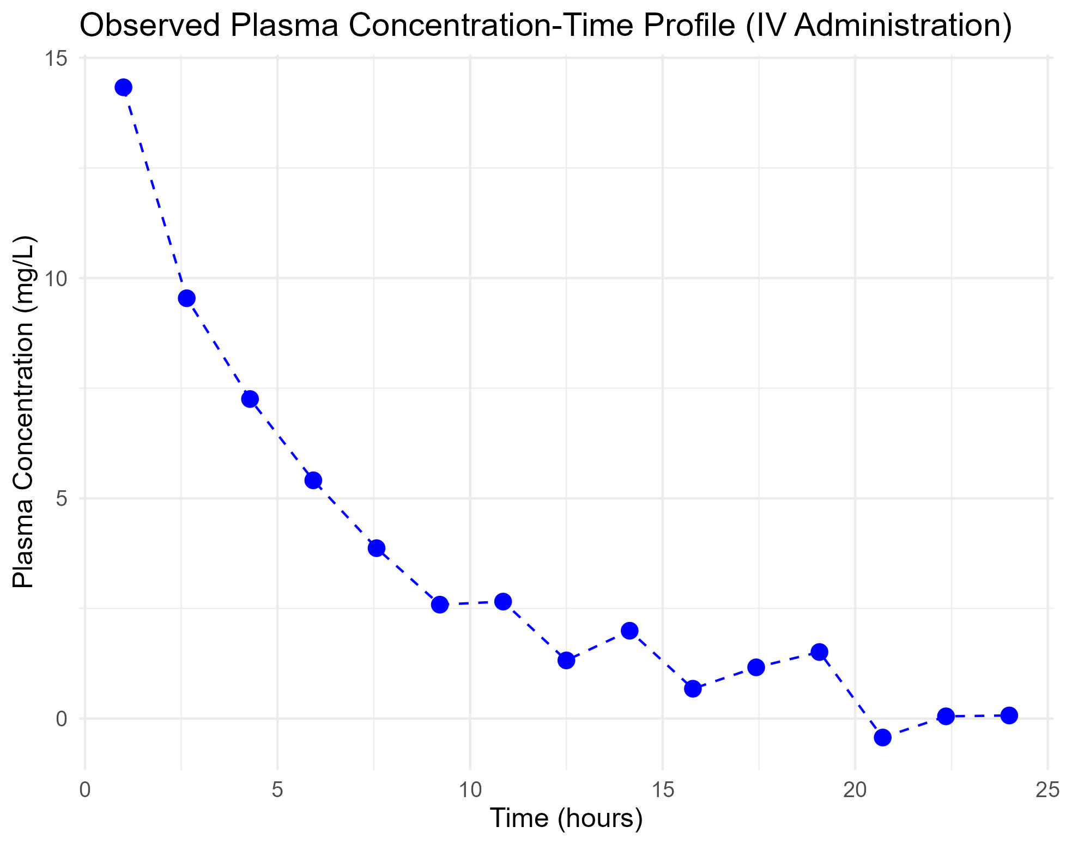
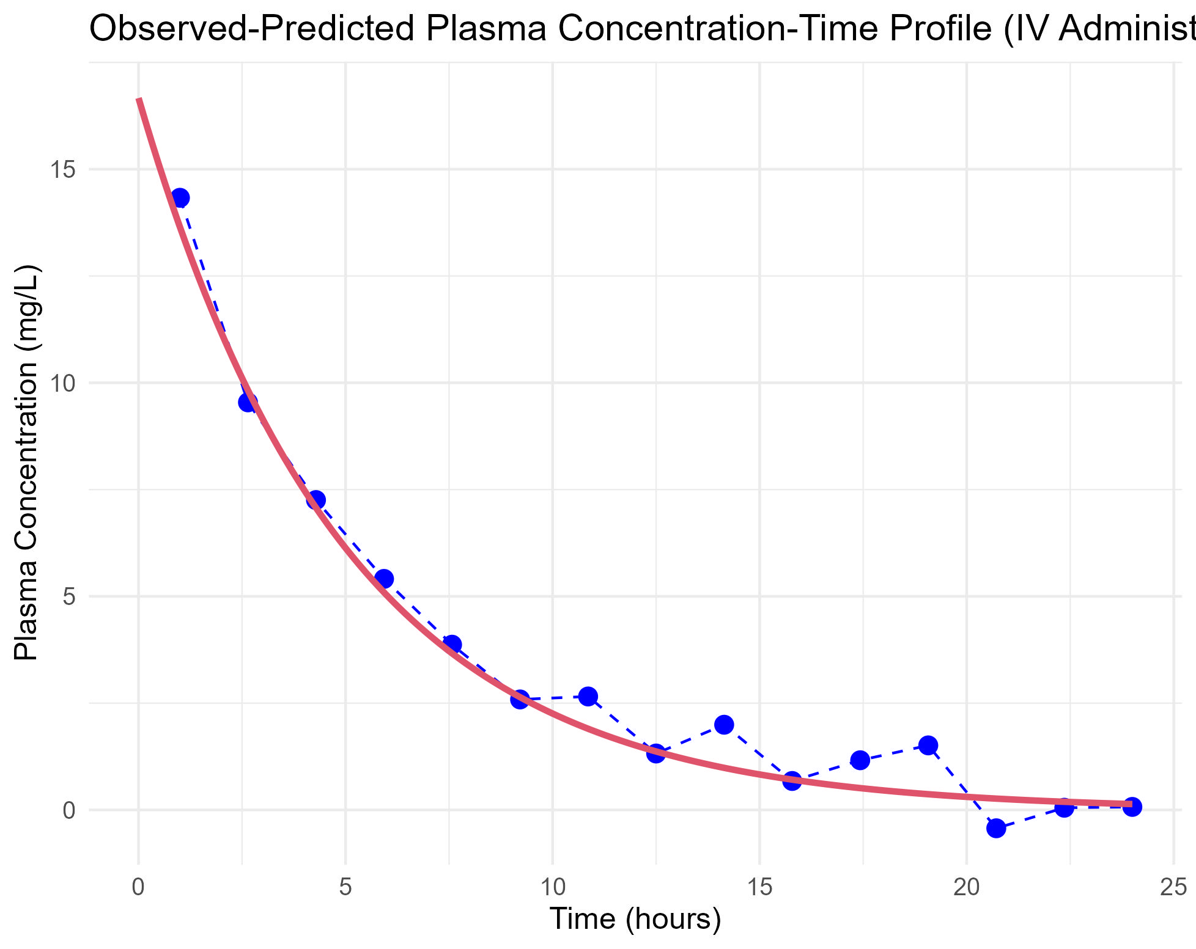
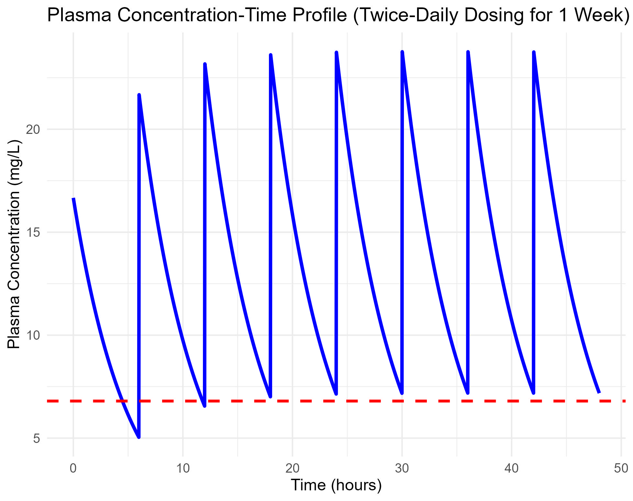
A useful model example
Assume you have plasma exposure data following a single IV administration
Need to predict steady-state concentrations after multiple IV dosing.

Slide 7
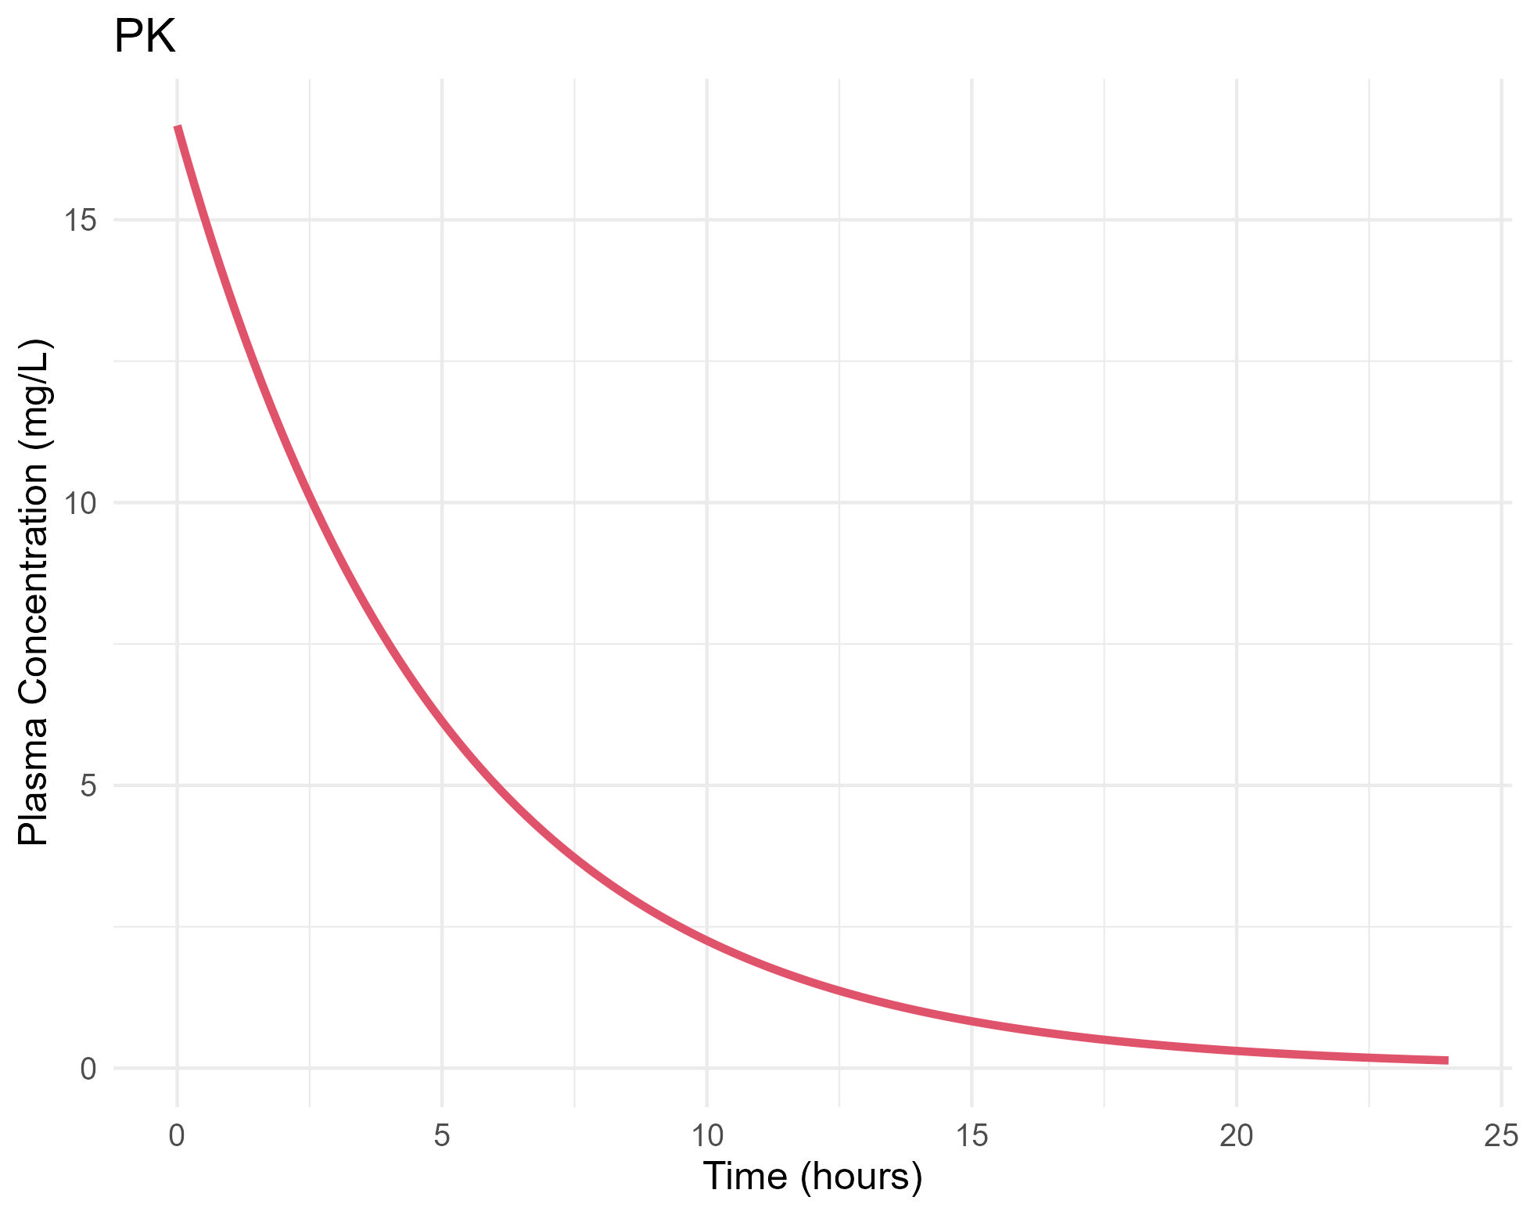
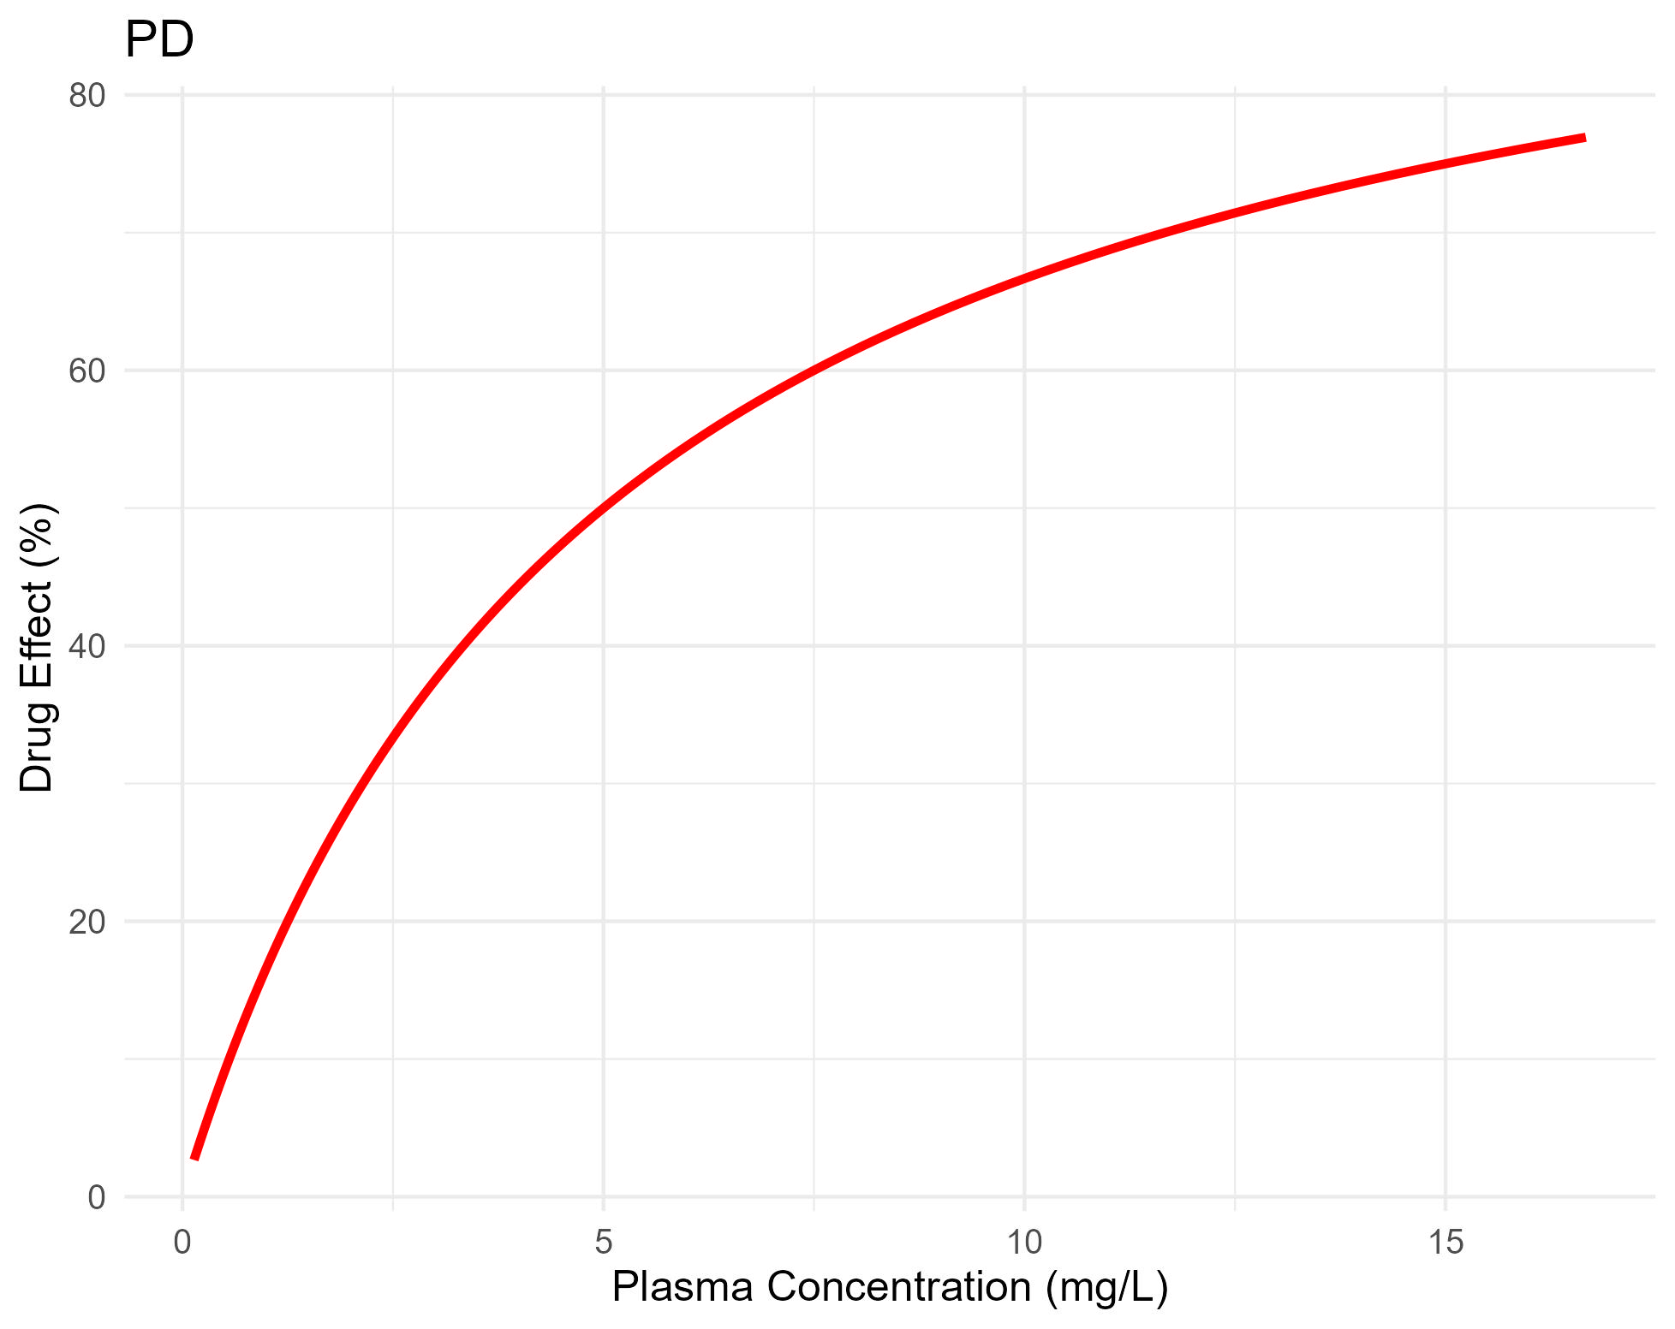
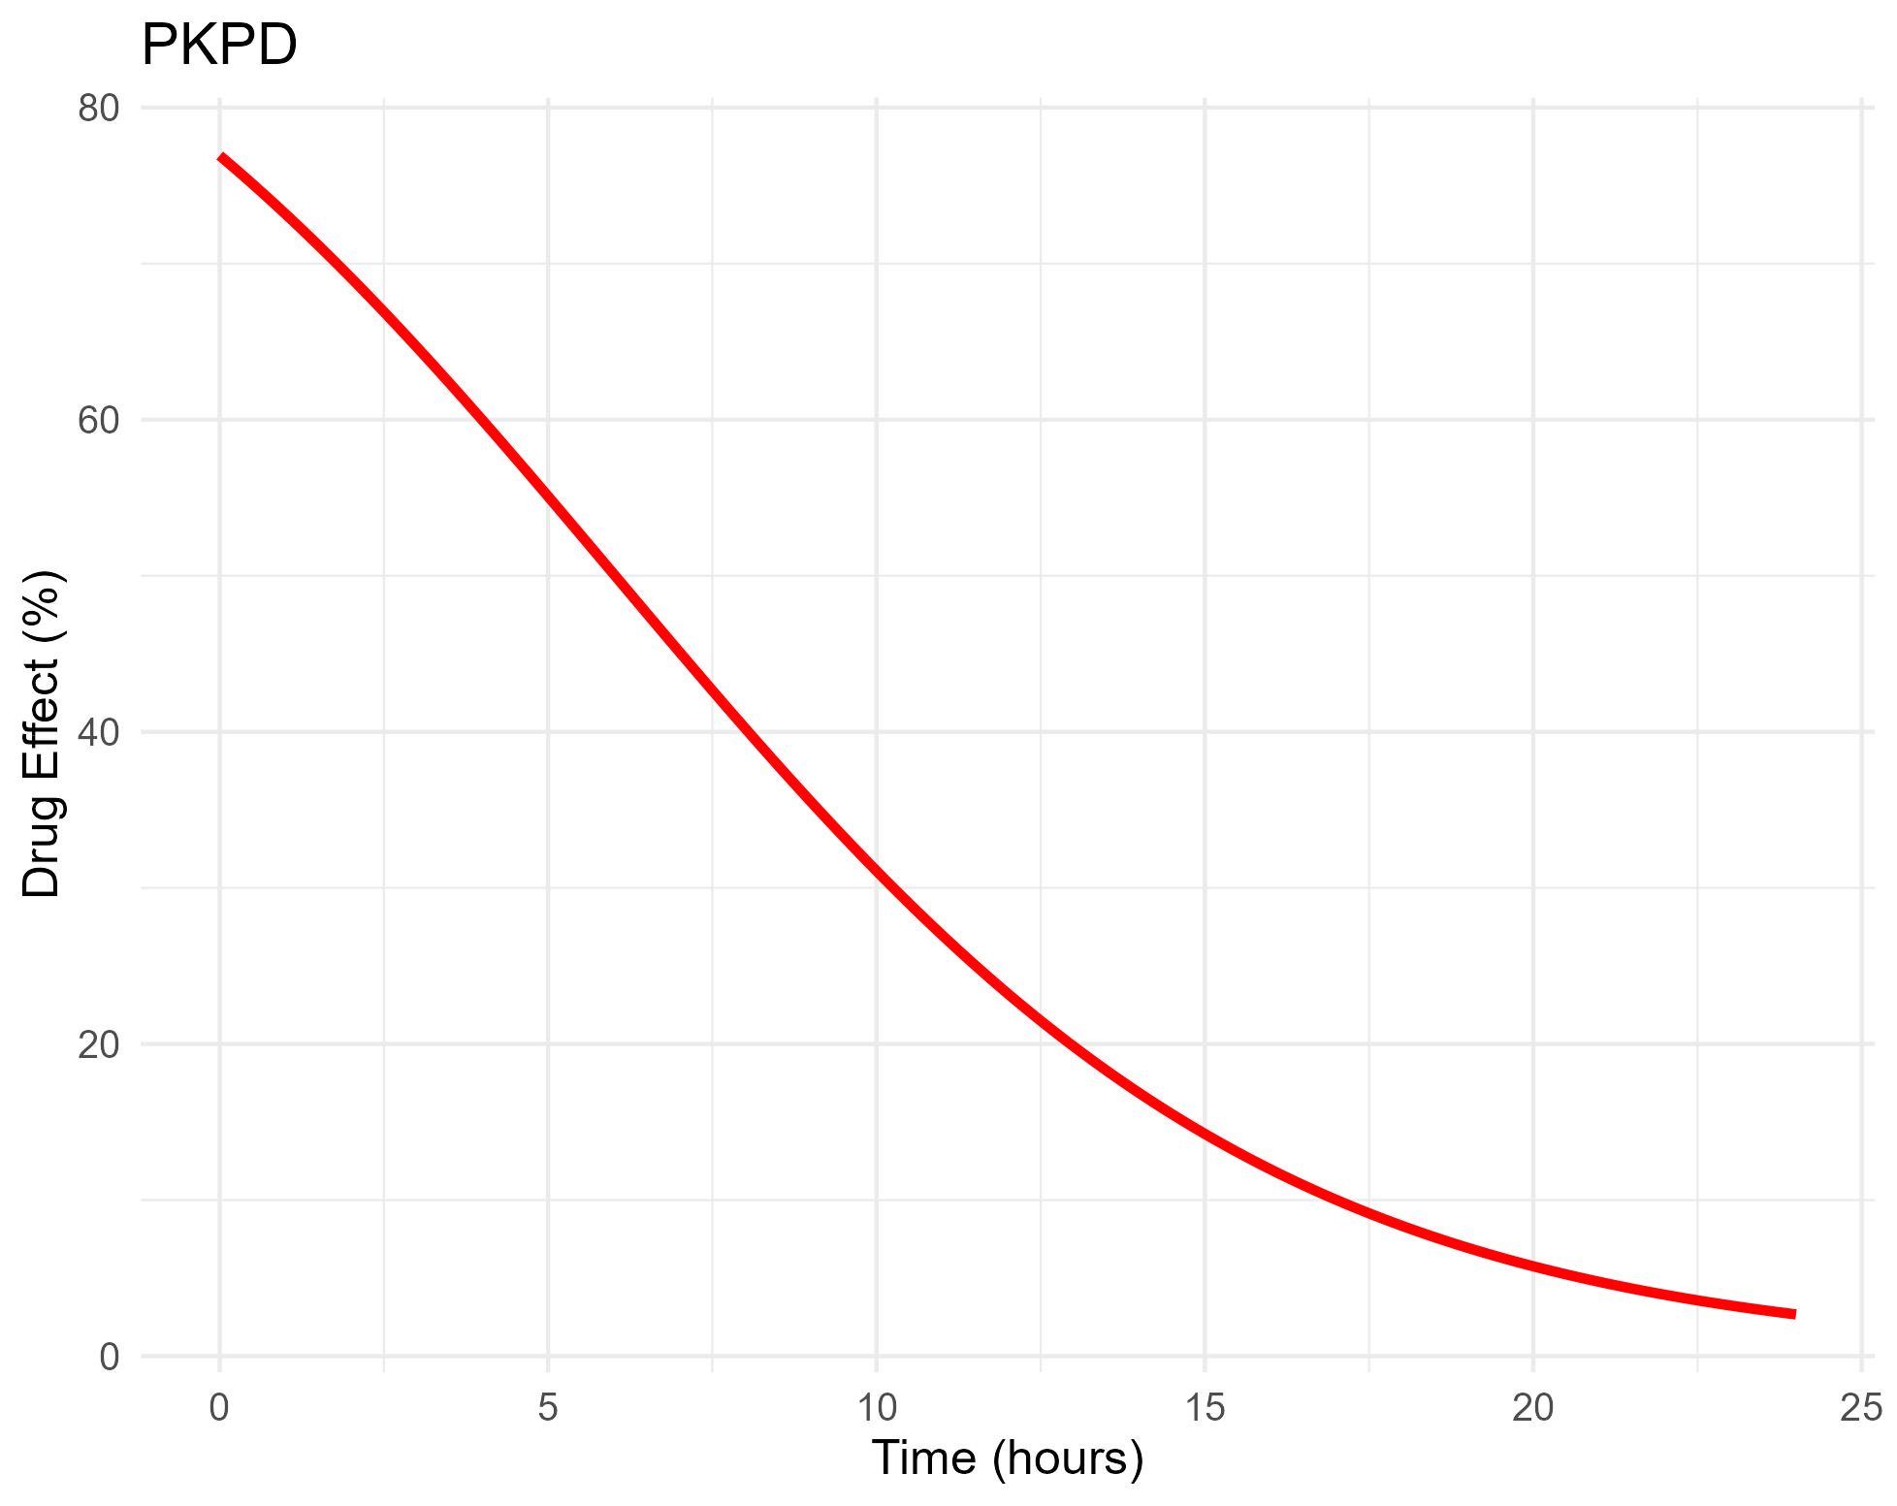
What is PK/PD?
Pharmacokinetics
Pharmacodynamics
PK/PD
If PK/PD is well understood, we can predict PD changes under different PK conditions.

Slide 8
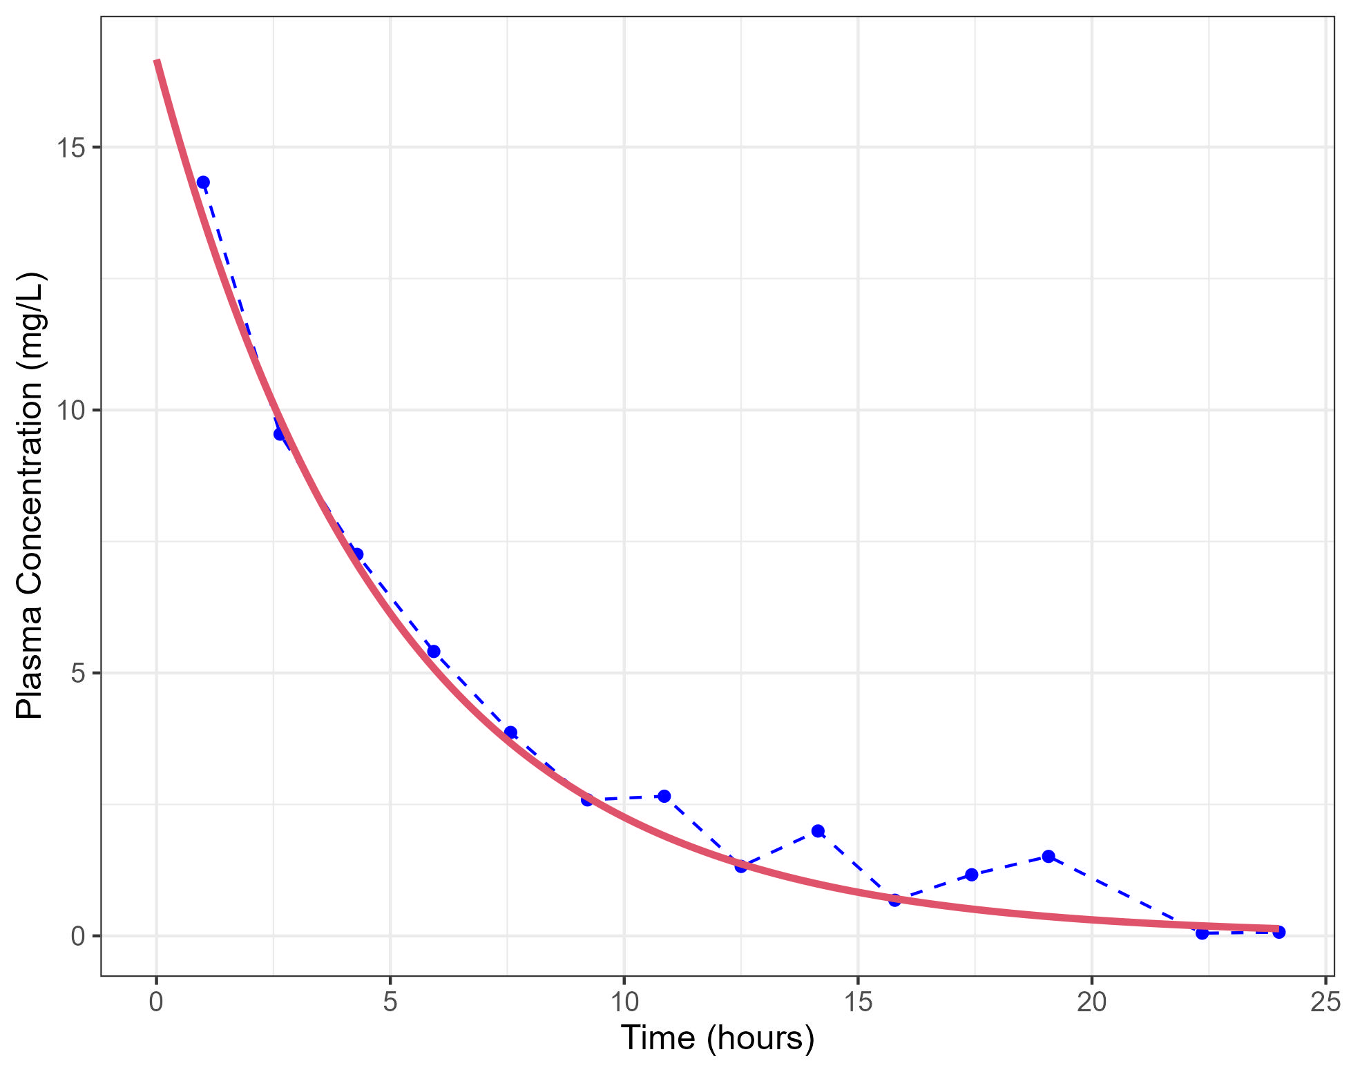
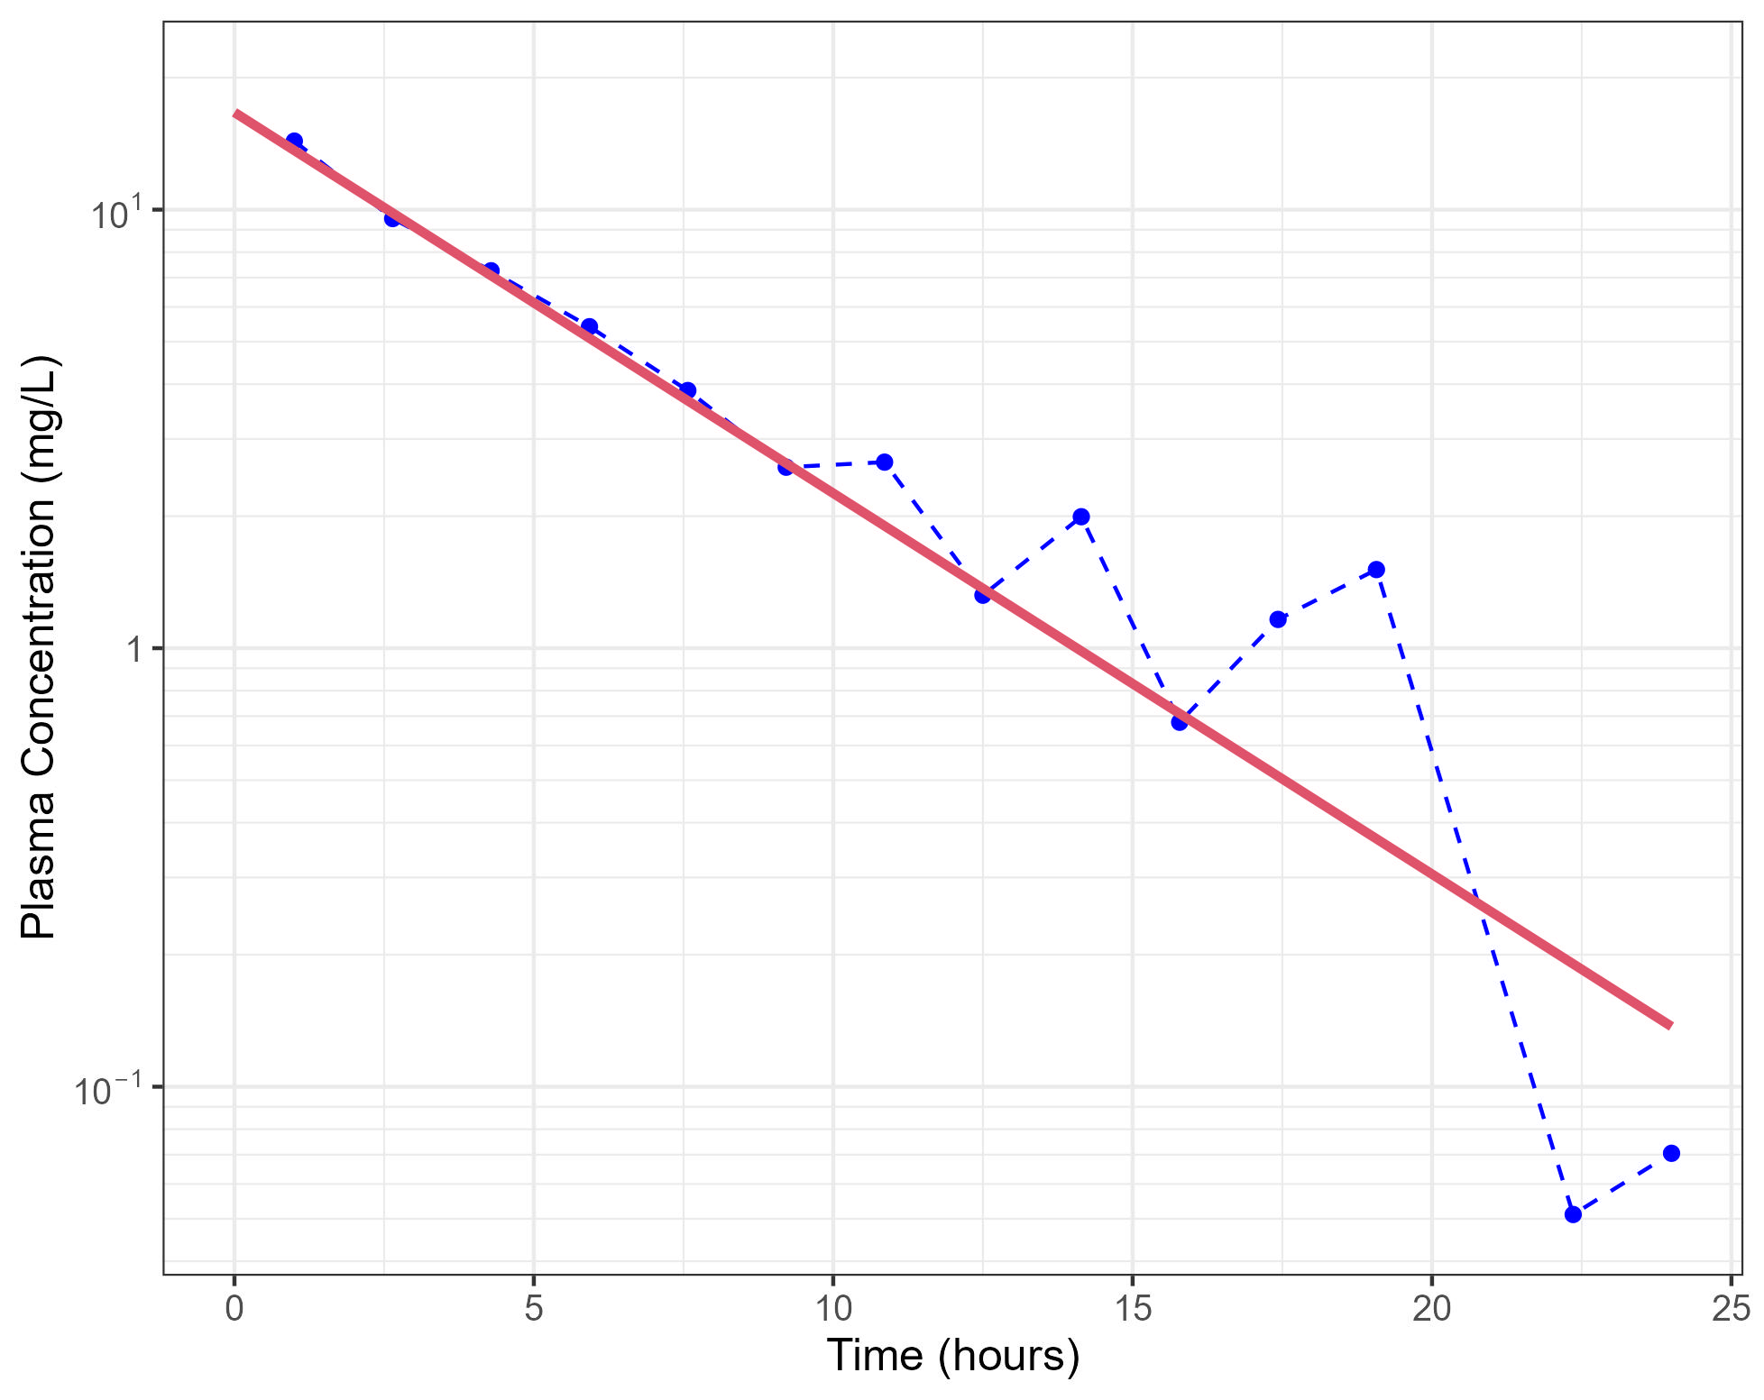
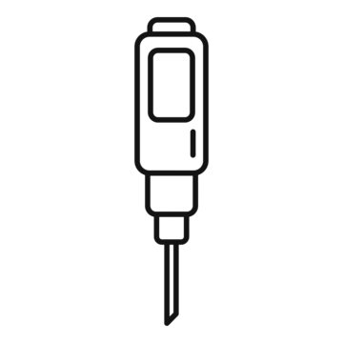
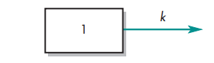

PK models: 1 Compartment IV
Whole body is represented by a single compartment with volume (V)
Drug is eliminated from the compartment in a first-order fashion with and elimination rate constant (k)

Slide 9
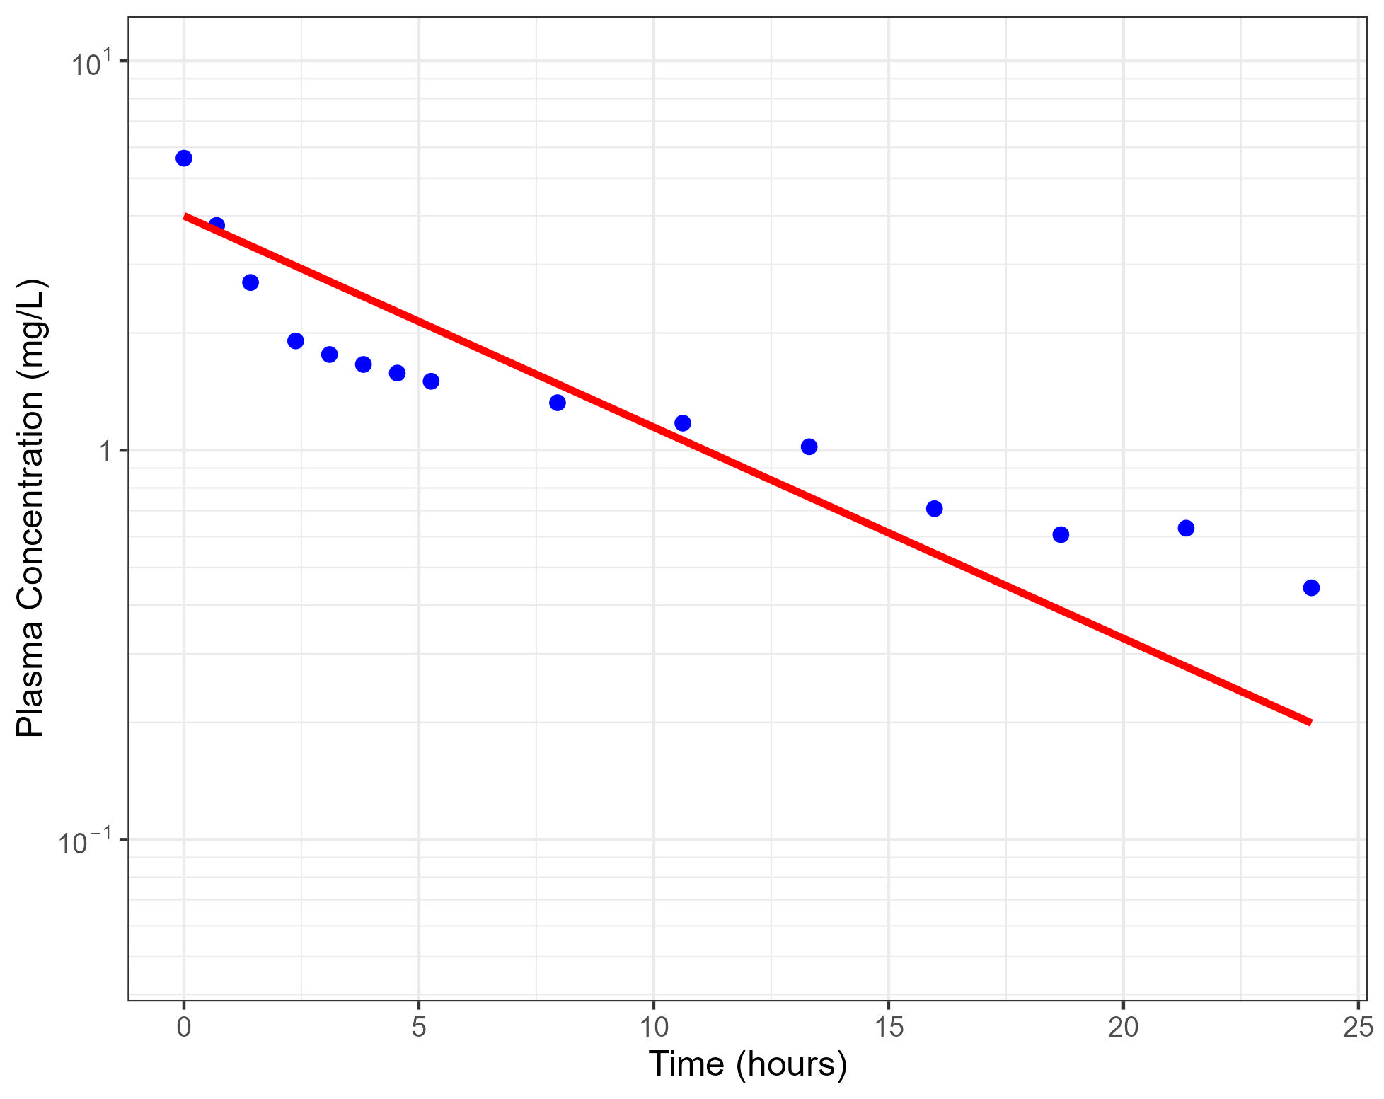
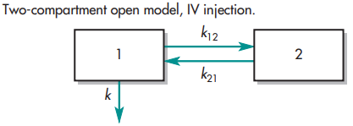
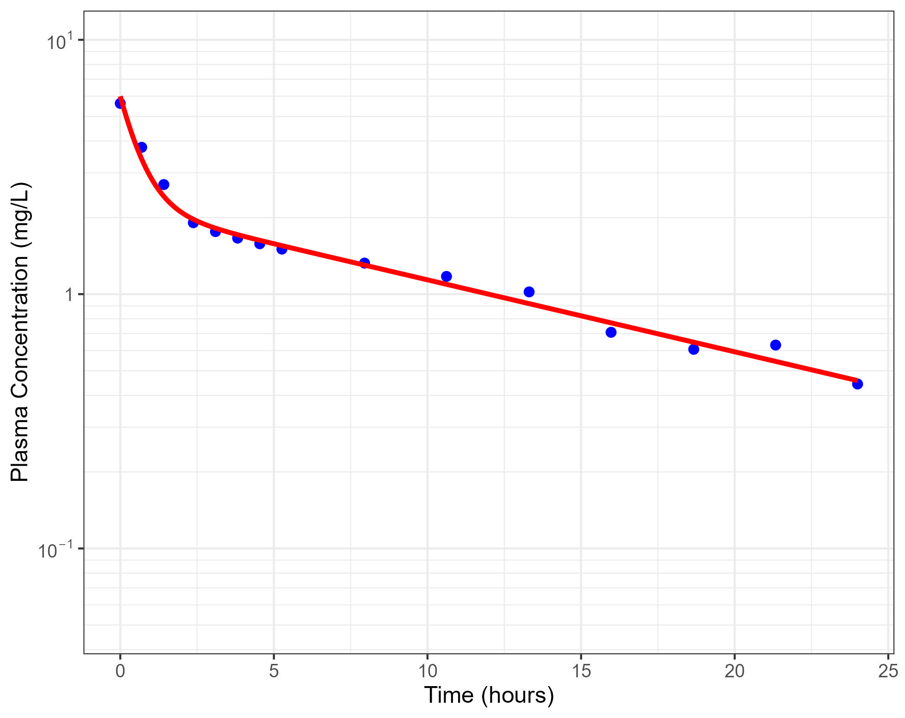




PK models: 2 Compartment IV
Some data won’t fit to a single compartment model.
A more complex model (with relaxed assumptions) would be needed.

Slide 10
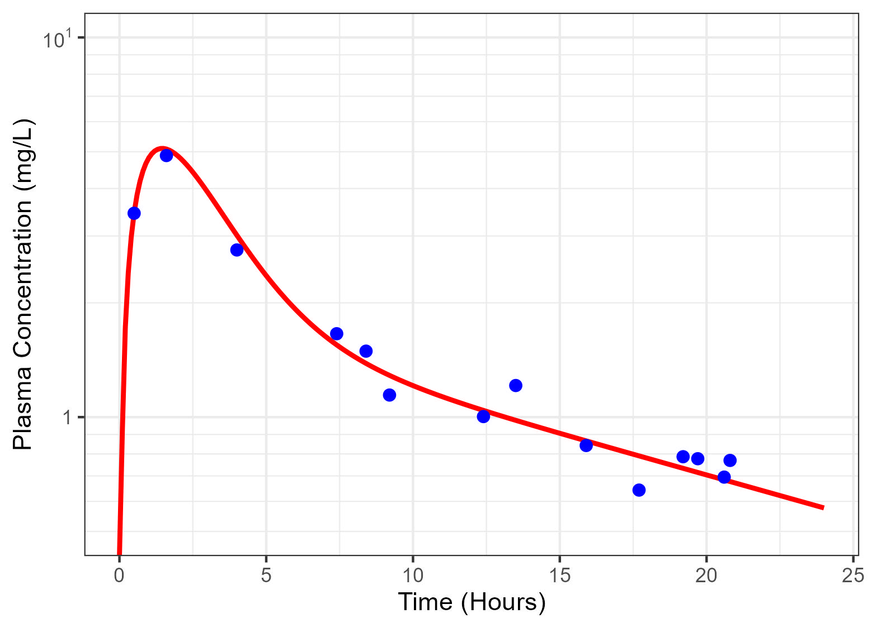
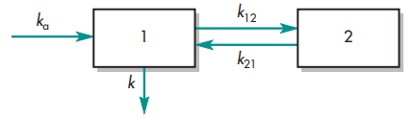
PK models: 2 Compartment Extravascular
To model absorption process in case of extravascular administration
Oral
Intramuscular
Subcutaneous, etc.

Slide 11
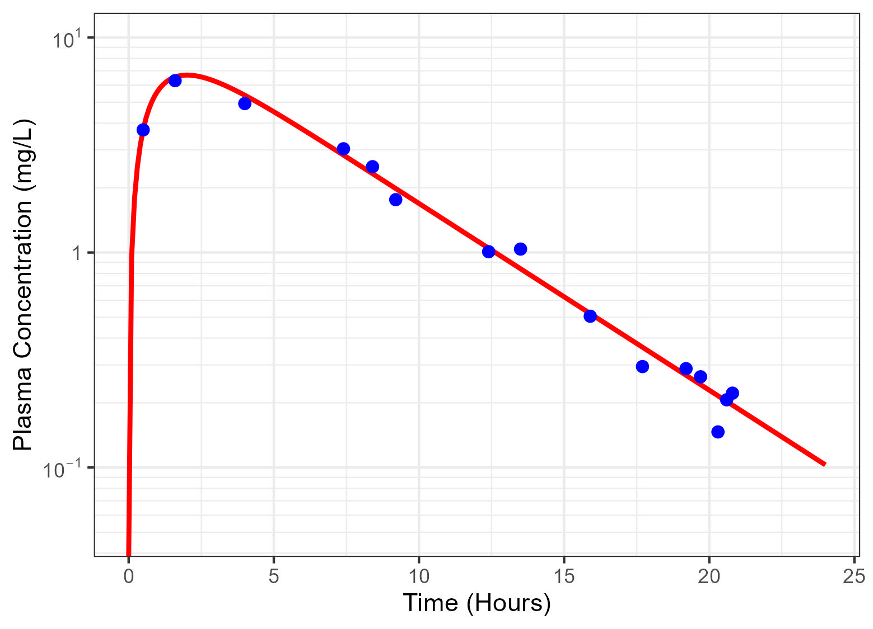
PK models: Summary
1 Compartment
2 Compartment
Intravenous
Extravascular

Slide 12


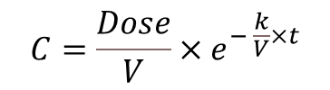
PD model: Direct Emax Model
1 Compartment IV
PK/PD
PD
$$C=\frac{Dose}{V}×e^{− \frac{k}{V}×t}$$

Slide 13
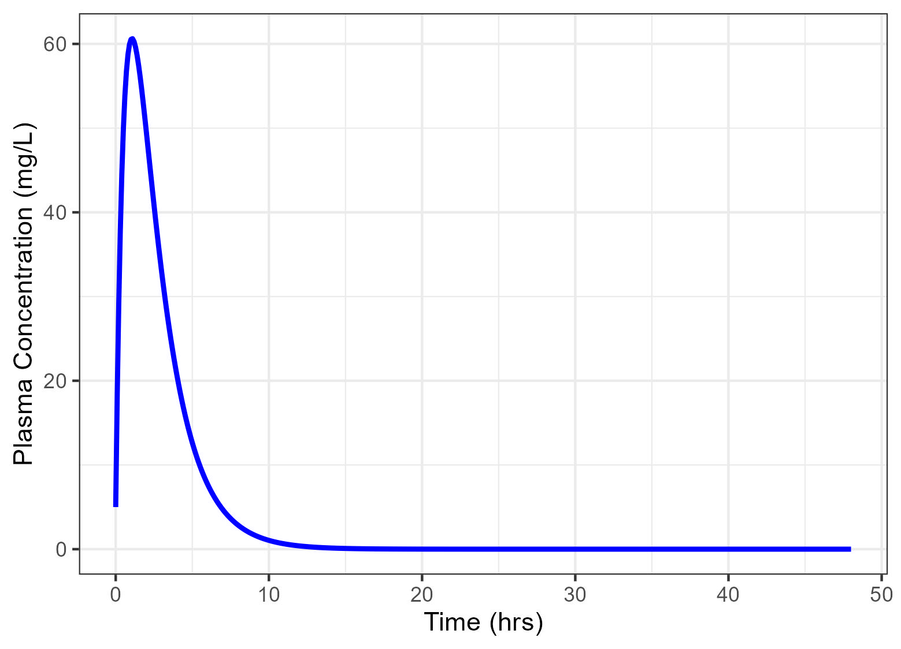
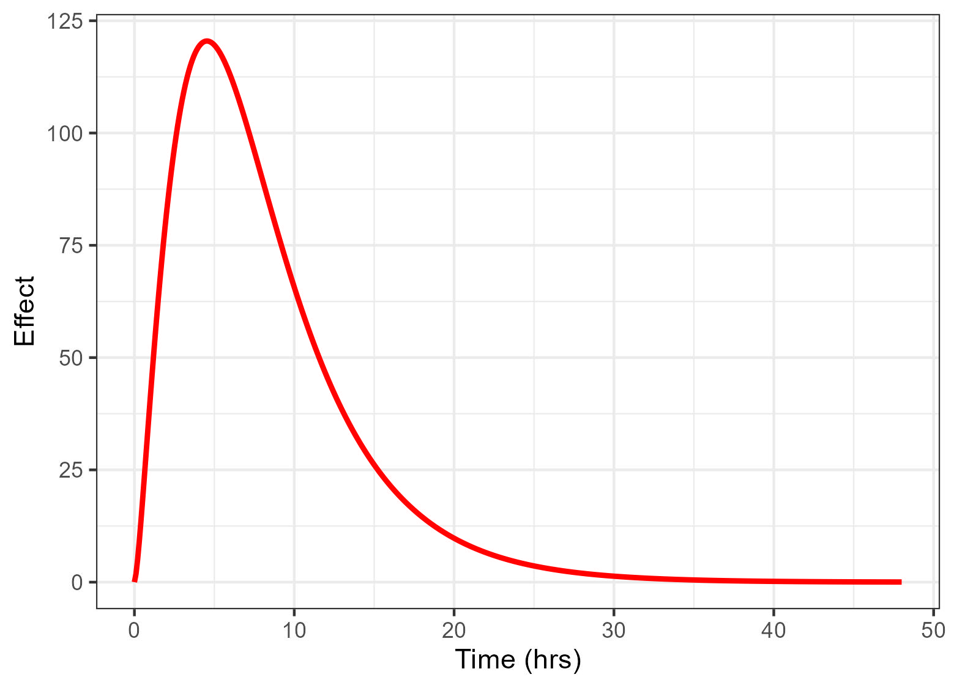
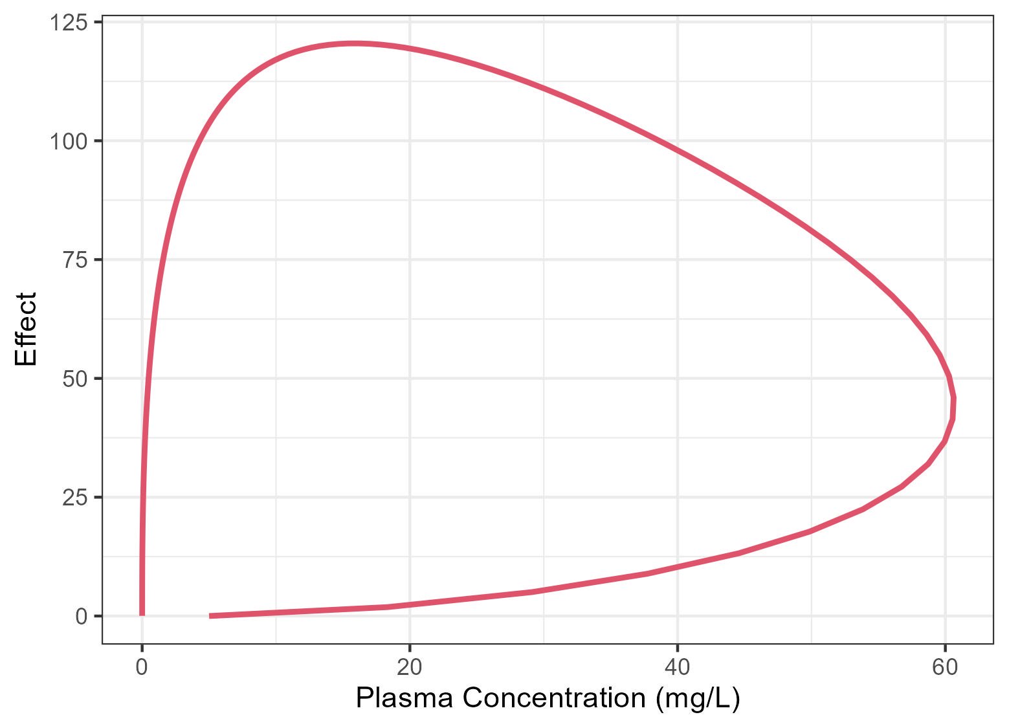
PD model: Indirect Emax Model
1 Compartment Extravascular
PK/PD
PD
Accounts for time delay in response
Maximum effect is later than plasma maximum concentration
Effect versus time shows hysteresis

Slide 14
Impact of direct vs indirect PKPD
Indirect PKPD relationship:
The duration of effect maybe significantly greater than the duration of exposure.
Dosing frequency Consideration:
Less frequent dosing may be needed than for direct PK/PD
Modelling the single dose PK/PD data would allow for the optimal design of the repeat dose study

Slide 15
Recommendations
PK/PD experiments should be designed:
Integrate all available knowledge (PK, in vitro pharmacology and biology) and design studies to test hypothesis.
Select dose levels and sample times to investigate concentration-effect and time dependence.
Avoid simple dose-effect interpretation
Exposure derives efficacy, dose is just a tool to achieve exposure
Obtain exposure-time and effect-time data where possible.
Integrate modelling and simulation into PK/PD design to maximise value of studies.

Slide 16
Summary
Model integrate knowledge of a drug and can help support decision making throughout the drug discovery process.
A model doesn’t have to be perfect to be useful.
Refine models as more data become available to replace assumptions and make them even more useful.
Models should be used in combination with biological knowledge/hypotheses to optimise PK/PD study designs.

Slide 17
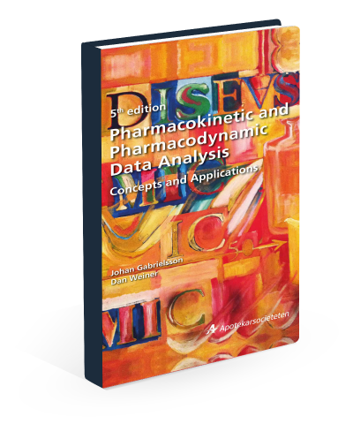
References/further resources
PK/PD Data Analysis: Concepts and Application
Johan Gabrielsson and Dan Weiner
https://www.certara.com/ebook/pharmacokinetic-and-pharmacodynamic-data-analysis/#main

Slide 18
Thank You Any Questions?

