Slide 1

Drug Discovery and Development Course
Machine Learning and Mechanistic Models
Abdallah Derbalah

Slide 2

Terms of Use – CC BY 4.0 License
These materials are shared to support teaching, research, and presentation activities across the GC ADDA community. All content is provided under the Creative Commons Attribution 4.0 (CC BY 4.0) license, which allows you to use, share, adapt, and build upon the material freely, including for commercial purposes. Please ensure that any use includes proper attribution to the original creators, indicates any modifications you make, and maintains the same open license. No additional restrictions may be applied.
Credit the author(s) as follows:
CC BY 4.0 [author, institution]

Slide 3

Learning Objectives
To introduce the concept of machine learning and artificial neural networks.
To understand the challenges of using full-scale mechanistic models
To illustrate an example of how ML can help over come some of those challenges

Slide 4
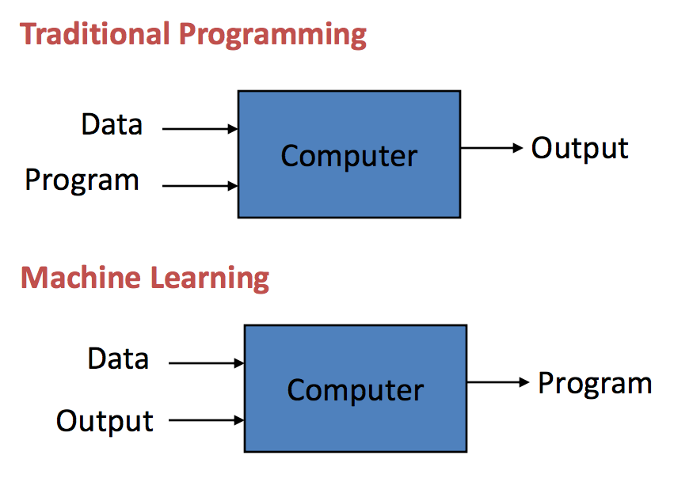
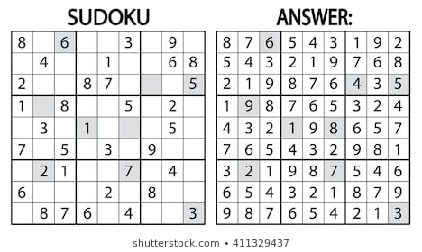

What is machine learning?

Slide 5
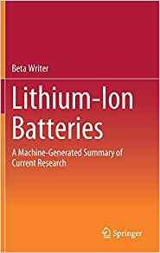
Artificial Neural Networks (ANNs)
ANNs are the most common model for machine learning.
Have wide range of applications:
  Image Processing: face recognition, medical image diagnosis, … etc.
  Prediction: sales, stock prices, treatment and disease outcomes,… etc.
  Natural Language processing: sentiment analysis, text summarisation, language identification and translation, … etc.
  Speech recognition: text-to-speech conversion.

Slide 6
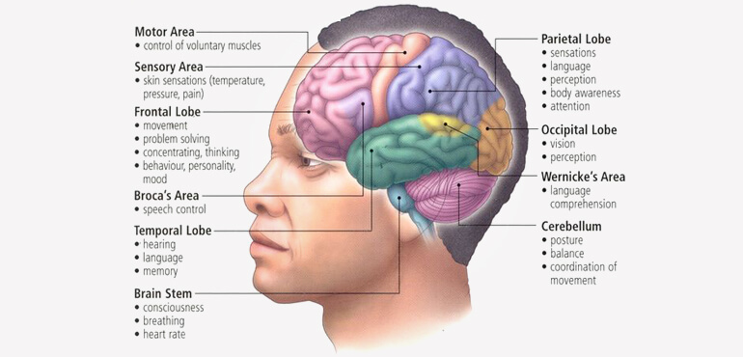
How do our brains learn?

Slide 7
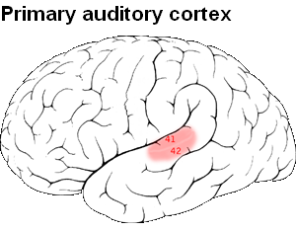


How do our brains learn?
Roe et al, The journal of Neuroscience 1992; 12(9):3663

Slide 8
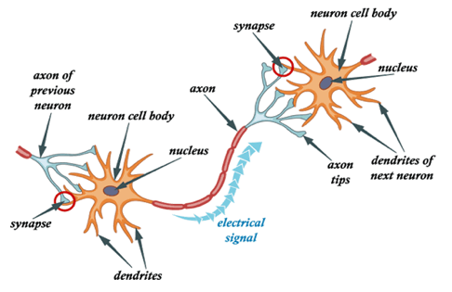
A biological neuron

Slide 9
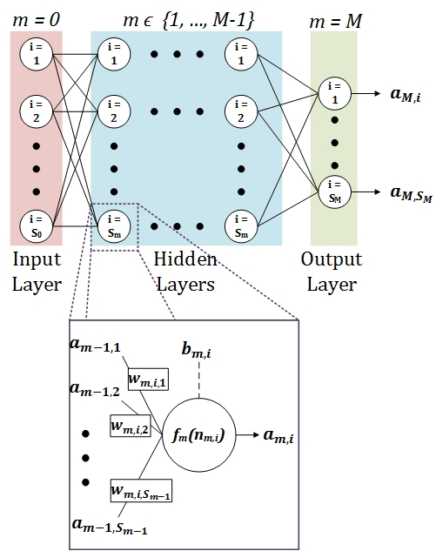
An artificial neuron

Slide 10
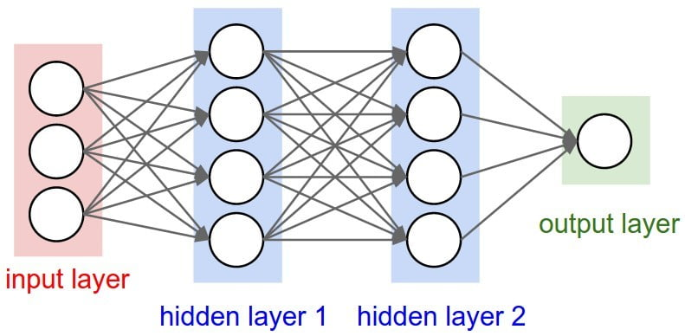
Feed-forward neural networks
Notes:
The universal approximation theorm

Slide 11
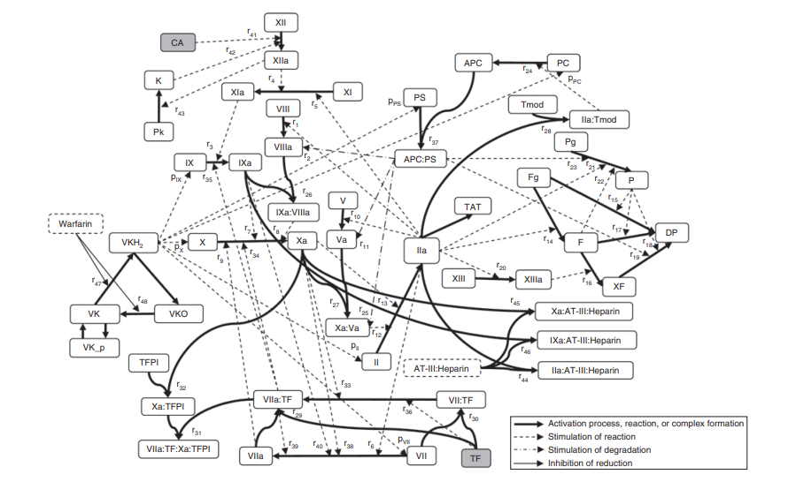
The Coagulation network model

Slide 12
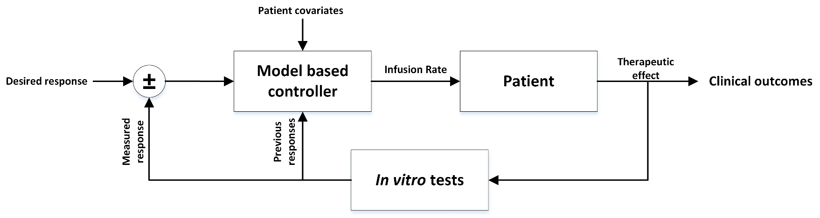
Designing a Control System

Slide 13
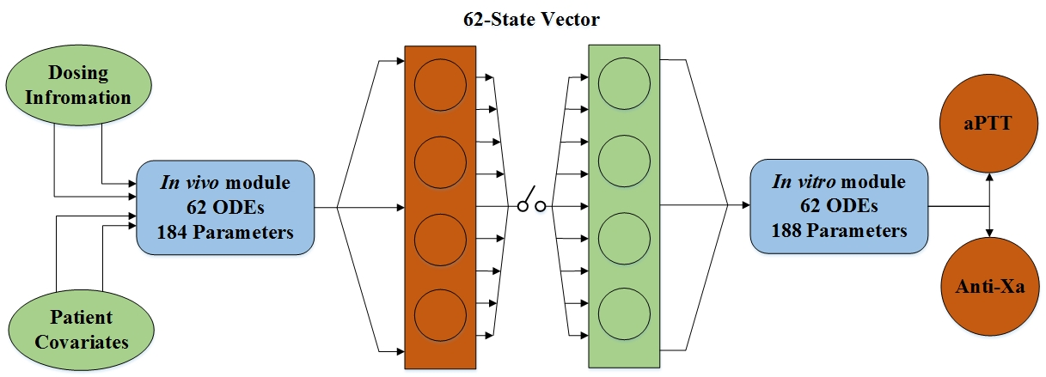
The Coagulation network model

Slide 14
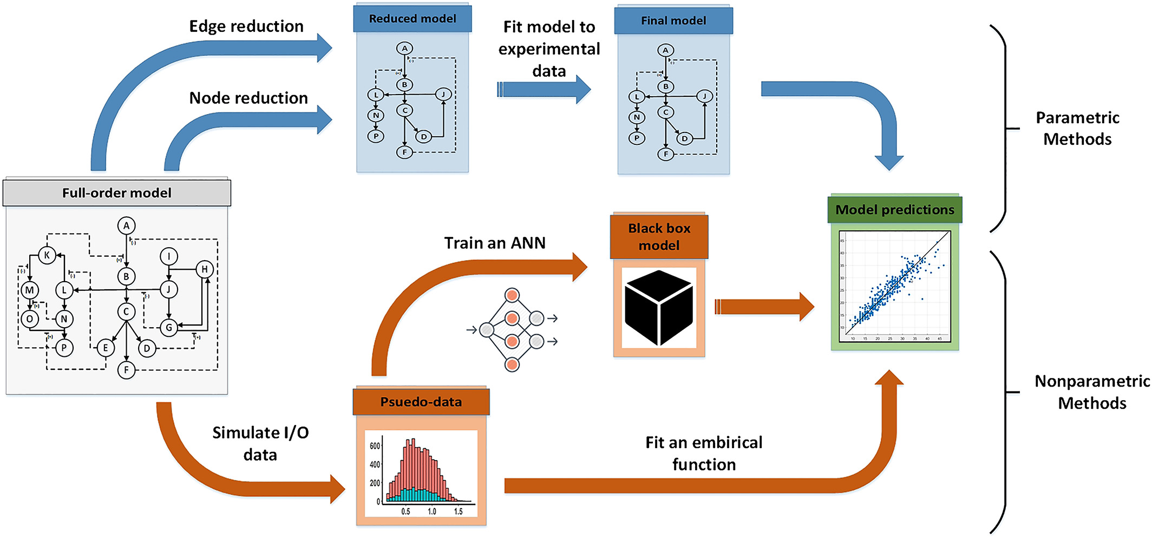
QSP model simplification approaches

Slide 15
The ML approach
Pseudo-data simulation and preprocessing
Architecture selection and training of ANN
ROM Validation

Slide 16
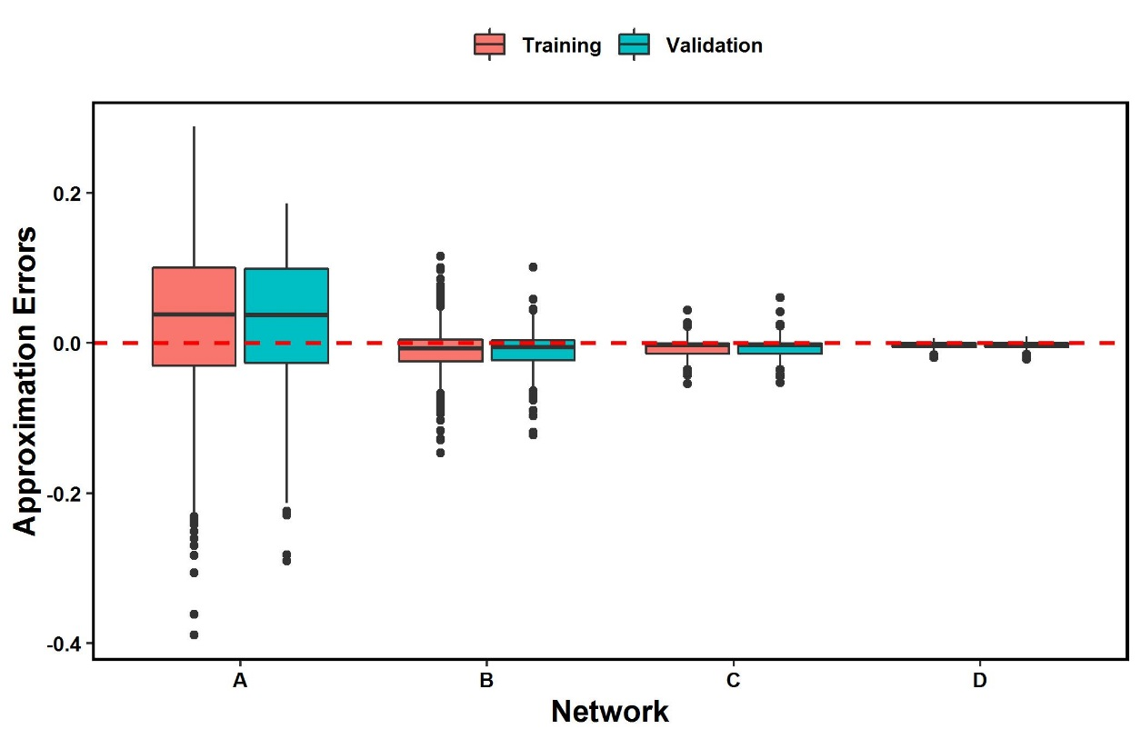
Results
Distribution of Normalised training and evaluation errors of different networks architectures

Slide 17
Results
Computational cost for neural networks with different performance levels
Network | Hidden nodes | Parameters | Training time (seconds) | Simulation time (seconds)*
A | 7 | 73 | 2.8 | 0.018
B | 11 | 77 | 6.5 | 0.018
C | 15 | 97 | 16.3 | 0.027
D | 25 | 179 | 51 | 0.022
* For 10,000 pairs of input-output data

Slide 18
Summary
ML-based model simplification has several advantages:
  Automatable
  Efficient
  Accurate
  Structure agnostic
  Experimental data independent
A limitation is being non-parametric method

Slide 19
References/Further Resources
Derbalah, A., & Al-Sallami, H. (2021). Reduction of quantitative systems pharmacology models using artificial neural networks. Journal of Pharmacokinetics and Pharmacodynamics, 48(4), 543-560. https://doi.org/10.1007/s10928-021-09742-3
Zhang, M., & Shen, C. (2023). Quantitative systems pharmacology in the age of artificial intelligence. CPT: Pharmacometrics & Systems Pharmacology, 12(2), 123-134. https://doi.org/10.1002/psp4.13047

Slide 20
Questions?

