Slide 1
Drug Discovery and Development Course
Introduction to Pharmacokinetic Modelling:
Volume of distribution
Clearence
Linear and non-linear pharmacokinetics
Ali Mohamed

Slide 2

Terms of Use – CC BY 4.0 License
These materials are shared to support teaching, research, and presentation activities across the GC ADDA community. All content is provided under the Creative Commons Attribution 4.0 (CC BY 4.0) license, which allows you to use, share, adapt, and build upon the material freely, including for commercial purposes. Please ensure that any use includes proper attribution to the original creators, indicates any modifications you make, and maintains the same open license. No additional restrictions may be applied.
Credit the author(s) as follows:
CC BY 4.0 [Ali Mohamed, African Institute for Biomedical Science and Technology, Zimbabwe]

Slide 3
Learning objectives
Volume of distribution
Clearance
Linear pharmacokinetic
Nonlinear pharmacokinetic
Compare the difference between linear pharmacokinetics and nonlinear pharmacokinetics

Slide 4
Volume of distribution

Slide 5
Absorption
Distribution
Elimination
I
N
P
U
T
Drug in blood
L
O
S
S
Dose of drug
Drug at active site
Metabolism (M) + Excretion (E)
Pharmacological effect
Need to maintain concentration of the drug at its site of action to achieve a therapeutic effect

Slide 6
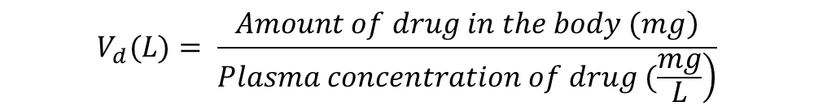
Definition of volume of distribution
The volume of distribution (Vd) is a pharmacokinetic parameter representing an individual drug’s propensity to either remain in the plasma or redistribute to other tissue compartments.
By definition, Vd is a proportionality constant that relates the total amount of drug in the body to the concentration of drug measured in a biological fluid (plasma) at a given time.
Based on the above equation:
  A drug with a high Vd has a propensity to leave the plasma and enter the extravascular compartments of the body.
    High Vd -> More distribution to other tissue
  Conversely, a drug with a low Vd has a propensity to remain in the plasma.
    Low Vd -> Less distribution to other tissue
$$V_{d}(L)= \frac{\left.Amount of drug in the body (mg\right)}{\left.Plasma concentration of drug (\frac{mg}{L}\right)}$$
Notes:
Volume of distribution is a way to describe how a drug spreads in the body after it's been taken
Volume of distribution is called a “primary pharmacokinetic parameter”, which means that this parameter depends on the physiologic properties of the body and the physiochemical properties of the drug.
Not Identical with Functional Volume: Vd doesn't correspond to a specific anatomical space. Instead, it reflects how the drug spreads between the blood and tissues.
A drug with a high Vd has a propensity to leave the plasma and enter the extravascular compartments of the body, meaning that a higher dose of a drug is required to achieve a given plasma concentration.

Slide 7
What is distribution?
Distribution is the reversible transfer of drug between the site of measurement (usually plasma) and other sites within the body (tissues etc.)
Distribution within the vascular system is very quick (a few minutes)
Distribution into other tissues takes longer and is influenced by physico-chemical properties of drug molecule and organ perfusion rates
Drug in tissues cannot normally be measured directly.
  Information on the rate and extent of tissue distribution is inferred from the plasma
  conc– time profile of drug
Notes:
Distribution within the vascular system is very quick due to several key factors:
High Blood Flow Velocity: The heart pumps blood forcefully, creating a high velocity of blood flow through the arteries and veins.
Extensive Network: The vascular system consists of an extensive network of blood vessels that reach almost every part of the body, ensuring rapid delivery of nutrients and oxygen.
Pressure Gradient: Blood moves from areas of higher pressure (arteries) to lower pressure (veins), facilitating quick distribution.
Measuring drug concentrations directly in tissues is challenging for several reasons:
Invasiveness: Direct measurement often requires invasive procedures like biopsies, which can be painful and carry risks of complications.
Complex Distribution: Drugs distribute unevenly within tissues due to factors like blood flow, tissue binding, and cell membrane permeability
Dynamic Processes: Drug distribution is a dynamic process influenced by ongoing metabolism and excretion, making it difficult to capture accurate concentrations at a single point in time1
Technical Limitations: Current technology may not be sensitive enough to measure low concentrations of drugs in specific tissues without affecting the tissue itself
Inference from Plasma Data: Since directly measuring drug levels in tissues is difficult, scientists use the plasma concentration-time profile to infer how the drug is distributed in the body. This profile helps estimate the rate and extent of the drug's distribution to different tissues
Pharmacokinetic Parameters: Key parameters like peak plasma concentration (Cmax), time to reach peak concentration (Tmax), and area under the curve (AUC) are analyzed to understand the drug's behavior in the body

Slide 8
Factors affecting volume of distribution
Volume of Distribution depends on:
extent of drug-plasma protein binding
tissue affinity
drugs pKa
partition coefficient of the drug in fat (lipid solubility)
patient‘s gender
patient‘s age
patient‘s disease
patient‘s body composition
Notes:
Extent of Drug-Plasma Protein Binding: Drugs that bind extensively to plasma proteins have a lower Vd because they remain in the bloodstream and are less available to distribute into tissues
Tissue Affinity: Drugs with high affinity for tissues have a higher Vd as they tend to accumulate in tissues rather than staying in the bloodstream
Drug's pKa: The pKa of a drug affects its ionization state, which influences its ability to cross cell membranes and distribute into tissues
Partition Coefficient (Lipid Solubility): Lipophilic (fat-soluble) drugs have a higher Vd because they can easily cross cell membranes and accumulate in fatty tissues
Gender: Differences in body composition between genders can affect Vd. For example, women generally have a higher percentage of body fat, which can increase the Vd for lipophilic drugs
Heart Failure
Effect: Reduced blood flow to tissues.
Impact on Vd: May decrease Vd for some drugs due to poor tissue perfusion, but increase it for others due to fluid accumulation

Slide 9
Distribution: getting drug from blood to the tissues
Some drugs bind to plasma proteins (albumin, alpha-glycoproteins) in blood
  cannot enter tissue (only unbound drug can permeate membranes)
  reversible binding
  competition among drugs for binding
Some tissues have lipid barriers resisting drug penetration
  blood brain barrier, placenta
Drug may be soluble or bound to proteins in particular tissues and then slowly released
  drug reservoirs (e.g. Chloroquine to melanin)
Drug may produce an effect in other tissues to produce a side effects
  unspecific receptor binding
Notes:
Binding and Unbinding: When a drug binds to plasma proteins like albumin or alpha-glycoproteins, it forms a temporary complex. This binding is not permanent; the drug can detach (unbind) from the protein and become free again.
Equilibrium: The process of binding and unbinding reaches an equilibrium where a certain proportion of the drug is bound to proteins, and the rest is unbound and free to move into tissues.
Impact on Drug Distribution: Only the unbound (free) drug can cross cell membranes and enter tissues. The bound drug remains in the bloodstream and does not exert its therapeutic effects until it becomes unbound.
Competition: Multiple drugs can compete for the same binding sites on plasma proteins. If two drugs are present, they may displace each other, affecting the amount of free drug available.

Slide 10
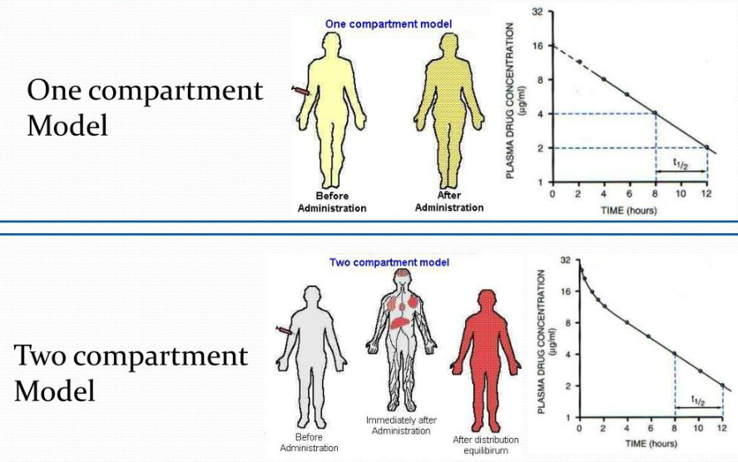
Single vs multi-compartment models of distribution
Immediately after administration of an IV bolus, a drug enters the “central” compartment, which is composed of the plasma, highly perfused organs (liver, kidneys, etc.) and other tissues where drug distribution is instantaneous.
Eventually, some drugs may begin to move from the central compartment to the “peripheral” compartment, which is composed of tissues to which drug distributes slower.
Notes:
Single compartment model: Some drugs display pharmacokinetics in which they distribute “instantaneously.” These drugs appear to remain in the central compartment and not distribute to peripheral compartments. Therefore, any measured decline in drug plasma concentration is a result of drug elimination from the body only. These drugs are said to display single-compartment models of distribution as they do not move to peripheral compartments. The Vd of these drugs can be represented by a single value, which is the Vd of the central compartment (Vc)

Slide 11
Extent of distribution
Apparent volume of distribution (v)
We cannot measure the drug in the tissues, but we can measure it in the blood.
It does not distinguish in which tissue the drug goes to, just the amount in the body.
Apparent volume that the drug occupies at a concentration equal to that in plasma
Hypothetical value, rarely a physiological space (e.g., total body water)
Notes:
apparent volume in which a drug would need to be uniformly distributed to produce the same concentration as it currently is in the blood plasma.
Imagine you inject a drug into the bloodstream and then measure how much of it is in the blood plasma. The volume of distribution (Vd) tells you:
i.e. If this amount of drug were evenly spread out in a certain volume of fluid, what volume would that be to match the concentration we see in the blood?
"Apparent" volume means it's a theoretical value, not an actual physical space in the body.
It helps us understand how extensively a drug spreads throughout the body after administration.

Slide 12
Apparent volume of distribution (V)
Value depends on reference fluid measured (plasma, blood, unbound drug)
C, Cb and Cu can differ as a consequence of binding to cells and plasma proteins
However, at equilibrium:
amount plasma blood plasma water

Slide 13
Tissue binding
A= V·C = V_{P}·C + V_{TW}·C_{TW}
Amount in Body = Amt in plasma + Amt outside plasma
V = V_{P} + V_{TW} · C_{TW}/C
fu= Cu/C; similarly fu_{TW} =Cu_{TW}/C_{TW}
At the equilibrium Cu = Cu_{TW}
fuC = fu_{TW} C_{TW}
fu/fu_{TW} = C_{TW}/C

Slide 14
V = V_{P} + V_{TW} · fu/fu_{TW}
V fu 
V↓ fu_{TW} 
If measured in blood
V = V_{b} + V_{TW} · fu,b/fu_{TW}

Slide 15
Clearance

Slide 16
Concept of clearance
Drugs are removed from the body by various elimination processes.
Drug elimination refers to the irreversible removal of drug from the body by all routes of elimination.
Proportionality constant
Clearance is the parameter that relates rate of elimination to concentration:
CL = Rate of Elimination / C plasma
Units of flow (mg/h)/(mg/L) =
L/h
Is the apparent volume of plasma (or blood or plasma water) completely cleared of drug per unit of time
Rate of elimination = CL·C = CL_{b}·C_{b} = CL_{u}·C_{u}
plasma blood plasma water
Value of clearance depends upon site of measurement
Notes:
Drug elimination is usually divided into two major components: excretion and biotransformation. Drug excretion is the removal of the intact drug.
Biotransformation or drug metabolism is the process by which the drug is chemically converted in the body to a metabolite.
Clearance (CL) is defined as the volume of plasma from which a drug is completely removed per unit time.
is a pharmacokinetic parameter representing the efficiency of drug elimination

Slide 17
Description of clearance
By Site of Measurement:
Plasma CL
Blood CL_{b}
Plasma water (unbound) CL_{u}
By Organ:
Hepatic CL_{H}
Renal CL_{R}
Notes:
Total Body Clearance is the sum of clearance from all eliminating organs (e.g., kidneys, liver, lungs).
Renal Clearance refers to drug elimination via the kidneys.
Hepatic Clearance involves metabolism by the liver, often through enzymes like cytochrome P450.
Pulmonary and other routes (e.g., skin, GI tract) may also contribute for specific drugs

Slide 18
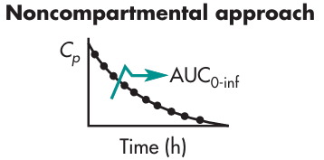
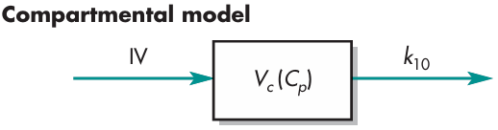

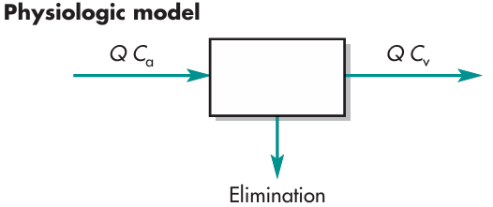
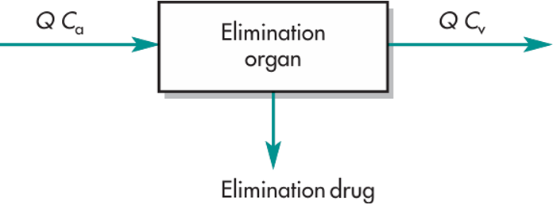
Clearance models
“Clearance” (Cl) is a specific pharmacokinetic term used to describe the rate at which drug is cleared, by whatever mechanism, from a particular volume of plasma.
Static volume and first-order processes are assumed in simpler models. Cl = k₁₀ x V_{c}.
Clearance is the product of the blood flow through an organ (Q) and the extraction ratio of that organ (E).
For example, the hepatic clearance is: Cl_{H} = Q_{H} x E_{H}
Drug clearance model.
Q = blood flow, C_{a} = incoming drug concentration [usually arterial drug concentration]
C_{v} = outgoing drug concentration [venous drug concentration].)
Notes:
Clearance thus encompasses both renal and extrarenal (usually hepatic) clearance.
For most drugs, clearance remains fairly constant.

Slide 19
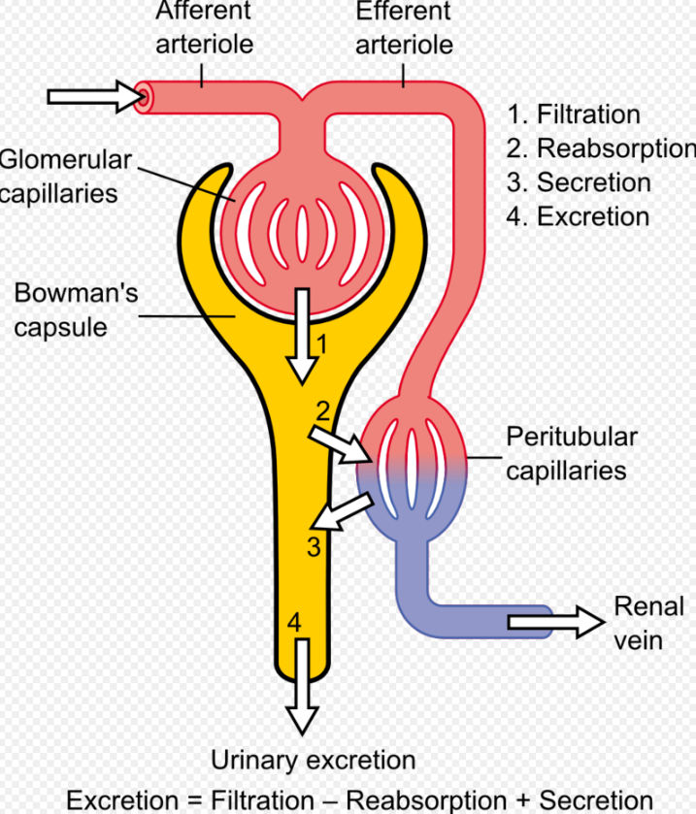

Slide 20
Dependence of elimination on both distribution and CL
Amount in body (A)
A = C . V
Fractional elimination rate constant, k, defined as:
Rate of elimination
CL·C
CL
k =
=
=
Amount
V·C
V
CL = k ·V
Or, expressed in terms of half-life:
ln 2
0.693 V
t_{1/2}
=
=
k
CL

Slide 21
Additivity of clearance
Liver and kidney are major organs of elimination
Rate of
Elimination
Rate of
Excretion
+
Rate of Hepatic
Metabolism
=
CL·C = CL_{R}·C + CL_{H}·C
Dividing by C:
CL = CL_{R} + CL_{H}

Slide 22
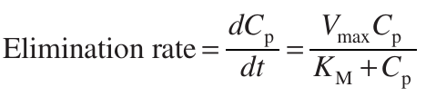
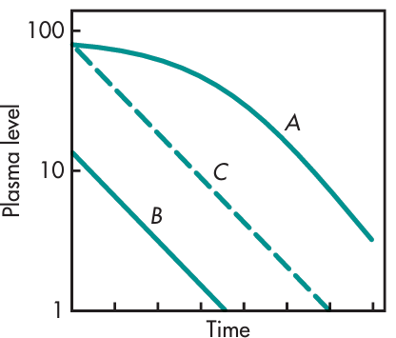
Saturable enzymatic elimination processes
The elimination of drug by a saturable enzymatic process is described by Michaelis–Menten kinetics
If C_{p} is the concentration of drug in the plasma, then
Where:
V_{max} is the maximum elimination rate
K_{M} is the Michaelis constant that reflects the capacity of the enzyme system
  equal to the drug concentration or amount of drug in the body at 0.5V_{max}
Plasma level–time curves for a drug that exhibits a saturable elimination process.
Curves A and B represent high and low doses of drug, respectively, given in a single IV bolus.
  The terminal slopes of curves A and B are the same.
Curve C represents the normal first-order elimination of a different drug.
Notes:
It is important to note that K_{M} is not an elimination constant, but is actually a hybrid rate constant in enzyme kinetics, representing both the forward and backward reaction rates and equal to the drug concentration or amount of drug in the body at 0.5Vmax
The values for K_{M} and V_{max} are dependent on the nature of the drug and the enzymatic process involved.

Slide 23
Linear Pharmacokinetics

Slide 24

Linear Pharmacokinetics
Linear pharmacokinetics is a characteristic of drugs that implies direct proportionality between dose and exposure.
Drug concentrations generated in an individual after the administration of a dose are linearly related with the amount of dose administered.
  This means that a 20 mg/kg dose provides two-fold the exposure of a 10 mg/kg dose, but not necessarily the pharmacological effect.
For this to be possible, the kinetics that governs the transfer of drug molecules between the different body spaces must be of first order.
  The ADME can be quantified using the following kinetic equation:
first-order kinetics
ADME is proportional to the drug concentration

Slide 25
Linear Pharmacokinetics . . .
Key Features of Linear Pharmacokinetics:
Proportional Dose-Concentration Relationship
If you double the dose, the plasma concentration and drug exposure (AUC) also double.
This makes it easy to predict how much drug will be in the body after a given dose.
Constant Clearance and Half-life (t½)
The body eliminates the same fraction of the drug per unit time, regardless of the dose.
For example, if the half-life is 4 hours, it stays 4 hours whether the dose is 100 mg or 400 mg.

Slide 26
Linear Pharmacokinetics . . .
Key Features of Linear Pharmacokinetics . . . :
Predictable Accumulation
Drug accumulation during multiple dosing is predictable, making it easier to reach and maintain therapeutic levels.
Time-Invariant Pharmacokinetics
The pharmacokinetic parameters (e.g., clearance, volume of distribution) do not change over time or with repeated dosing.
Linear Relationship in Pharmacokinetic Graphs
Plots of dose vs. AUC or dose vs. C_{max} show a straight line.
Simplified Dose Adjustments
Because of the proportionality, dose adjustments are straightforward and based on linear scaling.

Slide 27
Non-linear Pharmacokinetics

Slide 28
Non-linear Pharmacokinetics
The pharmacokinetic (PK) of most drugs can be adequately described by first-order or linear processes.
However, there are a small number of drugs which have nonlinear absorption or distribution.
Several drugs that are eliminated from the body in a nonlinear fashion.
  Increased doses or chronic multiple doses can cause deviations from the linear PK profile.
  This nonlinear pharmacokinetic behavior is also termed dose dependent.
Nonlinear kinetics is usually due to saturation occurring in one of the pharmacokinetic mechanisms:
  Protein binding, hepatic metabolism, or active renal transport of the drug.
The elimination or absorption half lives change as doses are increased.
The half-life increases with increased dose due to saturation of an enzyme or transporter system important for drug absorption or elimination.

Slide 29
Non-linear Pharmacokinetics . . .
Nonlinear (Dose-Dependent) Pharmacokinetics
Occurs when one or more ADME processes become saturated at therapeutic or higher concentrations. This leads to disproportionate changes in drug levels with dose changes.
Nonlinear Absorption
Occurs when:
Transporters involved in drug uptake (e.g., active transport) become saturated.
Solubility limits are reached in the GI tract.
Example: Gabapentin shows decreased bioavailability at higher doses due to saturation of its L-amino acid transporter.

Slide 30
Non-linear Pharmacokinetics . . .
Nonlinear (Dose-Dependent) Pharmacokinetics . . .
Nonlinear Distribution
Occurs when:
Plasma protein binding or tissue binding sites become saturated.
This can lead to a higher free drug concentration than expected.
Example: Salicylates can saturate plasma protein binding, increasing free drug levels disproportionately.
Nonlinear Elimination
Occurs when:
Metabolic enzymes (e.g., CYP450s) or renal transporters are saturated.
This leads to zero-order kinetics, where a constant amount of drug is eliminated per unit time.
Examples: Ethanol metabolized by alcohol dehydrogenase, which becomes saturated even at low concentrations.

Slide 31


Michaelis-Menten kinetic
The kinetics of the capacity-limited processes can be described by Michaelis-Menten kinetics.
Michaelis Menten kinetics is a model that is designed to explain generally the velocity of enzyme-catalyzed reactions and their gross mechanism.
The Michaelis-Menten equation is a mathematical equation that relates the rates of enzyme-catalyzed reaction with the concentration of both substrate and enzyme.
v₀: reaction velocity
v_{max}: maximum reaction velocity
[S]: substrate concentration
K_{M}: Michaelis constant
This means that the rate and the substrate concentration are directly proportional to each other.
The reaction is first-order kinetics.
This means that the rate is equal to the maximum velocity and is independent of the substrate concentration.
The reaction is zero-order kinetics.
Notes:
When plasma drug concentrations are substantially higher than Km (usually [S] > 10 × Km ), the value at which the enzymatic process can be saturated, the rate of change of the drug concentration becomes independent of the concentration itself.
Under these conditions, the rate of drug disappearance is constant, i.e., zero-order kinetics.

Slide 32
When plasma drug concentrations are substantially higher than Km,app (usually Cp (t) > 10 × Km,app ), the value at which the enzymatic process can be saturated, the rate of change of the drug concentration becomes independent of the concentration itself
When drug concentrations are substantially lower than Km,app (usually (t)

Slide 33
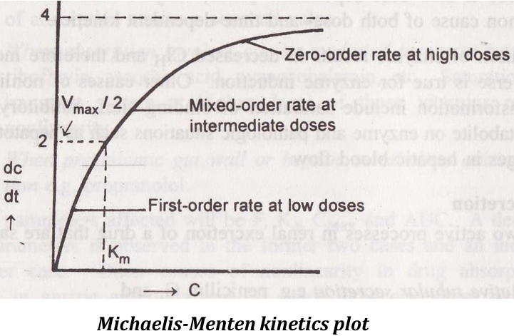


Michaelis-Menten kinetic . . .
At
Therefore, K_{m} is equal to the concentration of the substrate when the rate is half of the maximum velocity
MUCLecture_2024_51458225.pdf

Slide 34
Michaelis-Menten kinetic . . .
K_{m} (Michaelis constant)
Definition: K_{m} is the substrate concentration at which the reaction rate is half of Vmax.
Interpretation:
It reflects the affinity of the enzyme for its substrate.
  A low K_{m} means high affinity (the enzyme reaches half-maximal activity at a low substrate concentration).
  A high K_{m} means low affinity (more substrate is needed to reach half-maximal activity).
V_{max} (Maximum velocity)
Definition: V_{max} is the maximum rate of the enzymatic reaction when the enzyme is fully saturated with substrate.
Interpretation:
It represents the maximum catalytic capacity of the enzyme.

Slide 35
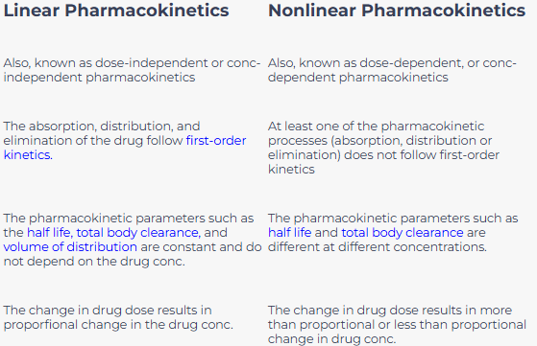
Linear vs Non-linear Pharmacokinetics . . .
Linear And Non-Linear

