Slide 1
Drug Discovery and Development Course
Introduction to Pharmacokinetic Modelling
Distribution
Ali Mohamed

Slide 2

Terms of Use – CC BY 4.0 License
These materials are shared to support teaching, research, and presentation activities across the GC ADDA community. All content is provided under the Creative Commons Attribution 4.0 (CC BY 4.0) license, which allows you to use, share, adapt, and build upon the material freely, including for commercial purposes. Please ensure that any use includes proper attribution to the original creators, indicates any modifications you make, and maintains the same open license. No additional restrictions may be applied.
Credit the author(s) as follows:
CC BY 4.0 [Ali Mohamed, African Institute for Biomedical Science and Technology, Zimbabwe]

Slide 3
What is Distribution?
Distribution is the reversible transfer of drug between the site of measurement (usually plasma) and other sites within the body (tissues etc.)
Distribution within the vascular system is very quick (a few minutes)
Distribution into other tissues takes longer and is influenced by physico-chemical properties of drug molecule and organ perfusion rates
Drug in tissues cannot normally be measured directly. Information on the rate and extent of tissue distribution is inferred from the plasma conc. – time profile of drug

Slide 4
Distribution: getting drug from blood to the tissues.
Some drugs bind to plasma proteins (albumin, alpha-glycoproteins) in blood
- cannot enter tissue (only unbound drug can permeate membranes)
- reversible binding
- competition among drugs for binding
Some tissues have lipid barriers resisting drug penetration
- blood brain barrier, placenta
Drug may be soluble or bound to proteins in particular tissues and then slowly released
- drug reservoirs (e.g. Chloroquine to melanin)
Drug may produce an effect in other tissues to produce a side effects (unspecific
receptor binding)

Slide 5
Volume of Distribution - Vd
Vd is the proportionality constant relating the amount of drug in the body to blood or plasma concentration – it is the apparent space or volume into which a drug distributed
1. Into buckets with equal volume, 10L of water, 100 units of
drug administered.
2. Concentration is V/dose = x units/L
3. On measuring conc. In A and B, A = 10units/L, B = 1 unit/L
4. Back calculation for Volume, A = D /C = 10L, B = 100L
5. Active charcoal in B traps some of the drug giving an imaginary
large volume into which the drug is distributed. The trapped drug
is therefore not accessible to the site of measurement (water or
plasma for PK studies).
6. Apparent volumes relate to the total amount of drug in the system
(bucket or body) to the site of measurement (water or plasma)
7. Volume of Distribution (Vd) is the volume the drug would occupy
if it were present everywhere at the same concentration as it is
in plasma.
Dose (100)
Dose (100)
C 10
C 1
V = 10L
V = 100L

Slide 6

Volume of Distribution – ratio between the amount of drug in body (Dose) and the concentration of the drug (c) measured in blood or plasma
apparent volume
not necessarily identical with volume of functional entity
is a proportionality factor between dose and concentration
may be estimated from direct intra-compartmental administration
Volume of Distribution depends on
extent of drug-plasma protein binding
tissue affinity
drugs pKa
partition coefficient of the drug in fat (lipid solubility)
patient‘s gender
patient‘s age
patient‘s disease
patient‘s body composition

Slide 7
Tissue distribution
Tissue perfusion can limit distribution
Governed in part by affinity of drugs for macromolecules and
membranes in tissue.
Storage of drugs in adipose tissues
– poses a health problem
– neutral and acidic drugs with log P < 2 are stored in adipose tissues
Basic drugs have an affinity for lean tissues

Slide 8
Perfusion Rate Limitation
Tissue Group | Blood flow (L/min) | Volume (L/70kg) | V/Q | Equilibrium
VRG=vessel rich group tissues (heart, liver, kidney, brain, vital tissue) – small proportion of body mass | 4.5 | 6 | 1.3 | fast
MG = muscles (slow perfusion & distribution) | 1.1 | 33 | 30 | slower
FG = adipose tissue | 0.3 | 15 | 45 | slower
VPG = vessel poor group of tissues (bones, tendons etc) - | 0.08 | 13 | 156 | Slowest due to low blood flow
NET | 5-6 Litres
80% of drug is delivered to VRG therefore uptake of drug is very rapid

Slide 9

Cardiac output
Heart
VRG
M
F
VPG
Notes:
“Advanced - Level” PK
Distribution dynamics
Concentration- and time-
dependence
Metabolite kinetics
Pharmacodynamic link

Slide 10
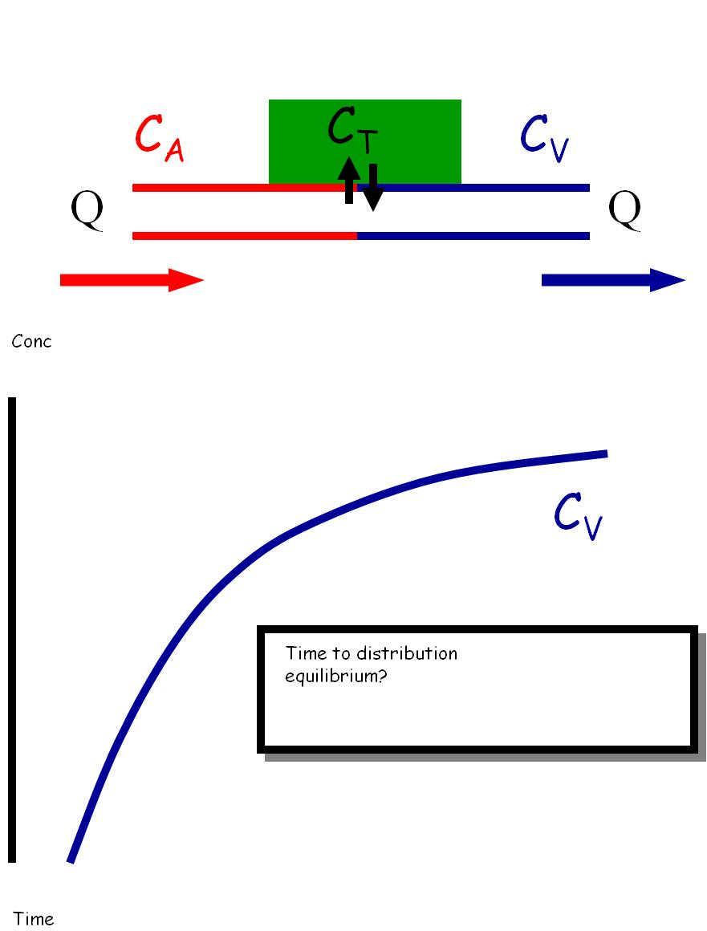
Perfusion rate limitation
Perfusion
Diffusion
Ca = arterial , Cv = venous
Q = blood flow
Diffusion usually rapid (faster than
blood flow) therefore limit becomes how
Fast compound is deliver by blood)
Perfusion rate limitation likely with
Small lipophilic molecules distributing
Across thin highly permeable membranes.
Equilibration rapid with highly
perfused tissues
Equilibration slow with poorly perfused
tissues
With Ca conc constant, time it takes for Cv
conc to be equal to Ca = Distribution
Equilibrium
Tissue
Conc
CA
‘steady
State’
Time to Distribution?
Time

Slide 11
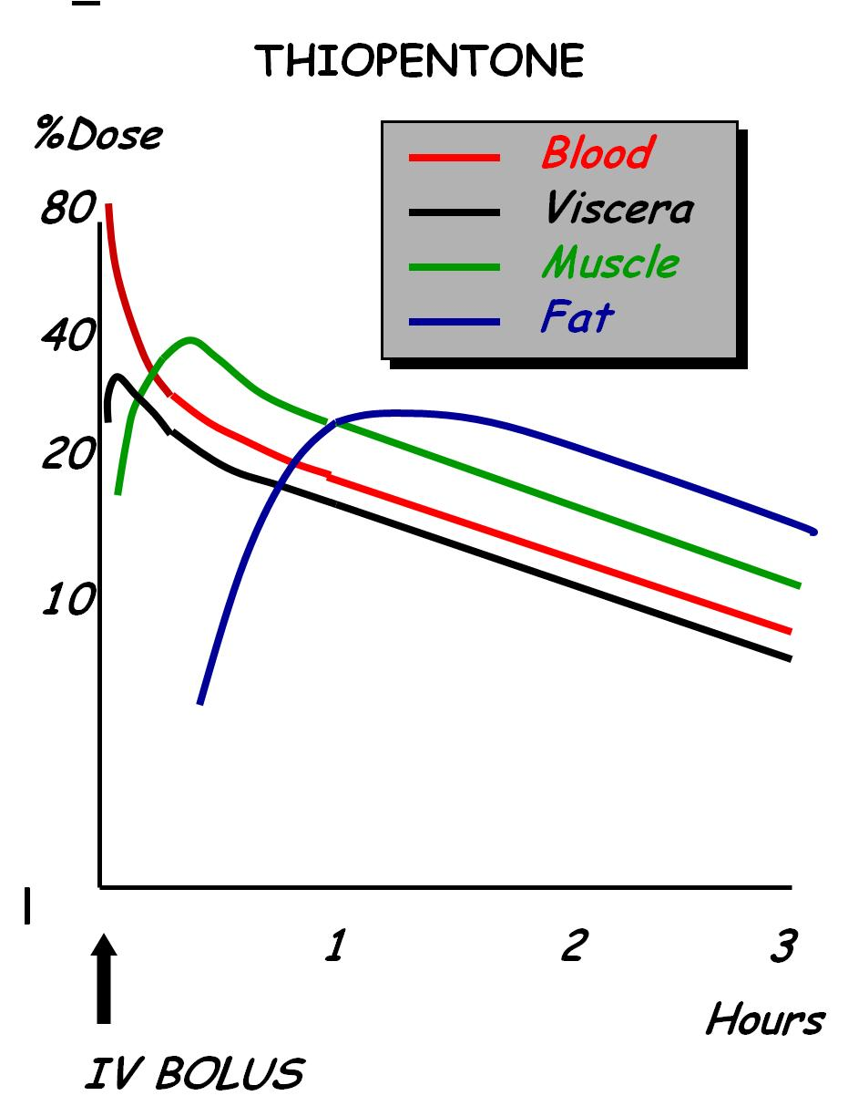
Thiopentone for induction of Anaesthesia
Thiopentone – very lipid soluble to get
to the brain, the site of action
Viscera (blood) concentration rapidly
goes down
Half of drug goes to VG tissue
Vd increase with time so, thus, T1/2
gets longer
Equilibriates
and drug starts
to go to fat
Declines
in parallel
Rapid pharmacology
‘short acting drug’

Slide 12
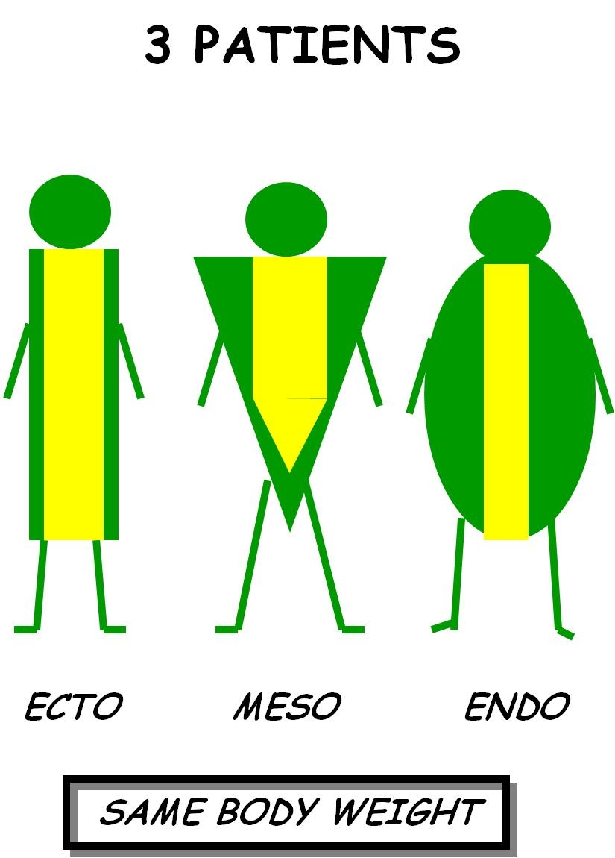
Who will be the easiest to put to sleep?
Half drug
goes to FG
Clinical manifestations of Perfusion
Limited Distribution:
Patients die during anaesthesia
In heart disease or shock, blood flow is low
In stress, turning white due to centralisation
of perfusion to the brain and vital organs
(and not peripheral regions)
Thin Muscular Fat

Slide 13
Permeability Limited Distribution
Likely to occur with polar molecules (e.g. anti-biotics) – less lipid soluble compounds
Relatively impermeable membranes (e.g. blood brain barrier -BBB)
Uptake is permeability/diffusion limited and not blood flow limited
Little protein in the Ccsf
Unbound in plasma
Ccsf/Cu
Entry of drugs into cerebrospinal fluid
  Plasma concentrations are kept constant
  For same tissue, uptake slower for polar
  compounds
  Blood flow is the same
  Difference is in membrane permeability
  BBB – tight junctions
1.0
Thiopentone
Pentobarbitone
barbitone
0.5
Salicylic Acid
sulphaguanidine
0
0 20 40 60 80
Minutes
Notes:
For CNS – barrier is at capillary level
For other tissues (muscle and kidney, capillary is porous and barrier is at cellular level)

Slide 14
Transporter limited distribution
Enterocytes
Protection
Against xenobiotics
BBB
Protec brain
P-GLYCOPROTEIN
Placenta
Protect foetus
Kidney
Excrete
compounds

Slide 15
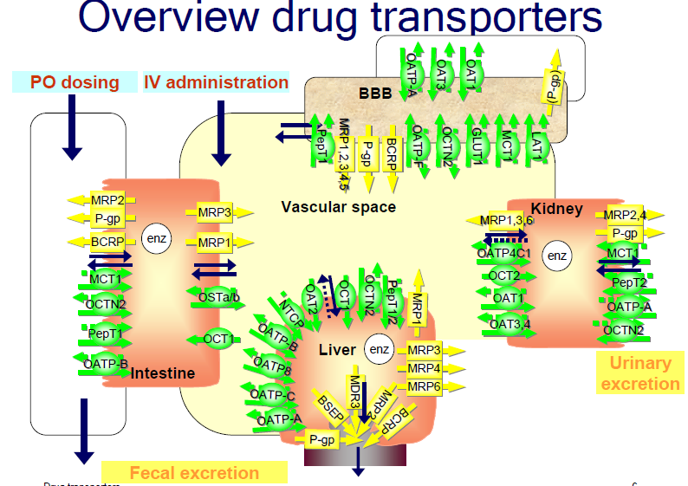

Slide 16
Factors Affecting Rates of Diffusion
Lipophilicity (logP)
Ionisation (pKa)
Protein Binding
Nature of membrane

Slide 17
Volume depends on extent of distribution
D
D
D
D
D
D
D
D
Blood
Capillary wall
Interstitium
Cell

Slide 18
Fractions bound & unbound
D
D
D
D
C_{tot} = C = C_{unbound} + C_{bound}
f_{bound} = f_{b} = C_{b}/C
f_{unbound} = f_{u} = C_{u}/C
f_{b} + f_{u} = 1

Slide 19
Volume of distribution (in homo)
Tissue water ≈ 39L
Amount of drug in body = amount in plasma + amount in tissues
V • C_{p} = V_{p} • C_{p} + V_{T} • C_{T}
If Vd of drug is <3L, it is limited to the plasma (blood)
If Vd of drug is >3L<15L, it likely also distributed to interstitial fluid
If Vd of drug is up to 39L, it also distributes to intracellular water
If Vd for drug is >40L, it distributes to other tissues

Slide 20
Plasma
Tissue
Cu
Cu_{T}
Cb
Cb_{T}
V_{P} = 3L
V_{T} = 37L
fu = Cu/C
fu_{T} = Cu_{T}/C_{T}

Slide 21
Tissue-to-blood partitioning
u= unbound
b = bound
T = Tissue
Blood
Tissue
C_{b}
C_{b,T}
C
C_{T}
C_{u}
C_{u,T}
Rearrange:

Slide 22
Amount in Body = Amount in Blood + Amount in Tissues
V.C = V_{P}.C + V_{T}.C_{T}
_{Divide through by C}
V = V_{P} + V_{T}.C_{T}/C
Cu = fu.C ; Cu_{T} = fu_{T}.C_{T}
Cu = Cu_{T}
fuC = fu_{T}.C_{T}
fu/fu_{T} = C_{T}/C

Slide 23
Blood and Tissue Drug Binding
V = V_{P} + V_{T}.C_{T}/C
Substituting CT/C by fu/fuT
V = V_{P} + (fu/fu_{T}).V_{T}
3L
37L

Slide 24
Volume of distribution
fu increase, Vd increases
fu decreases, Vd decreases
fuT increases, Vd decreases
fuT decreases, Vd increases
Vd = plasma volume, 0.04 L/Kg (2.8L),
drug distributes only in vasculature.
Vd = 0.6L/Kg (42L), drug distributions
into total body water.
Vd > 2L/Kg (140L), drug extensively
distributed into tissue

Slide 25
Vd of some drugs on the market
Compound | IV Dose (mg) | C₀ (mg/L) | V (L)
warfarin | 5 | 0.63 | 8
stavudine | 20 | 0.44 | 45
zidovudine | 200 | 2 | 100
saquinavir | 12 | 0.017 | 700
chloroquine | 100 | 0.005 | 20000

Slide 26
Serum albumin
42 - 55 g/L (≈600 µM; MW ≈ 66500 daltons; 585 amino acids)
Acids: "specific" reversible binding:
  4 "sites" with high affinity but low capacity
- Sudlow site I : warfarin-azapropazone, salicylic acid
- Sudlow site II: indole-benzodiazepine, flufenamic and salicylic acid
- ”digitoxin site"
- ”tamoxifen site”
Several sites for long-chain fatty acids
Bases: non-specific reversible binding:
  hydrophobic interactions: low affinity, high capacity
Binds bilirubin
60% of body albumin is located outside of plasma

Slide 27
α₁-acid glycoprotein (AGP)
AAG, AGP, AAP, orosomucoid
≈ 0.7 g/L (15 µM; range 10 - 40 µM)
Polypeptide chain with 183 a.a. and 5 carbohydrate parts. MW 37000-54000 daltons.
1 high affinity site + non-specific sites
  Hydrophobic interactions important
bases: high affinity, low capacity sites
  Examples: liponavir, saquinavir, quinine
An acute-phase protein up-regulated during trauma/stress
  Infection
  Inflammation
  Surgery

Slide 28
Saturation of Protein Binding in the blood:
Upon entering the blood stream, drug molecules may bind to serum albumins:
Concentrationn of albumin in plasma: 0.6mM (40g/L)
Concentration of acid alpha-1 glycoprotein: 0.015mM
In a few cases (e.g. salicylate, phenylbutazone, diflunisal), therapeutic drug concentrations are high enough to start to saturate albumin binding sites so that unbound protein concentration decreases and fu increases while total drug
concentration increases less than proportionately with increases in dose.
This occurs more commonly for drugs which bind to acid α1-glycoprotein because of the lower concentration of binding protein.

Slide 29
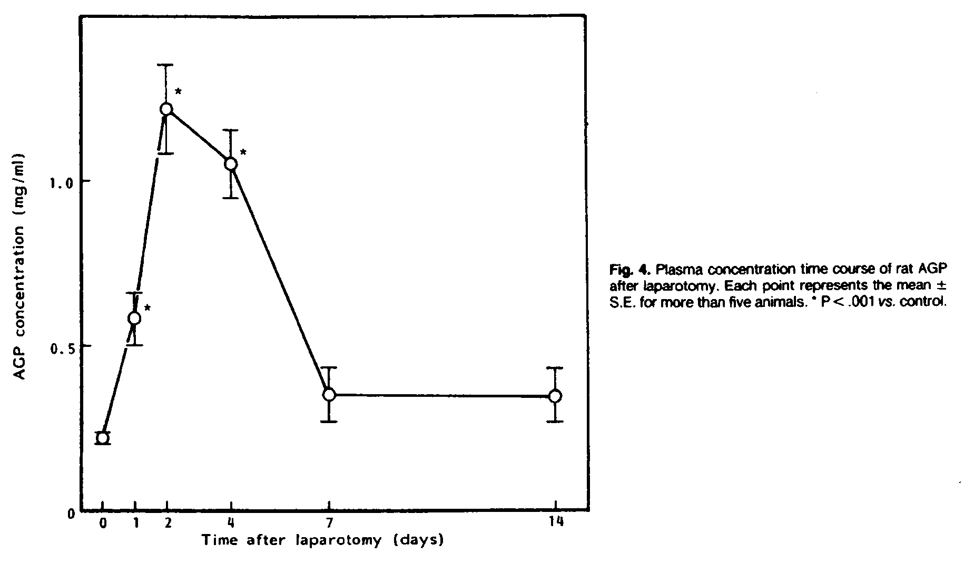
AGP levels in laparatomised rats - Effects of Stress
Yasuhara et al. JPET 1985; 235: 513-520

Slide 30
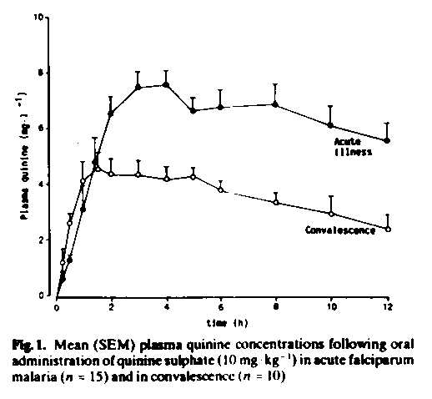
Quinine concentrations are higher during malaria infection
Less bound to other tissue
Acute illness
Convalescence
Supanaranond et al. EJCP 1991; 40: 49-52

Slide 31
Species differences
Important in interspecies allometric scaling

Slide 32
Variability in unbound fraction
Principle:
  The higher the degree of plasma protein binding (f_{b}), the larger variability in unbound fraction (f_{u}) is to be expected

Slide 33
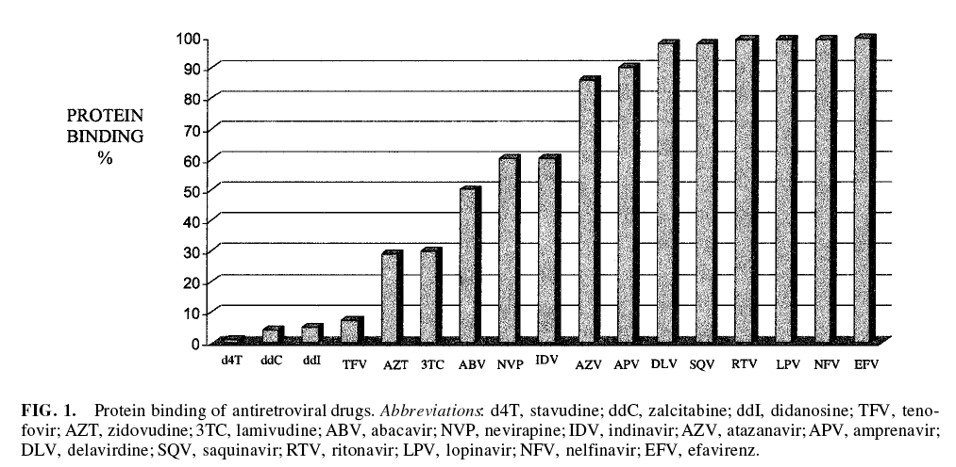
Protein binding of ARVs
The lipophilic non-nucleoside analogue inhibitors (efavirenz & nevirapine) and protease inhibitors are more
Extensive plasma protein bound than the hydrophilic nucleoside analogue inhibitors

Slide 34
Displacement
Distribution
Clearance
C
10
10
7.5
5
Cu
2
1
1.5
1
fu
0.2
0.1
0.2
0.2
Before
Displacement
After
Redistribution
At new
steady-state
After
Displacement

Slide 35
Displacement from plasma binding sites
Drugs most likely to elicit an increase in effect
  >90% bound
  >10% of molar concentration of binding site
  low volume of distribution (<10L)
  Narrow therapeutic index
  high extraction/parenteral route
Even though displacement is unlikely to cause clinical effects,
it is important to allow for it when measuring and interpreting
plasma drug concentration.

Slide 36
Summary
Small lipophilic molecules show perfusion rate-limited distribution.
  Tissue uptake being directly proportional to capacity and inversely proportion to blood flow
Membrane permeability becomes rate-limiting for polar compounds and for some tissue barriers
The net extent of distribution is indicated by the apparent volume of distribution which is a function of real volumes of plasma and tissue water and the balance of plasma and tissue drug binding.
A physiological conception of volume of distribution allow an understanding and prediction of the effects of disease and drug interactions.

Slide 37
Acknowledgements
Geoffrey Tucker
Johan Gabrielsson
Michael Ashton

