Slide 1
Drug Discovery and Development Course
Introduction to Pharmacokinetic Modelling
Absorption
Ali Mohamed

Slide 2

Terms of Use – CC BY 4.0 License
These materials are shared to support teaching, research, and presentation activities across the GC ADDA community. All content is provided under the Creative Commons Attribution 4.0 (CC BY 4.0) license, which allows you to use, share, adapt, and build upon the material freely, including for commercial purposes. Please ensure that any use includes proper attribution to the original creators, indicates any modifications you make, and maintains the same open license. No additional restrictions may be applied.
Credit the author(s) as follows:
CC BY 4.0 [Ali Mohamed, African Institute for Biomedical Science and Technology, Zimbabwe]

Slide 3
Learning objectives
Definitions & Kinetics of Absorption
Properties of the GI tract
Mechanisms of drug permeability
Factors affecting drug absorption
Physicochemical
Physiologic
Bioavailability

Slide 4

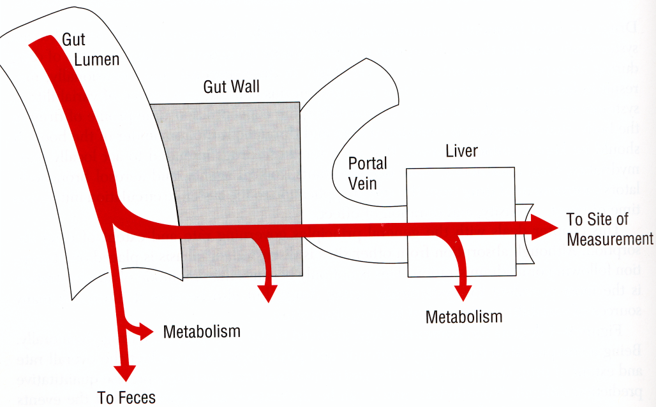
Definition of absorption
Absorption is the transfer of unchanged drug from its site of application into the
bloodstream. Its rate is determined by the absorption rate constant (Ka) and its
extent by bioavailability (F).
Absorption
Cmax
Elimination
[D]
mg/L
Before C_{max} abs.rate > elim. rate
After C_{max} abs.rate < elim. rate
At C_{max} abs.rate = elim.rate
Tmax
IV administration results in 100% absorption (Fraction absorbed = 1.0)
PO administration associated with loss of some drug (Fraction absorbed < 1.0)
Notes:
Absorption kinetics generally describe the process of the drug entering into the central compartment (circulation). Absorption is determined by multiple different processes, and is commonly described by two factors: time independent = Extent (F) and time dependent = Rate.
Absorption is more that permeability and solubility, it includes perfusion, metabolism, and transport

Slide 5
Absorption Rate(Ka) - how much drug is absorbed per unit of time
Absorption rate constant is the proportionality
constant that relates the rate of drug absorbed
into the body. Pharmacokinetic samples collected
around Tmax are critical to describe the absorption
characteristics of a drug.
2. A lag time (t-Lag) in absorption is defined as time delay
prior to the commencement of drug absorption. This can
be due to gastric emptying and intestinal motility
Non-compartmental approach “model-independent”, Ka can be described by parameters such as: T_{max} and (C_{max})

Slide 6
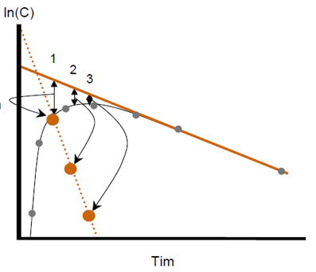
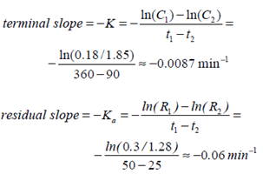
Estimation of Ka – Using the method of residuals
Done With data from extravascular drug administration
Plot the drug-concentration versus time, with time on
x-axis and conc. on y-axis.
Obtain the slope of the terminal phase by extrapolation
Take any points on the upper part of the
line (x1,x2,and x3) and drop vertically to obtain
corresponding points on the curve(x’1,x’2,x’3)
Read the conc. values at x1 and x’1 and so on and plot
the difference at the corresponding time point’s t1,t2,t3.
a straight line will be obtained with a slope of –ka
A
kel
ka
FOR MOST DRUGS
Ka>Kel
Notes:
1. When using the method of residuals, the minimum of three points should be used to define the line and data points shortly after tmax shouldn’t be used as this is post-absorption phase. Only data points from the elimination phase should be used to define the rate of drug absorption as a first-order process.
2. If drug absorption occurs immediately after oral administration, then the residual lines obtained will intersect on y-axis at point A. this represents a hybrid constant

Slide 7
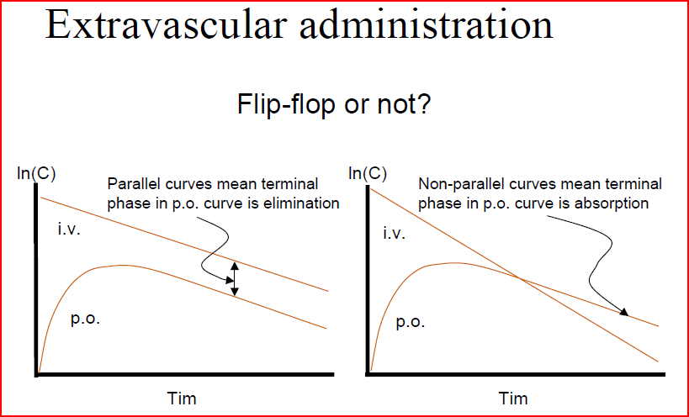
Drugs having flip-flop characteristics: are generally the one that have fast elimination.(ke>ka).
So for drugs with large kel, the chance of flip-flop is much greater.
Notes:
Flip-Flop Of Ka And Kel:
Using the method of residuals to estimate ka and kel, the terminal phase of the absorption curve is usually represented by kel whereas steeper slope is represented by ka .In few cases kel obtained from oral absorption does not agree with that obtained after I/v bolus. Apparently the ka and kel obtained by this method has been interchanged. This phenomenon is termed as “flip-flop” of ka and kel.
So in order to demonstrate that the steeper curve represents kel for a drug given extravescularly, drug must be given I/vly into the same patient. After I/v inj. Decline in the plasma-level time curve represents the true-elimination rate.

Slide 8
Significance of Absorption-Rate Constant
A change in rate of absorption (ka) has generally less clinical significance than a change in extent of drug absorbed (bioavailability).
For many immediate-release dosage forms, the absorption process is first-order due to the physical nature of drug diffusion.
The calculation of ka is useful in designing a multiple-dosage regimen.
Knowledge of ka and kel allows for the prediction of peak and trough plasma drug concentrations following multiple dosing.
In bio-equivalent studies, time of peak concentrations can be very useful in comparing respective rates of absorption of a drug from chemically equivalent drug products.
Notes:
Immediate-release dosage forms are designed to disintegrate and release the active drug quickly after administration. This allows the drug to be absorbed rapidly into the bloodstream, providing a swift onset of action. In immediate-release dosage forms, the drug is designed to dissolve quickly after administration. The dissolved drug then diffuses across biological membranes into the bloodstream. This diffusion process typically follows first-order kinetics because the rate of diffusion depends on the concentration gradient between the site of administration and the bloodstream. First-order kinetics means that the rate of drug absorption is directly proportional to the concentration of the drug that remains to be absorbed. Tmax indicates the time it takes for a drug to reach its maximum concentration in the bloodstream after administration.
By comparing the Tmax of two chemically equivalent drug products, researchers can determine if they are absorbed at the same rate

Slide 9
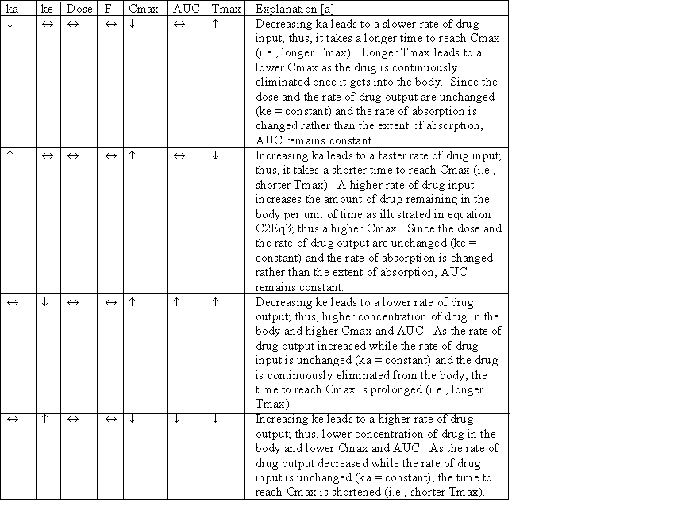
Decreased rate of absorption
lower than normal leads to
peak steady state concentration
(Cssmax) achieved at a later
time, lower Cmax, and higher
Cmin. The amount of drug
absorbed has NOT changed,
thus no change in daily dose
is needed. Decreased extent
of absorption leads to lower
Css (i.e., cannot reach expected
level). The amount of drug
absorbed is decreased; thus,
an increase in daily dose may
be needed.

Slide 10
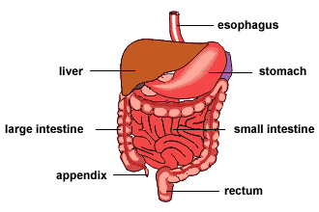
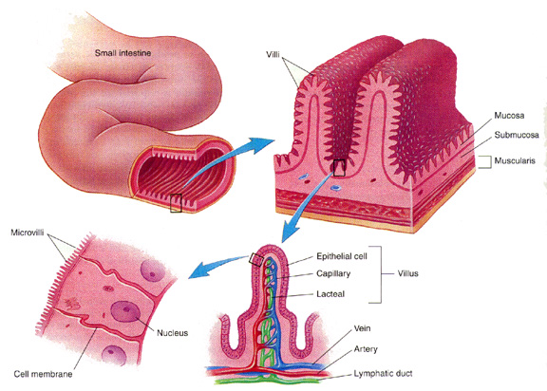
Gastrointestinal (GI) Tract
Absorption
Area
Fick´s law:
Rate of diffusion
= P • Area • (C₁- C₂)
(P = partition into
membrane)
Stomach
1 m²
Small intestine
200 m²
Notes:
Fick's law describes the diffusion process of particles, such as molecules, across a concentration gradient. It's fundamental in understanding how substances move from areas of high concentration to areas of low concentration. P is the permeability coefficient (partition into the membrane). Permeability Coefficient (P): This represents how easily the substance can pass through the membrane. It depends on the properties of both the substance and the membrane.
Surface Area (Area): The larger the area, the greater the rate of diffusion, as more substance can pass through at once.
Concentration Difference (C_1 - C_2): The rate of diffusion is driven by the difference in concentration across the membrane. A larger difference results in a higher rate of diffusion.

Slide 11
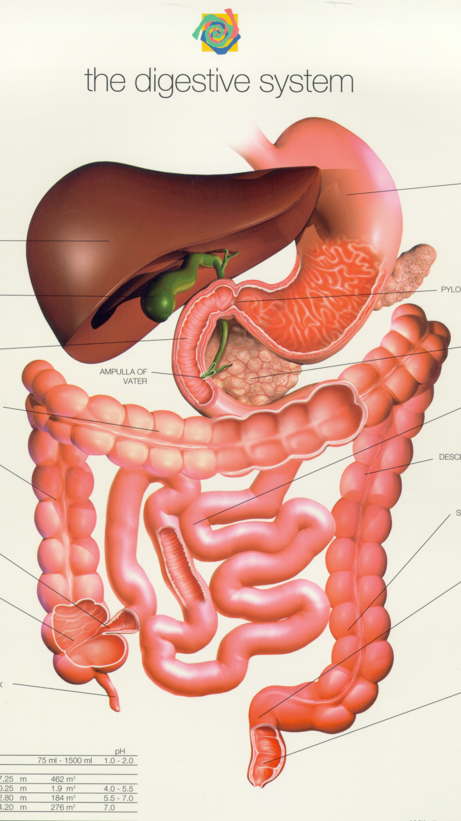
Gut
transit 0.5-2 hrs, pH 1-2
Liver
Gallbladder stores bile
Duodenum
transit: 20 min
pH 6-6.5
Pancreas
Secretes enzymes and bicarbonate
Jejunum
transit 2-3 hrs
pH 6.5-7.0
Ileum
transit: 3-5 hrs
pH 7-7.4
Colon
transit: 4-36 hrs
pH 6-8

Slide 12
Artemisinin plasma concentrations: [ng/mL]
2000
Oral 500 mg
2000
Rectal 500 mg
1500
1500
1000
1000
500
500
0
0
0
2
4
6
8
10
0
2
4
6
8
10
Time [hr]
Time [hr]
IMPE
ART-3
Ashton et al. CPT 1998; 63:482-92

Slide 13
Food-drug interactions
In general, food will delay gastric emptying
Specially so for solid and fat-containing food
T_{max} will be longer and C_{max} lower
Bioavailability can
decrease for drugs that are labile in the GI tract or which bind to food components
tetracyclines and Ca²⁺
increase for drugs with poor solubility
lumefantrine
Notes:
Primary Absorption Site: Most drugs are absorbed in the small intestine due to its large surface area and favorable conditions Delayed Emptying: If gastric emptying is delayed, the drug remains in the stomach longer, potentially reducing its absorption rate and bioavailability. Acidic Environment: The stomach's acidic pH (1-2) can degrade certain drugs. Delayed emptying exposes the drug to this harsh environment for a longer period, which can affect its stability and effectiveness

Slide 14
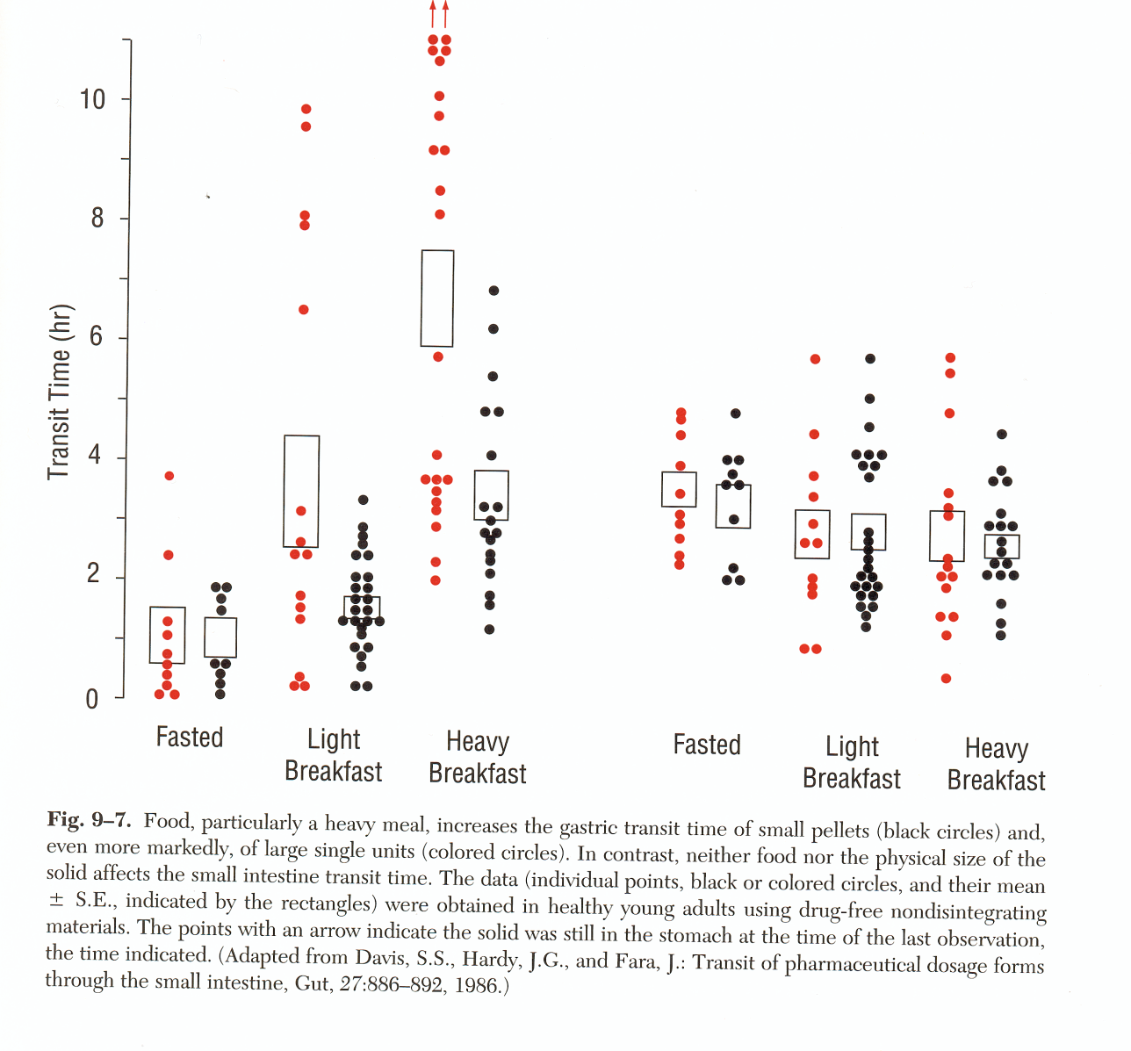
Effect of foods on GI Transit times
Stomach
Small intestine
Solid tablet
Small pellet
Food results in variable transit time: more variation in stomach
Rowland & Tozer

Slide 15
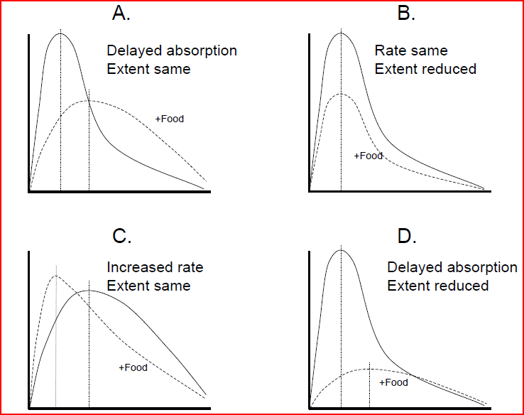
Effects of food on Ka and F

Slide 16


Dissolution of solid dosage forms
1. disintegration
primary particles
granules/solid particles
2. dissolution
Molecules/ions in solution
3. diffusion
Enterocytes

Slide 17
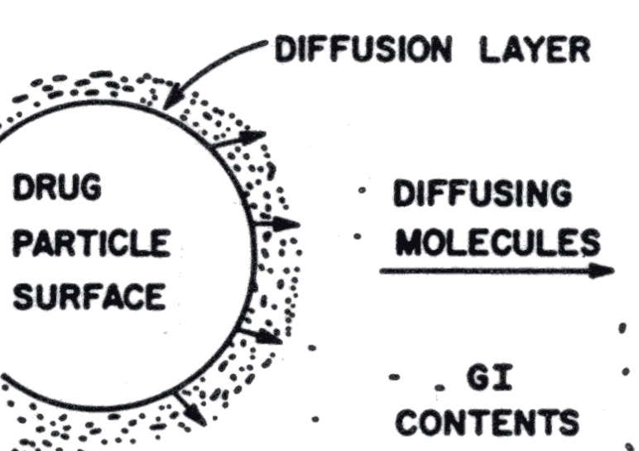
Dissolution Rate
Dissolution rate =∑ particle surface area X (Drug Solubility/dissolution layer thickness)
Many drugs are not very water soluble. Therefore the dissolution rate often becomes the rate limiting step for oral drug absorption.
ONLY SOLUBLE COMPOUND IS ABSORBED

Slide 18
In vitro dissolution testing of amodiaquine products
Intra-batch difference of
in vitro dissolution rate
Drug Formulation important towards
absorption (rate-Ka and extent – F) of medicines

Slide 19
Ways to improve dissolution
Select the crystalline form of the compound which has the highest dissolution rate.
Use a salt form to improve solubility
Chloroquine HCl
Usually a water-free form of a molecule more water soluble than a hydratized form.
Piperaquine phosphate 4•H₂0
Improve solubility by creating a pro-drug
Artesunate (dihydroartemisinin-succinic acid)

Slide 20
Mechanisms of drug permeability
1
2
3
4
5
6
1= transcellular
2= paracellular
3= active uptake into the cell
4= active efflux out of cell
5= efflux of intracellular formed metabolite
6= endocytosis/transcytosis
Different pathways have different molecular requirements and contributions to overall transport

Slide 21
Intestinal absorption often 1:st order
Diffusion rate = Permeability • Area • (C₁- C₂) ≈ P • A • C₁
C₁
C₂ ≈ 0
Blood
”sink conditions”
Similar to when you open a tap with the drainage open

Slide 22
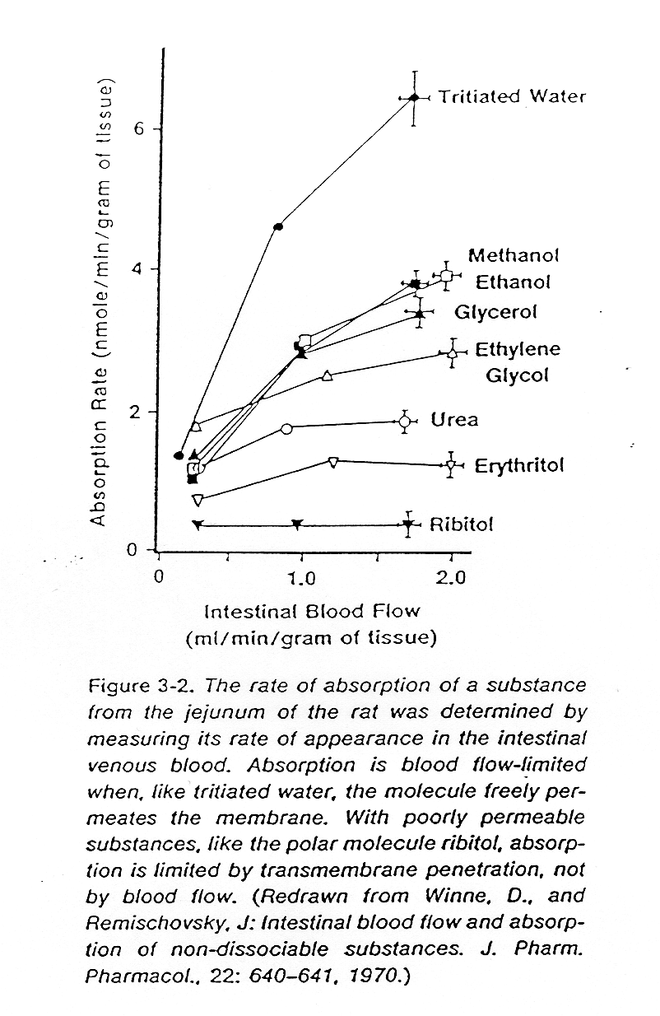
Blood flow and Permeability limited absorption
Blood flow dependent absorption of compounds
Highly permeable compounds
Permeability limited absorption of compounds
Poorly permeable compounds

Slide 23
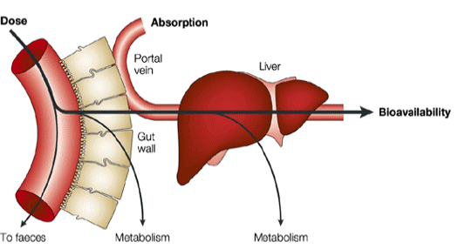
Intestinal Absorption
Physicochemical properties
pKa
Lipophilicty
solubility
Permeability
Passive diffusion
Paracellular
Active transport
Metabolism
Intestinal lumen metabolism
First pass gut metabolism
First pass liver metabolism
fa (%)
F(%) = fa(1-Egx Eh)
Affected by:
* Formulation
* Enzymes in the lumen
* Solubility
* Unspecific binding
Affected by:
* Conc. gradient,
* Intracellular enzymes,
* Mechanisms of absorption
Nature Reviews Drug Discovery 2:192-204 (2003)
Notes:
A concentration gradient refers to the difference in the concentration of a substance between two regions. It is a key concept in diffusion and other transport processes

Slide 24
Intestinal drug absorption
Passive diffusion is predominant
Physico-chemical properties of drug is important
Lipophilicity, molecular size, ionisation degree
Paracellular transport
Tight junctions between epithelial cells
Uncommon since MW has to be < 200 and small total area
Active transport
Active uptake transporters (amoxicillin)
Active efflux transporters
P-glycoprotein (Pgp)
Notes:
Fosfolipider finns mer detaljerad struktur i boken.

Slide 25
Physicochemical factors affecting oral absorption
Hydrophilicity & lipophilicity
Molecular Weight
Ionizability and charge
Polar surface area
Particle size in suspension
Polymorphism of crystalline forms
Molecular size
Complexation

Slide 26
Lipophilicity (logD)
Lipophilicity is the most important physical property of a drug in relation to its absorption, distribution, potency, and elimination.
Lipophilicity is often an important factor in all of the following:
Solubility
Absorption
Plasma protein binding
Metabolic clearance
Volume of distribution
Enzyme / receptor binding
Biliary and renal clearance
CNS penetration
Storage in tissues
Bioavailability
Toxicity
Notes:
Lipophilicity refers to the chemical property of a substance that describes its ability to dissolve in fats, oils, and lipids. It is a crucial factor in pharmacology and drug design

Slide 27
Transcellular transport
Most drugs use this route
Lipophilicity, major determinant of transcellular permeability
AZ12418612
NK; efflux???
3
>40% of compounds can be classified according to lipophilicity (>85% correct predictions)
892 compounds measured
Ackn. Susanne Winiwarter

Slide 28
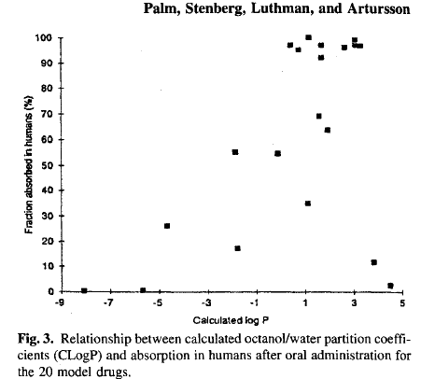
Predictiveness of intestinal absorption
Fraction absorbed (%)
Lipophilicity (Log P)

Slide 29
1 2 3 4 5 6 7 cpds
Usually the in vivo solubility is much higher than the in vitro measured in buffer systems

Slide 30
Biopharmaceutical Classification System (BCS)
(Amidon et al 1995)
I
II
III
IV
The product between solubility and permeability determines drug absorption, Fa
If a compound has high permeability and low solubility:
The permeability can create a sink favouring dissolution of the compound
Dissolution limitation can occur
If a compound has low/restricted permeability
The dissolution limitation will become more pronounced
A certain solubility is required to get the compound absorbed

Slide 31
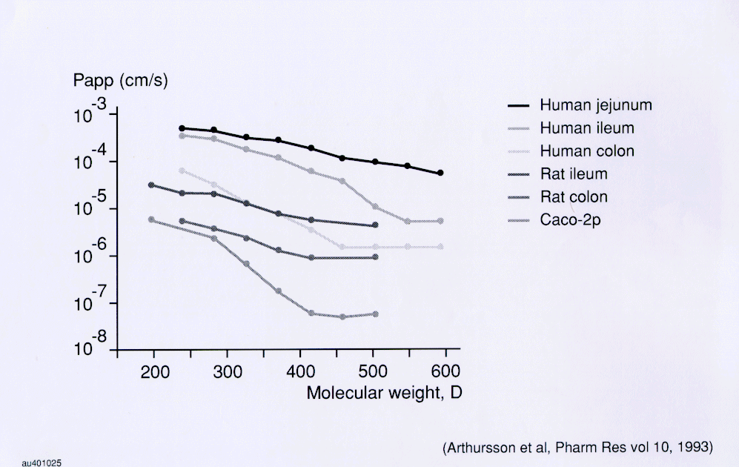
Paracellular transport is MW-dependent

Slide 32
Absorption of some Hydrophilic Drugs in Rat, Dog and Man
Dogs tends to overestimate Human % absorbed due to larger pores favouring paracellular transport

Slide 33
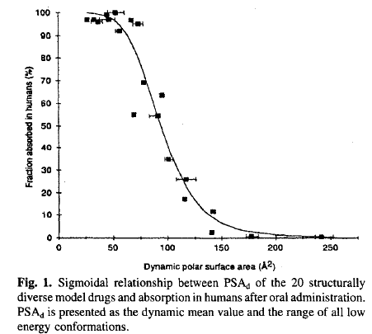
Predictiveness of intestinal absorption
Polar surface area (PSA) is the area occupied by nitrogen and oxygen
atoms, and hydrogen atoms attached to these heteroatoms
Fraction absorbed (%)
Polar surface

Slide 34
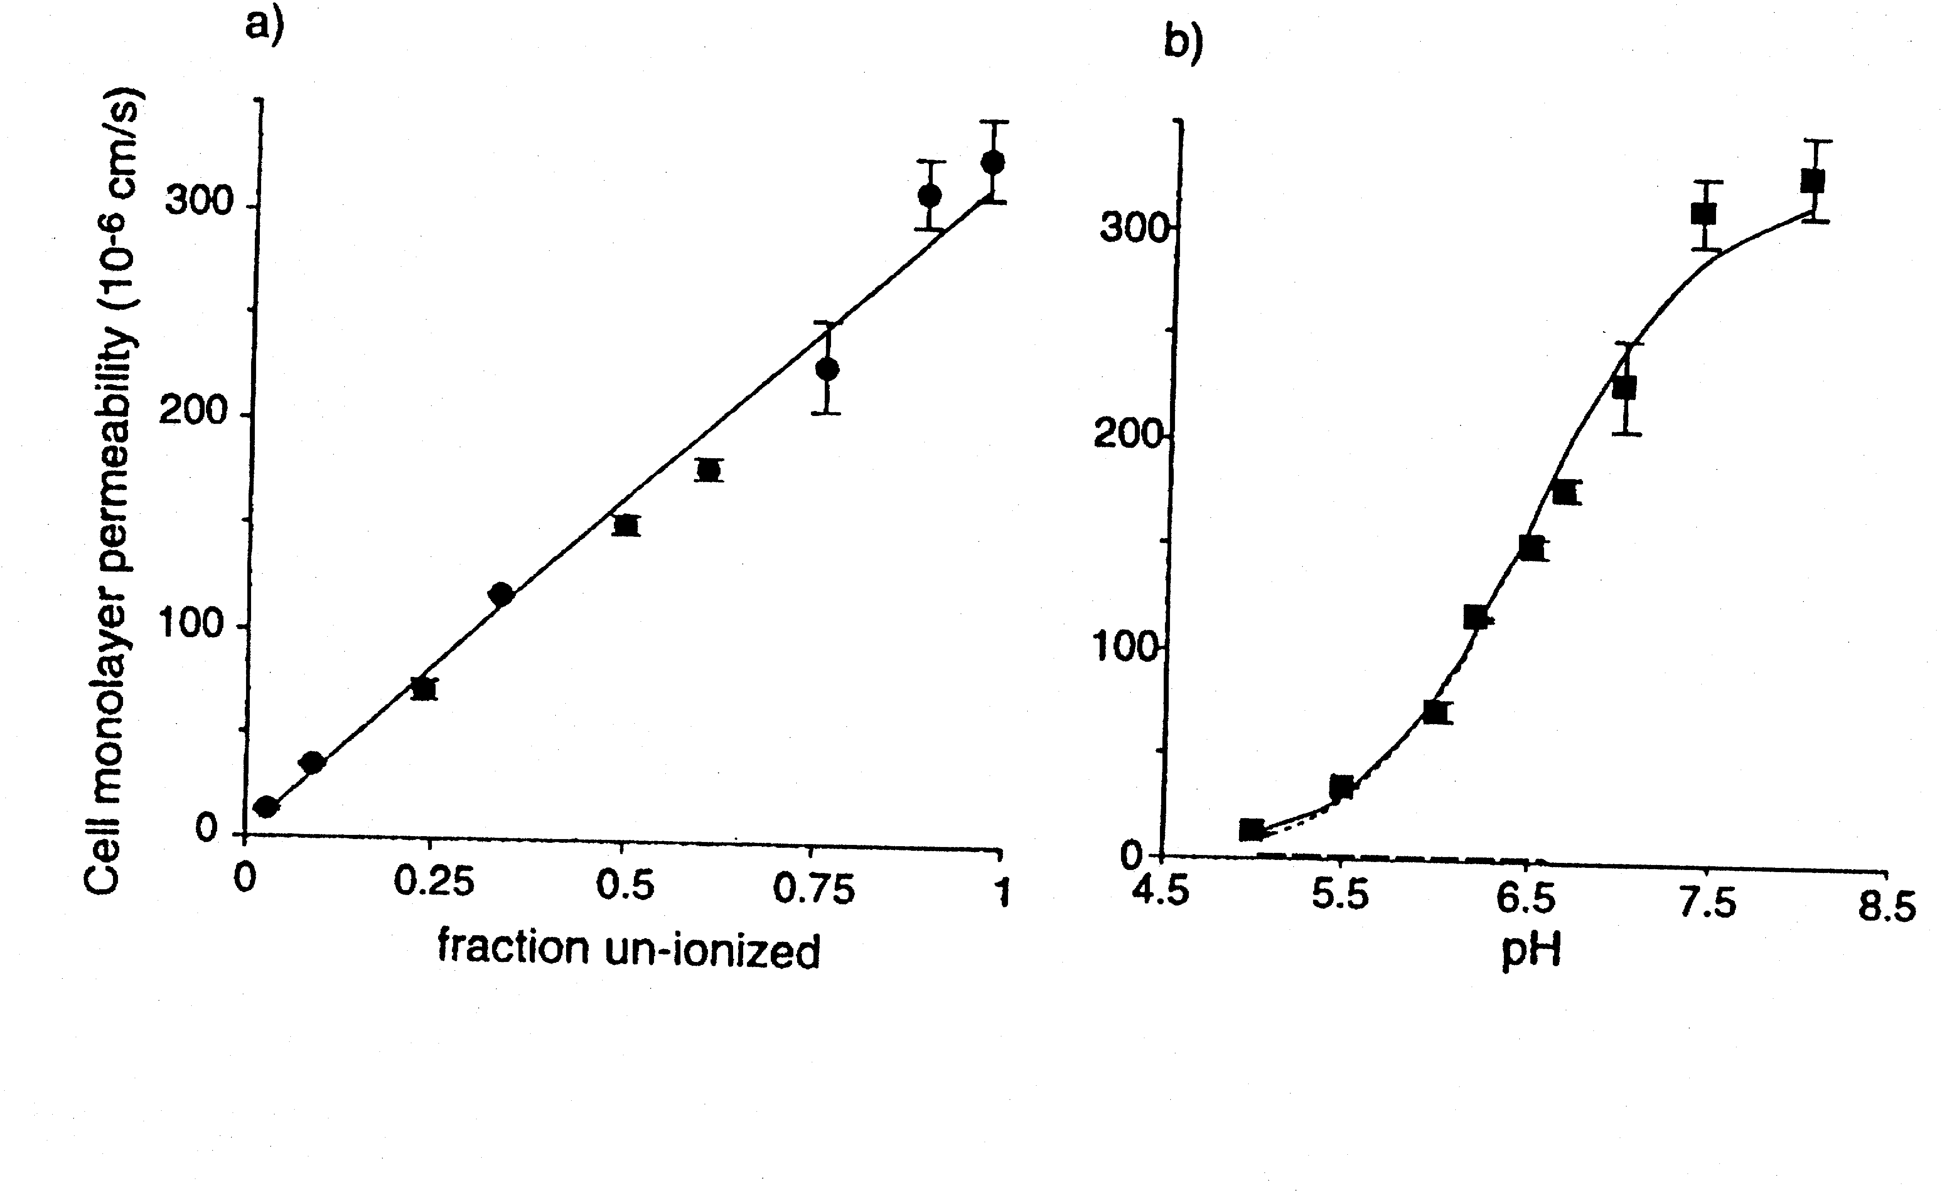
pH - Partition Hypothesis
Only the neutral form of an ionisable molecule is able
to penetrate cell membranes by passive diffusion
pH dependent Caco2 permeability of alfentanil
pKa = 6.5
J. Pharm. Exp. Ther. 1999, 291, 435-443

Slide 35
“Rule of Five”
> 5 H-bond donors
Molecular weight > 500
Calculated log P > 5
Sum of N’s and O’s > 10 (H-bond acceptors)
Two or more alerts suggests
potential for poor oral absorption.
Lipinski, C.A., et.al., Advanced Drug Del. Rev., 1997, 23, 3-29

Slide 36
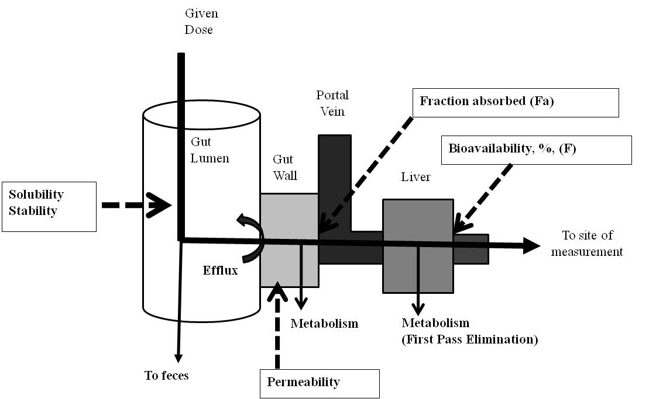
First-pass elimination
Many orally administered drugs absorbed intact from the small intestine, are transported via vena porta to the liver where they are extensively metabolized prior to reaching systemic circulation
Bioavailability F = F_{abs}•F_{gut}•F_{H}

Slide 37
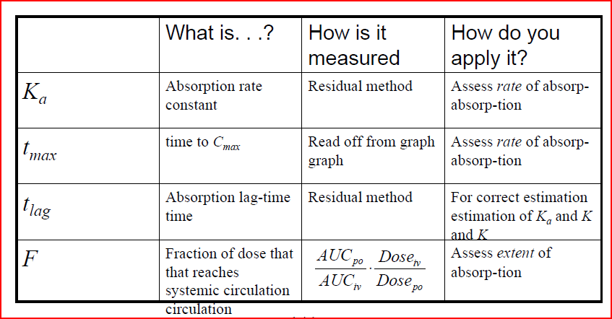
Summary of absorption & bioavailability
Absorption is not just solubility & permeability
It includes metabolism, perfusion and transport!
Good presentation on absorption: http://www.authorstream.com/Presentation/aSGuest96259-983592-factors-affecting-drug-absorption/

