Slide 1
Drug Discovery and Development Course
Introduction to Pharmacokinetic Modelling
Ali Mohamed

Slide 2

Terms of Use – CC BY 4.0 License
These materials are shared to support teaching, research, and presentation activities across the GC ADDA community. All content is provided under the Creative Commons Attribution 4.0 (CC BY 4.0) license, which allows you to use, share, adapt, and build upon the material freely, including for commercial purposes. Please ensure that any use includes proper attribution to the original creators, indicates any modifications you make, and maintains the same open license. No additional restrictions may be applied.
Credit the author(s) as follows:
CC BY 4.0 [Ali Mohamed, African Institute for Biomedical Science and Technology, Zimbabwe]

Slide 3
Learning objectives
Non compartmental modelling
Pharmacokinetic (PK) parameters
Model flow diagrams
Compartmental PK modelling

Slide 4
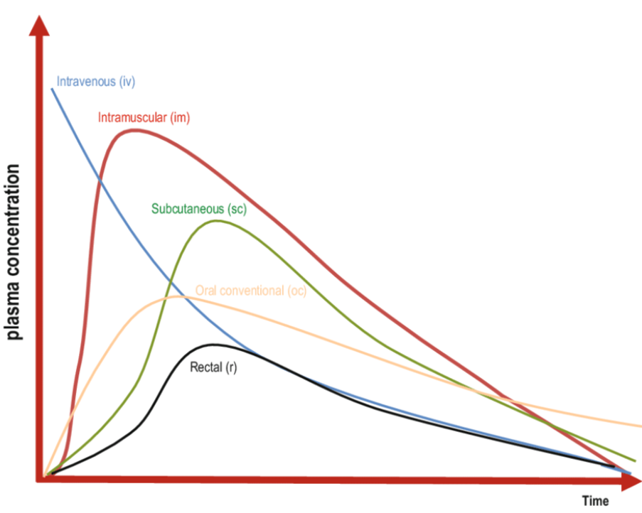
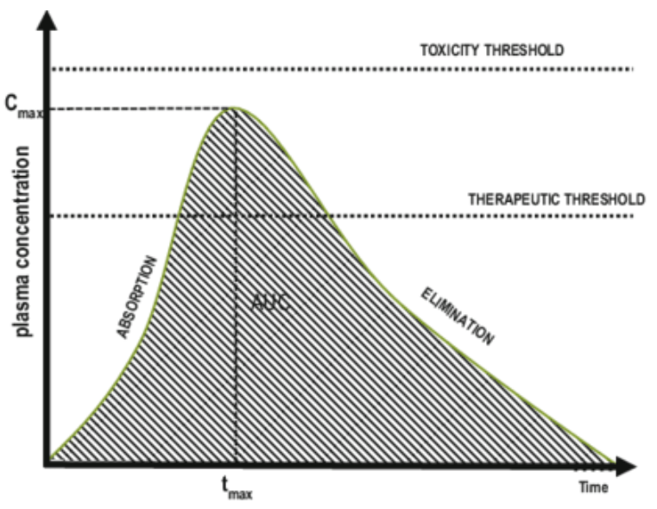
Non-compartmental modeling
Concentration vs time profile
Depending on the route of administration

Slide 5
Non-compartmental modeling . . .
Definitions and Terminology
Concentration: the measurement of the amount of drug contained in a specific volume of a biological fluid, typically plasma or urine (Cp)
Maximum concentration: The highest OBSRVED concentration from those included as the measurements of the time course of drug. C_{max}
Time of maximum concentration: The time at which the highest concentration is measured from those included as the measurements of the time course of drug. T_{max}
Half-life: the length of time necessary to eliminate 50% of the remaining amount of the drug present in the body. t_{1/2}
Area Under the Curve: the integration of drug concentration measurements over time using calculus. AUC_{0-inf}, AUC₀₋₂₄, AUC_{0-t}

Slide 6
Non-compartmental modeling . . .
Definitions and Terminology . . .
Bioavailability:
Clearance: is a proportionality constant that relates the rate of drug elimination (in mass/time) to Blood or Plasma concentration. CL
  It is the volume of blood from which ALL drug is removed in unit time.
Volume of distribution: is the proportionality constant relating the amount of drug in the body to blood or plasma concentration. Vd
  It is the apparent space or volume into which a drug distributed

Slide 7
Use of non-compartmental modeling
The noncompartmental approach for data analysis does not require any specific compartmental model for the system (body) and can be applied to any PK data.
The main purpose of the noncompartmental approach is to estimate various PK parameters, such as systemic clearance, volume of distribution at steady state, and bioavailability.

Slide 8
Pharmacokinetic parameters

Slide 9

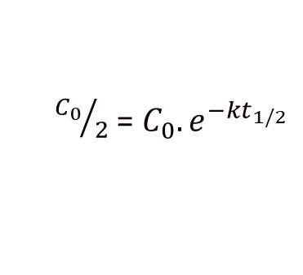
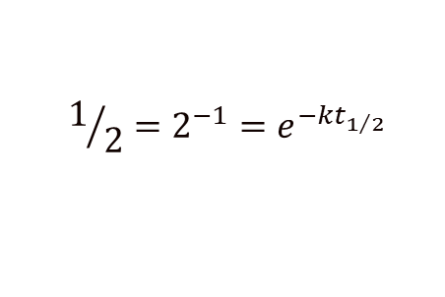
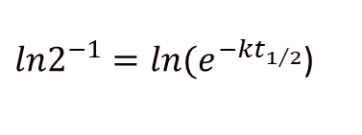
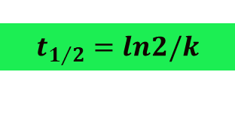
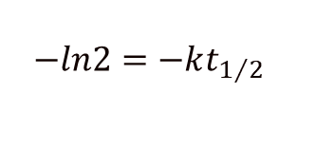
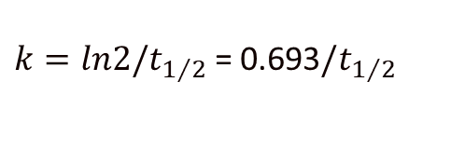
Half-life
Equation for Exponential
decay processes
At t_{1/2} when C = C₀/2
C₀
C = C₀.e^{-kt}
cancel out the C₀
take natural logs on both sides
cancel out the signs on both sides

Slide 10
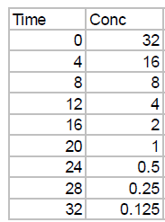
Importance of Half-life
Guides on how often we should take a drug to keep at steady state concentrations
Informs us on how long it will take before a drug is completely cleared from our body
The rule of thumb to both scenarios is 4-5 half lives!
(by 4 half lives, 16hours, only 6% of the drug will be remaining!)

Slide 11
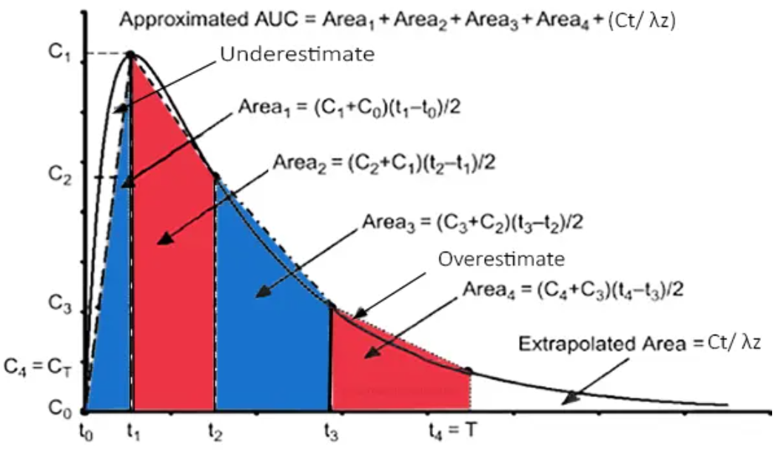
Determination of Area Under the Curve (AUC)
Estimation of Exposure
AUC = AUC (0-t_{z}) + AUC(t_{z}-∞)
AUC (0-t_{z})
  Linear trapezoidal rule
  Log-linear trapezoidal rule
AUC(t_{z}-∞)
  Extrapolation
t = t_{z}
AUC is the total amount of drug that reaches the circulatory system at any given time. Units: ng.hr/ml

Slide 12
Linear trapezoidal rule
Mean conc * base
Notes:
The area is the sum of a number of trapezoidals

Slide 13
Linear trapezoidal rule . . .
simple but:
assumes a straight line between data points
error may be large when curve is steep
over estimates AUC at the decending part of the curve
under estimates AUC at the ascending part of the curve

Slide 14
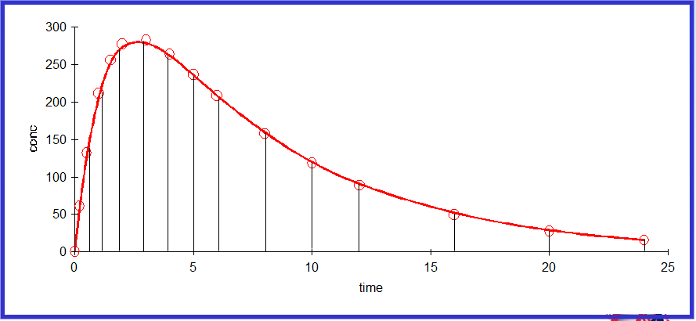
Log-linear trapezoidal rule

Slide 15
Log-linear trapezoidal rule . . .
gives less error in estimate of AUC
==> to be preferred
accuarate for mono-exponential decline
may produce errors for ascending curve
may produce errors near the peak
may produce errors in a steeply declining polyexponential curve

Slide 16
Which one to choose?
linear or log-linear trapezoidal rule?
combination (lin up / log down)
  linear trapezoidal rule for ascending concentrations and plateau concentrations
  log-linear for descending concentrations
  Log-linear for drugs with long half-lives – have not been proven to be better.

Slide 17
Extrapolated AUC
AUC(t_{z-∞} ) = C_{last}/k
AUC (t_{z-∞} ) = C_{pred,last}/λ_{Z}
Notes:
Extrapolation to infinity

Slide 18
Extrapolated AUC
Log C
should ideally be as small as possible
should not exceed 10-25 % of total AUC
C_{last, predicted}
AUC(t_{z-∞}) = C_{last, pred}/l_{z}
C_{last}
AUC(t_{z-∞}) = C_{last}/λ_{z}
Time

Slide 19
Importance of AUC
Enables the estimation of drug bioavailability (F)
Enables the estimation of drug clearance (CL)

Slide 20
Estimation of Drug Bioavailability
In Conc (µM or mg/L)
In Conc (µM or mg/L)
Time (hr)
Time (hr)
AUC_{i.v}
AUC_{p.o}
AUCp.o X Dosei.v
AUCi.v X Dosep.o
F =
Drug that reaches systemic circulation, estimates extend of absorption

Slide 21
Importance of Bioavailability
The high oral bioavailability reduces the amount of an administered drug needed to achieve the desired pharmacological effect and thus could reduce the risk of side effects and toxicity.
It determines the degree and rate at which drug-active substances are absorbed into the bloodstream after extravascular root.
Therapeutic Effectiveness: Bioavailability determines the fraction of an administered dose that reaches the systemic circulation unchanged, directly influencing the drug’s therapeutic effect.
Dosage Optimization: Understanding bioavailability helps in designing optimal dosing regimens to ensure that the drug reaches the desired concentration in the bloodstream to achieve its pharmacological effect.

Slide 22
Calculating Clearance (CL)
Clearance (CL) is a proportionality constant that relates the rate of drug elimination (in mass/time) to
Blood or Plasma concentration. It is the volume of blood from which ALL drug is removed in unit time.
At any point after dosing, Rate of elimination (ng/min) = CL x C
i.e amount eliminated in dt = CL*Conc*dt
∞
Integrating gives: Total drug eliminated = CL x
Cdt
= CLx AUC
₀
Assuming all drug entering the body by i.v, is eventually eliminate, the total amount administered will equal to amount eliminated.
Dosei.v = CL x AUCi.v; CL = Dosei.v
AUCi.v
For p.o
CL/F = Dose/AUC
CL is expressed as volume/time hence can be taken as the volume of blood or plasma that must be cleared of drug per unit time to produce the observed elimination rate.
For each organ, the CL can not exceed blood flow through that organ

Slide 23
Volume of Distribution - Vd
Vd is the proportionality constant relating the amount of drug in the body to blood or plasma concentration – it is the apparent space or volume into which a drug distributed
A
B
1. Into buckets with equal volume, 10L of water, 100 units of
drug administered.
2. Concentration is V/dose = x units/L
3. On measuring conc. In A and B, A = 10units/L, B = 1 unit/L
4. Back calculation for Volume, A = D /C = 10L, B = 100L
5. Active charcoal in B traps some of the drug giving an imaginary
large volume into which the drug is distributed. The trapped drug
is therefore not accessible to the site of measurement (water or
plasma for PK studies).
6. Apparent volumes relate to the total amount of drug in the system
(bucket or body) to the site of measurement (water or plasma)
7. Volume of distribution (V) is the volume the drug would occupy
if it were present everywhere at the same concentration as it is
in plasma.
Dose (100)
Dose (100)
C 10
C 1
V = 10L
V = 100L

Slide 24

Volume of Distribution - Vd
Compounds that are highly lipophilic tend to bind to tissue components (e.g., proteins, lipids), and there is very low blood concentration. Vd exceeds body water volume (0.7 L/kg) and may reach levels as high as 200 L/kg.

Slide 25
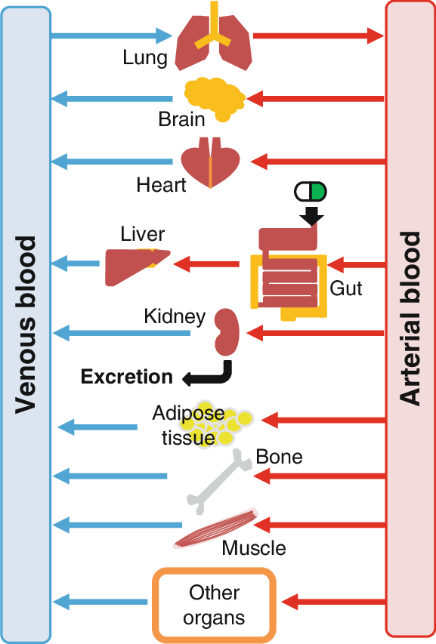
Model flow diagram
Ideal situation
Source: DOI:10.1007/978-94-007-6169-8_59-1

Slide 26
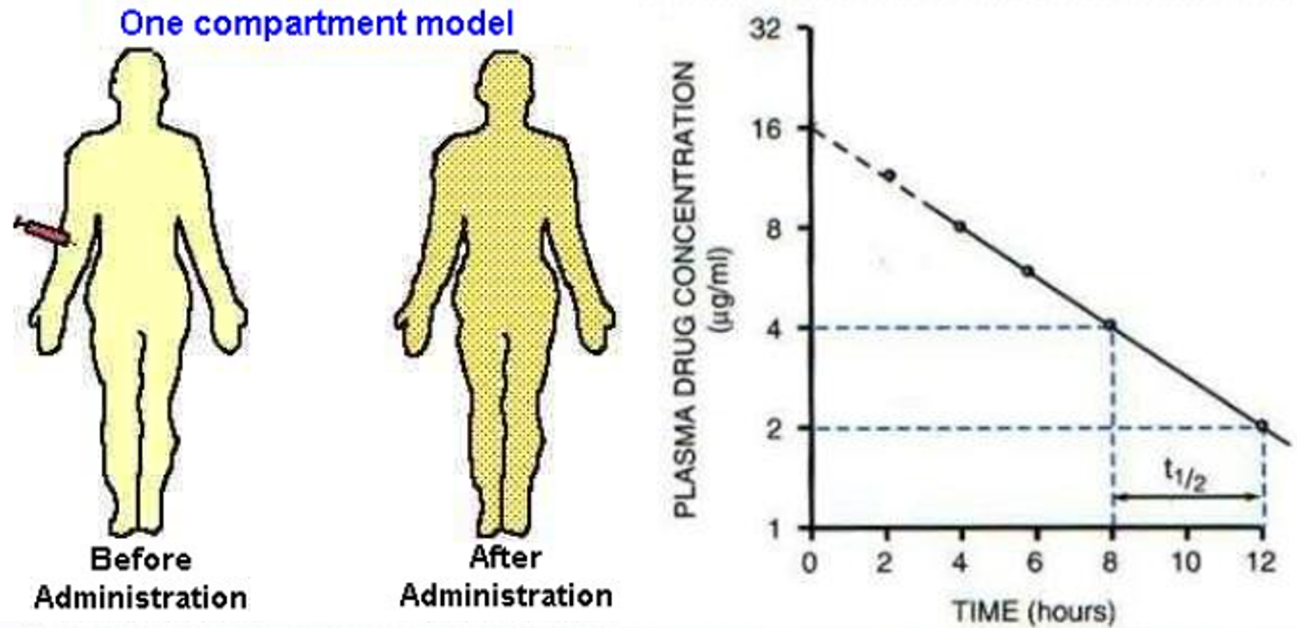
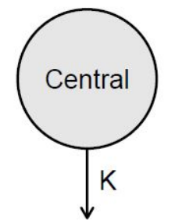
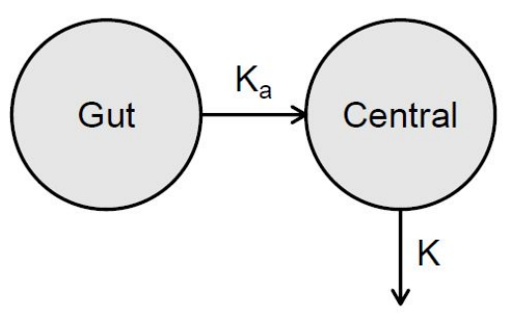
Model flow diagram : One-compartment
IV
PO

Slide 27
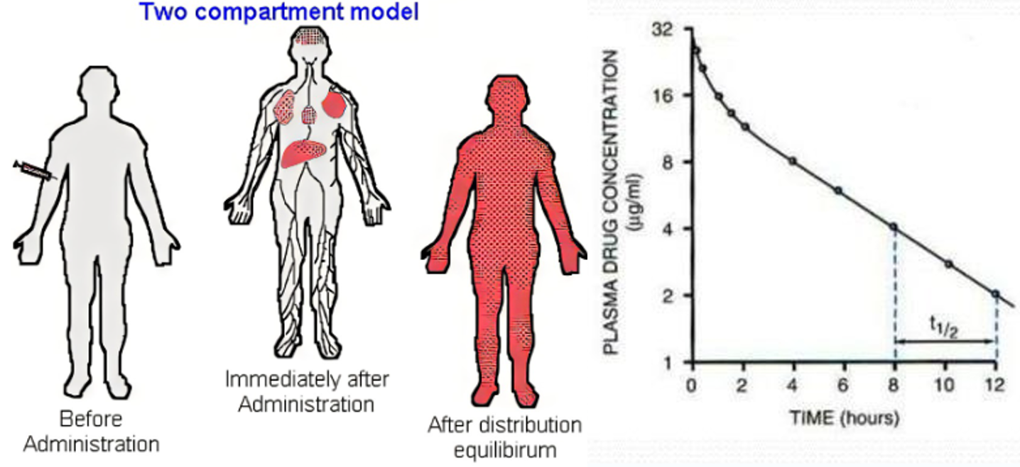
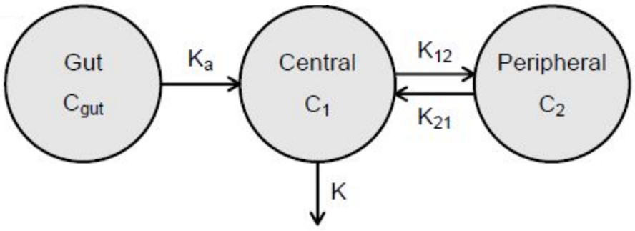
Model flow diagram: Two-compartment

Slide 28
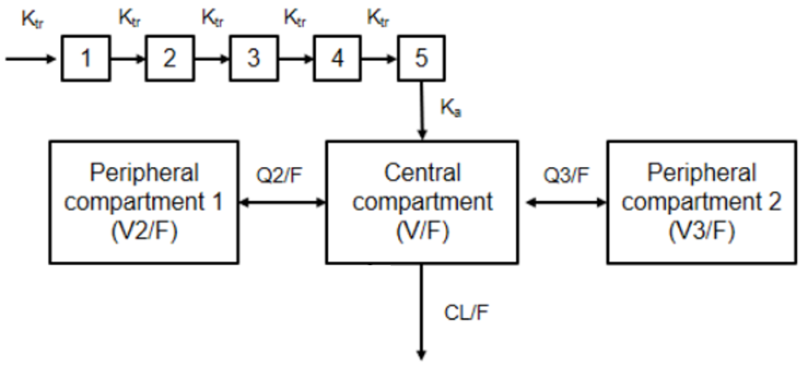
Model flow diagram: Three-compartment
Transit compartments
Dose
Delayed absorption

Slide 29


Compartmental modeling
Compartmental modelling is a model-based method used for estimating PK parameters.
To apply this method, the body is divided up into hypothetical compartments.
A compartment is a group of tissues with similar blood flow and drug affinity.
It represents the body as a finite number of interconnected, well-mixed, and kinetically homogeneous compartments.
The containers do not necessarily represent actual physiological tissues in the body but are used as a proxy of physiologic region so that PK parameters can be determined.

Slide 30
Compartmental modeling . . .
Assumptions
Body as Compartments: The body is represented as a finite number of interconnected, well-mixed, and kinetically homogeneous compartments.
Instantaneous Distribution: It is assumed that the drug distributes instantaneously and homogeneously throughout the compartment or compartments.
  Implying that the apparent volume of distribution (Vd) is constant within a relatively small time window.
First-Order Kinetics: The model assumes that drug elimination within the compartment follows first-order kinetics.
  The rate of drug elimination is proportional to the drug concentration present in the compartment.

Slide 31
Compartmental modeling . . .
Assumptions . . .
Rate Constants: Rate constants are used to describe the rate of drug movement between compartments.
  Assumed to follow first-order kinetics.
These assumptions allow for the mathematical modeling of drug kinetics, which can be used to predict the concentration of a drug in the body over time.
A basic mathematical model of PK is a compartment model that can be transcribed as a set of differential equations that describe the relationship between drug concentration and time.

Slide 32
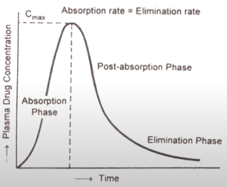
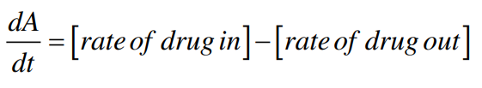
Compartmental modeling . . .
The mathematical expressions that describe the compartment PK model are obtained by writing the corresponding mass balance equation.
  Solving the resultant differential equation.
By solving the mass balance, it is possible to obtain equations of amount of drug or concentration in the compartment versus time.
In compartmental analysis, one mass balance equation is considered for each compartment encompassed by the model.
The mass balance equations take the following general form:

Slide 33
Compartmental modeling . . .
Model formulation: One-compartmental model
In a one-compartment model, we make two important assumptions:
Linear pharmacokinetics.
  By this, we mean that elimination is first order and that pharmacokinetic parameters (ke, Vd, Cl) are not affected by the amount of the dose.
  Of course, a change in dose will be reflected by a proportional change in plasma concentration
Immediate distribution and equilibrium of the drug throughout the body
Can be used to predict Cp vs t profile and other pharmacokinetic parameters

Slide 34


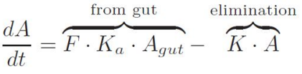
Compartmental modeling . . .
Model formulation: One-compartmental model
For IV dose, according to the law of mass action and first-order kinetics.
For oral dosing, an extra gut compartment (right) is often sufficient to model the absorption phase.
Given K_{a} > K, we can model the concentration in the central compartment as:

Slide 35

Compartmental modeling . . .
Model formulation: Two-compartmental model
In a two-compartment it is assumed:
The central compartment is assumed to include the blood or plasma from which the drug is eliminated.
The drug initially enters the central compartment, from which it is distributed to the peripheral compartment
The peripheral compartment is assumed to contain well-perfused tissues from which the drug must be transferred to the central compartment for subsequent elimination.
The distribution from compartment 1 to compartment 2 and the redistribution from compartment 2 to compartment 1 follow (apparent) first-order kinetics.

Slide 36
Compartmental modeling . . .
Model formulation: Two-compartmental model . . .
By integrating the mass balances for each compartment, it is possible to obtain equations for drug amount in each compartment versus time

Slide 37
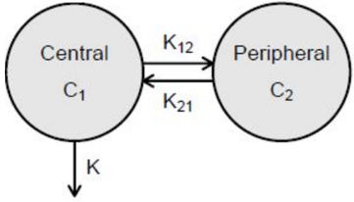
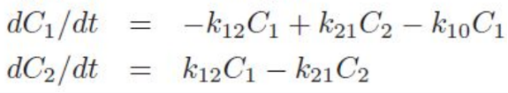
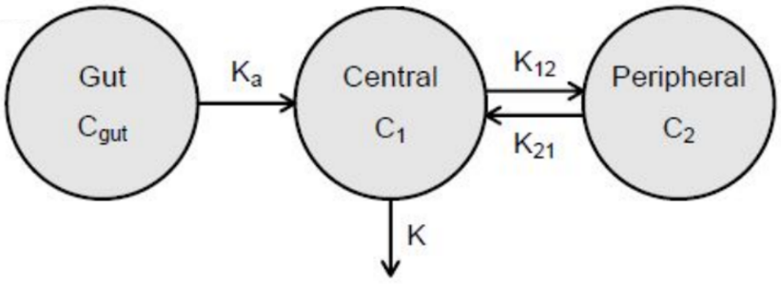
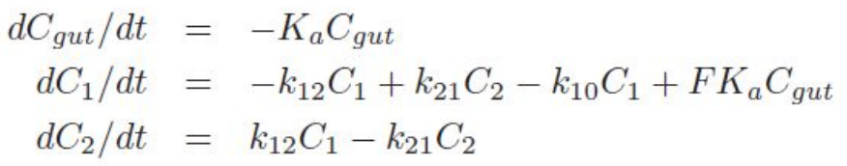
Compartmental modeling . . .
Model formulation: Two-compartmental model
For IV dose, according to the law of mass action and first-order kinetics.
For oral dosing, an extra gut compartment is added to model the absorption phase.

Slide 38
Non-compartment vs Compartment models
Non-compartment models
Do not require assumptions to compartment model.
Simple algebraic equations. No curve fitting and no computers.
Time course changes in C₀ cannot be predicted precisely.
Applicable to linear pharmacokinetics.
C-time profile is regarded as statistical distribution
Compartment models
These require elaborate assumptions to fit the data.
Curve fitting of experimental data using computers.
It is a tedious method.
Time course changes in C₀ can be predicted precisely.
Applicable to linear and nonlinear pharmacokinetics
C-time profile is regarded as expressions of exponents.

Slide 39
Summary
From the concentration vs time plot, we can begin to understand the absorption and elimination characteristics of the drug
Two common approaches to understanding a drug’s PK.
i. Non-Compartmental Analysis (NCA)
NCA doesn’t rely on assumptions about body compartments.
Provides more consistency as it uses algebraic equations to estimate pharmacokinetic (PK) parameters.
Less complex than compartmental methods, often faster and more cost-efficient.

Slide 40
Summary . . .
The most common PK parameters described by an NCA are:
Maximum concentration (C_{max}) and time of maximum concentration (t_{max})
Area under the concentration-time curve (AUC)
Volume of distribution (Vd)
Systemic clearance (CL)
Terminal half-life (t_{1/2})

Slide 41
Summary . . .
ii. Compartmental PK analysis
Assumes the body consists of interconnected, well-mixed compartments (e.g., blood, organs).
Segments the body into distinct partitions and uses complex mathematical models to describe the movement and interaction of drugs within these compartments.
Potential for variability in output due to different assumptions used to build the PK model.
Based on nonlinear regression analysis, which can be more complex.
Advantages include characterizing PK across multiple studies and informing dosage adjustments based on various factors.

Slide 42
Summary . . .
Both methods have their place in pharmacokinetics.
Deciding whether to use a noncompartmental analysis versus a compartmental analysis approach is not a function of how sophisticated the method is but depends in large part upon the purpose of the, the data available, and the complexity of the drug’s behaviour in the body.

Slide 43
Can you suggest when you will use NCA and when you will use compartmental PK approach?

