Slide 1
Drug Discovery and Development Course
Introduction to Drug Discovery and Development
Jeremy Burrows

Slide 2

Terms of Use – CC BY 4.0 License
These materials are shared to support teaching, research, and presentation activities across the GC ADDA community. All content is provided under the Creative Commons Attribution 4.0 (CC BY 4.0) license, which allows you to use, share, adapt, and build upon the material freely, including for commercial purposes. Please ensure that any use includes proper attribution to the original creators, indicates any modifications you make, and maintains the same open license. No additional restrictions may be applied.
Credit the author(s) as follows:
CC BY 4.0 [author, institution]

Slide 3

Learning objectives
Understand the overview of the drug discovery and development process
Understand importance of working on the right biology
Understand those properties that impact the chemical quality of a compound series

Slide 4
Drug Discovery Philosophy
Be curious – the best question is “why?”
You will not understand everything outside your domains of expertise – ask questions!
Do not pretend to be an expert in areas where you are not
Be responsible for understanding and delivering expertise in areas where you are expert – explain your thinking and interpretation of data to others
Ask, listen and learn from those who are experts outside your area
Focus on the goal of delivering a candidate drug
Drug Discovery is not the same as doing basic science
Don’t do something because you can do it, rather focus on answering the right questions
Gather data, define the issues, ruthlessly focus on solving the issues with chemistry, biology and pharmacokinetics
Collaboration and team-work are key
It is not about “me” but the project and the project team
All need to learn the multi-disciplinary language of Drug Discovery

Slide 5

Drug Discovery – where to start?
X
Drug discovery is a misnomer
“a wrong or inaccurate use of a name or term”
Except for some natural products – drugs are novel chemical entities that did not exist before they were made
Derived from imperfect starting compounds that have been extensively changed and optimized across many parameters
Drug discovery is a journey with various options
New biology – need to find a disease indication
Defined disease – need to find the best approach
It is better to start from the end and define a route to get there!
Target Product Profile (TPP)
TPP describes the profile of the medicine necessary to meet the goals of patients, care givers and payers

Slide 6
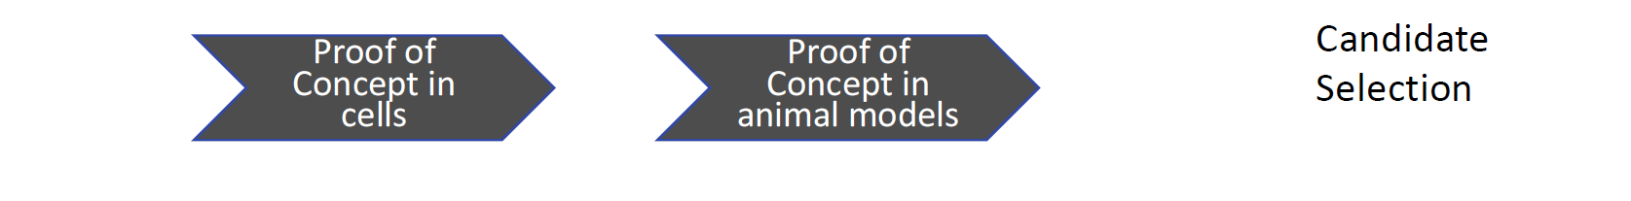
Drug Discovery Phases
Hit-to-Lead
Proof of Concept: Demonstration that the target/ compound series gives the desired response before studying in humans

Slide 7
What biological target to work on?
Critical to work on compounds having biology relevant for disease
If not, even the best project team delivering the best candidate drug will deliver failure over years costing USD millions
So biological target must be validated for the disease
Many ways to confirm validation
Best to have evidence across several areas – genetic, phenotypic, disease model, chemical
Test cascade is the sequence of assays run to support optimisation
Test cascade must also be validated and relevant for the disease
In vitro biochemical, cellular phenotypic and in vivo efficacy assays are robust, validated with controls and deliver data that translate to patients
If not, even if working on the best target for the disease, the test cascade will lead the project team in the wrong direction
Right biology and right assays!

Slide 8
Hit identification options
Target Based
High Throughput Screening (HTS); often large compound numbers in low volume (384 / 1536 well)
Focused Screen (biased!)
Subset of molecules based on target class / structural knowledge
Fragment Screen
High concentration screen of small molecules - biophysical methods (MWt <250)
Crystallography often required for optimisation / confirmation of binding
Virtual Screen
In-silico docking compound library into protein model (X-ray / AlphaFold)
Structure based design
Exploit structural knowledge to design molecules
Phenotypic screen
Seeking to see a desired response in cellular systems
Screening many targets
Literature – work from a known ligand, could be a back-up

Slide 9
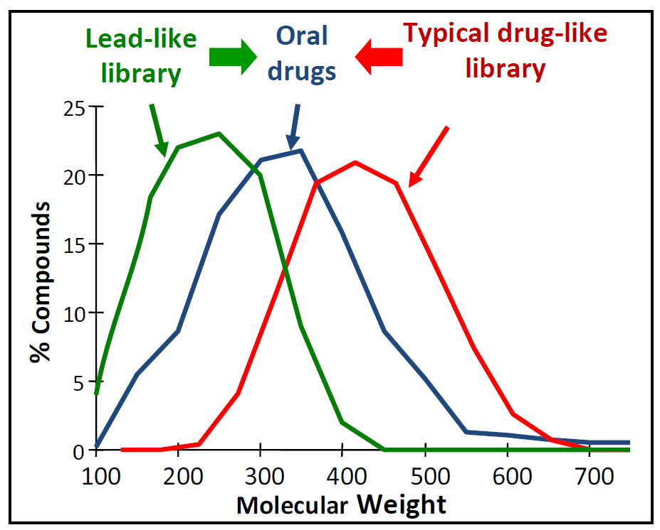
What happens during optimisation?
Optimization often results in increasing Mol Wt and modulating lipophilicity (cLogP) to deliver a lead and candidate drug
If a library is screened where the molecules have high Mol Wt then high potency compounds may be found – but they are hard to optimize
Small Mol Wt “lead-like” molecules have a better chance of binding to a receptor than larger drug-like molecules and may have weaker potency – but they are easier to optimize
Focus on a screening library or hits that are “Lead-like” will give a greater chance of success
Teague, S.J.; Davis, A.M.; Leeson, P.D.; Oprea, T. The Design of Leadlike Combinatorial Libraries. Angew. Chem. Int . Ed. 1999, 38, 3743-3748

Slide 10
What makes a good hit?
Potency and selectivity
Drug-like properties including low Molecular Weight (MW) and low lipophilicity (LogP)
Synthetic accessibility and versatility
No undesirable groups
Freedom to Operate (FTO) and Intellectual Property (IP) space

Slide 11
Potency
Potency is the measure of compound activity and reflects the thermodynamics of a compound binding to a biological target
Governed by ΔG=ΔH-TΔS
ΔH enthalpy – bond breaking (i.e. desolvation) and bond forming (how well the drug binds to the target)
ΔS entropy – overall impact on disorder of the system
Most, but not all, drugs in the nM range
Weaker compounds require higher concentrations to efficiently interact with target leading to increased chances of off-target effects
Potency impacts dose size
Potency is NOT the only game in town!

Slide 12
Ligand Efficiency (LE) – A measure of “Fit”
Binding contribution per non-H atom
“Goodness of fit”
Optimising a low LE hit has risks
Poor, non-optimal fit to target; Potency gained by bulk and not specific interactions
LE = -RTlnKi HA = no. of Heavy atoms i.e. non-H atoms
HA R = Gas Constant (0.001987kcalK⁻¹mol⁻¹)
T = Temperature in Kelvin
Ki = Potency in M
LE = pIC₅₀*1.37/HA [pIC₅₀ is -Log₁₀(IC₅₀)]
Has units kilocalories per mole per non-H atom
Lipophilicity Ligand
Efficiency
LLE = pIC50 - LogD

Slide 13
Mentimeter: Which molecule would you rather work on?
Ki = 100nM
Ki = 10,000nM

Slide 14
Which molecule would you work on?
Ki = 100nM
Heavy atoms = 37
LE = 0.26
Ki = 10,000nM
Heavy atoms = 18
LE = 0.38

Slide 15
Selectivity
At Hit stage it is most critical to understand the selectivity over the most relevant off-targets
Cellular selectivity >10 fold over cytotoxicity in hit
If biological target known, selectivity to closest human targets of concern, plus targets known to cause toxicity such as hERG
Helps to define the scale of the challenge for Hit-to-Lead
Selectivity can be altered with chemistry – so criteria increase with later phases
What selectivity window is needed ultimately?
Depends on impact of non-selectivity!
Need to define what assays are used to define selectivity
At least 100-1000 fold selectivity typical goal for a candidate
hERG – 30 fold margin based on IC₂₀ vs free Cmax at therapeutic dose

Slide 16
Lipophilicity (LogP)
Partition coefficient is called LogP
Measure of lipophilicity or degree to which a compound will partition into ‘fatty’ tissue vs water
Add Compond to Aqueous
Measure analyte in aqueous phase before and after shaking with organic solvent.
P = conc in org = 18 = 9
conc in aqu 2
LogP = Log₁₀P = 0.954
clogP = calculated LogP
organic
solvent
i) mix
ii) separate
buffer

Slide 17
Solubility
Why is solubility important?
Drugs must be in solution to be absorbed
What solubility do I need?
Depends upon route of administration – e.g. oral versus IV
Related to dose size
Higher potency means lower solubility tolerated
Thermodynamic solubility measure is best, but kinetic OK for trends
Remember that compound that resembled brick dust? Forget it!
A compound is more soluble as its partitioning into water increases i.e. lower logP the better
If a compound is ionized to an acid or base – more soluble
LogD is distribution coefficient and corrects LogP for ionization
High melting point lowers solubility

Slide 18
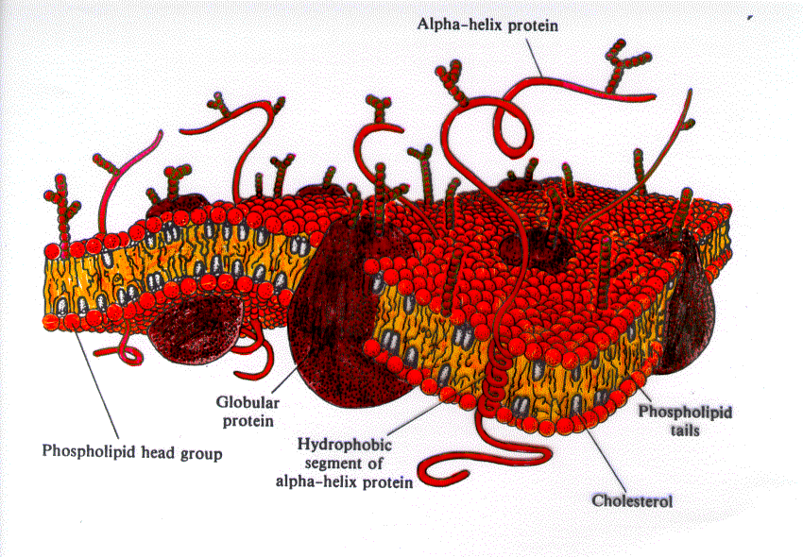
Permeability
tPSA =
Topological
Surface
Area

Slide 19
Lipinski’s Rule of 5
Empirical rule, based on observation (marketed drugs) of physicochemical Assessment of orally bio-available drugs
Poor absorption is likely when molecule has
>5 Hydrogen-bond donors (NH, OH)
>10 H-bond acceptors (Heteroatoms)
cLogP >5
MW >500
Oral drugs need to be ADME compliant
Absorption, Distribution, Metabolism, Elimination
Also called DMPK – Drug Metabolism, Pharmacokinetics
C. Lipinski and A. Hopkins, Nature, 432, 855-861, (2004)

Slide 20
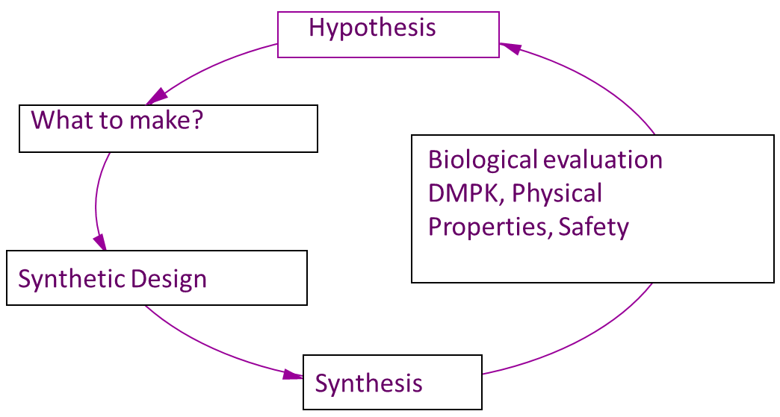
Synthetic accessibility and versatility
The central engine of a drug discovery project is the Hypothesis-design-make-test cycle
If a chemical series’ synthesis is inaccessible the cycle cannot complete or is drastically slowed down
Feasibility to modify the chemical structure at different points – synthetic versatility – important to explore scope of series
Drug

Slide 21
Undesirable groups and toxicophores
Includes groups known to:
Be reactive
Be unstable
Be Toxic
Give rise to toxic species on metabolism
Lead to rapid metabolism and excretion
Have caused clinical candidates to fail
Such chemistry should be avoided or optimised out in Hit Generation

Slide 22
Freedom to Operate and Intellectual Property
Important to know if a hit series has been published
Chemical substructure searches of literature
Provide information on novelty and known pharmacology of series
if not novel – information can help with synthesis, other biological activity and competition
If the project plan is to ultimately file a patent application, then the compounds patented must be novel and inventive
No issue if series is novel from the outset – just need to keep confidential
If not novel, then chemistry will need to factor this in as an additional constraint
Must not publish or disclose novel chemical structures and data before patent application filed

Slide 23
Hit-to-Lead
Phase to drive project towards target product profile, addressing key issues along the way
Aim is to validate chemical series as being able to deliver a compound meeting the profile by showing the series is:
Potent and Selective
Drug-like (physicochemical)
Drug-like (DMPK/ADME)
Potential for acceptable safety
At lead stage the optimal profile does not have to exist in one compound, but each component should exist within the series
Scope to deliver a candidate is believed to exist

Slide 24
DMPK
DMPK = Drug Metabolism and Pharmacokinetics
ADME = Absorption, Distribution, Metabolism and Elimination
PD = Pharmacodynamics
Pharmacokinetics is what the body does to a drug
Want appropriate PK in animals (for efficacy and safety studies) and then to optimise, based on predicted human PK, to a candidate drug
Pharmacodynamics is what the drug does to the body
Want to predict what drug concentration/ exposure results in efficacy
Demonstrate efficacy at those concentrations in disease model
Predicted human efficacious concentration defines human dose target
https://wcair.dundee.ac.uk/training/training-resources/basicsofdmpk/

Slide 25
DMPK: Oral Dosing
To be active, oral drugs must:
dissolve
survive range of pH (1.5-8)
survive intestinal flora/ fauna
cross membranes
survive liver (oxidation and conjugation)
avoid active transport to bile
avoid excretion by kidneys
partition into appropriate place(s)
bladder
kidneys
BBB
bile
duct
liver

Slide 26
Lead Optimisation
This phase fine tunes properties of the series such that the entire package is present in one or more compounds
Optimisation of all properties, using the same or similar assays as used in Hit-to-Lead
Often requires synthesis and in-depth evaluation of a large number of related analogues
Can be expensive owing to the large number of complex studies required
These are usually built in at the latter stages owing to low through-put or high cost of such tests which limits numbers of compounds that can be tested
Candidate Criteria should be clearly defined

Slide 27
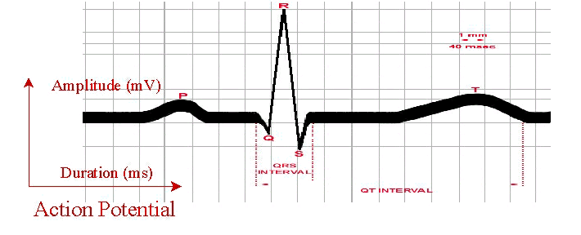

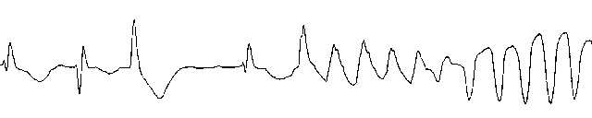
Additional studies: QT effects & Genotoxicity
30% of post-marketing withdrawal of drugs has been attributed to QT prolongation
Majority inhibit the IKr current mediated by hERG channels
IKr - 'rapid' delayed rectifier current that conducts potassium (K+) ions out of the muscle cells of the heart
Ames test used to assess the mutagenic potential of chemical compounds
Uses well characterised bacterial strains

Slide 28
Additional studies: CMC (Chemistry Manufacturing and Control)
Cost of goods
Criterion will depend on dose and therapy area
Chemical stability
Check for decomposition in a range of situations to mimic the intestine
Shelf-life stability
Compound subjected to humid conditions at elevated temperature to mimic accelerated shelf storage
Crystal form
Salt selection (for acidic or basic drugs) or co-crystal
Potential look at polymorphic forms to find the most stable polymorph
Solubility and F% then measured with correct final form

Slide 29
Drug discovery into drug development
A candidate drug is an experimental “drug”
Still a lot to do before it is a drug
No direct evidence it is safe in animals let alone humans
No direct evidence it works in real patients
Clinical trials
Long, expensive and littered with failure
Main causes of clinical failures are
Efficacy – it doesn’t work! (~55%)
Safety – unexpected toxicity (~30%)
Safety and efficacy – risk/ benefit – assessed by independent stringent regulatory authority

Slide 30
Non-clinical studies and Clinical trials in humans
Preclinical development – 12-24 months
GLP rodent and non-rodent and other safety studies, GMP scale-up
Phase I – 3-9 months
Healthy volunteers – safety, PK and maximum dose (20-80 male volunteers)
Phase IIa – 6-12 months
Patients – safety and efficacy (100-200 patients)
Phase IIb – 12-24 months
Patients – safety and efficacy (200-500 patients)
Phase III – 2-4 years
Patients – safety efficacy (up to 3,000 patients)
Phase IV – Post approval studies to monitor for safety

Slide 31
Summary
Drug Discovery is all about finding the ‘sweet spot’ where all properties necessary for a drug come together
Candidate drug and target must be consistent with the TPP
The principles and art of drug discovery are consistent regardless of biological target or disease
Specific disease biology knowledge necessary
Regulators or patients do not care whether a drug was discovered in Pharma or Academia
The data packages, compound/ science quality have to be the same
Drug discovery is multi-disciplinary and highly collaborative in nature
Asking for help and advice is not a weakness

Slide 32
References
Pharmacokinetics and metabolism in drug design – D.A.Smith, H. van de Waterbeemd and D. K. Walker. Wiley-VCH, ISBN 3-527-30197-6
The organic chemistry of drug design and drug action. R.B.Silverman. Academic Press, ISBN 978-0126437324
Goodman and Gilman’s The pharmacological basis of therapeutics. L. Brunton, J. Lazo, K. Parker. McGraw-Hill Medical, ISBN 978-0071422802
Drug Discovery handbook – S. C. Gad (Ed). Wiley (2005), ISBN ISBN 0-471-21384-5
Principles of early drug discovery – S. Rees at al, Br J Pharmacol. 2011 Mar; 162(6): 1239–1249
Drug discovery process - https://www.youtube.com/watch?v=DhxD6sVQEYc

Slide 33
Think with the end in mind: TPP Work on the right biology Many options to find chemistry – validation of series is key Optimisation is not just about potency DMPK and safety too determine whether you have a drug

Slide 34
Practical lessons from a lifelong quest to discover medicines
You need a thick skin: the science will beat you with a stick every day
Stay humble
And yet: you are constantly exposed to magic; the science is continually mind-blowing
Helping make drugs that save people’s lives: indescribable
Stay positive
Keep learning, try new things, think big, take chances
Biology is what usually gets you
Work hard, sweat the details, avoid unforced errors
Structure can help you—and so can cellular phenotype
Integrate everything: technologies, disciplines, hypotheses, mindsets,literature data, you name it
Teams make drugs. Great teams behave in predictable ways and thrive in supportive environments. But teams are complex—and the interpersonal stuff is at least as important as the science
Luck is a big factor in all our successes. Did I mention that you need to stay humble?
Good fortune in our lives enables all we accomplish—pay it forward
Mark Murkco, Medicinal Chemistry Reviews, 2022, 57, 27

Slide 35
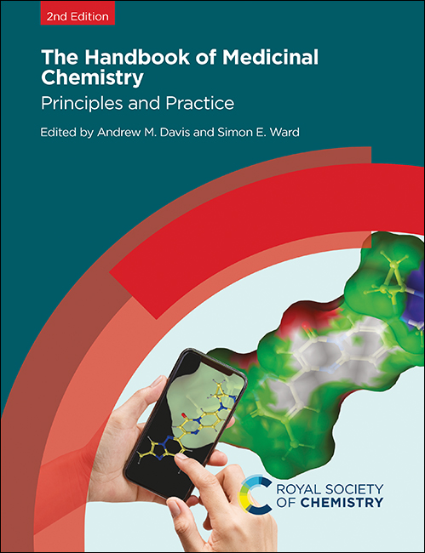

Slide 36
Abbreviations
Target: biological molecule, usually a protein, whose function is to be modulated
Hit: small molecule with promising activity in a primary screening assay
Lead: molecule with suitable properties for optimization to give a drug candidate
Candidate: molecule selected for development – no further optimisation
Asset: a molecule or project with value associated with its stage in the pipeline
Pipeline: an organisation’s ensemble of projects at various stages
TPP: Target Product Profile – description of the required drug
KO: Genetic Knockout (usually mouse)
FTIH: First Time in Human (aka Phase I Clinical Trial) – safety assessment in healthy volunteers
PoC: Proof of Concept (aka Phase II Clinical Trial) – compound/mechanism gives desired clinical response
NOAEL: No Observed Adverse Effect Level
MTD: Maximum Tolerated Dose
MW/MWt: Molecular Weight
MED: Minimum Effective Dose
HTS: High Throughput Screen
SAR: Structure-Activity Relationship – relationship between the compound’s structure and its activity
DMPK: Drug Metabolism & Pharmacokinetics – how the drug is handled by the body
ADMET: Absorption, Distribution, Metabolism, Elimination or Excretion, Toxicology
PD: Pharmacodynamics – the activity of the drug in an animal or patient
DDI: Drug-Drug Interaction – the effect of one drug on another, e.g. blocking or increasing metabolism
LO: Lead Optimisation

