Slide 1
Drug Discovery and Development Course
Introduction to Clinical Pharmacometrics
Mwila Mulubwa

Slide 2

Terms of Use – CC BY 4.0 License
These materials are shared to support teaching, research, and presentation activities across the GC ADDA community. All content is provided under the Creative Commons Attribution 4.0 (CC BY 4.0) license, which allows you to use, share, adapt, and build upon the material freely, including for commercial purposes. Please ensure that any use includes proper attribution to the original creators, indicates any modifications you make, and maintains the same open license. No additional restrictions may be applied.
Credit the author(s) as follows:
CC BY 4.0 [Mwila Mulubwa, H3D University of Cape Town, South Africa]

Slide 3
Learning objectives
Define pharmacometrics and describe it’s key components.
Understand the role of pharmacometrics in drug development and clinical decision-making.
Understand the importance of mathematical modelling in drug dosing, efficacy, and safety optimization.
Identify tools and software used in pharmacometrics.

Slide 4
Pharmacometrics
The science of quantitative pharmacology.
Clinical trial design
Population PK modelling
Pharmacometrics
Dose regimen optimization
PK-PD modelling
Stochastic Simulation
Optimal experimental design
Use of models based on pharmacology, physiology and disease for quantitative analysis of interactions between drugs/compounds and organism.
It combines principles of pharmacology, mathematics and statistics.

Slide 5
Key components of pharmacometrics
Population pharmacokinetics (PopPK)
Pharmacodynamics (PD) modelling
Disease progression modelling
Model simulation

Slide 6
Pharmacometrics in clinical practice
Therapeutic drug monitoring: Adjusting dosages of drugs with narrow therapeutic windows to ensure efficacy while minimizing toxicity.
Individualized dosing – Helps tailor drug dosages based on patient-specific factors like age, weight, organ function, and genetics, leading to personalized medicine.
Drug development and regulatory decisions: Supports the development of new drugs by predicting efficacy and safety.
Disease progression modelling: Helps in predicting the disease progression and treatment response.
Pediatric and geriatric dosing: Addresses challenges in drug dosing for special populations where clinical trials are limited.
Optimizing clinical trials: Enhances the design of clinical trials by simulating optimal sample size and dosing regimens.

Slide 7
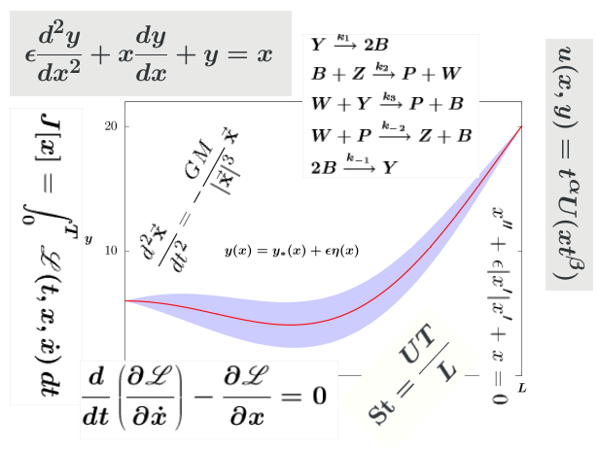
Mathematical model
"You cannot understand the physical world in any deep or satisfying way without using mathematical reasoning." R. P. Feynman
"No human investigation can be called real science if it cannot be demonstrated mathematically." Leonardo da Vinci.
Abstract description or representation of a system.
Modelling in pharmacometrics refers to the process of creating a mathematical representation of a real-world scenario (e.g. time profiles of drug concentration or biomarker) to make a prediction or provide insight.

Slide 8
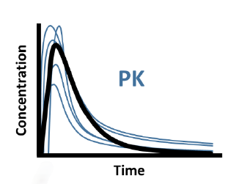
Population pharmacokinetics (PopPK)
Study of the sources and correlates of variability in drug concentrations in a patient population receiving clinically relevant doses.
Body weight
Age
Sex
Genetics
Disease e.t.c

Slide 9
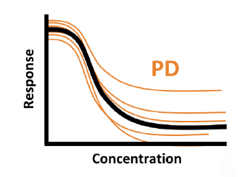
Pharmacodynamics (PD)
Models describing relationship between drug concentration and effect (desirable and undesirable).
Effect may be immediate (proportional to the exposure e.g. Cmax or AUC).
Delayed (effect seen some time after drug exposure).

Slide 10
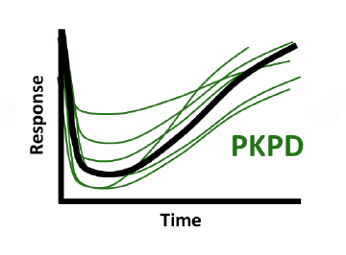
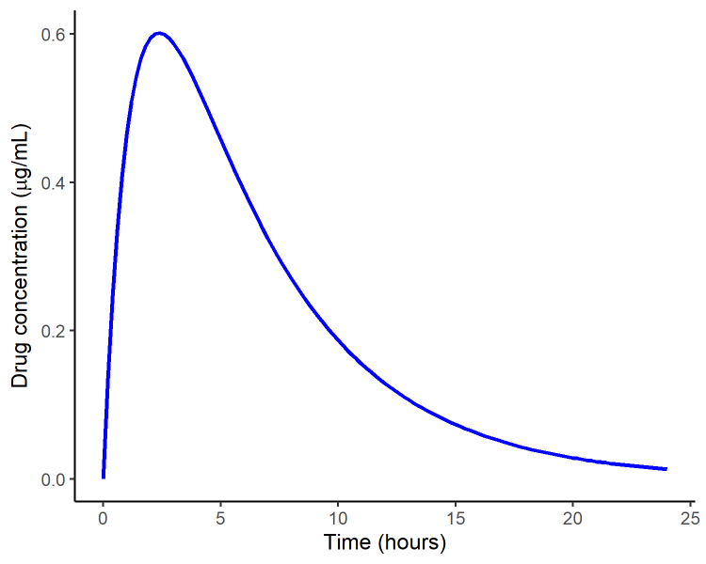
PK-PD relationship
ABSORPTION
DISTRIBUTION
ELIMINATION
Metabolism
& Excretion
Dose
Drug in blood
Drug at active site
PHARMACODYNAMIC EFFECT
10

Slide 11
Disease progression model
A disease progression model describe how a disease develops over time in an individual or population.
It helps predict the stages, severity, and outcomes of a disease by incorporating various biological and clinical factors.
Can be linked to pharmacokinetics to model cure.

Slide 12
Modelling tools
MonolixSuite version 2024R1 (https://lixoft.com/products/)
Monolix (nonlinear mixed-effects modelling)
Simulx (Monte Carlo simulation)
Pkanalix (Noncompartmental analysis
MxlEditor (Writing or editing model scripts)
Sycomore (Model comparisons and evaluation)
Datexplore (Data exploration)
R environment (https://cran.r-project.org/)
R Studio (https://posit.co/download/rstudio-desktop/)
Parkages: dplyr, ggplot2, gridExtra

Slide 13
Thanks!

Slide 14
Your key idea / concept / question

