Slide 1
Drug Discovery and Development Course
In vivo pharmacokinetics
Franco Lombardo
February 13, 2025

Slide 2

Terms of Use – CC BY 4.0 License
These materials are shared to support teaching, research, and presentation activities across the GC ADDA community. All content is provided under the Creative Commons Attribution 4.0 (CC BY 4.0) license, which allows you to use, share, adapt, and build upon the material freely, including for commercial purposes. Please ensure that any use includes proper attribution to the original creators, indicates any modifications you make, and maintains the same open license. No additional restrictions may be applied.
Credit the author(s) as follows:
CC BY 4.0 [author, institution]

Slide 3

Key objectives
What are VD and clearance?
How do we estimate them?
Are transporters involved?
What is DDI?
Some renal physiology and excretion points to remember.

Slide 4

Why study PK?
“Good”
Pharmacokinetics
The roots of our ADME worries!
Convenient
Dosing Regimens
Higher Patient
Compliance
Better
Efficacy
One definition of drug-like could be “pharmacokinetics friendly” as we have to deliver these drugs to humans...therefore we need to reason about pharmacokinetics. (Zhao, DDT, 2011, 64, 158-163).
Competitive
Advantage

Slide 5
How do we study it? Well…with models!
Non-compartmental
Physiologically-based PK
REVIEW of PK/PD
Jusko, J. Pharm. Sci. 2013, 102, 2930-2940.
TWO OTHER REFS 2023. IN ADDITIONAL INFORMATION?
Compartmental
Fan J, de Lannoy IA, Pharmacokinetics Biochem Pharmacol. 2013, 87, 93-120
Nice and condensed review of PK and PD

Slide 6
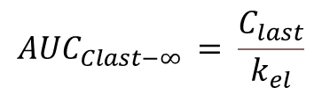
Non-Compartmental Analysis
Trapezoidal Rule for AUC calculation
(Typical plot for an iv dose)
(C_{o} is not measured experimentally but estimated by regression)
(Typical plot for an extravascular dose)
Generally, C_{last}
$${AUC}_{Clast−∞ }= \frac{C_{last}}{k_{el}}$$
Linear trapezoids (shown) or log-linear trapezoids
k_{(el)} is elimination rate constant which is calculated via linear regression of the terminal phase of PK curve.

Slide 7
Extravascular administration: rates and phases
Rate of absorption > rate of elimination
Cmax
Rate of absorption ≈ rate of elimination
Rate of absorption < rate of elimination
Rate of absorption ≈ 0 (no drug left in GI tract or site of administration) rate of elimination dominates this region
Tmax

Slide 8
Absorption and bioavailability
Absorption and Bioavailability are not interchangeable
Bioavailability (BA or F) is defined as:
F = AUC_{route1}/ AUC_{route2} * Dose_{route2}/Dose_{route1}
if route 2 (reference) is intravenous then the BA is defined as “absolute”
If not, then we talk about relative BA or F, and F is generally defined as the result of
F = f_{a}*f_{g}*f_{h}
Where f_{a}, f_{g} and f_{h} are, respectively, the fraction absorbed, the fraction escaping gut metabolism and the fraction escaping first-pass liver metabolism.
Bioavailability may also be influenced by food either negatively (Cmax and/or AUC w/food) or positively ( Cmax and /or AUC w/food)
A single species cannot generally be considered predictive of human, watch for dose, formulation as well as particle size and species-specific factors. Musther et al. Eur. J. Pharm. Sci. 2014, 57, 280-291. However, we generally consider an average of multiple species F as a reasonable approximation.

Slide 9
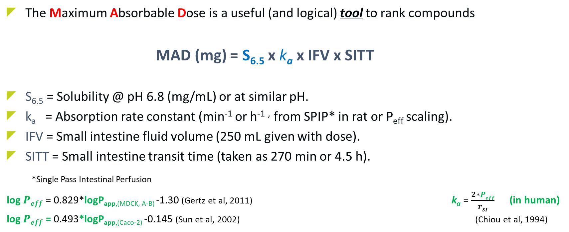
Getting…M.A.D.
The Maximum Absorbable Dose is a useful (and logical) tool to rank compounds
MAD (mg) = S_{6.5} x k_{a} x IFV x SITT
S_{6.5} = Solubility @ pH 6.8 (mg/mL) or at similar pH.
k_{a} = Absorption rate constant (min⁻¹ or h⁻¹ , from SPIP* in rat or P_{eff} scaling).
IFV = Small intestine fluid volume (250 mL given with dose).
SITT = Small intestine transit time (taken as 270 min or 4.5 h).
*Single Pass Intestinal Perfusion
log $Peff$ = 0.829*logP_{app,(MDCK, A-B)} -1.30 (Gertz et al, 2011) k_{a} = $\frac{2∗Peff}{rSI}$ (in human)
log $Peff$ = 0.493*logP_{app,(Caco-2)} -0.145 (Sun et al, 2002) (Chiou et al, 1994)
NOT “UNIVERSAL”…DATA DEPENDENT
MAD: K. C. Johnson et al. Pharm. Res. 1996, 13, 1795-1798; Hintz and Johnson Int. J. Pharm. 1989, 51, 9-17; W. Curatolo, PSTT, 1998, 1, 387-393. (A very good “applied” description).
P_{app}, P_{eff} and k_{a}: Chiou, W. L., Biopharm. Drug Disp. 1994, 15, 709-717; Sun D et al. Pharm. Res. 2002,19, 1400-1416; Lennernas H., Xenobiot. 2007, 37, 1015-1051; Gertz M. et al. Drug Metab. Dispos. 2011, 39, 1633-1642

Slide 10
The quest for CNS drugs
Loryan et al. Unbound Brain-to-Plasma Partition Coefficient, K_{p,uu,brain}-a Game Changing Parameter for CNS Drug Discovery and Development. Pharm Res. 2022 39, 1321-1341
Loryan et al. Brain Distribution of Drugs: Pharmacokinetic Considerations. Handb Exp Pharmacol. 2022, 273, 121-150.
de Lange ECM et al. Understanding the Blood-Brain Barrier and Beyond: Challenges and Opportunities for Novel CNS Therapeutics. Clin Pharmacol Ther. 2022, 4, 58-773.
Kettle J et al. Discovery of AZD4747, a Potent and Selective Inhibitor of Mutant GTPase KRASG12C with Demonstrable CNS Penetration J. Med. Chem. 2023, 66, 9147−9160
Other references in back up slides
Strategies for Structural Modification of Small Molecules to Improve Blood−Brain Barrier Penetration: A Recent Perspective
Xiong et al, J. Med. Chem. 2021, 64, 13152−13173

Slide 11
Some words of wisdom about K_{p,uu} and BBB
*How Much is Enough? Impact of Efflux Transporters on Drug delivery Leading to Efficacy in the Treatment of Brain Tumors
Wenjuan Zhang · Ju‑Hee Oh · Wenqiu Zhang · Sneha Rathi · Jiayan Le · Surabhi Talele · Jann N. Sarkaria · William F. Elmquist
Pharm. Res. 2023, 40, 2731–2746
“In another words, is there a numerical cutoff value for K_{p,uu} for potentially effective treatment of brain tumors? The short answer is NO.”
Sato, et al. Translational CNS Steady-State Drug Disposition Model in Rats, Monkeys, and Humans for Quantitative Prediction of Brain-to-Plasma and Cerebrospinal Fluid-to-Plasma Unbound Concentration Ratios. AAPS J, 2021, 23: 81
“These results suggest that the use of Kp,_{uu,CSF} as a surrogate of _{Kp,uu,brain} in rats, monkeys, and humans will have to be reconsidered especially under which conditions Kp,uu,CSF can be assumed to equal Kp,uu,brain.”
“In addition, the MDCK-MDR1 cell line was selected to determine the in vitro efflux activity for MDR1 in these models because we previously observed that MDCK-MDR1 had superior sensitivity in efflux ratio and correlated well with the brain disposition of different compounds.”
Main points
K_{p}(total) is not useful and may be misleading.
There is no ABSOLUTE threshold for K_{p,uu} what is your potency?*
K_{p,uu CSF} may be appealing as it is measurable in human, but it is typically higher (some 3-fold) than K_{p,uu,brain}.
DO NOT “CONDEMN” a compound o the basis of BCRP and/or MDR1 efflux. Think of risperidone and paliperidone!
Doran et al, Drug Metab Dispos 2005, 33, 165–174.

Slide 12
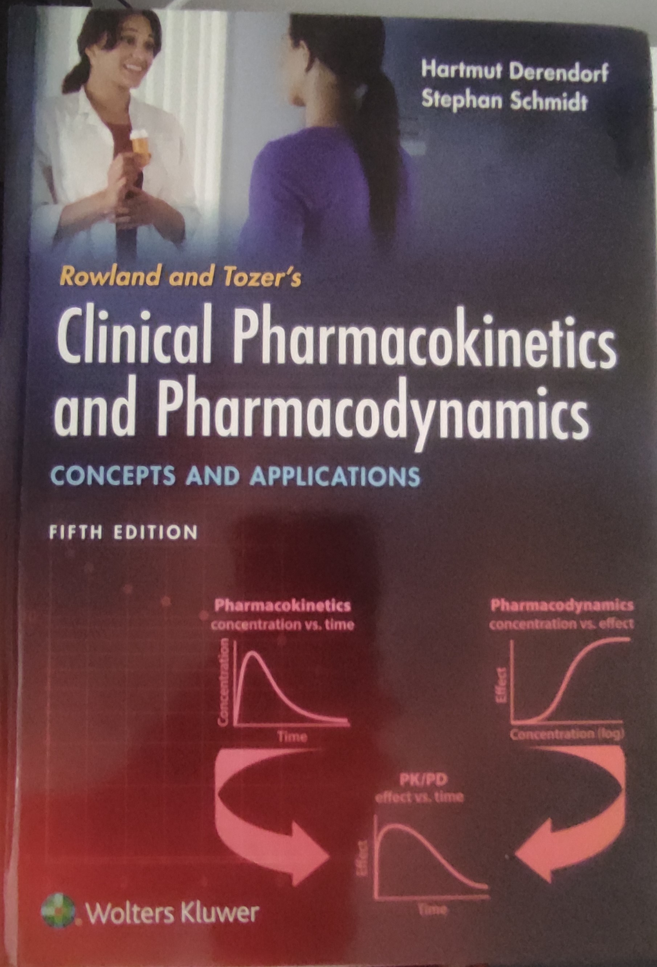
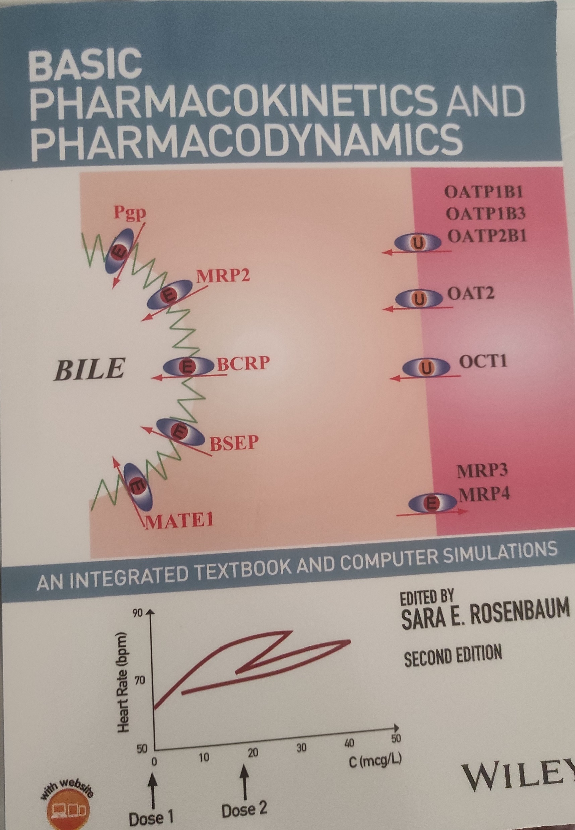

Compartmental Pharmacokinetic Analysis
Mathematical treatment of a two compartment PK model from iv dosing
IV injection
Distribution
Comp 1
Comp 2
Elimination
Mathematical equations associated with a two-compartment PK model (most often used)
(sometimes there is the need to use a more complex three compartment PK model)
Differential equation
Integral equation

Slide 13
Compartmental Pharmacokinetic Analysis
Example of a compound with one compartment PK model
Example of a compound with two compartment PK model
NOTE THE LOGARITHMIC SCALE OF CONCENTRATION
NOTE THE LOGARITHMIC SCALE OF CONCENTRATION

Slide 14
PBPK-Models
Lin, Chen et al. Pharm Res 2022, 39 1701-1731
They mentioned Gastroplus ®, SIMCYP ® and PK-SIM ® and offered a thorough discussion of challenges and opportunities
https://www.simulations-plus.com/software/gastroplus/pbpk-software/

Slide 15
PBPK-Models
Mathematical model that integrates compound specific data (e.g., lipophilicity, particle size, permeability etc.) with physiology (system specific parameters such as blood flow, tissue volumes etc.) to model, fit and predict PK of compounds
PBPK models composed of many compartments corresponding to the different tissues of the body, e.g., adipose, bone, brain, gut, heart, kidney, liver, lung, muscle, skin, and spleen, which are connected by the circulating blood system (arterial and venous)
See for example Jones HM et al, AAPS J, 2009, 11, 155-166
However,
The complexity of PBPK models, which include many
adjustable parameters, mandates the definition of a consistent
model building strategy and best practice guidance.
We believe that a consistent PBPK strategy for FIH predictions,
based on best practices and experience across companies,
should increase the confidence of regulatory agencies
in this application.
Miller NA et al. Clin. Pharmacokin. 2019, 58, 727-746
See also: PBPK Analyses, Format and Content Guidance for Industry, FDA, August 2018
For a very recent discussion and retrospective analysis on Genentech compounds see : Mao et al. Biopharm. Drug Dispos 2023, 44, 315-334

Slide 16
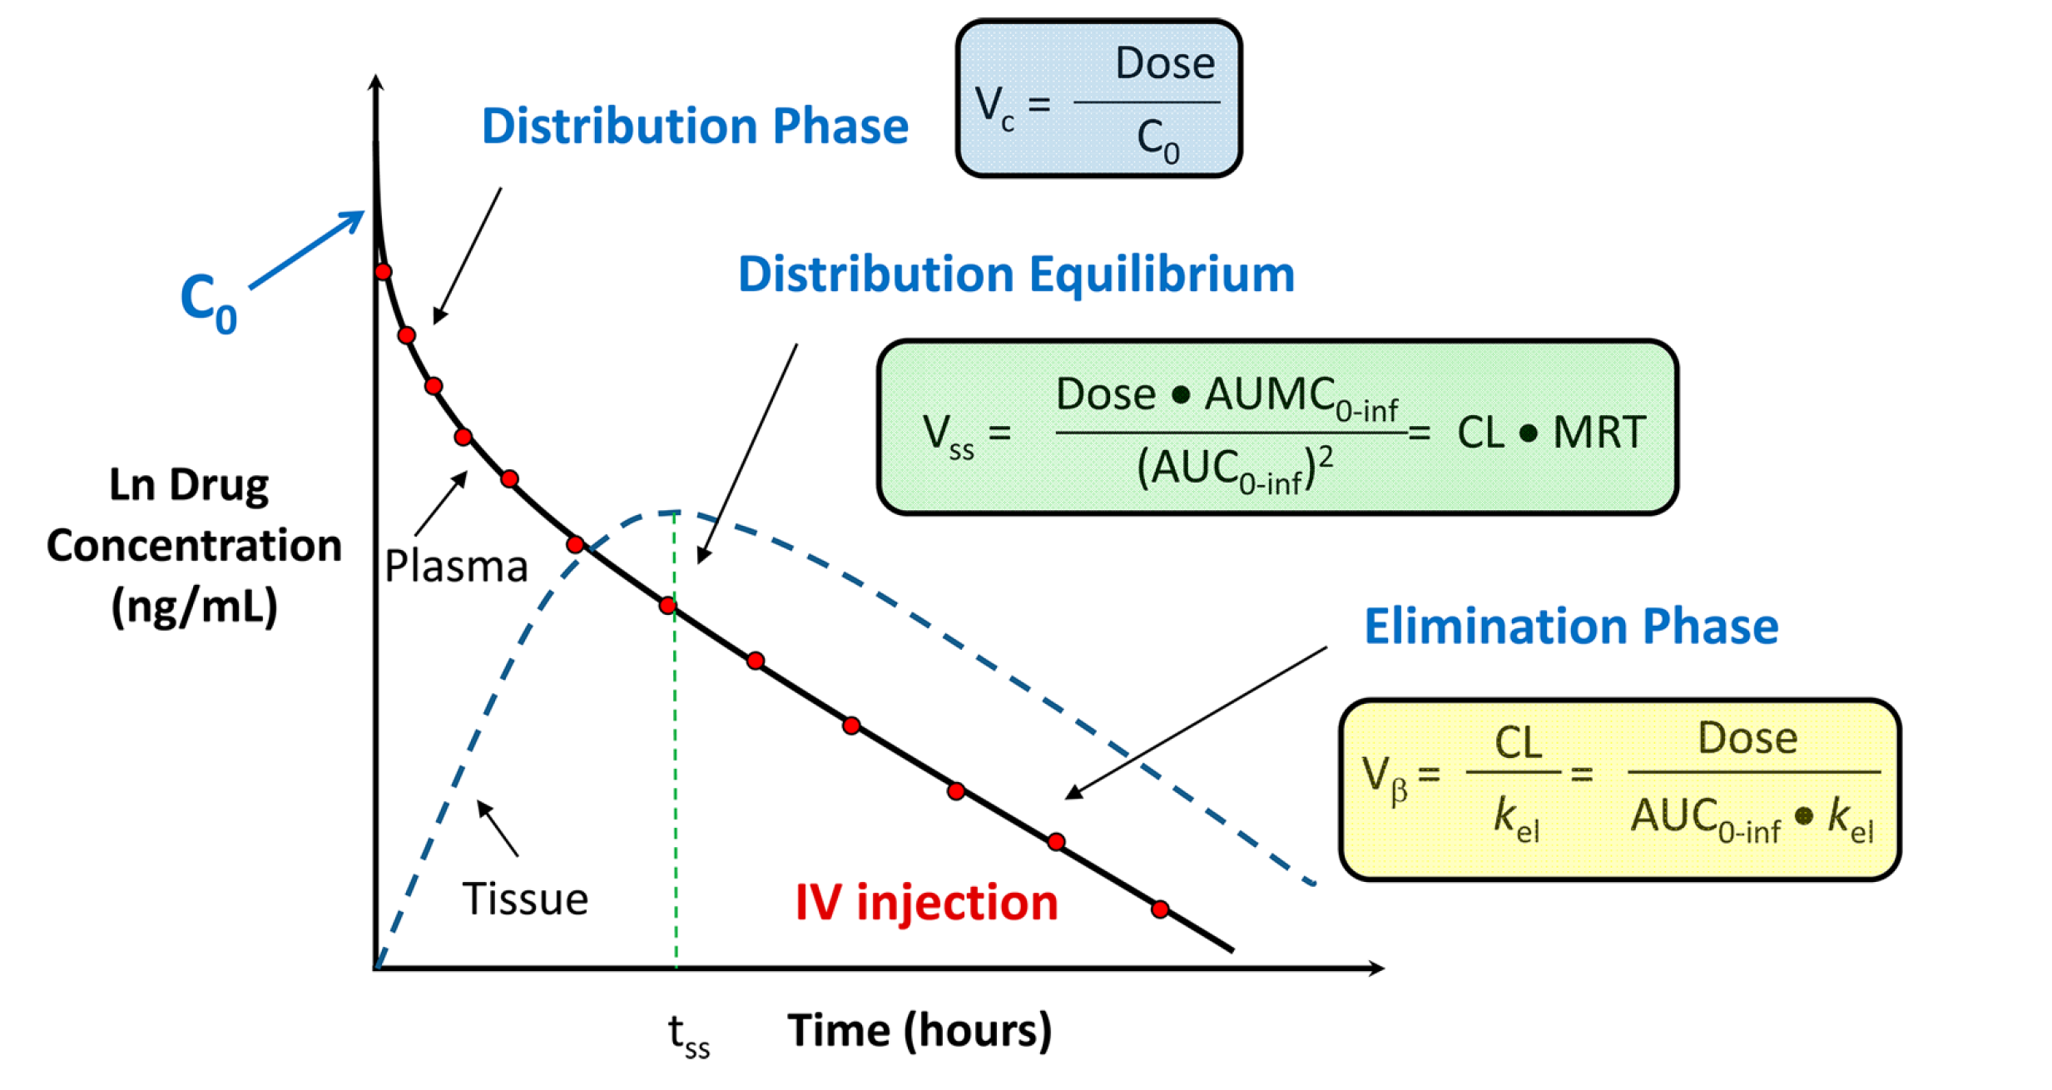
PK Parameters: Volume of Distribution
The various types of VD and
their determination
A proportionality constant between dose and concentration
In vivo: from plasma data.
Reproduced from: Smith, Beaumont, Maurer and Di. Volume of Distribution in Drug Design J. Med. Chem. 2015, 58, 5691-5698.
“Accurate V_{ss} prediction is still an evolving field.”
Mathew et al. J. Pharm Sci 2021, 110, 1799-1823
SOME PHYSIOLOGICAL VOLUMES
Hsu, Chen and Broccatelli Drug Metab Disp 2021, 49, 330-336.
Berellini and Lombardo, Drug Metab Disp 2019, 47, 1380-1387
Lombardo, Bentzien, et al. J. Pharm. Sci. 2021, 110, 500-509

Slide 17
PK Parameters: Clearance
(Predominantly) Distribution
Dose - After dosing directly into blood stream (e.g., i.v.)
Total exposure - Area under the concentration vs. time curve
(Predominantly) Elimination
Dose
CL_{TOT} =
Area Under the curve
Most important PK parameter and is a measure of drug elimination from the body. Defined as the volume of biological fluid that is cleared of drug per unit of time (unit of mL/min or L/hr) or per unit of time and unit of weight (mL/min/kg).
CL is measured after systemic (IV) administration of a compound. CL following non-systemic administration (PO, SC, IM or IP) is called apparent CL (CL/F)
Clearance is additive!
Cl_{TOT} = Cl_{met} + Cl_{ren} + Cl_{biliary} +…..
Rate of elimination is independent of fluid where it was measured
Rate = Cl_{bl}*C_{bl} = Cl_{pl}*Cl_{pl}
Some diagnostics possible knowing hepatic blood flow of species (human 20.7 mL/min/kg)
Basic Pharmacokinetics and Pharmacodynamics, 2nd ed. S. Rosenbaum Ed., Wiley, NY 2017.

Slide 18
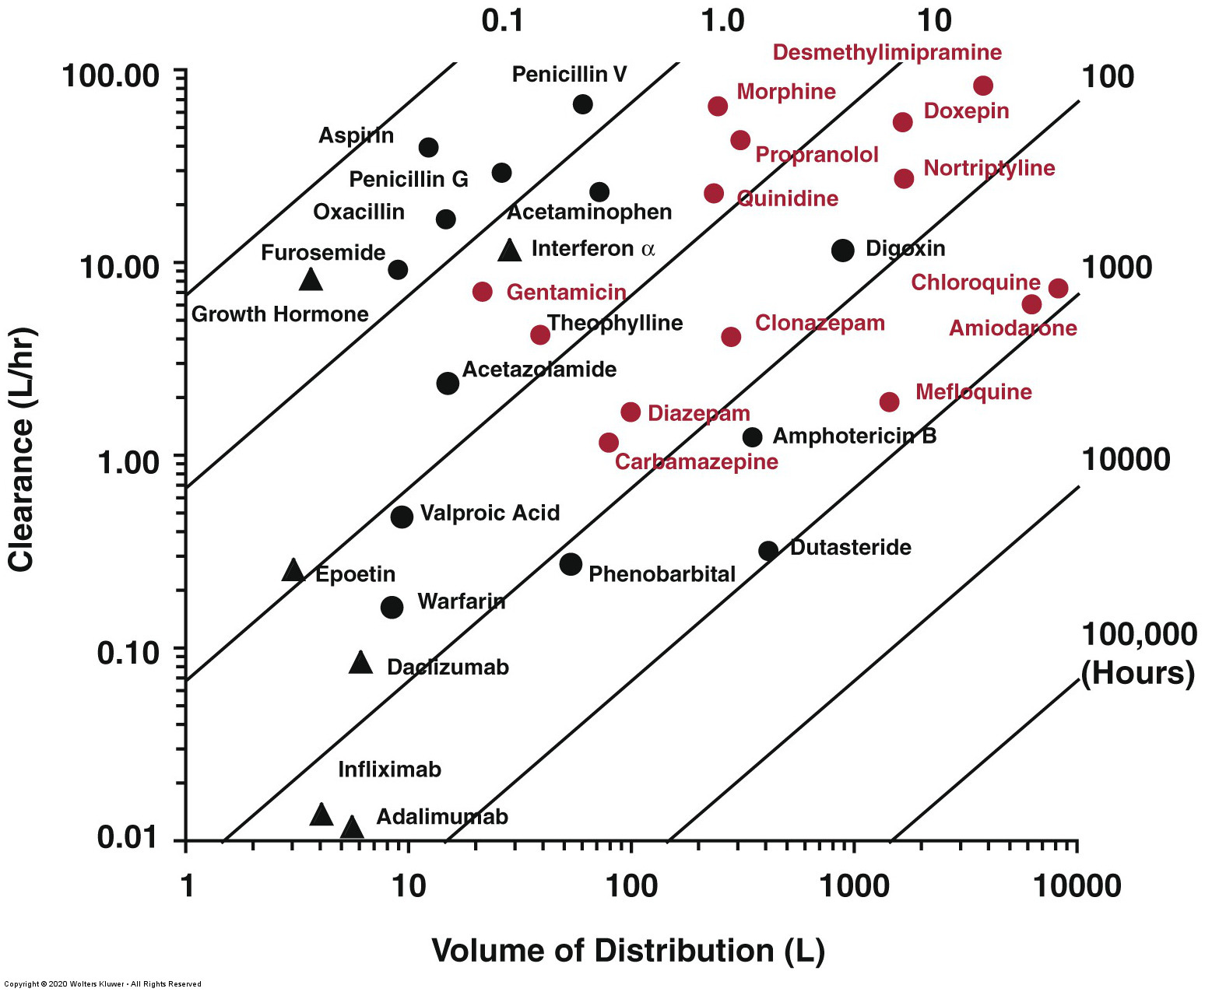
PK PARAMETERS: HALF-LIFE (t_{1/2})
In blood (or plasma)
t_{1/2} = 0.693 x VD_{β}
CL
MRT = VD_{ss}
CL
Basic compounds
Acidic compounds
Proteins
Digoxin is neutral while amphotericin B is zwitterionic
In the body
Q: why is this region not populated?
Figure 5-19 in Rowland and Tozer’s book. Ch. 5-Elimination

Slide 19
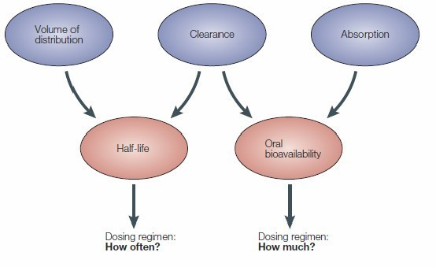
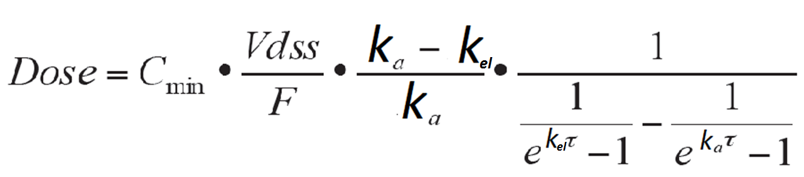


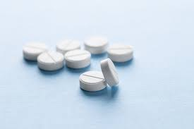
Human PK and dose prediction: the ultimate (lofty) goals!
Upstream or More Downstream? How Early?
80-90% accurate…..
within a factor of 10!
Equations from: K. M. Page, Validation of Early Human Dose Prediction: A Key Metric for Compound Progression in Drug Discovery. Mol. Pharm. 2016, 13, 609-620.
M. Wenlock, Profiling the estimated plasma concentrations of 215 marketed oral drugs. Med. Chem. Comm. 2016, 7, 706-719.

Slide 20
Some simpler estimation methods but…more approximated
Maurer, Smith, Beaumont and Li Dose Prediction in Drug Design
J. Med. Chem. 2020, 63, 6423−6435
Quantifiable reduction in disease severity

Slide 21
Human Dose Prediction: Forgotten Assumptions
The ultimate goal of discovery project teams is to determine Human Dose and Dosing Regimen which require prediction of human PK parameters.
Human PK parameters can be predicted via a variety of approaches.
Dose is determined utilizing predicted human PK parameters and a pharmacologically relevant concentration/target engagement/ target suppression which is likely to yield a beneficial therapeutic effect.
Important to remember both the PK and pharmacological assumptions applied in predicting human dose and uncertainty in translation of efficacy from pre-clinical studies to human!
Zou, Yu et al. Applications of Human Pharmacokinetic Prediction in First-in-Human Dose Estimation. AAPS J 2012, 14, 262-281. (Nice review of approaches to FIH)

Slide 22
Human Dose Prediction: Forgotten Assumptions
Barrow and Lindsley, J. Med. Chem. 2023, 66, 4273−4274
Another flawed comparison that is often employed is to administer several compounds in a series (with or without a positive control) at the same dose (e.g., 25 mg/kg) and drawing definitive conclusions. PK−PD is about exposure not dose!
The goal is to administer compounds so that they achieve comparable exposures and draw comparisons based on exposures relative to the EC50/IC50’s free (or, in rare cases total exposure).
Finally, and while not required, it is very informative to understand if in vivo efficacy is Cmax-driven or trough-driven, as this informs the necessary PK for a novel mechanism and translation to human use.
For some of the caveats, and potential errors, in determining IC50 and EC50 see:
Srinivasan and Lloyd, J. Med. Chem. 2024, 67, 17391-17934

Slide 23
Human Dose Prediction: Dose fractionation and recognition of PK driver
MIC = 650 ng/mL
TOTAL C_{max,ss} = 824 ng/mL
TOTAL C_{min,ss} = 681 ng/mL
TOTAL C_{max,ss} =1303 ng/mL
TOTAL C_{min,ss} = 312 ng/mL
For a recent example see : Vendeville et al J. Med. Chem. 2024, 67, 21126-21142
50 mg/kg qd less efficacious than 15 mg/kg bid

Slide 24
Dose fractionation and Wajima’s human dose prediction method.
Gibhard L, Njoroge M, Mulubwa M, Lawrence N, Smith D, Duffy J, Le Manach C, Brunschwig C, Taylor D, van derWesthuyzen R, Street LJ, Basarab GS, Chibale K. 2024.
Dose-fractionation studies of a Plasmodium phosphatidylinositol 4-kinase inhibitor in a humanized mouse model of malaria.
Antimicrob Agents Chemother 68:e00842-24.https://doi.org/10.1128/aac.00842-24

Slide 25
Human Dose Prediction: Forgotten Assumptions
Limitations of exposure data
Muller PY, Milton MN,
Nature Rev. Drug Discov., 2012 , 11, 751-761
First, plasma exposure is only a surrogate for tissue exposure, which is actually driving most pharmacological and toxicological effects. Using plasma exposure as a surrogate for tissue exposure assumes that free tissue exposure, in equilibrium, is similar to free plasma exposure, which is usually the case for drugs that have reasonable membrane permeability.
Furthermore, in certain cases, plasma levels of a drug may not directly correlate with efficacy.
…..this lack of correlation is because of saturable binding to the target ACE pool
…the dosing regimen and the duration of dosing may considerably affect the pharmacological and/or toxicological effects induced by the drug (for example, an intermittent dosing schedule is sometimes used for oncology drugs to decrease toxicity). This is true particularly for drugs with (predicted) short half-lives in humans and oral drugs with low solubility. A twice a day dosing regimen would also be envisaged in cases when lower doses given more frequently are used in an attempt to reduce (expected) Cmax- driven toxicities

Slide 26
Points to take home
1. Pharmacokinetics models: non-compartmental, compartmental and PBPK
2. Applications and some details: recognizing compartments.
3. Volume(s) of distribution, clearance (additive), AUC, t1/2 and MRT concepts.
4. Routes of administration and absolute vs. relative bioavailability.
5. The blood-brain barrier
6. Dose prediction: target exposure, caveats and assumptions. The Wajima method.

