Slide 1
Drug Discovery and Development Course
in silico approaches to drug design
Joe Eyermann

Slide 2

Terms of Use – CC BY 4.0 License
These materials are shared to support teaching, research, and presentation activities across the GC ADDA community. All content is provided under the Creative Commons Attribution 4.0 (CC BY 4.0) license, which allows you to use, share, adapt, and build upon the material freely, including for commercial purposes. Please ensure that any use includes proper attribution to the original creators, indicates any modifications you make, and maintains the same open license. No additional restrictions may be applied.
Credit the author(s) as follows:
CC BY 4.0 [author, institution]

Slide 3
Learning Objectives
Overview of in silico (CADD) resources
Integrating in silico methods with drug discovery data
Building strong relationships with drug discovery teams

Slide 4
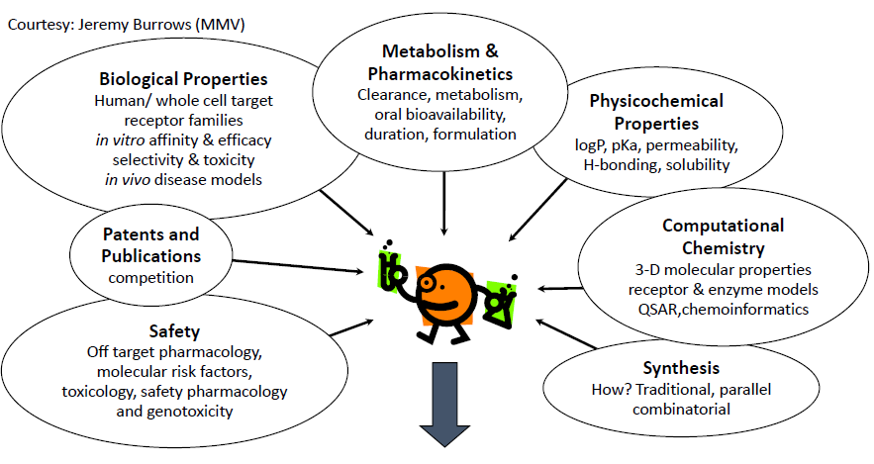
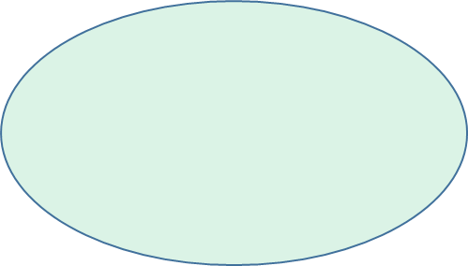
Drug Discovery Process
Being able to use all of the above information and knowledge to design a molecule
that overcomes any hurdles to become a drug

Slide 5
Computer-Aided Drug Design Tools
Small Molecule Tools
2D structure databases (reagents, screening compounds)
Physical property predictions (lipophilicity, solubility, pKa, etc)
Cambridge Crystal Structure Database
2D to 3D structure conversion
Conformation analysis
Pharmacophore model generation
Pharmacophore searching
Electronic structure properties (quantum mechanics)
Metabolism and toxicity prediction
……
Protein Tools
Protein Data Bank crystal structures
Genome databases
Homology modelling
Protein-ligand docking and scoring
Active-site ‘hotspot’ analysis
Molecular dynamics
…..
As much or more about thinking than calculations!!!

Slide 6
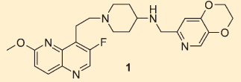
Ligand-Based Scaffold Hopping
Phenotypic hit from whole cell antibacterial screen
Topoisomerase inhibitors in patents
Attractive series with novel mechanism
  Potent broad spectrum antibacterial activity
  Excellent drug-like properties
  No cross resistance with clinical agents (e.g. fluoroquinolones)
Challenges
  Significant cardiovascular risk
    Original lead from sodium channel blocker program (GSK)
No protein-ligand x-ray structure available

Slide 7
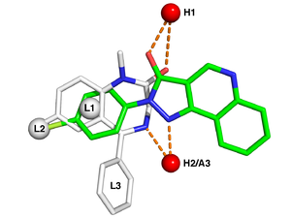
Pharmacophore Models
An ensemble of steric and electronic features necessary to ensure the optimal interactions with a specific biological target and to trigger (or block) its biological response (and the 3D relationship between those features)
Pharmacophore features can include:
  Hydrogen-bond donors and acceptors
  Aromatic rings
  Positive or negative charges
  Hydrophobic groups

Slide 8
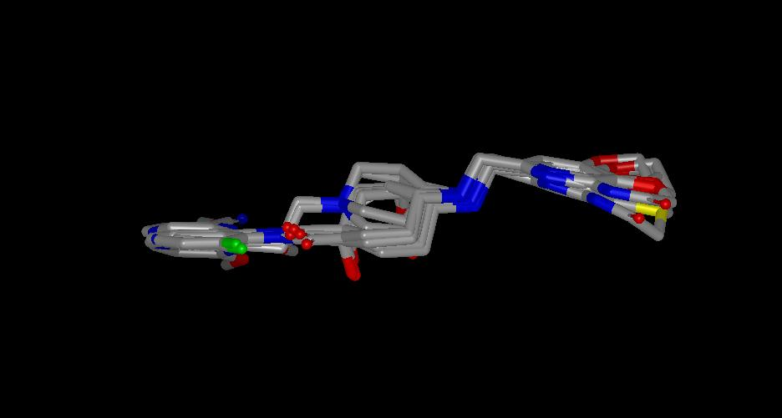
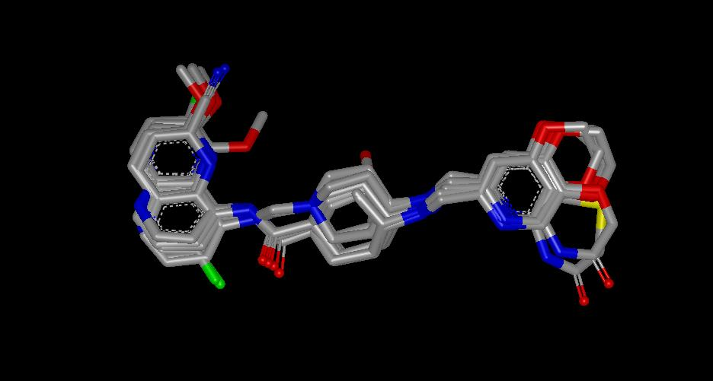
Pharmacophore Model Based on Patents
Select conformationally constrained analogs
Overlap ring centers and H-bond donors/acceptors using QXP software
Use MM and QM to confirm low-energy conformers
QXP: McMartin and Bohacek, J. Comput. Aided Mol . Des., 1997, 4, 333.
Side View
Top View

Slide 9
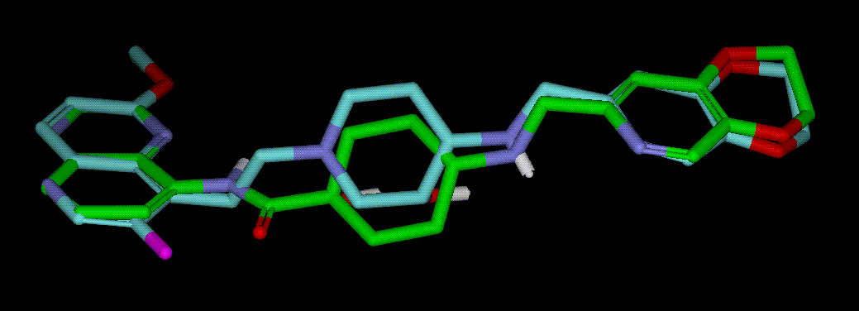
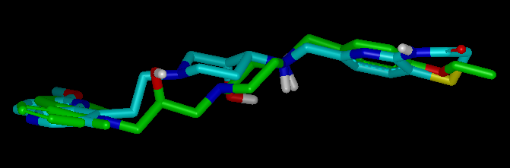
3D Search Generates Novel Target Idea
3D Pharmacophore Search of AstraZeneca Compound Collection
N-linked Hit
No MIC or IC50
N-linked not covered in patents
Extensive medicinal chemistry efforts explored variations in the LHS, linker and RHS groups – guided by the pharmacophore model
LHS Linker RHS
Reck, et. al., J. Med. Chem. 2011, 54, 7834

Slide 10
AstraZeneca’s Topoisomerase II Inhibitors
GSK, C-linked
MIC Sau 516 = 0.03 uM
hERG = 4.4 uM
fu (human) = 6 %
Log D = 1.8
pKa
AZD5206, N-linked
0.06 uM
35 uM
26%
0.6
8.5
AZD9742
0.14 uM
233 uM
25%
0.96
7.03
pKa reduction (>1 log unit)
hERG improvement over GSK (>50-fold)
Protein binding significantly improved
Reck, et. al., J. Med. Chem. 2012, 55, 6916

Slide 11
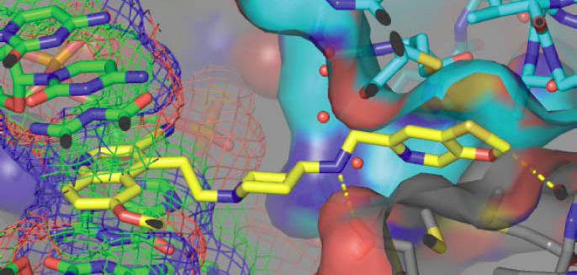
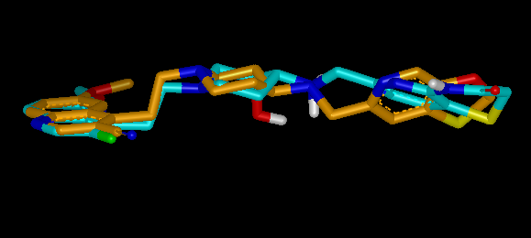
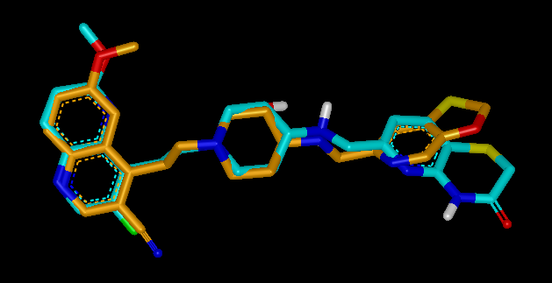
Pharmacophore Model vs X-ray Structure
Bax, et. al, Nature 2010, 466, 935-940.
Overlay of a NBTI inhibitor from pharmacophore modeling (cyan carbons) versus NBTI inhibitor conformation (gold carbons) observed bound to GyrA from the reported crystal structure

Slide 12
Mur Ligases as Antibacterial Targets
Mur ligases: a set of essential bacterial enzymes involved in construction of the cell wall.
UDP GlcNac
Enoyl pyruvoyl
UDP GlcNac
UDP MurNac
UDP MurNacL-Ala
Fosfomycin
4-[(2-napthyl)methyl]
-D-Glutamate
UDP MurNacL-Ala
D-GluL-Lys/DAP
D-AlaD-Ala
UDP MurNacL-Ala
D-GluL-Lys/DAP
UDP MurNac
L-AlaD-Glu
D-Cycloserine

Slide 13
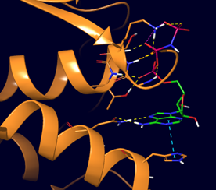
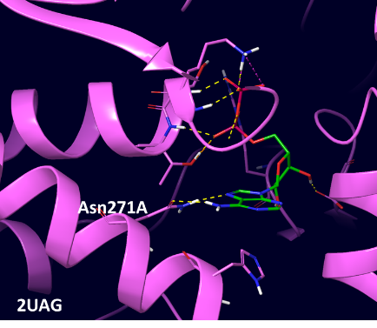
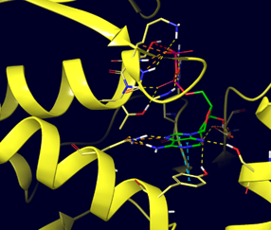
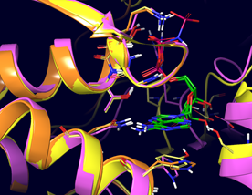
Mur Ligase ATP Binding Sites are Well Conserved
Aba murC
Eco murD
Mtb murE
6CAU
Aba murC
Eco murD
2XJA
Mtb murE
murC/D/E
Percent identity and similarity of mur ligase ADP binding sites
Pursue a multitargeting approach to limit resistance

Slide 14
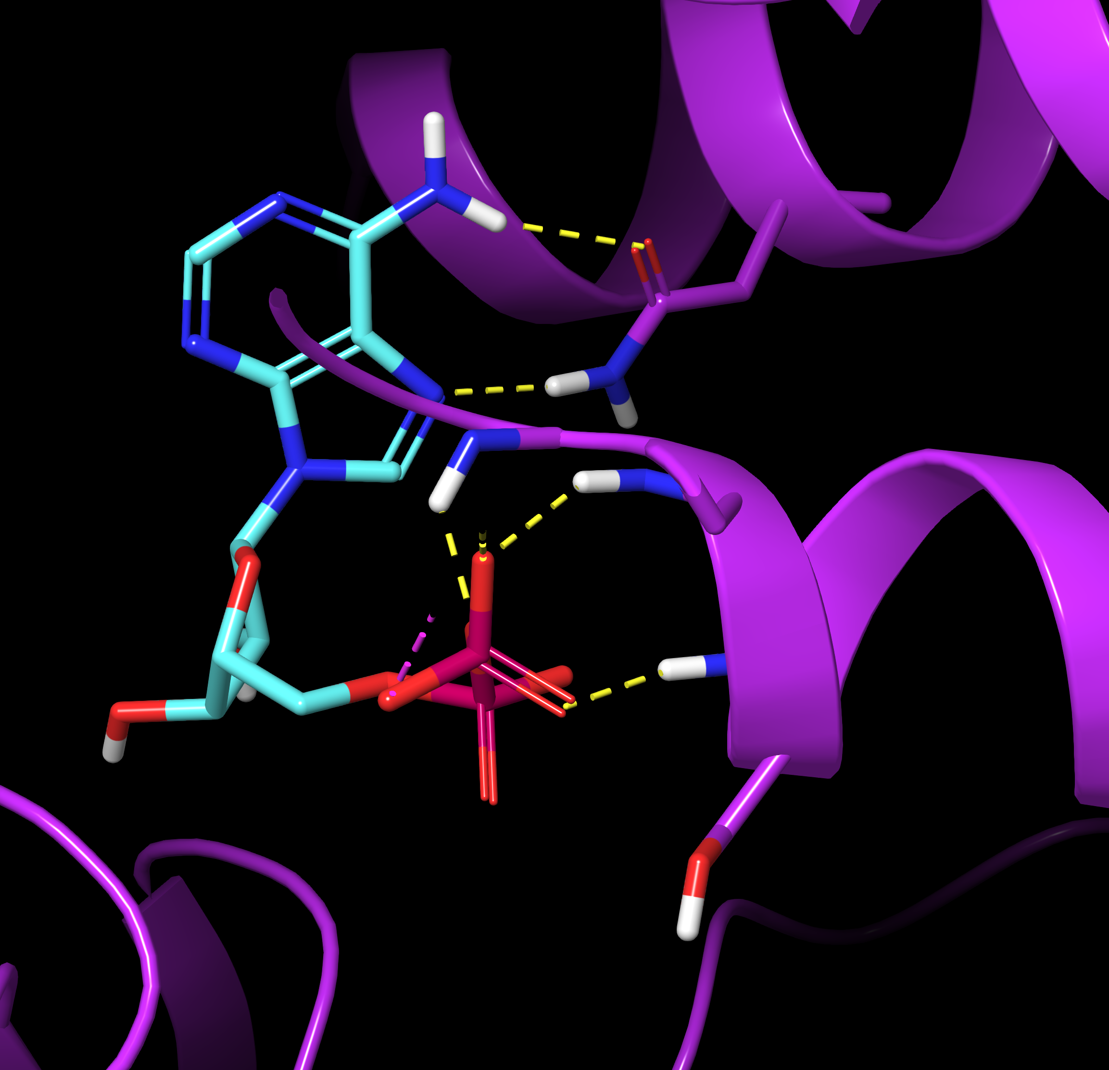
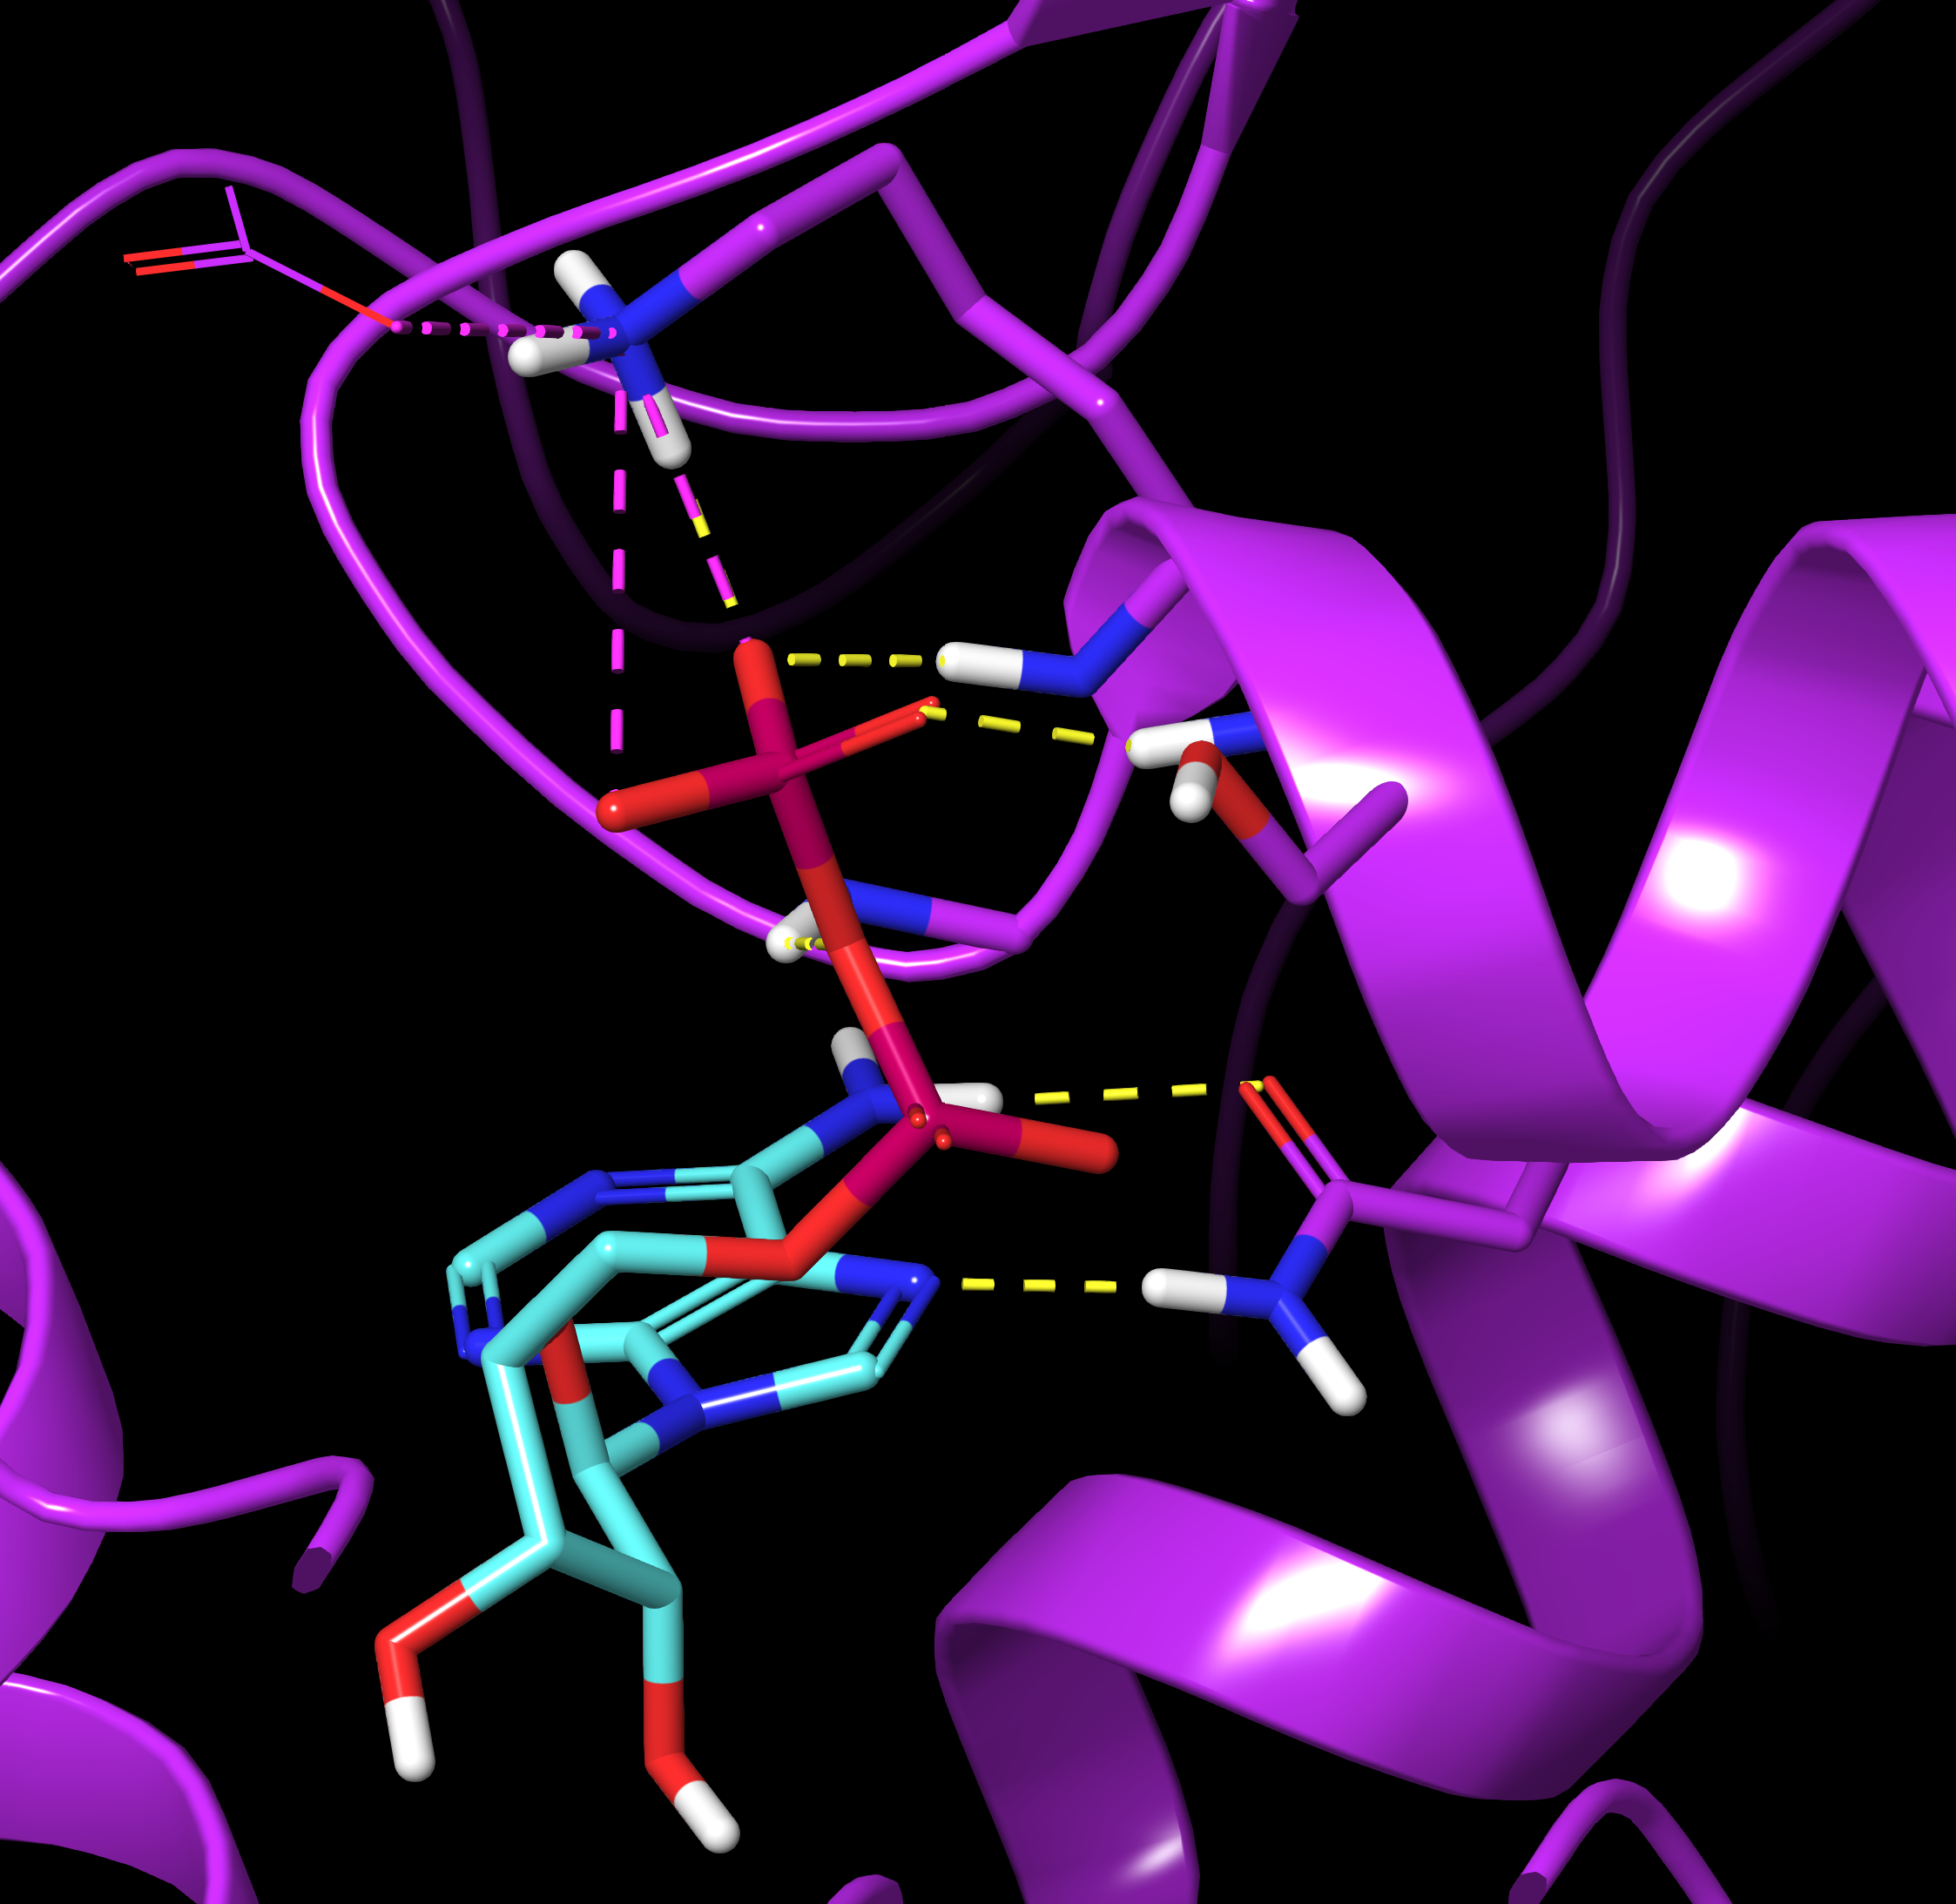
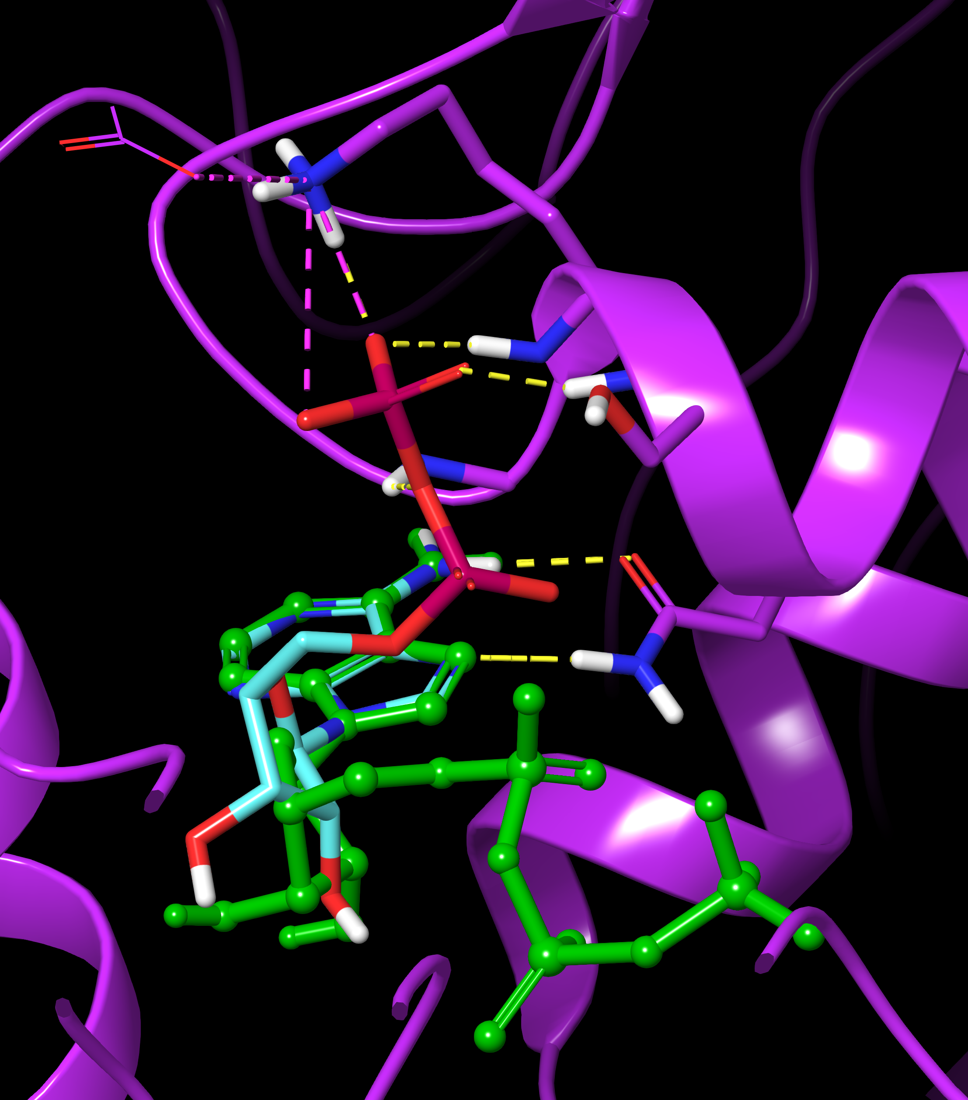

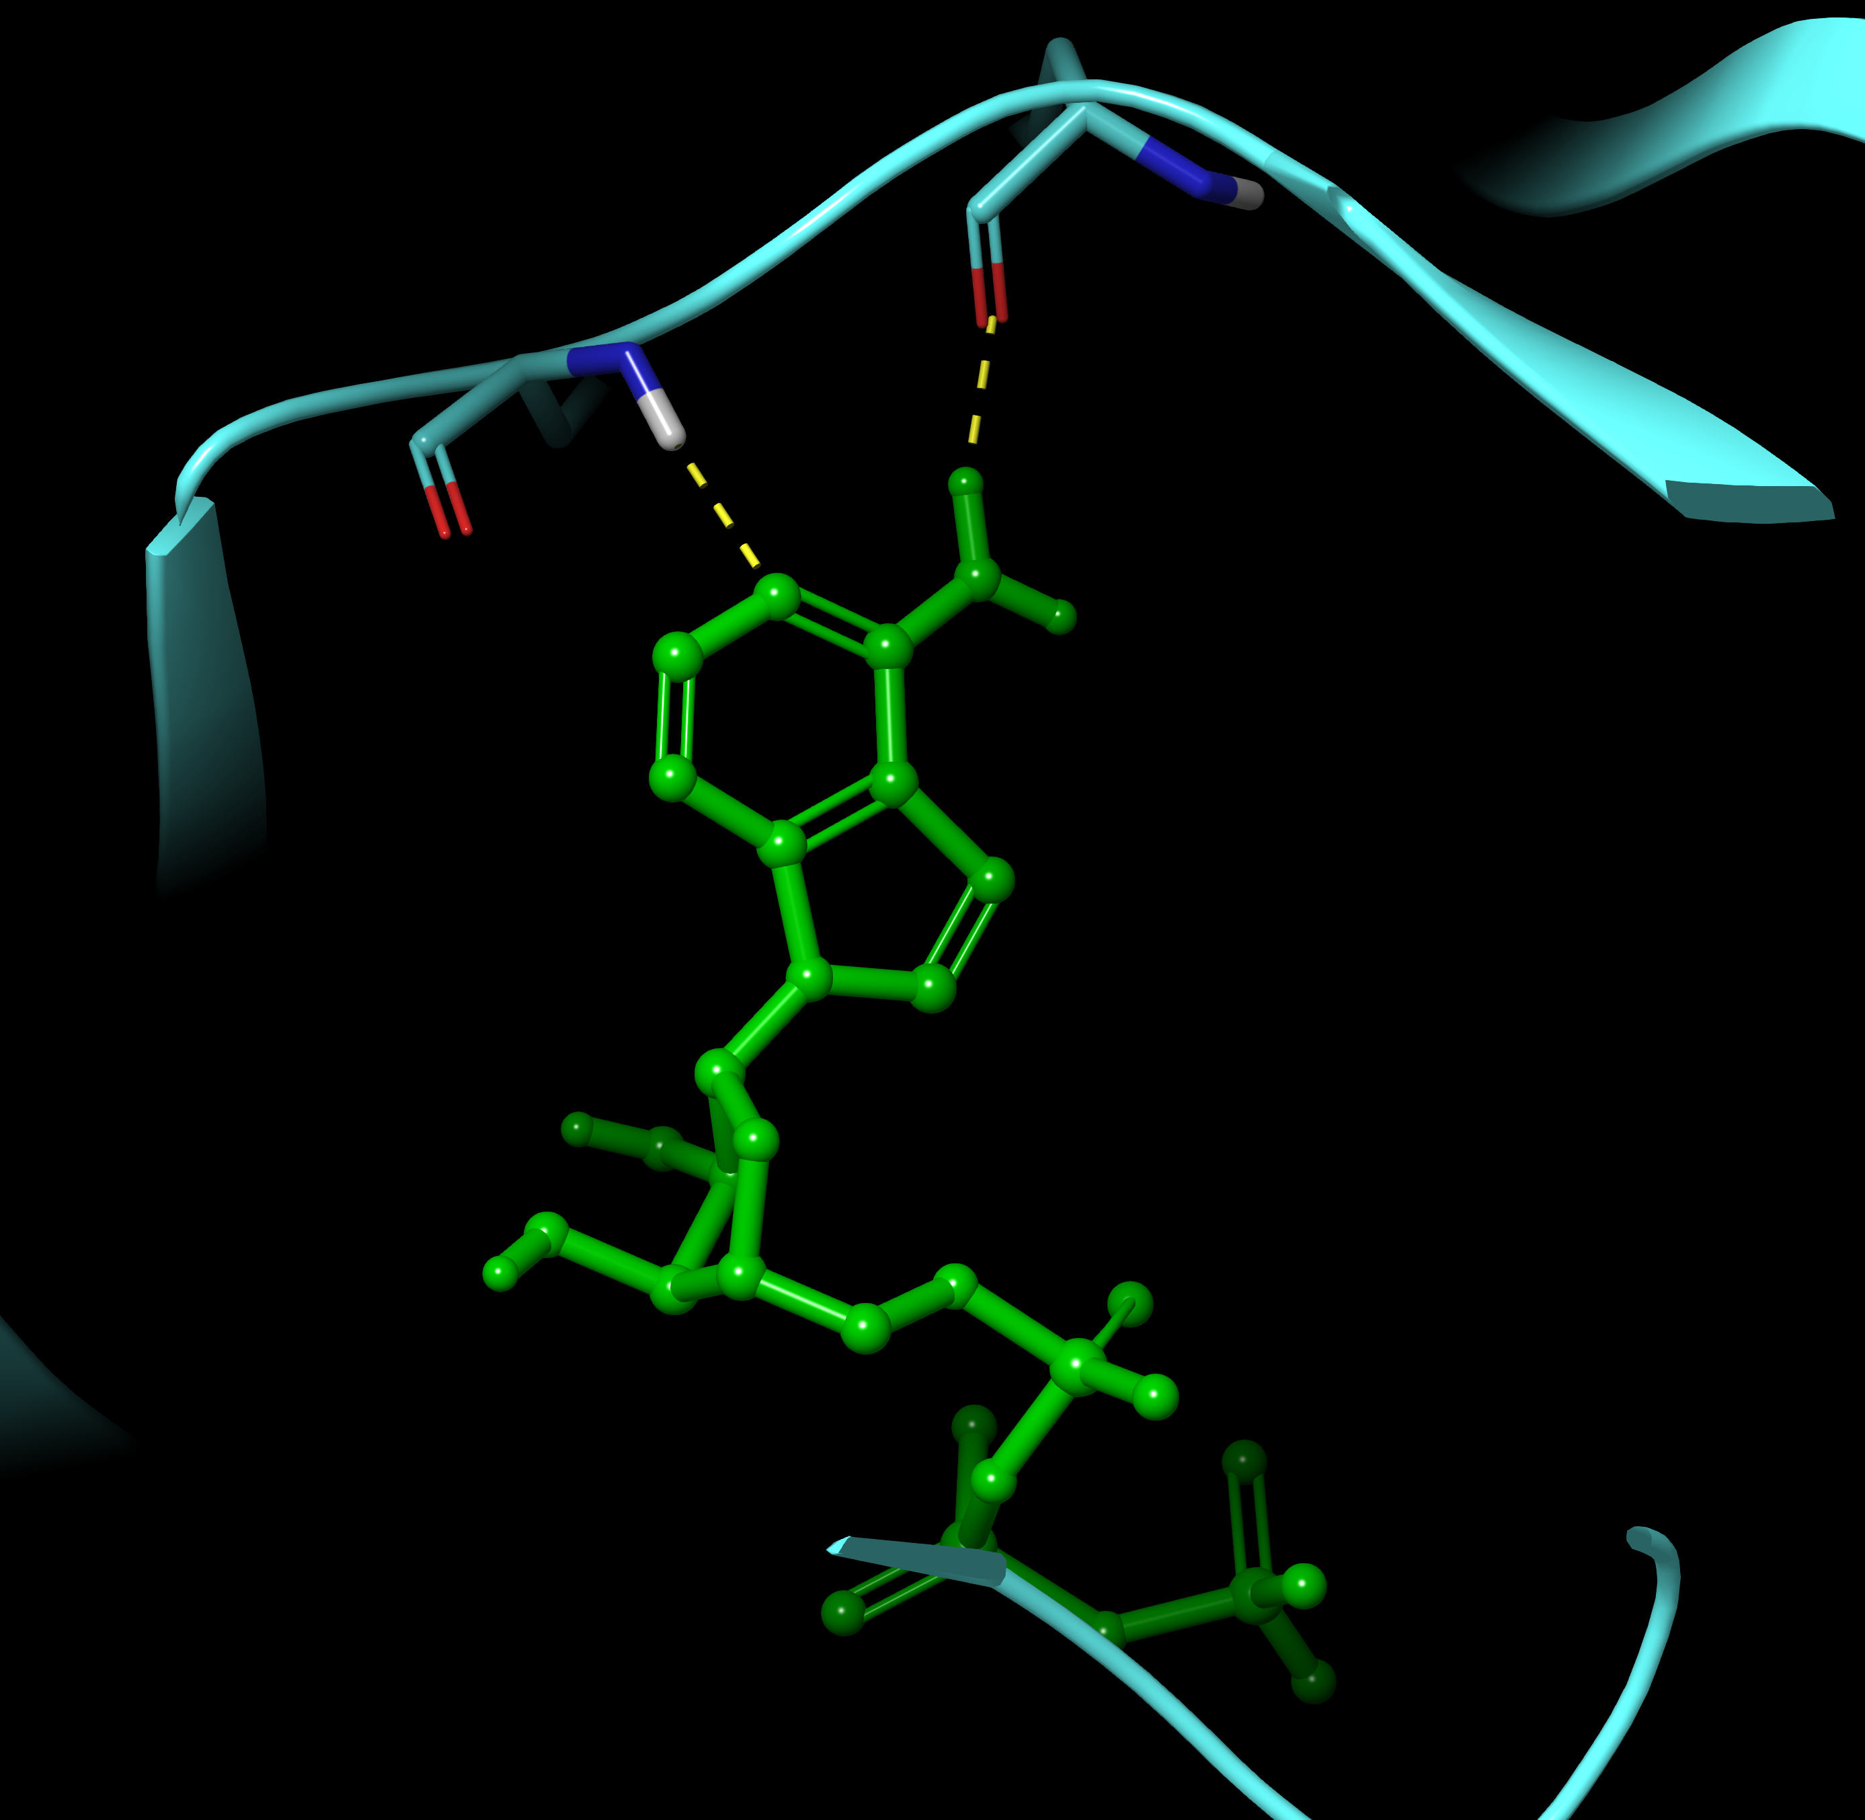
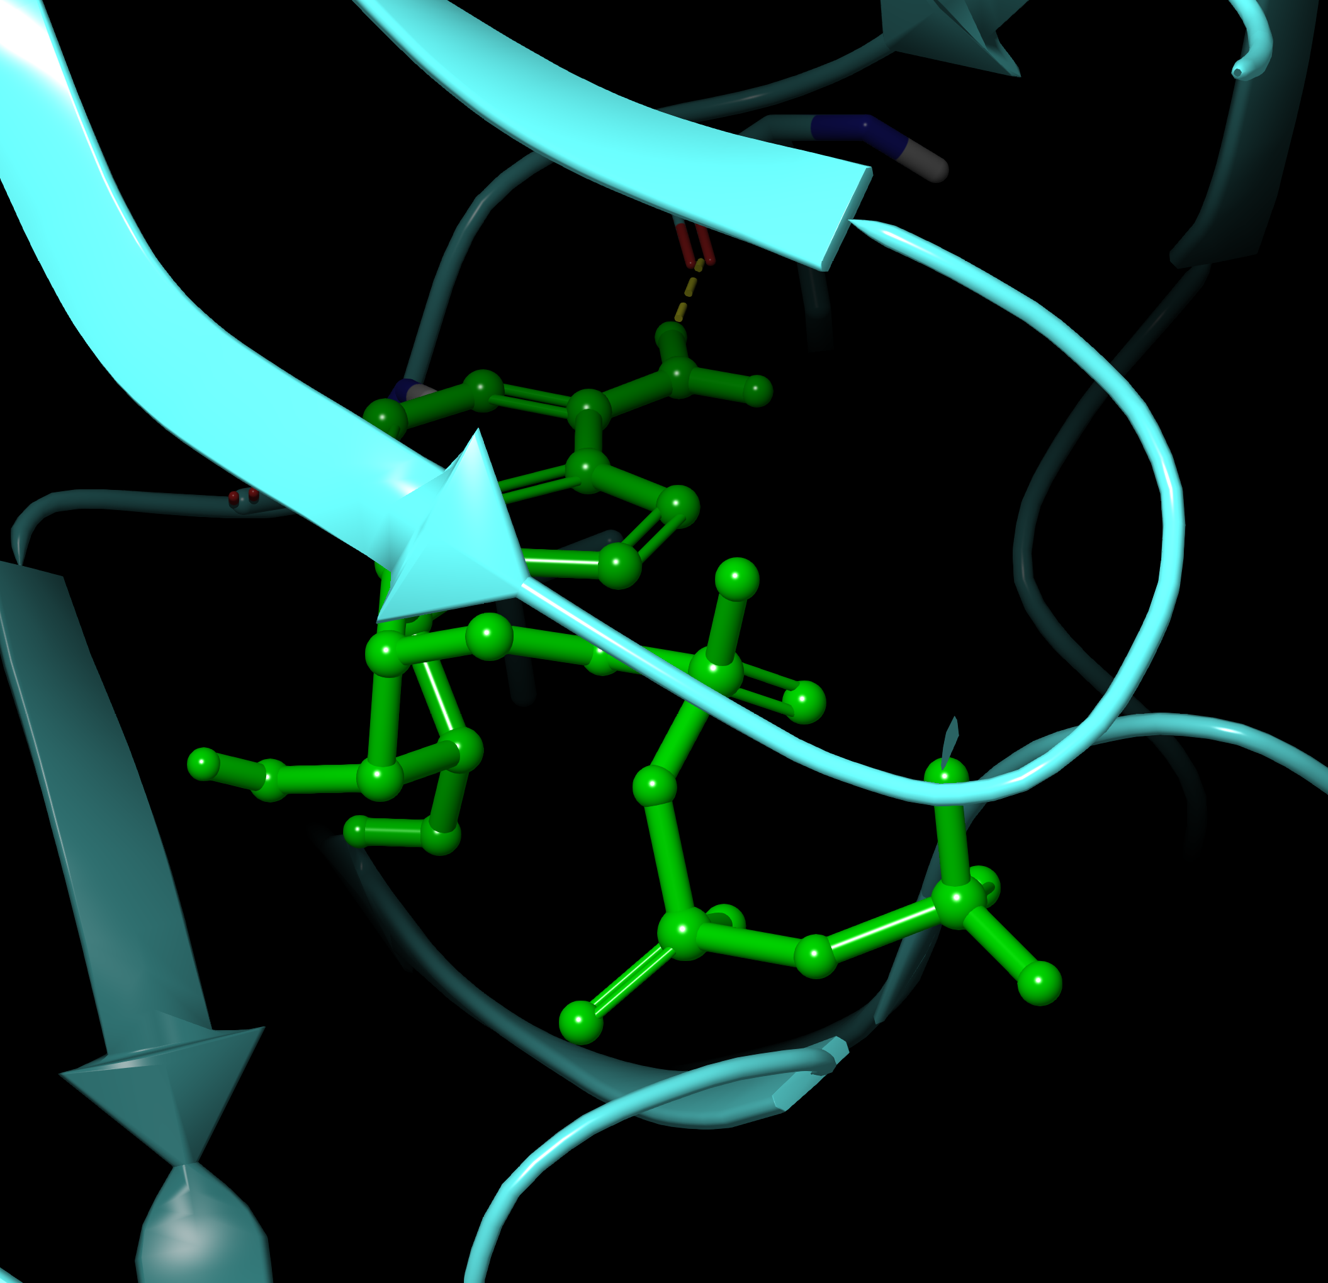
Human Kinase vs Bacterial Mur Ligase ATP Binding Sites
N271
E. coli
murD
Ligase
N271
2UAG
2UAG
N271
Hinge
Hinge
Human
CDK2
Kinase
P Loop
murD ADP forms H-bonds to
end of murD helix – significant
difference to ATP interaction with
catalytic lysine in human kinases
1HCK
1HCK

Slide 15
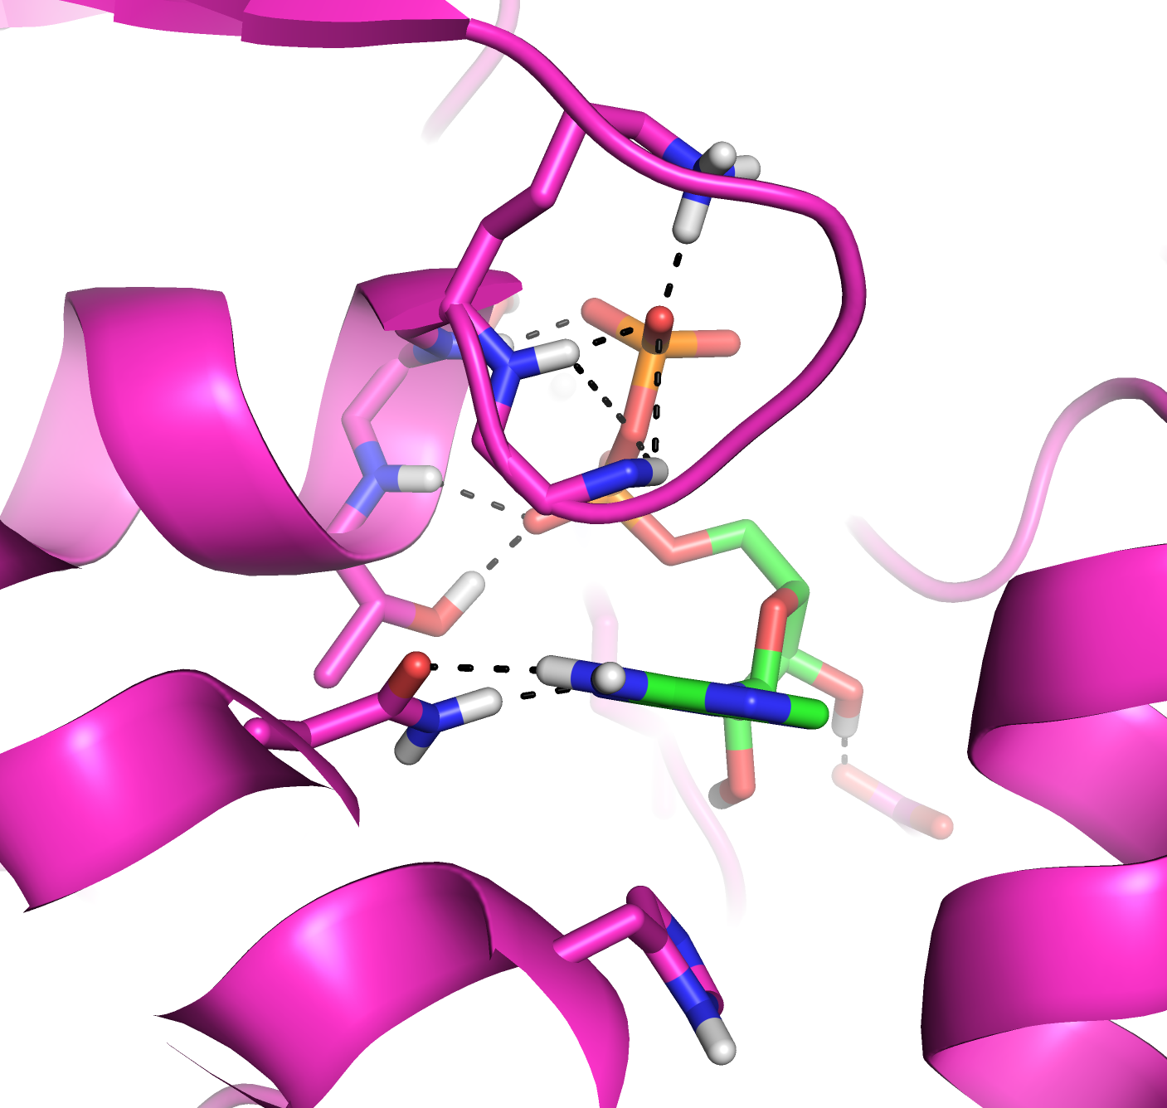
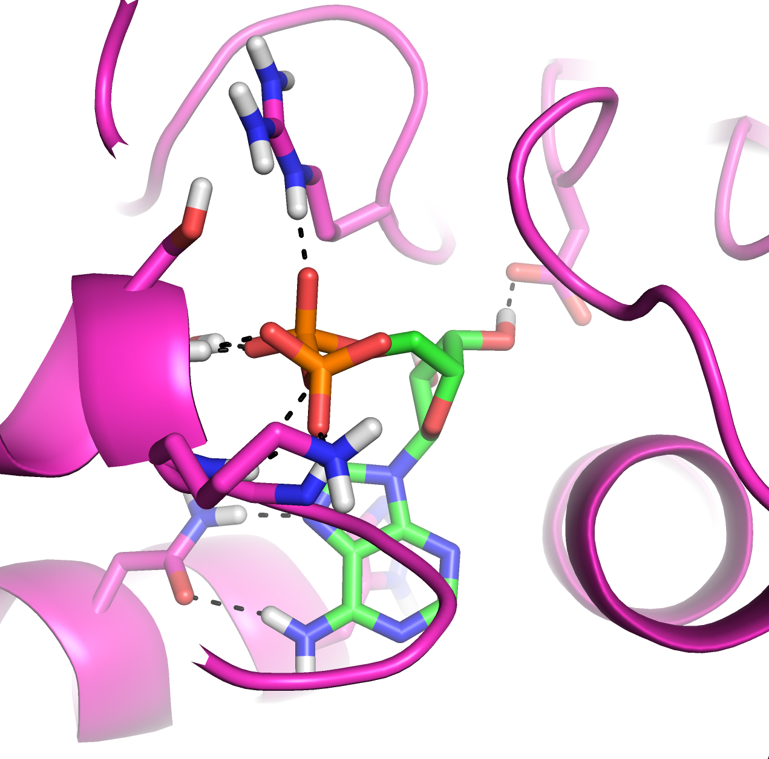
Analyze Active Site Hotspots: E. coli murD with ADP
helix
helix
Asn271
Asn271
Adenine ring of ADP forms two H-bonds to Asn271
β-phosphate forms multiple H-bonds to murD helix
Helix terminus provides multiple H-bond donors to interact with ligand H-bond acceptors
Acceptors in murD inhibitors improves chances of inhibitor permeability against Gram- bacteria

Slide 16
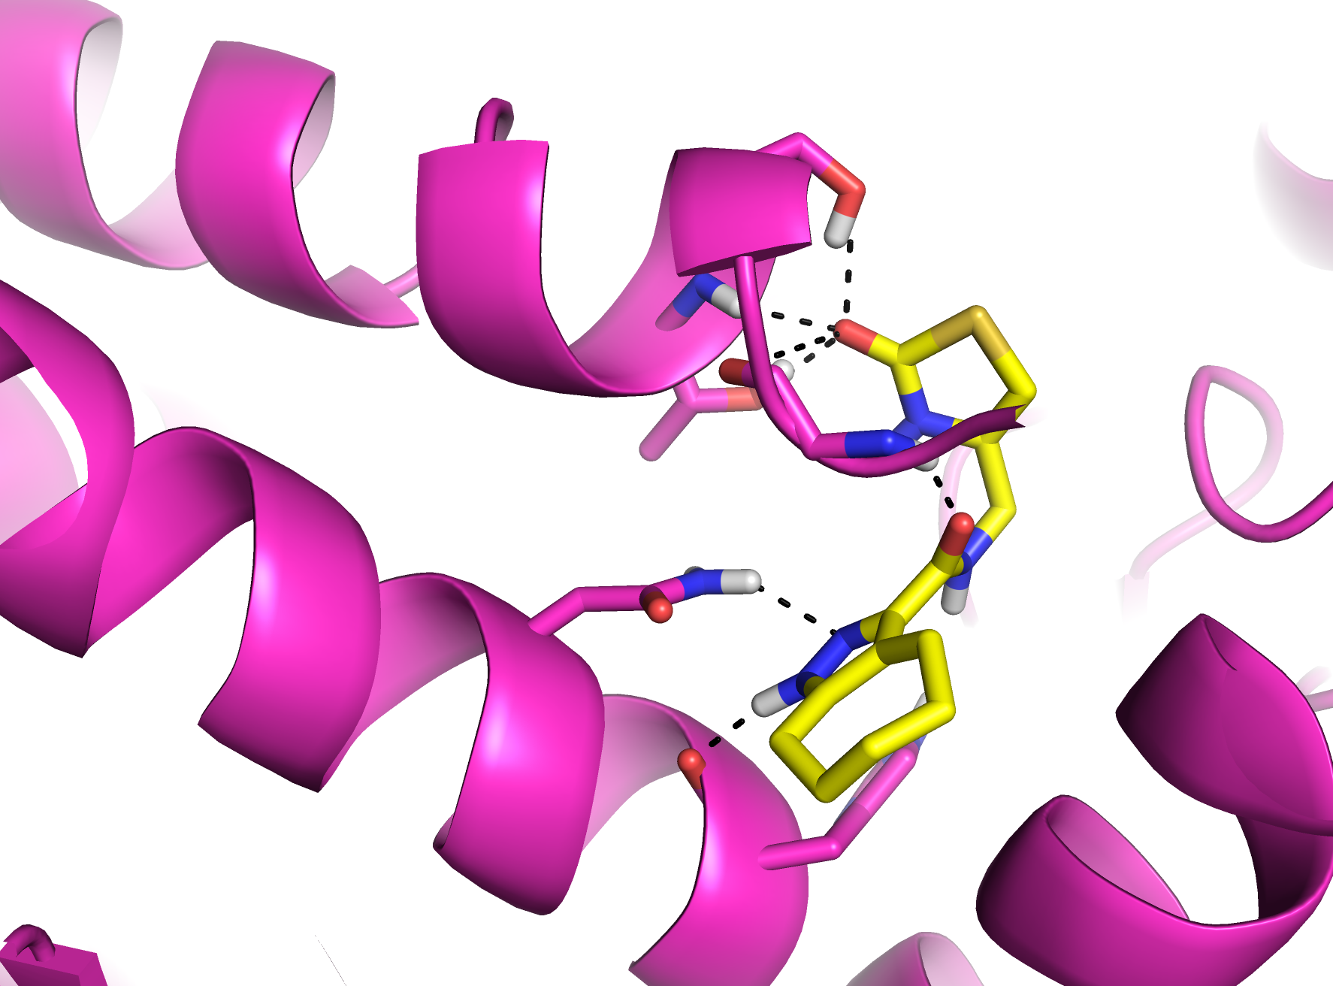
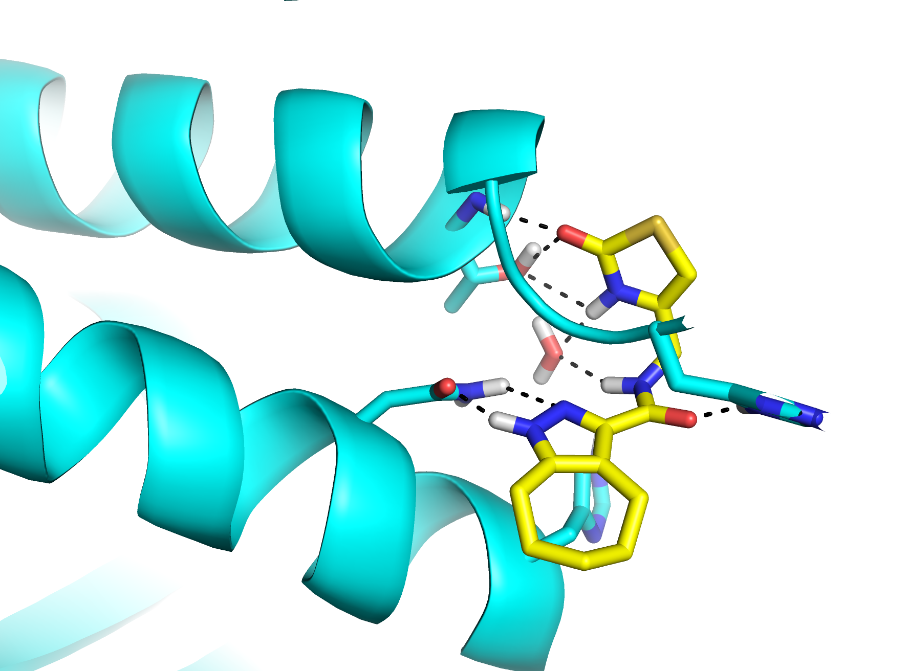
Virtual Screen
Virtual screen of 40,000 compound Enamine kinase focused library
  Virtual screen against S. alg, MurD, E. coli murD and E. coli MurE
  Selected compounds binding to Asn sidechain and H-bond donors interacting helix terminus
helix
helix
Asn
Asn
Pae murD
Pae murC

Slide 17
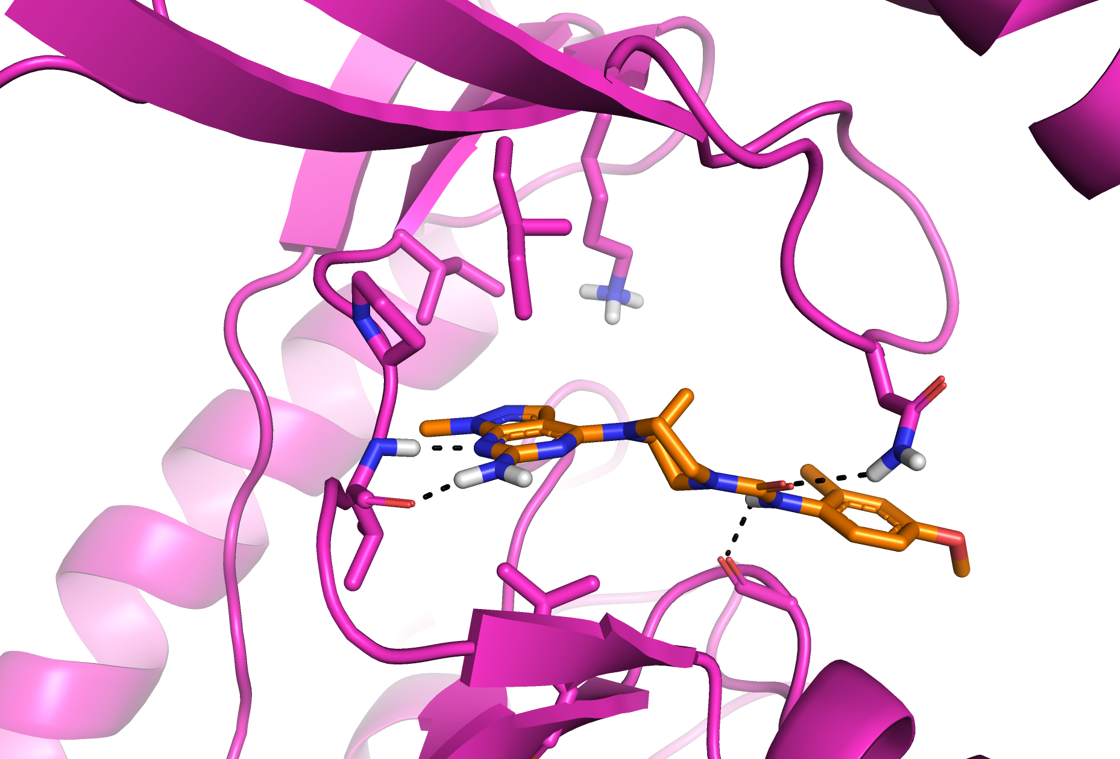
Human PI4Kb x-ray Structure
Cat. Lys
P-loop
GK
Hinge
Crystal structure (PDB: 6GL3) of Hs PI4K3b with inhibitor illustrating key interaction in the ATP binding site.
Hs PI4Kb vs PfPI4K sequence
Identity 36%
Similarity 61%

Slide 18
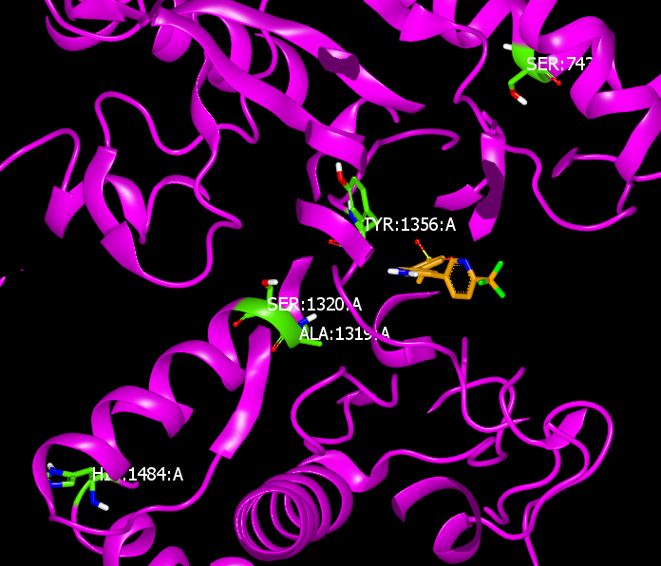
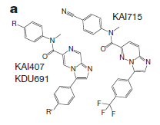

Mutations Observed for Pf PI4K inhibitors
PI4K Mutations
H3D ‘048: S743T, A1319V
Quinoxaline (BQR695): Y1356F(14X)
Imidazopyridine: S1320L (6X), H1484Y(2)
Imidazopyrazines
H3D MMV ‘048
Quinoxaline
H3D PI4K inhibitor IC50 is 10X more potent than PfNF54 IC50 (cell activity)
PI4K mutation to H3D PI4K inhibitor occur distal to binding site (‘second layer’ and beyond)
Mutations to H3D PI4K inhibitor cause only 2-3 fold shift in Pf IC50
Use mutation data and human PI4K x-ray structure to build Pf PI4K homology model

Slide 19
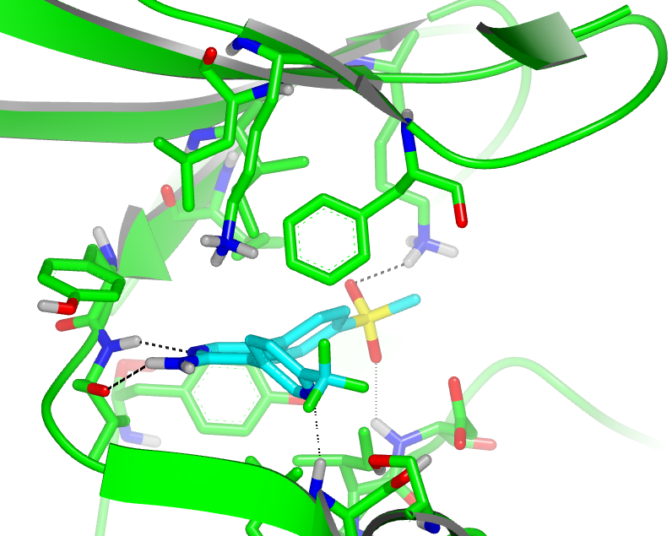
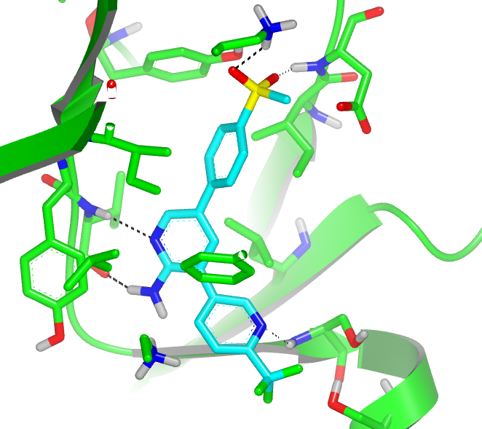
MMV0048 model in Pf PI4K Homology Model
Cat. Lys
K1308
K1308
D1430
P-loop
Gatekeeper
I1354
I1354
F827
V1357
Hinge
F827
V1357
Hinge
S1362
D1430
S1362
PvPI4K IC₅₀ = 3.4 nM

Slide 20
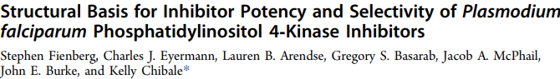
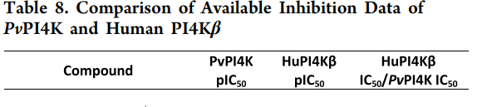
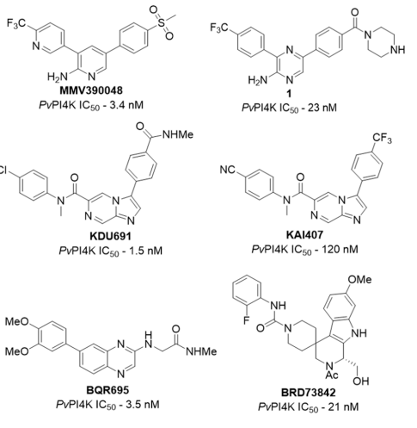
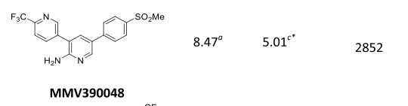
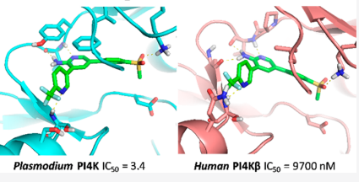
PfPI4K Inhibitor MMV0048 Kinase Selectivity
ACS Infect. Dis. 2020, 6, 3048−3063
Also examined MMV0048 HsPI3K isoform selectivity

Slide 21
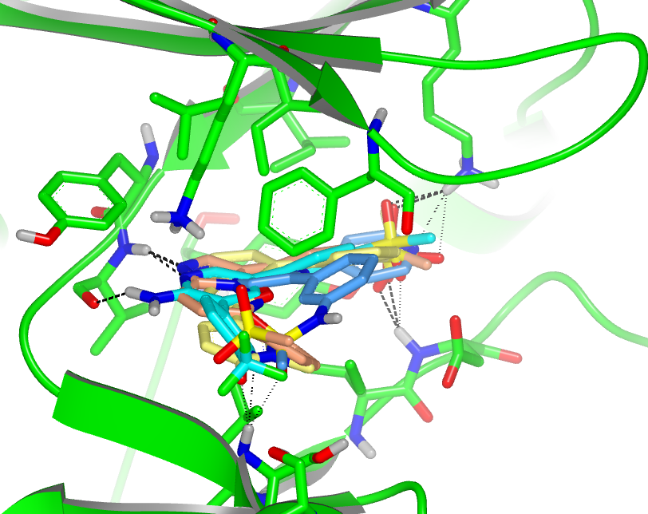
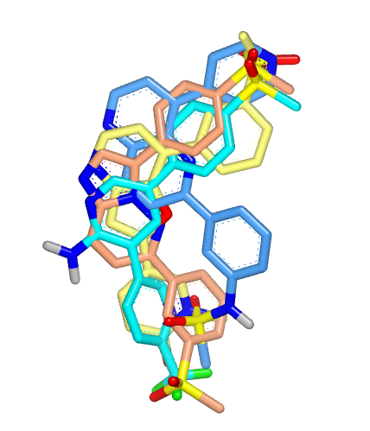
Pf PI4K Inhibitor Models – Scaffold Hopping Opportunity
Use models and structure activity relationships for scaffold hopping to
identify next generation Pf PI4K inhibitors
Gatekeeper
Cat. Lys
Hinge
K1308
V1357
Gatekeeper
I1354
P-loop
F827
Hinge
Hinge
D1430
S1362

Slide 22
in silico resources
PubMed Central: https://pmc.ncbi.nlm.nih.gov/:
ChEMBL: https://www.ebi.ac.uk/chembl:
SciFinder: https://www.cas.org/solutions/cas-scifinder-discovery-platform/cas-scifinder:
BLAST: https://blast.ncbi.nlm.nih.gov/Blast.cgi?CMD=Web&PAGETYPE=BLASTHome
Plasmodium Database PlasmoDB: https://plasmodb.org/plasmo/app
Trypanosome Database TriTrpDB: https://tritrypdb.org/tritrypdb/app
DataWarrior: https://openmolecules.org/datawarrior/
WebCSD: https://www.ccdc.cam.ac.uk/solutions/software/webcsd/
Protein Structure Data Bank: https://www.rcsb.org/
KLIFS: https://klifs.net/index.php
AlphaFold: https://alphafold.ebi.ac.uk/
MetaSite: https://www.moldiscovery.com/software/metasite/
pyMol (free): https://anaconda.org/conda-forge/pymol-open-source
Schrodinger: https://www.schrodinger.com/
MOE: https://www.chemcomp.com/en/index.htm
Openeye: https://www.eyesopen.com/
Compound vendors: (e.g. SelleckChem, Enamine, Chembridge, eMolecules, etc)

Slide 23
Integrating CADD into Drug Discovery
Drug discovery (hunting) is a TEAM sport!
CADD and computational chemists can help with offense and defense
Deep dive on all data – both internal project data and external data
Thinking about the data is as important as the calculations
Important to benchmark/validate CADD methods for your project
Still challenge to predict binding affinities a priori

Slide 24
Phenotypic or Target-Based Projects?
Which approach provides the best opportunity to integrate CADD and data to deliver a drug candidate?

