Slide 2

Logo Interpretation
Integration within the Grand Challenges brand:
The use of a common typeface unites the family of logos that are housed under the overarching GCA brand. This unity provides brand consistency while still allowing the individual programmes to have visual autonomy through the unique, locally-created symbol.

Slide 3
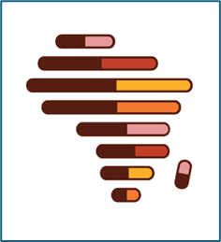
Logo Interpretation
Symbolic meaning:
The capsule shape reflects the end goal of meeting the needs of the patient
The capsules increase in length and become progress bars (online on user interfaces), symbolising advancement
The bars/capsules represent the individual projects/programs/hubs of drug discovery within GC ADDA. Each can be seen working independently; however, when seen together, the map of Africa is apparent. This symbolises that our individual efforts, when joined via the network, drive progress and positive change on the continent

Slide 4
We must develop drug discovery research capacity near patients in Africa to understand and meet their health needs. GC ADDA is poised to tackle these challenges. Together we can unleash the potential of the continent.

